Slide 1
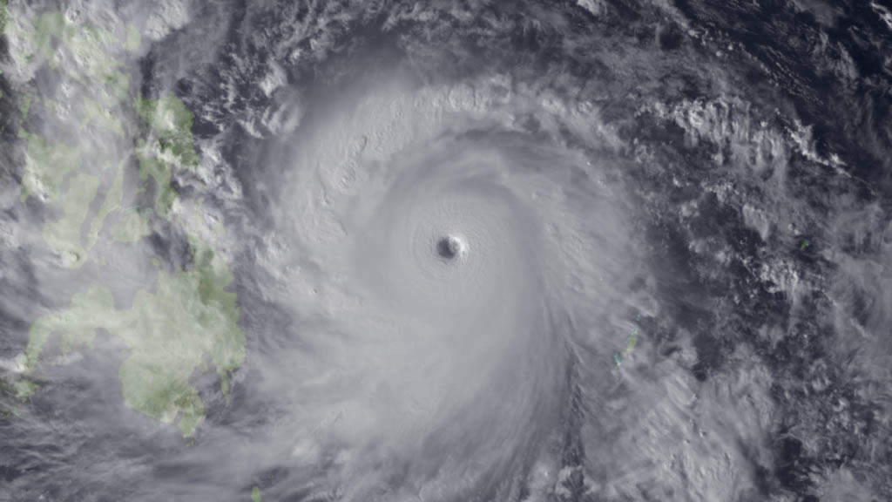
69th Interdepartmental Hurricane Conference
2015 Tropical Cyclone Research Forum
Typhoon Haiyan
Tropical Cyclone Operations and Research:
Setting our Future Course
March 1 – 5, 2015
Notes:
Leave this slide on the screen as the FC walks to podium

Slide 2
Final Remarks
Mr. David McCarren
Federal Coordinator for Meteorology (Acting)
69th Interdepartmental Hurricane Conference
2015 Tropical Cyclone Research Forum
Tropical Cyclone Operations and Research:
Setting our Future Course
The Office of the Federal Coordinator for
Meteorological Services and Supporting Research
(OFCM)

Slide 3
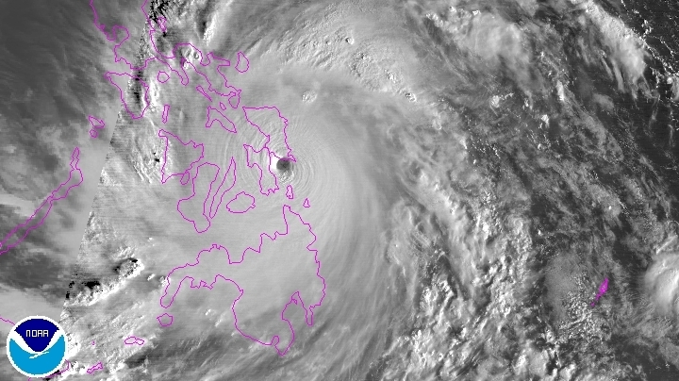
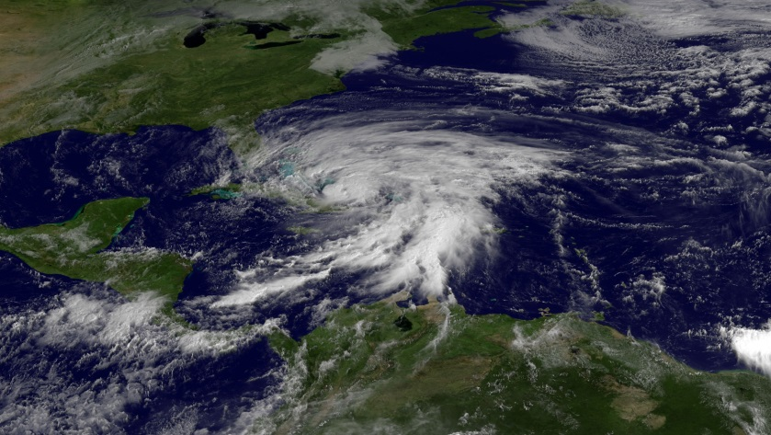
Reminder of Why Are We Here
Typhoon Haiyan, one of the most powerful storms in history. Yet we remember Sandy, Irene, Katrina, and so many others…
Typhoon Haiyan
We must continue to build upon the synergy and collaboration we’ve achieved in the tropical cyclone community since we developed the 2007 Interagency Strategic Research Plan for Tropical Cyclones: The Way Ahead to:
  Ensure we get the “biggest bang for the buck” in a tough budgetary climate
  Ultimately, minimize the Nation’s vulnerability to nature’s most destructive forces
Sandy
Hurricane Irene
Notes:
3
yphoon Haiyan (known as Typhoon Yolanda in the Philippines) devastated portions of Southeast Asia, particularly the Philippines, on November 8, 2013.
It is the deadliest Philippine typhoon on record, killing at least 6,201 people in that country alone.
Haiyan is also the strongest storm recorded at landfall, and unofficially the strongest typhoon ever recorded in terms of wind speed. As of January, 2014, bodies are still being found.
The thirtieth named storm of the 2013 Pacific typhoon season , the Joint Typhoon Warning Centre (JTWC) assessed the system as a Category 5-equivalent super typhoon.
Highest winds 10-minute sustained: 230 km/h (145 mph)
1-minute sustained: 315 km/h (195 mph)
Lowest pressure 895 mbar (hPa); 26.43 inHg (Estimated)
Fatalities 6,241 confirmed, 1,785 missing
Damage $1.5 billion (2013 USD) (Preliminary total)

Slide 4
Forum Outcomes
Partnerships are more important than ever; the ability of our TC community to work together keeps the TC forecast and warning enterprise moving forward.
Sandy supplemental has also had a big impact.
A lot of work is focused on genesis and rapid intensification.
The NOAA/Navy multi-model ensemble will be expanded to all basins
Assimilation of dropsonde observations have a positive impact on model track forecasts.
Model results much improved for track and intensity in 2014.
New (some on the horizon) observation technologies are extremely promising; e.g., HDSS, APAR, air-deployable profiling floats, wave gliders, Coyote UAS, GOES-R, and the CYGNSS satellite constellation.
NOAA flying hours are up.

Slide 5
Forum Outcomes - 2
Key research issues are model intensity errors, rapid intensification, and genesis.
May be useful to invite the growing number of state meteorologists to the IHC to give state government views of TC impacts on their citizens, societal costs and issues, and ways to improve TC forecast info for integration in their decision processes
An acronym definition list would be helpful for the IHC attendees(related to abstracts and presentations). Could build from past IHCs.
The presentations reflected excellent collaborations and partnerships in research and applications. The number of platforms and the data being shared is impressive. A considerable amount of R&D data is getting into operations.

Slide 6
Next Steps
Update and publish the 2015 National Hurricane Operations Plan
Complete a comprehensive assessment of our Nation’s tropical cyclone research program and publish an assessment report, to include updated priorities for the operational centers (NHC, CPHC, and JTWC)

Slide 7
A Special Thank You
Forum Technical Director Assistant Director | Mr. Bob Dumont (OFCM/STC) Col Paul Roelle (Air Force / OFCM)
Forum Coordinator for Logistics | Ms. Erin McNamara (OFCM)
Webinar and Audiovisual | Mr. Ken Barnett (OFCM) Mr. Tony Ramirez (OFCM/STC)
Registrars | Ms. Erin McNamara (OFCM) Ms. Christina Bork (OFCM) Ms. Michelle McCambridge (UCAR)
Forum Coordinators | Mr. Bob Dumont (OFCM/STC) Mr. Michael Bonadonna (OFCM) Dr. Daniel Melendez (NWS)
Forum Rapporteurs | Mr. Floyd Hauth (OFCM/STC) Mr. Bob Dumont (OFCM/STC) Mr. Michael Bonadonna (OFCM) Dr. Daniel Melendez (NWS)
Notes:
7

Slide 8
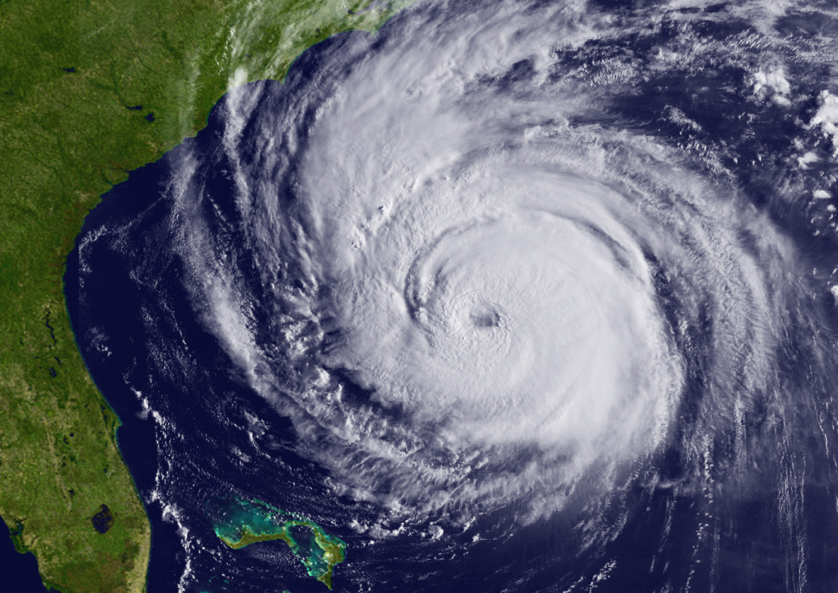
The 2015 TCRF is Adjourned
Thank you for attending and participating in the
2015 Tropical Cyclone
Research Forum
On behalf of the Office of the Federal Coordinator for Meteorology,
Have a safe trip home!

