Slide 1
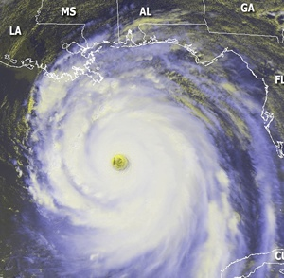
Working Group for Tropical Cyclone Research (WG/TCR)
Midcourse Review
Dr. Frank Marks (NOAA) and Dr. Ron Ferek (Navy)
Co-Chairs, Working Group for Tropical Cyclone Research (WG/TCR)

Slide 2
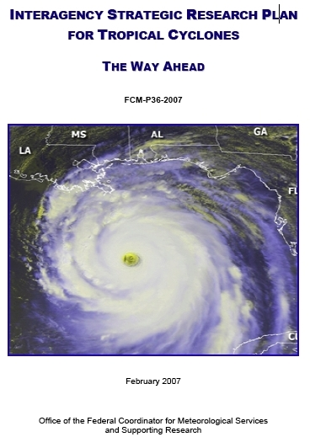
History of JAG/TCR
February 2005: Federal Coordinator formed Joint Action Group for Tropical Cyclone Research (JAG/TCR)
February 2007: JAG/TCR culminated with publication of Interagency Strategic Research Plan for Tropical Cyclones: The Way Ahead
Highlights of Interagency Plan
  Chapter 4 summarizes operational tropical cyclone forecast and warning centers (TPC/NHC, CPHC, JTWC) needs:
    Table 4-1: Operational Priorities of TC Forecasting & Warning Centers
  Chapter 5 presents research priorities to meet those needs
    Table 5-1: Research Priorities in Atmospheric and Ocean Science
Notes:
2

Slide 3
History of WG/TCR
Key Finding / Recommendations
  Chapter 6 recommended TC research coordination that would:
    Monitor and update operational needs of the tropical cyclone forecast and warning centers (Table 4-1)
    Monitor and update research priorities (Table 5-1)
    Develop a multiagency research implementation plan that outlines specific strategies to address all the operational priorities (Working Group for Tropical Cyclone Research (WG/TCR)
Notes:
3

Slide 4
WG/TCR Objectives / Tasks
Keep Tables 4-1 and 5-1 updated
  Table 4-1: Ops priorities (became Table 1)
  Table 5-1: Research needs (became Table 2)
Map agency meteorological research efforts against TC research needs and operational priorities
Analyze / compare results
Develop interagency implementation strategy
  Leverage agency existing plans / resources to ensure priorities are addressed
Update information at IHC
Notes:
4

Slide 5
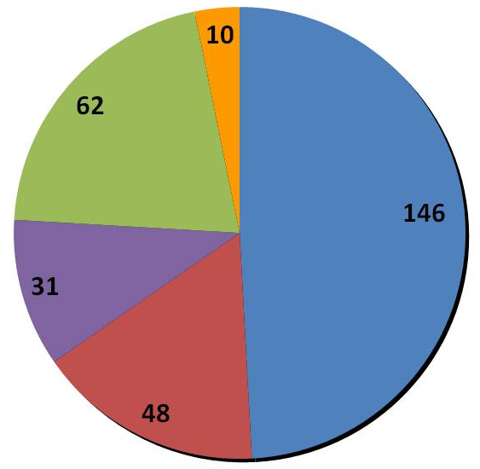
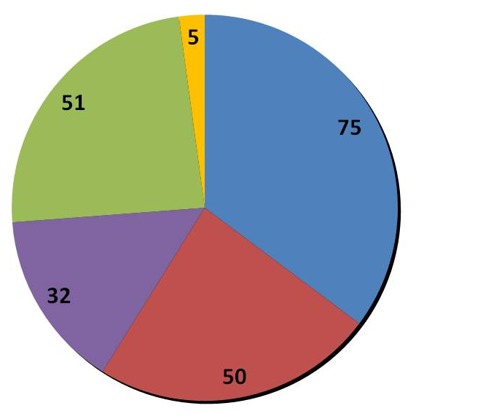
Man-years by Agency
2008 Snapshot
(Total Man-years: 211)
2010 Snapshot
(Total Man-years: 296)
2012 Snapshot
(Total Man-years: 240)
+40%
-19%
+14%

Slide 6
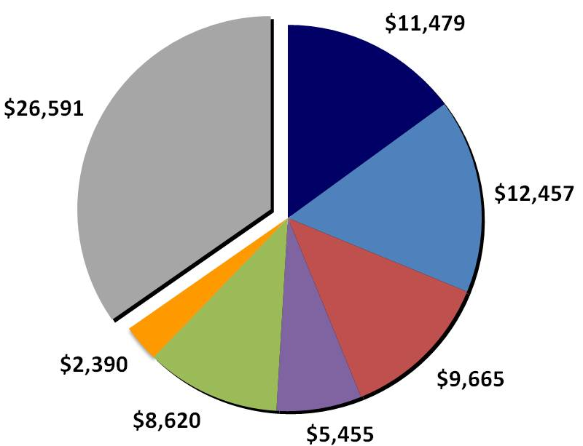

Total Support by Agency
2008 Snapshot
Total: $50,155K
2010 Snapshot
Total: $76,658K
2012 Snapshot
Total: $54,931K
Field Experiments: IFEX, TCS-08
Field Experiments: PREDICT, GRIP, IFEX, ITOP &
Research Computer System (HFIP)
Field Experiments: IFEX, HS3 &
Research Computer System (HFIP)
HFIP
Cuts to HMA &
UAS R&D
HFIP
NOAA Total
$23,936
NOAA Total
$16,990
+53%
-28%
+10%
Notes:
HMA – Hurricane Mitigation Alliance: NOAA earmark to FIU focused on storm surge R&D

Slide 7
Analysis of Tropical Cyclone R&D
  Three snapshots that captured R&D activities
  Represents the spectrum of R&D across the community
  Research influenced by ops priorities; provides mechanism for essential feedback
Intensity change is still #1 operational priority
  Research (basic and applied) is still required, as this is a very difficult and complex problem
With HFIP and four major field experiments, R&D increased markedly in 2010 snapshot compared to 2008 snapshot
  Deltas between 2008 and 2010 not only reflect HFIP, but changing emphasis of field experiments
HFIP cuts and fewer major field experiments resulted in a sharp decrease in R&D from 2010 snapshot to 2012 snapshot
  Deltas between 2010 and 2012 not only reflect HFIP cuts & less emphasis on field experiments, but reduced emphasis on NOAA UAS and Surge R&D.

Slide 8
Analysis of Tropical Cyclone R&D
We have a process to:
    Keep the operational priorities updated
    Assess and evaluate how research is contributing to those priorities
    Allow research managers to make informed decisions for future investments
    Facilitate interagency collaboration and coordination
Starting to see interesting results from R&D
Raises awareness of the importance of R2O
Assess JAG/TCR recommendations progress (Table 6.2)

Slide 9
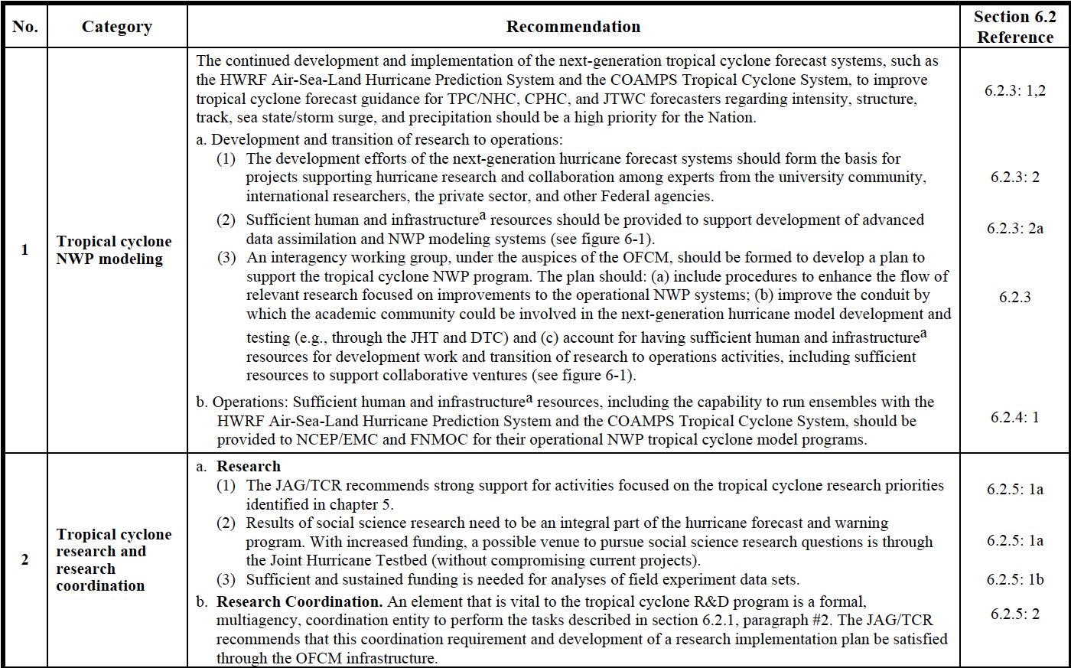
JAG/TCR Recommendations
HFIP
WG/TCR
Notes:
9

Slide 10
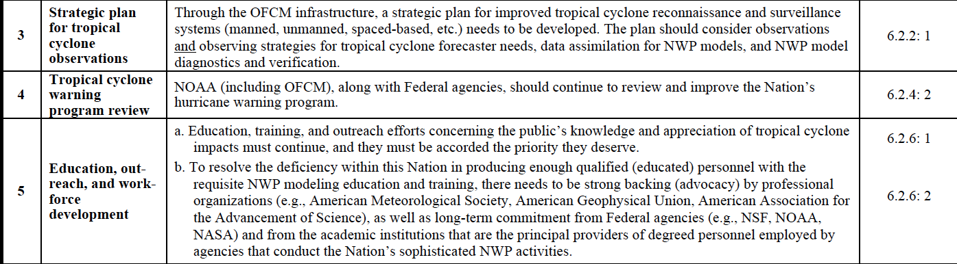
JAG/TCR Recommendations
JAG/TCR recommendations progress (Table 6.2)
  Progress addressing recommendations 1 & 2
  Recommendations 3, 4, & 5 needs more attention
Notes:
10

Slide 11
QUESTIONS?

Slide 12
JAG/TCR
Dr. Frank Marks OAR (NOAA/DOC) | Ms. Robbie Hood MSFC (NASA) | Dr. Ronald Ferek ONR (Navy/DOD)
Dr. James Goerss NRL (Navy/DOD) | Dr. Naomi Surgi NWS (NOAA/DOC) | Dr. James McFadden OMAO/AOC (NOAA/DOC)
Colonel Mike Babcock HQ AF (AF/DOD) | Dr. Ramesh Kakar Science Msn Directorate (NASA) | Dr. Daniel Melendez NWS (NOAA/DOC)
Dr. Stephan Nelson Physical & Dynamic Met. (NSF) | Mr. John Gambel Mitigation Division (FEMA/DHS) | Dr. Mark DeMaria NESDIS (NOAA/DOC)
Dr. Jack Davis U.S. Army COE (Army/DOD) | Dr. Chris Landsea NWS (NOAA/DOC) | Mr. Jeffrey Hawkins NRL (Navy/DOD)
Mr. Mark Welshinger OFCM (NOAA/DOC) | Dr. Russ Elsberry NPS (Navy/DOD) (SME) | Dr. Betty Hearn Morrow (SME)

Slide 13
WG/TCR
Dr. Frank Marks OAR/AOML/HRD (NOAA/DOC) | Dr. Ronald Ferek ONR (Navy/DOD) | Dr. Bradley Smull Physical & Dynamic Met. (NSF)
Dr. Scott Braun GSFC (NASA) | Dr. James McFadden OMAO/AOC (NOAA/DOC) | Dr. Robert Rogers OAR/AOML/HRD (NOAA/DOC)
Dr. Mark DeMaria NESDIS (NOAA/DOC) | Lt Col Jonathan Talbot 53rd WRS (AF/DOD) | Mr. James Franklin NWS/NHC (NOAA/DOC)
Mr. Stephen Lingsch HQ Navy (Navy/DOD) | Mr. Bob Falvey Director, JTWC (AF/DOD) | Ms. Robbie Hood OAR (NOAA/DOC)
Mr. William Curtis U.S. Army COE (Army/DOD) | Mr. Fred Toepfer NWS/OST (NOAA/DOC) | Mr. Jeffrey Hawkins NRL (Navy/DOD)
Dr. Alexis Lugo-Fernandez BOEMRE (DOI) | Dr. James Goerss NRL (Navy/DOD) | Lt Col Paul Roelle HQ AF (AF/DOD)
Dr. Gerald Heymsfield GSFC (NASA) | Dr. Daniel Melendez NWS/OST (NOAA/DOC) | Ms. Justyna Nicinska OAR (NOAA/DOC)
 |  | Col Gary Kubat OFCM
Notes:
13

Slide 14


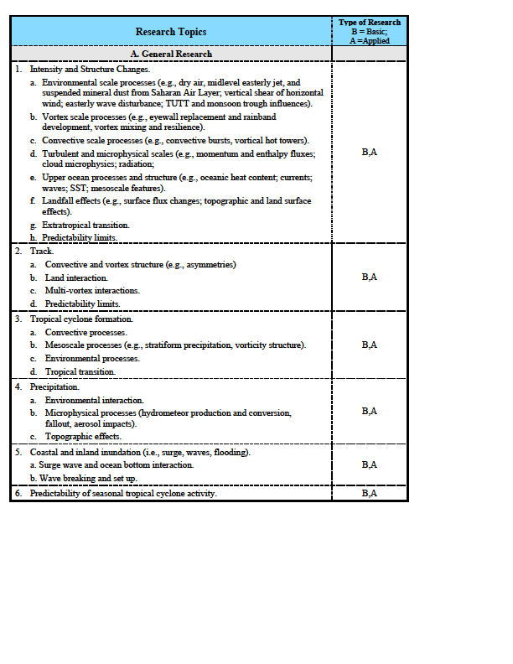
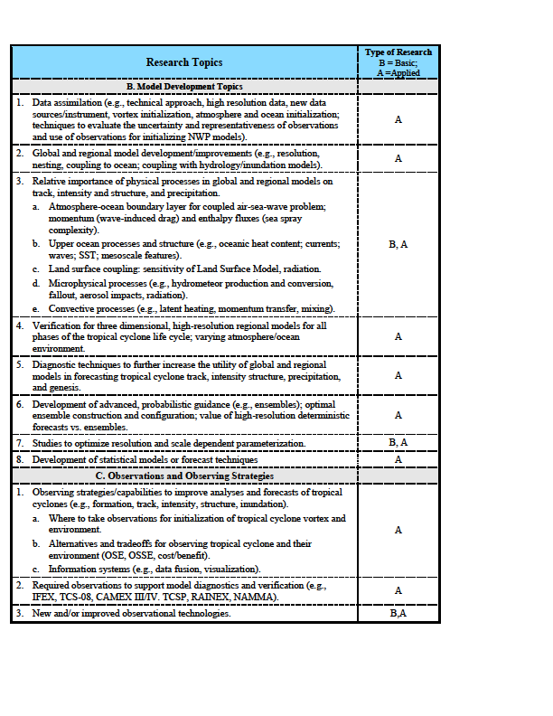
Research Needs
Table 2
Notes:
Highlighted research topic B8 added after looking at FY11operational priorities in AFFO for JHT. We noticed it as an omission from the original Table 2 and added it for future mapping. We did not remap the FY08 or FY10 to the FY09 JHT operational priorities to account for it. However, we plan to use it in the future mapping and comparisons.

Slide 15
Operational Priorities
Table 1
  Ops priorities extracted from FY09 JHT Announcement of Federal Funding Opportunity (AFFO)
NHC & CPHC Priority | JTWC Priority | Operational Need | Linkage to Research Needs
1 | 1 | Intensity Change | A1a-f, B1-B3, B6, B7, B8
2 | 2 | Improved Observations | B1, C1-C3
3 | 5 | Guidance Decision Tools | B5, B6
4 | 10 | Forecaster Efficiency | A4, A5, B2, B3, B6
5 | 6 | Storm Surge | A2, B1-B3, B5-B6
6 | 4 | Track Forecast | C1c
7 | 3 | Genesis | A3, B1-B3, B5-B7, B8
8 | 15 | Wind Analysis | B8
9 | 9 | Size/Structure | B1, B2, C1-C3
10 | 8 | Model Res vs Ensembles | A1a-g, B1-B7, B8
11 | 11 | QPF | B6, B7
12 | 7 | Radar/Satellite Data | B1, C1c
From
Table
2
  Ops priorities extracted from FY11 JHT Announcement of Federal Funding Opportunity (AFFO)
  Changes from Ops priorities from FY09 JHT AFFO

