Slide 1
Upcoming Changes to NHC Products
Forecast Improvement Priorities
Dr. Rick Knabb
Director, National Hurricane Center
5 March 2015
@NHCDirector

Slide 2
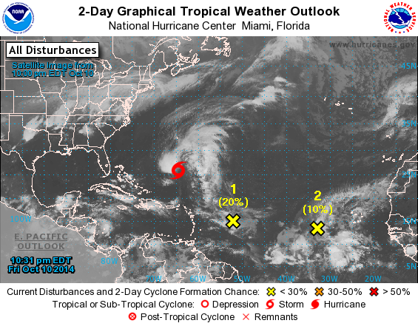
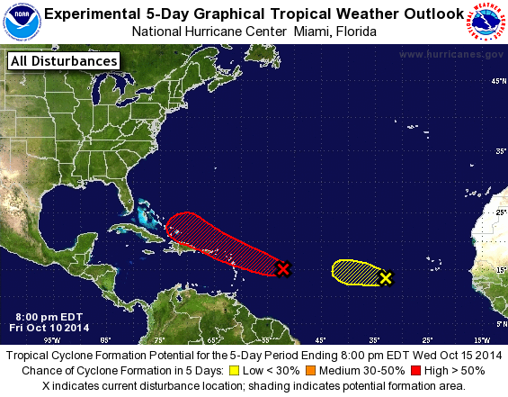
Graphical Tropical Weather Outlooks

Slide 3
Watches and warnings before genesis
Target 2016

Slide 4
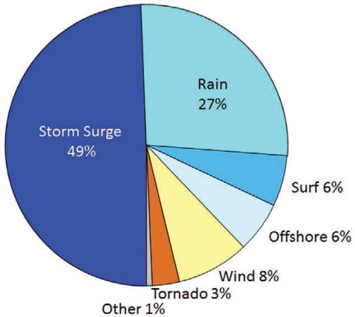
Causes of death directly attributable to Atlantic tropical cyclones
1963-2012

Slide 5
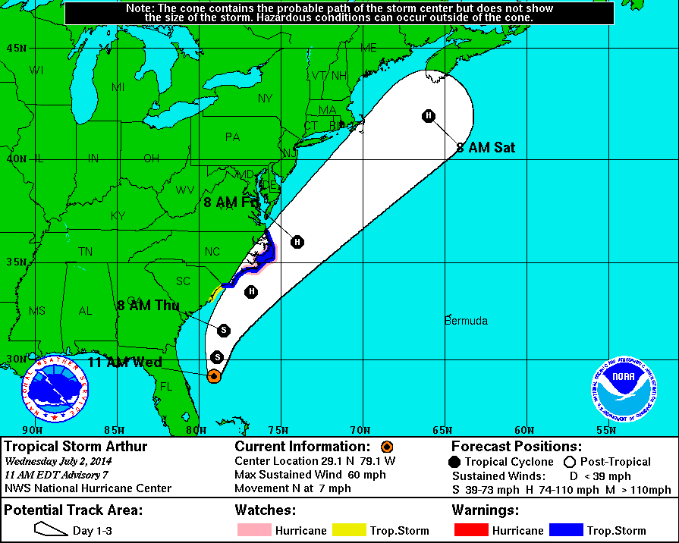
Hurricane Arthur
1-5 July 2014

Slide 6
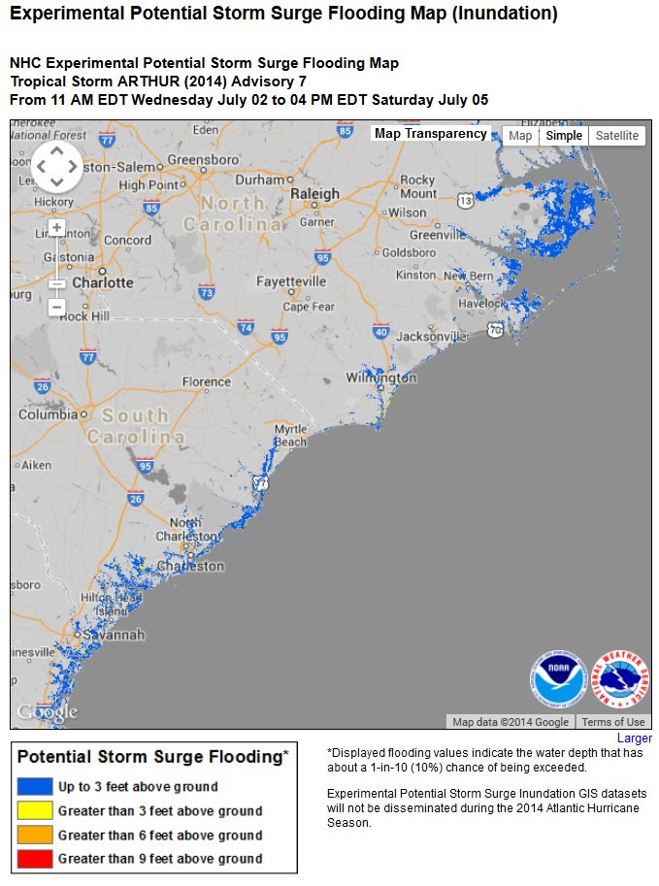
Experimental Potential Storm Surge Flooding Map
  Hurricane Arthur (July 2014)

Slide 7
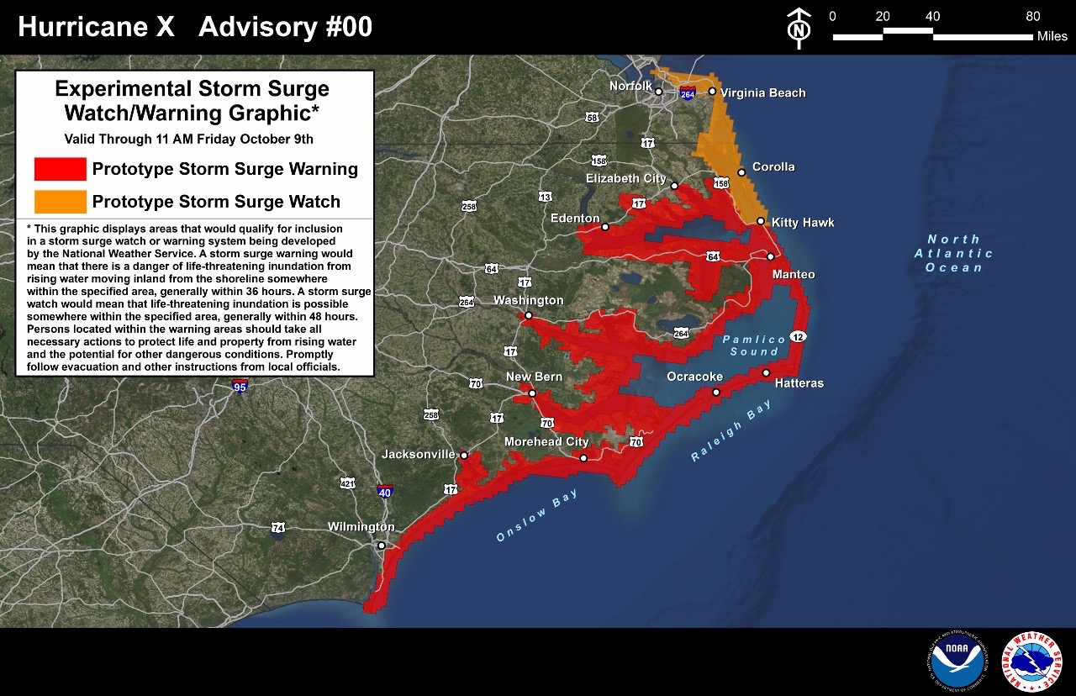
Prototype Storm Surge Watch/Warning Graphic
Experimental in 2015

Slide 8
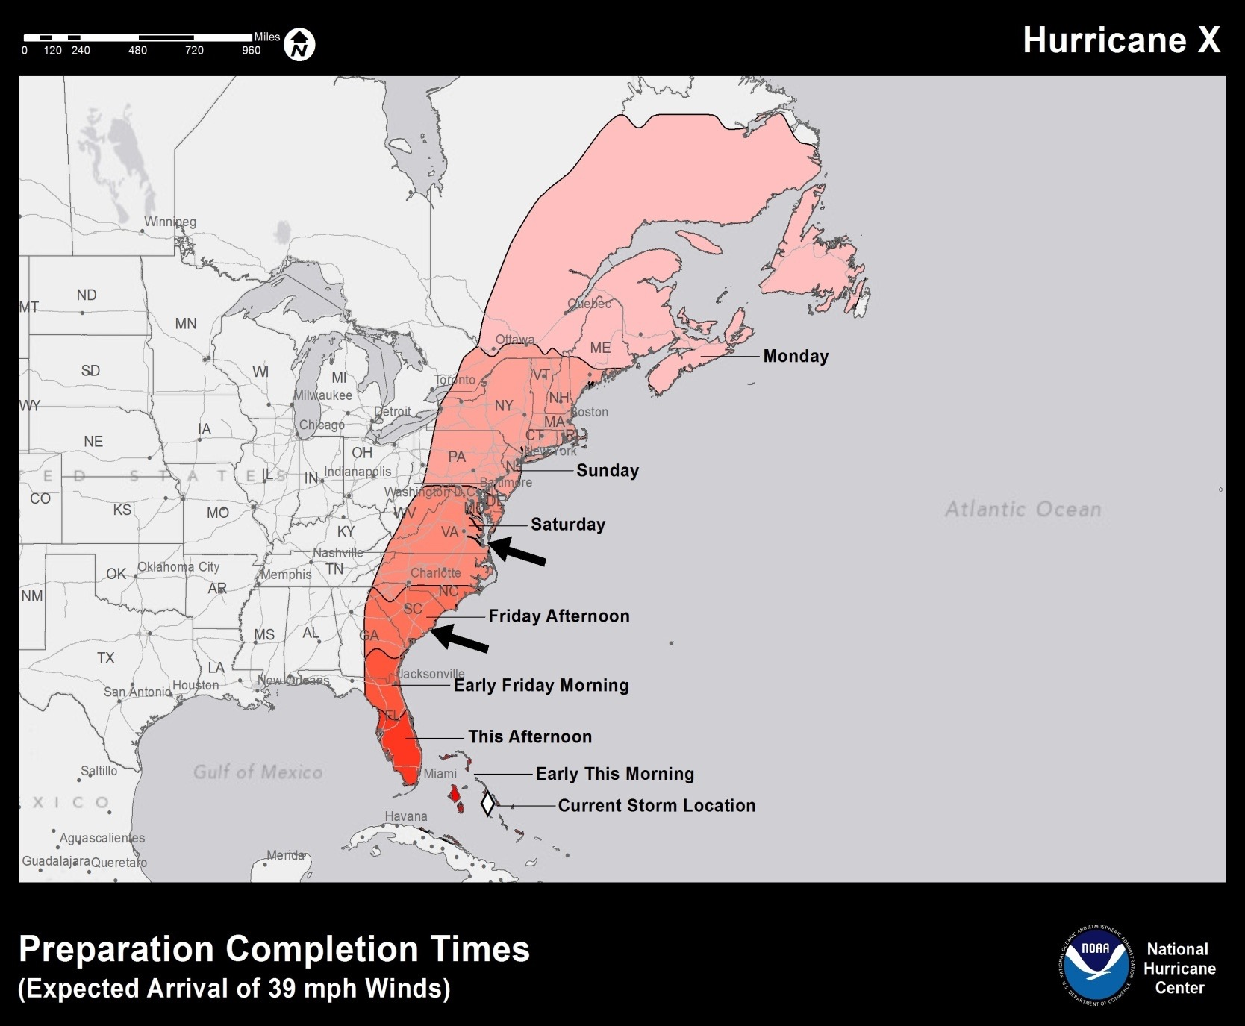
Wind Arrival Timing Uncertainty Product
Under Development

Slide 9
2014 Forecast Improvement Priorities
NHC-1/JTWC-1. Guidance for tropical cyclone intensity change, especially for the onset, duration, and magnitude of rapid intensification events, as well as for over-water rapid weakening events.
NHC-2/JTWC-2. Improved capability to observe the tropical cyclone and its environment to support forecaster analysis and model initialization.
NHC-3/JTWC-8. Statistically based real-time guidance on guidance to assist in the determination of official track and intensity forecasts. This could include multi-model consensus approaches, provided in probabilistic and other formats.
NHC-4/JTWC-9. Enhancements to the operational environment (e.g., ATCF, AWIPS- II) to increase forecaster efficiency, by expediting analysis, forecast, coordination, and/or communication activities.

Slide 10
2014 Forecast Improvement Priorities
NHC-5/JTWC-11. Techniques or products to support pre-genesis disturbance track, intensity, size, and wind speed probability forecasts.
NHC-6/JTWC-15. Advanced coastal inundation modeling and/or applications, visualization, or dissemination technology that enhances operational storm surge forecast accuracy or delivery.
NHC-7/JTWC-4. Improved and extended track guidance. Identification, and then reduction of, the occurrence of guidance and official track outliers, focusing on both large speed errors (e.g., accelerating recurvers and stalling storms) and large direction errors (e.g., loops), and on specific forecast problems, including interactions between upper-level troughs and tropical cyclones, track forecasts near/over land--especially elevated terrain, and extratropical transition.
NHC-8/JTWC-5. Guidance for tropical cyclone genesis at both the short-range (0-48 hours) and the medium-range (48-120 hours) that exhibits a high probability of detection and a low false alarm rate for, and/or provides probability of, genesis.

Slide 11
2014 Forecast Improvement Priorities
NHC-9/JTWC-12. Modernize the satellite-based classification system used for monitoring subtropical cyclones (e.g., the Hebert-Poteat Technique).
NHC-10/JTWC-17. Develop techniques for incorporating tropical cyclone predictions within the NWS National Digital Forecast Database.
NHC-11/JTWC-18. Develop guidance on the best flight track strategies for synoptic surveillance missions that take into account hurricane forecaster use as well as data assimilation needs.
NHC-12/JTWC-7. Operational analysis of the surface wind field in tropical cyclones, including the analysis of the maximum sustained winds, and winds affecting elevated terrain and high-rise buildings.

Slide 12
2014 Forecast Improvement Priorities
NHC-13/JTWC-10. Guidance for changes in tropical cyclone size/wind structure and related parameters, including combined sea heights.
NHC-14/JTWC-6. Single-model track or intensity ensembles that have skill comparable to multi-model consensus techniques.
NHC-15/JTWC-3. Techniques to improve the utility of microwave satellite and radar data for tropical cyclone intensity and location analysis (e.g. develop a “Dvorak-like” technique using microwave imagery).
NHC-16/JTWC-14. Guidance for precipitation amount and distribution associated with tropical cyclones and tropical disturbances.

Slide 13
2014 Forecast Improvement Priorities
NHC-17/JTWC-13. Improved techniques for estimating the intensity of tropical cyclones passing over and north of sea-surface temperature gradients.
NHC-18/JTWC-16. Develop tropical cyclone climatology software that provides statistics on closest point of approach to a station, bearing and distance to a station, cyclone intensity statistics for a point or location, return period statistics, etc.

