Slide 1
A COMPLETED HURRICANE SURGE VISUALIZATION MODEL AND ONGOING EFFORTS TO USE THE MODEL TO ASSESS PUBLIC UNDERSTANDING OF RISKS DUE TO STORM SURGE
B. Lee Lindner, Stephen Duke, Janet Johnson
College of Charleston
Frank Alsheimer
National Weather Service, Charleston

Slide 2
Background
CHARLESTON HAS EXPERIENCED MANY HITS OR NEAR MISSES IN THE PAST 20 YEARS
93% OF OUR 202 SURVEY SUBJECTS HAD EXPERIENCED HURRICANE EFFECTS
YET, MOST FAILED TO UNDERSTAND BASIC HURRICANE ADVISORIES
HALF DID NOT REALIZE STORM SURGE IS THE MAIN THREAT
MOST HAD NO CLUE WHAT A PARTICULAR SURGE DEPTH MEANT RELATIVE TO THEIR HOME ELEVATION
MOST DID NOT HAVE AN EVACUATION PLAN
HALF FELT THE NWS OVERSTATES THE DANGERS

Slide 3
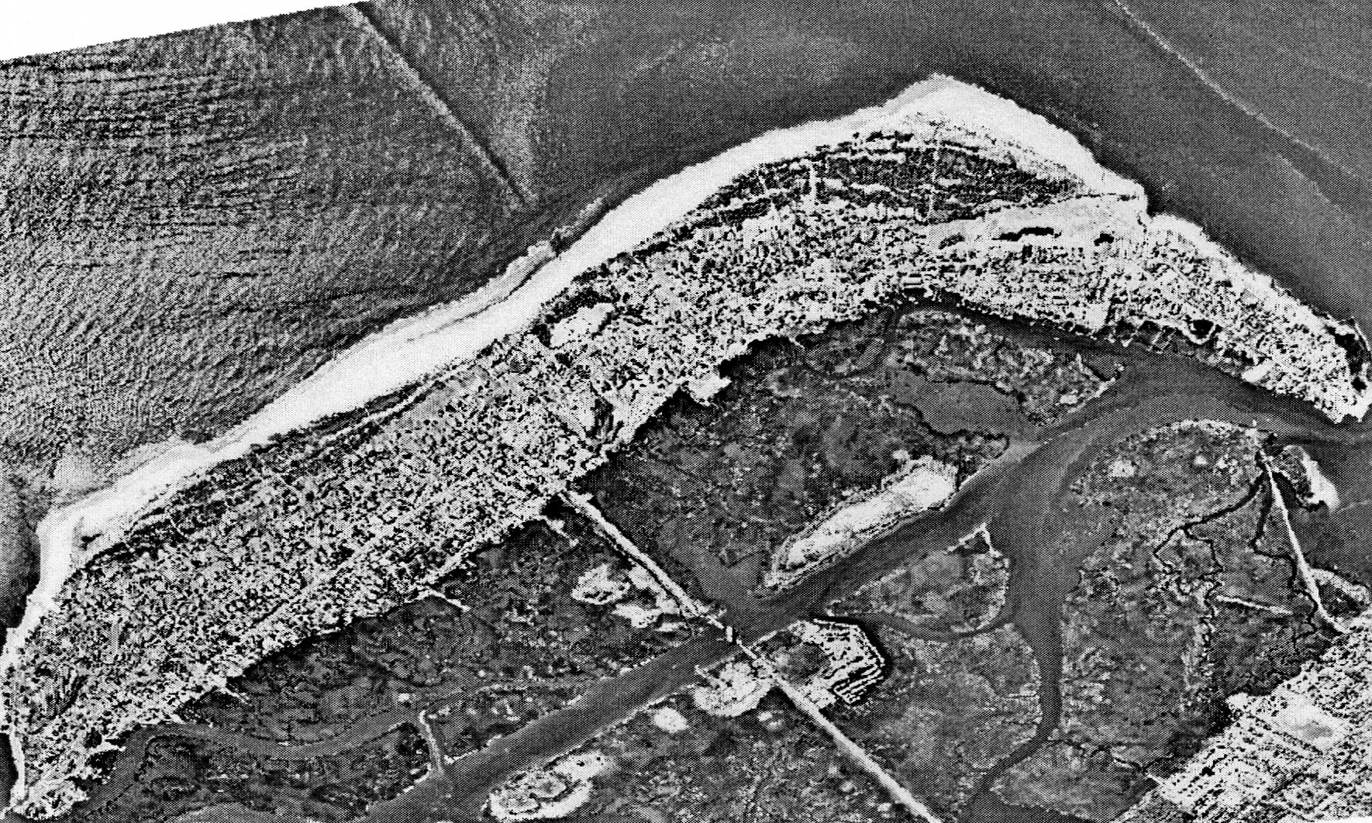
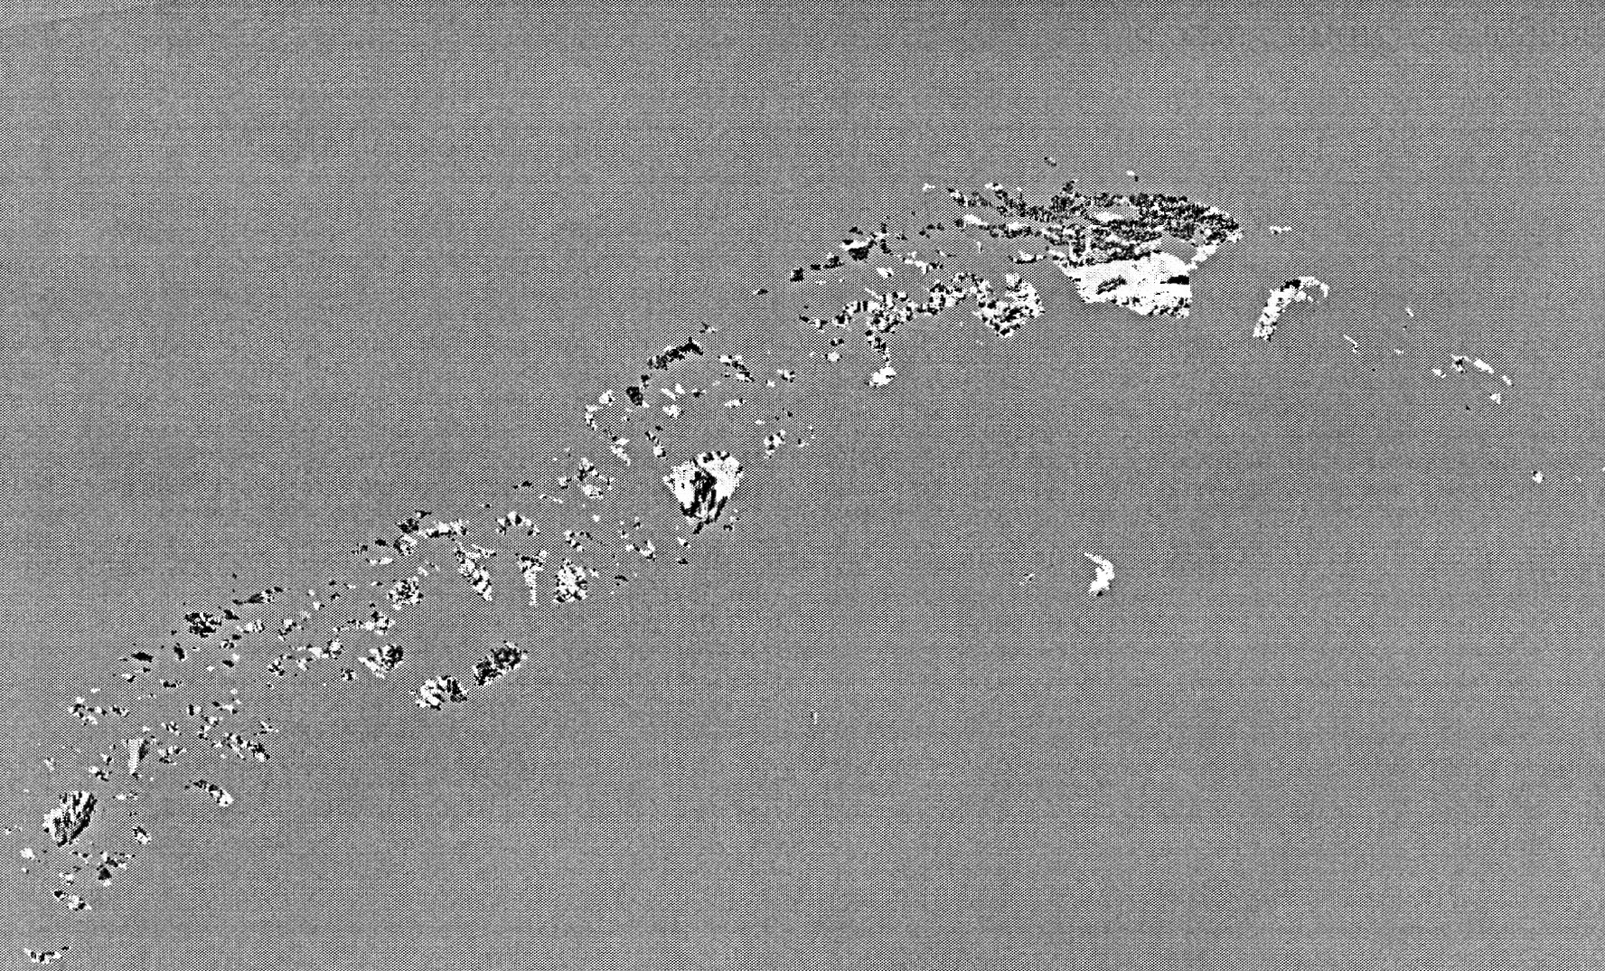
Sullivan’s Island, SC

Slide 4
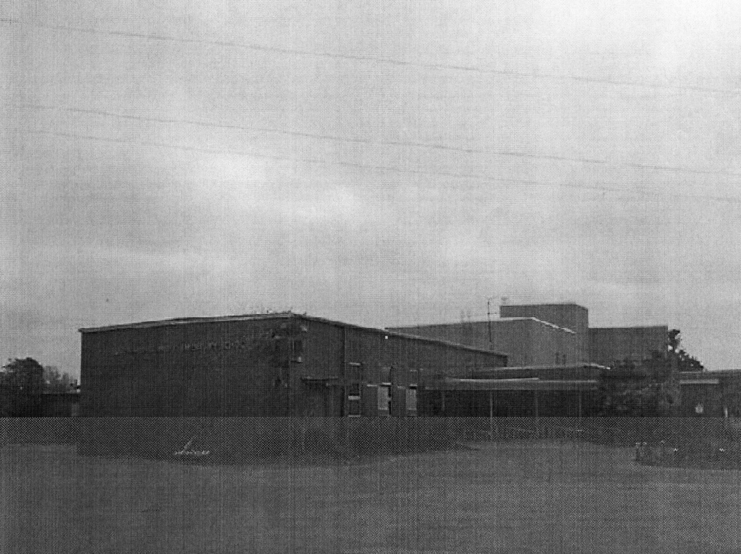

Slide 5
Surge Visualization Model
INTERACTIVE WEB SITE
  Background on Study
  Basic Hurricane Physics
  Hurricane Surge Visualization Model
  Error Warnings
DATA ON ONE THOUSAND LANDMARKS (every 2 blocks)
DATABASE OF 50 SLOSH SIMULATIONS (Thanks Brian Jarvinen)
COMBINE SLOSH, ELEVATION, TIDAL DATA
OVERLAY WATER DEPTH ON PHOTOGRAPHS

Slide 6
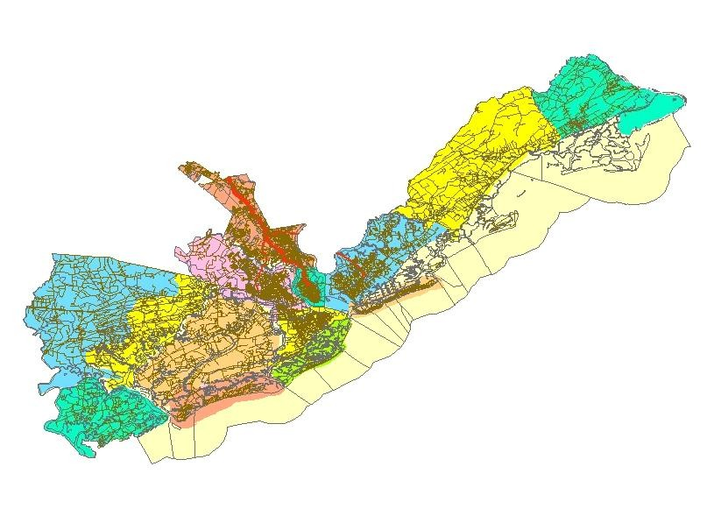
GIS map, Charleston County

Slide 7
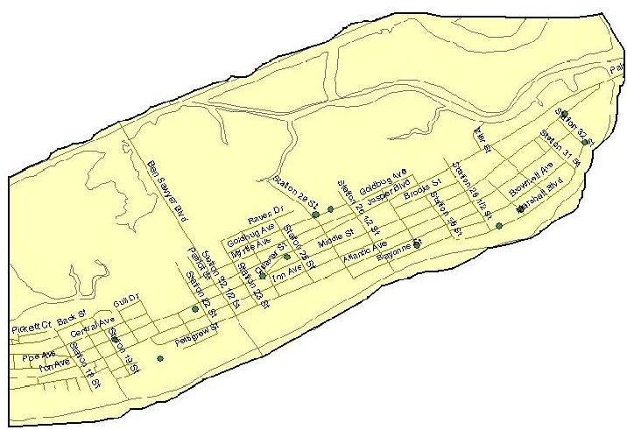
Zoom to Sullivan’s Island

Slide 8
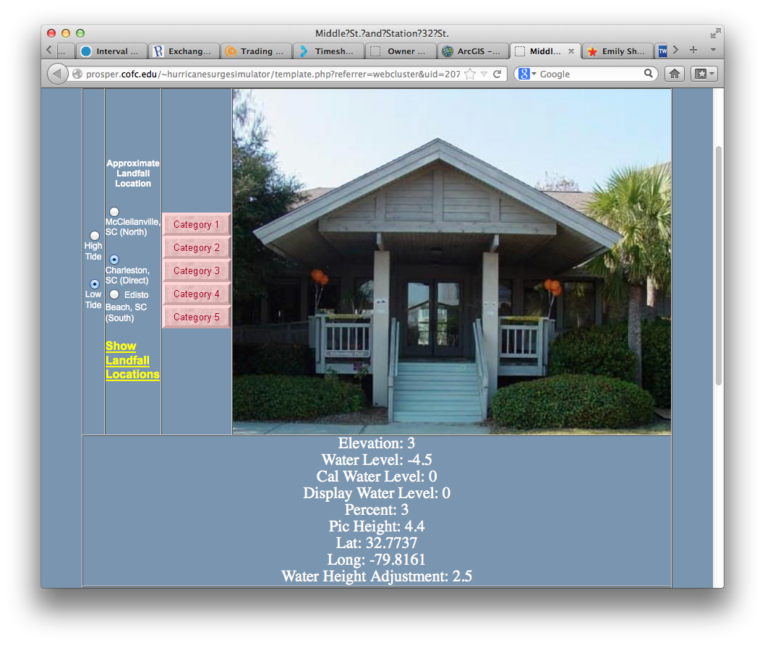
Category 1
Category 1

Slide 9
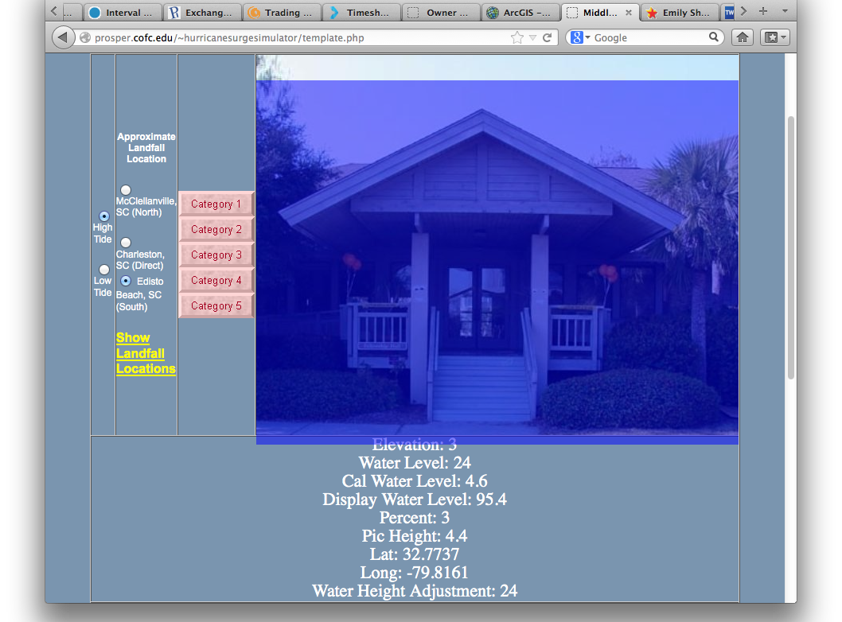
Category 5

Slide 10
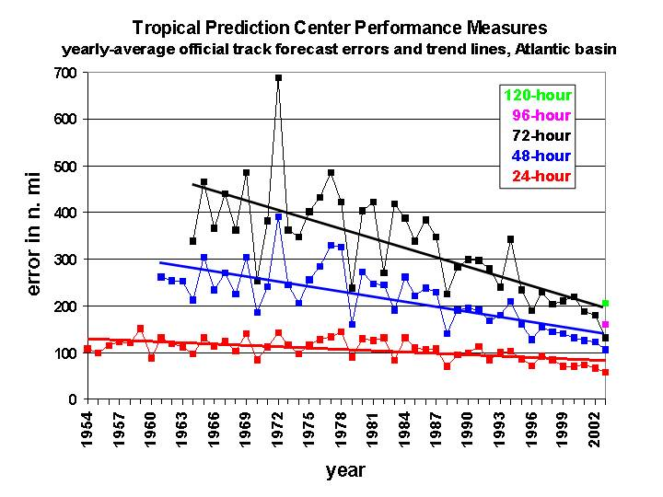
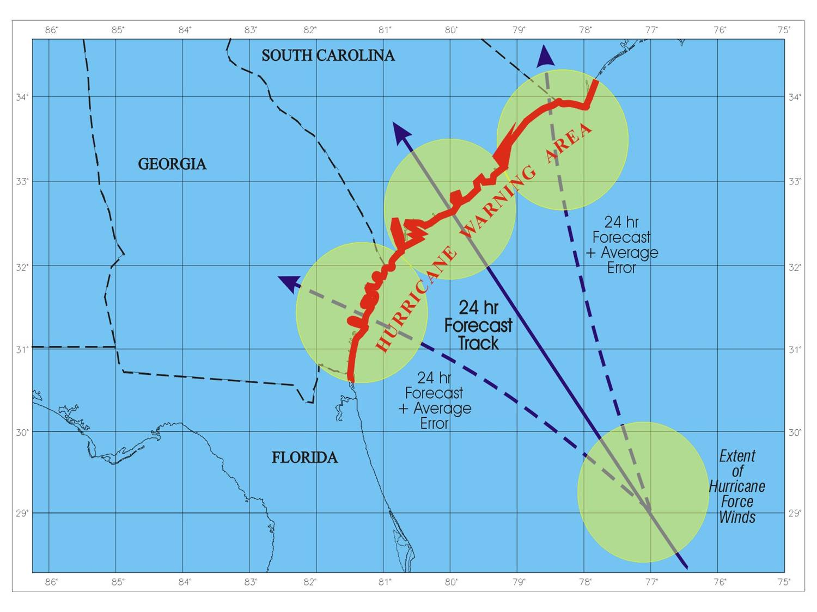
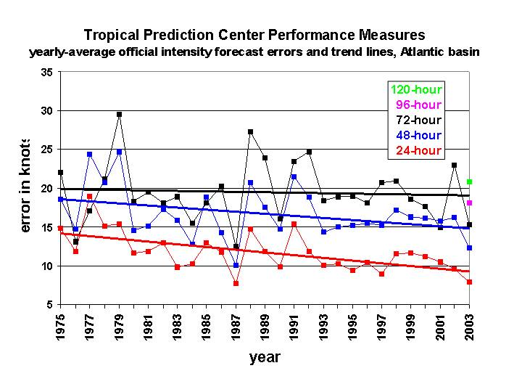

Slide 11
Procedure
SURVEY HUNDREDS OF RESIDENTS
SITE ADDRESS ONLY RELEASED TO SURVEY SUBJECTS
DEMOGRAPHICAL DATA
UNDERSTANDING OF HURRICANE PHYSICS EXPLORED BEFORE AND AFTER USING THE SITE
EXPLORE UNDERSTANDING OF UNCERTAINTIES IN FORECAST, ELEVATIONS, WAVES, INLAND FLOW, ETC.
DETERMINE PROBLEM AREAS FOR FUTURE MODELS
PUBLISH

Slide 12
Subjects
Interviewed by local TV broadcaster
Shown in primetime sweeps week
Few in audience visited website
Only 10% did the second survey
Additional subjects found through personal interaction at events

Slide 13
SITE
prosper.cofc.edu/~hurricanesurgesimulator/index.html
SKIP SURVEYS BY SIMPLY CLICKING CONTINUE
DATA NEEDS TO BE JUST LOCAL RESIDENTS
COMMENTS, SUGGESTIONS WELCOME

Slide 14
Summary
PUBLIC HAS POOR UNDERSTANDING OF THE RISK ASSOCIATED WITH HURRICANE SURGE
STANDARD FLOODZONE MAPS ARE NOT EFFECTIVE FOR MOST PEOPLE
HOW EFFECTIVE WILL AN INTERACTIVE WEB SITE USING LOCAL LANDMARKS BE AT CONVEYING RISK OF HURRICANE SURGE?
USE AS AN EDUCATIONAL TOOL
DETER DEVELOPMENT OF LOW-LYING AREAS?
THANKS TO THE NOAA (UCAR) COMET PROGRAM!

Slide 15
Valued Contributors
Nancy Barton Robert Bright Shayna Brisacher
Stephen Brueske Anne Chalmers Charles Cockcroft
Rhonda Crawley Jessica Darone Claire Dupont
Ashley A Fields Katherine A Frederick Kristen Leigh Frye
Alexandra T Gatlin Lesley Germanow Evgeni Gurovich
Kelly Harper Brandon Harris Raymond Harris
Jerry Harrison Tobias John Hawthorne Daniel Johnson
George 'Pat' Kablick Dr. Charles Kaiser Dr. Robert Kennedy
Timmy Hartt Kent Amber Kuss Andrew Lassister
Cang Le Dr. Norm Levine Andrew Livingston
Jennifer L. Mantini Andrew Miller Dr. Laney Mills
Brad Milnes Chinedu Nwadiugwu Norton Brice Orange
Kristi Owens Frederick “Elliot” Quinn Sammy S Perkins
Joni Rennhack Eliza Morgan Reock Thomas G Rolfson
David Sattler Sterling Savage Cameron Self
Jay Sonner Zachary A Spring Dan St. Jean
Kristen R Steele Jennifer L. Thomas Dr. Fred Watts
Blake Williams

