Slide 1

NRL Tropical Cyclone Satellite Web Resource
Jeff Hawkins¹, Kim Richardson², Rich Bankert², Mindy Surratt², Song Yang², Jeremy Solbrig², Josh Cossuth³, Buck Sampson², John Kent⁴, and Arunas Kuciauskas²
¹Retired (January, 2015) from Naval Research Laboratory, Monterey, CA
²Naval Research Laboratory, Monterey, CA
³ National Research Council, Monterey, CA
⁴Scientific Applications International, Inc., Monterey, CA
POC: Rich Bankert
Richard.Bankert@nrlmry.navy.mil
OFCM 69th Interdepartmental Hurricane Conference
March 2-5, 2015
1

Slide 2
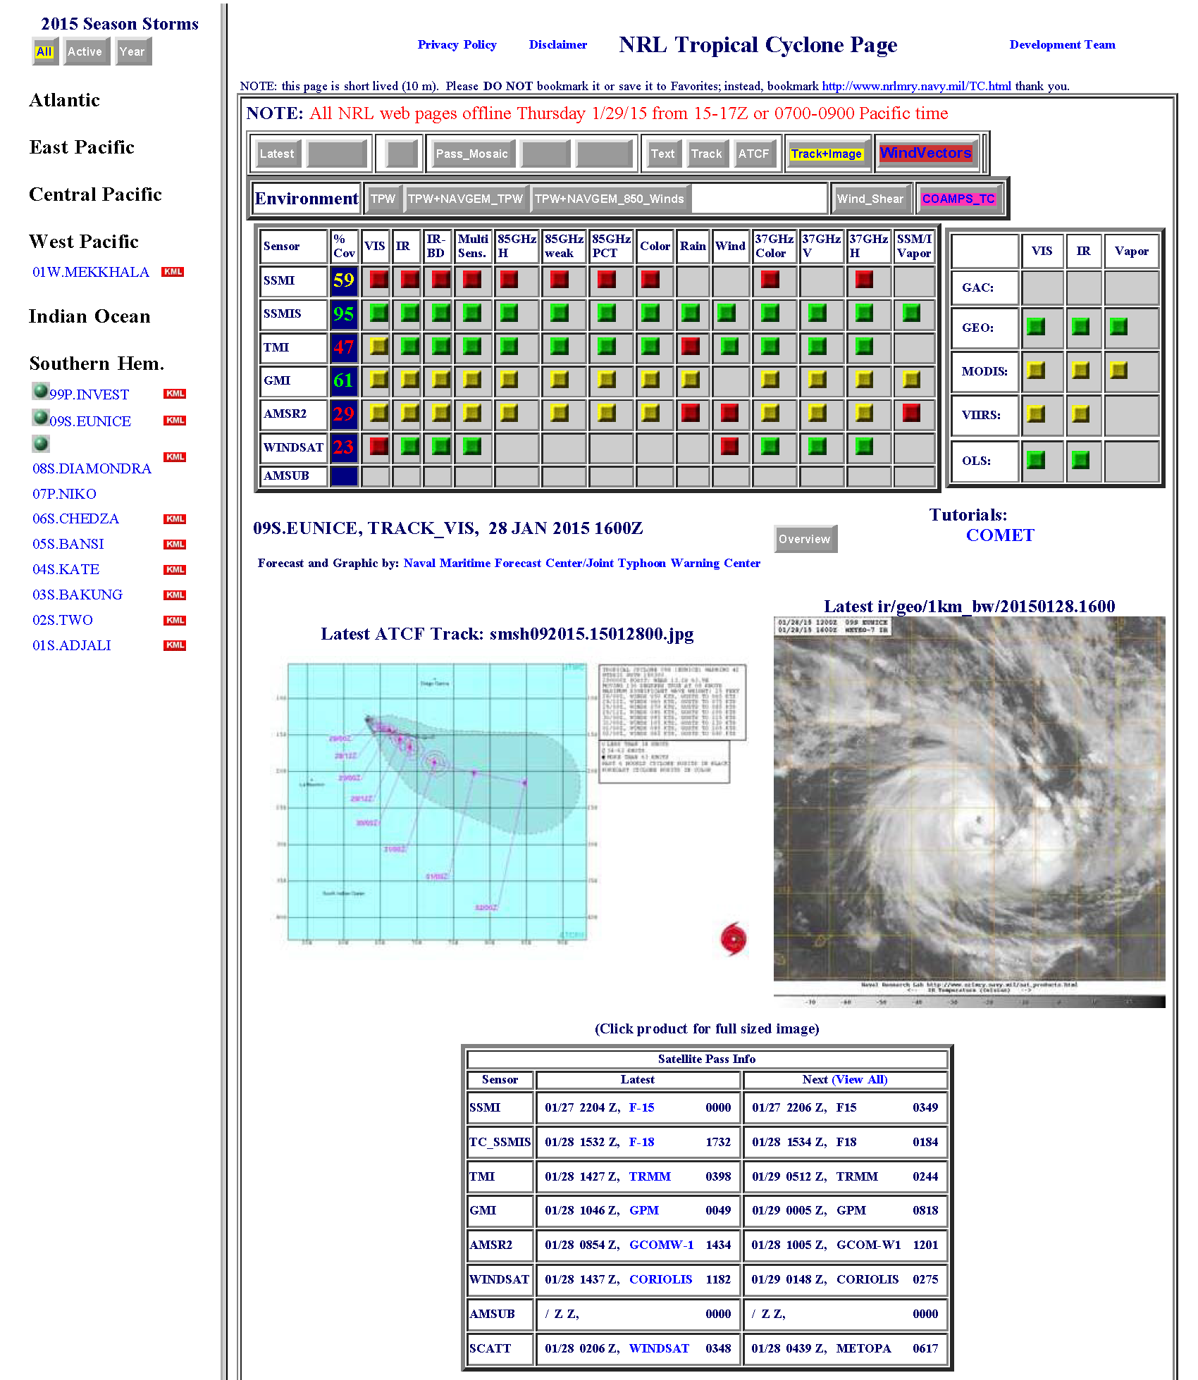
NRL Tropical Cyclone Satellite Web Resource
F-19 SSMIS
RapidSCAT
GPM GMI
GCOM AMSR2
Coming Soon: NPP ATMS
2

Slide 3
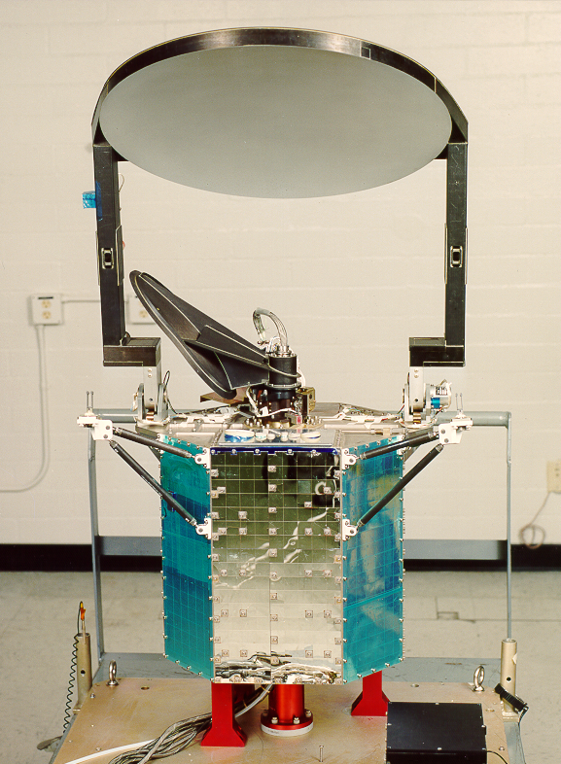
DMSP F-19 Special Sensor Microwave Imager Sounder (SSMIS)
Sensor: Passive Microwave Conical Scanner
Spacecraft: DMSP F-19
Launch: April 3, 2014 [0630 orbit]
Heritage: SSM/I, Seasat SMMR
Channels: 19, 22, 37, 91 GHz
~55, 55, 35, 12 km
Swath: 1700 km
TC Applications:
Continuity with legacy DMSP sensors
Collocated imager/sounder channels,
    improved retrievals
Large swath
Web Links: http://www.osdpd.noaa.gov/PSB/IMAGES/ssmisdoc.htm
3

Slide 4
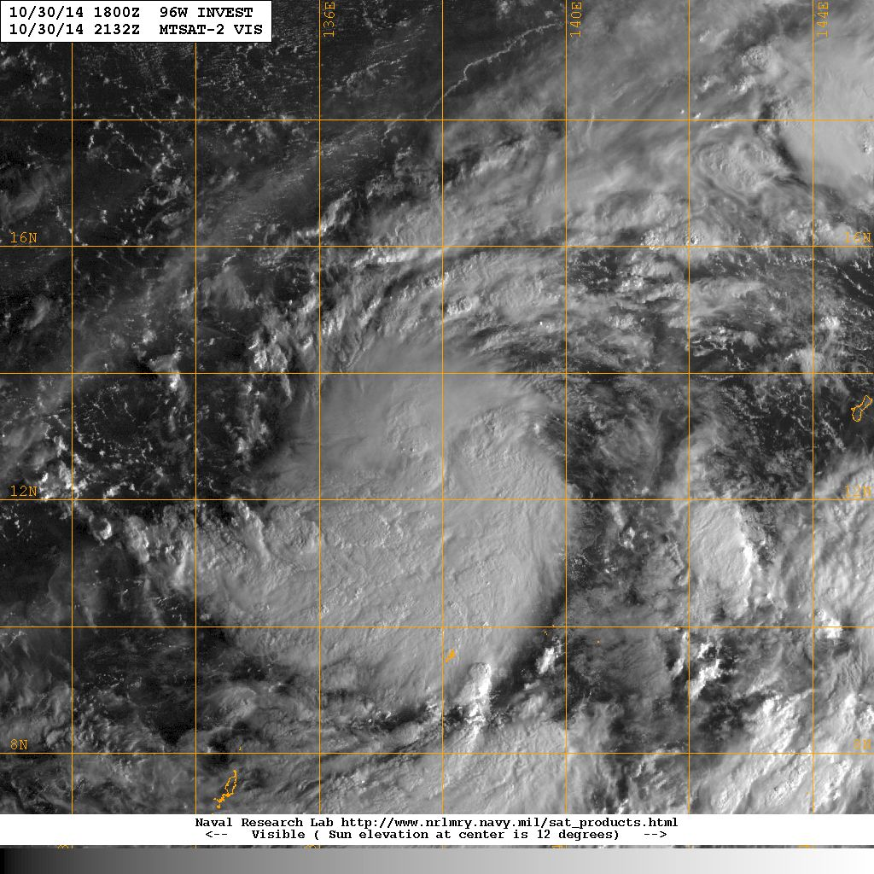
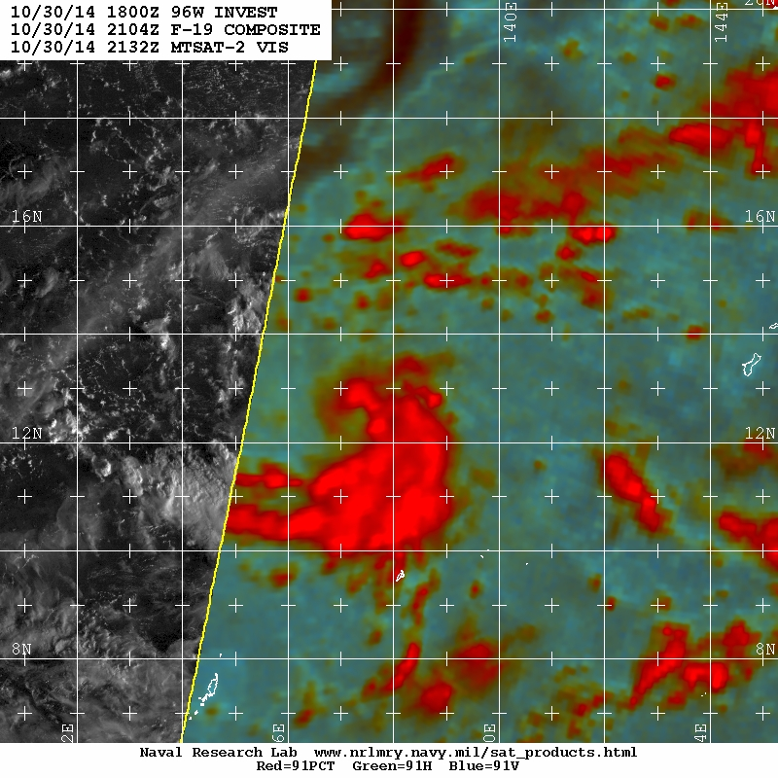
DMSP F-19 SSMIS
Precise center and developing eye in Pre-Super Typhoon Nuri
4

Slide 5
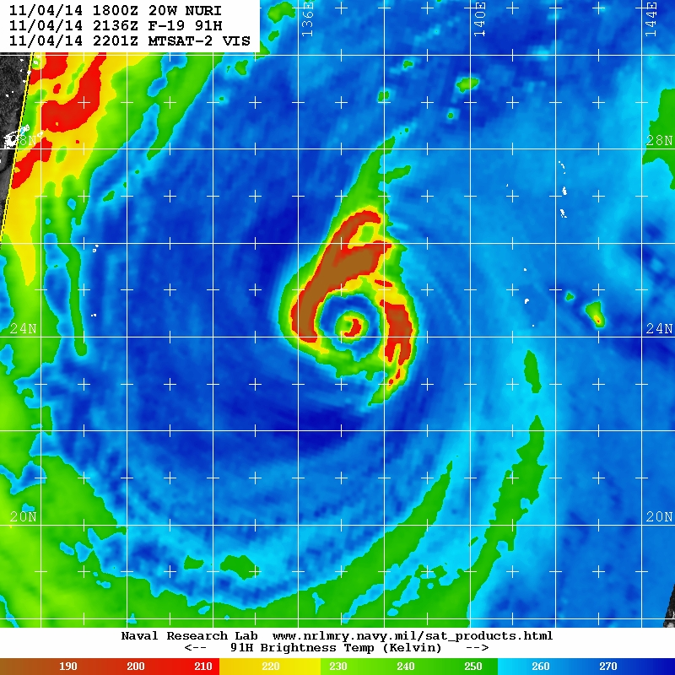
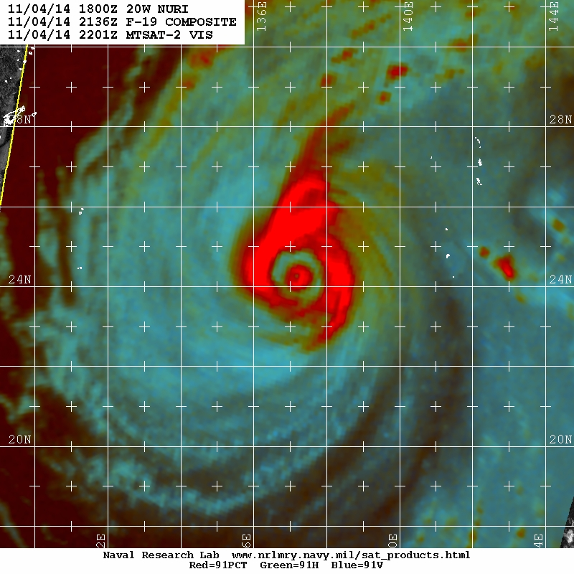
DMSP F-19 SSMIS
Investigating TC size and structure through different products
5

Slide 6
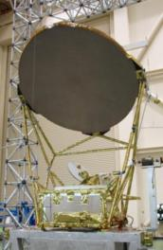
Advanced Microwave Scanning Radiometer
AMSR-2
Sensor: Passive Microwave Conical Scanner
Spacecraft: GCOM-W1
Launch: May 18, 2012 [1330 orbit]
Heritage: AMSR-E
Channels: 7, 10, 18, 23, 36, 89 GHz
50, 30, 18, 20, 10, 5 km
Swath: 1618 km
TC Applications:
1330 orbit splits the DMSP overpasses
Superb spatial resolution (36 GHz),
(3) All weather sea surface temperatures,
(4) 20% better resolution than AMSR-E.
2m versus 1.8 m dish
Web Links: http://suzaku.eorc.jaxa.jp/GCOM_W/w_amsr2/whats_amsr2.html
6

Slide 7
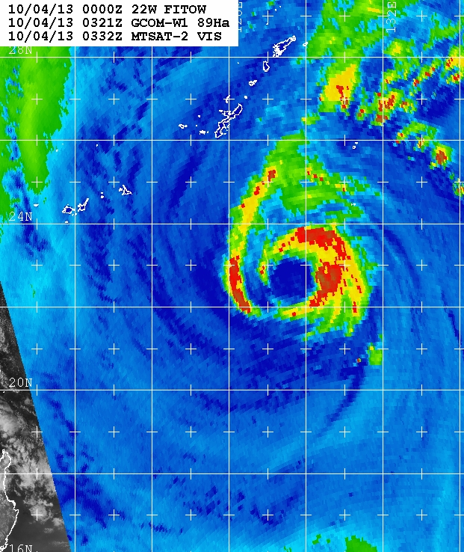
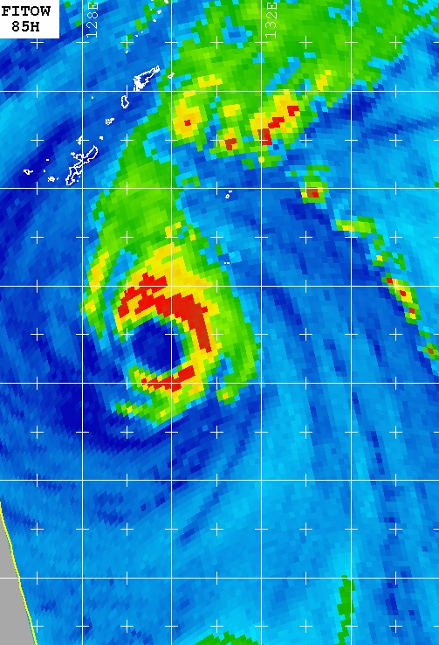
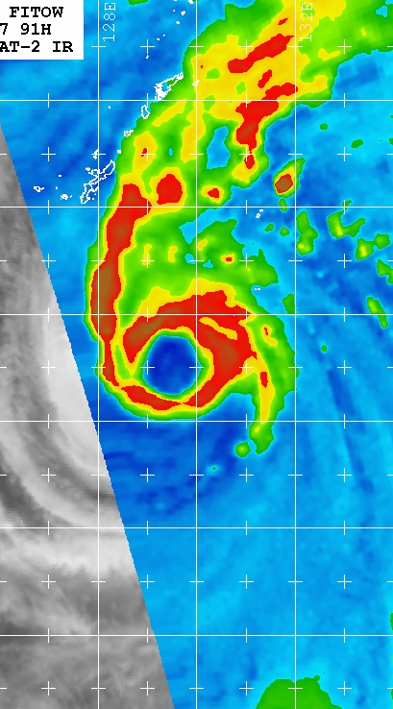
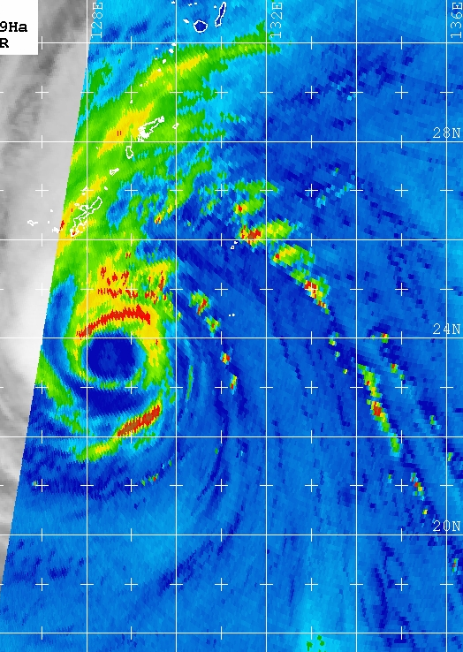
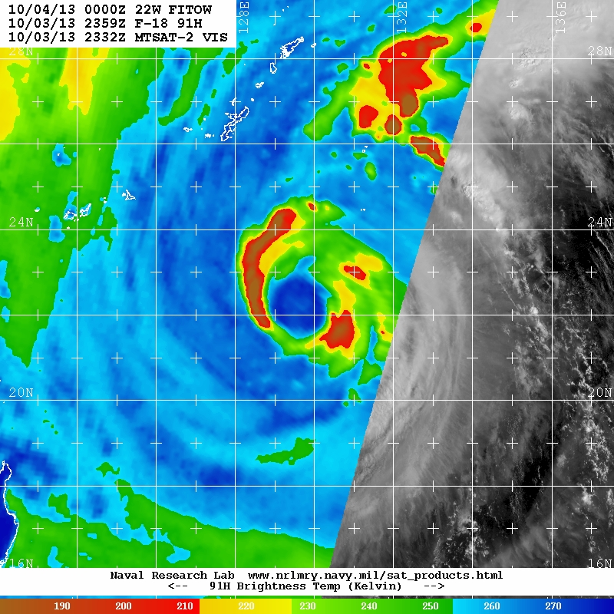
AMSR2
AMSR2 03Z
F-15 06Z
F-17 08Z
AMSR2 16Z
GCOM AMSR2’s large swath and excellent spatial resolution aids JTWC in monitoring Typhoon Fitow near Okinawa and Taiwan via 89 GHz H-pol T_{B} imagery
1330 LTAN greatly augments existing constellation TEMPORAL sampling
7

Slide 8
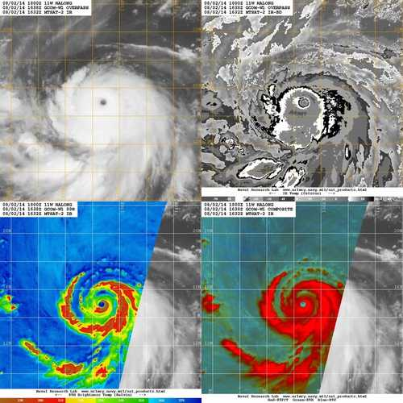
AMSR2
VIS/IR unable to capture inner core (double eyewall forming) structure
8

Slide 9
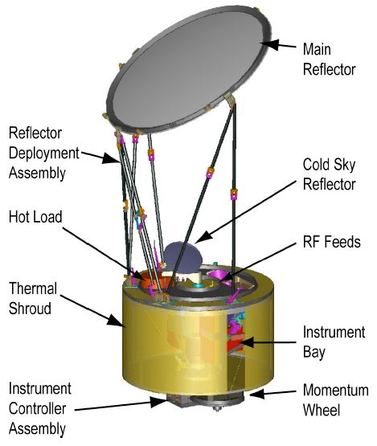
Global Precipitation Mission (GPM)
Microwave Imager (GMI)
Sensor: Passive Microwave Conical Scanner
Spacecraft: GPM
Launch: Feb 27, 2014 66 deg inclination
Heritage: TRMM microwave imager
Channels: 10, 19, 23, 36, 89, 150/166, 183 GHz
26, 15, 12, 11, 6, 6, 6 km
Swath: 885 km
Enhancements for TC Applications:
(1) Excellent spatial resolution,
Inclined orbit (66 deg) more over flights
Coincident precipitation radar
Web Links: http://www.nasa.gov/mission_pages/GPM/spacecraft/index.html
9

Slide 10
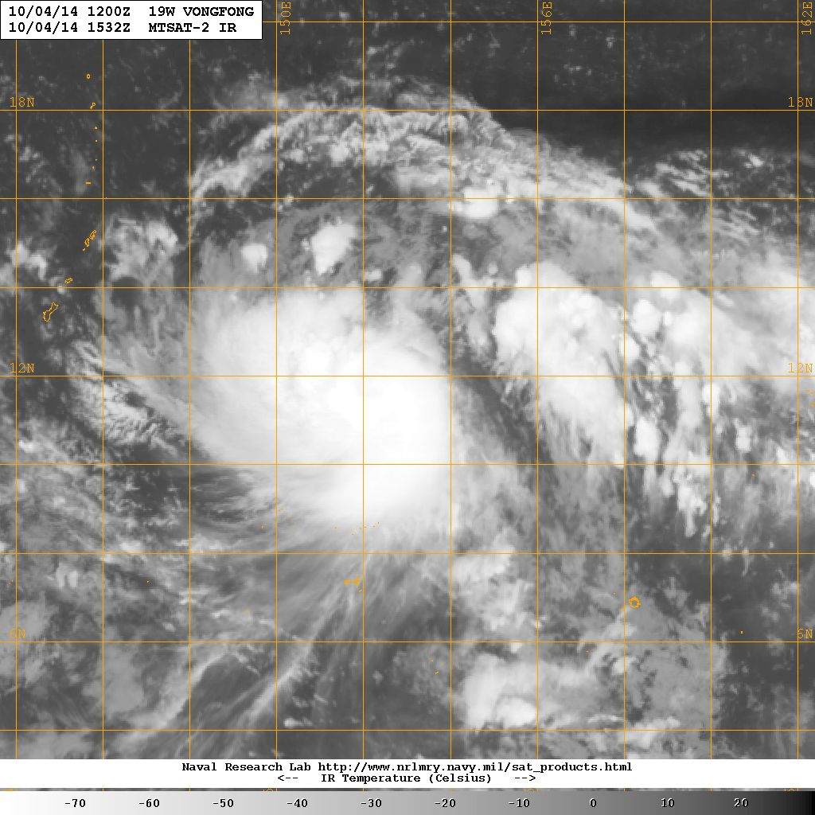
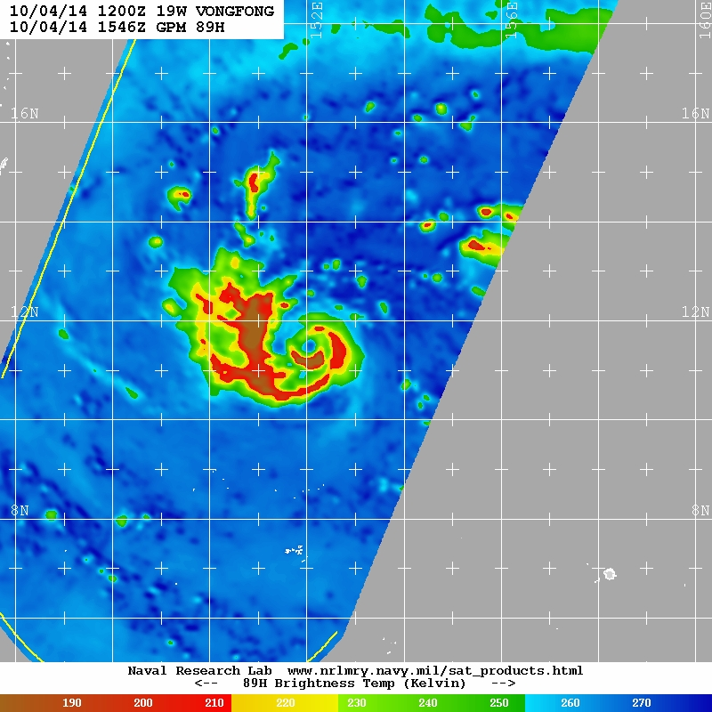
GMI
Timely GMI overpass reveals developing eye and eyewall
10

Slide 11
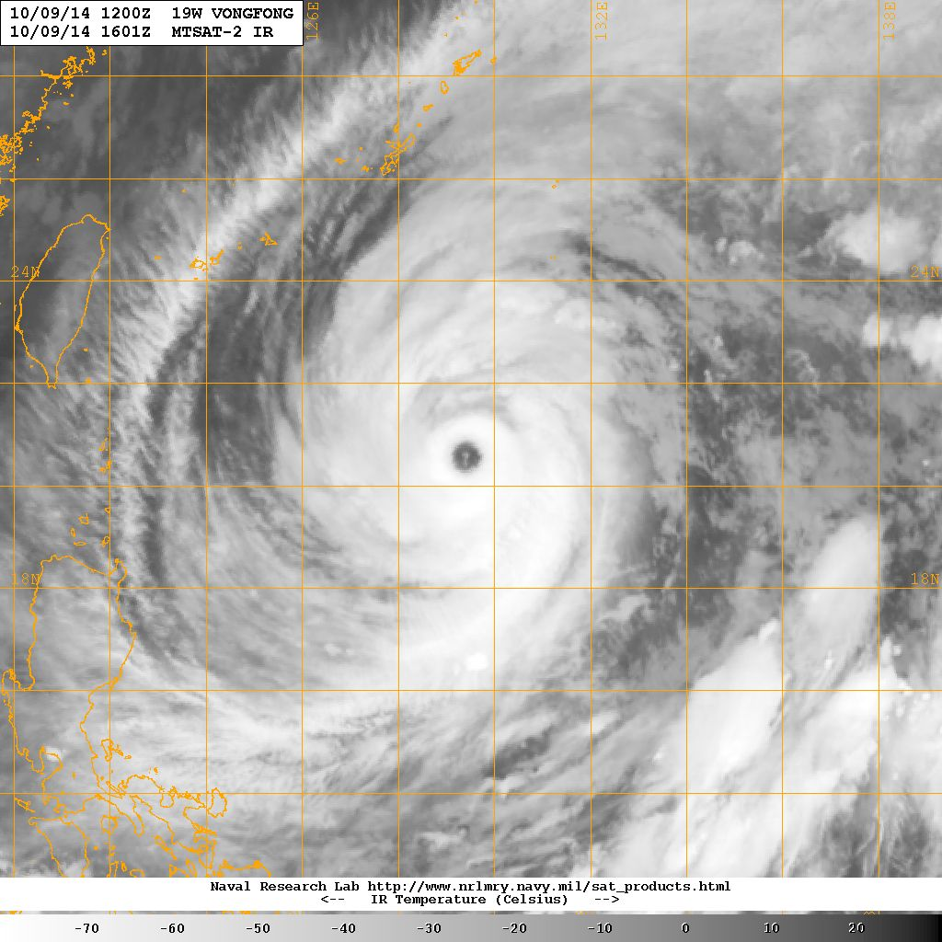
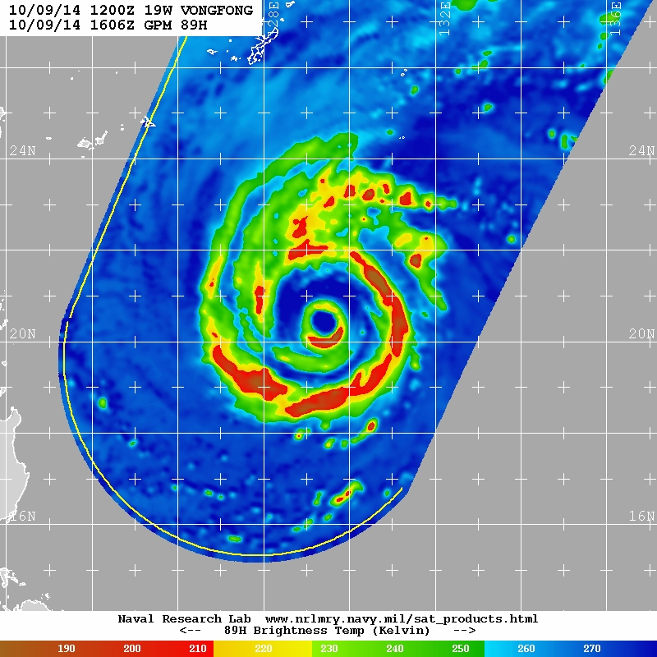
GMI
Strong eyewall in IR imagery shown to be weakening
11

Slide 12
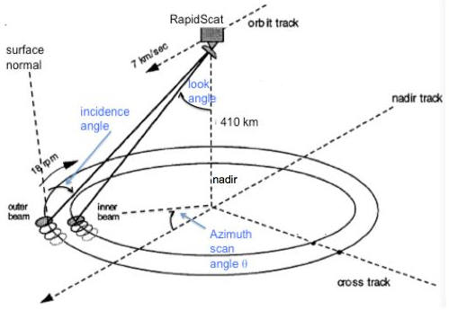
RapidSCAT
Sensor: Active microwave scatterometer
Spacecraft: International Space Station (ISS, 51.6 deg inclination)
Launch: Sept. 22, 2014
Heritage: QuikSCAT
Channels: 13.4 GHz (Ku-band)
Swath: 900 km
Enhancements for TC Applications:
(1) Ocean surface vector winds (OSVW)
25 & 12 km spatial resolution
Diurnal sampling, non sun sync orbit
< 2 hr data latency
Web Links: https://winds.jpl.nasa.gov/missions/RapidScat
12

Slide 13
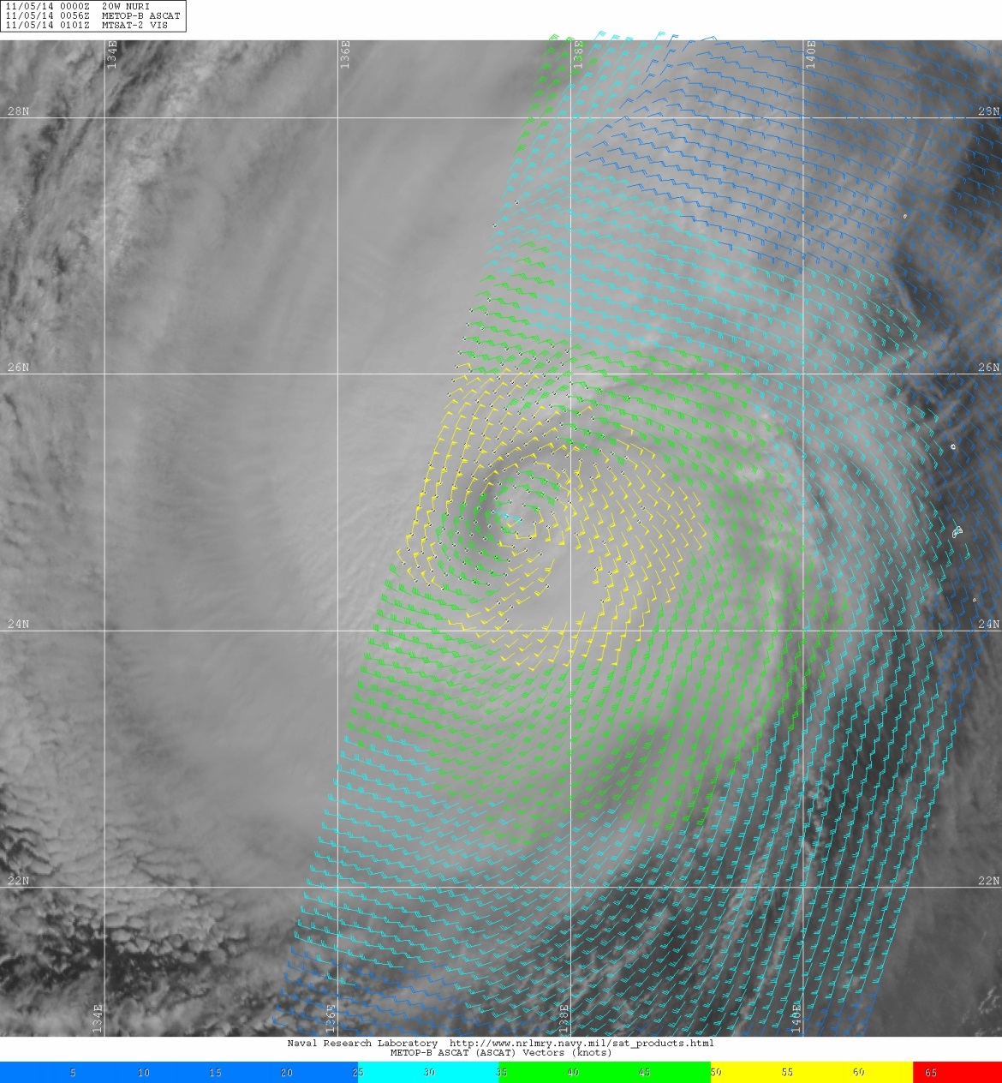
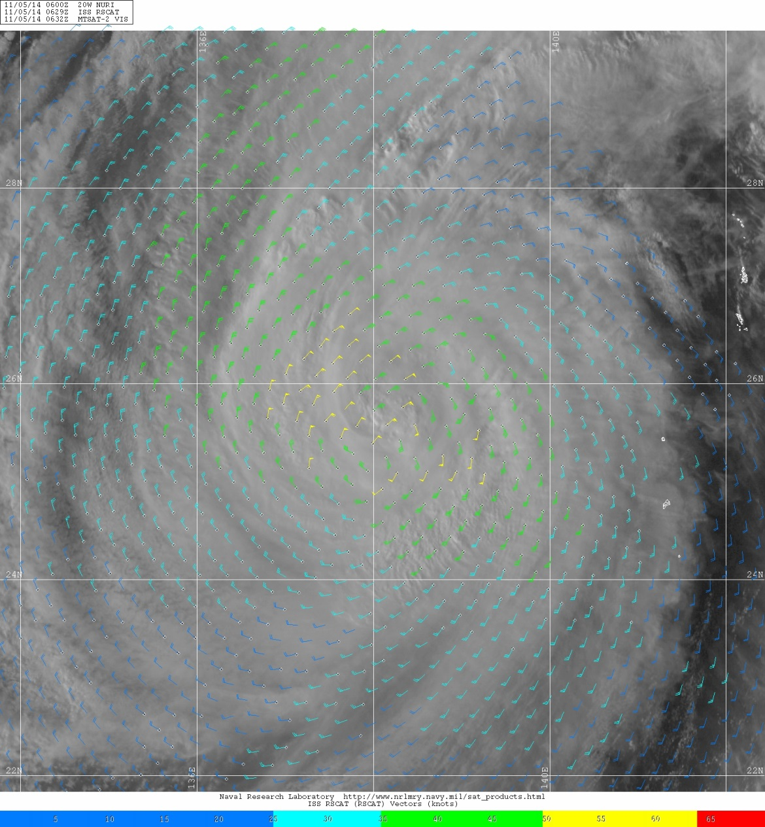
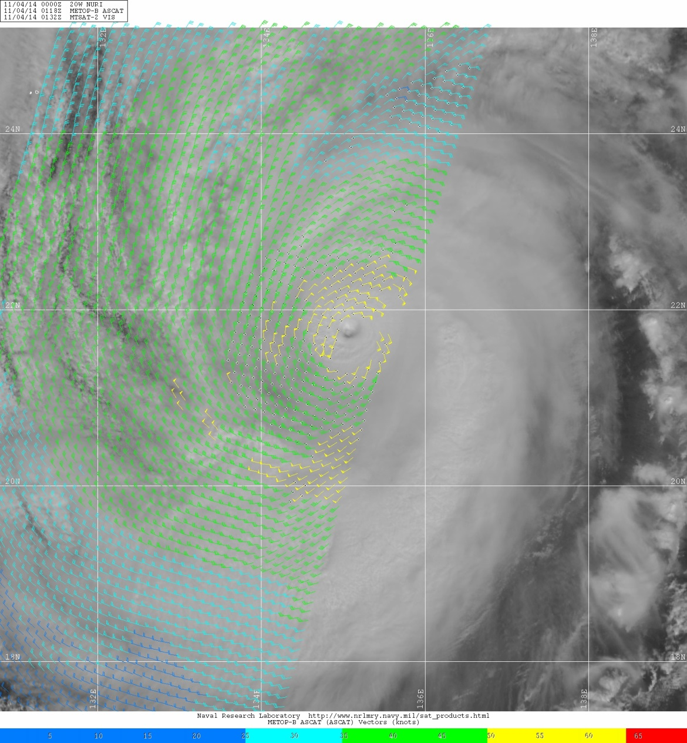
RapidSCAT
Typhoon Nuri
Wind field evolution from 11/04/2014 to 11/05/2014
Green > 34 kts
Yellow > 50 kts
11/04/2014
0118Z
ASCAT
12.5 km vectors
11/05/2014
0056Z
ASCAT
12.5 km vectors
11/05/2014
0629Z
RapidSCAT
25 km vectors
Significant decrease in R34
Diagnosing radius of gale for winds (> 34 kts)
13

Slide 14
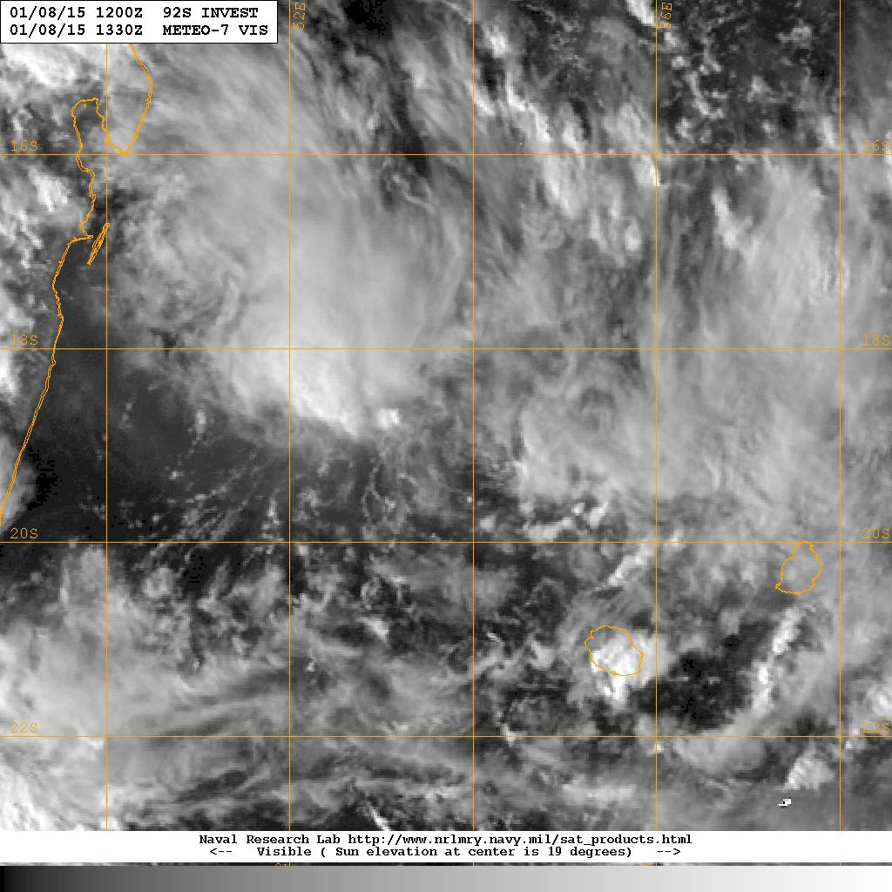
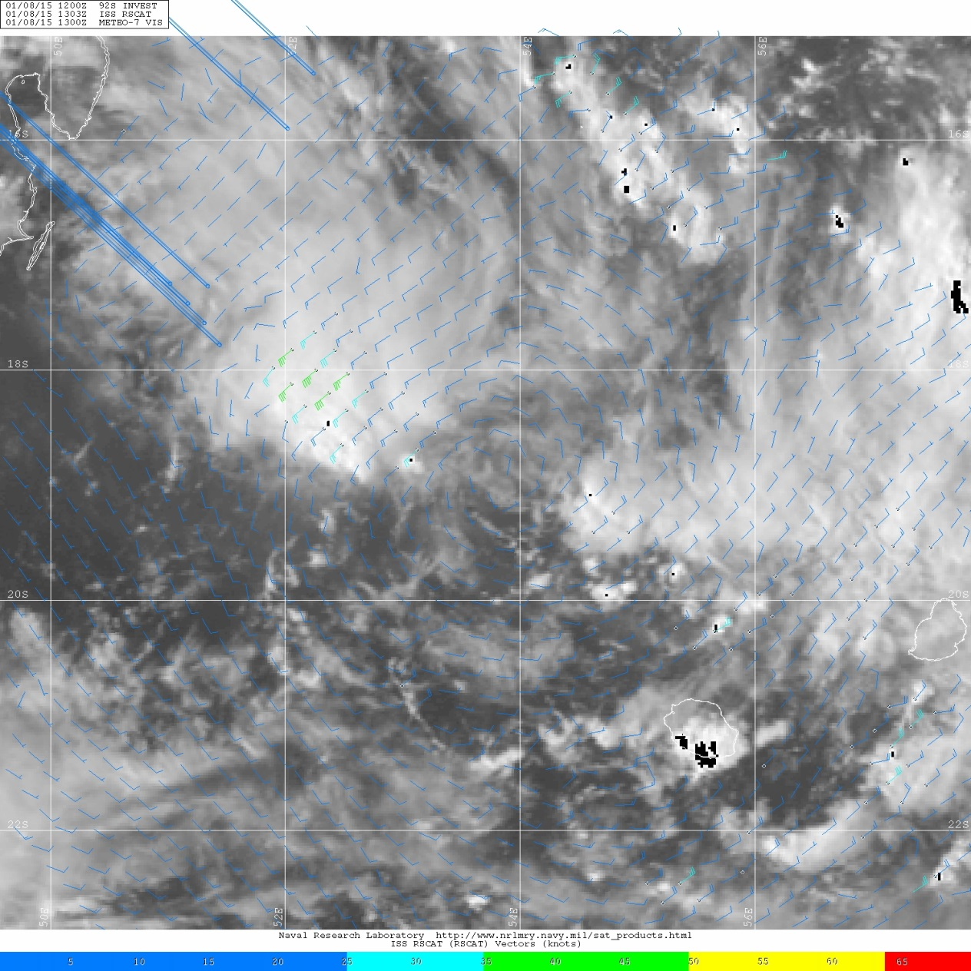
RapidSCAT
Note: RapidSCAT can be unavailable during:
ISS Attitude Maneuvers
Resupply ships
When other ISS needs take precedence
Pre-Very Intense TC Bansi
01-08-2015 @ ~1330Z
Meteosat-7 Visible
Where is the disturbance center?
14

Slide 15
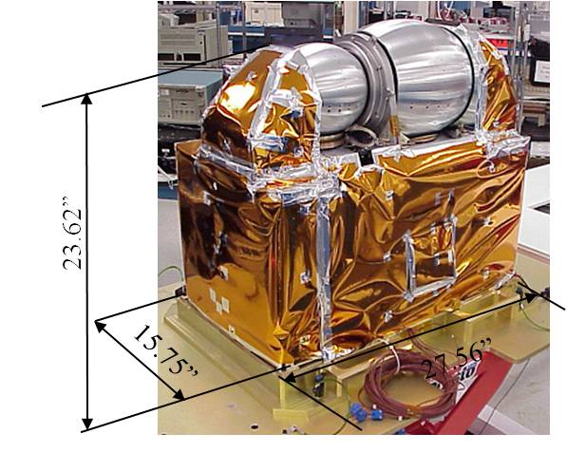
Advanced Technology Microwave Sounder (ATMS)
Sensor: Cross-Track Microwave Sounder
Spacecraft: Suomi-NPP
Launch: Oct 28, 2011 [1330 orbit]
Heritage: AMSU-A, MHS
Channels: 23, 31, 88, 166, 183 GHz
75, 75, 32, 16, 16 km (nadir)
Swath: 2503 km
Enhancements for TC Applications:
(1) Wide spatial coverage
14 orbits/day, fills any AMSR-E gaps
Improves current sounding capability
Web Links: http://npp.gsfc.nasa.gov/atms.html
15

Slide 16
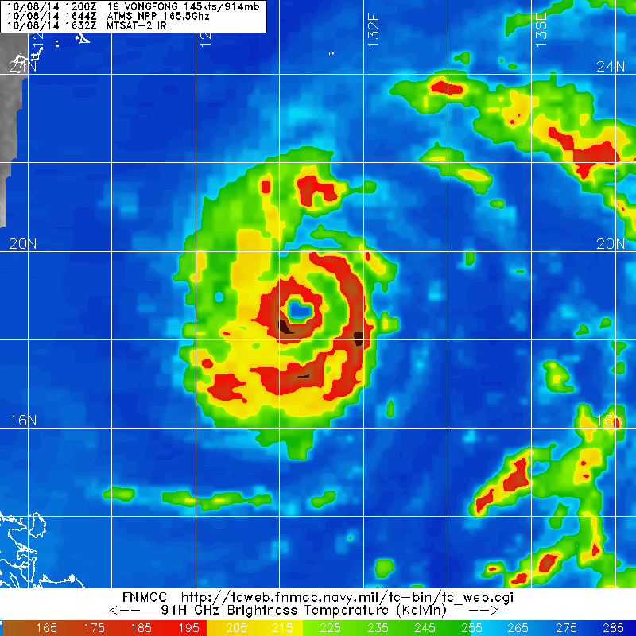
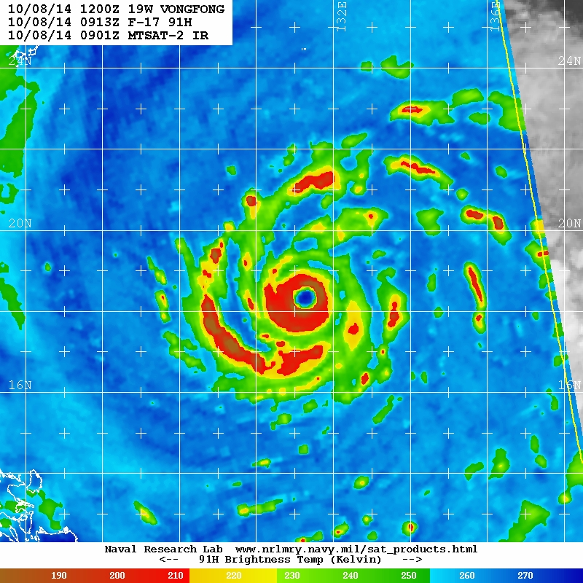
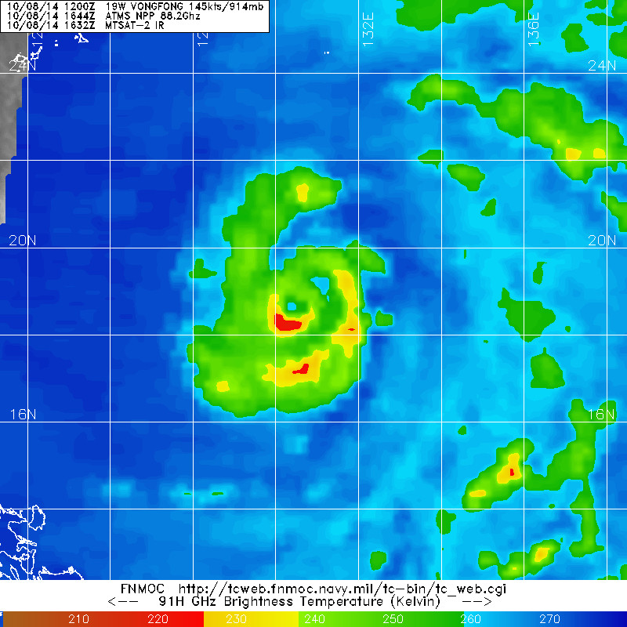
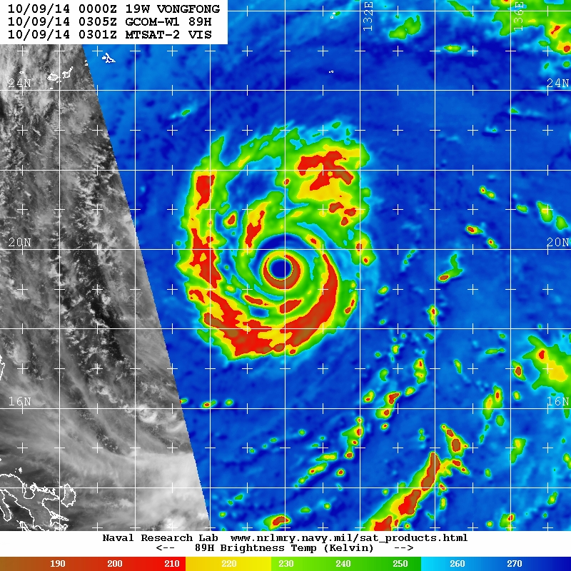
NPP ATMS
Some products now on FNMOC TC web
Coming soon to NRL TC web
Despite coarser resolution, can gain position and structure information
16

Slide 17

Passive Microwave Imager Missions
SSM/I
TRMM TMI
AMSR-E AMSR
WINDSAT
SSMIS
FY-3 MWRI
Russia MTVZA
MT MADRAS
GCOM AMSR2
GPM GMI
WSF
METOP SG
YEAR | 01 | 02 | 03 | 04 | 05 | 06 | 07 | 08 | 09 | 10 | 11 | 12 | 13 | 14 | 15 | 16 | 17 | 18 | 19 | 20 | 21 | 22 | 23 | 24 | 25
What’s left in a few years after
SSM/I & old R&D satellites fail
China/Russia sensor data not usable in the US
Megha Tropiques non functioning, no real-time data
WSF Status Unclear
Launches
Primary mission
Extended mission
Future
Mar 2015
17
Notes:
Summary of passive microwave imager sensors launched, in operations now and slated for future launch. All future satellites are tentatively listed until actual launch occurs. Launch dates are subject to change at anytime and might be delayed for multiple years.
AMSR-E failed on Oct 04, 2011
Acknowledgments:
Naval Research Laboratory, Marine Meteorology Division, Monterey, CA
Jeff Hawkins

Slide 18
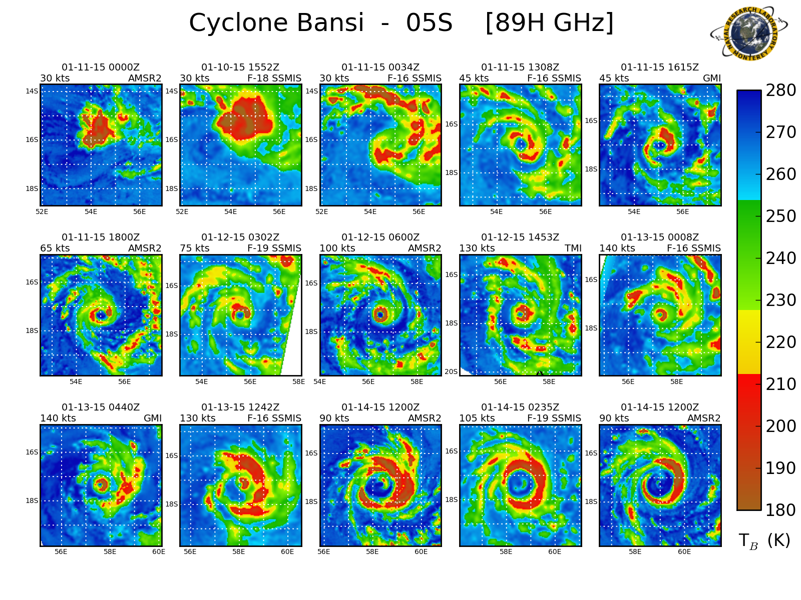
NRL TC Web Summary and Future
Expanded scope of operational and research sensors to benefit TC community in near-real time.
  DMSP F-19 SSMIS
  GCOM AMSR2
  GMP GMI
  NPP ATMS
Several current and proposed efforts to bring new research, graphics, and data to the NRL TC page.
The “glory years” of a “plethora” of sensors may be ending…
  US follow-on microwave imagers will soon be needed.
18

