Slide 1

The 2014 Satellite Proving Ground at the National Hurricane Center
Mark DeMaria¹
M. Brennan¹, J. Beven¹, H. Cobb¹, Nelsie Ramos¹,
A. Schumacher²,and M. Folmer³
¹ NOAA/NHC, ²CSU/CIRA, ³UM/CICS
69th Interdepartmental Hurricane Conference
March 2-5 2015

Slide 2
Outline
Overview the NHC GOES-R/JPSS Proving Ground
Summary of 2014 products
Forecaster feedback and examples
Plans for 2015

Slide 3
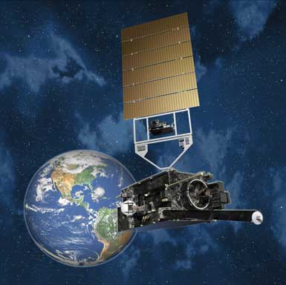
Overview of GOES-R
Next generation of GOES satellites
Planned launch: March 2016
  Advanced Baseline Imager (ABI)
    16 channels, improved spatial and temporal resolution
  Geostationary Lightning Mapper (GLM)
    Near continuous monitoring of total lightning
  Space Weather Instruments
  Communications Capabilities

Slide 4
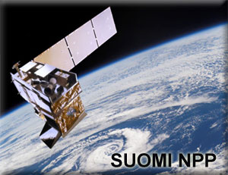
Overview of JPSS
Next generation of NOAA low-earth orbiting (LEO) satellites
Coordinated with EUMETSAT Met-Op mission
S-NPP Launched Oct 2011
  VIIRS IR and Visible imager
    Includes new Day-Night Band
  Advanced Technology Microwave Sounder (ATMS)
    Near continuous monitoring of total lightning
  Cross-Track Infrared Sounder (CrIS)
  OMPS and CERES
JPSS-1 launch early 2017

Slide 5
2014 NHC Proving Ground Products
Hurricane Intensity Estimate (HIE)
Super Rapid Scan Imagery (SRSO)
Tropical Overshooting Tops (TOT)
GOES-R Natural Color Imagery
Red-Green-Blue (RGB) Air Mass Product *
RGB Dust Product (EUMETSAT version) *
RGB Dust Product (CIRA version)
Saharan Air Layer (SAL) Product *
Pseudo Natural Color Imagery *
RGB Daytime Microphysics Product *
RGB Nighttime Microphysics Product *
RGB Convective Storms Product*
Lightning-based Rapid Intensification Index (RII)
GLD-360 Lightning Density
VIIRS Day/Night Band (S-NPP Product)
*Provided in N-AWIPS format through SPoRT

Slide 6
Collection of NHC
Forecaster Feedback
NHC on-line feedback form
Mid-project review (Sept 17th)
Blogs
  http://rammb.cira.colostate.edu/research/goes-r/proving_ground/blog
  http://nasasport.wordpress.com
Coordination with satellite liaisons
  Andrea Schumacher (CSU/CIRA) for HSU
    Replaced M. DeMaria in 2014
  Michael Folmer (UM/CICS) for TAFB
Notes:
Date in red needs to be confirmed / corrected (AS)

Slide 7
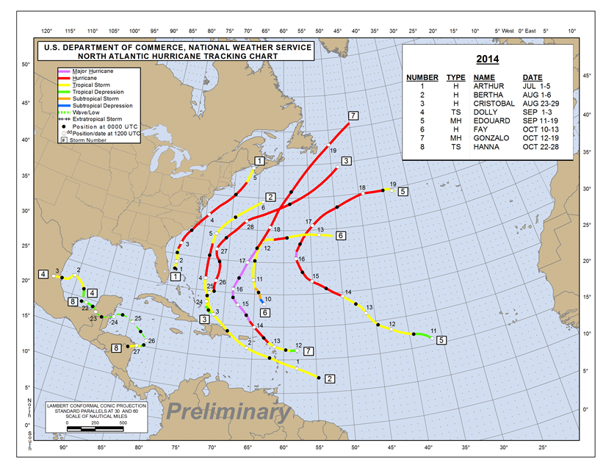
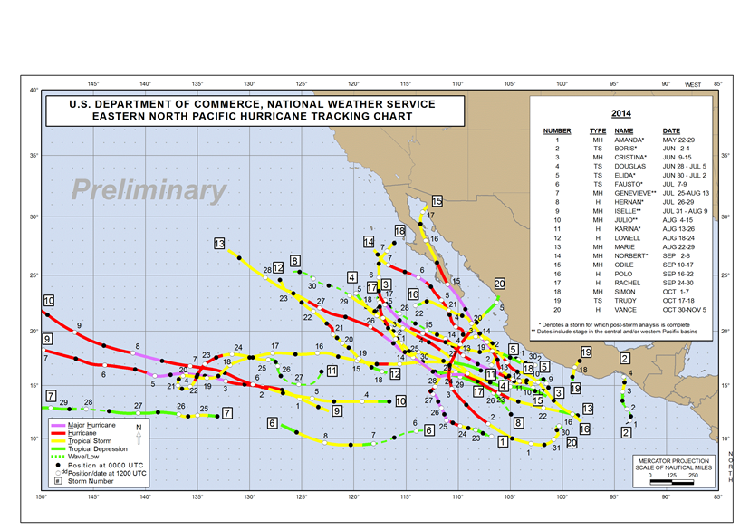
The 2014 Hurricane Season
Slightly below average Atlantic season
  8 named storms
  6 hurricanes
  2 major hurricanes
  Several rapid intensification cases
  Limited east Atlantic cases (MSG proxy area)
Very active East Pacific season
  20 named storms
  15 hurricanes
  9 major hurricanes
  Many rapid intensification periods

Slide 8
“Routine” Satellite Products
NHC Satellite Proving Ground held since 2010
Several products already have proven utility
Will likely become part of NHC’s routine satellite product set
  RGB Air Mass
  RGB Dust
  RGB Natural Color
  Saharan Air Layer
  Hurricane Intensity Estimate (GOES-R Dvorak algorithm)

Slide 9
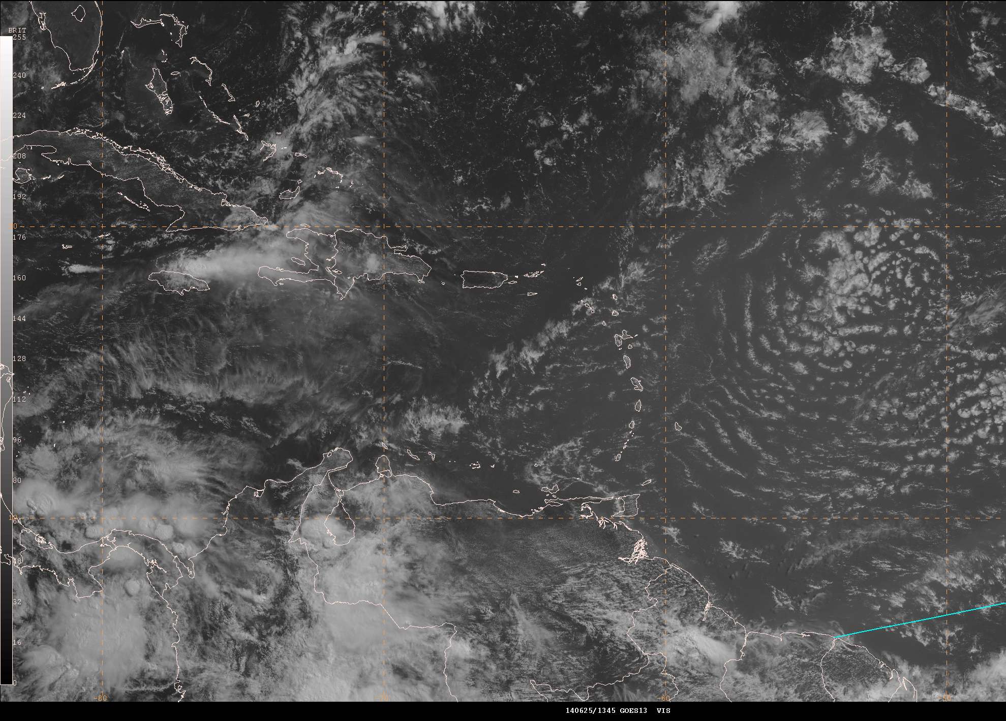
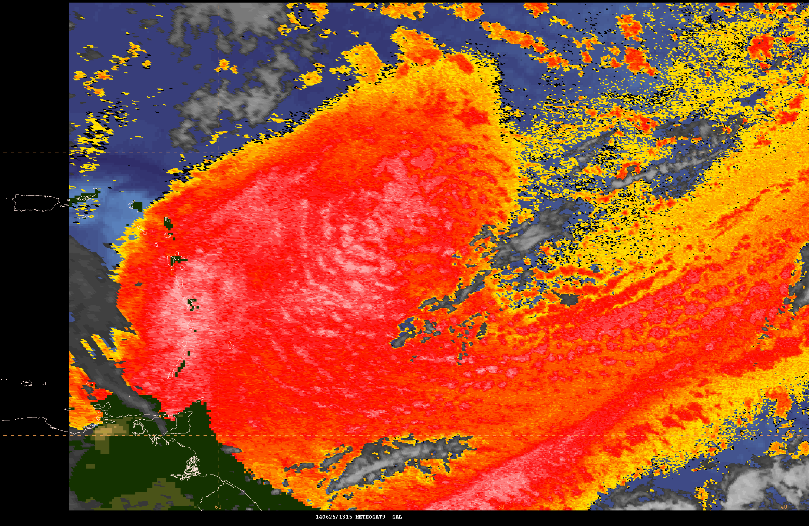
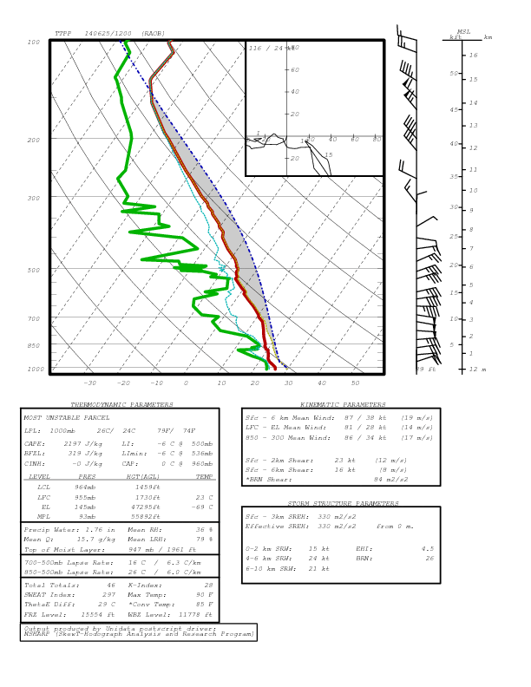
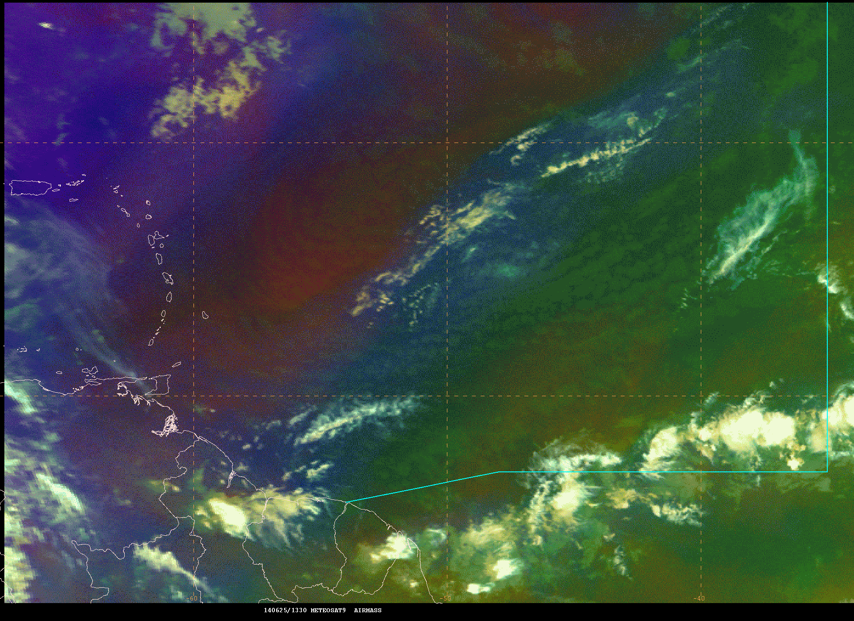
RGB Products for Saharan
Air Layer (SAL) Monitoring
June 25, 2015 Case
SAL Product
Visible Image
Air Mass RGB
Trinidad Sounding

Slide 10
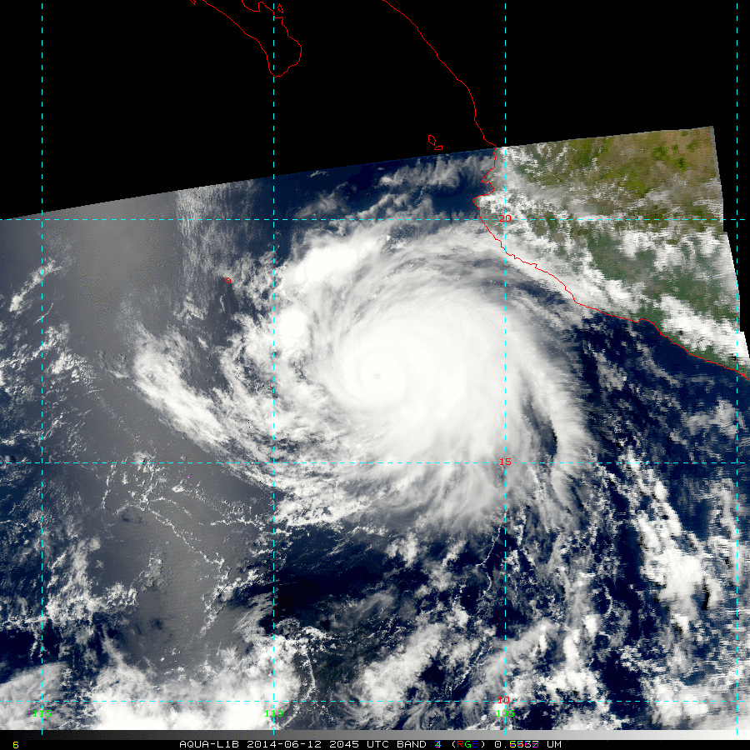
Natural Color Product (MODIS Proxy)
(Simulated Green Channel)
Hurricane Cristina 12 June 2014

Slide 11
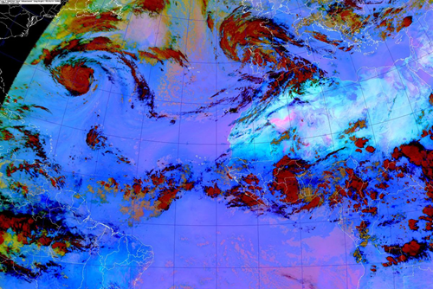
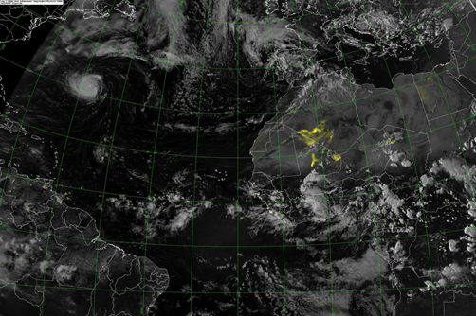
Refined Dust Product
15 UTC Sept 16, 2014
EUMETSAT Version
Dust in bright pink
Shows other cloud features
CIRA DEBRA Product
Uses background information to isolate dust
Brightness of yellow is confidence of detection

Slide 12
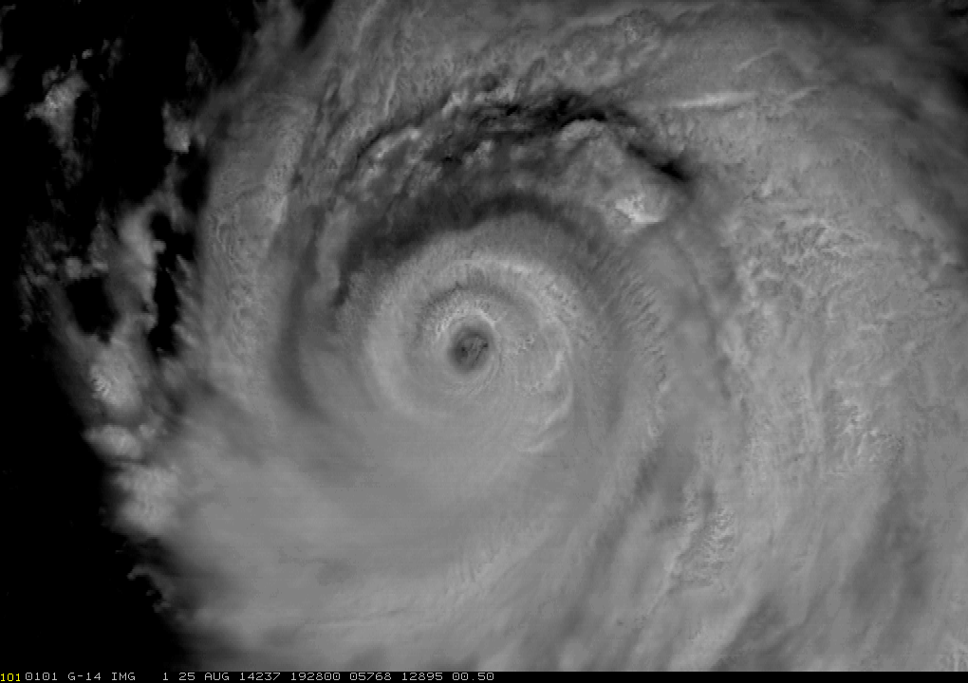
Super Rapid Scan Operations (SRSO)
GOES-R will have enhanced scanning capabilities
More opportunities to obtain 1 min data over mesoscale areas
GOES-14 taken out of storage for short periods for SRSO Tests
Hurricane
Marie (EP)
Aug 25, 2014
1930-2025 UTC

Slide 13
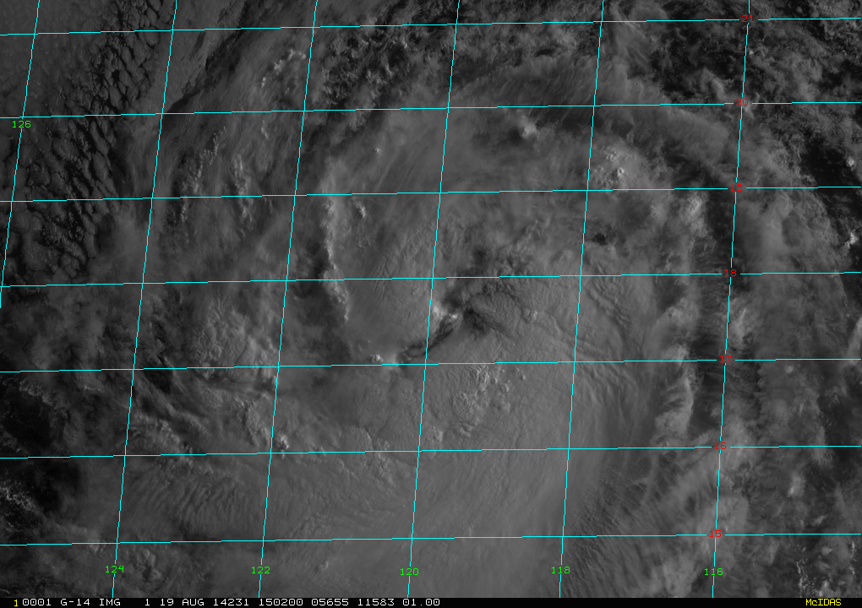
HSU Feedback on SRSO
SRSO loops too short for vortex scale evolution
  Would need 360 frames for 6 hr loops, AWIPS technology challenge
SRSO more useful for weak systems and near sunrise
Tropical Storm
Lowell (EP)
Aug 19, 2014
1505-1720 UTC

Slide 14
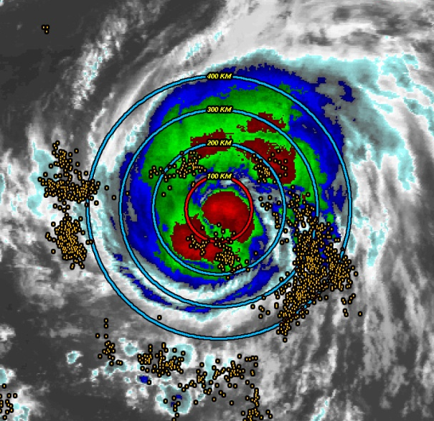
Lightning-based Rapid Intensification Index
Ground based WWLLN used as proxy for the GLM
RII algorithm modified to include lightning predictors
  Rain band lightning favors RI
  Inner core lightning signals end of RI period
Largest lightning outbreaks for sheared storms
Lightning/No lightning versions run
Current research on total lightning and asymmetric predictors (GLD-360 data and ENTLN)
Rain band Region
Inner core Region
Notes:
**Update example

Slide 15
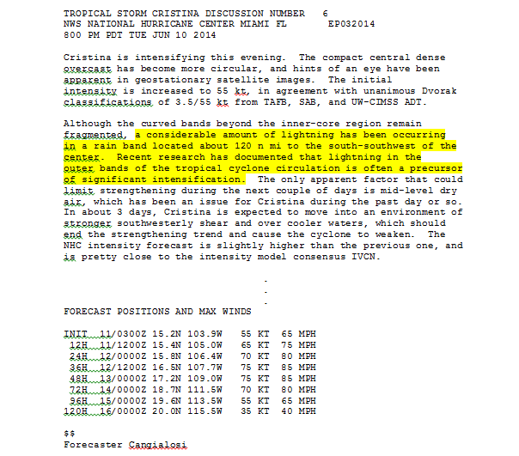
Qualitative Use of Lightning Products

Slide 16
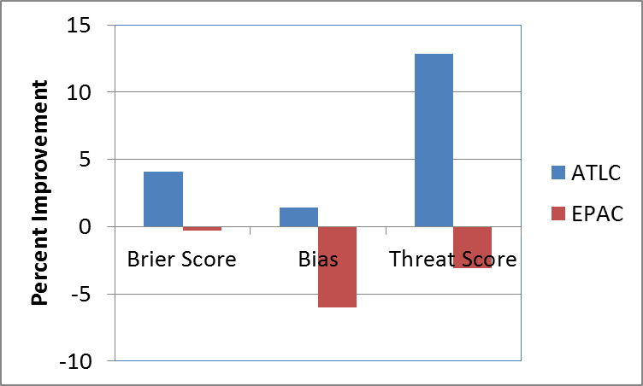
Verification of Lightning RII
Expanded Inner Core area from 0-100 to 0-200 km degraded E. Pacific Algorithm

Slide 17
Lightning Display Products
Vaisala GLD-360 proxy for GLM
Flash locations color-coded by time
New lightning density product
  Composites in 15 or 30 min intervals
  Flash locations per unit area and time
  Can be contoured
Forecast feedback
  Flash location/density products are complimentary
  Fine tuning of lightning density contour levels
Products need transition from N-AWIPS to AWIPS

Slide 18
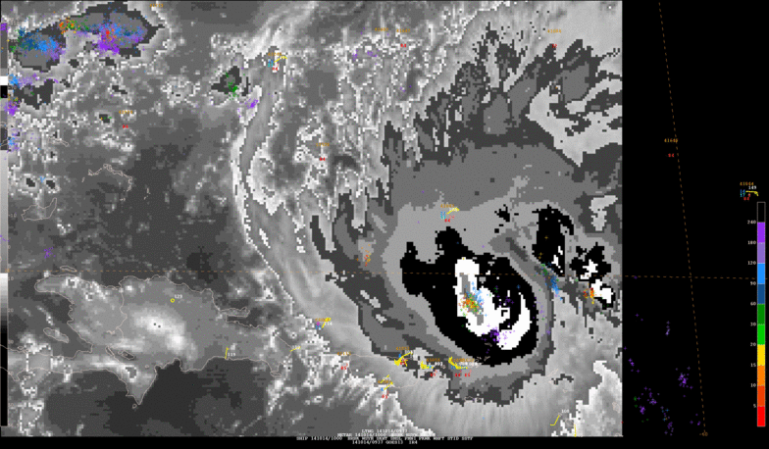
GLD-360 Lightning Locations
Hurricane Gonzalo (2014)

Slide 19
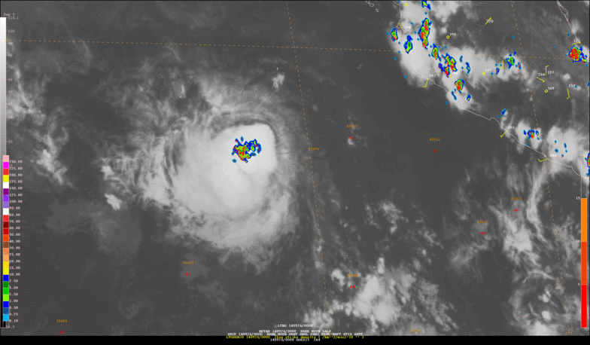
GLD-360 Lightning Density
Hurricane Rachel (2014)

Slide 20
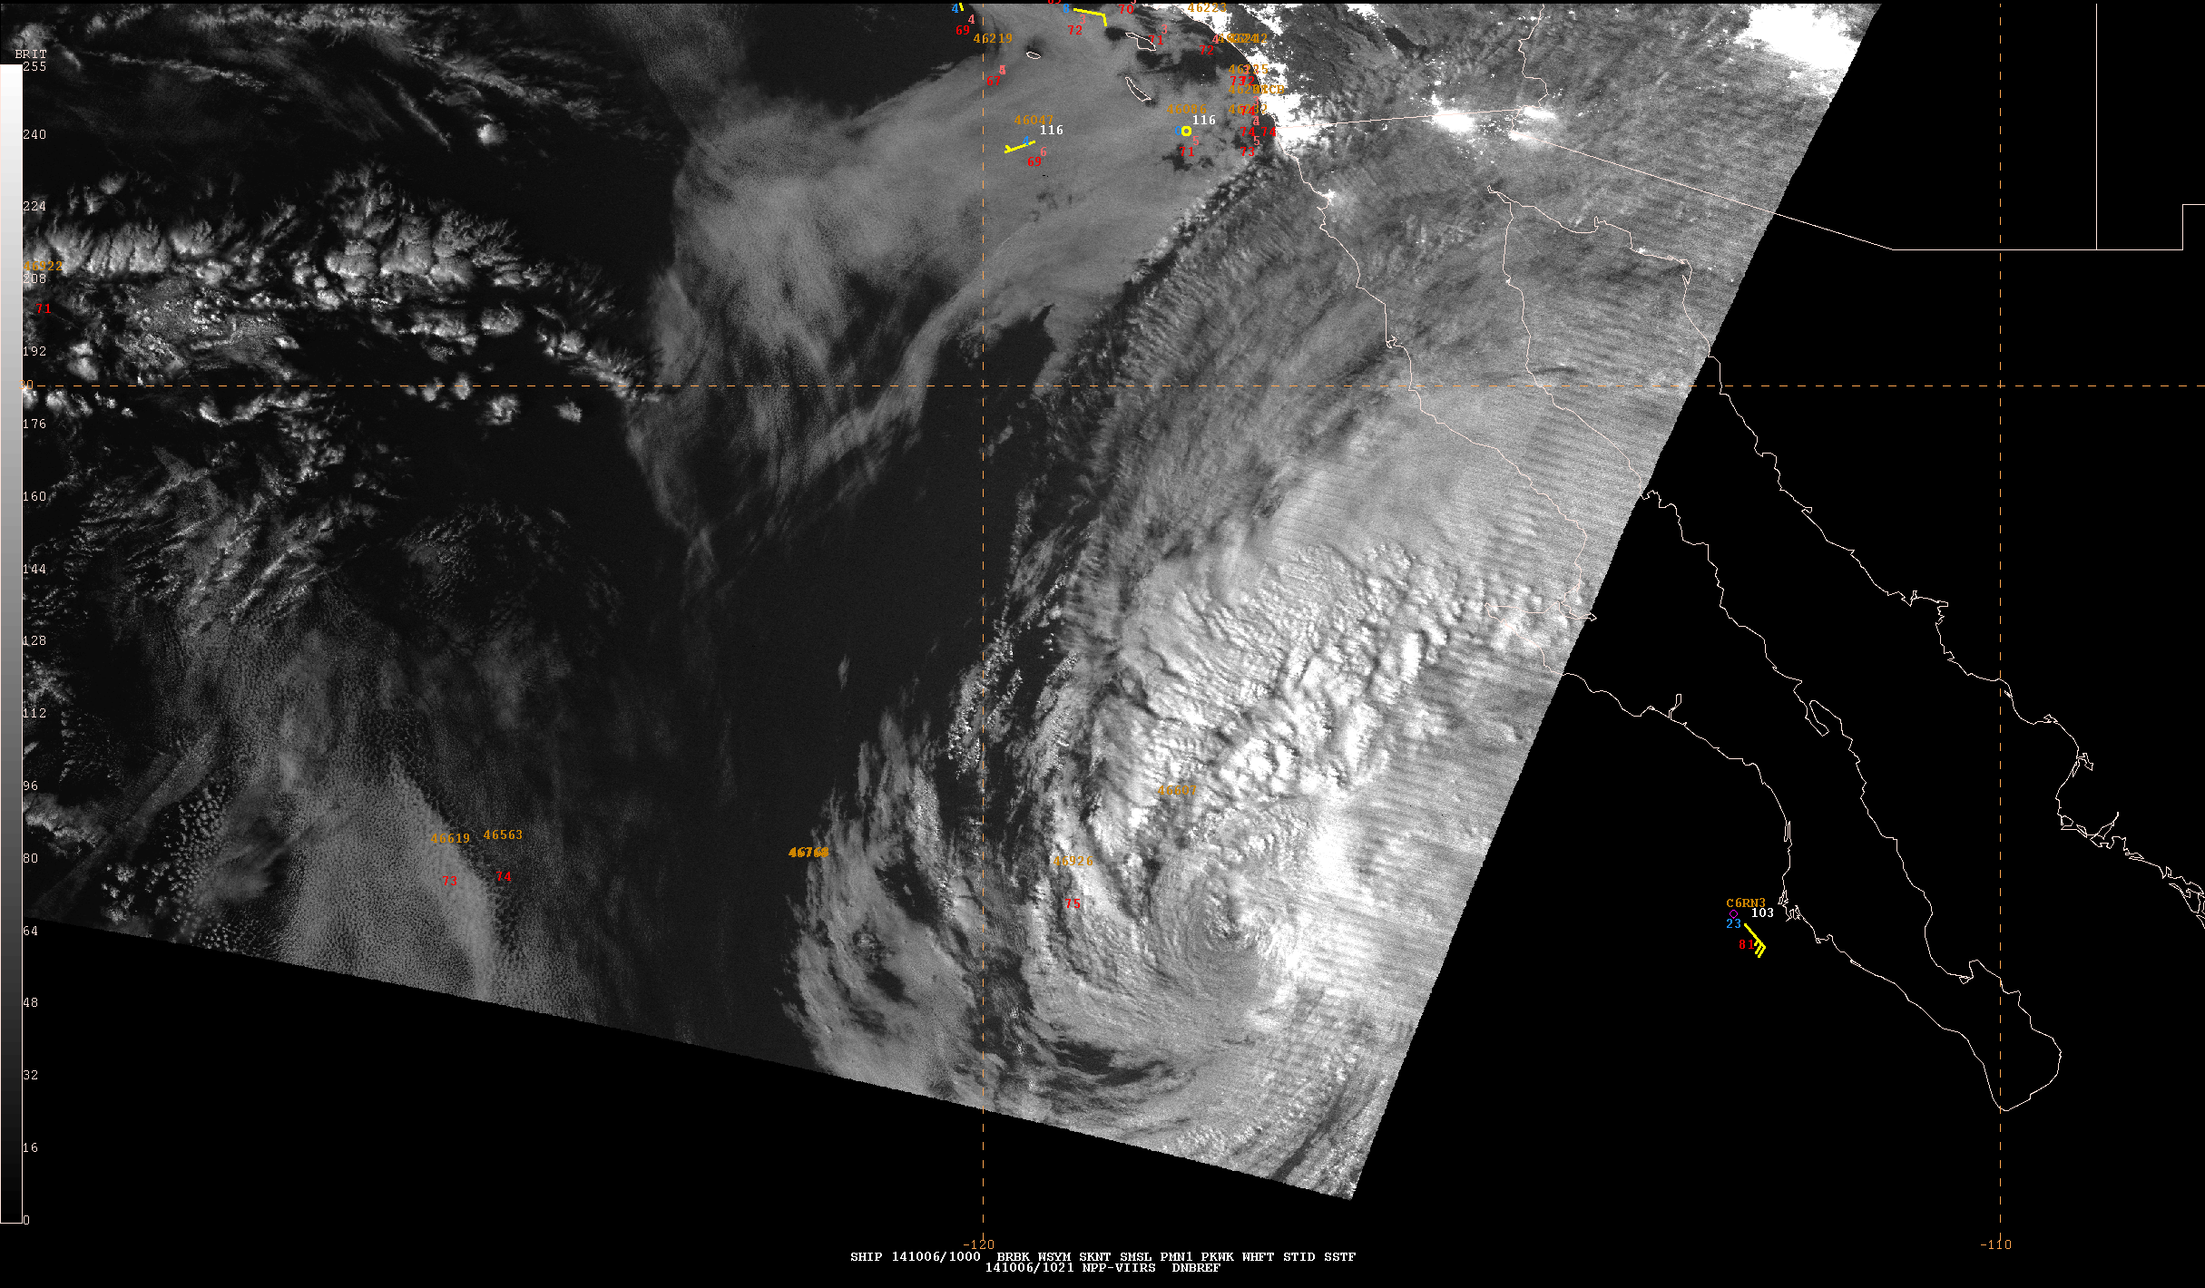
VIIRS Day-Night Band Reflectance
Tropical Storm Simon (East Pacific) in N-AWIPS
Low-light sensing on S-NPP, senses reflected moonlight at night
Can be used in similar ways to visible channel during the day
  Nighttime TC center fixing and structure identification
  Cloud monitoring
Main issue is time latency in areas without direct readout
Notes:
Need to add some text / feedback.

Slide 21
Plans for the 2015 PG
Last PG before GOES-R launch in 2016
  Final selection of initial GOES-R products for NHC
Initial development of AWIPS displays
Scale lightning RII for storm size
Obtain feedback on new cloud top RGBs and Atmospheric Motion Vectors (AMVs)
Expand the domain of low-latency VIIRS using additional direct readout sites
Investigate use of ATMS/CrIS soundings in storm environment
Notes:
Needs updating?

Slide 22
Summary
14 GOES-R and 1 S-JPSS products included in 2014 NHC Proving Ground
  Several GOES-R products already made the cut for NHC satellite product suite
SRSO has more utility for weak systems
Lightning density product complements flash locations
Lightning density should be scaled to storm size for the Rapid Intensification Index (RII)
More work needed to utilize cloud-top RGBs
Need expanded area of low-latency VIIRS data
2015 experiment may include ATMS/CrIS retrievals

