Slide 1
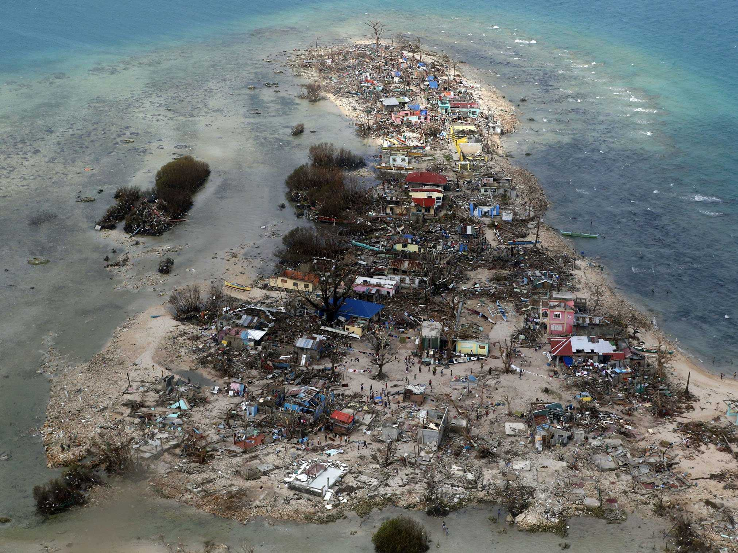


A Global Investigation of the Impacts of Landfalling Tropical Cyclones on Societies
Denise L. Balukas, Elizabeth A. Ritchie and Kimberly M. Wood
Department of Atmospheric Sciences, The University of Arizona,
Tucson, Arizona
‪www.businessinsider.com.au
Notes:
Bopha

Slide 2
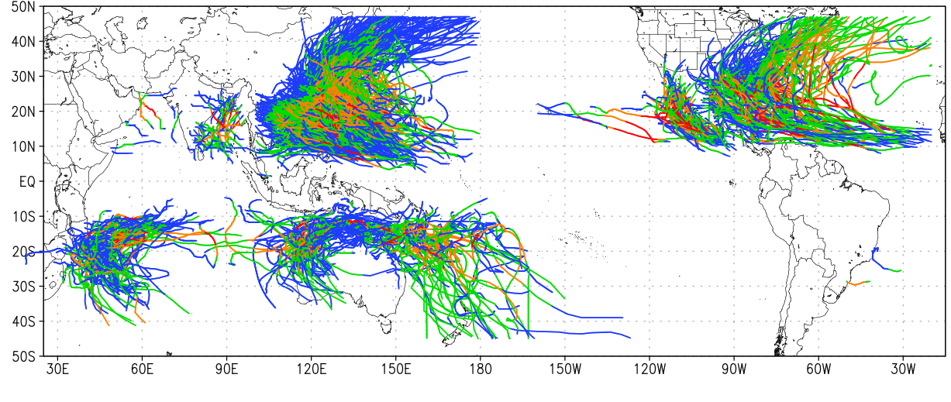
1980 2013 Landfalling Tropical Cyclone Tracks
Blue: < 34 knt Green: 34-63 knt Orange: 64-96 knt Red: > 97 knt

Slide 3
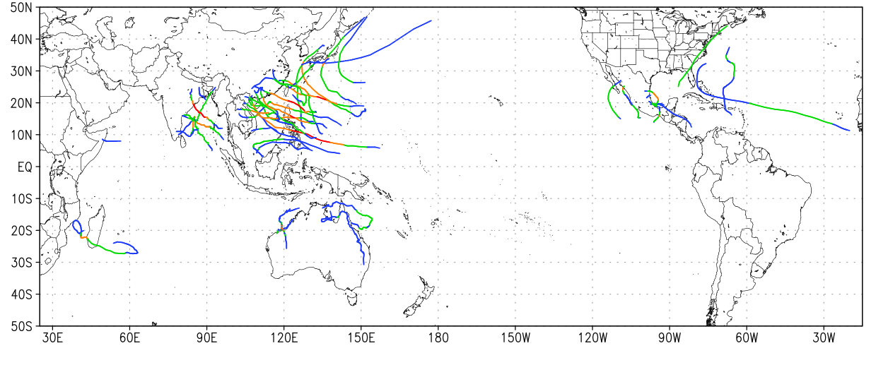
2013 Landfalling Tropical Cyclone Tracks
Blue: < 34 knt Green: 34-63 knt Orange: 64-96 knt Red: > 97 knt

Slide 4
2013 Landfalling Tropical Cyclone Tracks
Impacts of Landfalling Tropical Cyclones 2013
Fatalities: 8042
Persons Injured: 29,866
Persons Directly Affected: 44 million
Damages (USD 2013): $ 30.4 million
Blue: < 34 knt Green: 34-63 knt Orange: 64-96 knt Red: > 97 knt

Slide 5
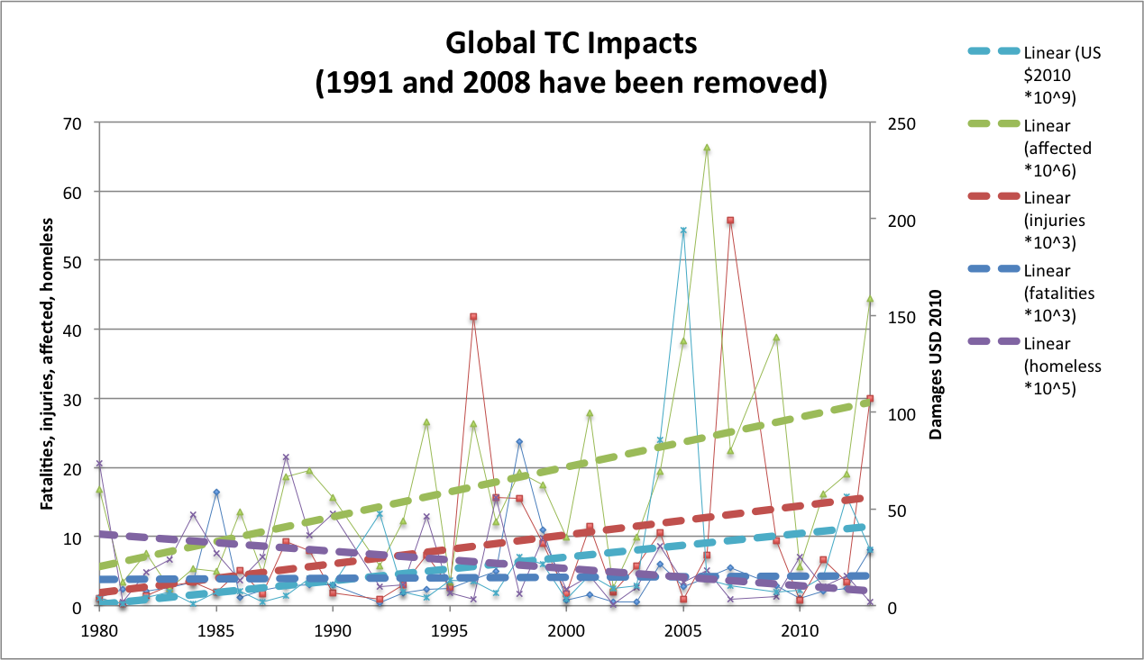
EXCEL plot of EMDAT impacts time series global
Starting Global, then going to regional later in the talk

Slide 6
Vulnerability is a result of many factors, including:
Age of population
Proximity to the coast
History with previous events
Wealth and infrastructure
Access to information
Access to emergency support
Frequency of landfalling TC events

Slide 7
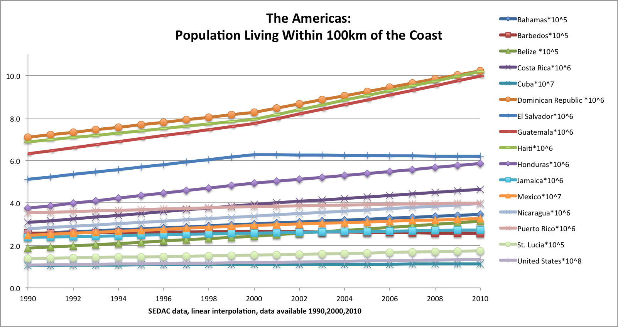
Using SEDAC data from 1990, 2000, 2010 for population living within 100 km of the coast. Important metric for vulnerability due to landfall frequency and intensity.

Slide 8
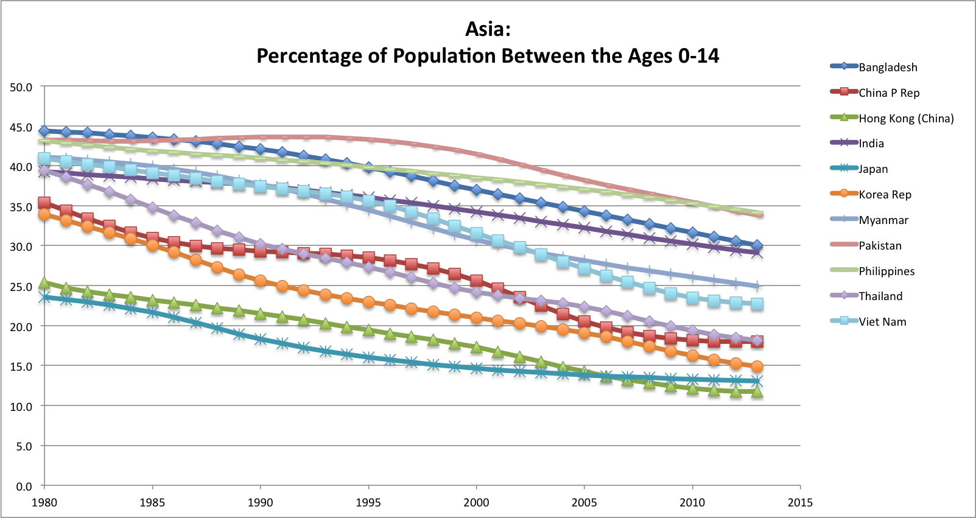
Using World Bank data for percentage of population ages 0-14 and 65+ (not shown). Population age is an important determinant in vulnerability to TC landfall impacts.

Slide 9
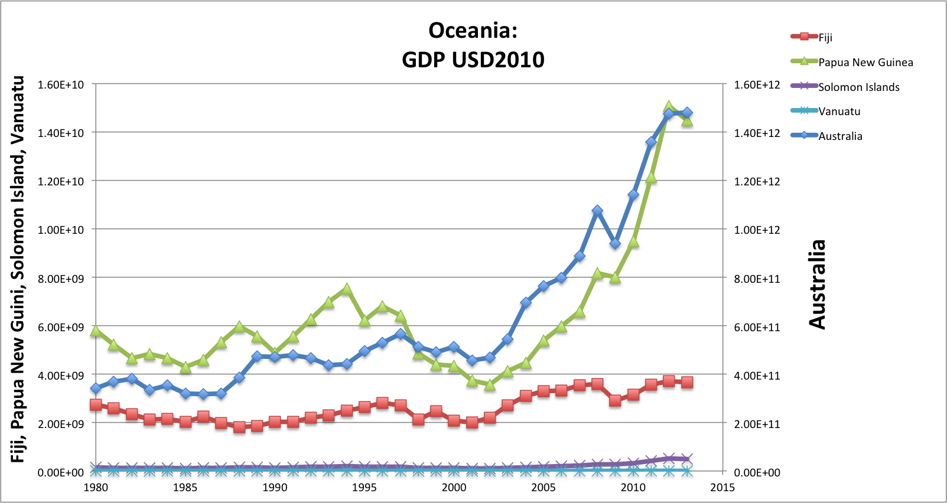
GDP data is sourced from World Bank. All values have been converted into 2010 US dollars. We are looking at GDP as an indicator of both wealth and infrastructure potential.

Slide 10
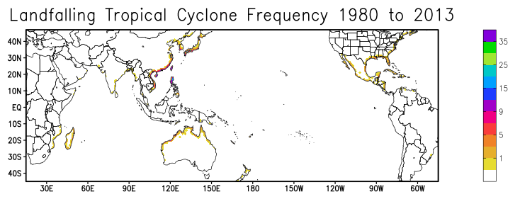
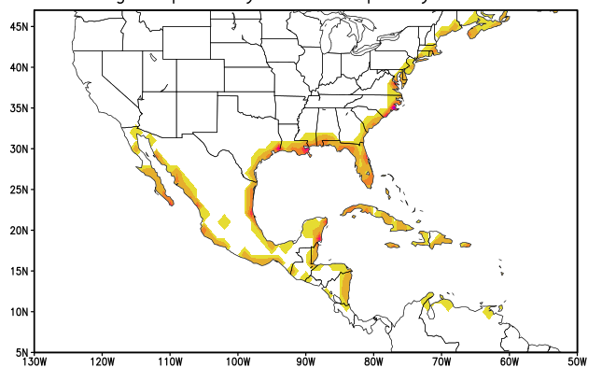
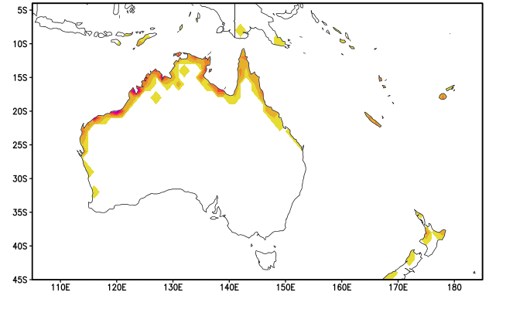
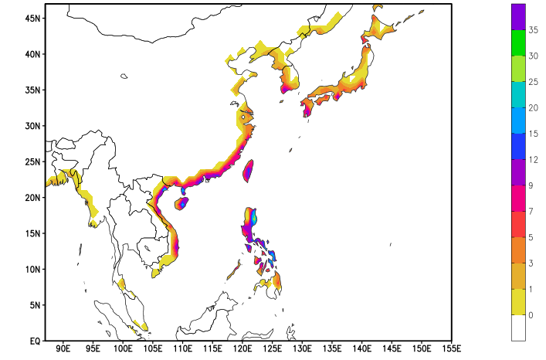
One Degree Grid, Hourly Interpolated TC Tracks, Initial Landfall Only

Slide 11
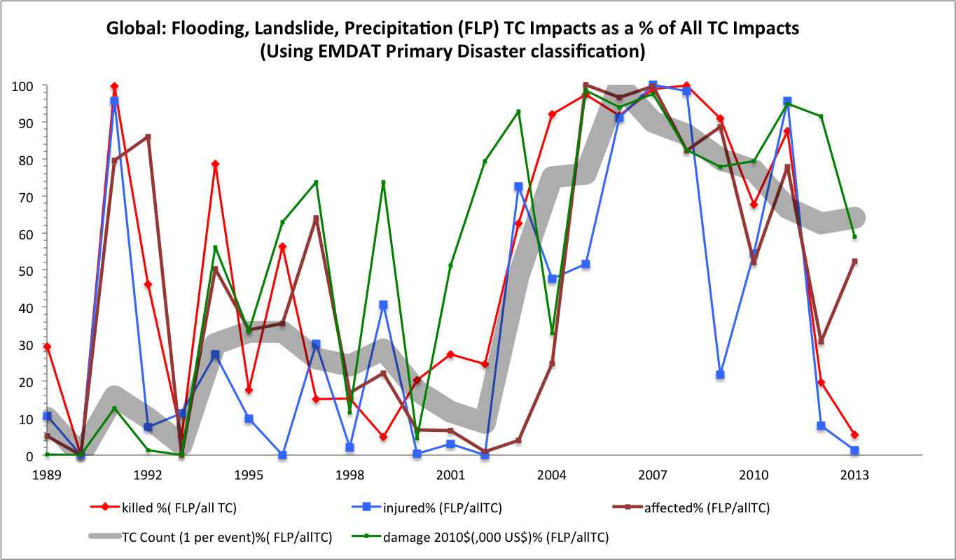

Slide 12
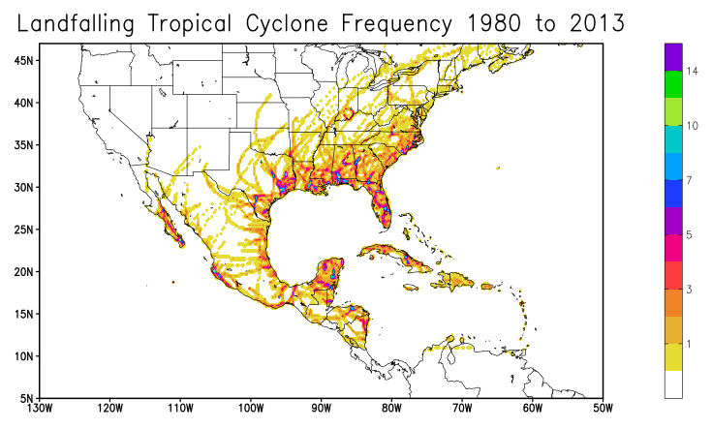
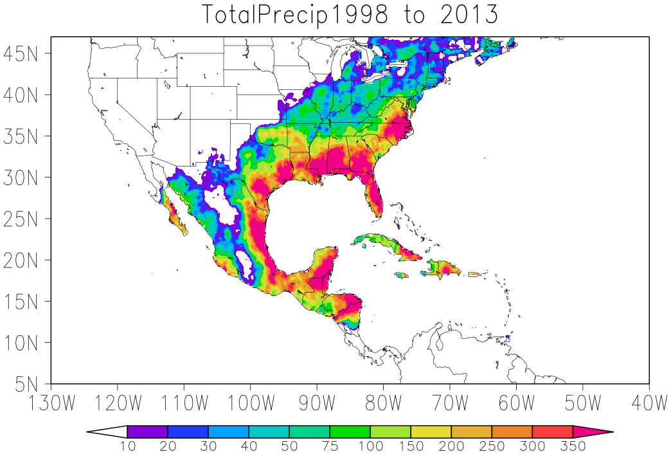
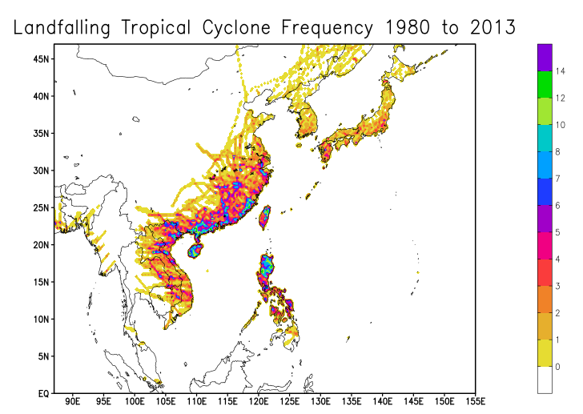
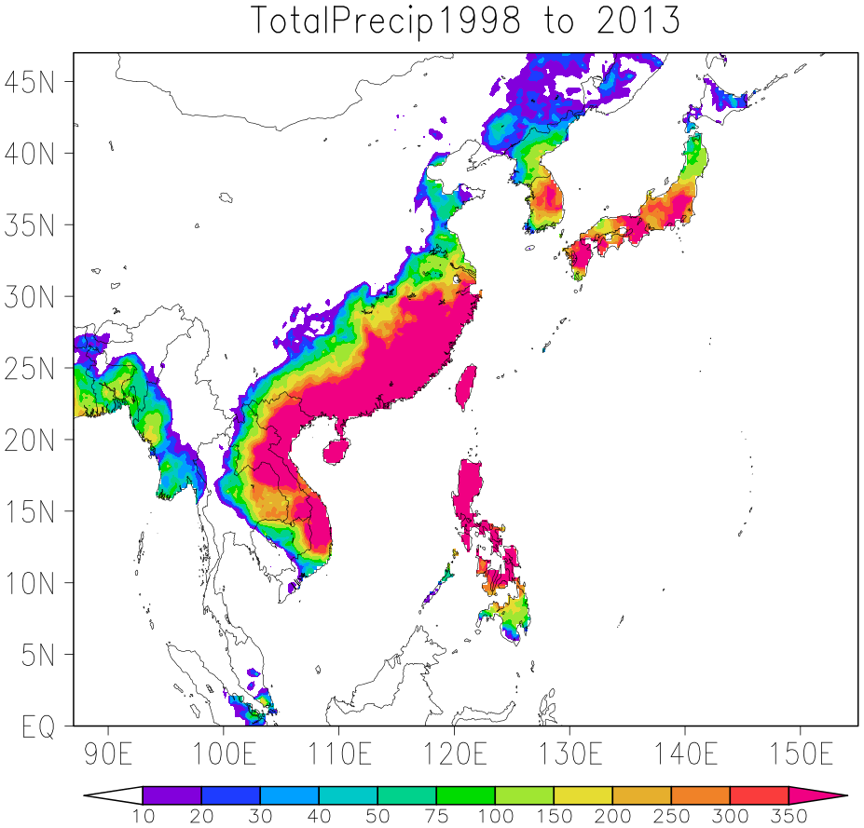
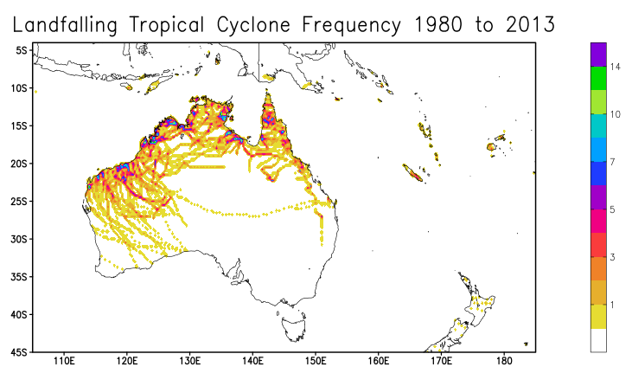
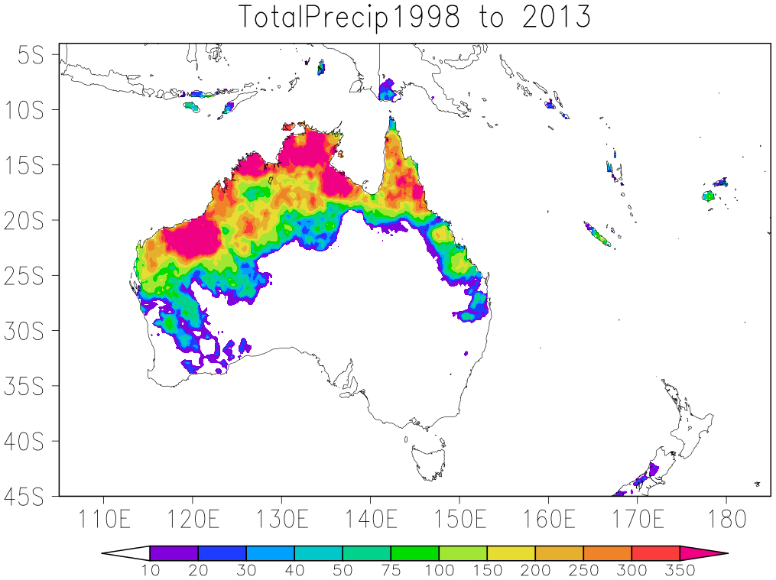
Hourly Interpolated Landfall Frequency
TRMM Precipitation Associated with TC Tracks

Slide 13
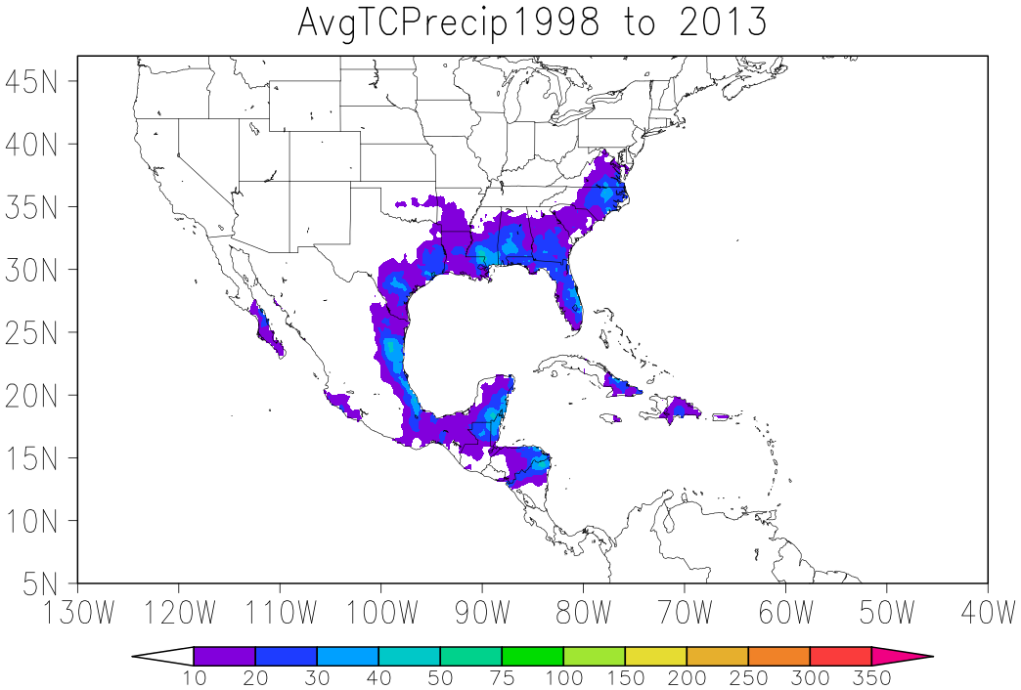
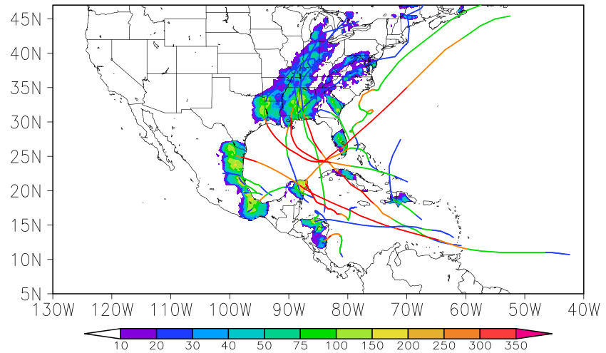
Average Precipitation Associated with TC (TRMM 1998-2013)
Precipitation Associated with TC Landfall 2005 (TRMM)
Hurricane Stan 2005

Slide 14
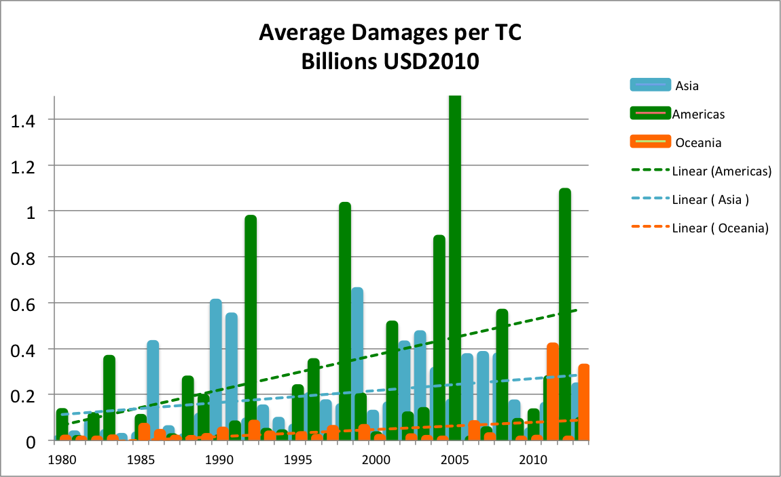

Slide 15
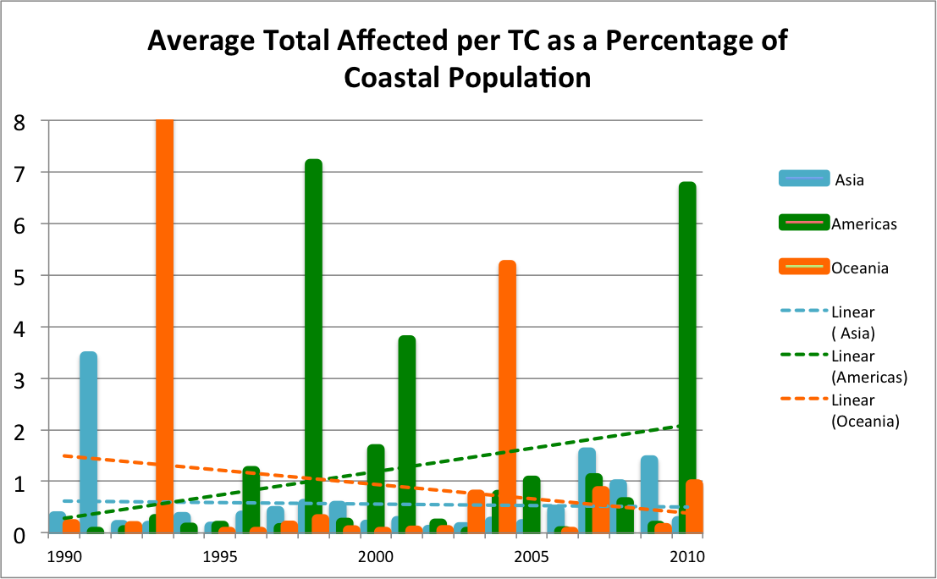

Slide 16
Future Research Goals:
Investigate precedent and antecedent soil moisture conditions to assess flooding potential
Investigate topography of impacted regions to assess potential for landslide and flooding impacts
Develop a method to account for the size of the windfield during the duration of the TC track
Further work with investigation of impacts with respect to socio-demographic data

Slide 17
Questions??
References:
Centre for Research on the Epidemiology of Disasters (CRED), Emergency Events Database (EM-DAT): D. Guha-Sapir, R. Below, Ph. Hoyois - EM-DAT: International Disaster Database – www.emdat.be – Université Catholique de Louvain – Brussels – Belgium.
Socioeconomic Data and Applications Center (SEDAC): Center for International Earth Science Information Network - CIESIN - Columbia University: National Aggregates of Geospatial Data Collection: Population, Landscape, And Climate Estimates, Version 3 (PLACE III), 2012.
World Bank Data: http://web.worldbank.org/WBSITE/EXTERNAL/0,,contentMDK:22547097~pagePK:50016803~piPK:50016805~theSitePK:13,00.html
Davidson, Rachel A., and Kelly B. Lambert. "Comparing the hurricane disaster risk of US coastal counties." Natural Hazards Review 2.3 (2001): 132-142.
Raghavan, S., and S. Rajesh. "Trends in tropical cyclone impact: A study in Andhra Pradesh, India." Bulletin of the American Meteorological Society 84.5 (2003): 635-644.
Center, Canadian Hurricane, et al. "SEVENTH INTERNATIONAL WORKSHOP ON TROPICAL CYCLONES.”
Mallick, Bishawjit, Khan Rubayet Rahaman, and Joachim Vogt. "Coastal livelihood and physical infrastructure in Bangladesh after cyclone Aila." Mitigation and Adaptation Strategies for Global Change 16.6 (2011): 629-648.

