Slide 1
Further Exploring the Potential for Assimilation of Unmanned Aircraft Observations to Benefit Hurricane Analyses and Forecasts
Jason Sippel - NCEP EMC / IMSG
(work completed at NASA GSFC)
Fuqing Zhang, Yonghui Weng – Penn State
Scott Braun – NASA GSFC
Dan Cecil – NASA MSFC

Slide 2
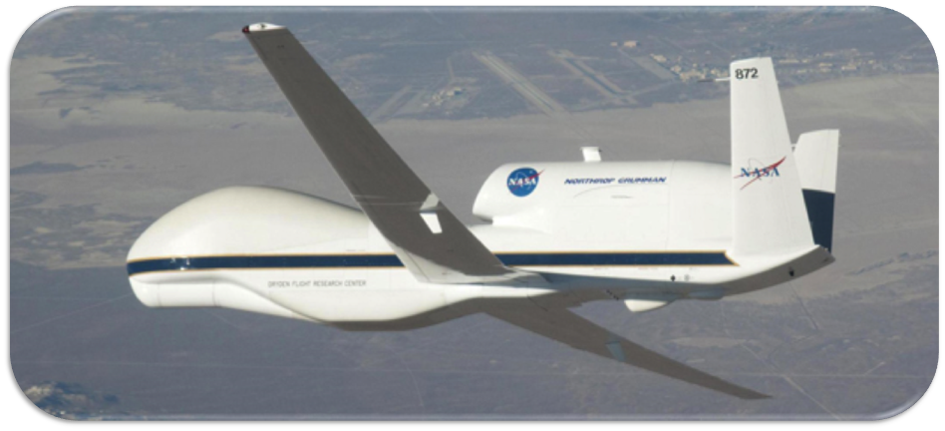
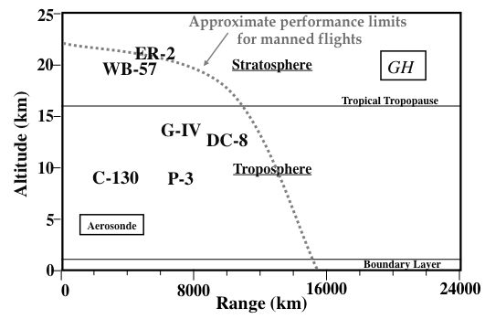
Background: NASA’s Global Hawk
NASA unmanned GH recently used in GRIP and HS3 experiments
GH presents unique opportunities for hurricane reconnaissance due to its extreme endurance
Data from GH might be useful for improving hurricane forecasts
Global Hawk

Slide 3
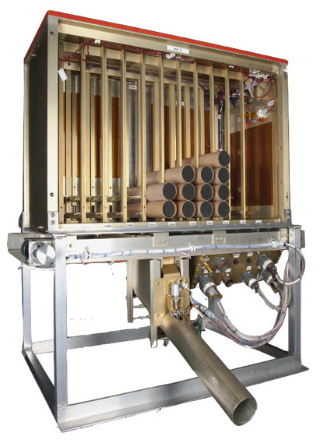
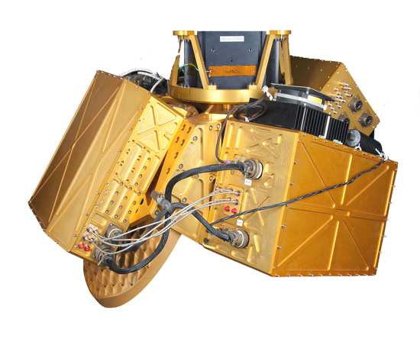
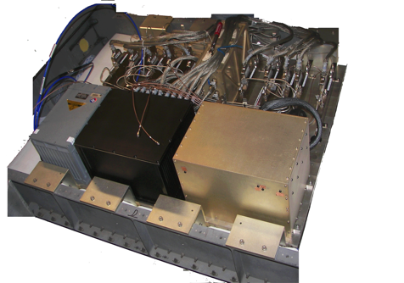
Background: NASA’s Global Hawk
Instruments of “interest”
Hurricane Imaging Radiometer (HIRAD)
Measurements: Microwave retrieval of wind speed and rain-rate retrievals over 60-km wide swaths
High Altitude Imaging Wind and Rain Airborne Profiler (HIWRAP)
Measurements: Doppler velocity and reflectivity
Airborne Vertical Atmospheric Profiling System (AVAPS)
Measurements: Up to 89 dropsondes measuring temperature, pressure, wind, and humidity.
Caveat: this combination has not been used on a single GH mission, so proxies have to be used

Slide 4
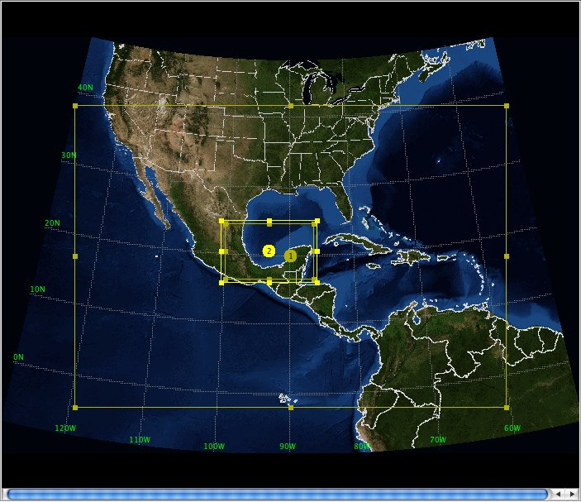
Previous work – EnKF assimilation of HIWRAP data in Hurricane Karl
WRF-EnKF from Zhang et al. (2009) with covariance relaxation
WRF-ARW V3.1.1, 27/9/3 km
30-member ensemble, IC/BCs from WRF-VAR + GFS
Focus on RI in Bay of Campeche 9/16-9/17 2010
Model domains

Slide 5
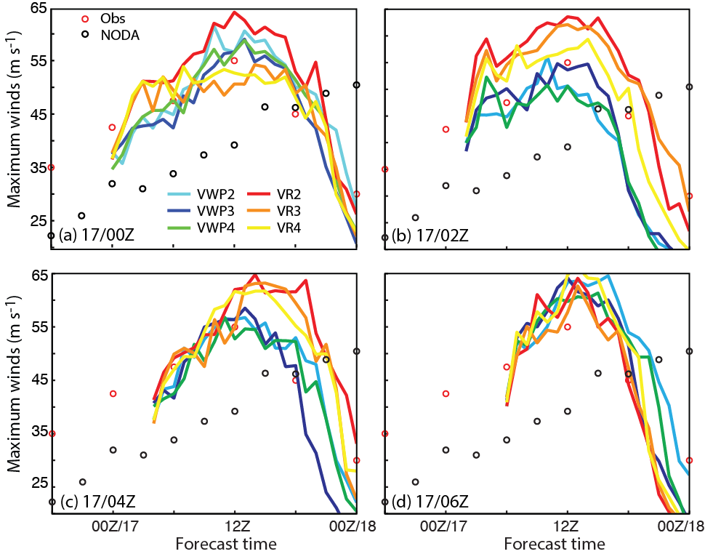
Previous work – EnKF assimilation of HIWRAP data in Hurricane Karl
WRF-EnKF system used to assimilate HIWRAP Vr and VWP observations
All experiments demonstrate forecast improvement upon NODA
Mean error from VWP experiments is slightly lower than that from VR experiments
VWP experiments have more forecast consistency
Observed maximum winds compared with a deterministic forecast without DA and EnKF-initialized forecasts

Slide 6
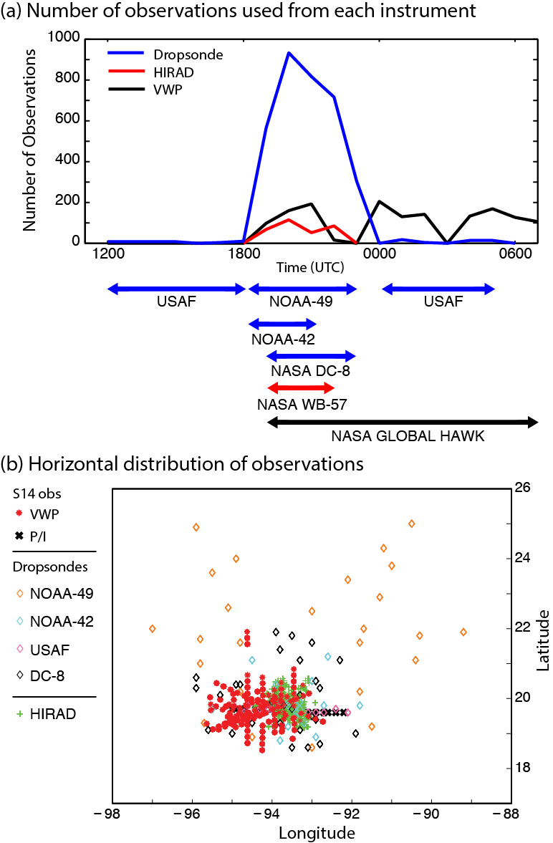
Observations of Karl
Assimilate data from:
GH-based HIWRAP (VWP product)
NOAA/NASA/USAF dropsondes (proxy for GH-based sondes)
WB-57-based HIRAD wind speed retrievals (proxy for GH-based data)

Slide 7
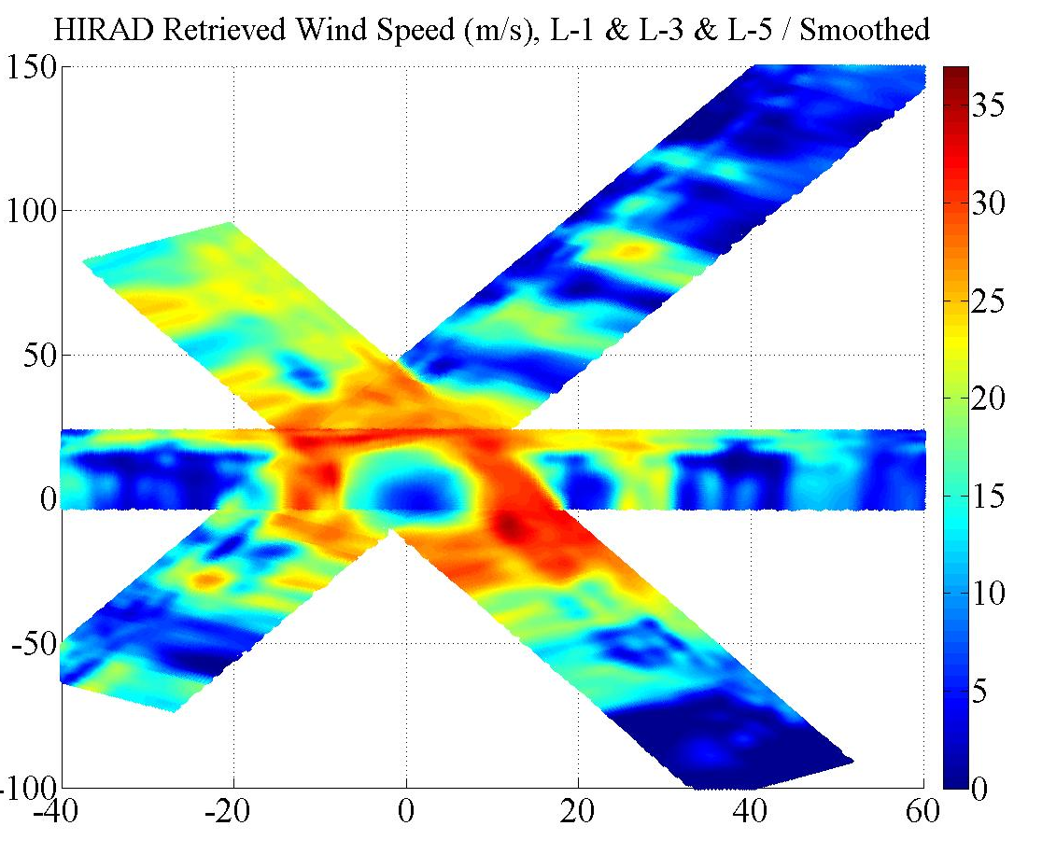
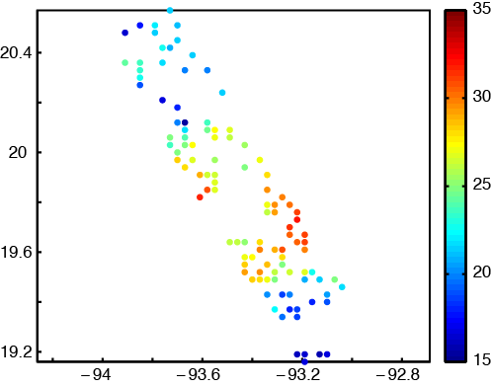
Observations of Karl
Retrieved wind speeds
Challenges with real data:
HIRAD data from Karl has issues, so significant manual QC was required (HIWRAP had issues as well)
Only speeds from half of HIRAD swath are used – the other half is likely unretrievable
Speeds <15 m/s unreliable
Fortunately, new HIRAD data is much, much better
Thinned SOs, leg 2

Slide 8
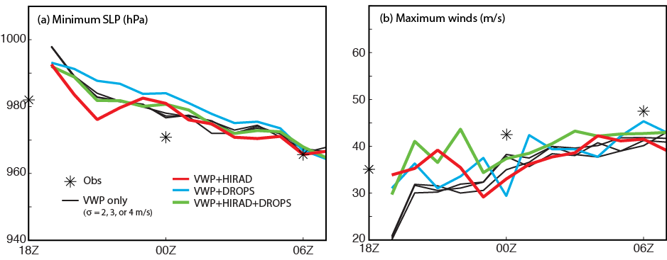
EnKF analyses: Intensity metrics
Quicker spinup of analysis winds with multiple sources
Best results when all three sources assimilated

Slide 9
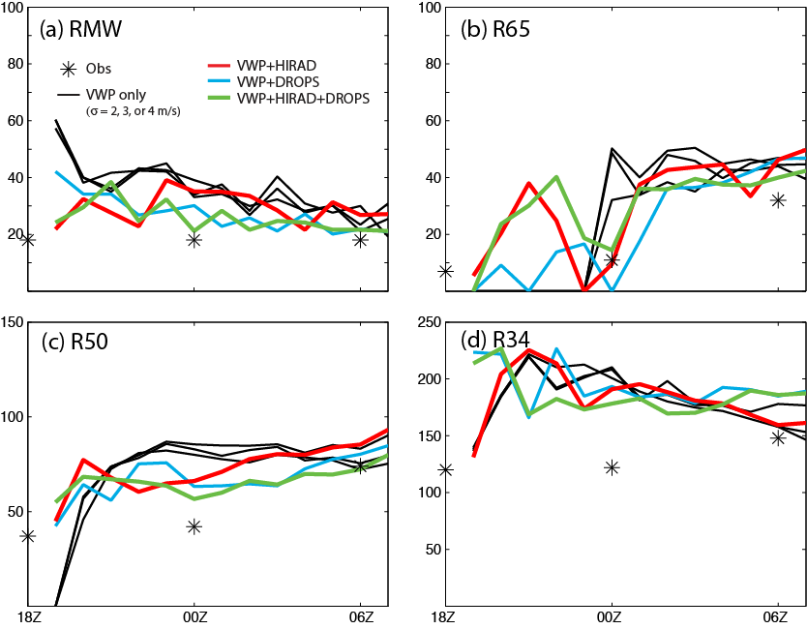
EnKF analyses: Size metrics
Quicker spinup of analysis winds with multiple data sources
Best results when all three sources assimilated

Slide 10
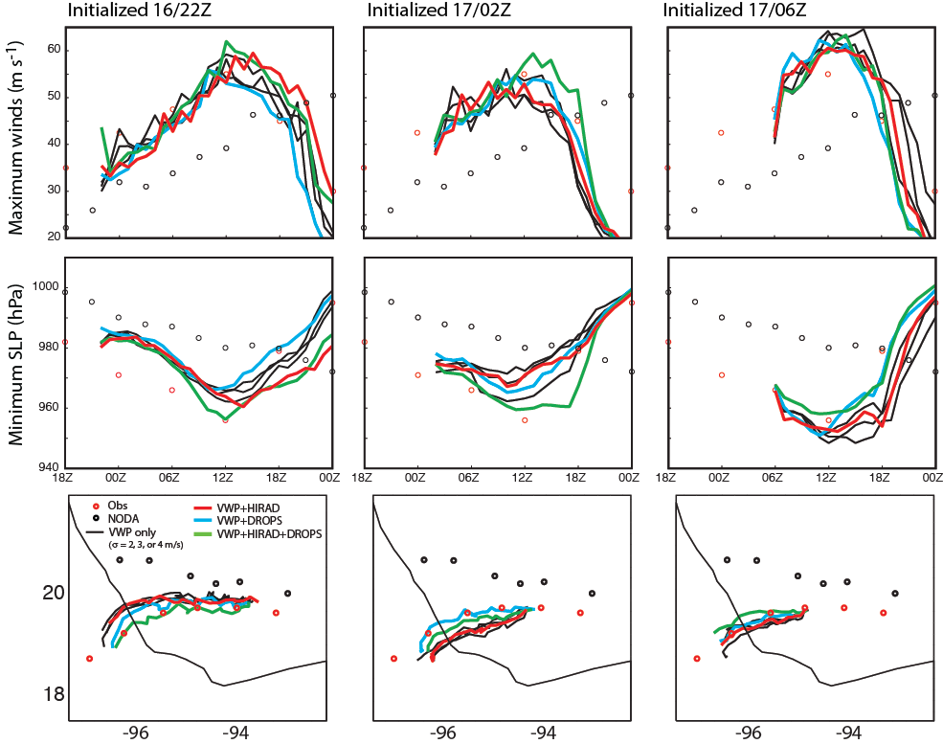
EnKF-initialized deterministic forecasts

Slide 11
EnKF-initialized deterministic forecasts
VWP+HIRAD+drops produces most consistent forecasts
Forecasts of SLP from VWP+HIRAD+drops are best, but forecast max winds are slightly biased
VWP+HIRAD doesn’t change forecast much
Adding drops improves forecast track

Slide 12
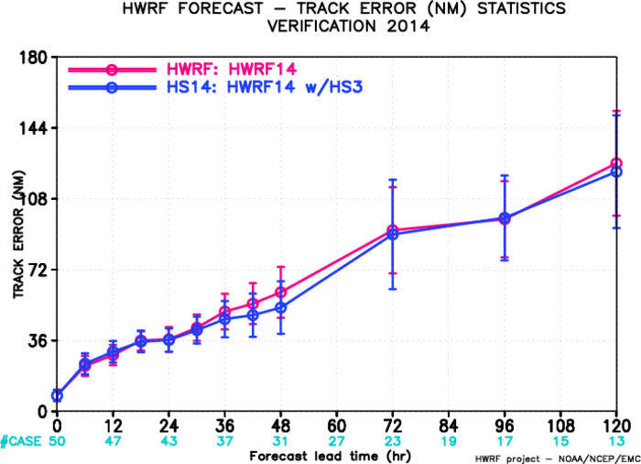
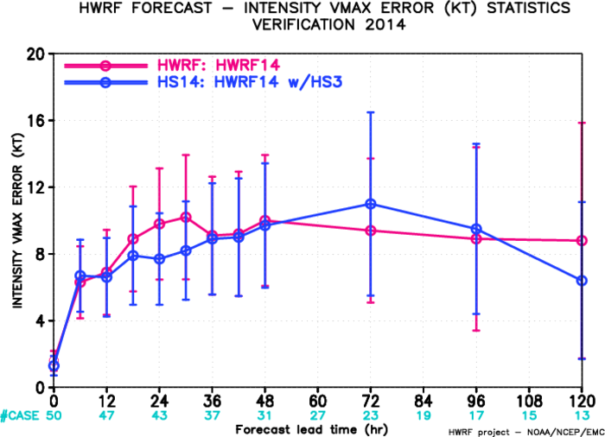
Looking ahead…
Conduct ARW & HWRF experiments from Hurricane Gonzalo (2014) when HIWRAP/HIRAD data become available
NOAA to use GH for 2015 hurricane season –operational dropsonde assimilation should improve forecasts
Enhanced TCVITALS assimilation techniques could further improve forecasts
HWRF track error with and without GH dropsonde assimilation (2014)
HWRF intensity error with and without GH dropsonde assimilation (2014)

Slide 13
Summary
NASA has used the Global Hawk for hurricane observations, and NOAA will in the future
Recent ARW-based experiments showed that assimilating GH-based HIWRAP data can improve hurricane analyses and forecasts
Assimilating data from other GH platforms further improves analyses and forecasts
Future tests will use data from Hurricane Gonzalo (2014) in ARW and HWRF systems with enhanced initialization techniques

