Slide 1


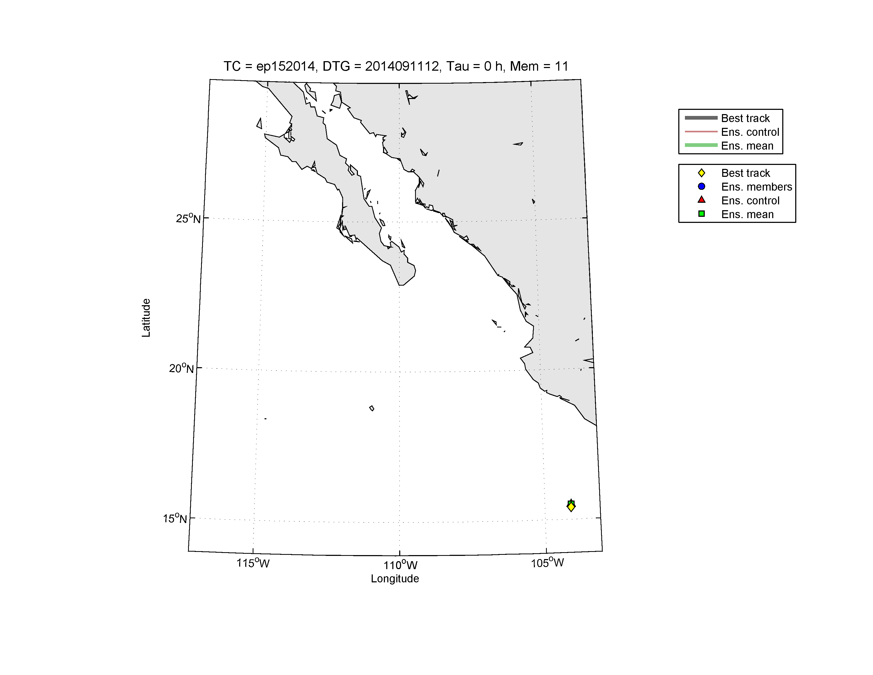
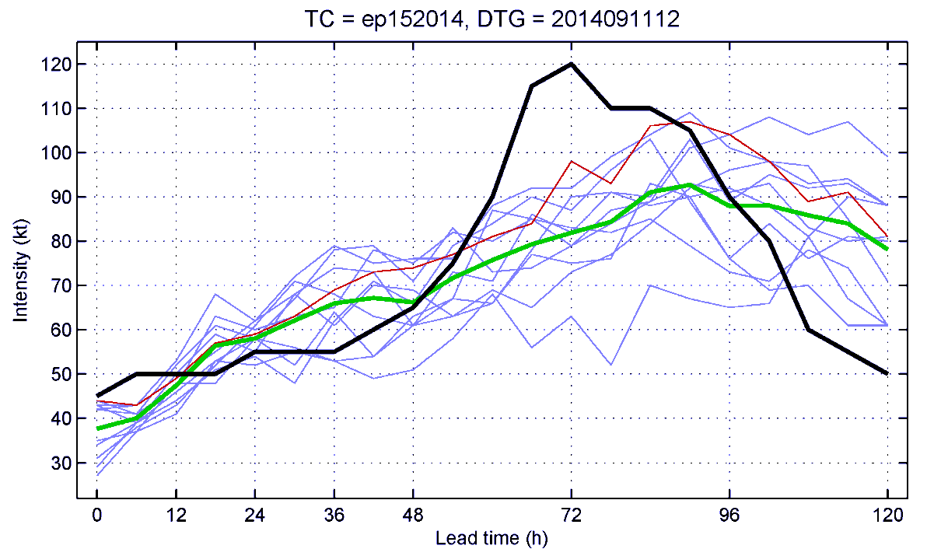
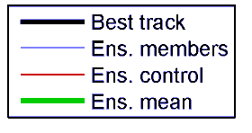
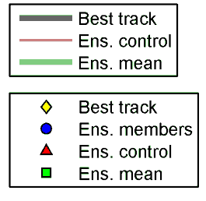
Real-time Probabilistic TC Prediction with Regional Dynamical Models:
The COAMPS-TC Ensemble and the Combined
COAMPS-TC/HWRF/GFDL Multi-model Ensemble
Jon Moskaitis, Alex Reinecke, Jim Doyle and the COAMPS-TC team
Naval Research Laboratory, Monterey, CA
2015 TCRF / 69th IHC, 4 March 2015
Real-time forecast example: Hurricane Odile (15E)
Landfall
While the control forecast keeps Odile offshore (like most
models at the time), the ensemble indicates a major
hurricane landfall on Baja is a possible outcome

Slide 2
Outline
2014 COAMPS-TC real-time ensemble demonstration
(2) COAMPS-TC ensemble results & conclusions
(3) COAMPS-TC/HWRF/GFDL combined ensemble
results & conclusions

Slide 3
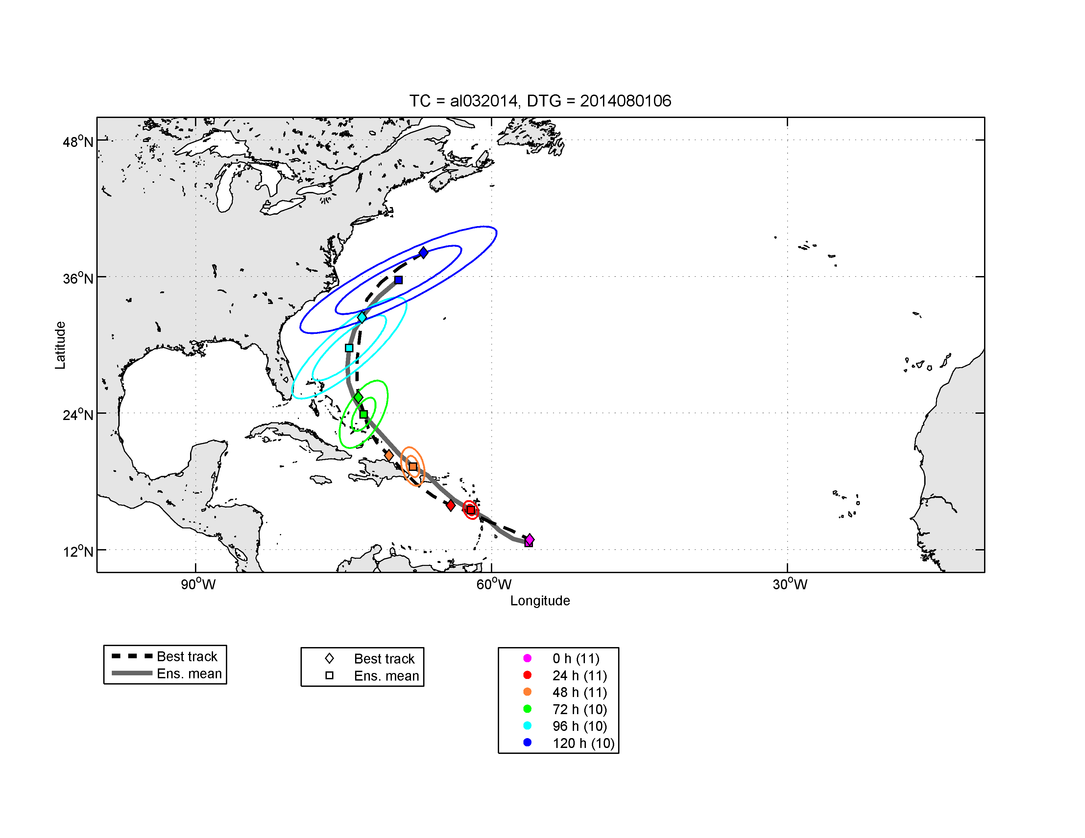
(1)
2014 COAMPS-TC real-time ensemble demonstration
Forecast sample
Basic ensemble configuration
Number | Name | Forecasts
03L | Bertha | 20
04L | Cristobal | 22
05L | Dolly | 8
06L | Edouard | 34
07L | Fay | 12
08L | Gonzalo | 27
09L | Hanna | 8
11E | Karina | 34
12E | Lowell | 2
13E | Marie | 30
14E | Norbert | 21
15E | Odile | 10
16E | TD 16 | 14
17E | Polo | 26
18E | Rachel | 26
19E | Simon | 23
21E | Vance | 25
02C | Ana | 11
1 unperturbed control + 10 perturbed members
3/9/27 km resolution in Atlantic, 5/15/45 km in Pacific
Forecasts every 6 h out to 120 h lead time
131 Atlantic cases
222 EastPac + CentPac cases
Track plot for every 4th Atlantic basin COAMPS-TC ensemble forecast

Slide 4
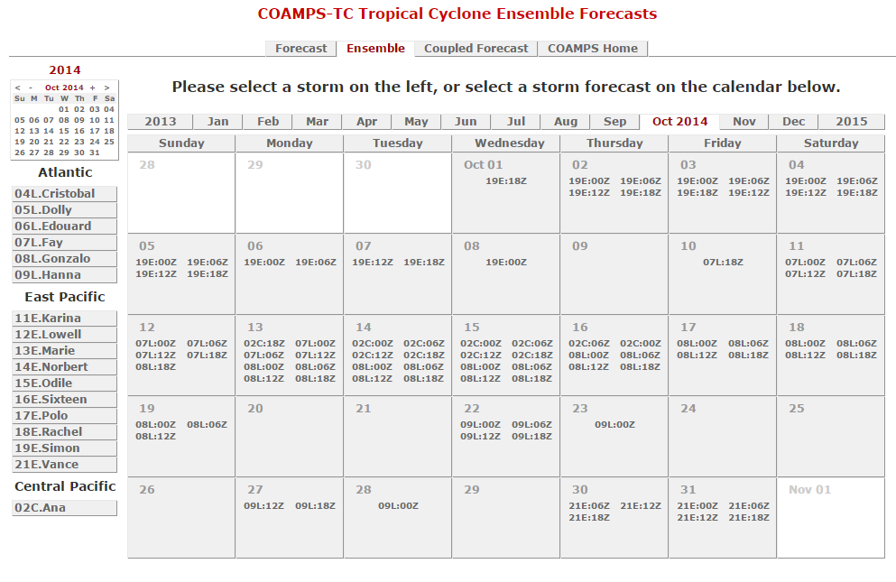
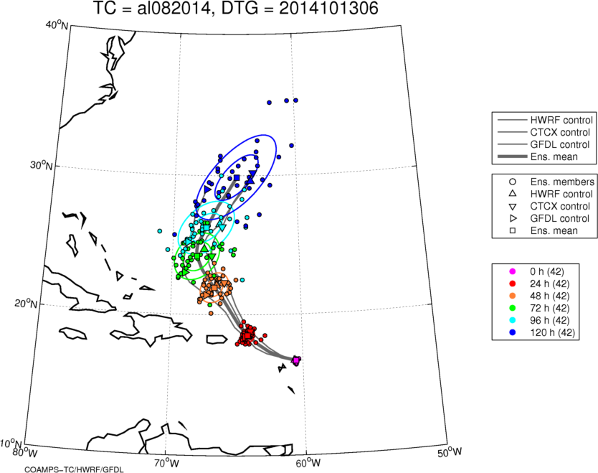
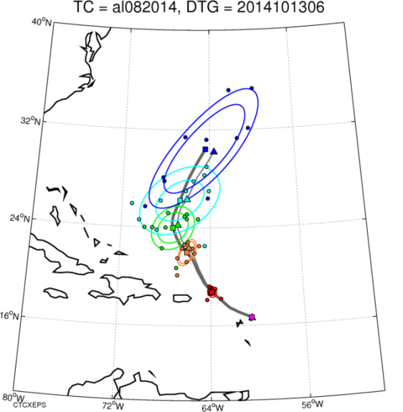
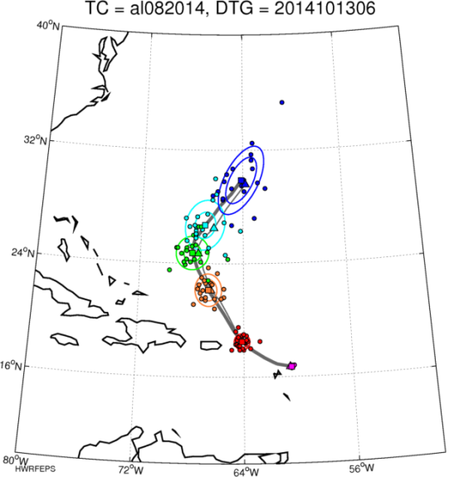
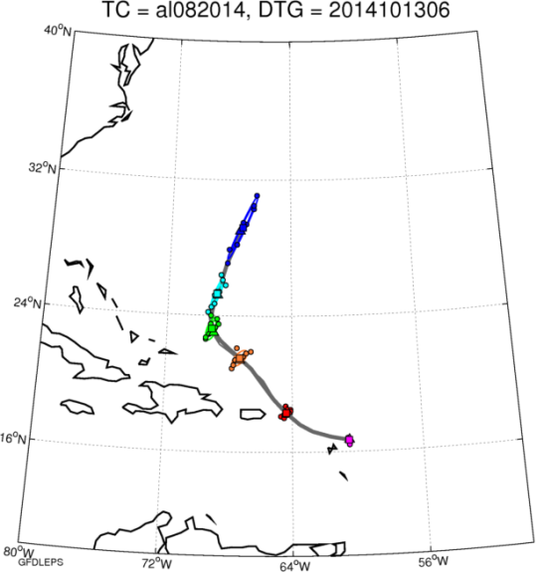
(1)
2014 COAMPS-TC real-time ensemble demonstration
Real-time website with track and intensity plots for COAMPS-TC, HWRF, GFDL, and combined EPS
http://www.nrlmry.navy.mil/coamps-web/web/ens
Combined EPS
COAMPS-TC EPS
HWRF EPS
GFDL EPS

Slide 5
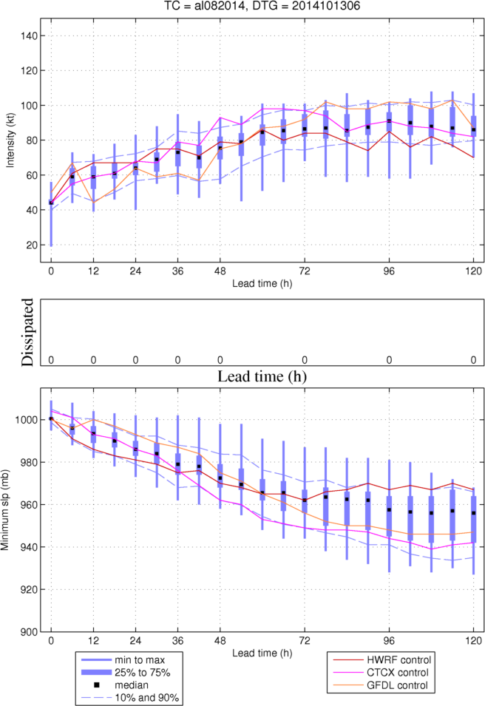
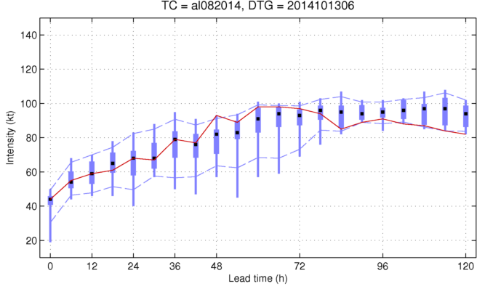
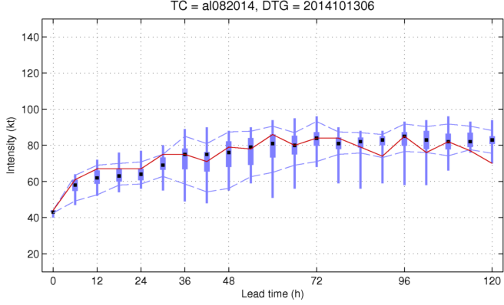
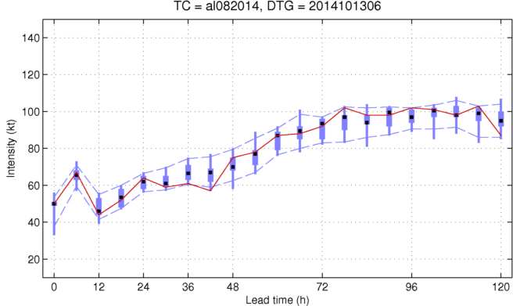
(1)
2014 COAMPS-TC real-time ensemble demonstration
Real-time website with track and intensity plots for COAMPS-TC, HWRF, GFDL, and combined EPS
http://www.nrlmry.navy.mil/coamps-web/web/ens
Combined EPS
COAMPS-TC EPS
HWRF EPS
GFDL EPS

Slide 6
(1)
COAMPS-TC ensemble configuration
Control member + 10 perturbed members at 3/9/27 km or 5/15/45 km resolution
Control member: Initialization from GFS analysis, except the TC vortex for which
a Rankine vortex is inserted based on TC vitals (position, intensity, wind radii).
Lateral boundary conditions from GFS forecast.
10 perturbed members: Initial and lateral boundary condition perturbations
Synoptic scale: Draw perturbations from WRFVAR cv3 static covariance for the
domain interior at initial time (add to GFS analysis) and for lateral boundaries
(add to GFS forecast)
Vortex scale: Perturb inserted Rankine vortex by perturbing the TC vitals parameters used
to generate vortex. Parameter variances are based on Torn and Snyder (2012)
and Landsea and Franklin (2013). The purpose is to realistically represent
the extant uncertainty in the vortex initial state.
No perturbations to physics or stochastic perturbations applied during integration

Slide 7
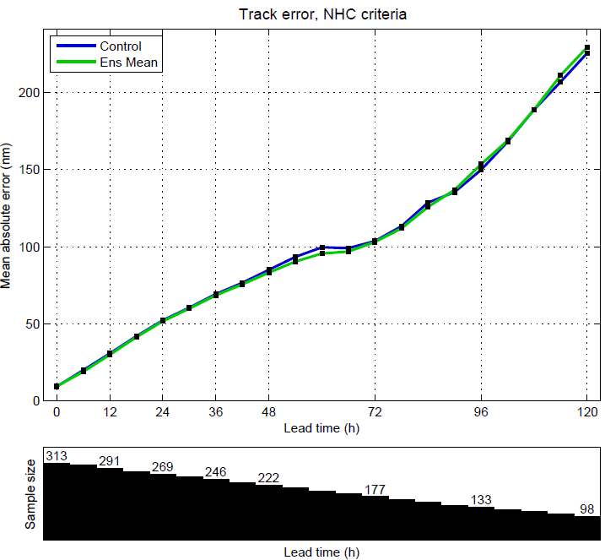
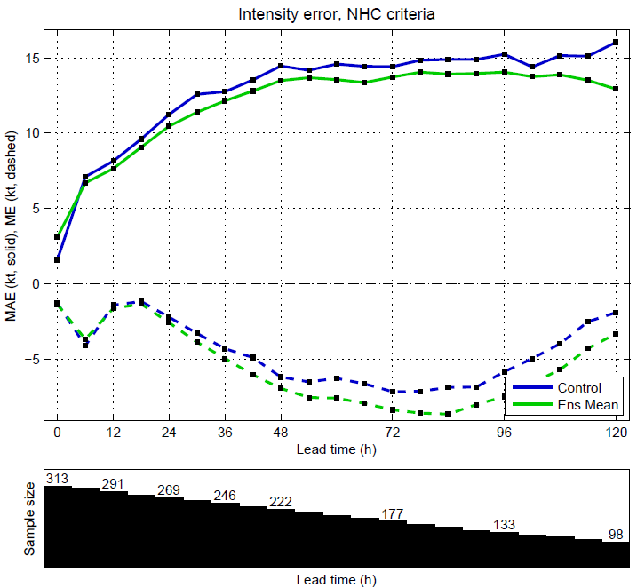
(2)
COAMPS-TC ensemble results
Deterministic verification: Control vs. Ensemble mean*
Track MAE
Intensity MAE (solid) and ME (dashed)
Sample size
Sample size
Overall, control member and ensemble mean
track errors are similar
Ensemble mean intensity MAE is lower than that of
the control for all positive lead times. Note negative bias for both control and ensemble mean.
* Ensemble mean defined to exist if 9 of 11 members present

Slide 8
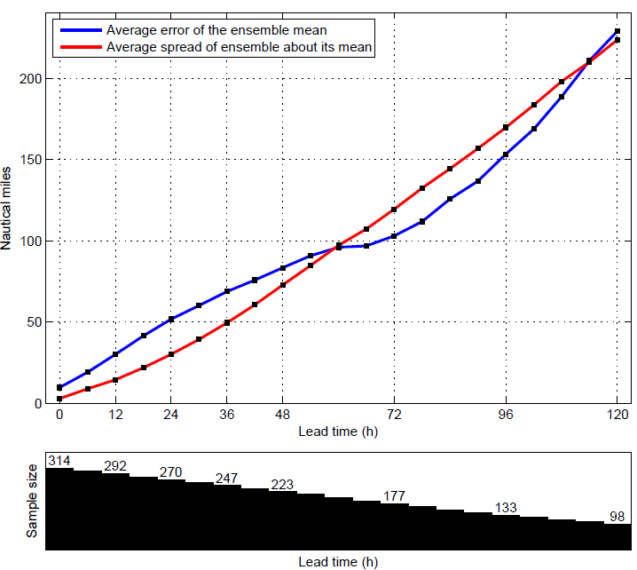
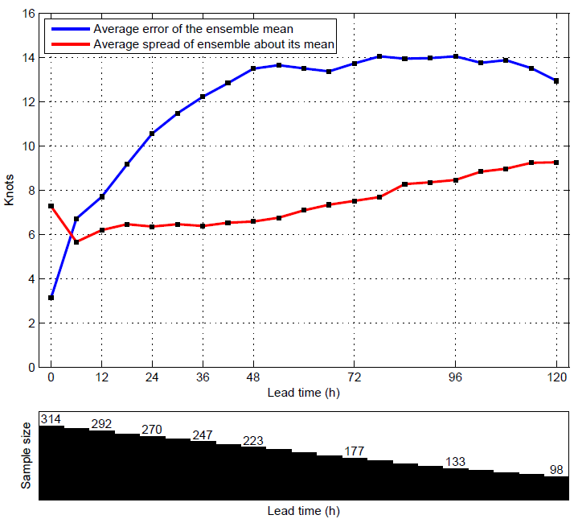
(2)
COAMPS-TC ensemble results
Probabilistic verification: Ensemble spread vs. Ensemble mean error
Track
Intensity
Sample size
Sample size
For track, average ensemble spread and average ensemble mean error are comparable
Intensity spread grows with time, but not nearly as much as intensity error. Part of the ensemble mean error is due to the negative bias, but still the ensemble is underdispersive.

Slide 9
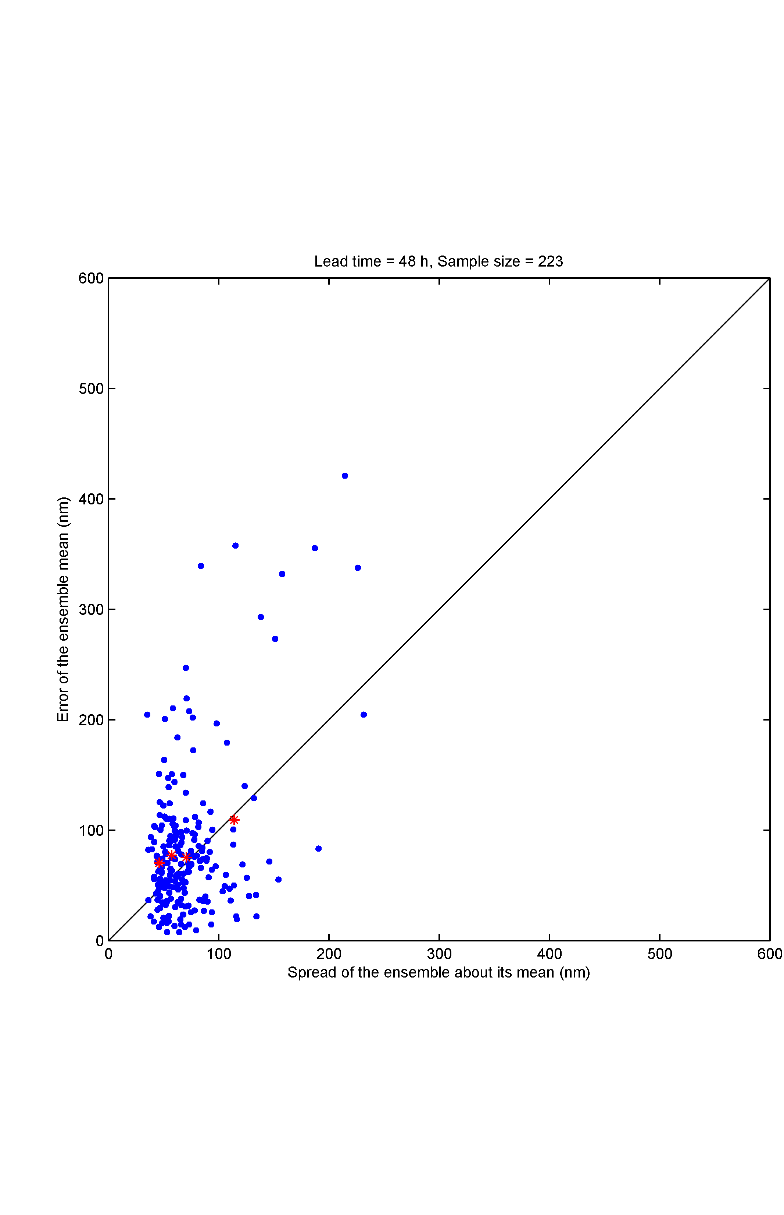
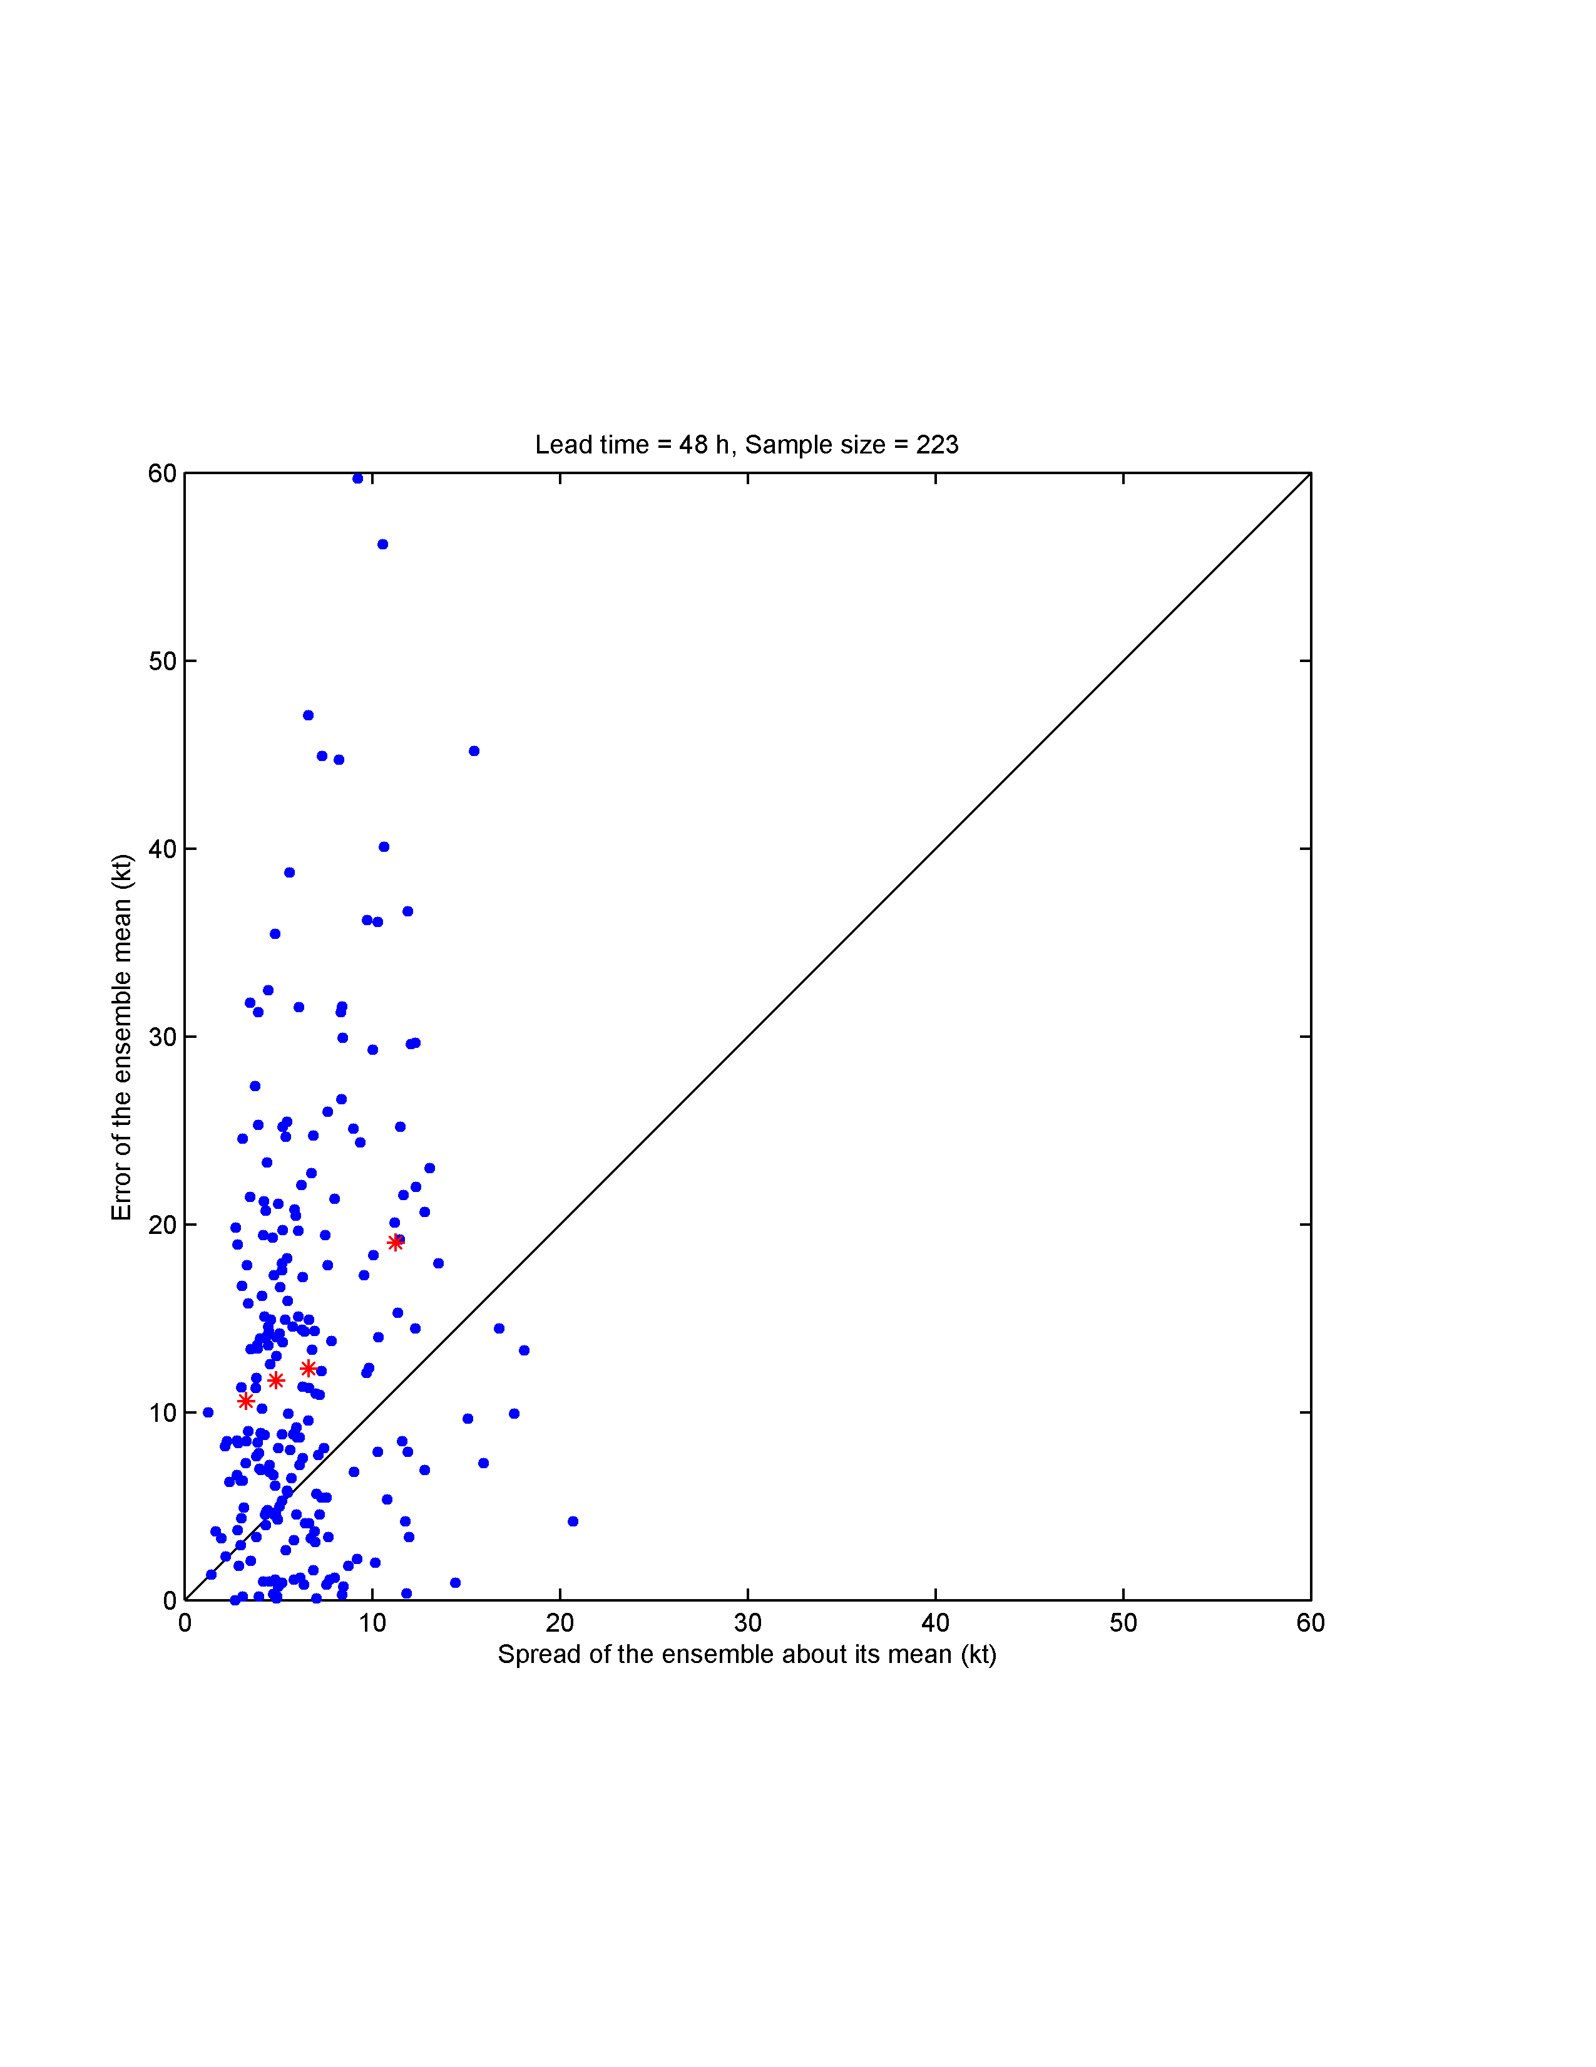
(2)
COAMPS-TC ensemble results
Probabilistic verification: Ensemble spread vs. Ensemble mean error
Track
Tau = 48 h
Intensity
Error of the ensemble mean (nm)
Error of the ensemble mean (kt)
Spread of ensemble about its mean (nm)
Spread of ensemble about its mean (kt)
The blue dots represent individual forecasts and red stars are bin-averages (4 equally populated bins)
Would like to see red stars line up along diagonal and few blue dots in upper left (large error / low spread)

Slide 10
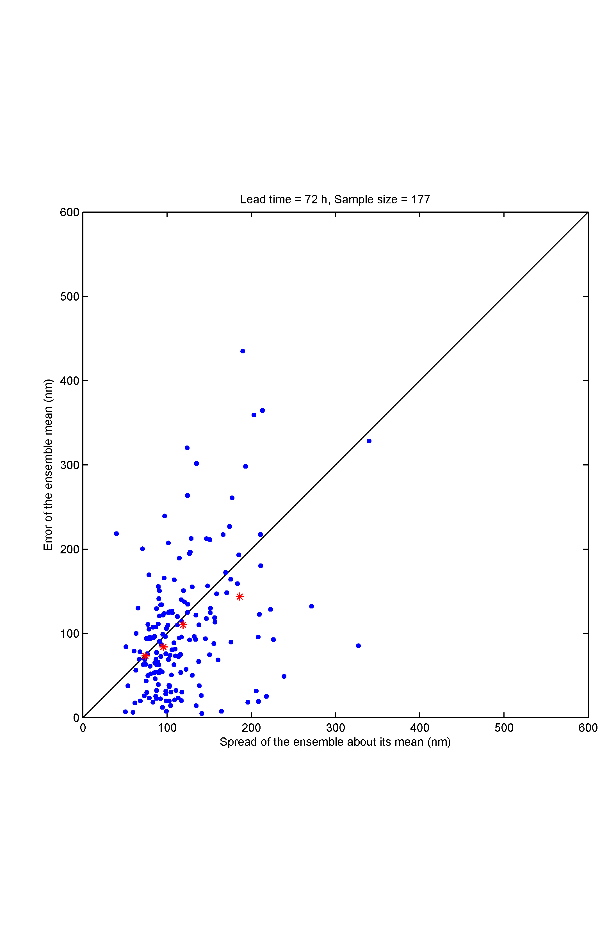
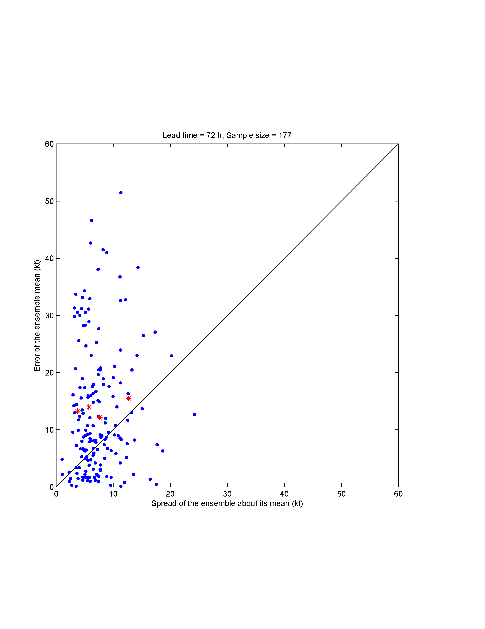
(2)
COAMPS-TC ensemble results
Probabilistic verification: Ensemble spread vs. Ensemble mean error
Track
Tau = 72 h
Intensity
Error of the ensemble mean (nm)
Error of the ensemble mean (kt)
Spread of ensemble about its mean (nm)
Spread of ensemble about its mean (kt)
The blue dots represent individual forecasts and red stars are bin-averages (4 equally populated bins)
Would like to see red stars line up along diagonal and few blue dots in upper left (large error / low spread)

Slide 11
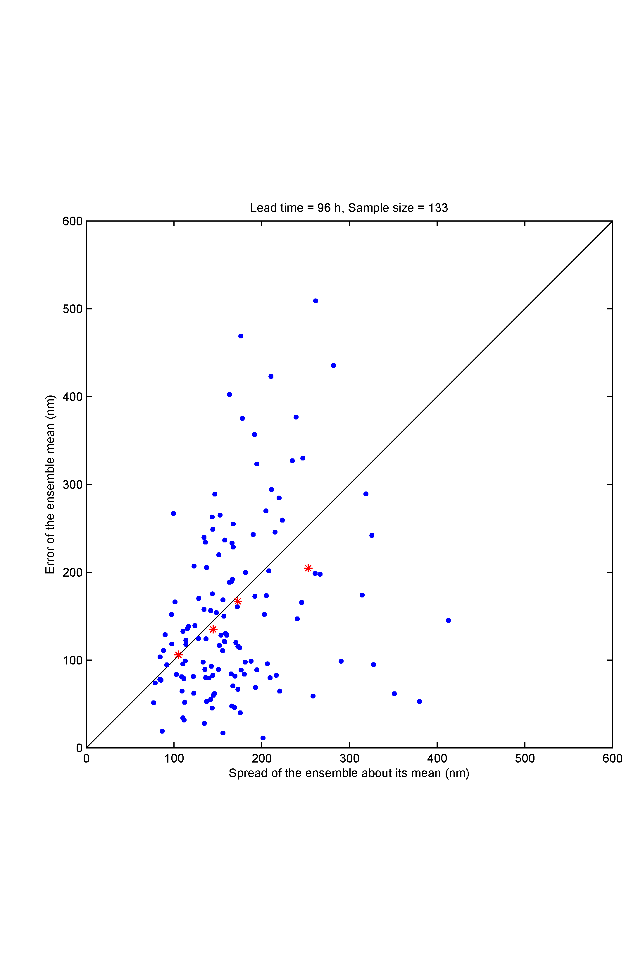
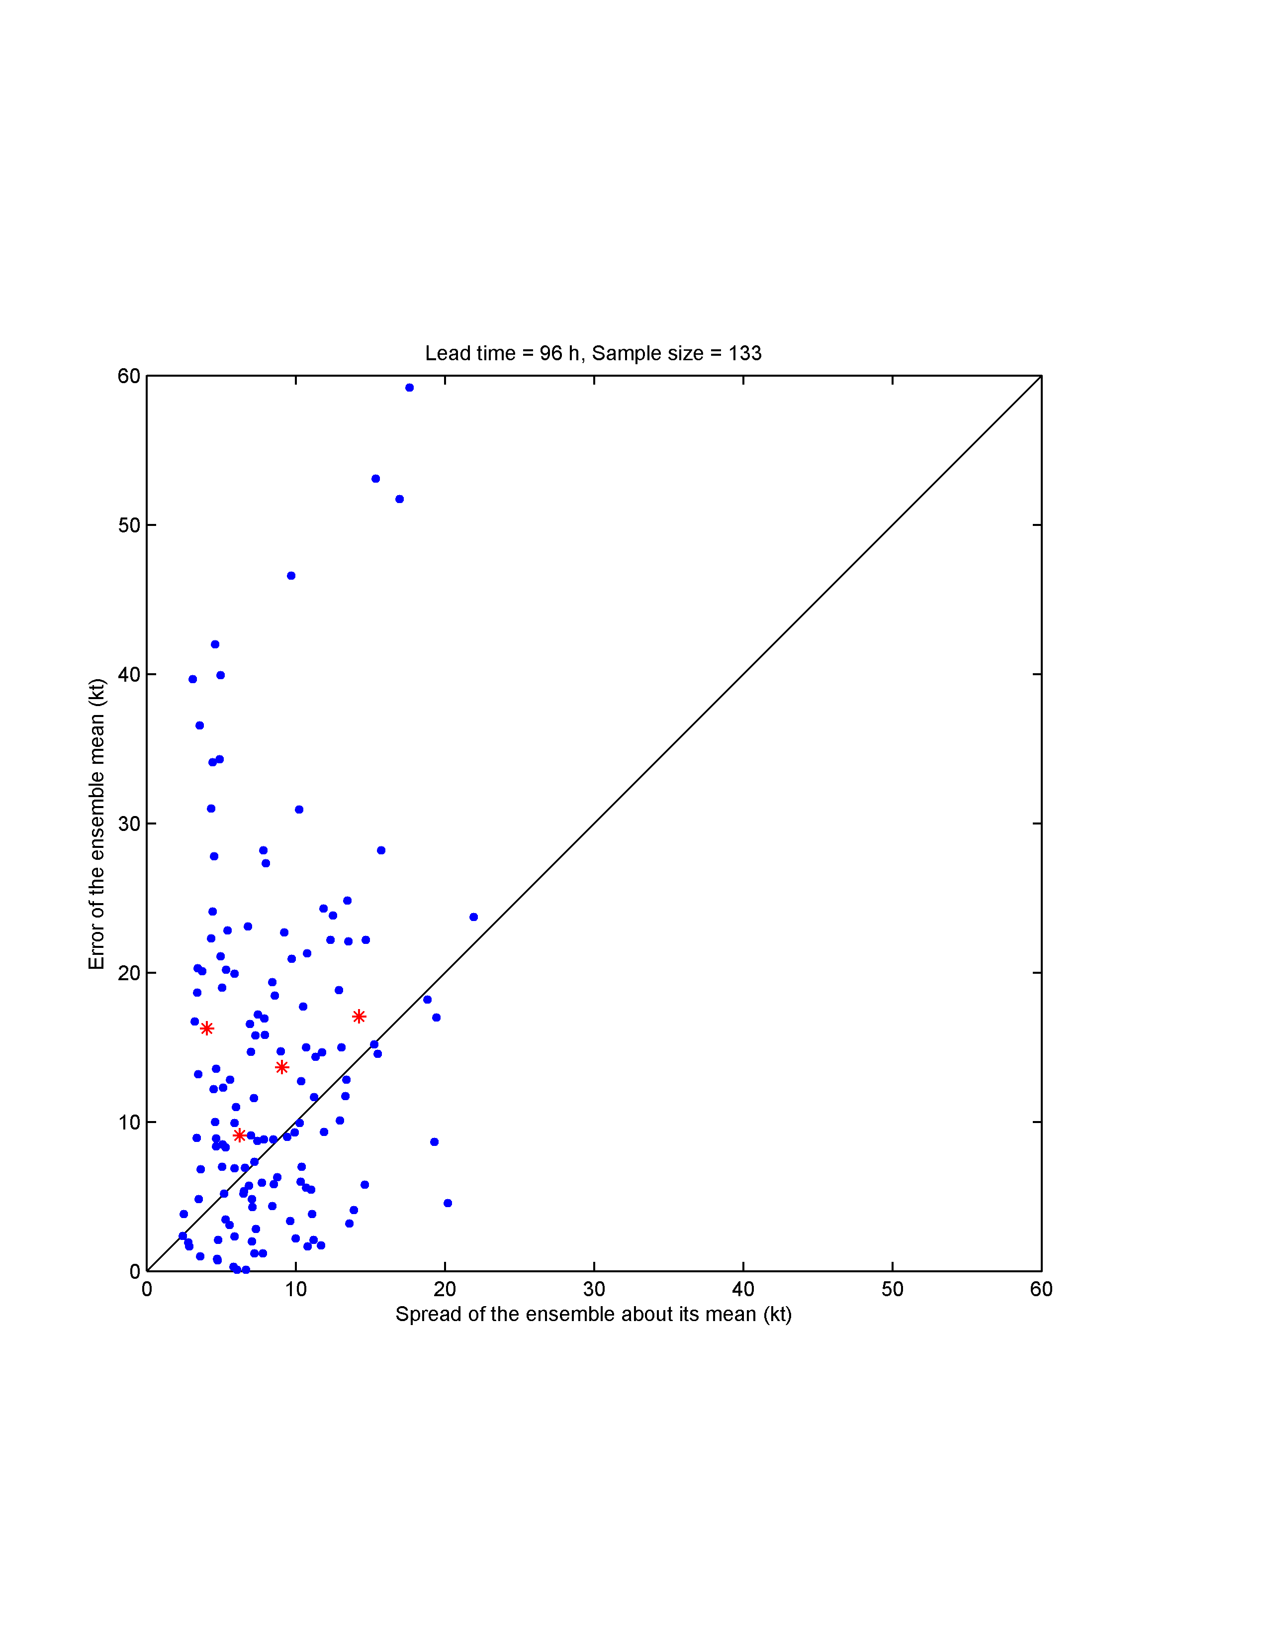
(2)
COAMPS-TC ensemble results
Probabilistic verification: Ensemble spread vs. Ensemble mean error
Track
Tau = 96 h
Intensity
Error of the ensemble mean (nm)
Error of the ensemble mean (kt)
Spread of ensemble about its mean (nm)
Spread of ensemble about its mean (kt)
The blue dots represent individual forecasts and red stars are bin-averages (4 equally populated bins)
Would like to see red stars line up along diagonal and few blue dots in upper left (large error / low spread)

Slide 12
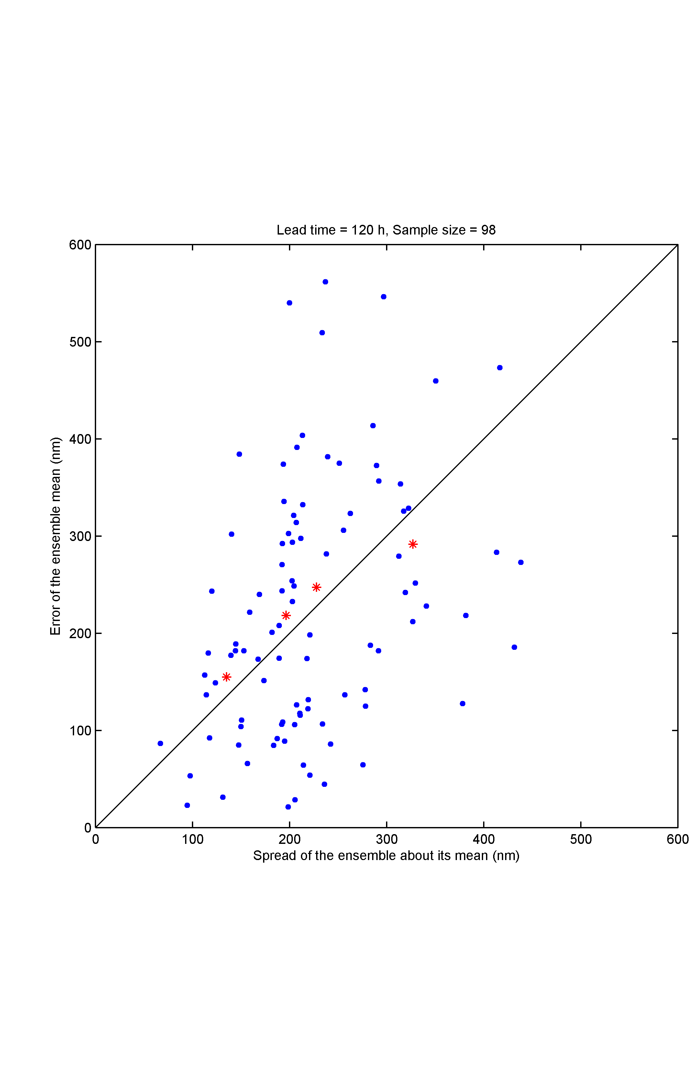
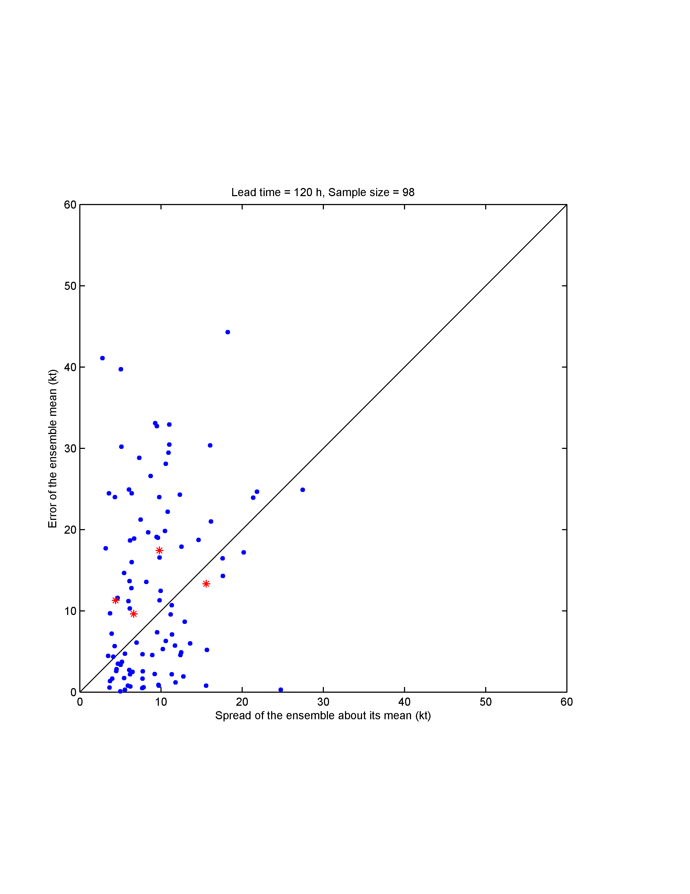
(2)
COAMPS-TC ensemble results
Probabilistic verification: Ensemble spread vs. Ensemble mean error
Track
Tau = 120 h
Intensity
Error of the ensemble mean (nm)
Error of the ensemble mean (kt)
Spread of ensemble about its mean (nm)
Spread of ensemble about its mean (kt)
For track, the relationship between ensemble spread and ensemble mean error is nearly ideal. Ensemble spread is an excellent predictor of ensemble mean error
For intensity, larger spread generally implies larger ensemble mean error, but the relationship is not as strong as for track

Slide 13
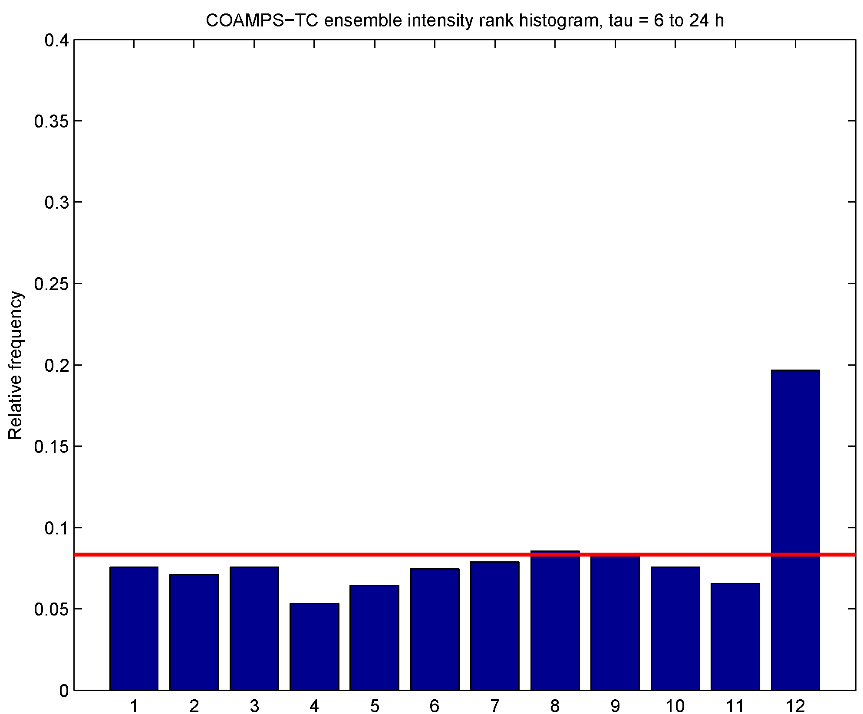
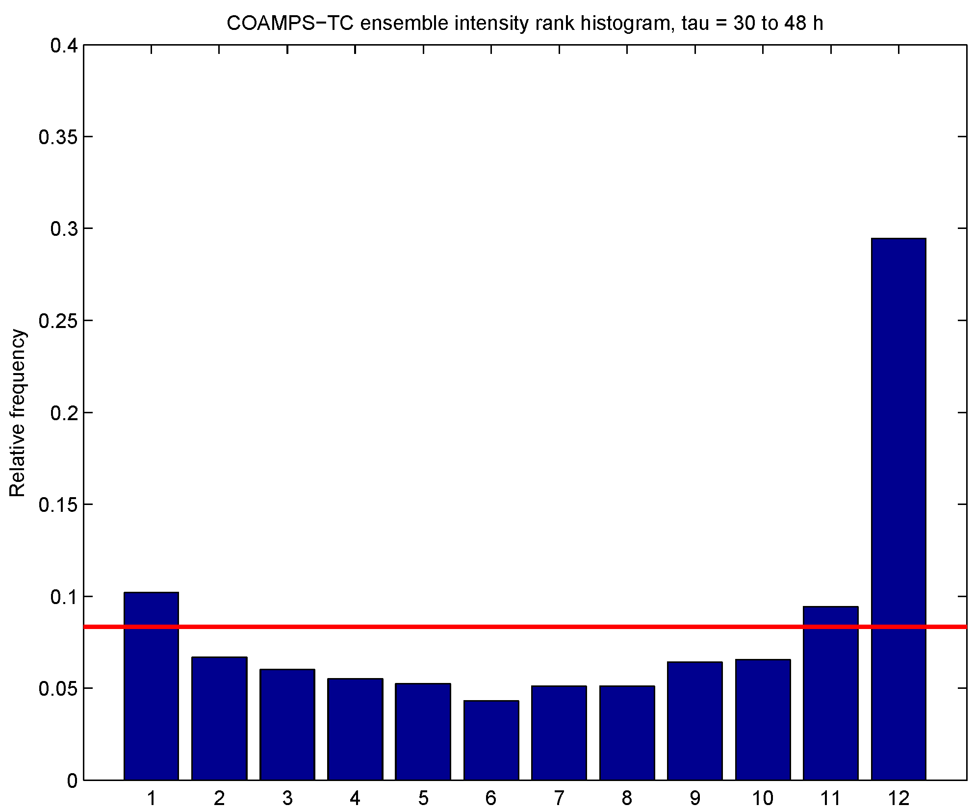
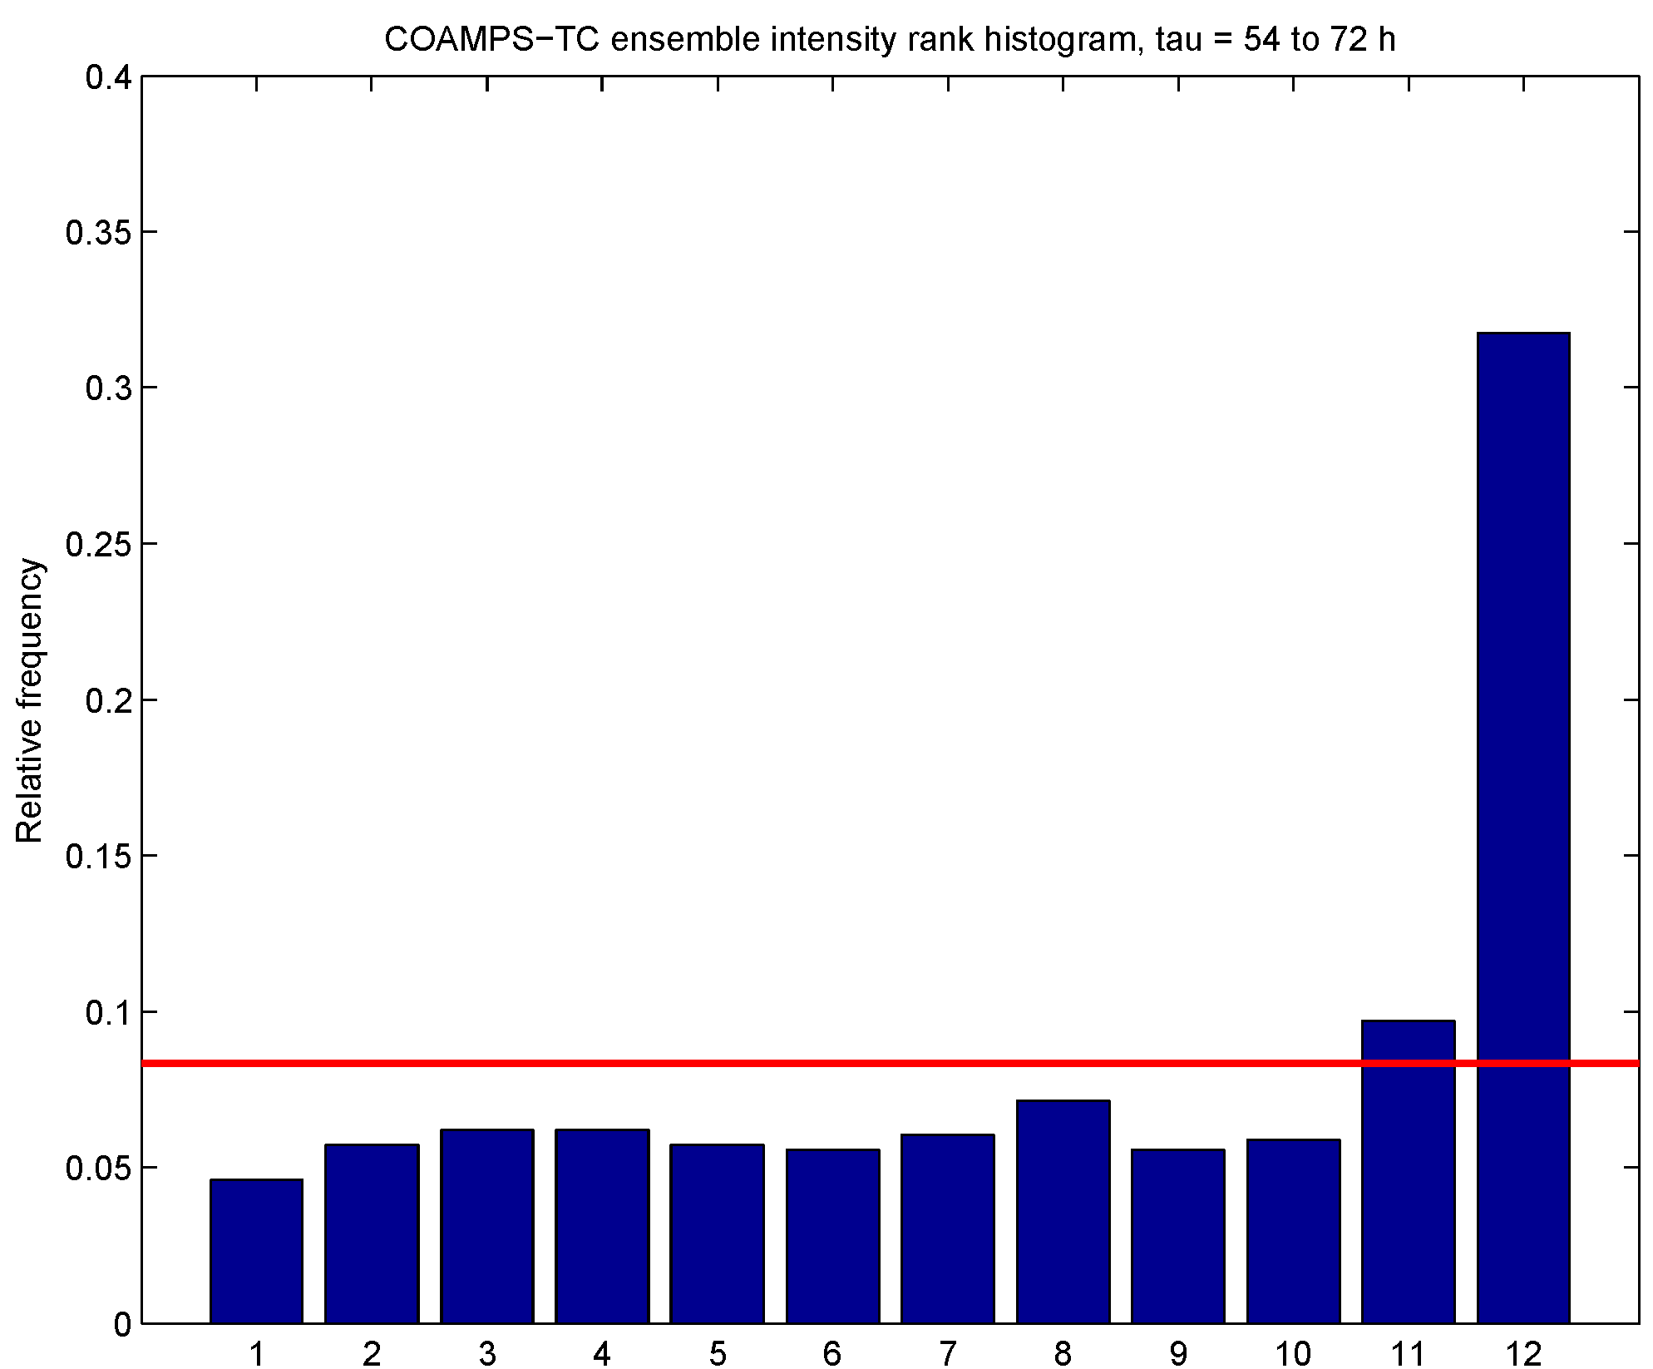
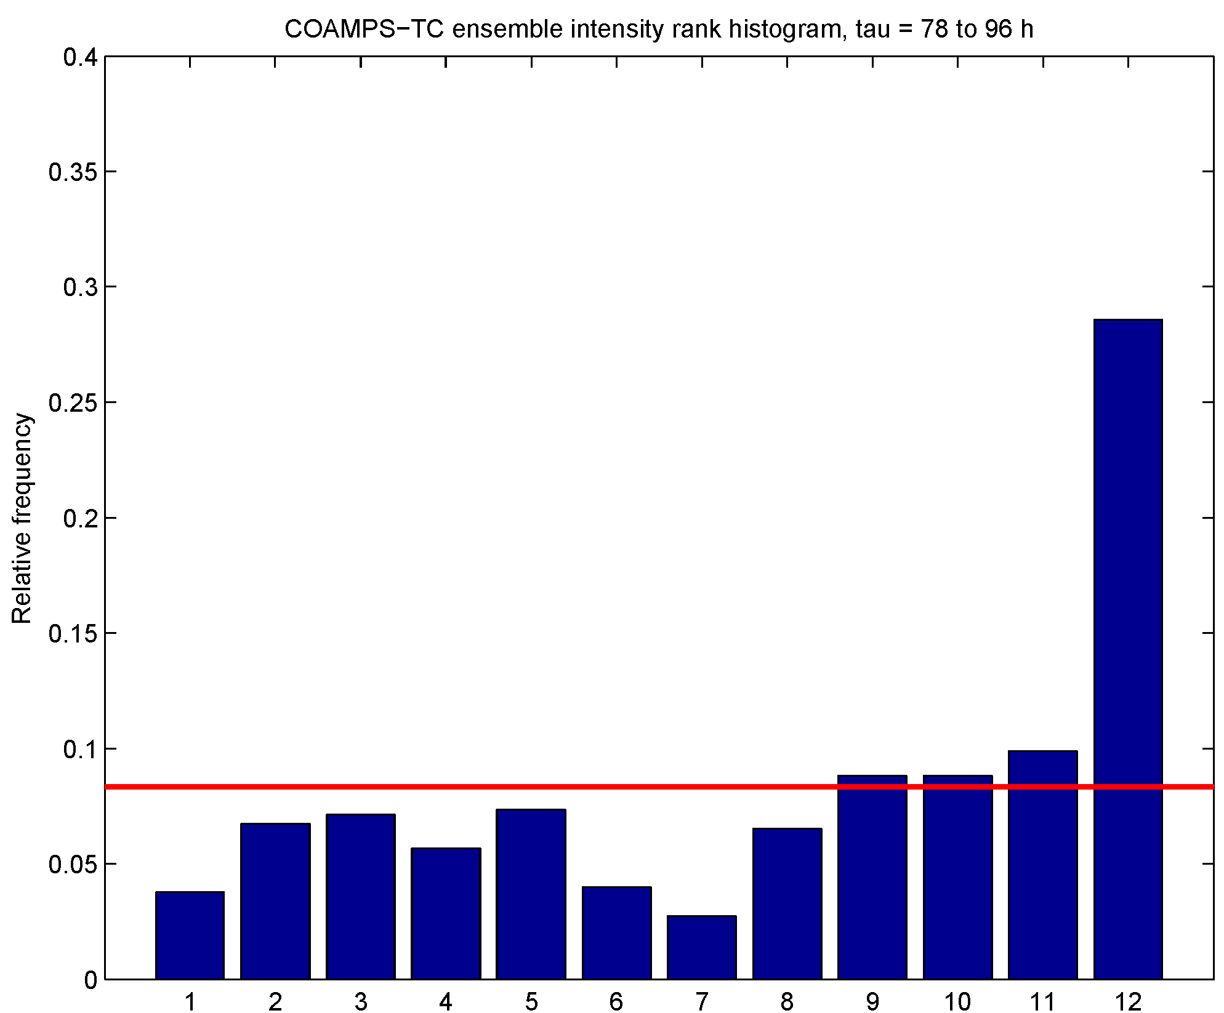
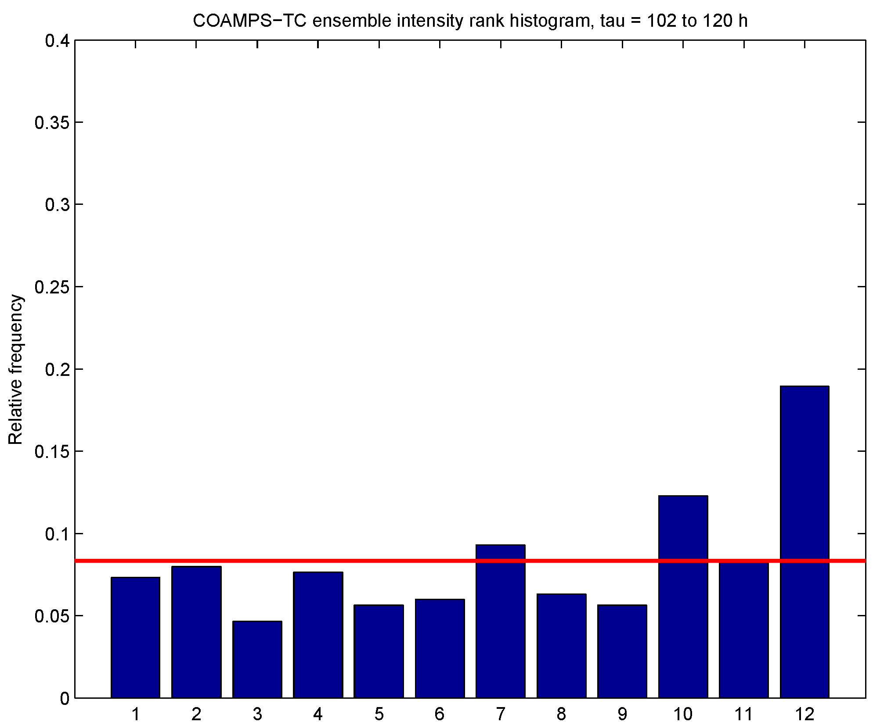
(2)
COAMPS-TC ensemble results
Probabilistic verification: Intensity rank histograms
Tau = 6-24 h
Tau = 30-48 h
Tau = 54-72 h
Relative frequency
Relative frequency
Relative frequency
Tau = 78-96 h
Tau = 102-120 h
Would like to see all the blue bars near the red line, indicating equal probability observation falls between any two ranked ensemble member (or falls outside either end of ensemble)
Relative frequency
Relative frequency
There is overpopulation of the right-most bin (all ensemble member forecasts < observed intensity),
but otherwise the rank histograms look quite good. Bias of intensity forecasts is a problem.

Slide 14
(2)
Conclusions for COAMPS-TC ensemble
The COAMPS-TC ensemble reliably ran in real-time, producing 353
forecasts of Atlantic, Eastern Pacific, and Central Pacific TCs during
the 3 month demonstration
For track the accuracy of the ensemble mean is similar to that of the
control member, but for intensity the ensemble mean is superior
The spread of the track prediction is consistent with the error of the
ensemble mean, and is a good predictor of ensemble mean error
Bias of intensity forecasts hurts performance in probabilistic validation,
but the results show promise

Slide 15
(3)
COAMPS-TC/HWRF/GFDL combined ensemble results
2014 real-time forecast sample
Retrospective forecast sample
Number/Year | Name | Forecasts
03L / 2014 | Bertha | 17
04L / 2014 | Cristobal | 20
05L / 2014 | Dolly | 4
06L / 2014 | Edouard | 29
08L / 2014 | Gonzalo | 24
09L / 2014 | Hanna | 2
Number/Year | Name | Forecasts
09L / 2011 | Irene | 14
12L / 2011 | Katia | 20
05L / 2012 | Ernesto | 15
09L / 2012 | Isaac | 16
14L / 2012 | Nadine | 36
18L / 2012 | Sandy | 12
07L / 2013 | Gabrielle | 7
09L / 2013 | Humberto | 13
96 total forecast cases
Forecasts run every 6 h
133 total forecast cases
Forecasts run every 12 h
Following slides use 2014 real-time forecast sample in calculating means,
but other validation metrics use the larger retrospective forecast sample.

Slide 16
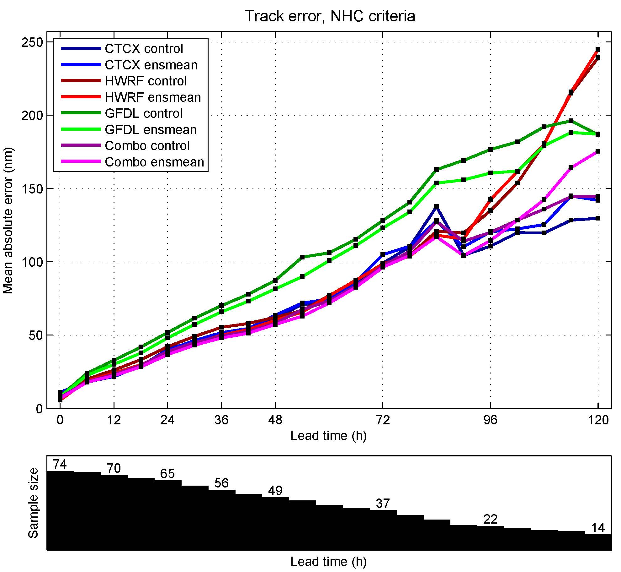
(3)
COAMPS-TC/HWRF/GFDL combined ensemble results
Deterministic verification: 2014 real-time track
For individual model, ensemble mean has accuracy similar to control member
Combined ensemble mean has accuracy similar to consensus of three control members
Control forecasts:
COAMPS-TC: C00C
HWRF: HW00
GFDL: GP00
Combo : Consensus of
C00C, HW00, and GP00
Ensemble mean requirements:
COAMPS-TC: 9 of 11 members
HWRF: 17 of 21 members
GFDL: 8 of 10 members
Combo: 34 of 42 members
Sample size

Slide 17
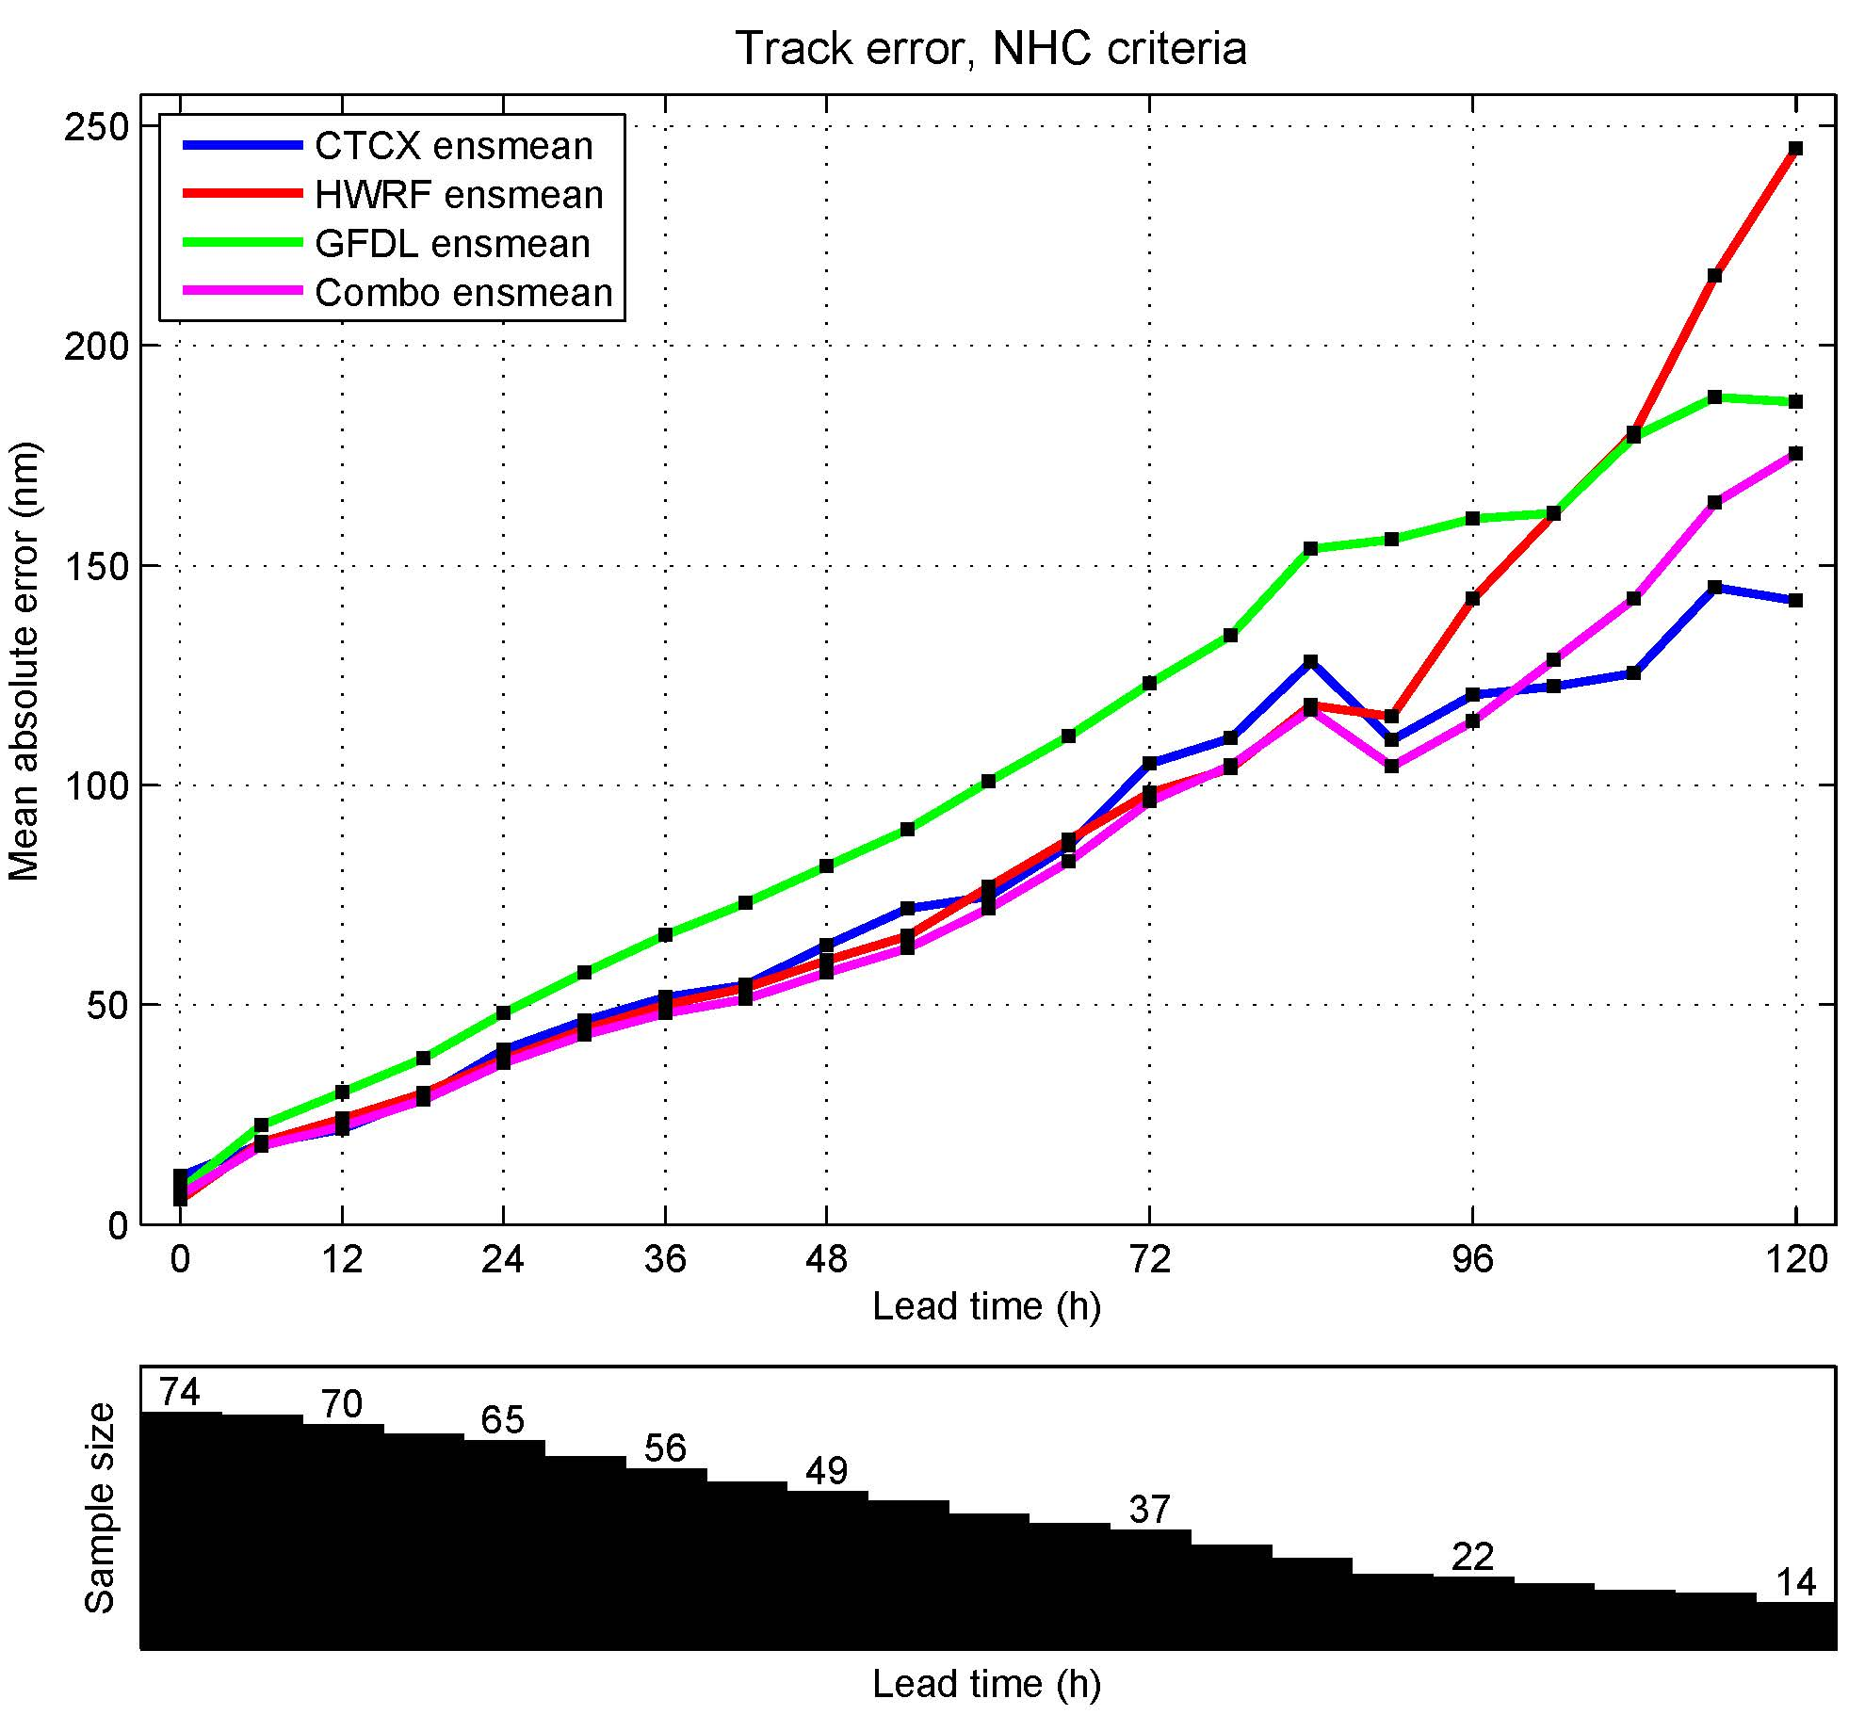
(3)
COAMPS-TC/HWRF/GFDL combined ensemble results
Deterministic verification: 2014 real-time track
For individual model, ensemble mean has accuracy similar to control member
Combined ensemble mean has accuracy similar to consensus of three control members
Ensemble mean requirements:
COAMPS-TC: 9 of 11 members
HWRF: 17 of 21 members
GFDL: 8 of 10 members
Combo: 34 of 42 members
Sample size

Slide 18
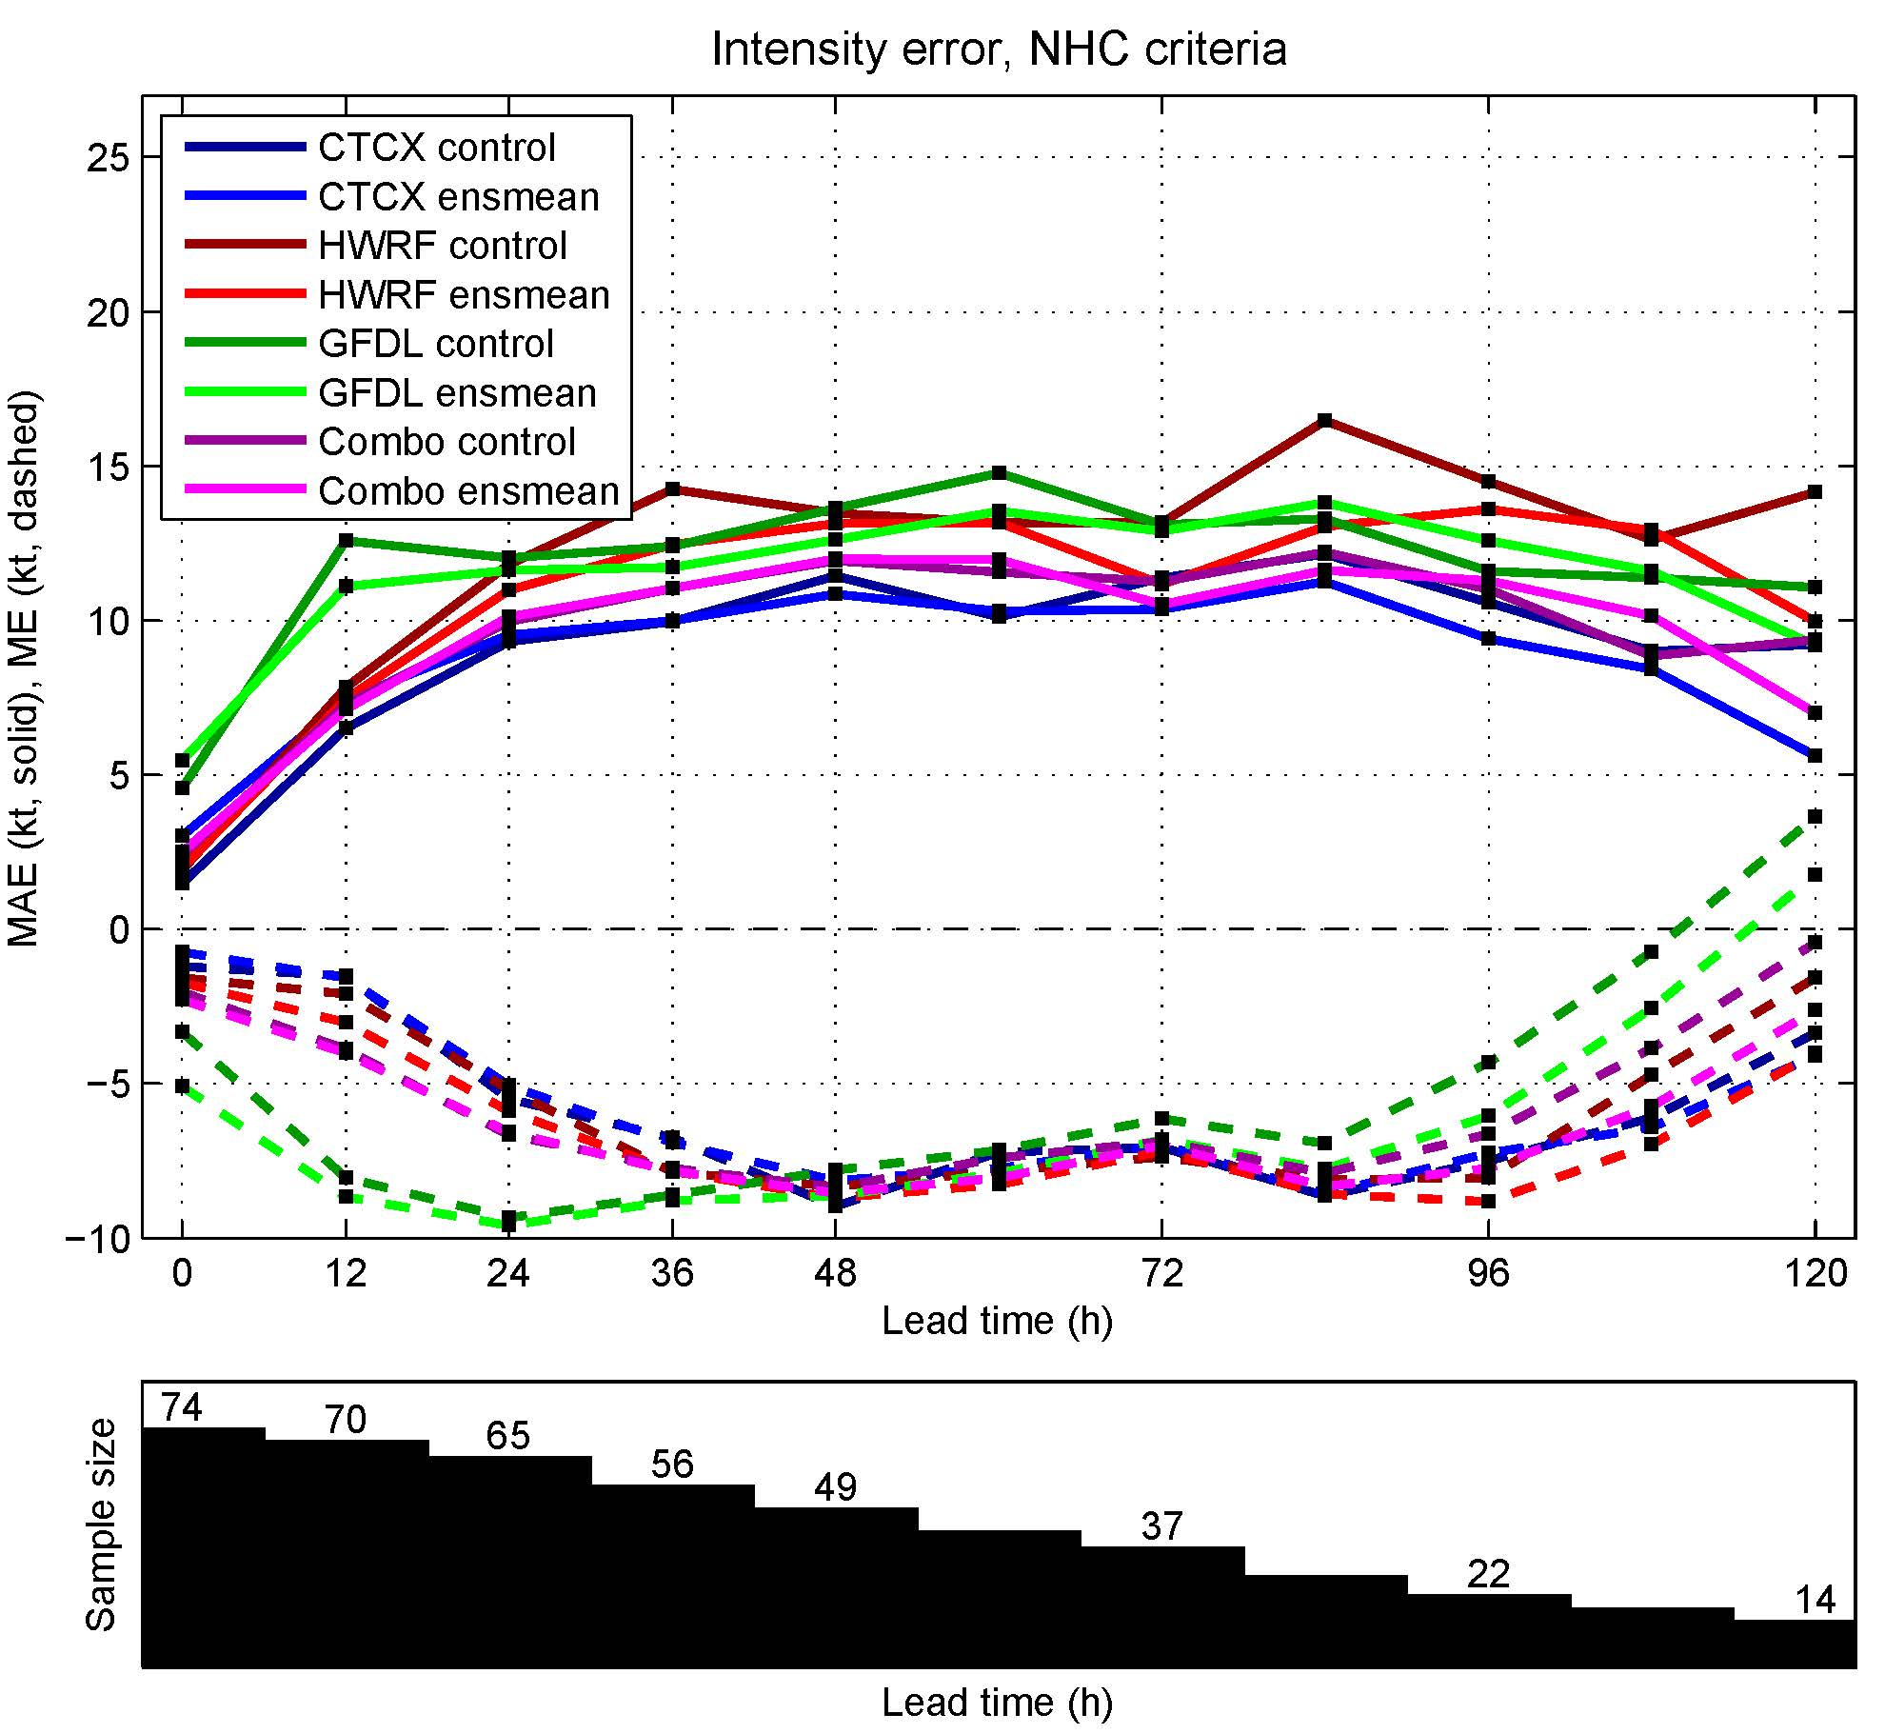
(3)
COAMPS-TC/HWRF/GFDL combined ensemble results
Deterministic verification: 2014 real-time intensity
Solid: Mean absolute error Dashed: Mean error
For individual model, ensemble mean has improved accuracy relative to the control
Combined ensemble mean has accuracy similar to consensus of three control members
Control forecasts:
COAMPS-TC: C00C
HWRF: HW00
GFDL: GP00
Combo : Consensus of
C00C, HW00, and GP00
Ensemble mean requirements:
COAMPS-TC: 9 of 11 members
HWRF: 17 of 21 members
GFDL: 8 of 10 members
Combo: 34 of 42 members
Sample size

Slide 19
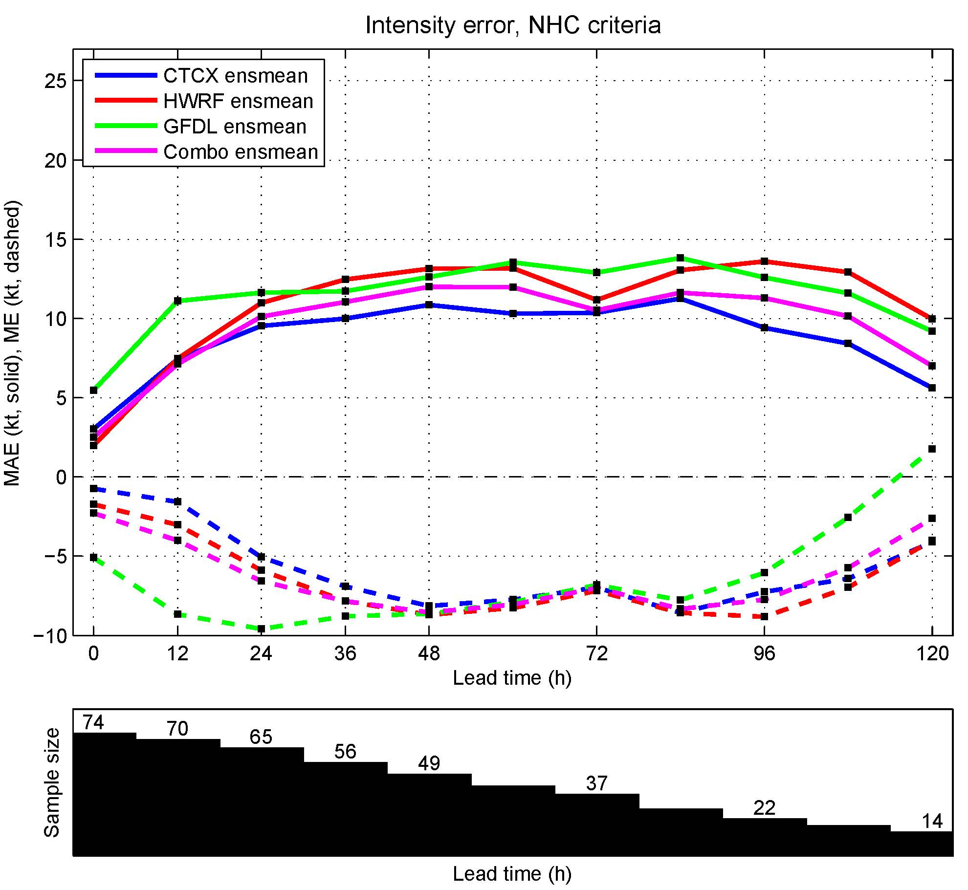
(3)
COAMPS-TC/HWRF/GFDL combined ensemble results
Deterministic verification: 2014 real-time intensity
Solid: Mean absolute error Dashed: Mean error
For individual model, ensemble mean has improved accuracy relative to the control
Combined ensemble mean has accuracy similar to consensus of three control members
Ensemble mean requirements:
COAMPS-TC: 9 of 11 members
HWRF: 17 of 21 members
GFDL: 8 of 10 members
Combo: 34 of 42 members
Sample size

Slide 20
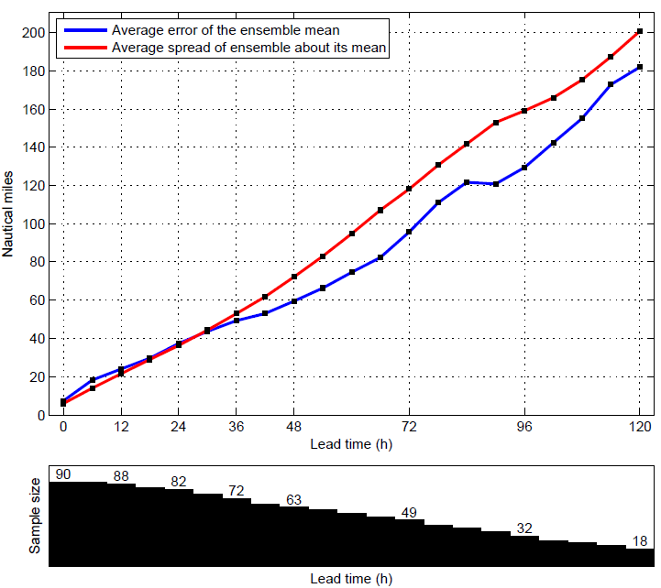
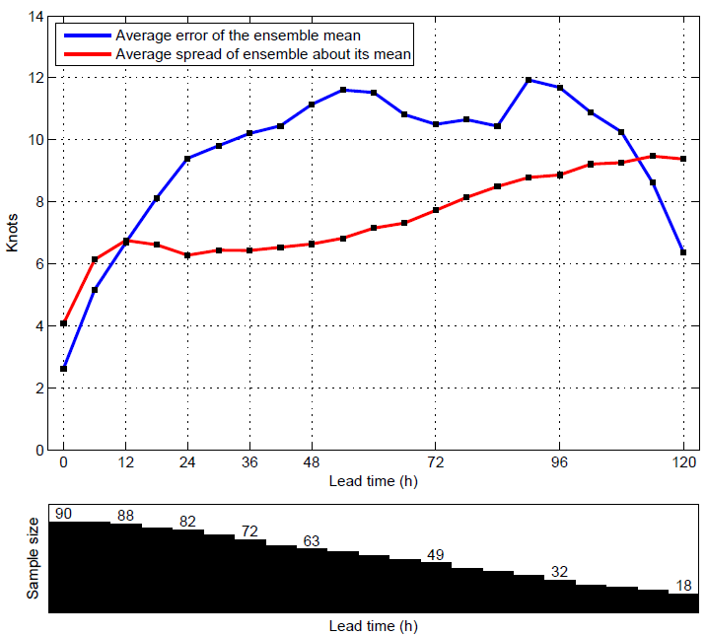
(3)
COAMPS-TC/HWRF/GFDL combined ensemble results
Probabilistic verification: Ensemble spread vs. Ensemble mean error
Track: 2014 real-time sample
Intensity: 2014 real-time sample
Sample size
Sample size
For track, average ensemble spread and average ensemble mean error are comparable
For intensity, spread is comparable to ensemble mean error early on, but then grows at a slower rate

Slide 21
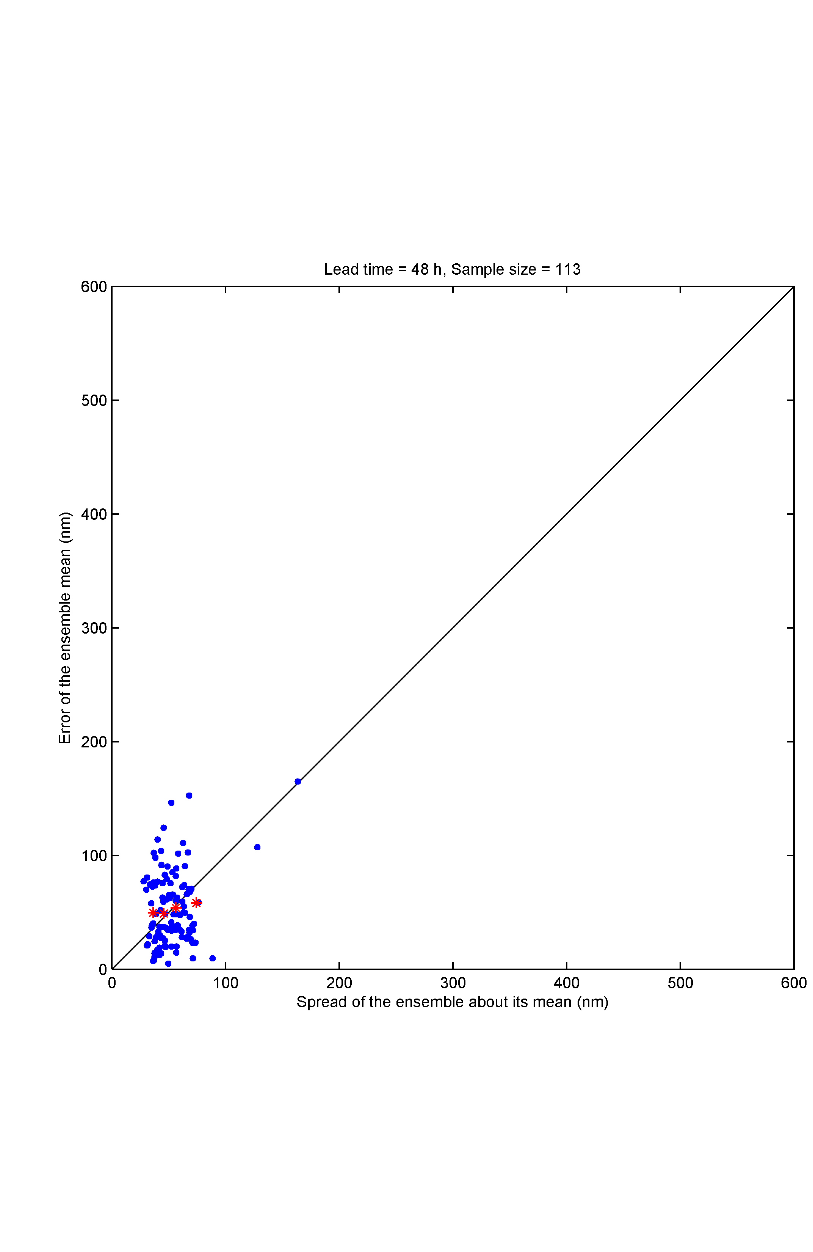
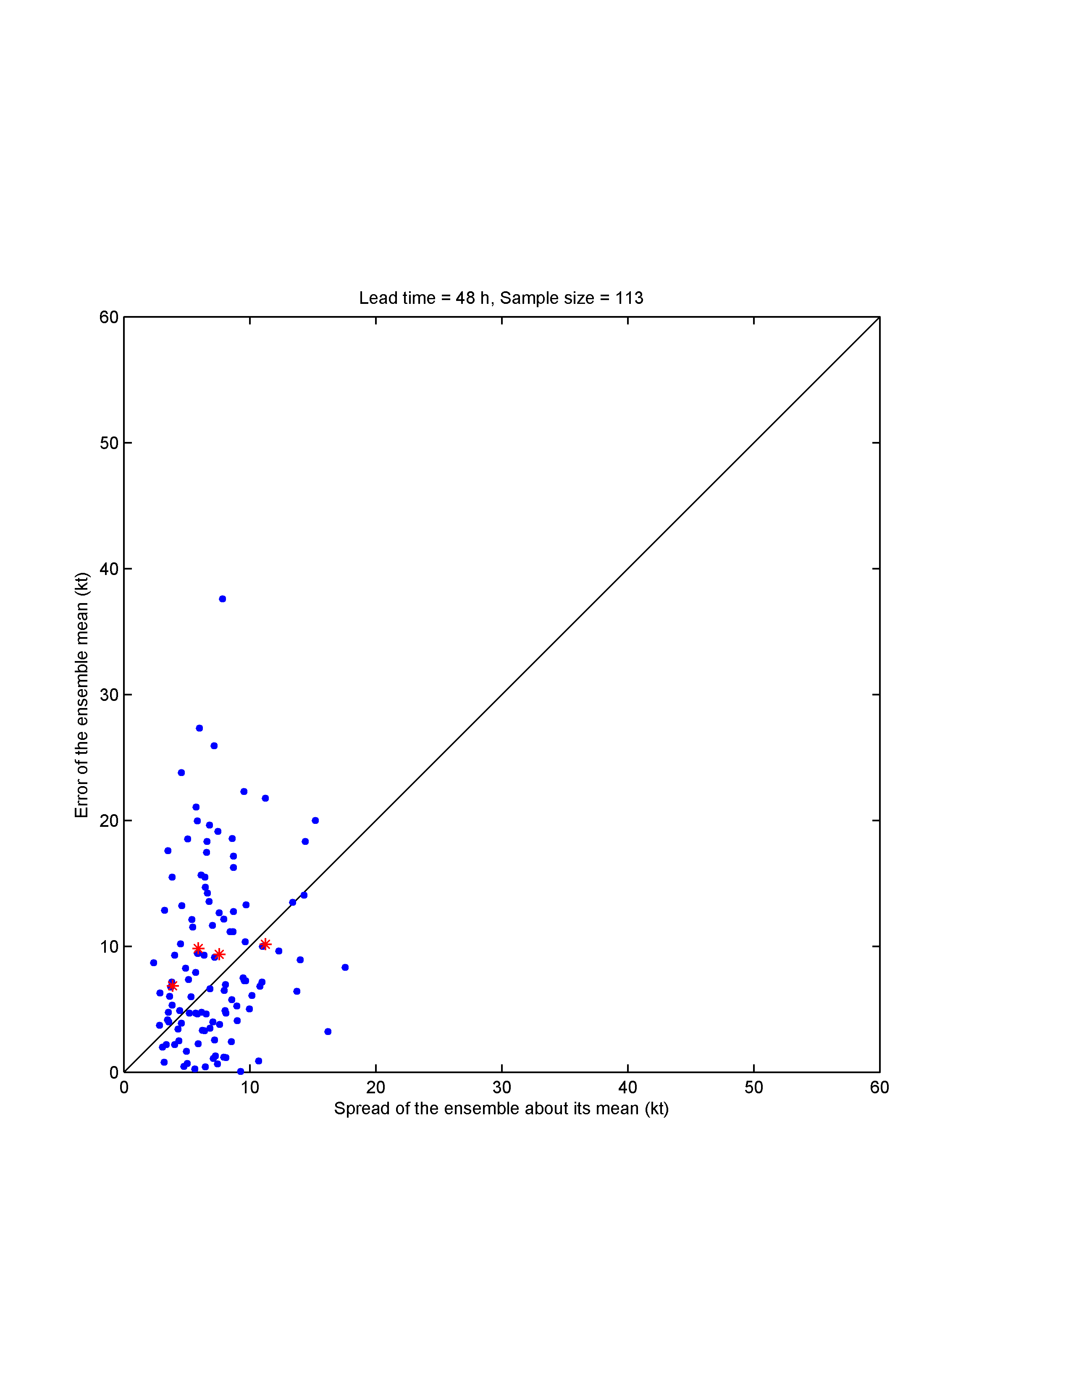
(3)
COAMPS-TC/HWRF/GFDL combined ensemble results
Probabilistic verification: Ensemble spread vs. Ensemble mean error
Tau = 48 h
Track: Retro sample
Intensity: Retro sample
Error of the ensemble mean (nm)
Error of the ensemble mean (kt)
Spread of ensemble about its mean (nm)
Spread of ensemble about its mean (kt)
The blue dots represent individual forecasts and red stars are bin-averages (4 equally populated bins)
Would like to see red stars line up along diagonal and few blue dots in upper left (large error / low spread)

Slide 22
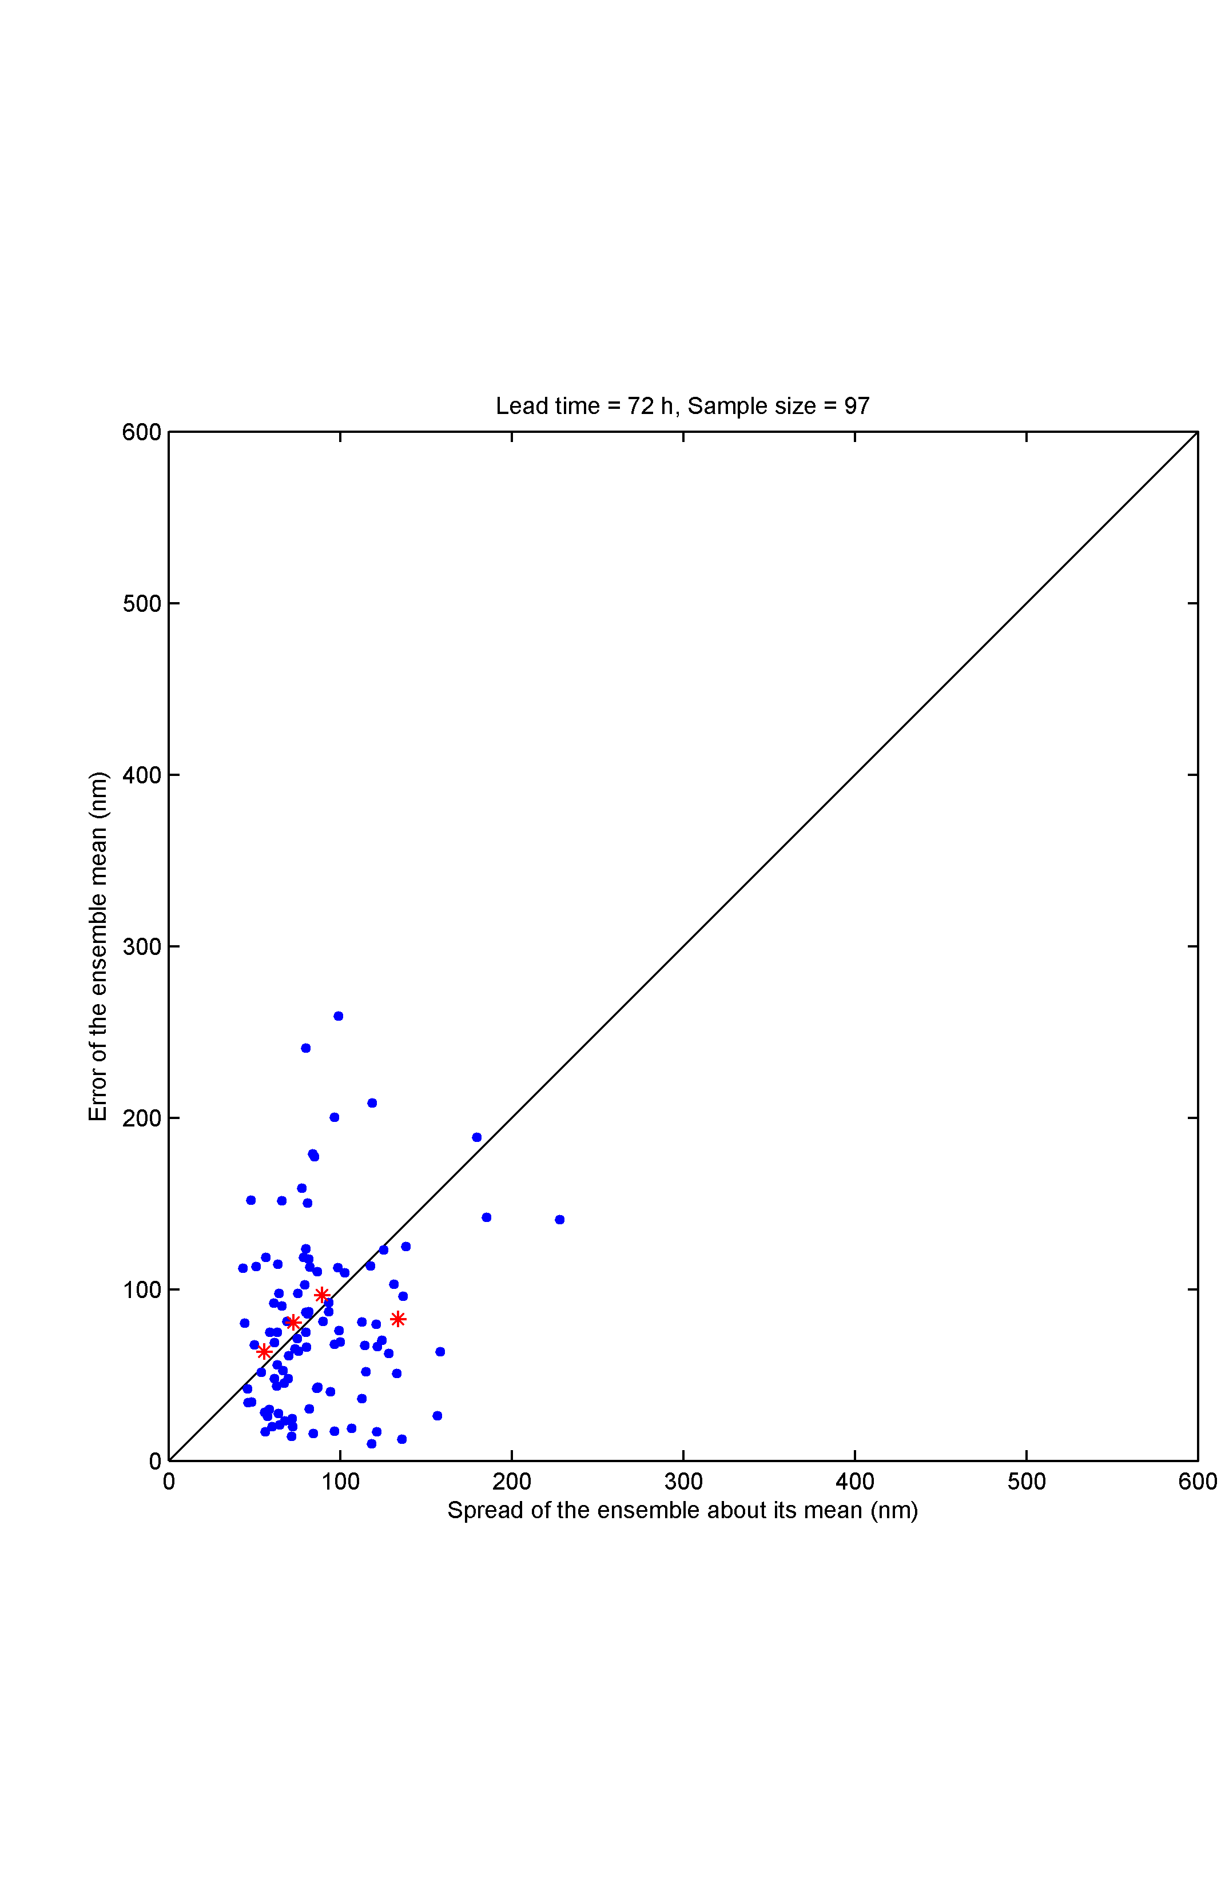

(3)
COAMPS-TC/HWRF/GFDL combined ensemble results
Probabilistic verification: Ensemble spread vs. Ensemble mean error
Tau = 72 h
Track: Retro sample
Intensity: Retro sample
Error of the ensemble mean (nm)
Error of the ensemble mean (kt)
Spread of ensemble about its mean (nm)
Spread of ensemble about its mean (kt)
The blue dots represent individual forecasts and red stars are bin-averages (4 equally populated bins)
Would like to see red stars line up along diagonal and few blue dots in upper left (large error / low spread)

Slide 23
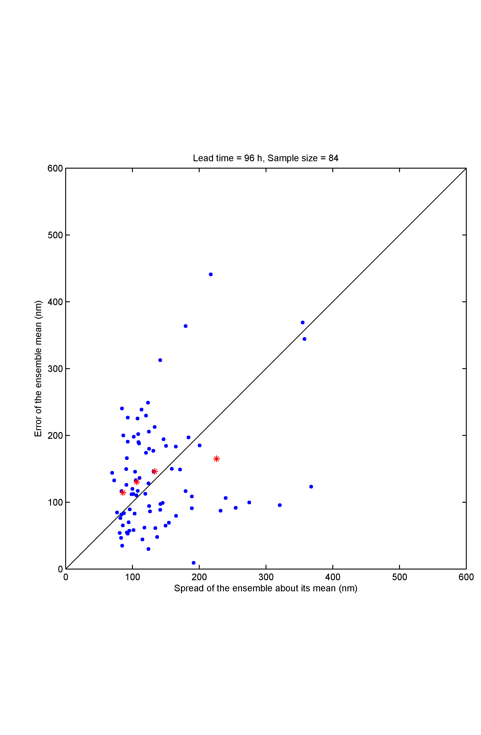
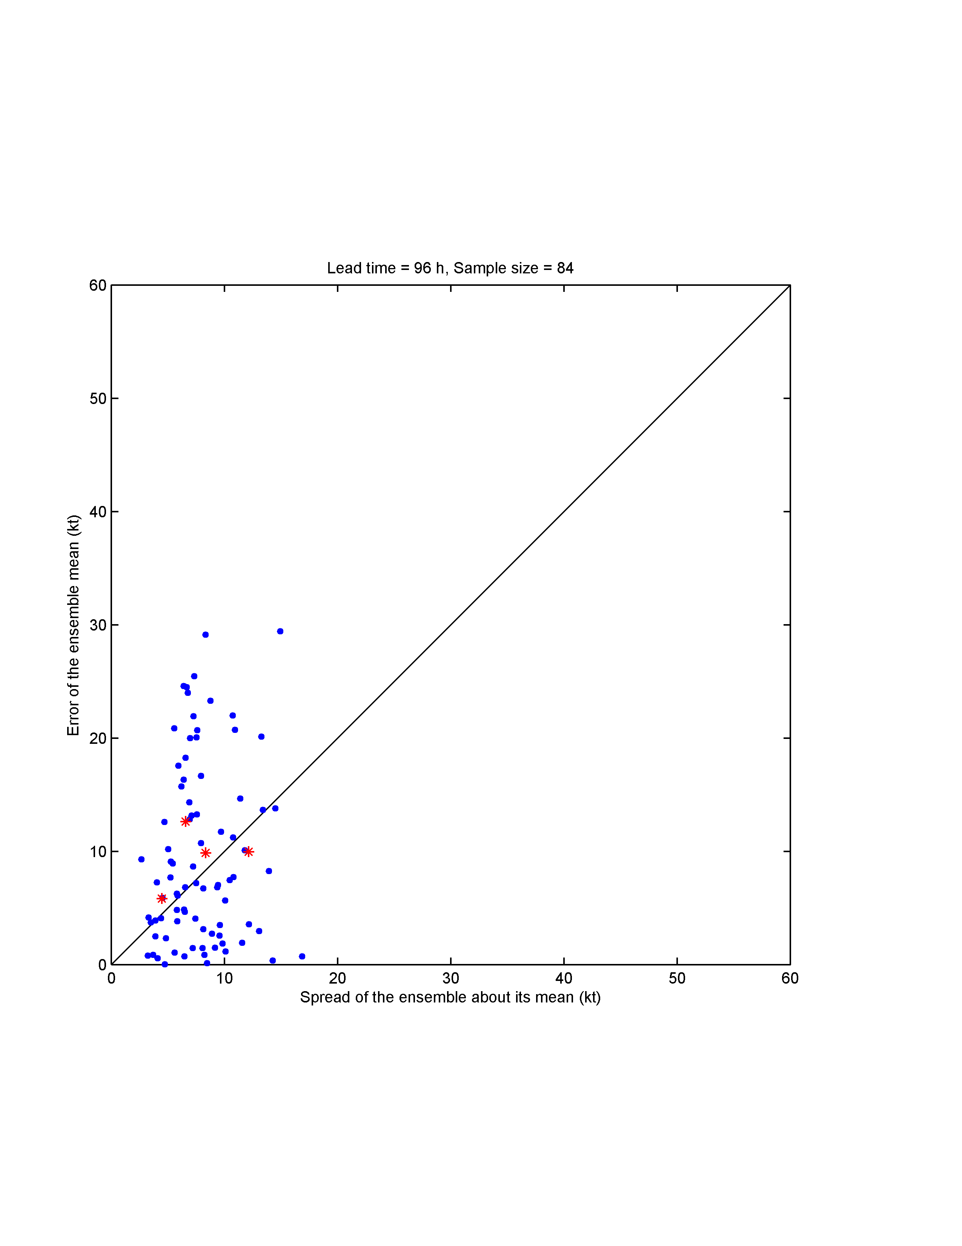
(3)
COAMPS-TC/HWRF/GFDL combined ensemble results
Probabilistic verification: Ensemble spread vs. Ensemble mean error
Tau = 96 h
Track: Retro sample
Intensity: Retro sample
Error of the ensemble mean (nm)
Error of the ensemble mean (kt)
Spread of ensemble about its mean (nm)
Spread of ensemble about its mean (kt)
The blue dots represent individual forecasts and red stars are bin-averages (4 equally populated bins)
Would like to see red stars line up along diagonal and few blue dots in upper left (large error / low spread)

Slide 24
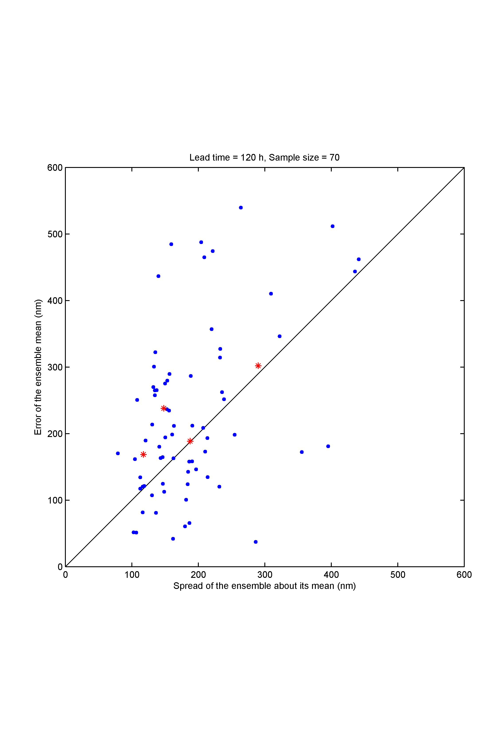
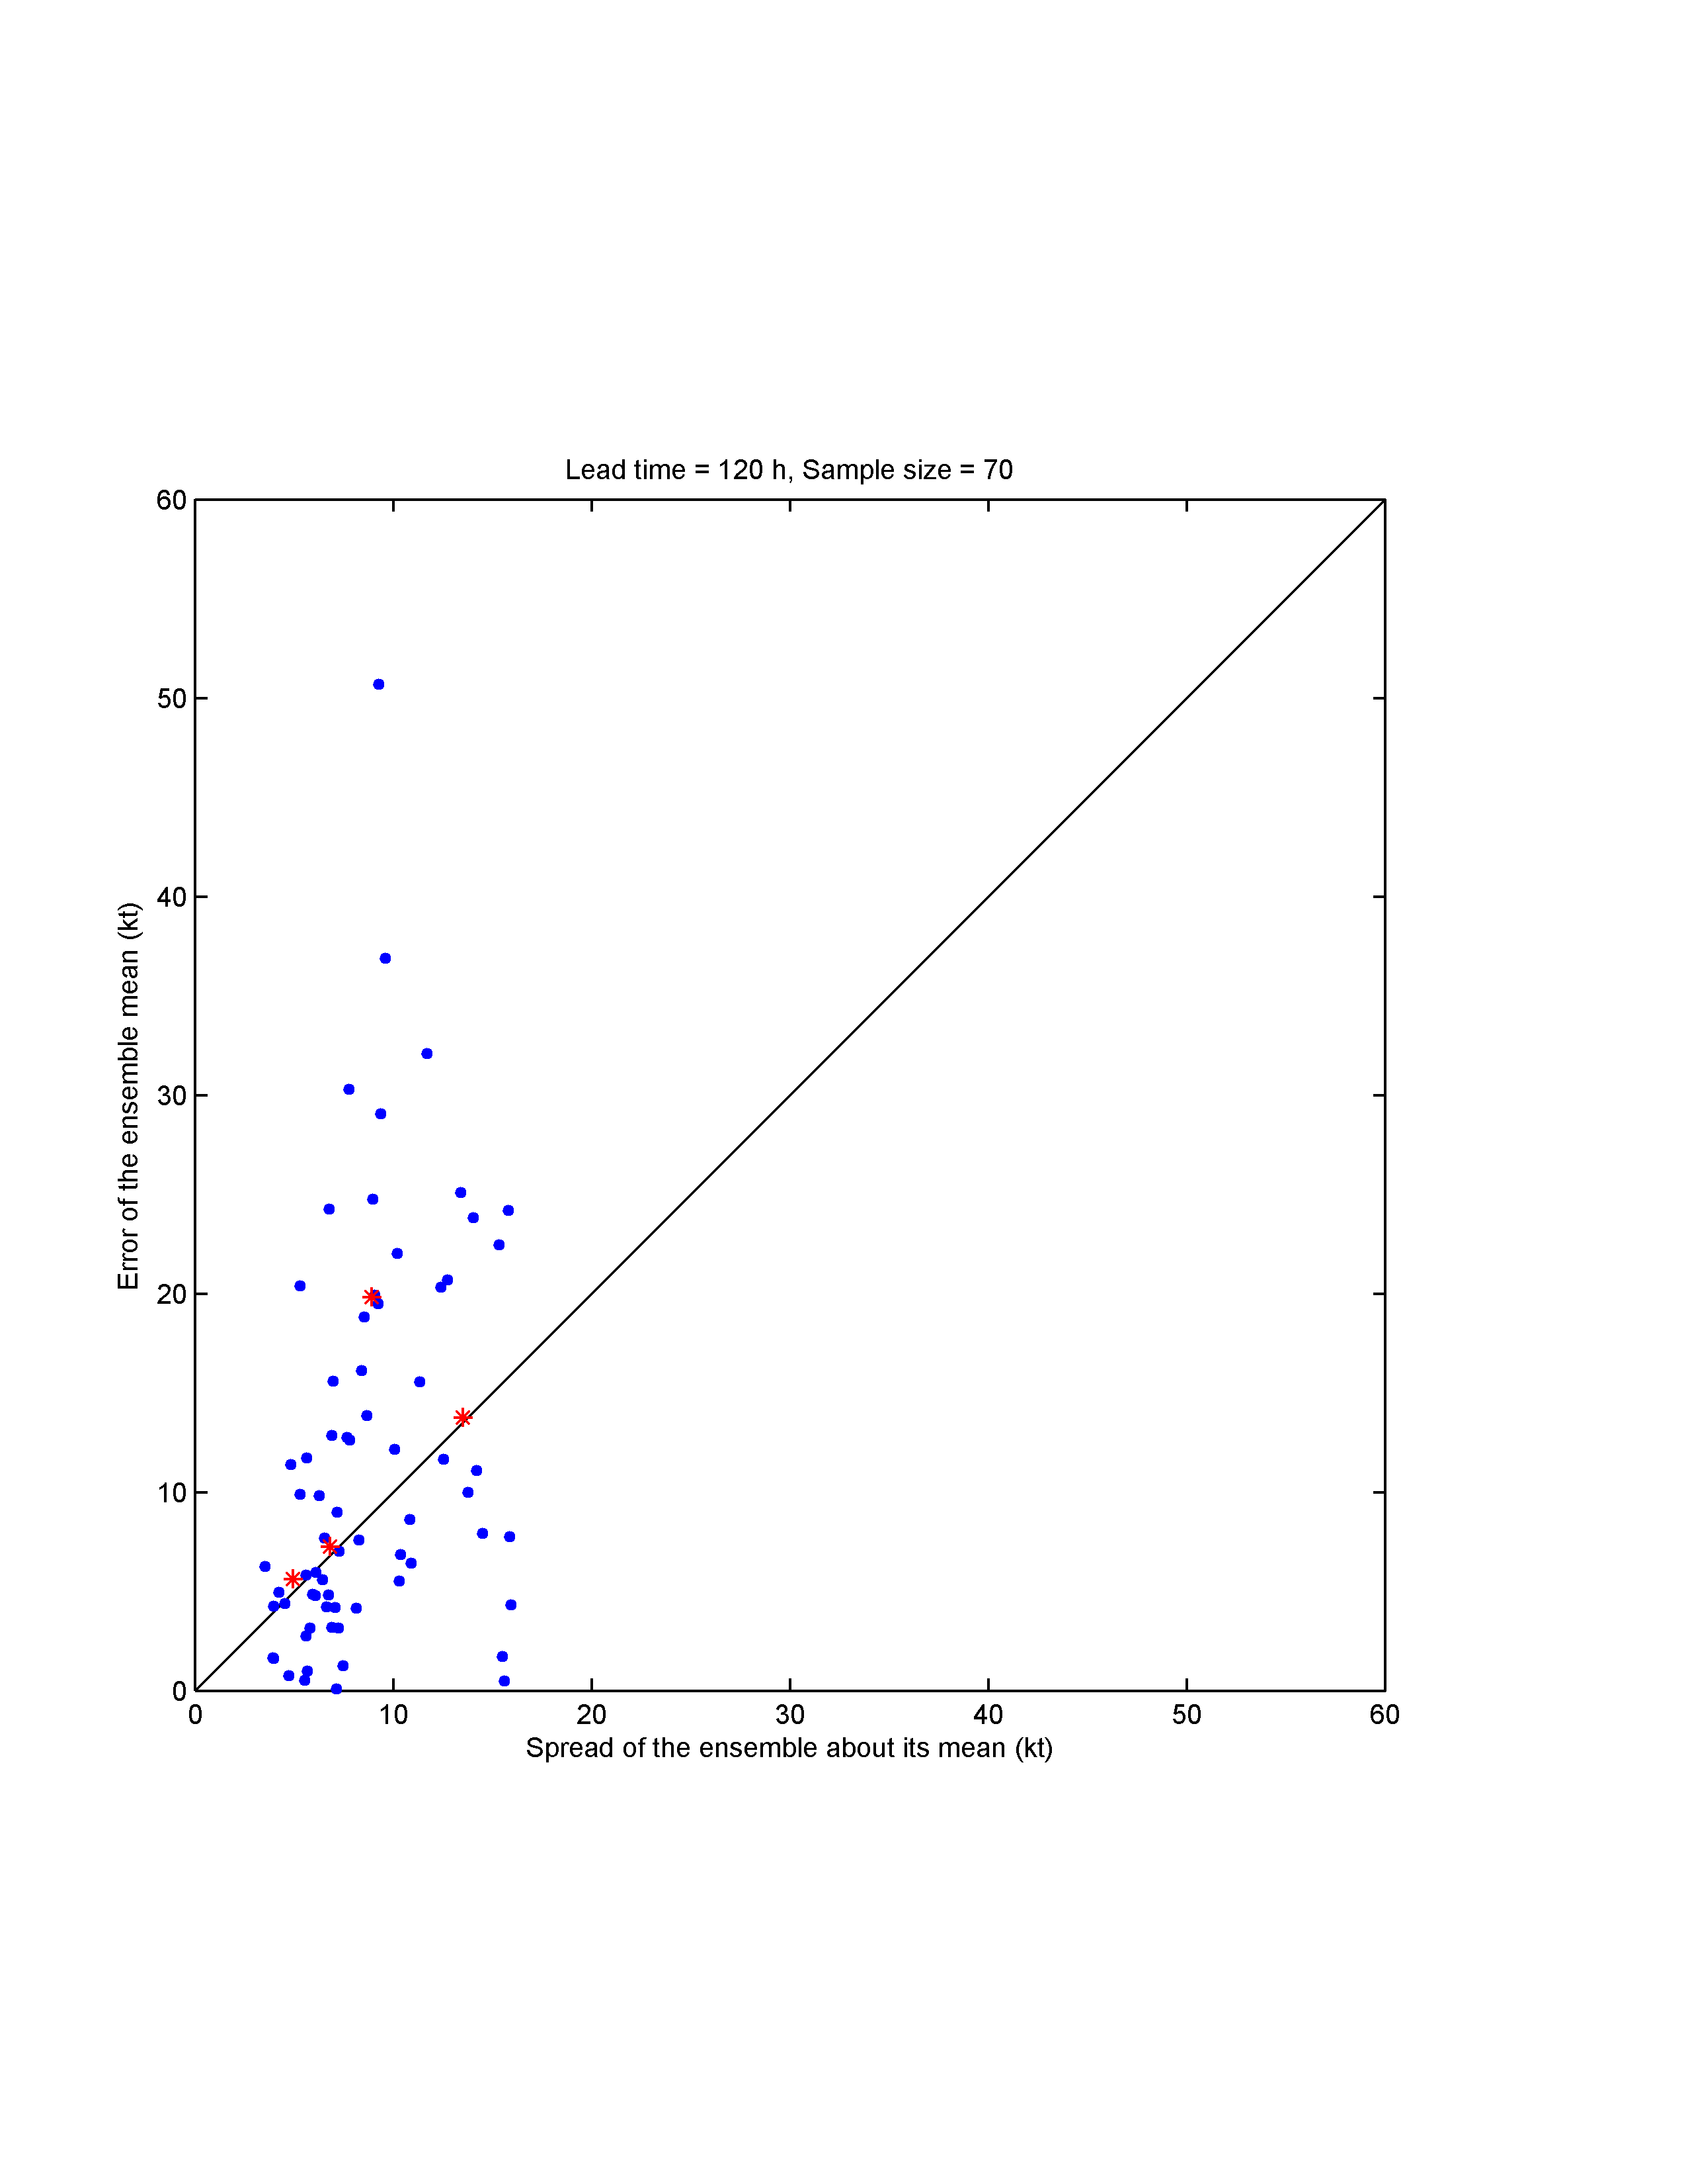
(3)
COAMPS-TC/HWRF/GFDL combined ensemble results
Probabilistic verification: Ensemble spread vs. Ensemble mean error
Tau = 120 h
Track: Retro sample
Intensity: Retro sample
Error of the ensemble mean (nm)
Error of the ensemble mean (kt)
Spread of ensemble about its mean (nm)
Spread of ensemble about its mean (kt)
The bin-averaged results generally show a positive correlation between spread and
ensemble mean error. On average, predictions with relatively large spread have
relatively large ensemble mean error.

Slide 25
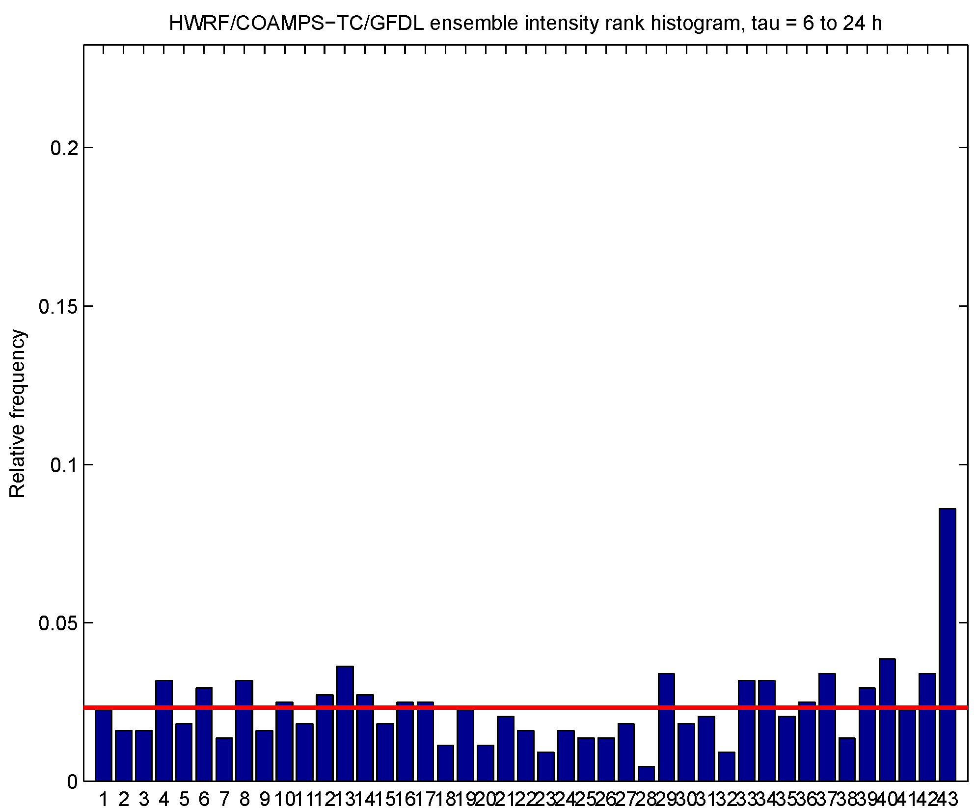
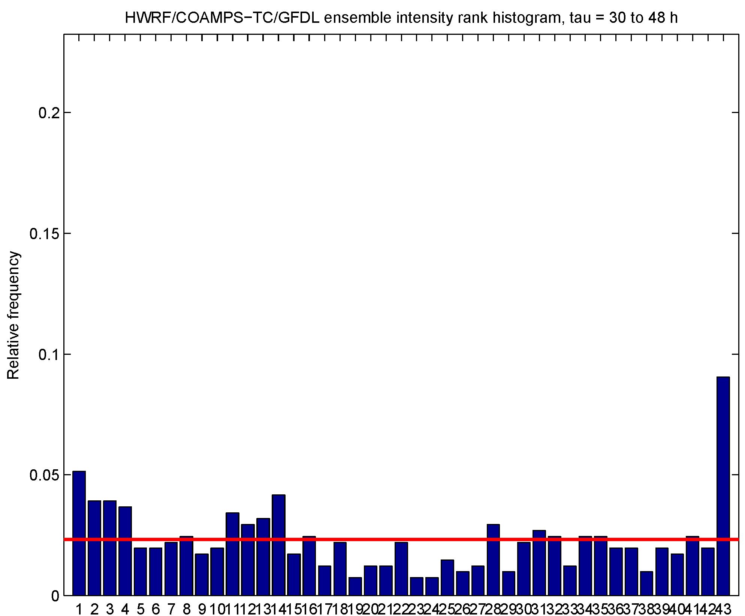
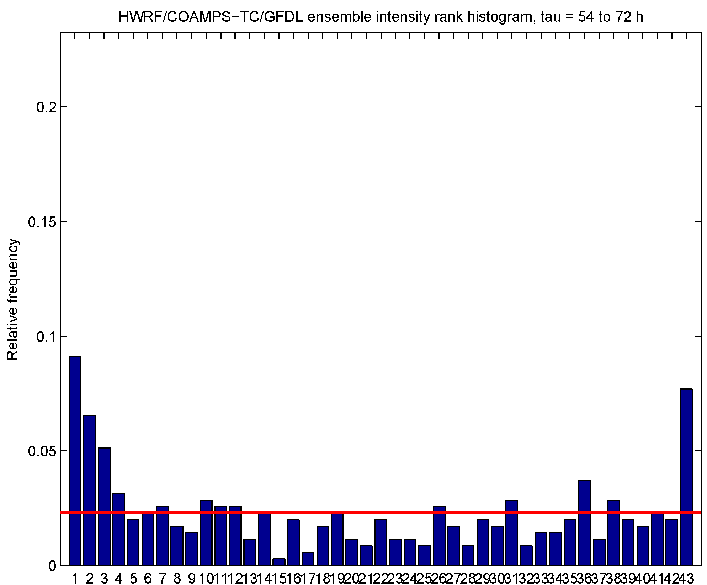
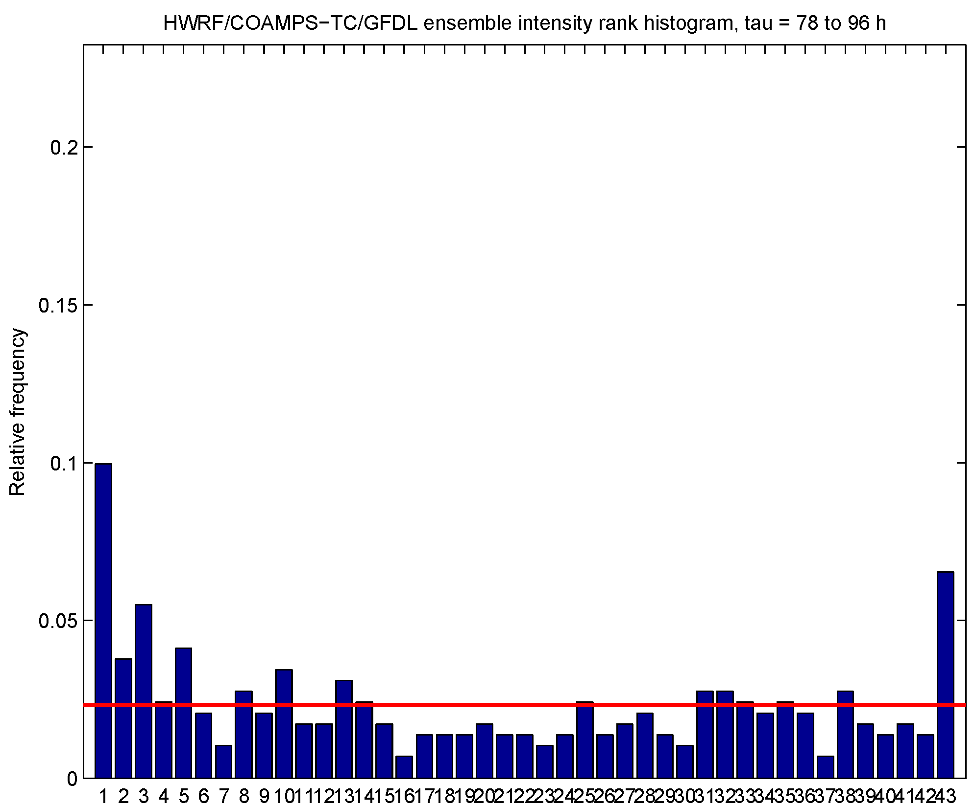
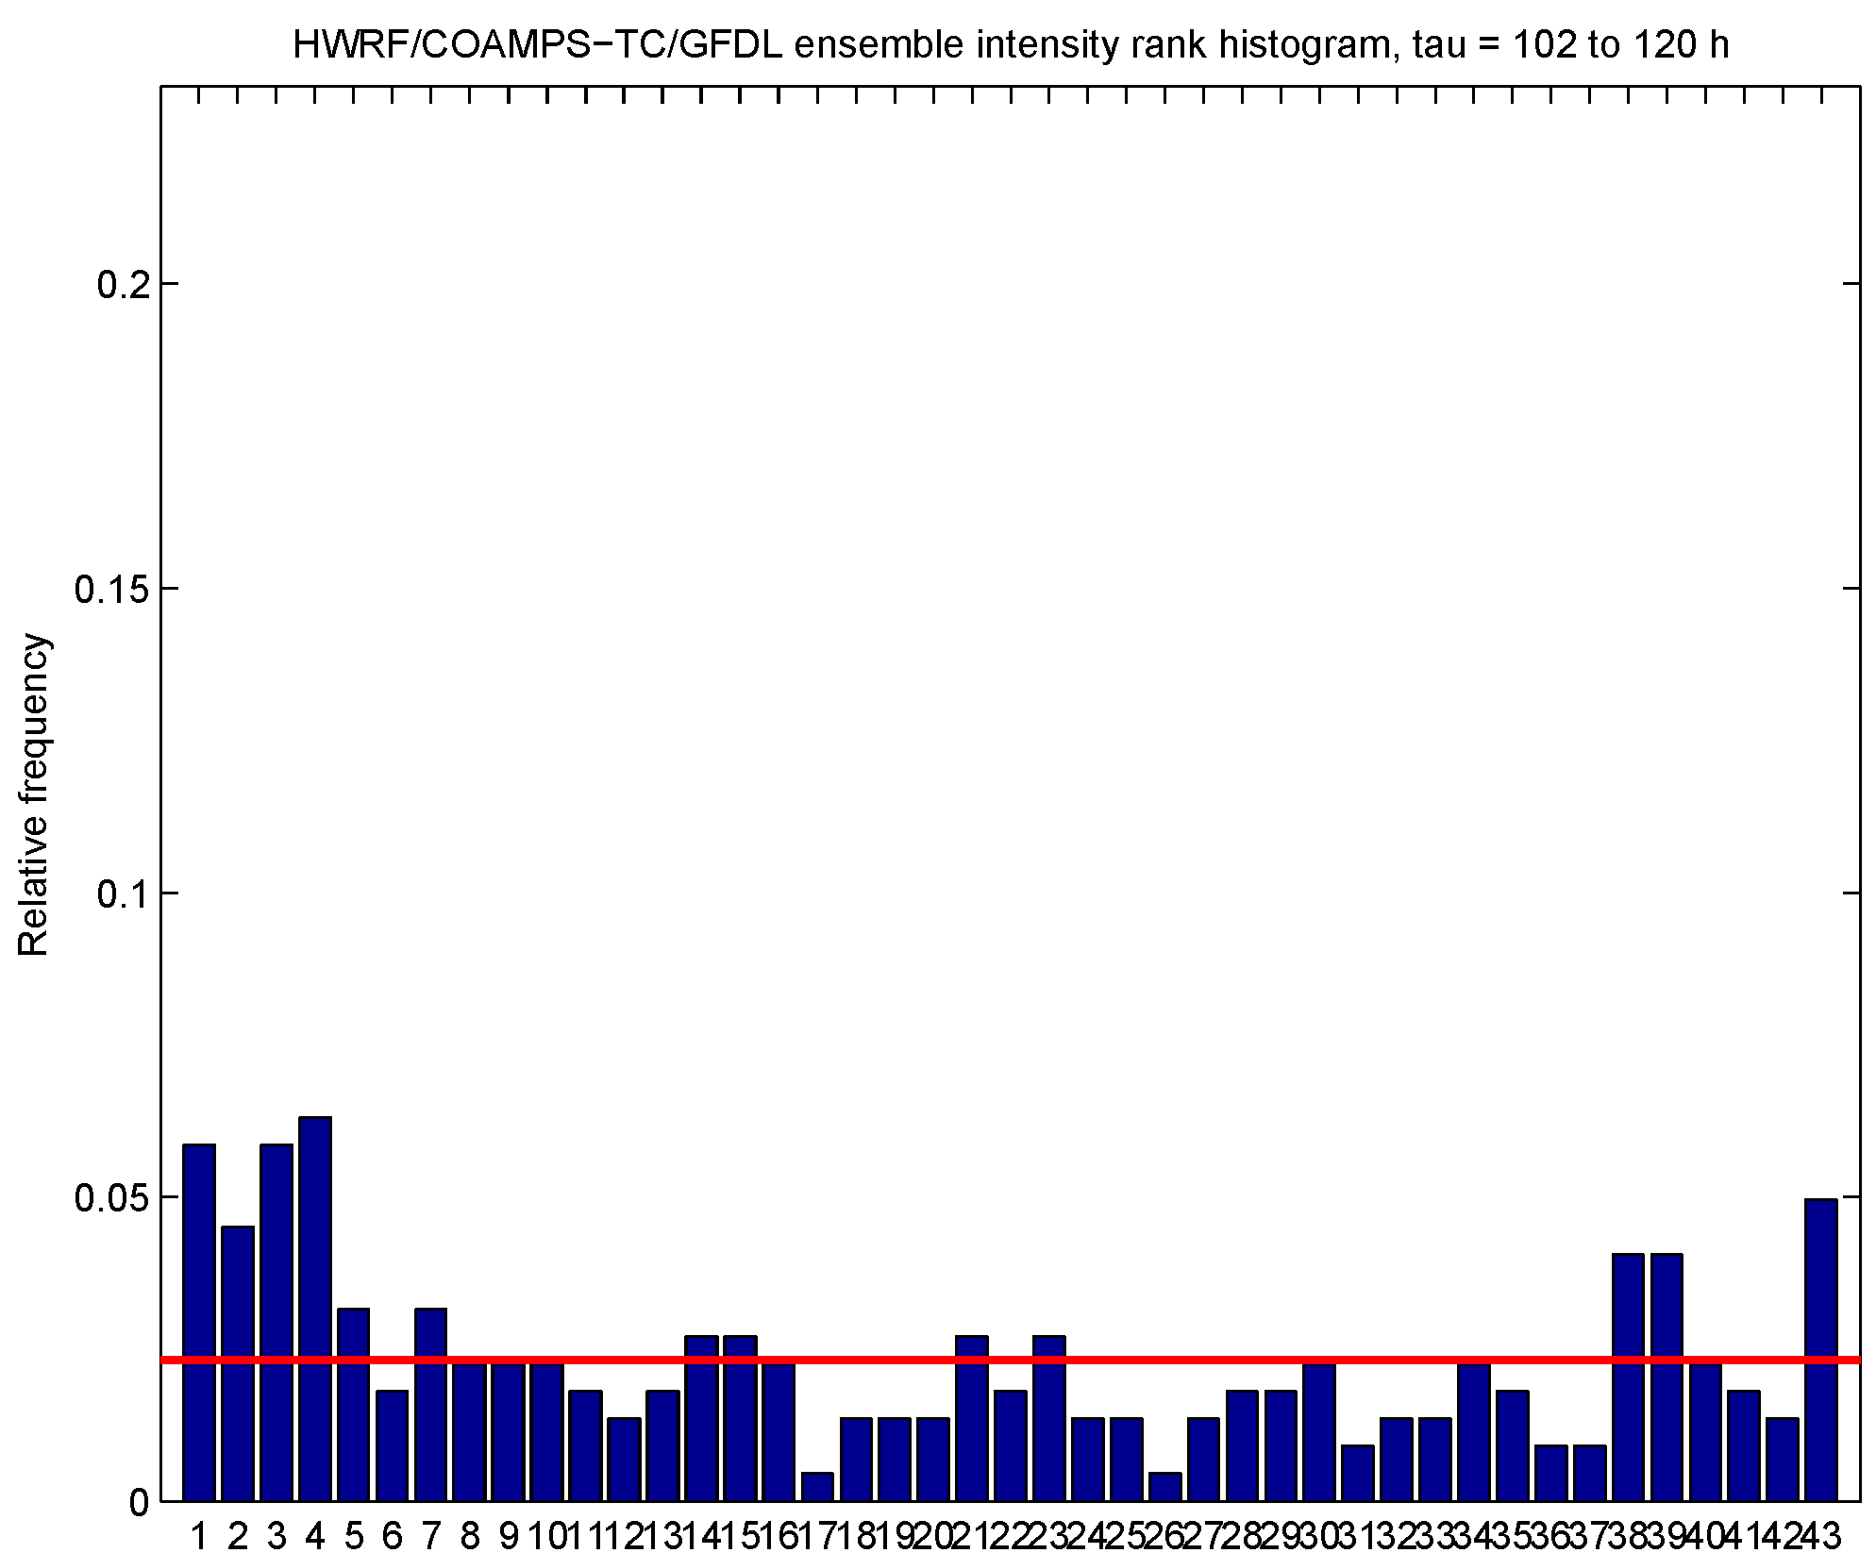
COAMPS-TC/HWRF/GFDL combined ensemble results
Probabilistic verification: Intensity rank histograms
Retro sample
Tau = 6-24 h
Tau = 30-48 h
Tau = 54-72 h
Relative frequency
Relative frequency
Relative frequency
Tau = 78-96 h
Tau = 102-120 h
Would like to see all the blue bars near the red line, indicating equal probability observation falls between any two ranked ensemble member (or falls outside either end of ensemble)
Relative frequency
Relative frequency
The bins on the ends of the histogram tend to be overpopulated. The is due both to bias and to underdispersion of the ensemble.

Slide 26
(3)
Conclusions for combined ensemble
The sample size for the 2014 Atlantic basin real-time demonstration is
quite small, but in concert with the retro sample we have a reasonable
basis for evaluating the performance of the combined ensemble.
From a deterministic prediction perspective, the combined ensemble
mean does not have clearly superior track and intensity accuracy
compared to the 3-model control consensus.
From a probabilistic prediction perspective, the combined ensemble
shows promise in identifying cases with potential for unusually large
or small ensemble mean error. The reliability of ensemble intensity
forecasts is decent, but improvements to model bias and dispersion
of the ensemble are needed to ensure the observed intensity does
not fall outside the ensemble envelope too often.

Slide 27
Future plans
2015 COAMPS-TC real-time ensemble demonstration
Atlantic: 1 control + 10 perturbed members, 3/9/27 km resolution
Eastern Pacific: 1 control + 10 perturbed members, 5/15/45 km resolution
Western Pacific: 1 control + 10 perturbed members, 5/15/45 km resolution
Continue development of COAMPS-TC ensemble
Work on increasing intensity spread (additional moisture perturbations at initial time?)
and reducing intensity bias
New products for website (ensemble mean fields, postage stamp plots, etc.)
to add to existing track and intensity products
New validation metrics for rapid intensification prediction
Continue collaboration with NOAA partners to bring
together the combined multi-model TC ensemble

Slide 28
Extra slides

Slide 29
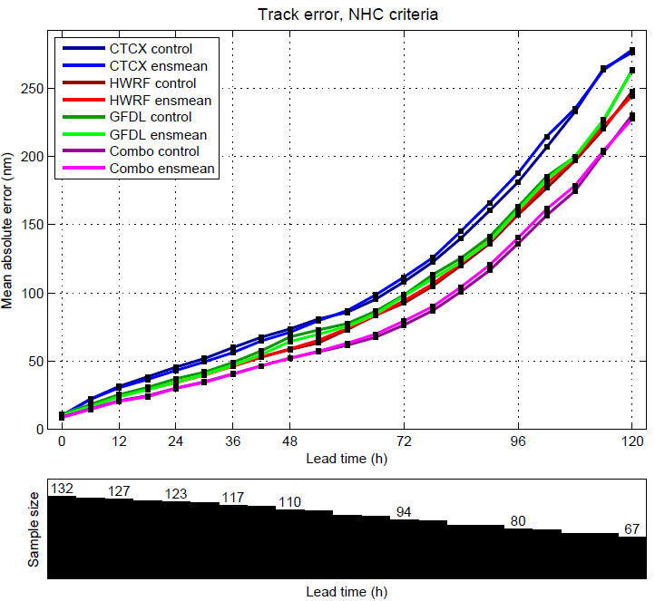
(3)
COAMPS-TC/HWRF/GFDL combined ensemble results
Deterministic verification: Retro track
For individual model, ensemble mean has accuracy similar to control member
Combined ensemble mean has accuracy similar to consensus of three control members
In the much larger retro sample, combo control and ensemble mean outperform component models
Control forecasts:
COAMPS-TC: C00C
HWRF: HW00
GFDL: GP00
Combo : Consensus of
C00C, HW00, and GP00
Sample size
Forecasts run every 12 h
Ensemble mean requirements:
COAMPS-TC: 9 of 11 members
HWRF: 17 of 21 members
GFDL: 8 of 10 members
Combo: 34 of 42 members

Slide 30

(3)
COAMPS-TC/HWRF/GFDL combined ensemble results
Deterministic verification: Retro intensity
Solid: Mean absolute error Dashed: Mean error
For individual model, ensemble mean has improved accuracy relative to the control
Combined ensemble mean has accuracy similar to consensus of three control members
In the much larger retro sample, combo control and ensemble mean outperform component models
Control forecasts:
COAMPS-TC: C00C
HWRF: HW00
GFDL: GP00
Combo : Consensus of
C00C, HW00, and GP00
Ensemble mean requirements:
COAMPS-TC: 9 of 11 members
HWRF: 17 of 21 members
GFDL: 8 of 10 members
Combo: 34 of 42 members
Sample size
Forecasts run every 12 h

Slide 31


(3)
COAMPS-TC/HWRF/GFDL combined ensemble results
Probabilistic verification: Ensemble spread vs. Ensemble mean error
Track: Retro sample
Intensity: Retro sample
Sample size
Forecasts run every 12 h
Sample size
Forecasts run every 12 h

Slide 32


(3)
COAMPS-TC/HWRF/GFDL combined ensemble results
Probabilistic verification: Ensemble spread vs. Ensemble mean error
Tau = 48 h
Track: 2014 real-time sample
Intensity: 2014 real-time sample
Error of the ensemble mean (nm)
Error of the ensemble mean (kt)
Spread of ensemble about its mean (nm)
Spread of ensemble about its mean (kt)
The blue dots represent individual forecasts and red stars are bin-averages (4 equally populated bins)
Would like to see red stars line up along diagonal and few blue dots in upper left (large error / low spread)

Slide 33


(3)
COAMPS-TC/HWRF/GFDL combined ensemble results
Probabilistic verification: Ensemble spread vs. Ensemble mean error
Tau = 72 h
Track: 2014 real-time sample
Intensity: 2014 real-time sample
Error of the ensemble mean (nm)
Error of the ensemble mean (kt)
Spread of ensemble about its mean (nm)
Spread of ensemble about its mean (kt)
The blue dots represent individual forecasts and red stars are bin-averages (4 equally populated bins)
Would like to see red stars line up along diagonal and few blue dots in upper left (large error / low spread)

Slide 34


(3)
COAMPS-TC/HWRF/GFDL combined ensemble results
Probabilistic verification: Ensemble spread vs. Ensemble mean error
Tau = 96 h
Track: 2014 real-time sample
Intensity: 2014 real-time sample
Error of the ensemble mean (nm)
Error of the ensemble mean (kt)
Spread of ensemble about its mean (nm)
Spread of ensemble about its mean (kt)
The blue dots represent individual forecasts and red stars are bin-averages (4 equally populated bins)
Would like to see red stars line up along diagonal and few blue dots in upper left (large error / low spread)

Slide 35


(3)
COAMPS-TC/HWRF/GFDL combined ensemble results
Probabilistic verification: Ensemble spread vs. Ensemble mean error
Tau = 120 h
Track: 2014 real-time sample
Intensity: 2014 real-time sample
Error of the ensemble mean (nm)
Error of the ensemble mean (kt)
Spread of ensemble about its mean (nm)
Spread of ensemble about its mean (kt)

Slide 36





COAMPS-TC/HWRF/GFDL combined ensemble results
Probabilistic verification: Intensity rank histograms
2014 real-time sample sample
Tau = 6-24 h
Tau = 30-48 h
Tau = 54-72 h
Relative frequency
Relative frequency
Relative frequency
Tau = 78-96 h
Tau = 102-120 h
Would like to see all the blue bars near the red line, indicating equal probability observation falls between any two ranked ensemble member (or falls outside either end of ensemble)
Relative frequency
Relative frequency

