Slide 1
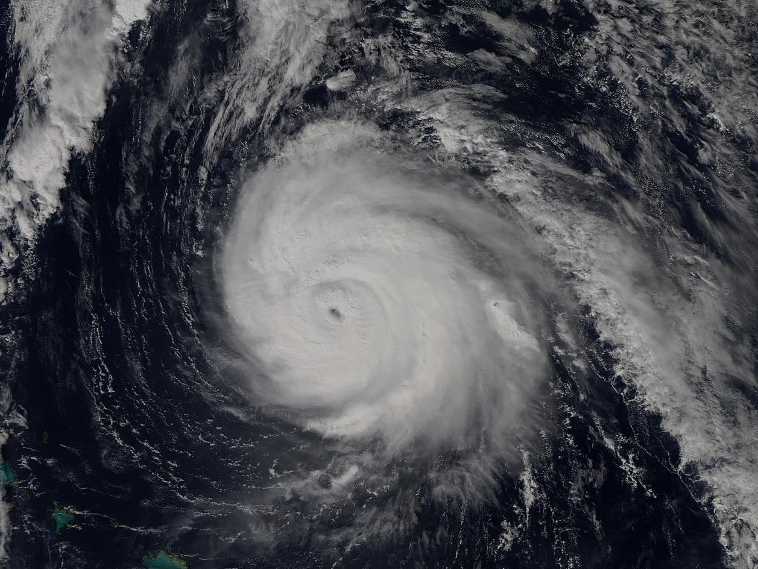


Recent COAMPS-TC Development and Future Plans
James D. Doyle, R. Hodur¹, J. Moskaitis, S. Chen, P. Black, E. Hendricks, H. Jin, Y. Jin, A. Reinecke, J. Schmidt, S. Wang
Naval Research Laboratory, Monterey, CA
¹IES/SAIC, Monterey, CA
Sponsor: Office of Naval Research
Hurricane Gonzalo 1745 UTC October 16, 2014. (NASA MODIS)

Slide 2
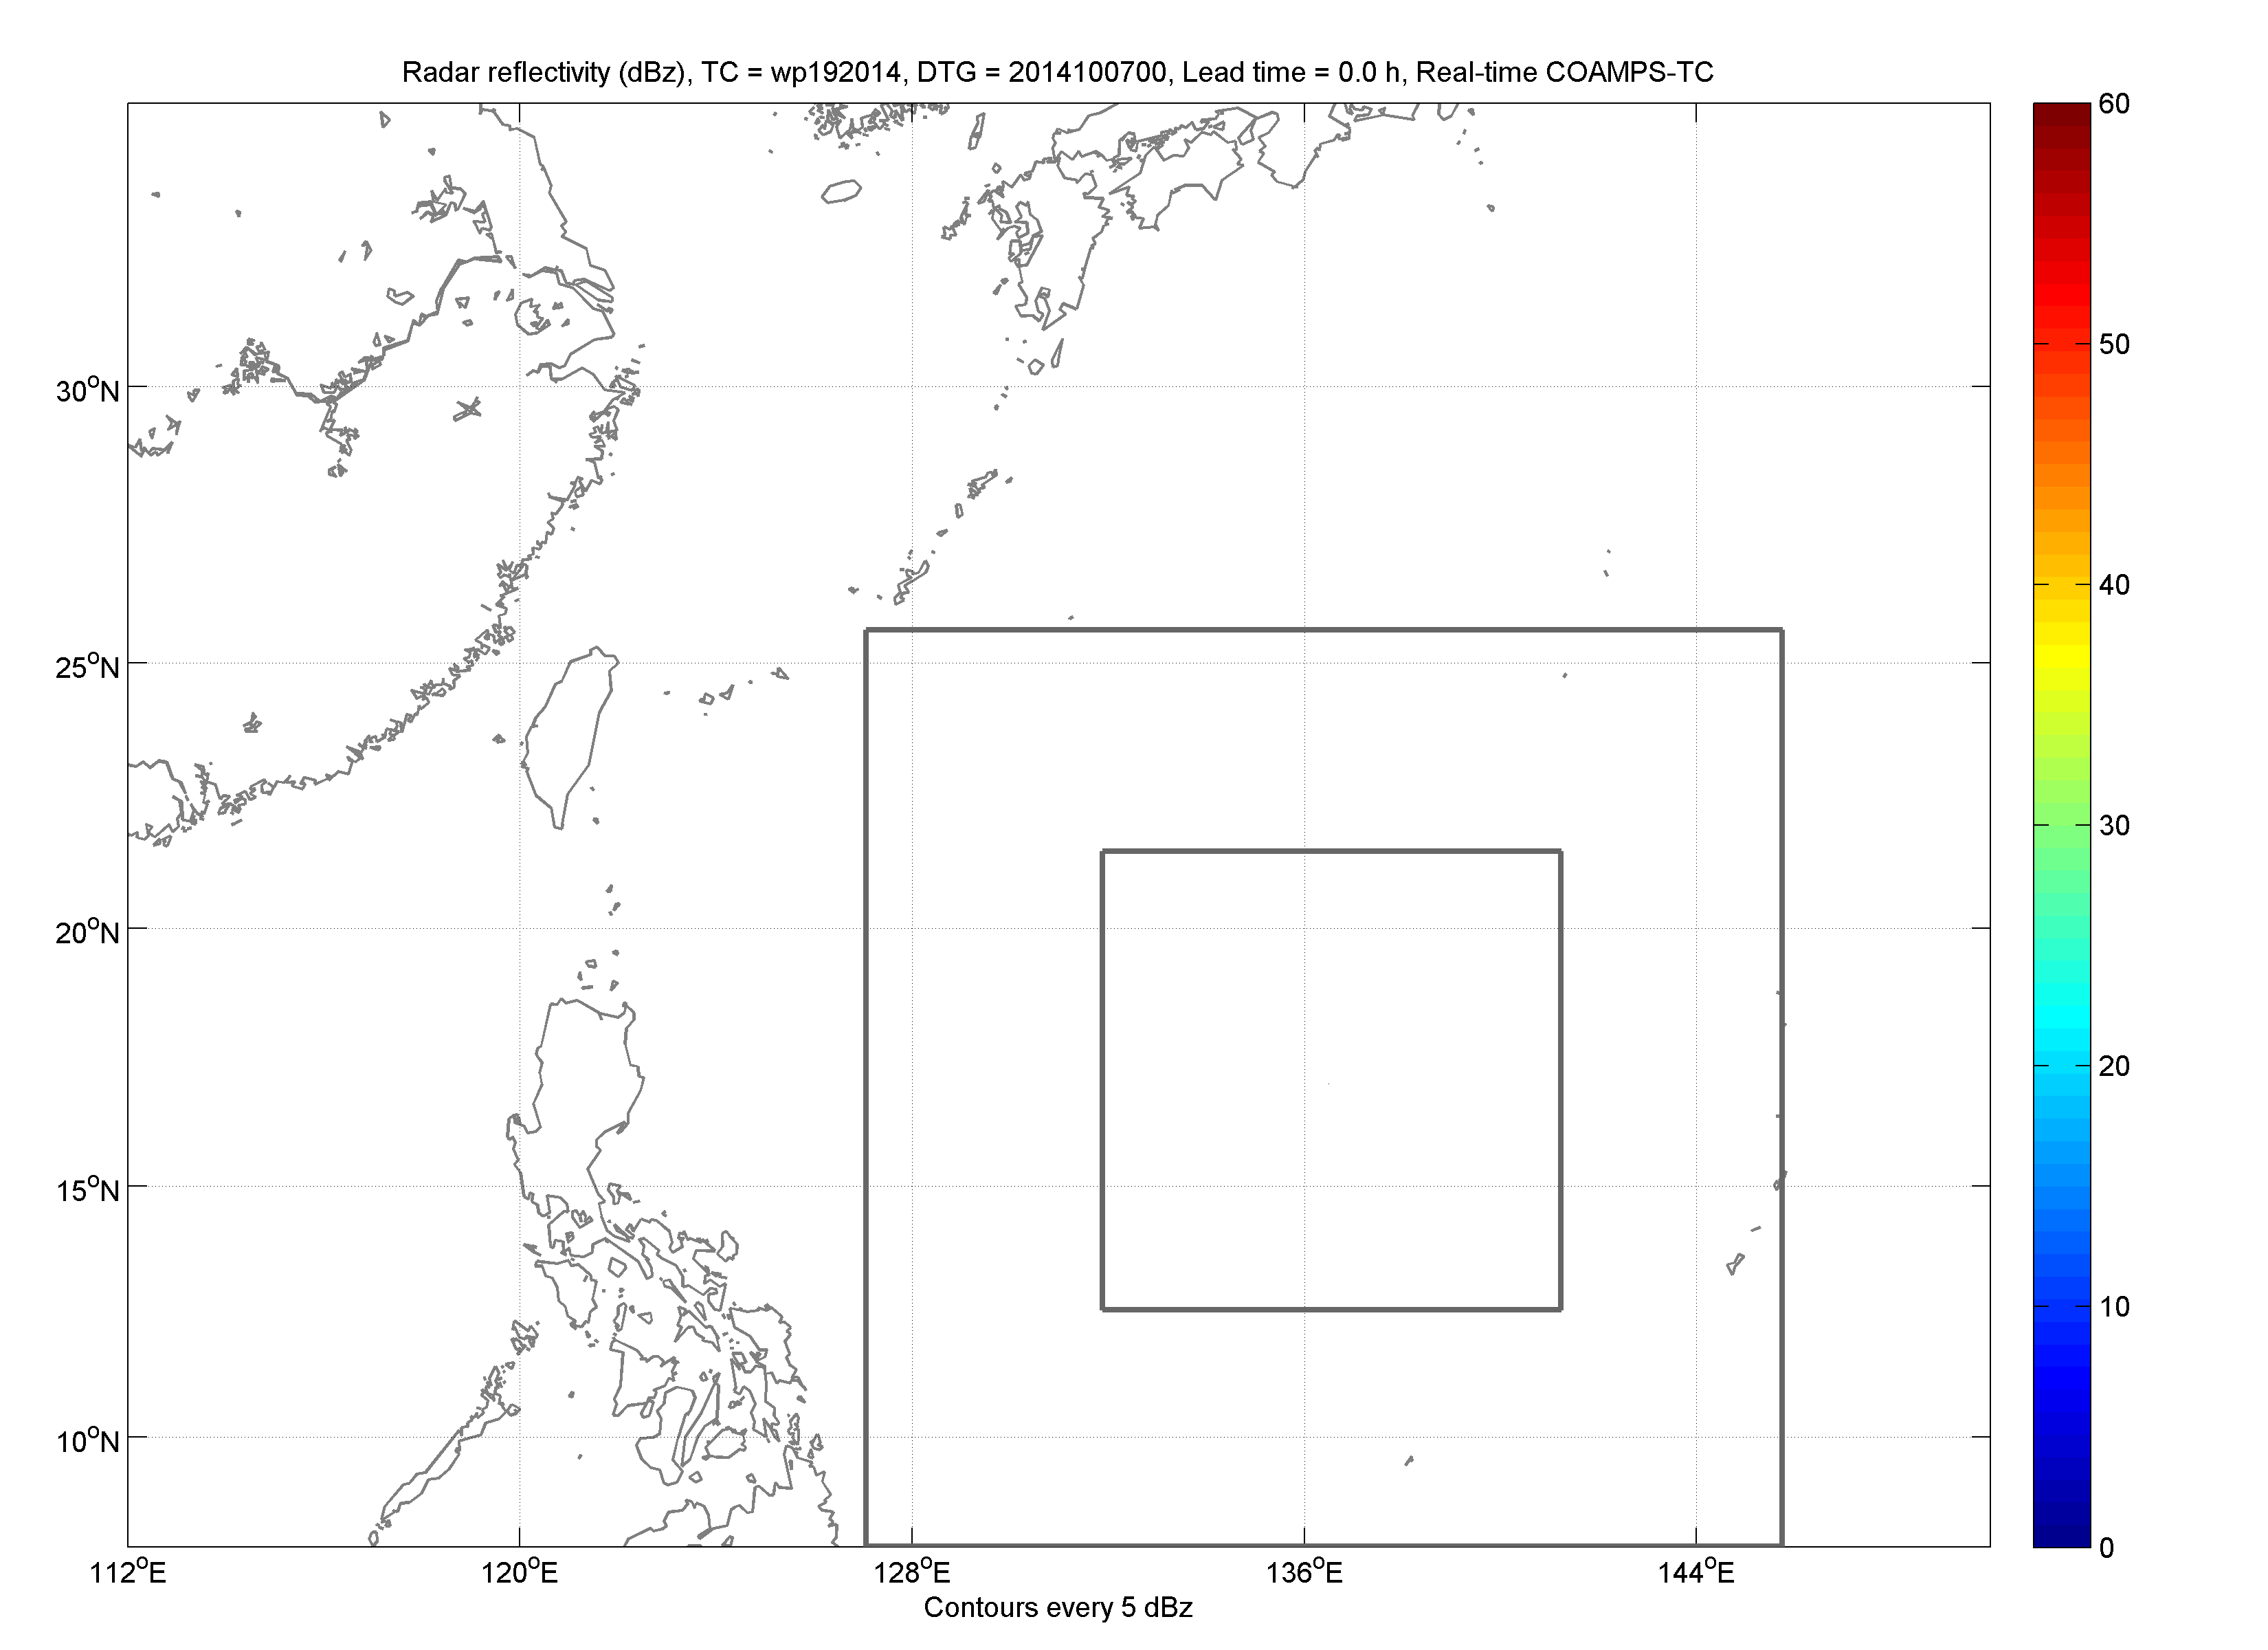
COAMPS-TC System Overview
Analysis: 3D-Var (NAVDAS), 4D-Var, EnKF DART, synthetic observations
Atmosphere: Nonhydrostatic, moving nests, TC physics
Ocean: 3D-Var (NCODA), ocean (NCOM), wave (SWAN, Wave Watch III)
Ensemble: COAMPS-TC EnKF DART, Ensemble Transform
Real-Time: Navy & NOAA HFIP prototyping activities
Ops; Testing: 45-15-5 km, GFS/NAVGEM BCs, cycling DA, uncoupled/coupled
Vongfong (2014) Simulated Radar Reflectivity

Slide 3
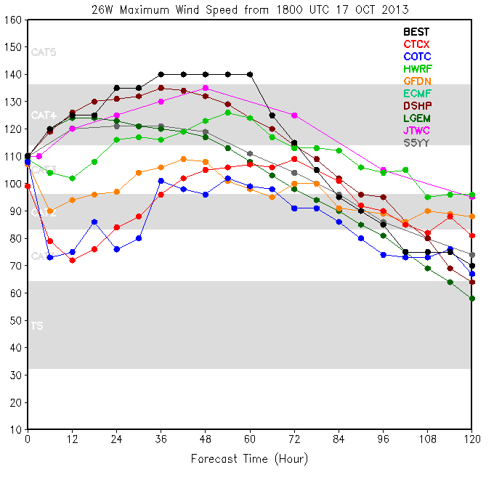
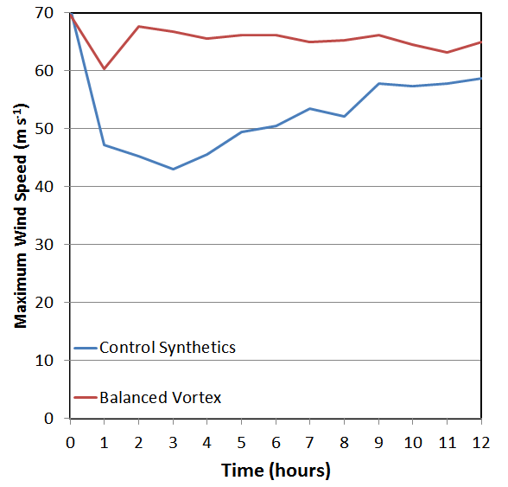
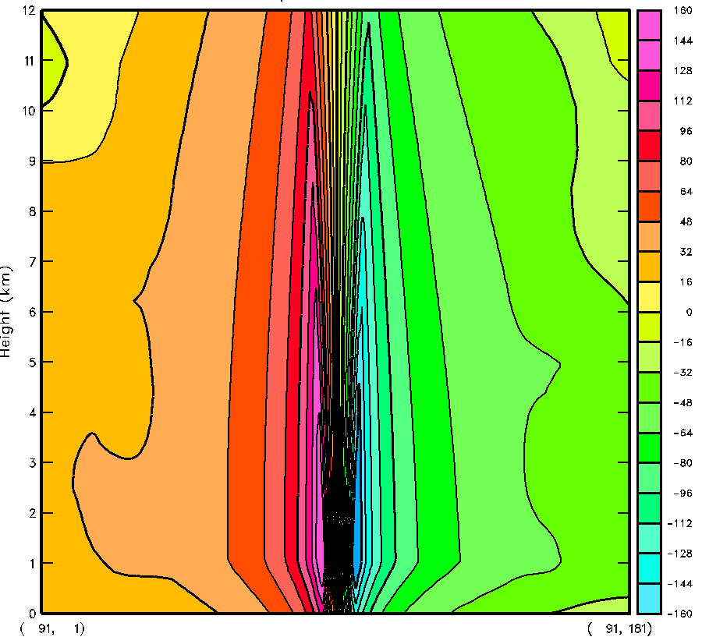
COAMPS-TC System Overview
Improved Vortex Initialization
Issue
Vortex initialization often suffers from a “spin-down” or “spin-up” of intensity in first 12-h of forecast.
Solutions
Introduce a 3D balanced vortex in COAMPS-TC
Dynamical Initialization (TCDI)
26W Max. Wind Speed
Key Findings
V_{max}, RMW, R₃₄,depth estimates needed for vortex
Non-linear balance eqn. used with BL theory.
Sloping eyewall & sheared flow can be included.
Method alleviates the spin-down of intensity.
V-component for 26W
Balanced
Example
East-west vertical cross-sections of v-wind (left) and time series of V_{max} for ST Francisco (26W/2013)
Control
V_{max} for 26W

Slide 4
COAMPS-TC 2014 Version
Comparison of 2013 and 2014 Versions
The ‘Control’ run is the 2013 version of COAMPS-TC.
The ‘New’ run uses the COAMPS-TC 2014 version
Both runs use operational NAVGEM for ICs and BCs
Sample details:
33 storms (01W-33W)
Long forecasts every 6 h
Largest components of sample
in terms of 120 h forecasts:
18: Francisco (26W)
17: Utor (11W)
11: Haiyan (31W)
9: Nari (24W)
8: Fitow (22W)
8: Soulik (07W)
7: Usagi (17W)
6: 30W
4: Wipha (25W)
4: Yagi (03W)
4: Sonamu (01W)
3: Pabuk (19W)
3: Trami (12W)
2: Lekima (28W)
2: Krosa (29W)
Control (2013)
New (2014)
Synoptic scale
initialization
Cycling NAVDAS
data assimilation
Global model analysis
(NAVGEM / GFS)
Vortex
initialization
Cycling NAVDAS
data assimilation,
TC synthetic obs
Direct insertion
of new balanced
vortex
Blend zone at
edge of grid 1
7 grid points
14 grid points,
New blending fnct.
Terrain
specification
New is smoother and slightly higher than
Control terrain with new silhouette parameters
Synoptic scale initialization, blend zone, new terrain improve track forecasts.
The change to the vortex initialization improves intensity prediction, particularly at the short lead times, and mitigate the “spin-down” problem.

Slide 5
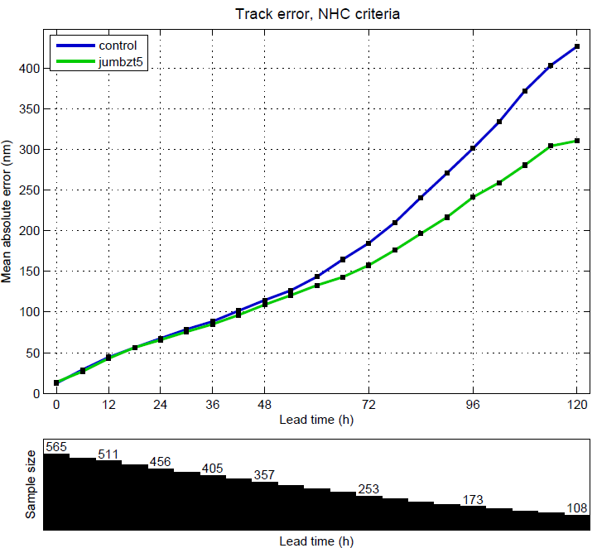
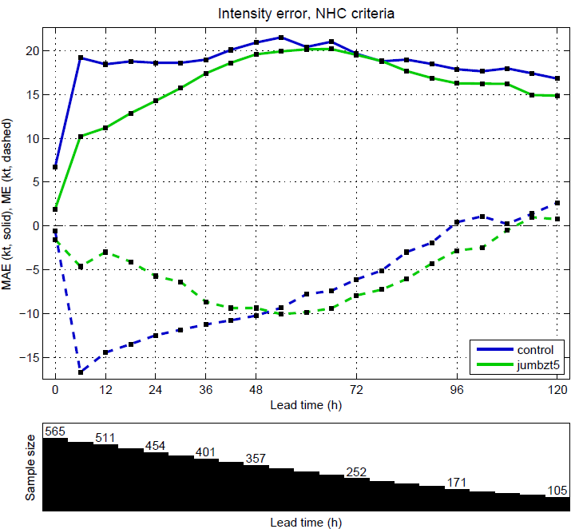
COAMPS-TC Summary Statistics
Comparison of 2013 and 2014 COAMPS-TC
Control: 2013 version
New: 2014 version
Control
Control
(2013)
New
(2014)
New
(2014)
Results of a large sample of WestPac retrospective tests (from 2013) using NAVGEM lateral boundary conditions demonstrate that the New (2014 Version) provides considerably improved track and intensity forecast performance relative to the 2013 version (Control).
The New model configuration was run by FNMOC and NRL for the 2014 season.

Slide 6
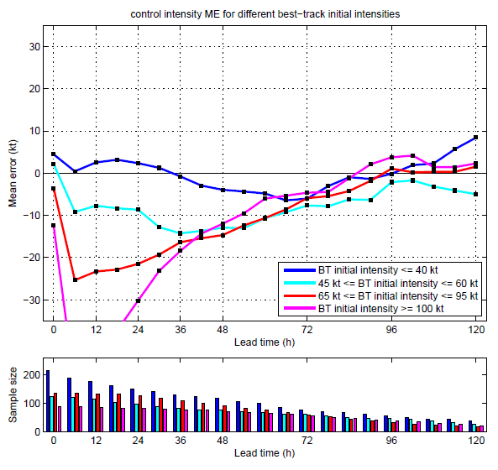
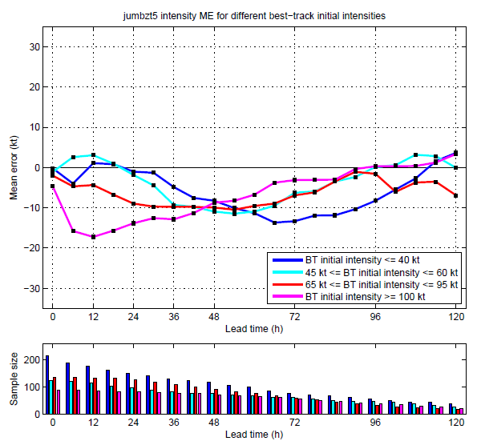
COAMPS-TC Summary Statistics
Improved Intensity Forecasts in 2014
Control intensity ME (2013)
New intensity ME (2014)
Intensity mean error, separated into 4 categories according to the best-track intensity of the TC at the forecast initial time.
Negative bias associated with the spin down gets worse as initial intensity increases. Biases at early lead times are greatly improved in New.
Spin-down remains for the most intense storms (pink category), but this is thought to be related to model physics rather than initialization.

Slide 7
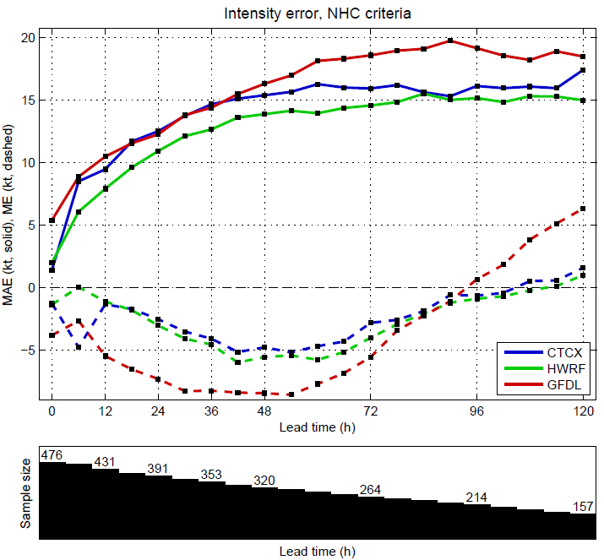
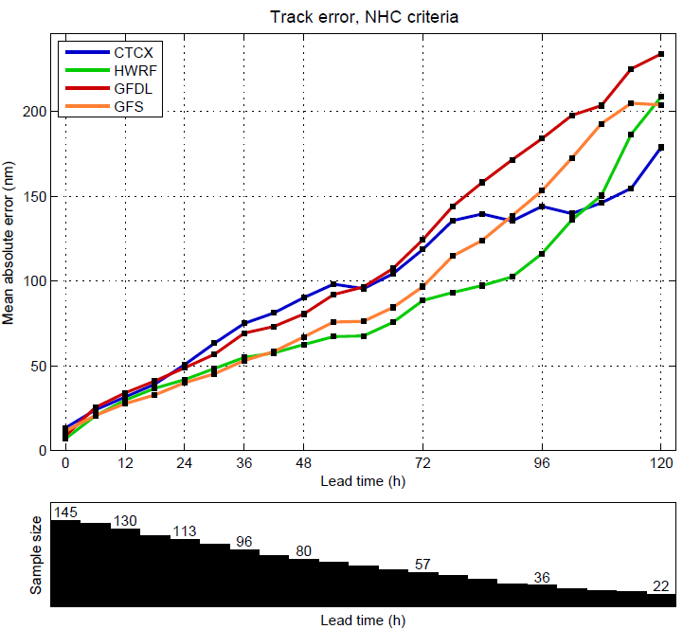
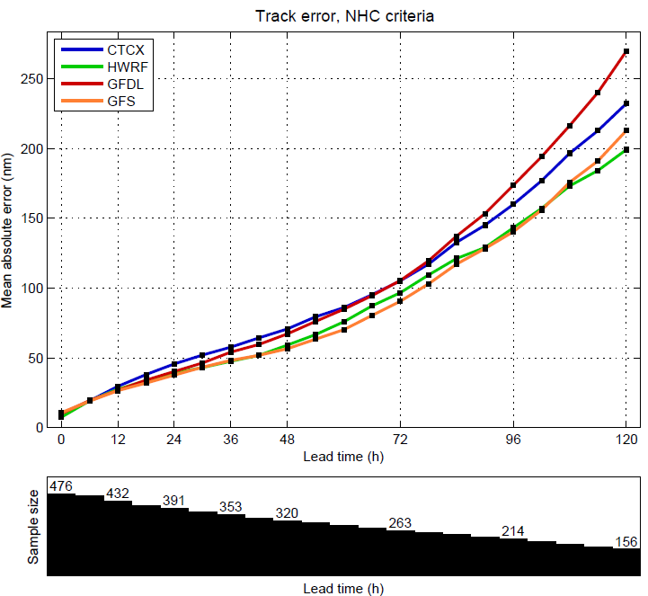
W. Atlantic, E. Pacific, C. Pacific
2014 (01L-09L, 02E-21E, 02C)
West Atlantic Track Error (nm)
East & Cent. Pacific Intensity Error (kt)
East & Cent. Pacific Track Error (nm)
COAMPS-TC track and intensity error much improved over 2013 and very competitive with other models.
COAMPS-TC along and cross track bias is much improved in 2014.
Spin-down in COAMPS-TC is now much less of an issue.
CTCX
HWRF
GFDL
GFS

Slide 8
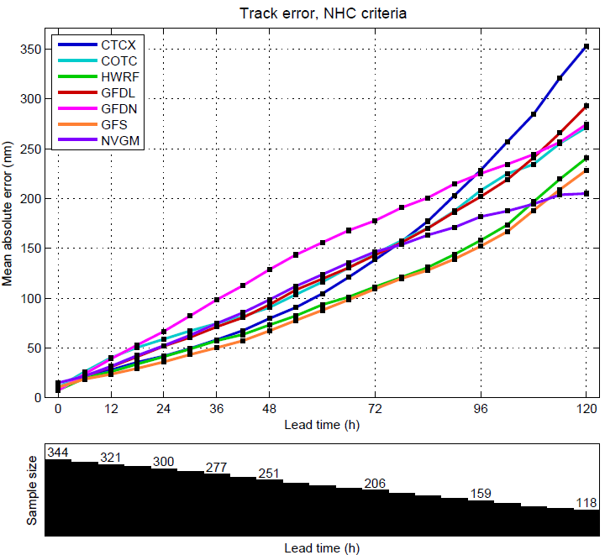
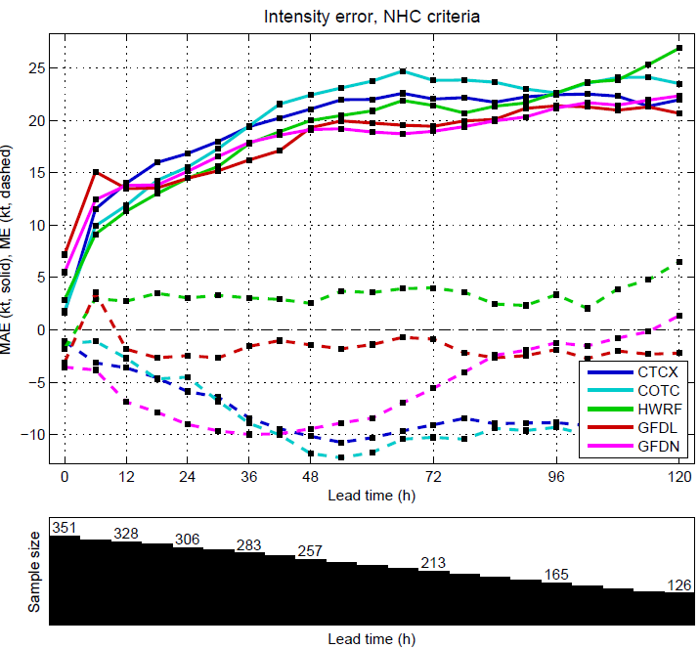
Western Pacific Basin
2014 (08W–22W)
Track error (nm)
Intensity error (kt)
CTCX (GFS)
COTC (NAVGEM)
HWRF
GFDL
GFDN
COAMPS-TC track & intensity error competitive with other models in WPAC.
CTCX (driven by GFS) has worse track error than COTC (driven by NAVGEM)
Much improved spin-down bias in first 36 h for both COTC and CTCX.
GFS
NAVGEM

Slide 9
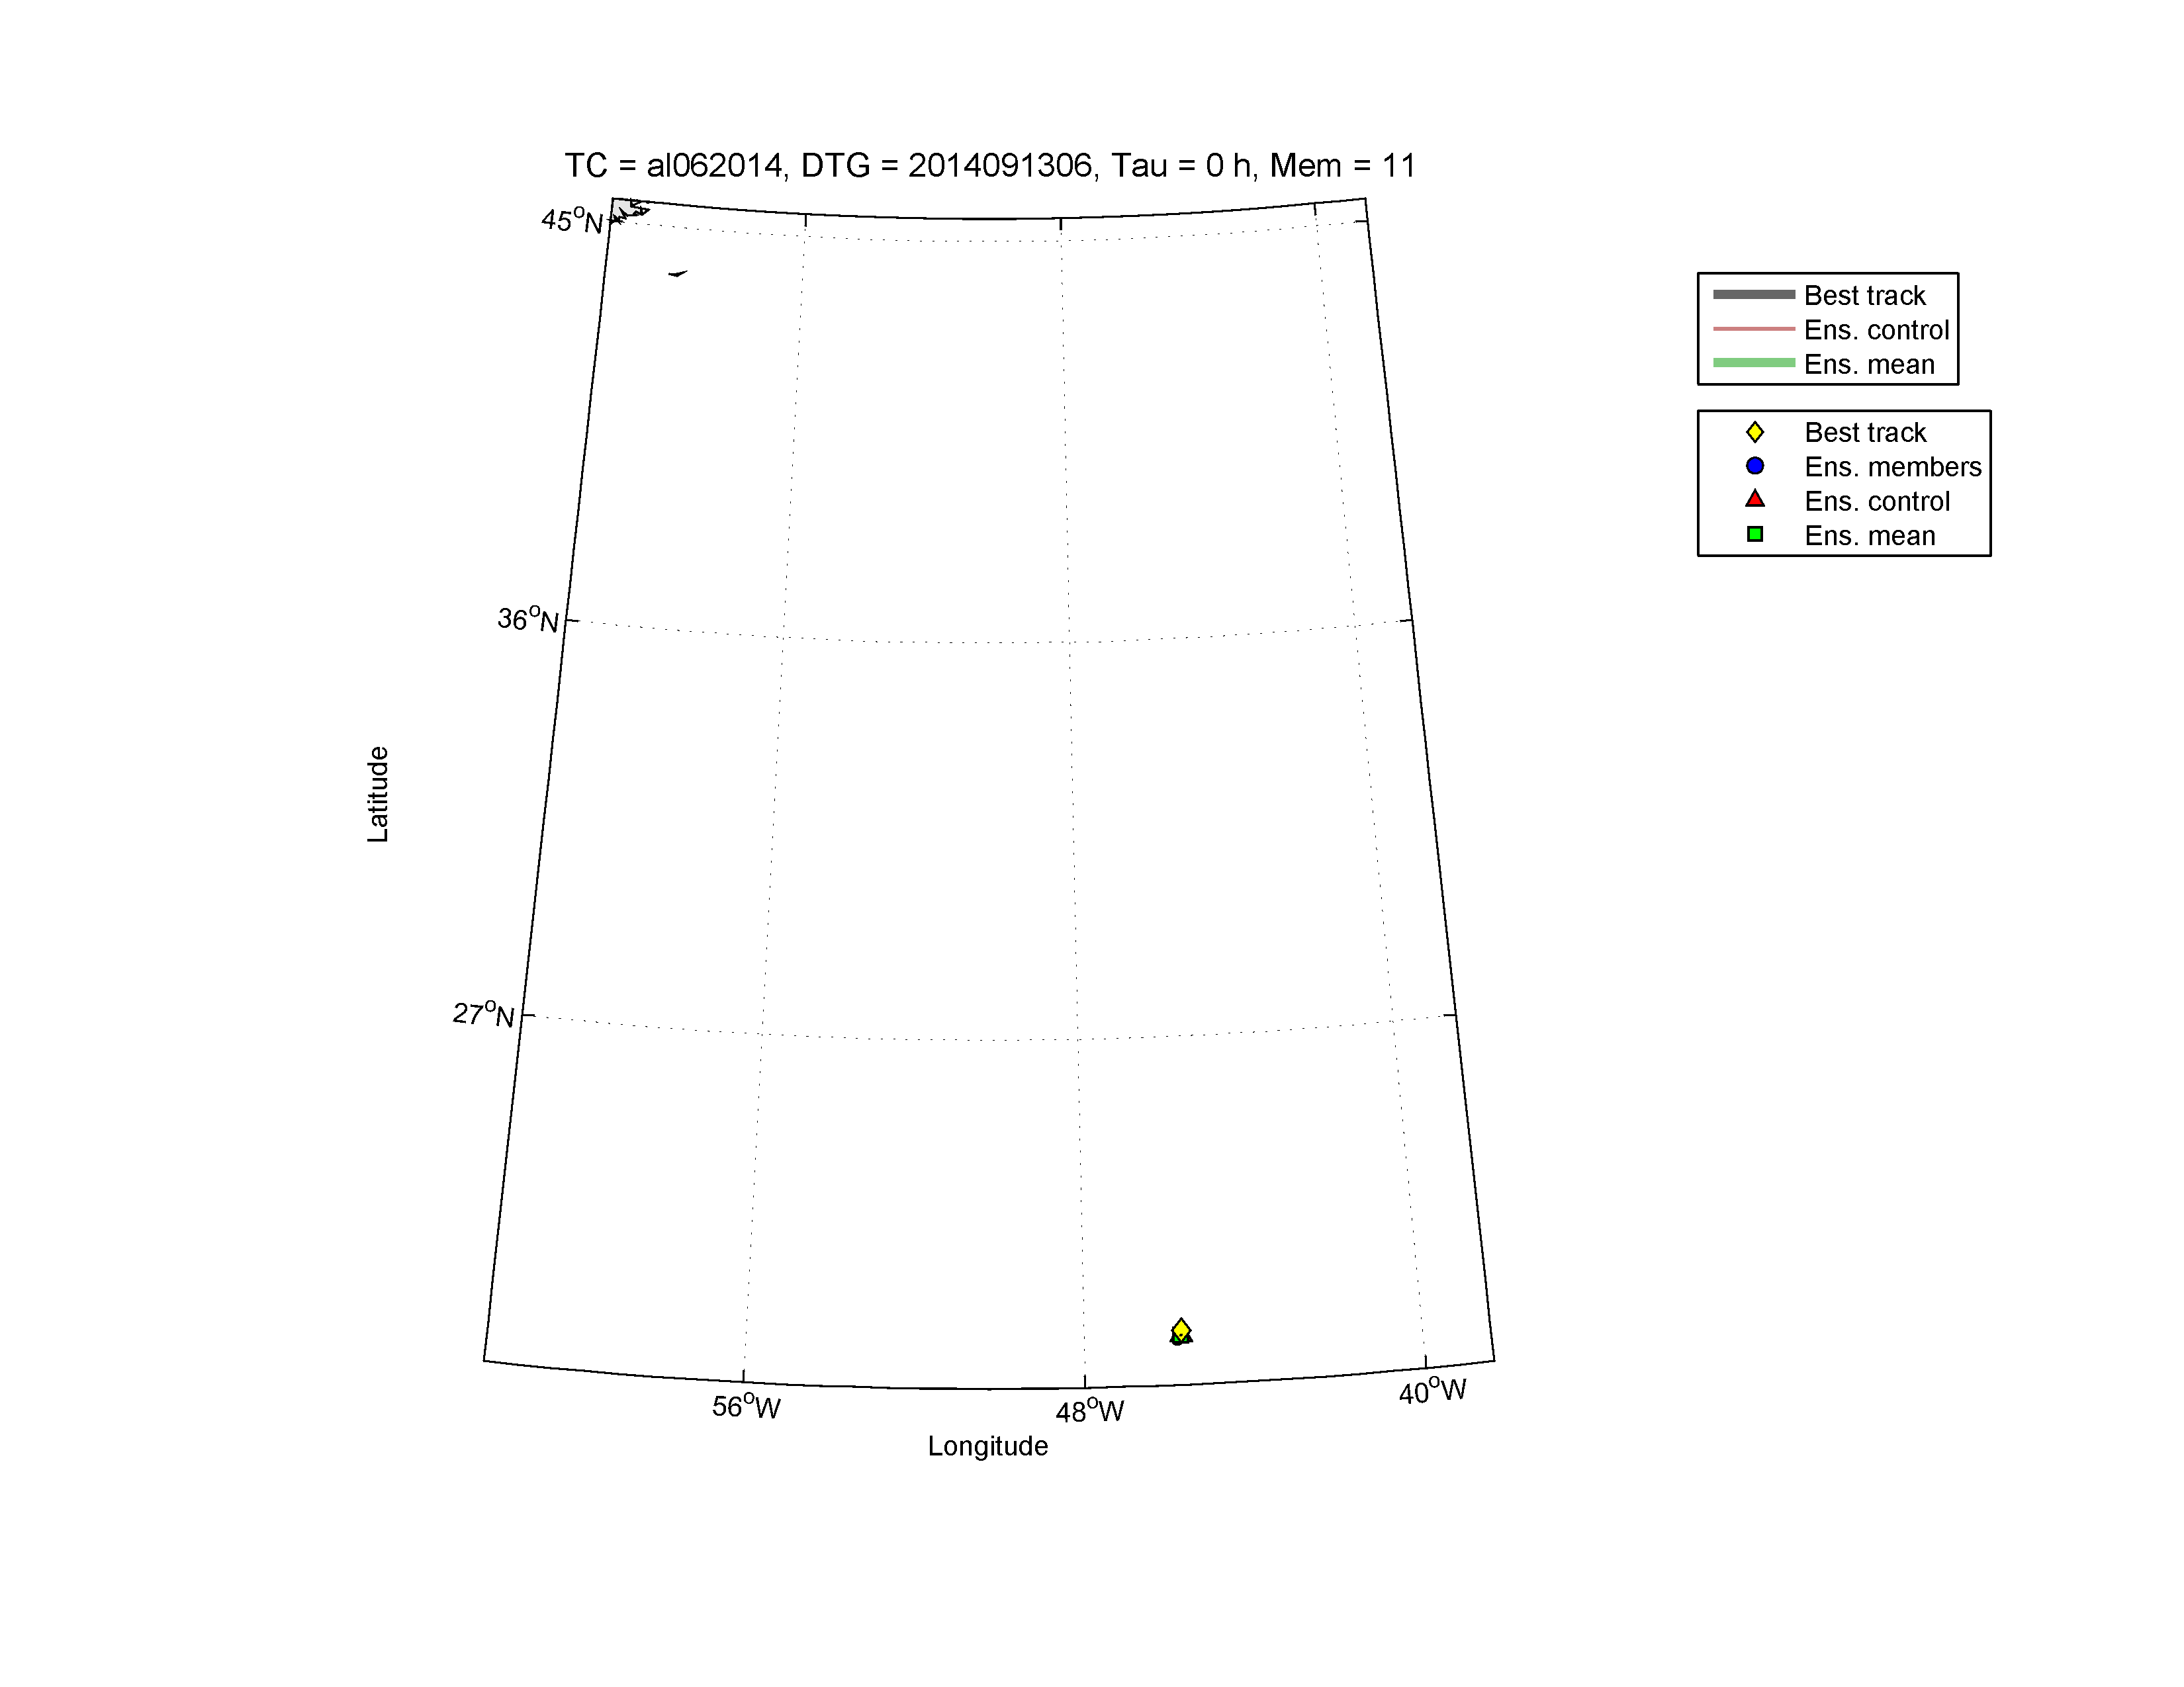
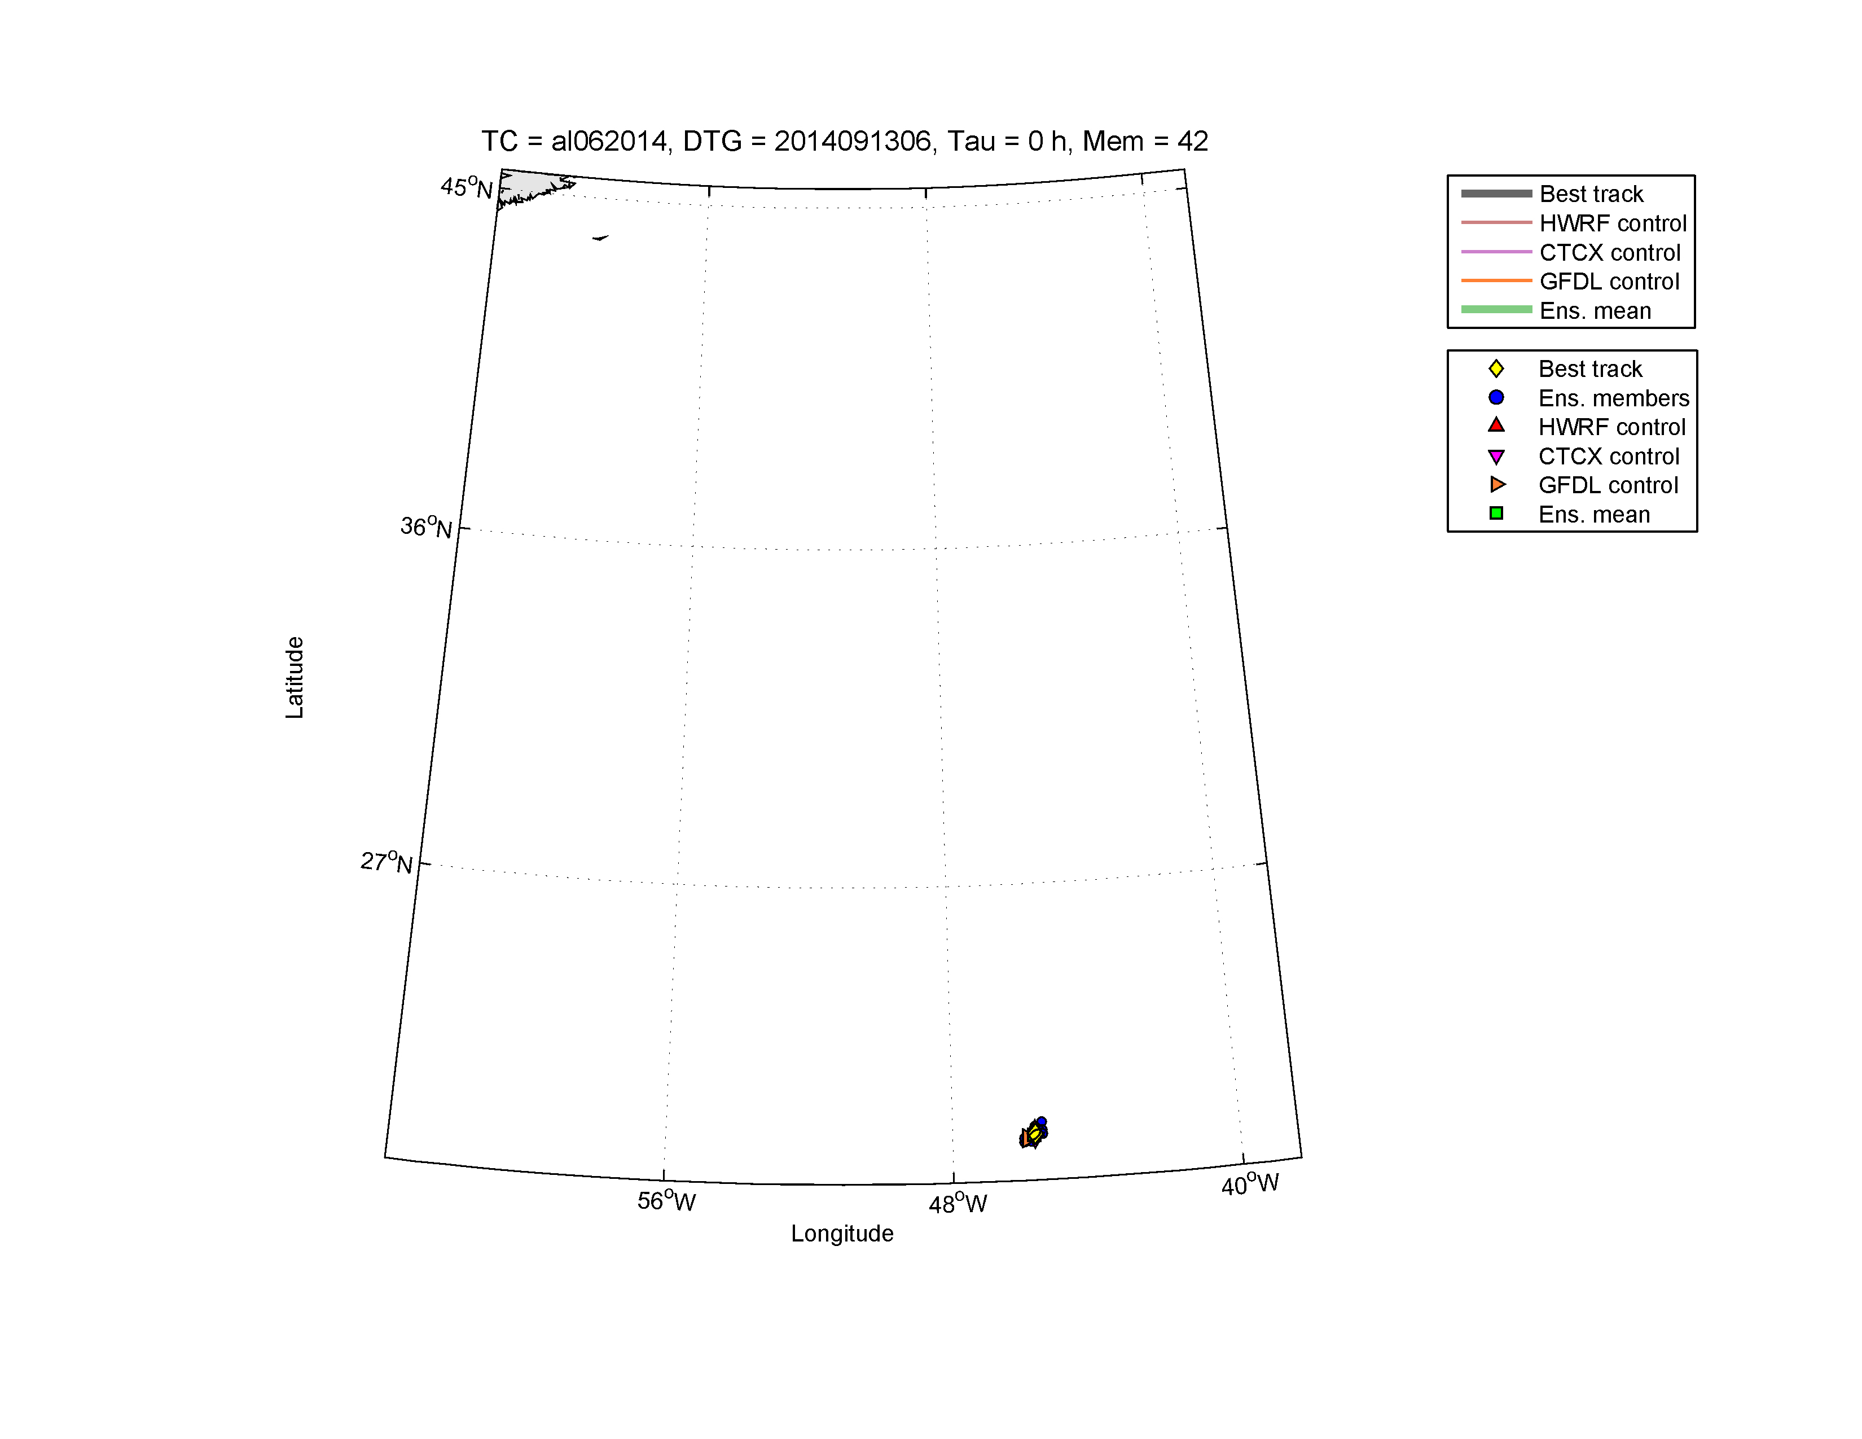
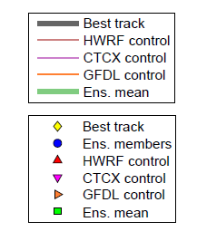
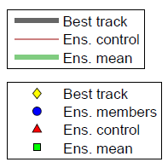
COAMPS-TC Ensemble System
NOAA/Navy Joint Ensemble
COAMPS-TC Ensemble Forecast for Edouard
Initialized 06 UTC 13 September 2014
COAMPS-TC
COAMPS-TC/HWRF/GFDL
An ensemble COAMPS-TC system (Δx=3 km) has been demonstrated in 2014.
Demonstrated HFIP joint COAMPS-TC/HWRF/GFDL 40 member system in 2014.
Continued demonstration of Navy/NOAA high-resolution ensemble in 2015.

Slide 10
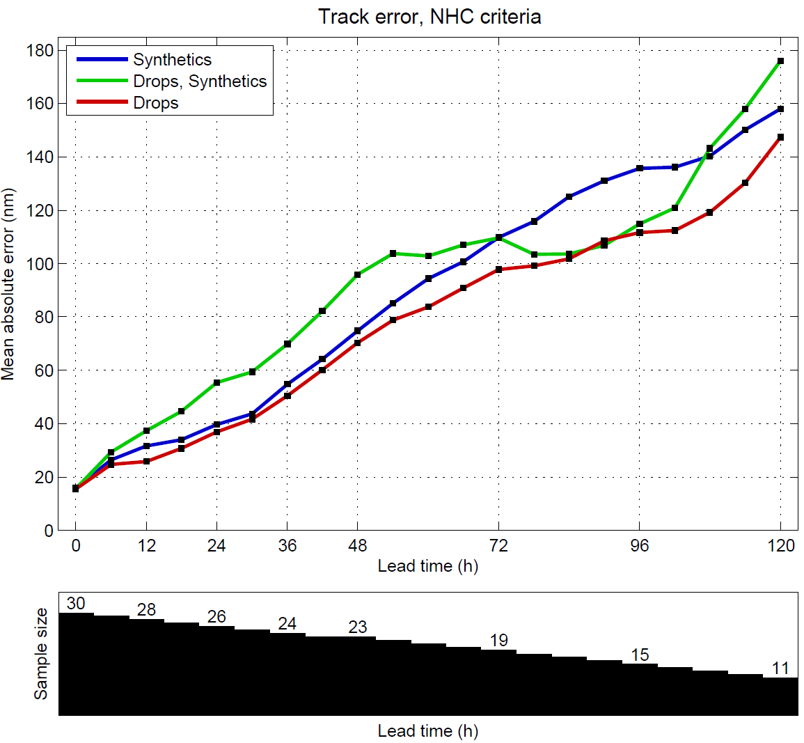
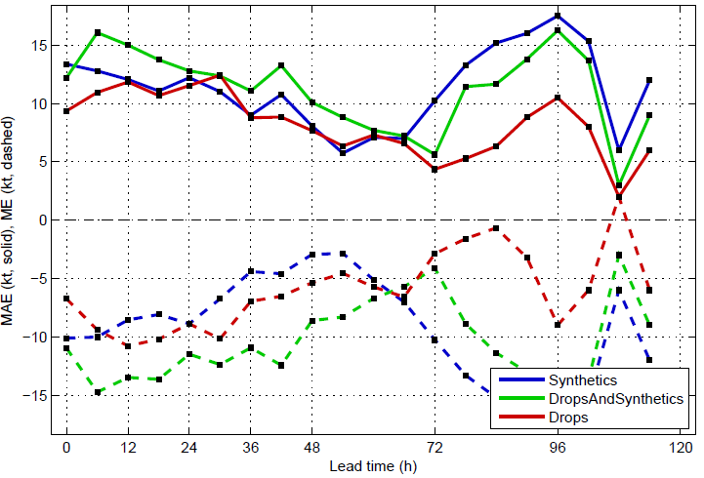
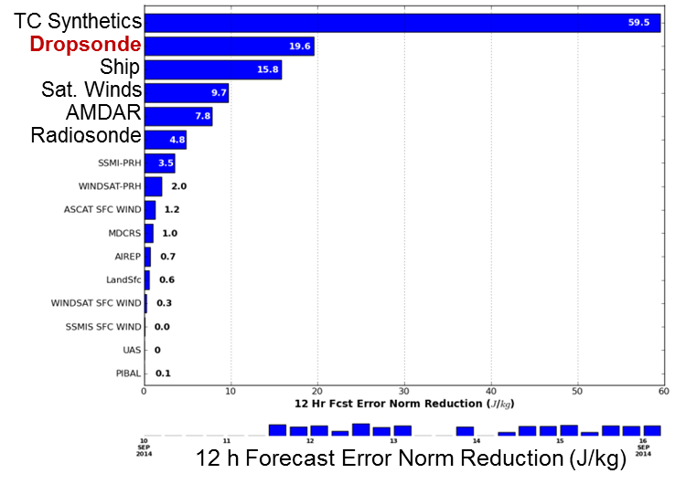
COAMPS-TC Dropsonde Impact
Impact of NASA HS3 Dropsondes (Edouard)
Track Error (nm)
Intensity Error (kts) (2nd-3rd flights)
No drops
+ synthetics
HS3 drops
+ synthetics
drops
HS3 drops
Impact (Per Observation)
Improved COAMPS-TC track using drops.
1st HS3 flight in 06L had a long ferry, fewer sondes, and compact pattern.
2nd & 3rd flights had very good coverage.
Intensity improved for 2nd 3rd flights.
Obs impact shows importance of drops.
ONR TCI & NOAA SHOUT impacts in 2015.
Observation Impact using Model and 3D-Var Adjoint
Notes:
Experiments using COAMPS-TC show a very positive impact when using the HS3 dropsondes alone (red) rather than initializing using the conventional method utilizing synthetic observations (blue) or a combination of the two (green). The track error is shown in the upper left panel along with the wind speed (upper right) and central pressure (lower right) errors.

Slide 11
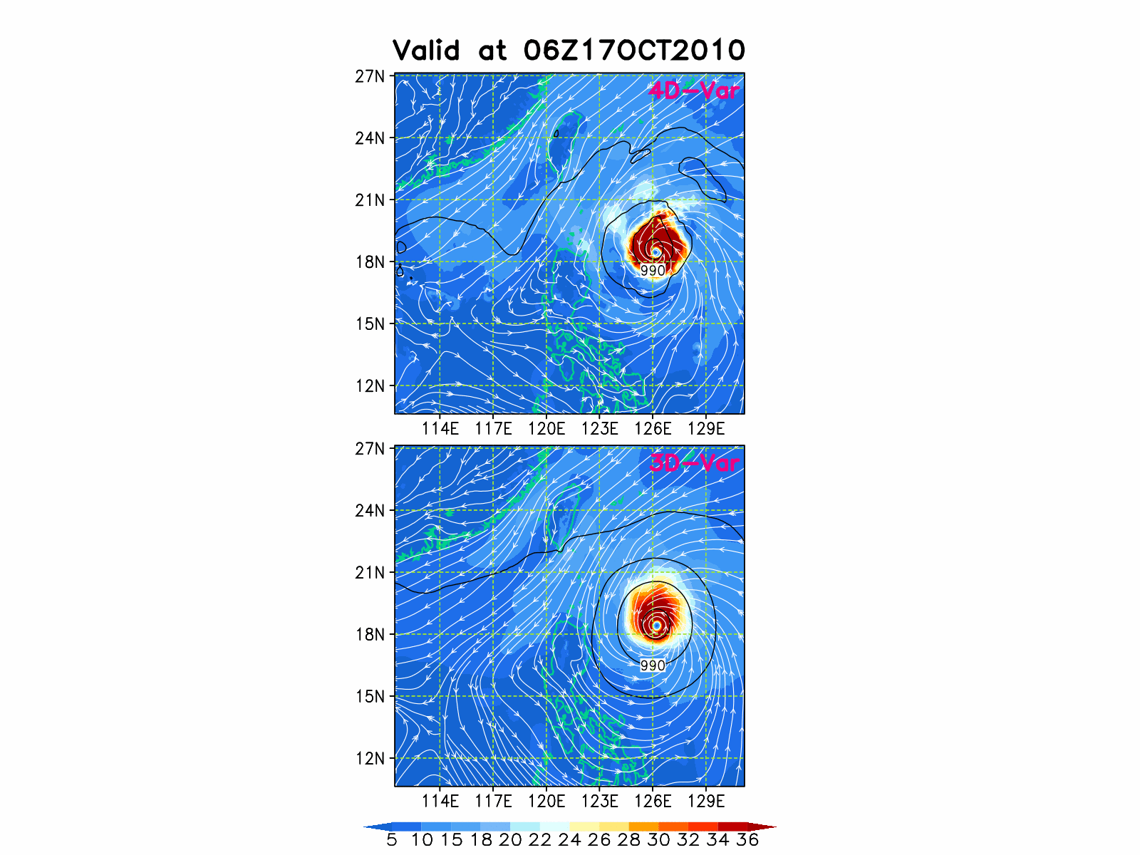
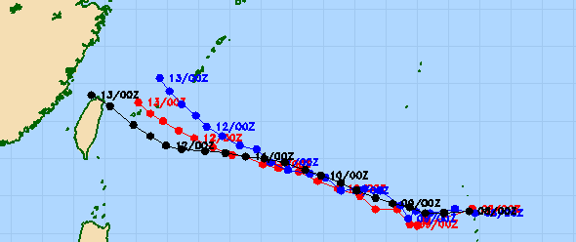
COAMPS-TC 2015+ Version
Data Assimilation and Physics Advancements
Super Typhoon Megi
New Vortex Initialization
Improved vortex initialization
TC Dynamical Initialization (DI)
Data Assimilation
4D-Var testing is underway
New Physics Options Available
New surface drag and PBL
RRTMG radiation
NRL & Thompson Microphysics
Air-Ocean-Wave Coupling
4D-Var
3D-Var
Typhoon Soulik (2013070800)
RRTMG
Fu-Liou
L. Xu
C. Amerault
X. Hong
Best

Slide 12
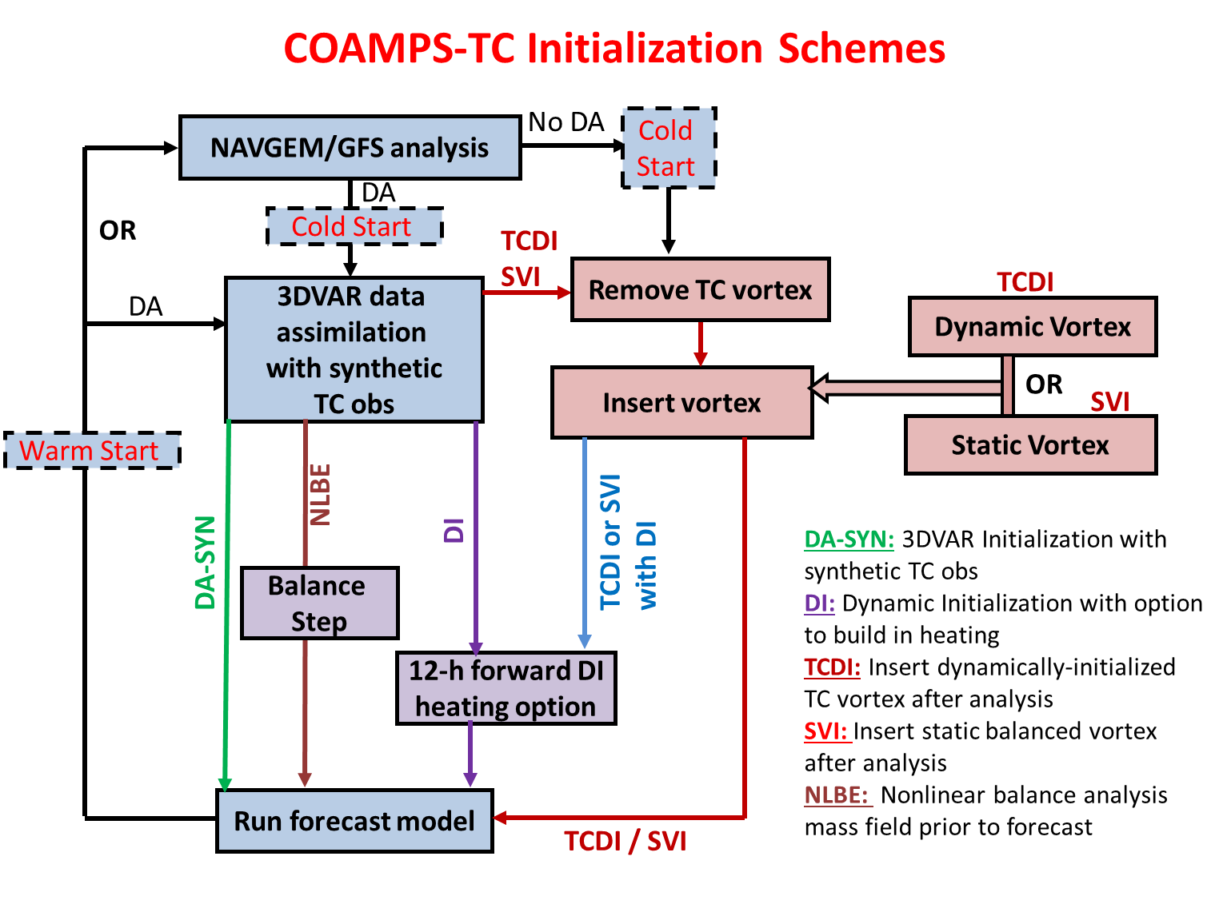
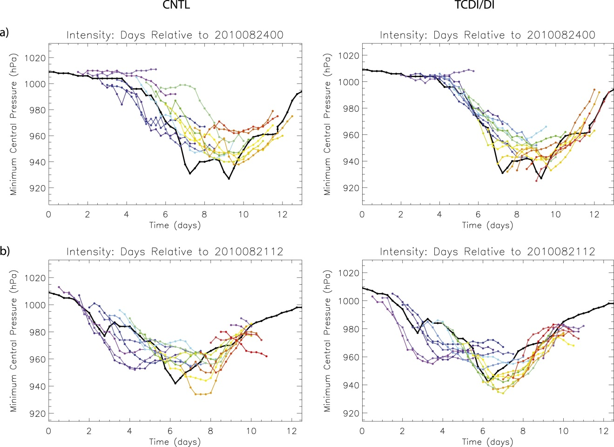
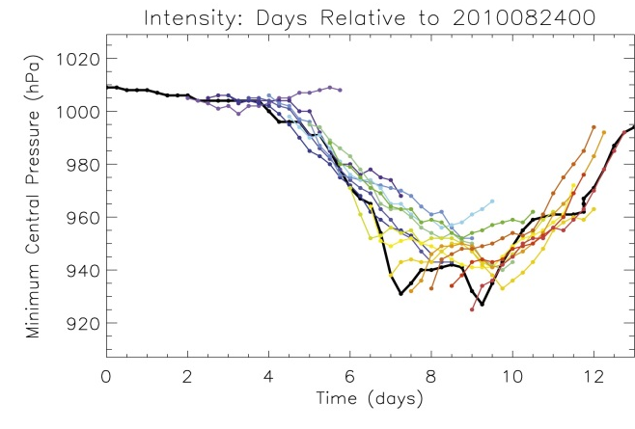
COAMPS-TC 2015+ Version
Dynamical Initialization in COAMPS-TC
Hurricane Earl (2010)
Intensity (mb)
Best
Control
Best
DI
New dynamical initialization algorithm has been developed.
    Uses a balanced vortex that is consistent with COAMPS-TC (5 km resolution)
    Correct initial size & intensity, relaxation for secondary circulation to develop.
  Dynamical initialization improves track & especially intensity forecasts.
  Currently under further testing/development for 2015 season.

Slide 13
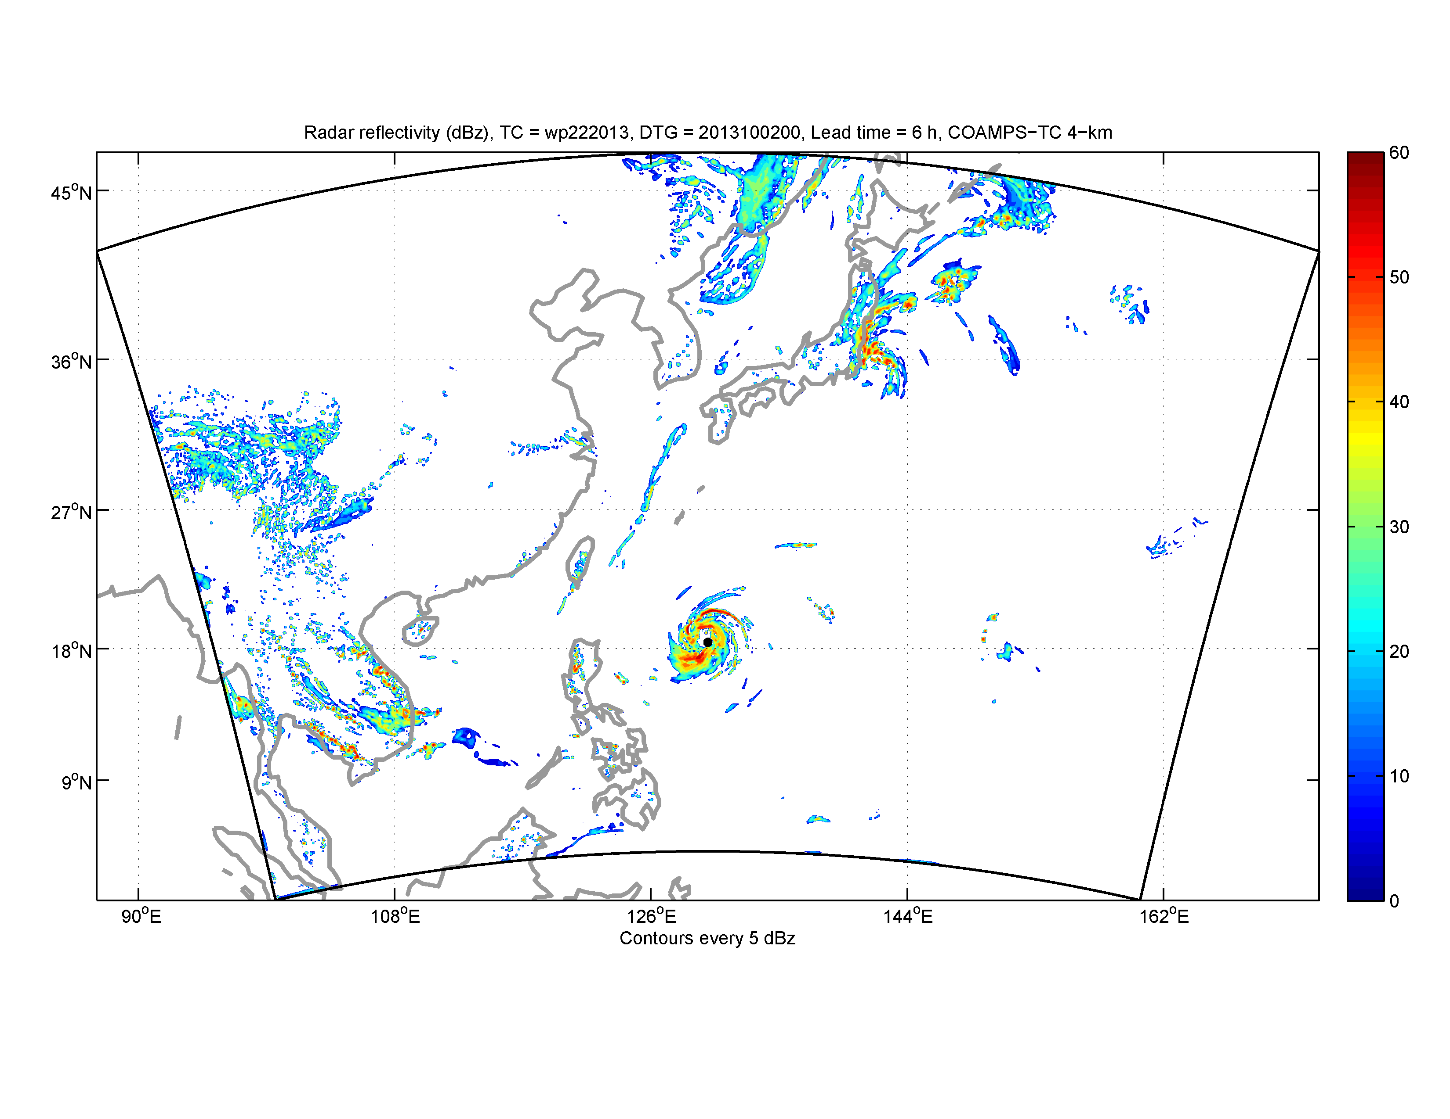
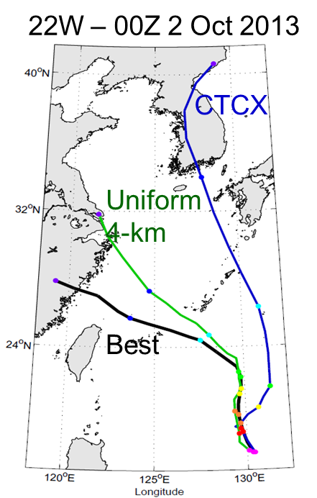
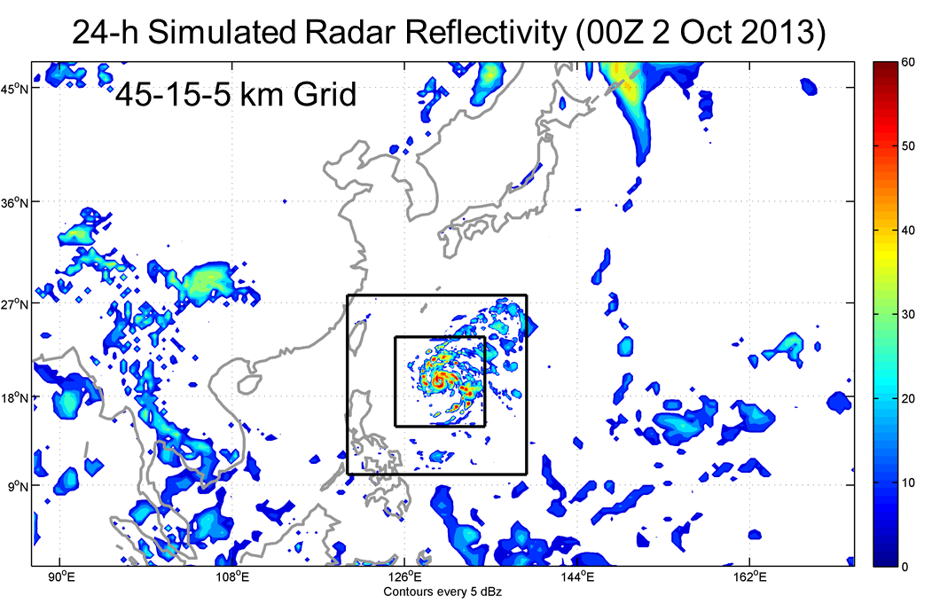
COAMPS-TC
Summary and Future Plans
COAMPS-TC Much Improved for Track and Intensity in 2014:
Improved “spin-down” and short term intensity error (new vortex initialization)
Improved track errors (new initialization; improved lateral BCs; terrain)
Multi-model high-resolution ensemble (NOAA/Navy) prospects are promising.
Future Plans (2015 and Beyond):
Development of advanced COAMPS-TC (underway)
  - TC physics: Emphasis on PBL, air-sea fluxes, microphysics
  Data assimilation: 4D-Var, radiances, radar, HDOB, SFMR
  Coupling: Ocean (NCOM), waves (WWIII/Swan), coupled DA
  - Resolution: 3-5 km (nest following ) to 3-4 km uniform resolution in basin
Utilize field observations
e.g., ONR TCI (HDSS),
NASA HS3, TSC08…
6-120h Simulated Radar Reflectivity (00Z 2 Oct 2013)
4 km Uniform Grid

Slide 14
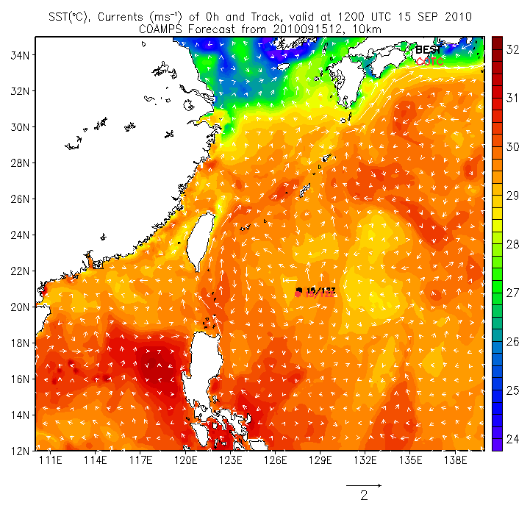
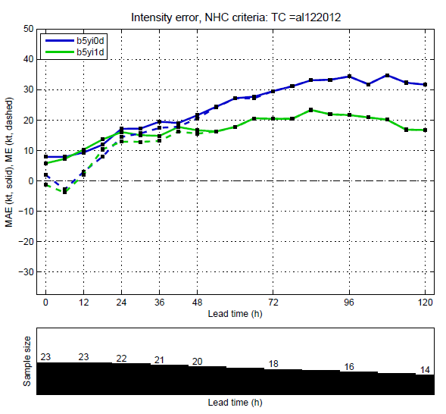
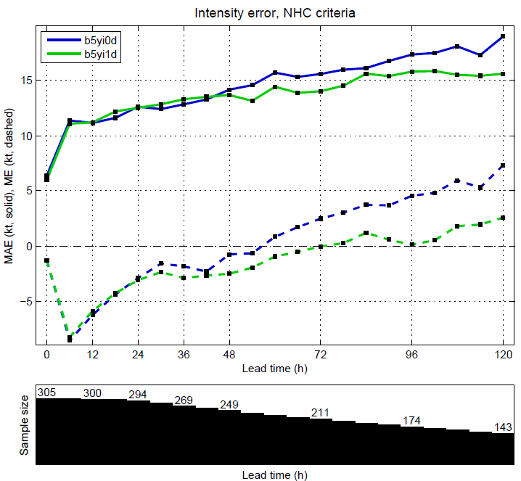
COAMPS-TC Air-Ocean-Wave Coupling
Problem
Air-sea interaction is important for TC intensity
Solutions
Introduce 1-D mixed layer cooling (interim)
Full air-ocean-wave coupling using ESMF
ONR ITOP TY Fanapi: SST (°C), Currents
Best Track
COAMPS
Leslie Intensity Error (kt)
WATL Intensity Error (kt)
No Cooling
No Cooling
1-D Ocean
1-D Ocean
12Z 15 Sep 2010
23 Cases
305 Cases (2010-2012)
Coupled Real–Time COAMPS-TC Predicts SST Wake of 2-4°C in Agreement with Observations
COAMPS contains a community based (ESMF) coupler to facilitate flexible and generalized exchange between components.
1-D ocean mixed layer model used in the interim prior to 3-D ocean.
Air-Sea (COAMPS-NCOM) coupling testing in FY14.
Air-Sea-Wave (COAMPS-NCOM-WWIII) transition in FY15.

Slide 15
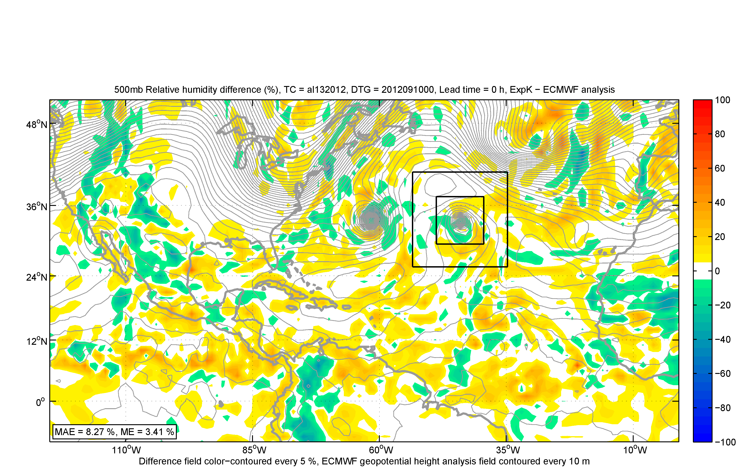
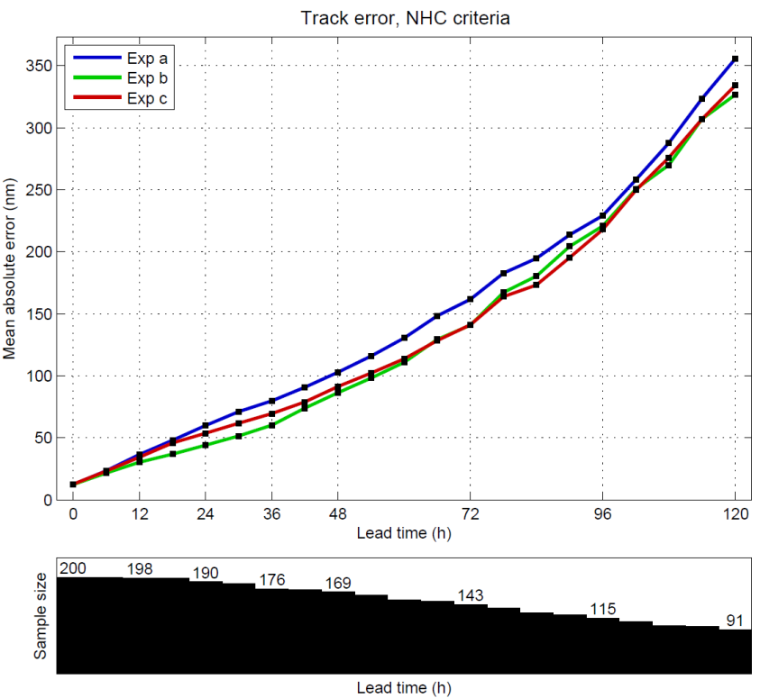
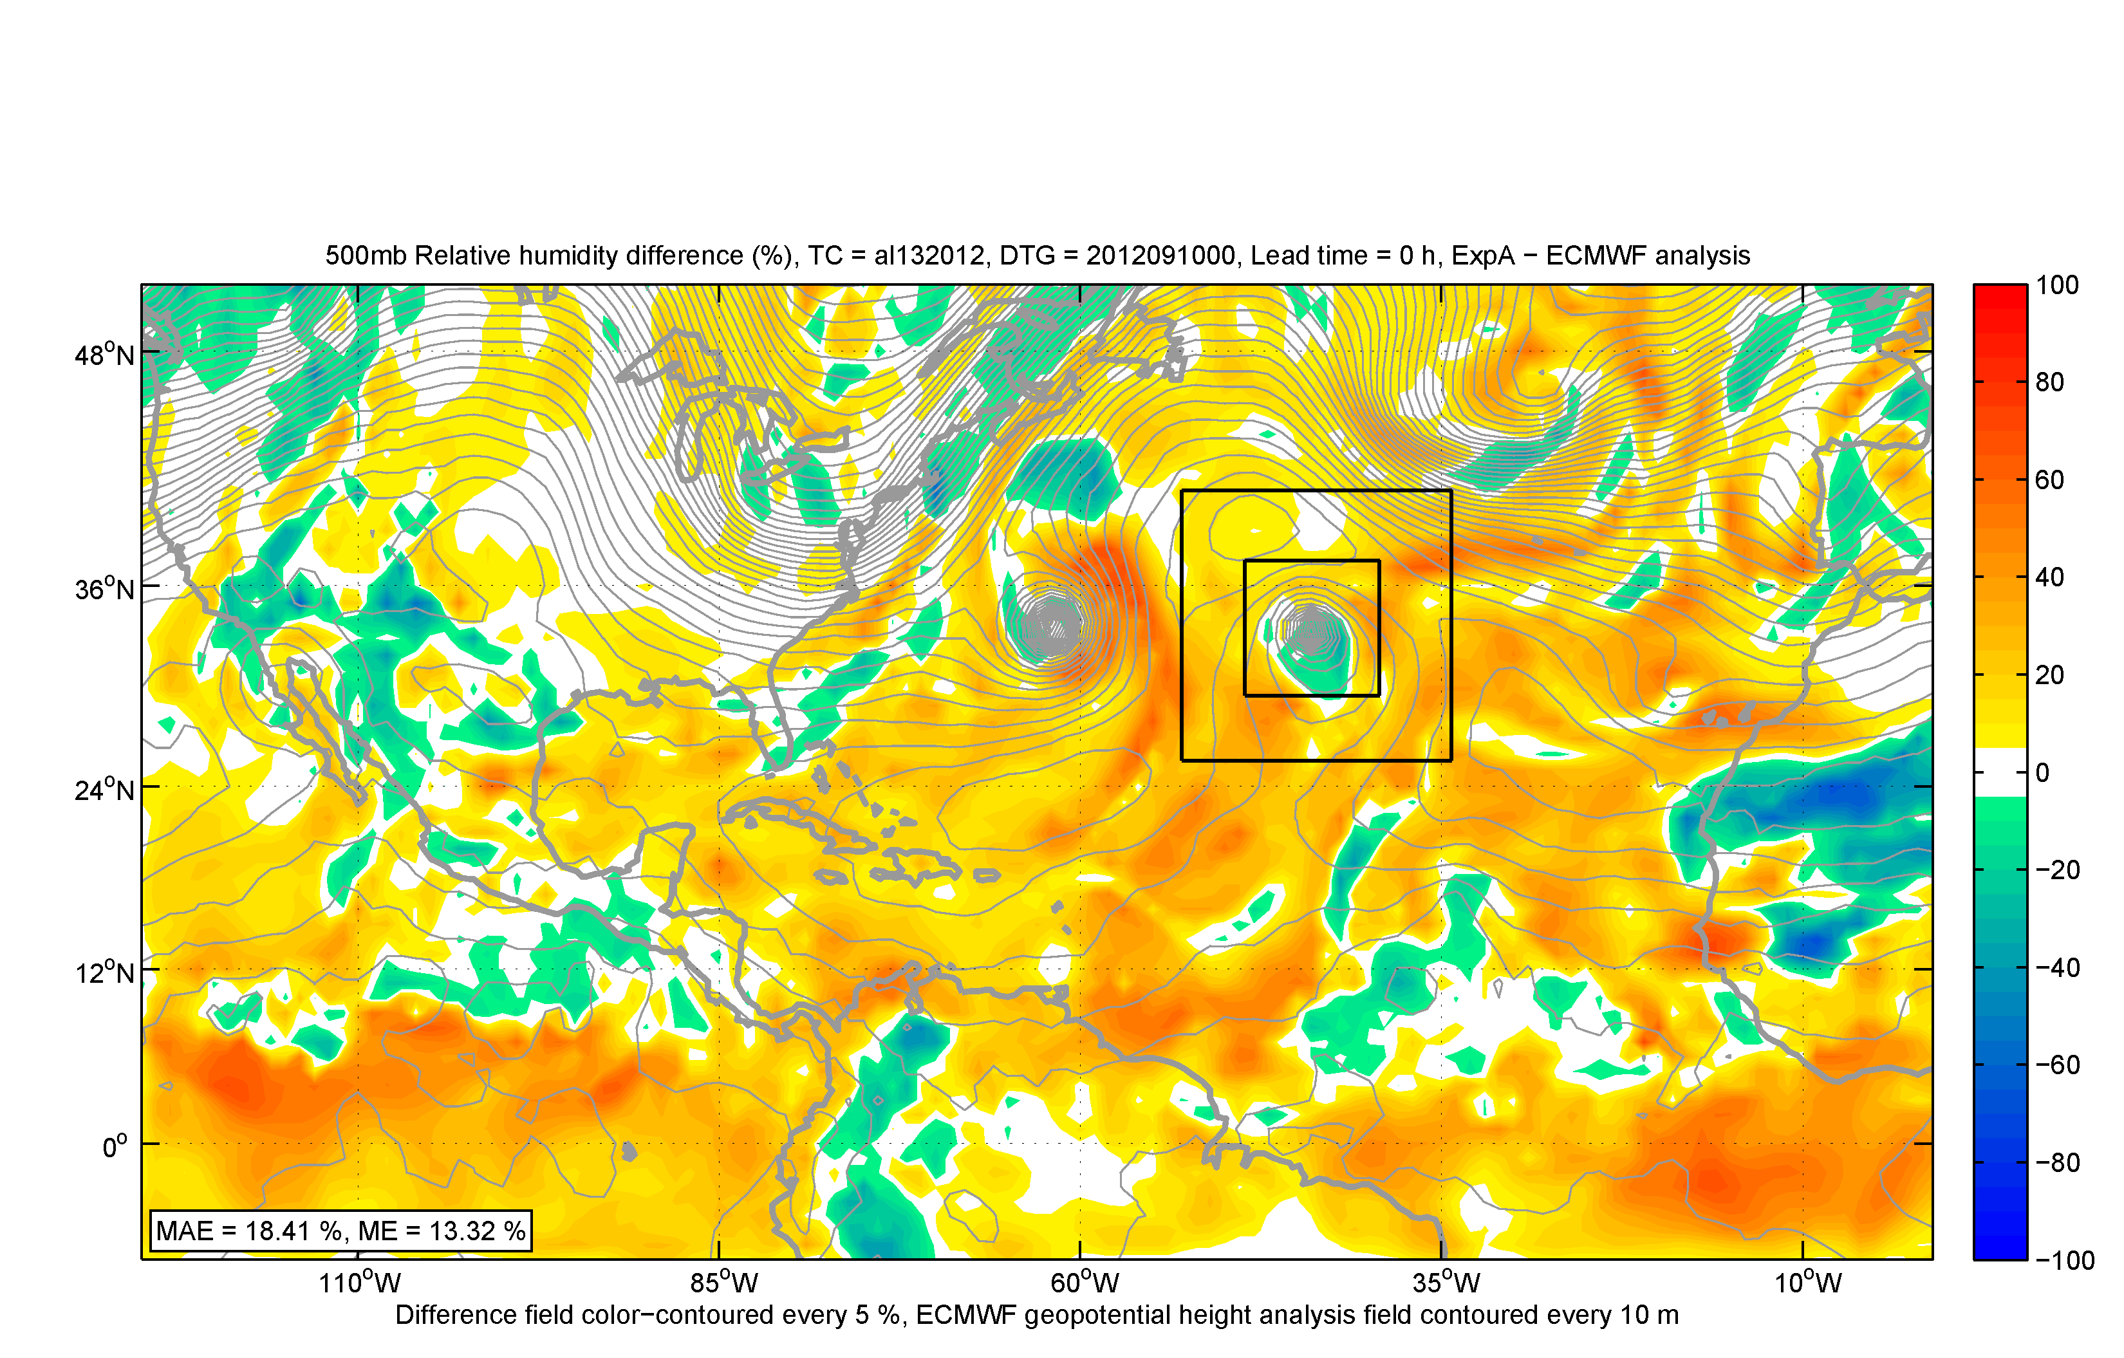
COAMPS-TC System Overview
Improved Large-Scale Analyses
Issue
COAMPS-TC track forecasts less skillful (in 2013) than other ops models.
Global models assimilate more observations (satellite) than regional models.
Solution
Cold start from NAVGEM/GFS or use global synthetic obs to define initial state
COAMPS 4D-Var cycling to improve track and intensity (testing underway).
Key Findings
Enhanced initial conditions lead to large improvement in track error.
500-mb RH
New-ECMWF Analysis
500-mb RH
Control-ECMWF Analysis
Track Error (nmi)
Control
GFS cold start
NAVGEM cold start
2010-2012 WATL
2012-2013 WPAC
Sample distribution of global and TC 1000 mb wind synthetics for a portion of the COAMPS-TC coarse mesh
COAMPS-TC track forecasts are improved using either GFS- or NAVDAS cold starts

Slide 16
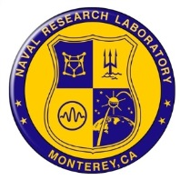
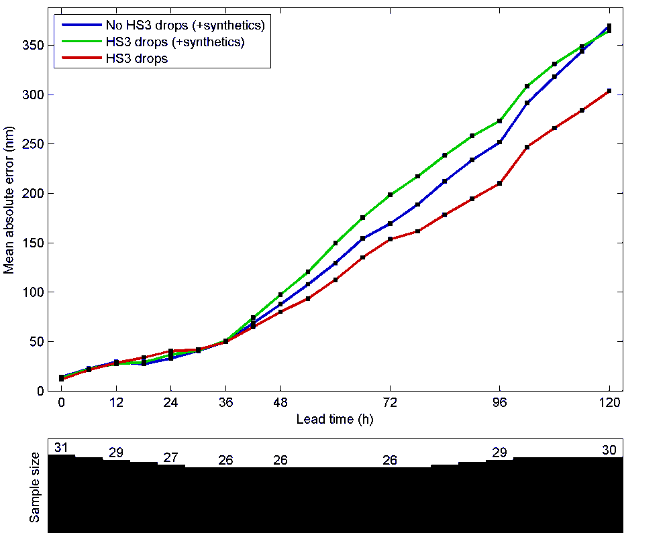
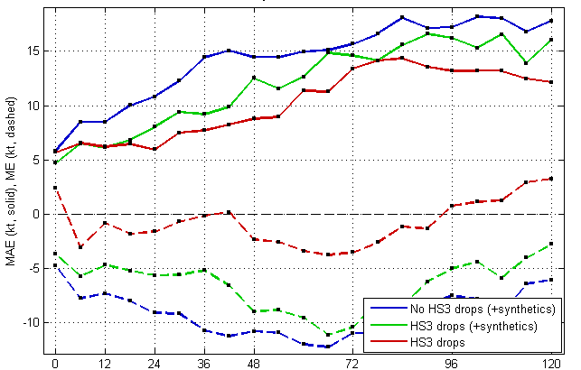
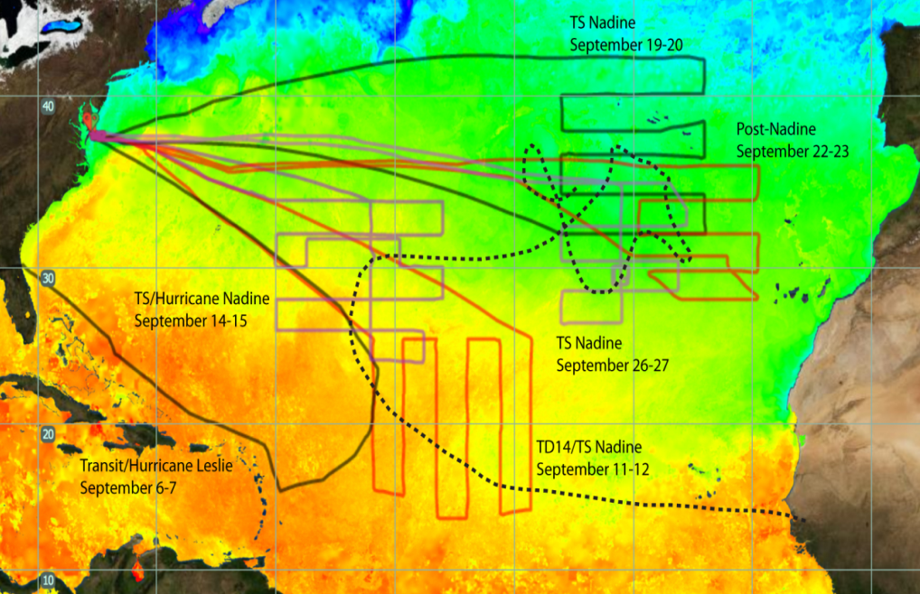
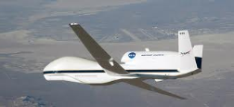
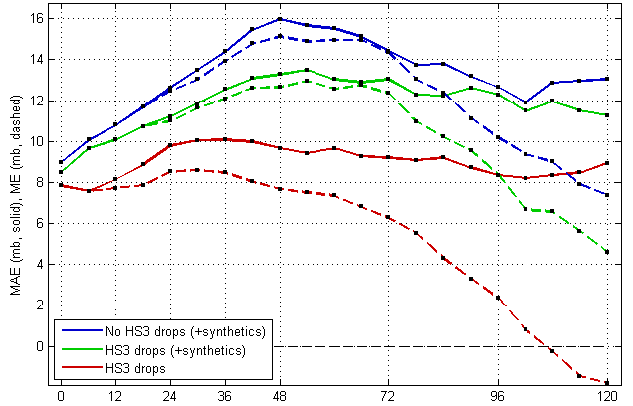
COAMPS-TC Dropsonde Impact
Impact of Dropsondes (Nadine)
Track Error (nm)
Global Hawk Flight Tracks
Intensity Error (knots)
HS3 drops
+ synthetics
76 Drops
No drops
No drops
+ synthetics
58 Drops
HS3 drops
HS3 drops
70 Drops
75 Drops
Bias (dashed)
30 Drops
34 Drops
Intensity Error (hPa)
No drops
Sensitive regions in Nadine were often well observed by HS3 dropsondes
Dropsonde impact experiments performed for 19-28 Sep. (3 flights)
  HS3 drops
  HS3 drops with synthetics
  No drops with synthetics
COAMPS-TC intensity and track skill are markedly improved using HS3 drops.
  -Future: impact vs. altitude; EnKF,4D-Var
HS3 drops
Bias (dashed)
Notes:
Experiments using COAMPS-TC show a very positive impact when using the HS3 dropsondes alone (red) rather than initializing using the conventional method utilizing synthetic observations (blue) or a combination of the two (green). The track error is shown in the upper left panel along with the wind speed (upper right) and central pressure (lower right) errors.

