Slide 1
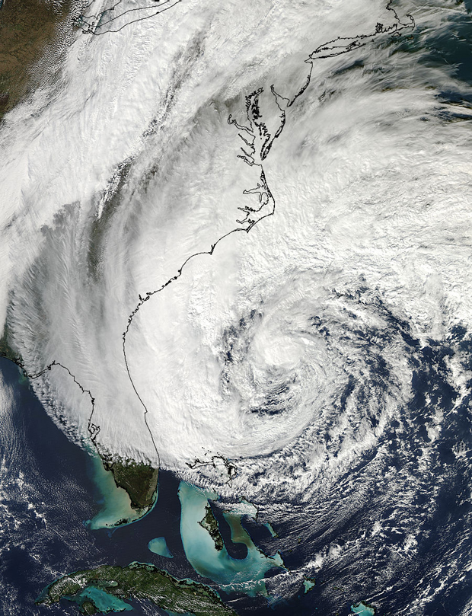
Direct Assimilation of Satellite-Derived AMVs into HWRF: First Results
William E. Lewis*, Christopher Velden*
Vijay Tallapragada†, Jaime Daniels‡
* SSEC/CIMSS (University of Wisconsin-Madison)
† NOAA EMC
‡ NOAA STAR
69th Interdepartmental Hurricane Conference
4 March 2015

Slide 2
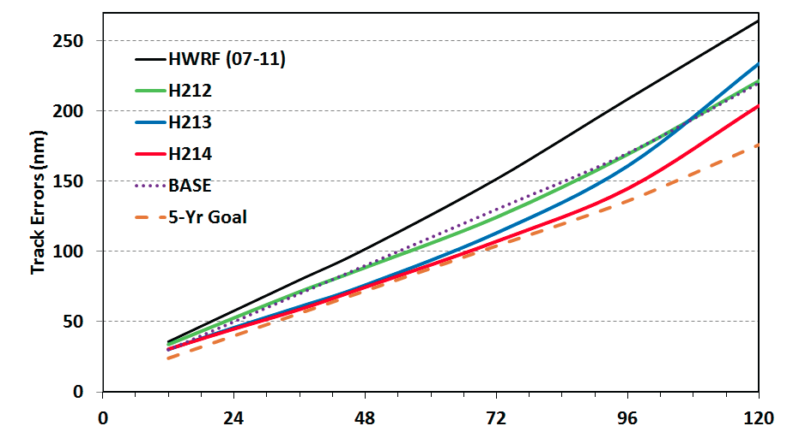
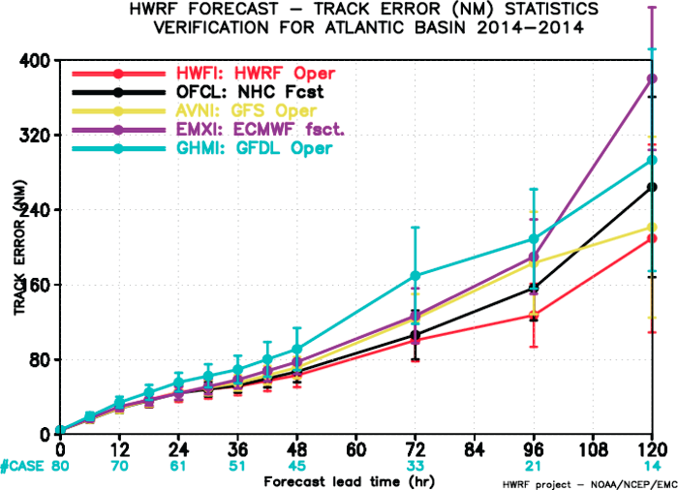
Motivation
HWRF model upgrades have resulted in steady improvement in
year-over-year track performance...
…exemplified in 2014 Atlantic results.

Slide 3
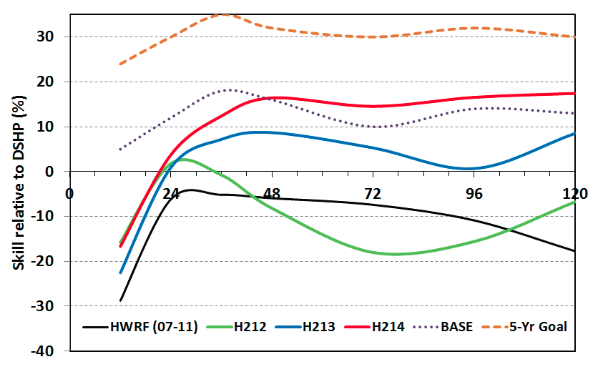
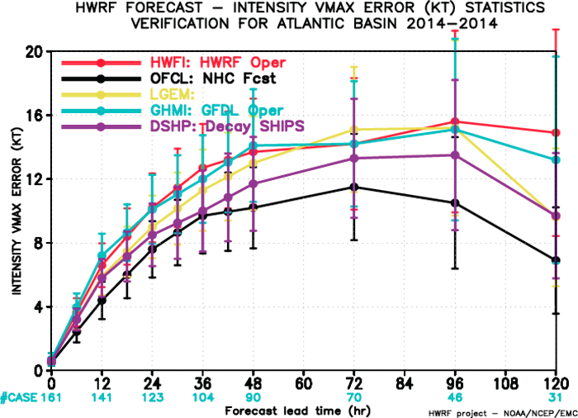
Motivation
However, intensity results have yet to catch up (0-24 hr skill remains negative w.r.t. SHIFOR,
and improvement has been rather sluggish compared to other lead times). This highlights
the importance of TC initialization.
Observations at the vortex scale, available at (hourly)⁻¹ or greater frequency, around the clock with continuous DA cycling, would be desirable...

Slide 4
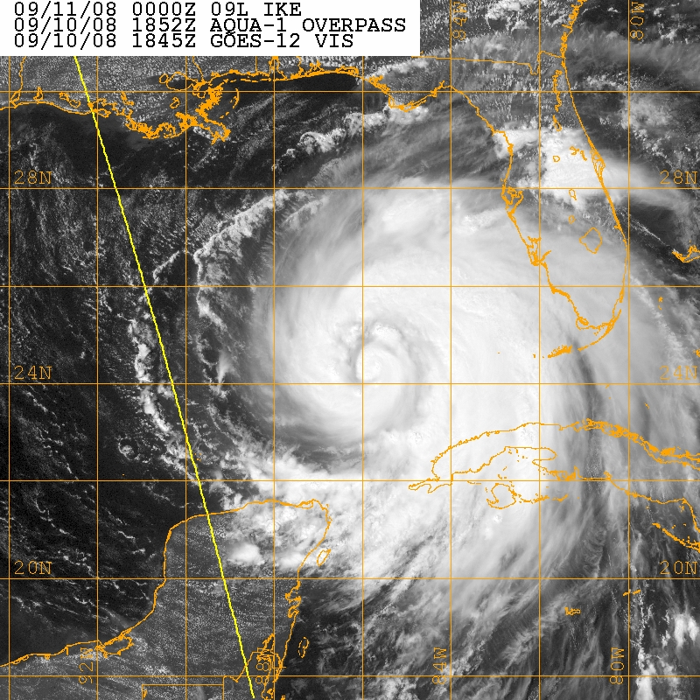
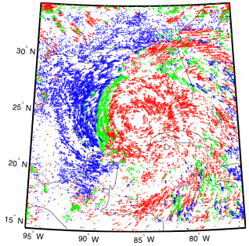
Satellite-Derived Atmospheric Motion Vectors (AMVs)
…have the potential to address such criteria.
Hurricane Ike (2008)
Example rapid-scan AMV plot for Ike
P ≤ 350 hPa 350 < P ≤ 800 hPa P > 800 hPa

Slide 5
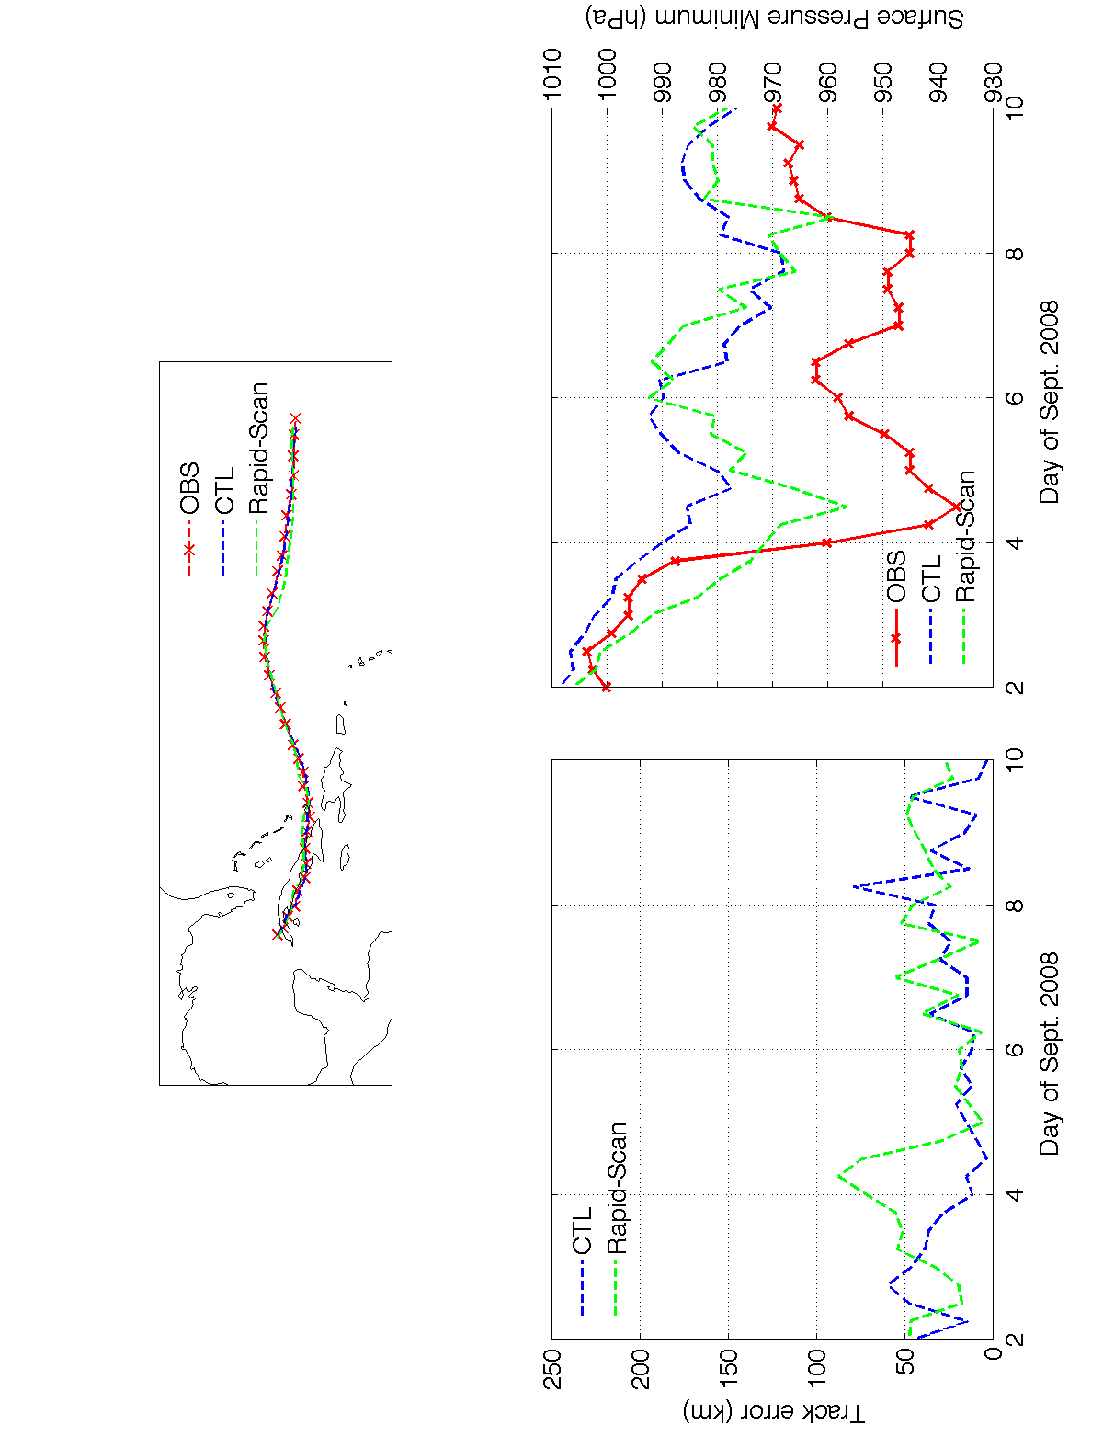
Recent Research
(Wu, Velden and Majumdar, 2014 - MWR)
Hurricane Ike Intensity Analyses
Assimilation of the GOES rapid-scan (RS) AMVs into the mesoscale DART/WRF system --- initial analyses of Hurricane Ike’s intensity (OBS) vs. a Control (CTL) without the RS AMVs.

Slide 6
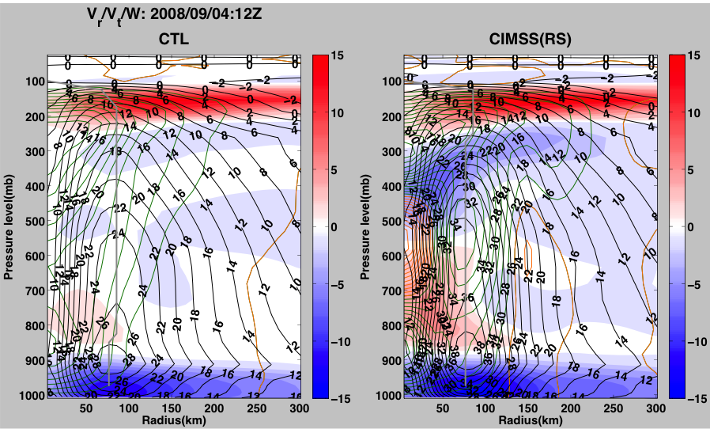
(Wu, Velden and Majumdar, 2014 - MWR)
Hurricane Ike Vortex Structure Analyses
1200 UTC 04 Sep 2008
Axisymmetric tangential wind (black contour, 2 ms⁻¹ int.), radial wind (shading), vertical motion (green upwards, orange downwards, contour int. = 0.05 ms⁻¹ ).

Slide 7
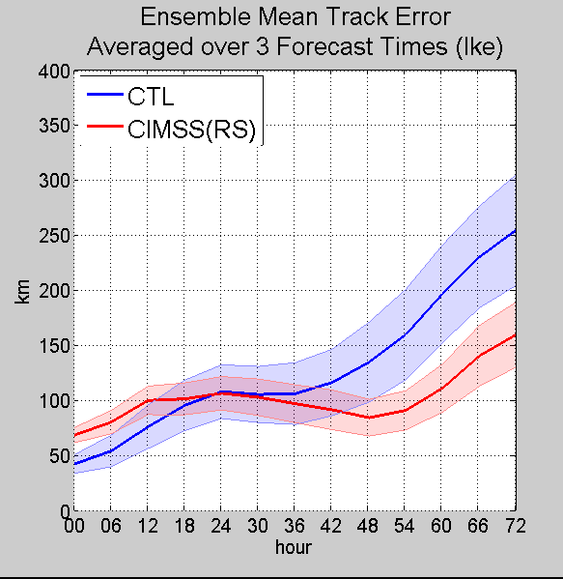
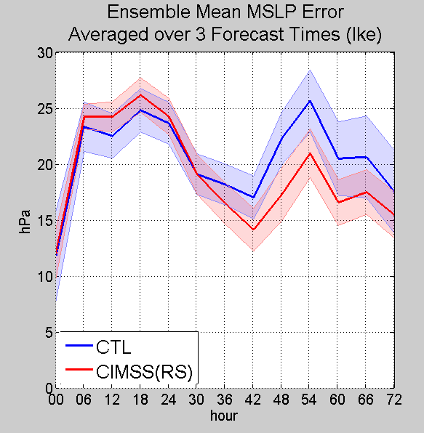
(Wu, Velden and Majumdar, 2014 - MWR)
Hurricane Ike Track and Intensity Forecasts
WRF-ARW Model Ensemble (84mem) -- CTL vs. CIMSS(RS)
For 3 forecast times: 00UTC on Sept. 2/4/6

Slide 8
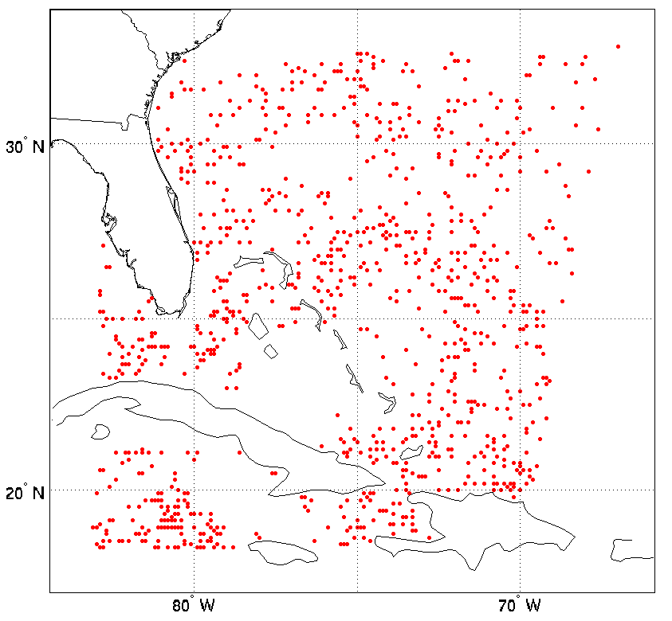
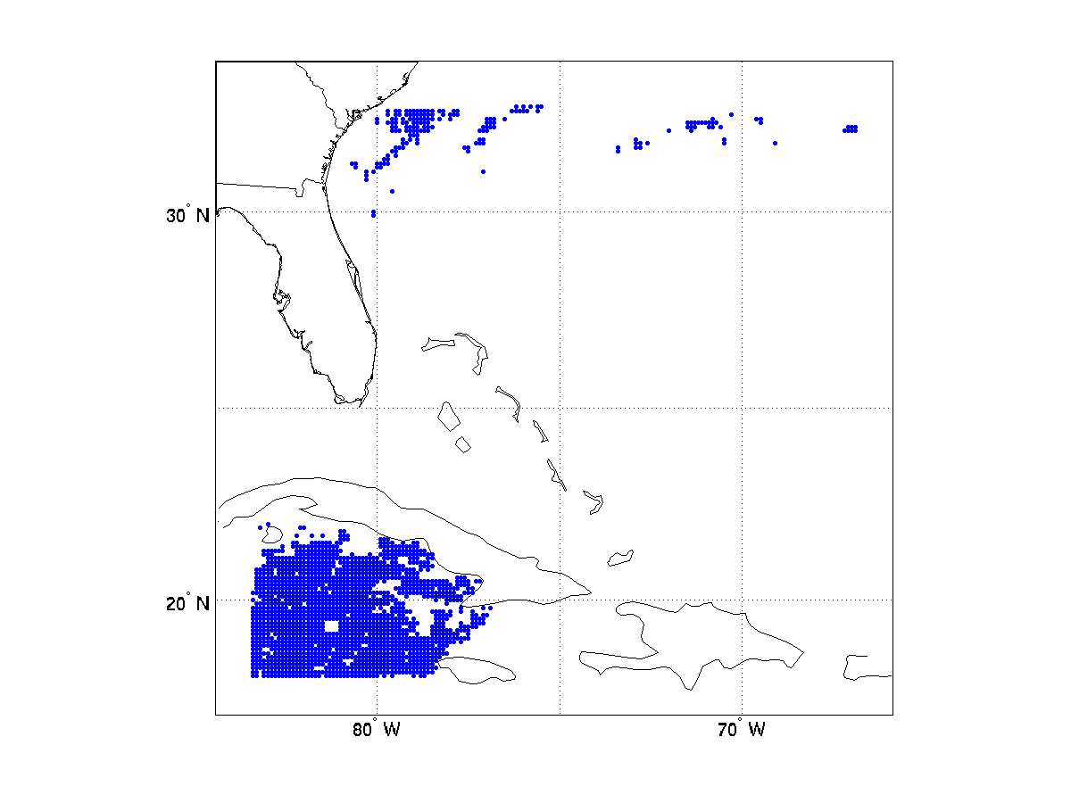
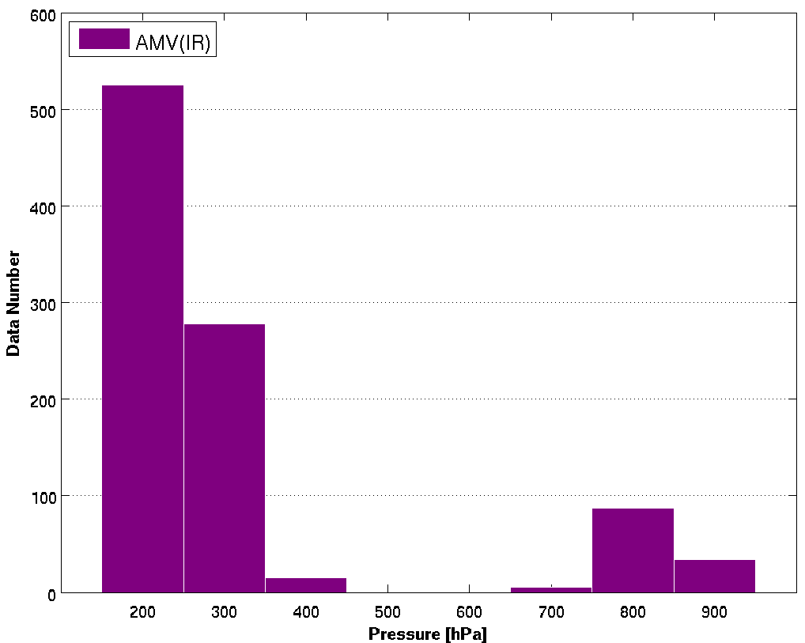
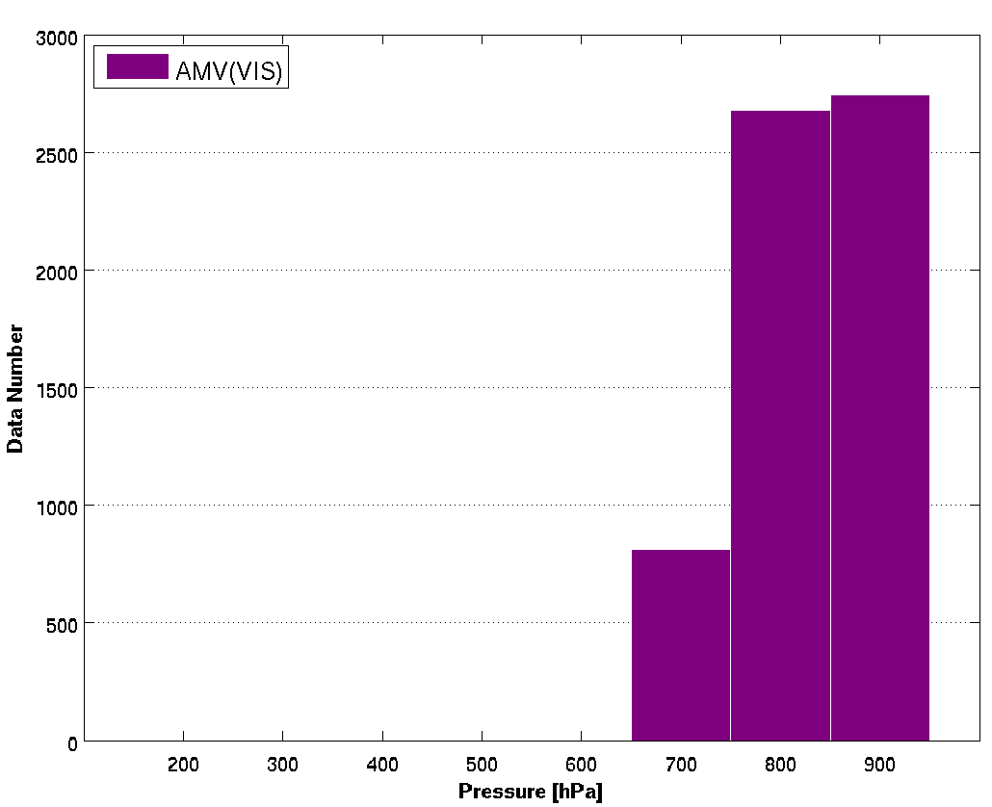
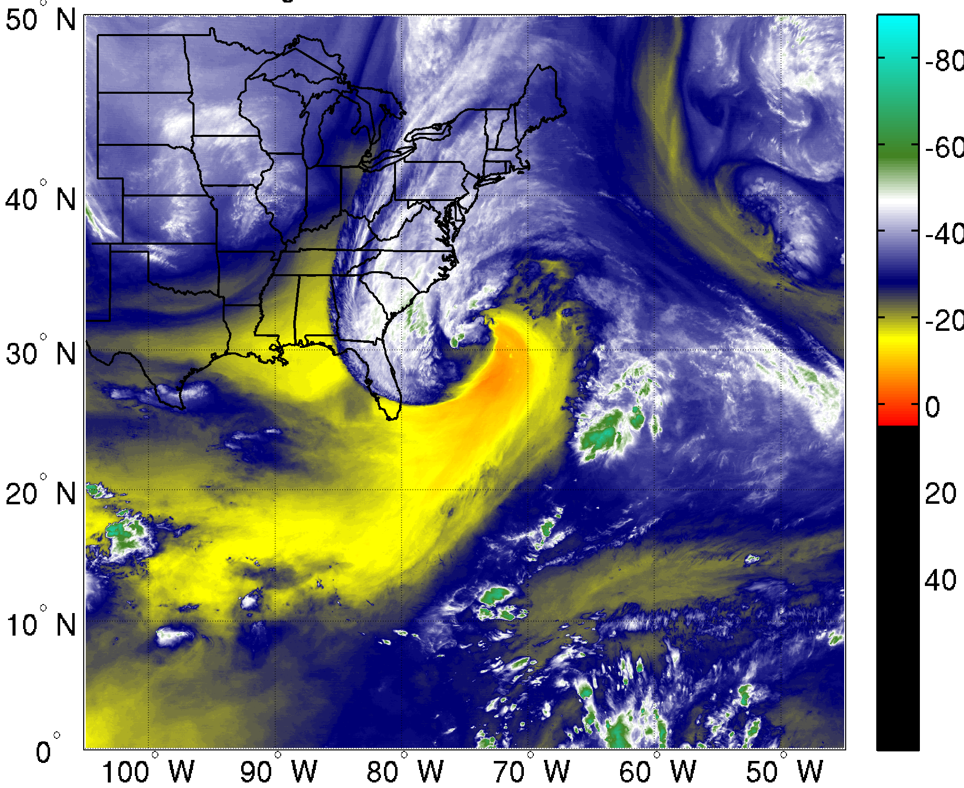
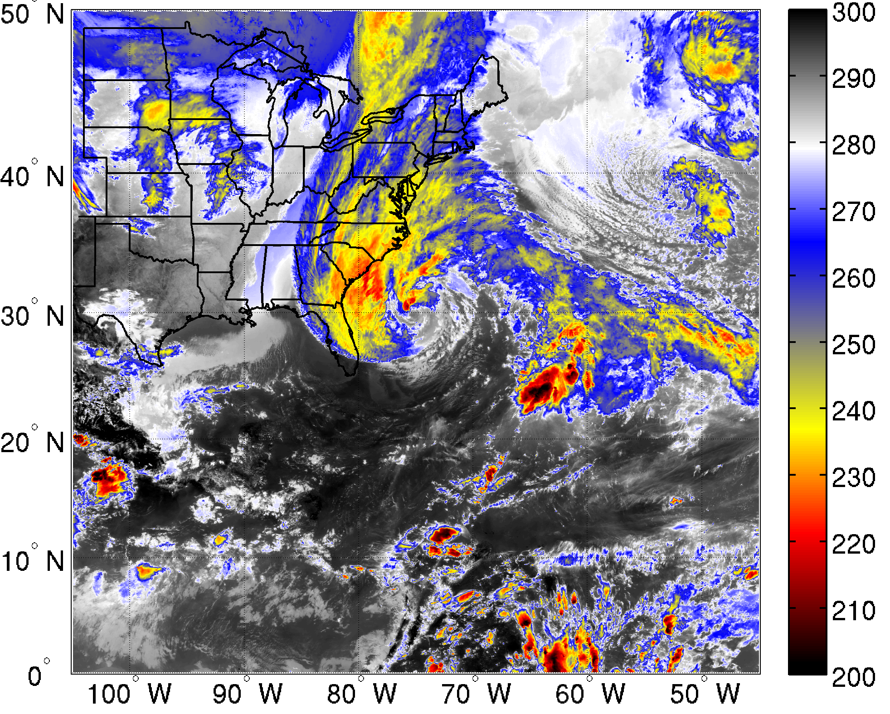
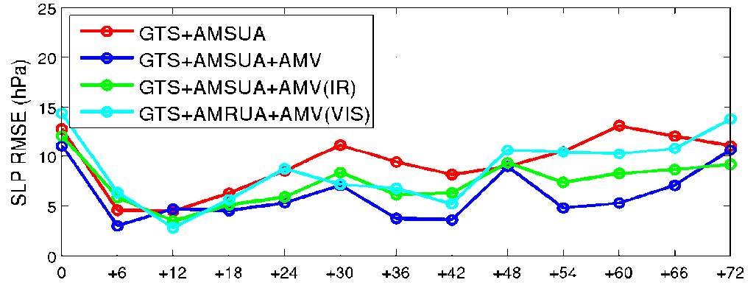
AMV assimilation experiments with CIMSS SDAT as research testbed
SDAT – Satellite Data Assimilation for Tropical storm (CIMSS/SSEC/UW-Madison) http://cimss.ssec.wisc.edu/sdat/
18 UTC 25 Oct 2012 AMV assimilated in GSI
WRF-ARW v3.2.1: 12 km horizontal resolution (400*350) , 52 vertical layers from surface to 10 hPa
GSI v3.1: 3-Dvar Data Assimilation Method
NAM background error covariance matrix
Cycled bias correction
Conventional Data – from GTS
Satellite radiances: AMSU-A from AQUA, Metop-A, NOAA-15 and NOAA-18
AMVs: GOES IR, VIS (Velden et al.)
IR
VIS
AMV IR
Above 300 hPa
AMV VIS
below 700 hPa
Hurricane Sandy
Assimilation : Oct 25 18z to Oct 27 18z, 2012
Forecasts: Oct 25 18z to Oct 30 18z, 2012
Assimilation every 3 hour
9 Groups of experiments
Forecast statistical results (9 samples)
SLP RMSE
GOES-13 WV 6.5μm
GOES-13 IR 11μm
VIS AMVs can improve TC track forecasts;
VIS+IR AMVs improve hurricane intensity forecasts

Slide 9
AMV Datasets for Sandy
For this study, all AMVs derived from special GOES-14 Super-Rapid-Scan Operations (SRSO)—continuous limited-area 1-min. imagery during Sandy
Two AMV algorithms tested:
Heritage—currently operational at NESDIS (AMV1)
Experimental—being developed for GOES-R (AMV2)
Both algorithms process AMVs from triplets of VIS (3-min. imagery) and LWIR/SWIR (5-min. imagery)
All AMVs are objectively QC’d, and output with Quality Indicator and Expected Error tags, which are used to filter inputs to the DA (thresholds based on previous research)

Slide 10
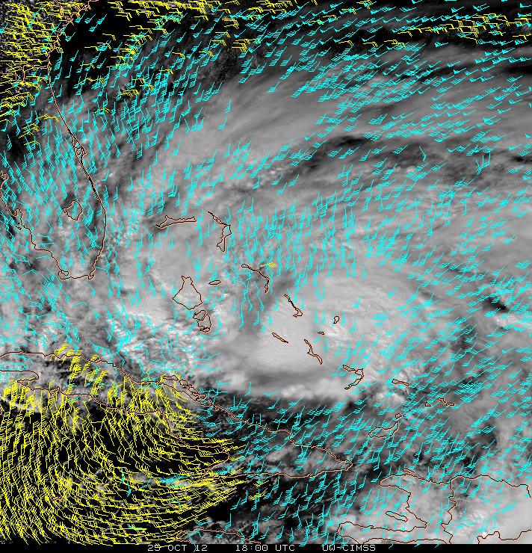
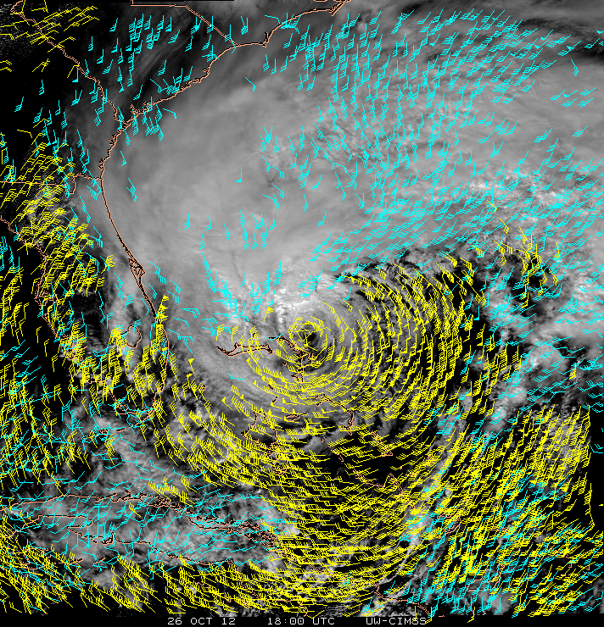
AMVs from GOES rapid-scans during Hurricane Sandy
1800 UTC 25 Oct, 2012 1800 UTC 26 Oct, 2012
100-500 hPa
500-950 hPa
VIS/IR cloud-tracked winds from 5-min interval GOES rapid-scan images

Slide 11
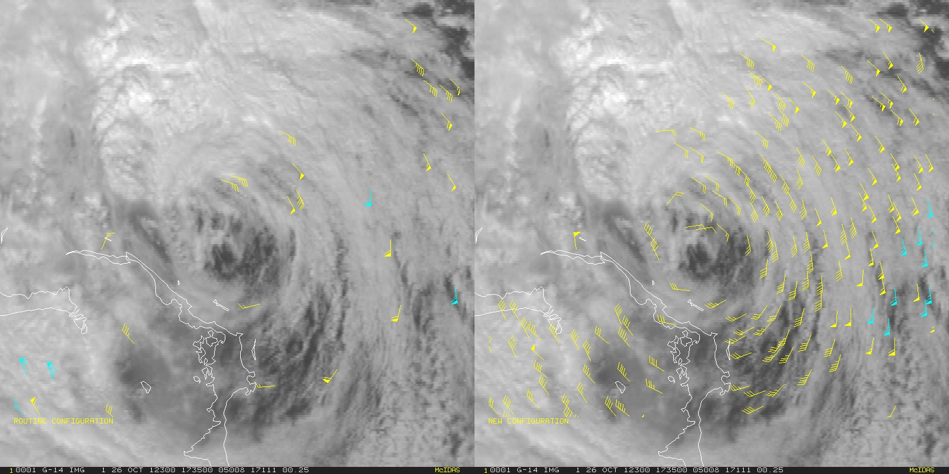
Exploit higher temporal sampling to generate higher-density AMV coverage
Low-level AMV output for Hurricane Sandy using routine 15-minute VIS imagery (left), and using new methodologies with 3-minute VIS imagery (right). Cyan vectors show hurricane force winds.

Slide 12
HWRF Experiments -- Methodology
HWRF (developmental branch, current as of Nov 2014) and NCEP/EMC GSI data assimilation (October 2014)
Run on ‘Jet’ computer (HFIP-supported resources)
Initial case for study: Hurricane Sandy (2012)
Control: 6-hr cycling DA from first TCVITALS message, assimilating RAOBs only (per Vijay’s suggestion)
Impact Experiments: as in Control, but additionally assimilate GOES rapid-scan AMVs with default GSI data thinning and QC procedures disabled. AMV datasets within +/- 3-hr of each analysis time were used.
All obs errors as in errtable from HWRF branch, except reduced 30% at all levels for AMVs (per suggestion of previous research).

Slide 13
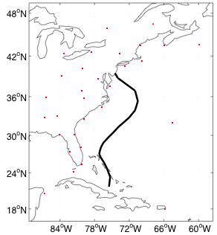
Hurricane Sandy HWRF Impact Study
Control (CTL) Run Description
HWRF initialized at 18 UTC 22 OCT 2014.
6-h cycling data assimilation
RAOB T, q, u, v and p_{s} assimilated at each synoptic reporting time (00, 06, 12, 18 UTC)
No other data assimilated
Period of interest: 18 UTC 25 OCT – 18 UTC 29 OCT (Sandy track shown at left)
RAOB LOCATIONS

Slide 14
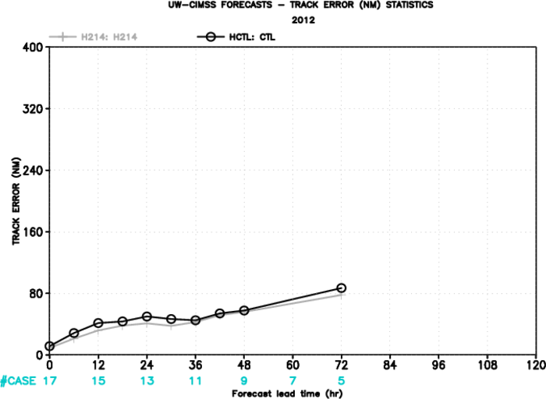
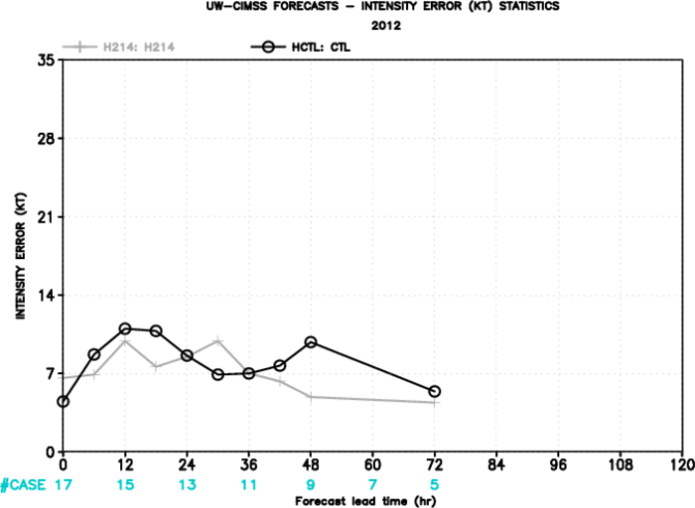
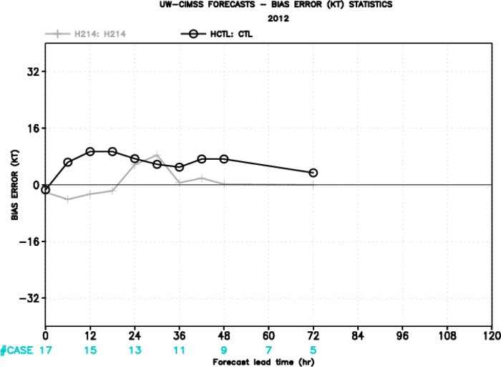
Hurricane Sandy HWRF Impact Study
CTL Forecast Results
Compared to H214 – Latest
HWRF version, assimilating
all operational data types and
recon drops/TDR, but no AMVs.
Track Forecast Error
H214 CTL
Track forecast error pretty close to H214.
Slightly better Initial intensity, but some
degradation in intensity forecasts.
Clear degradation (+) in intensity bias.
Intensity Forecast Error
Intensity Bias
H214 CTL
H214 CTL

Slide 15
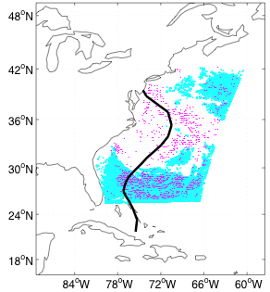
Hurricane Sandy HWRF Impact Study
AMV Experiment Description
AMV COVERAGE: 18 UTC 28 OCT 2012
Initialized from CTL
analysis at 12 UTC 25 OCT
No GSI DA thinning or QC
Assimilation of AMVs
begins at 18 UTC 25 OCT
Two AMV derivation algorithms tested:
Heritage operational (AMV1)
Experimental GOES-R (AMV2)
IR WINDS
VIS WINDS

Slide 16
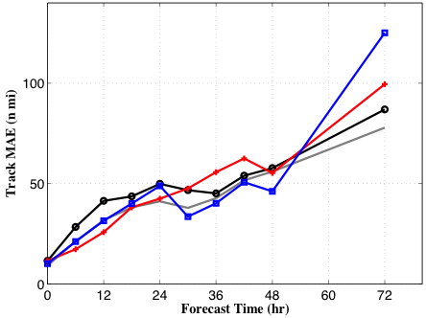
Hurricane Sandy HWRF Impact Study
Hurricane Sandy Track Forecast Error (MAE in n mi)
18Z 25OCT 2012 – 18Z 29OCT 2012
Cases (N)
17 15 13 11 9 7 5
Only 5
forecasts
H214 CTL AMV1 AMV2
Track forecast error reduced from CTL over first 24 (60 hr) in AMV1 (AMV2)

Slide 17
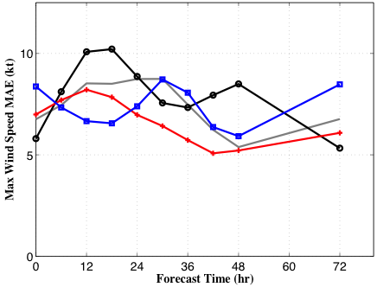
Hurricane Sandy HWRF Impact Study
Hurricane Sandy Intensity Forecast Error (MAE in kt)
18Z 25OCT 2012 – 18Z 29OCT 2012
Cases (N)
17 15 13 11 9 7 5
H214 CTL AMV1 AMV2
With the exception of t=72, better intensity at most forecast times (AMV1 most consistently)

Slide 18
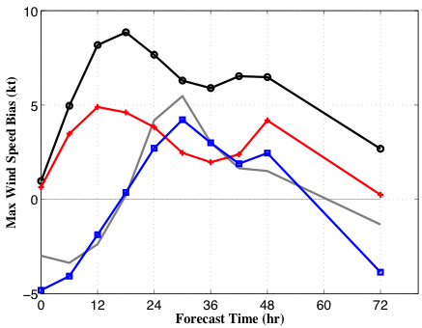
Hurricane Sandy HWRF Impact Study
Hurricane Sandy Intensity Bias (kt)
18Z 25OCT 2012 – 18Z 29OCT 2012
Cases (N)
17 15 13 11 9 7 5
H214 CTL AMV1 AMV2
Notable reduction in intensity bias over the CTL in both AMV1 and AMV2

Slide 19
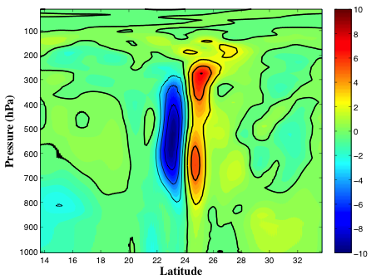
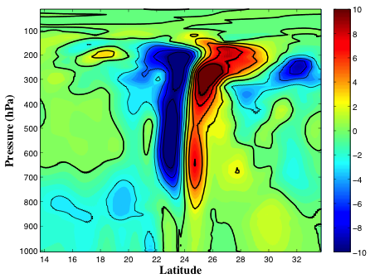
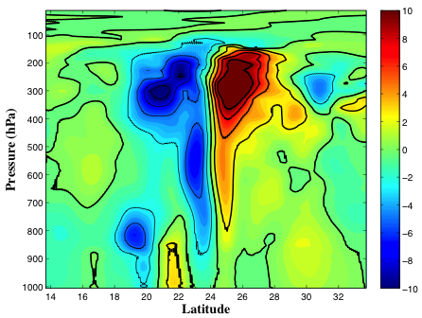
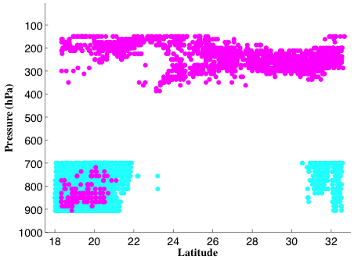
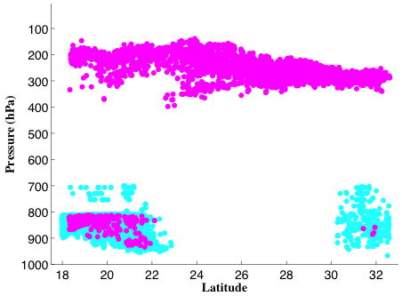
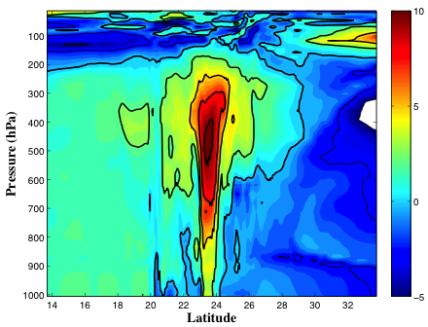
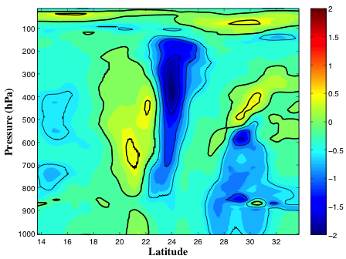
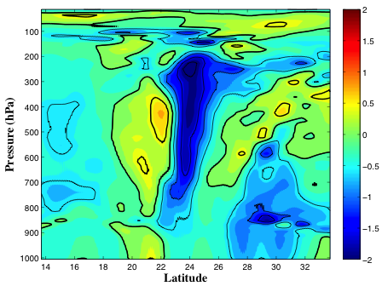
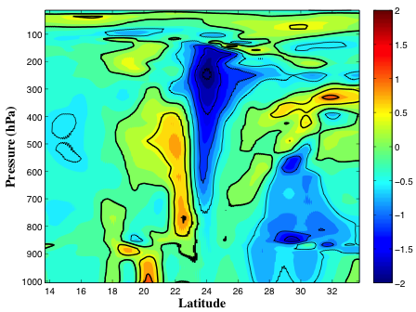
Meridional Cross Sections: 18 UTC 25 OCT Analysis Increments
Background T’ (K)
T increment (K)
U increment (m/s)
IR WINDS SWIR/VIS WINDS
AMV2 AMV1 CTL

Slide 20
Direct Assimilation of Satellite-Derived AMVs into HWRF: First Results
Conclusions
No harm was done to the patient!!
Direct assimilation of AMVs generally yield small HWRF track forecast improvements wrt CTL thru 60 hr for Sandy.
AMVs generally improve Sandy intensity (Vmax) forecasts thru 60 hr, and notably improve the intensity bias at most lead times.
The AMV experiment results for Sandy are on par with already quite good H214 results (operational HWRF run with all data assimilated including recon drops and TDR, but no direct assimilation of AMVs) for both track and intensity forecasts.
So, encouraging first results!......but…

Slide 21
Direct Assimilation of Satellite-Derived AMVs into HWRF: First Results
…More Work Ahead
Sandy: Rerun AMV experiments with observation sets initially withheld (TDR, dropsondes, satellite radiances, etc.)
Examine output/forecast fields/increments to help diagnose where AMVs are impacting the TC analysis and subsequent forecasts
Increase sample size (TC Gonzalo next, then other cases)
Further tuning to optimize AMV DA (vertical obs error, QC, etc.)
Hourly FGAT? (should result in better background fields for the high-density AMVs)
3-hourly DA cycling? Eventually 1-hourly to maximize AMV impact?
Increase spatial domain of AMV assimilation? (currently limited to HWRF inner domain analysis)

Slide 22
Direct Assimilation of Satellite-Derived AMVs into HWRF: First Results
William E. Lewis*, Christopher Velden*
Vijay Tallapragada†, Jaime Daniels‡
* SSEC/CIMSS (University of Wisconsin-Madison)
† NOAA EMC
‡ NOAA STAR
Questions?
Research sponsors: HFIP and GOES-R Risk Reduction

