Slide 1



Hurricane forecasts with Regional NMMB: Impact of HWRF Physics
Weiguo Wang and Vijay Tallapragada
EMC/NCEP/NOAA, College Park, MD 20740
TCRF/69th IHC
Mar. 2015
HIWPP Project Co-Lead: S.G. Gopalakrishnan, AOML/HRD

Slide 2
Outline
HWRF physics packages into NMMB
Hurricane simulations with regional NMMB
+ NMMB with ‘NAM physics’ vs with ‘HWRF physics’
+ NMMB with ‘HWRF phys’ vs operational HWRF
Issues and plans
Summary and Future work

Slide 3
HWRF physics into NMMB
Following physics schemes used in operational HWRF have been added to NMMB:
GFSPBL scheme
GFDL surface layer plus GFDL land surface scheme
SAS scheme
MESO-SAS scheme
Add empirical z₀ for hurricane to MYJ surface scheme
NMMB has “fer”, “fer_high” micophysics schemes, and “gfdl”, “rrtmg” for radiation; those are very similar to HWRF’s.

Slide 4
NMMB-hurricane flowchart
To be replaced by NMMB-DA/INIT
To be replaced by spectral data
Operational HWRF vortex Initial conditions
GFS 0.5-degree data
Boundary Conditions
NPS
namelist.nps
configure_file_d01
configure_file_d02
configure_file_d03
NMMB
Post/Tracker
Analysis/plots

Slide 5
NMMB Hurricane simulations
27-9-3 domains, 43-level, feedback=0.5
No ocean, no DA
Phys Options | Configuration 01 NAM-like phys | Configuration 02 hwrfphys | Configuration 03 Hwrfphys-noah
Turbulence/pbl: | MYJ | GFSHUR | GFSPBL
sfc_layer: | MYJ | GFDL | MYJ (z0 modification)
land_surface: | NOAH | GFDLSLAB | NOAH
convection: | BMJ | SASHUR | SASHUR
microphysics: | FER | FER | FER
shortwave: | GFDL | GFDL | GFDL
longwave: | GFDL | GFDL | GFDL

Slide 6
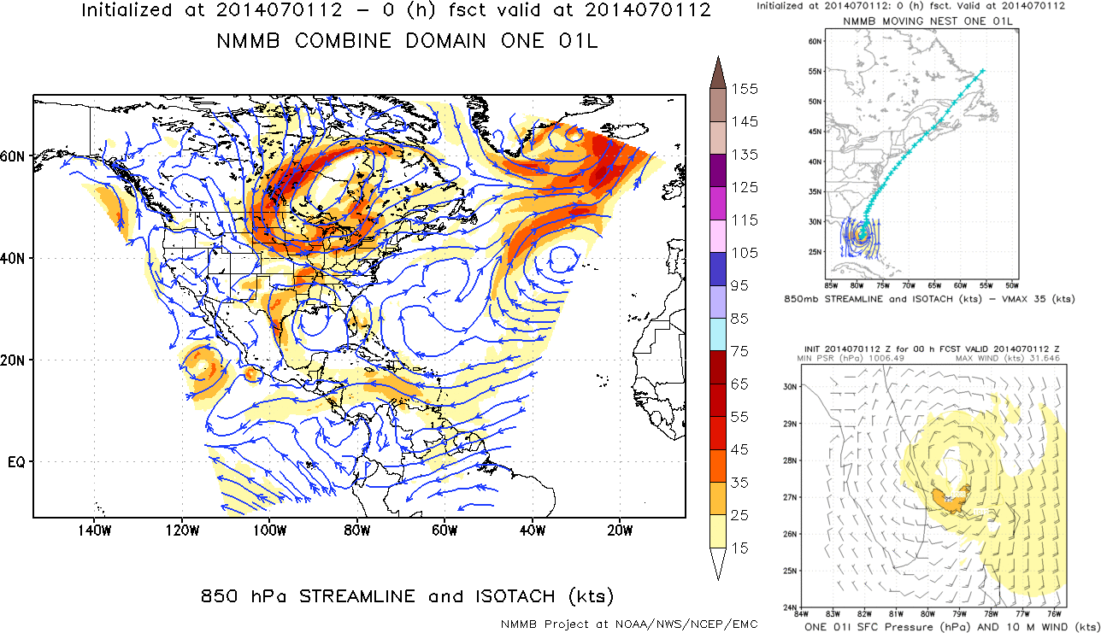
ARTHUR simulated by regional NMMB with HWRF phys: cycle 2014070112

Slide 7
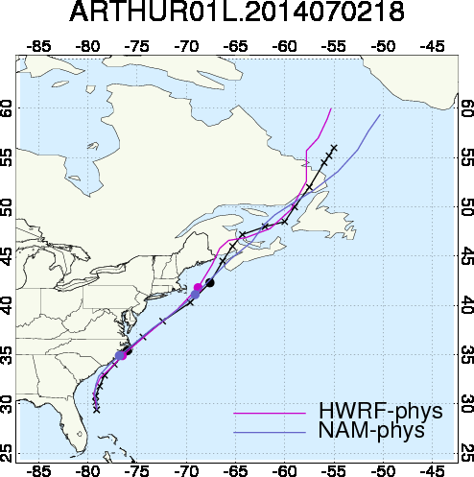
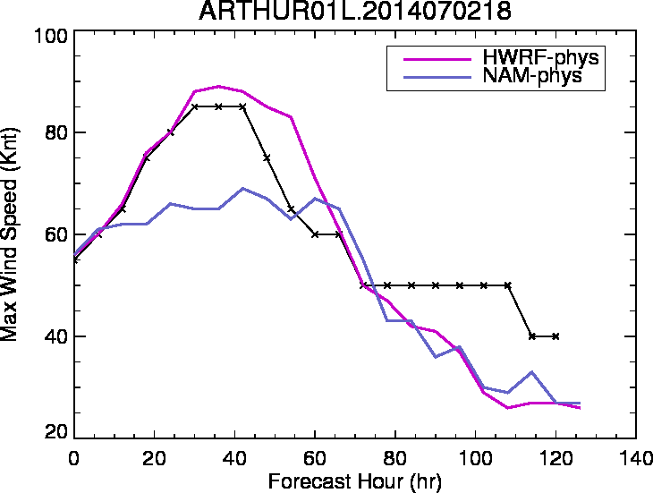
NMMB Track and intensity
Hwrfphys vs Nam-like phys
HWRF phys
NAM phys
Convection or/and surface layer (z0) schemes in NAM phys may explain its weaker intensity

Slide 8
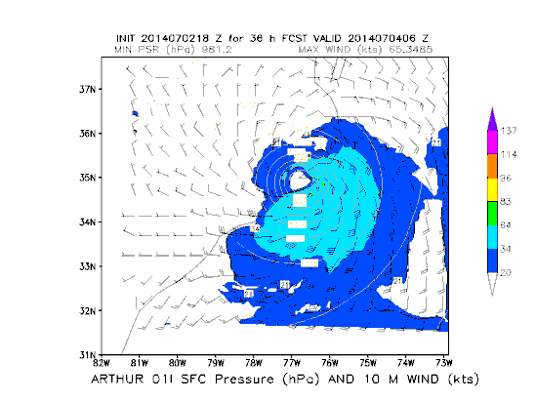
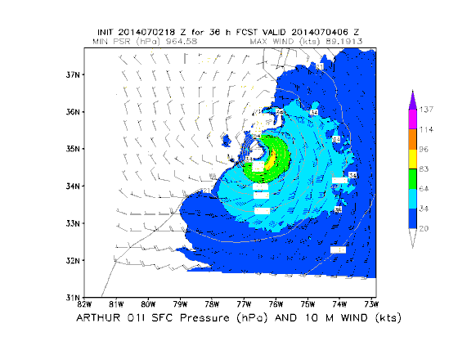
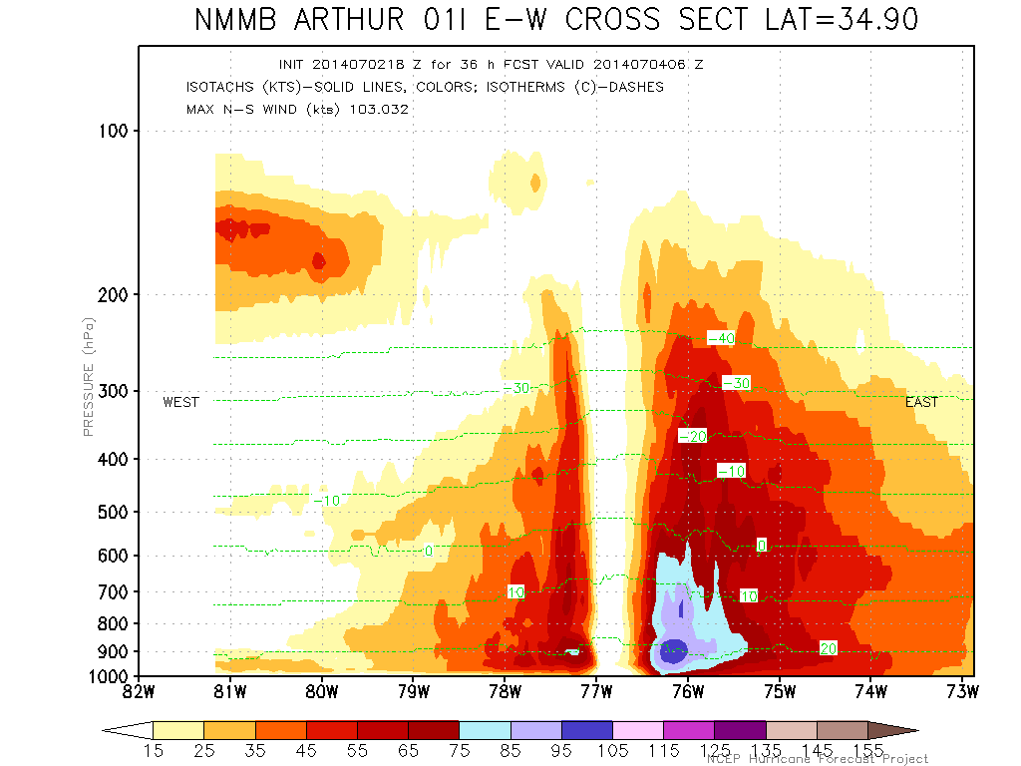
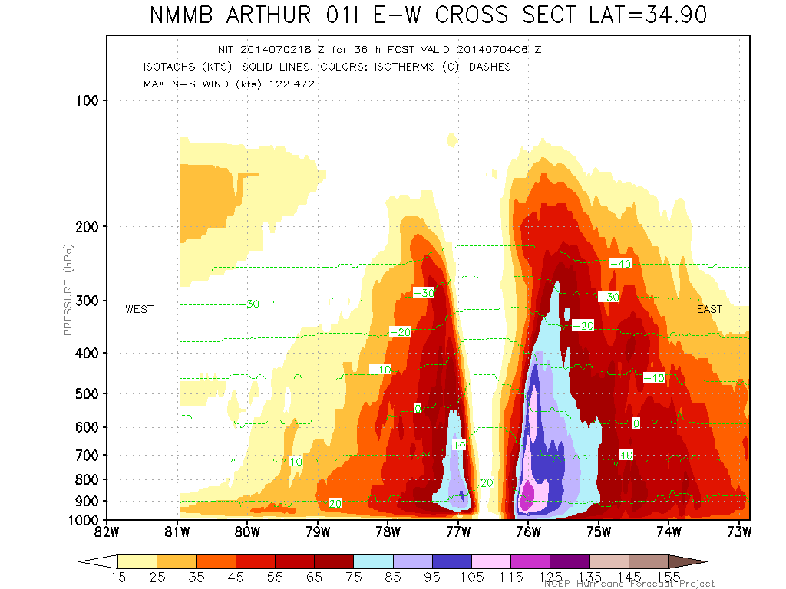
Wind Structure at 36 hr, near landing
NAM phys
HWRF phys
10m wind
E-W cross section

Slide 9
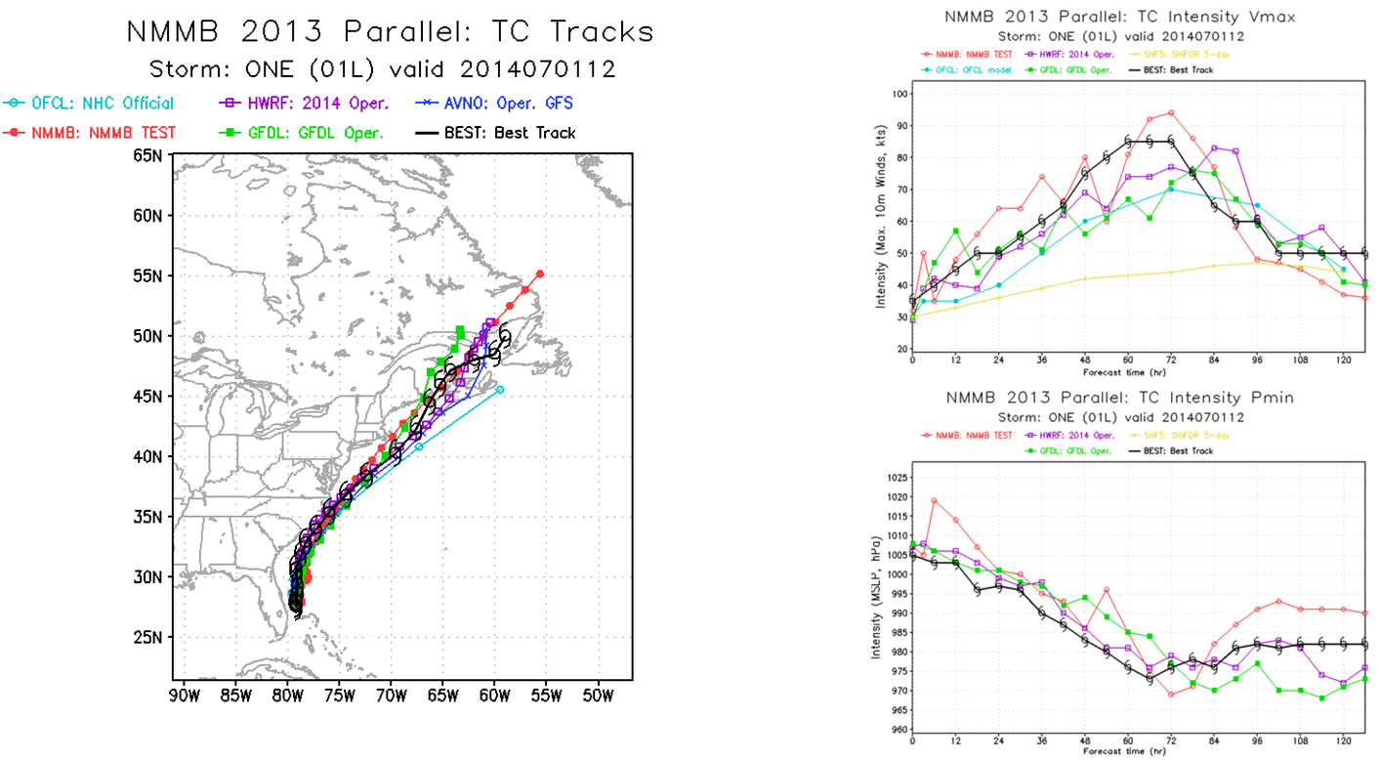
Compare NMMB using HWRF phys with Operational HWRF
NMMB (red) Intensity very close to HWRF (purple), and even better timing of max

Slide 10
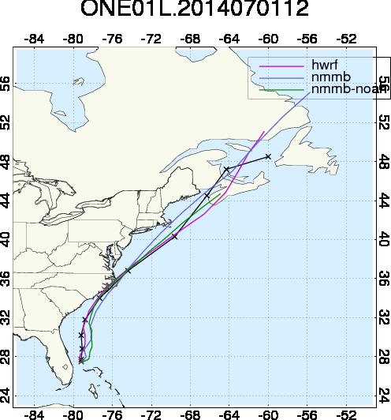
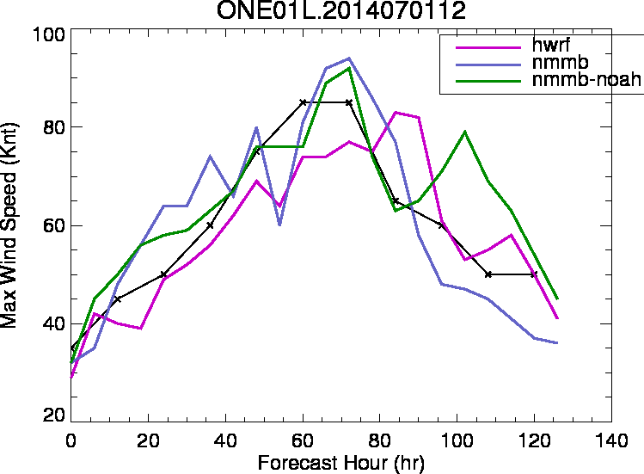
Other physics options:
GFSPBL-MYJ-noahLSM
(modified z0 over sea in MYJ sfc)
Operational HWRF
NMMB-hwrfphys
NMMB-hwrfphys-NOAH

Slide 11
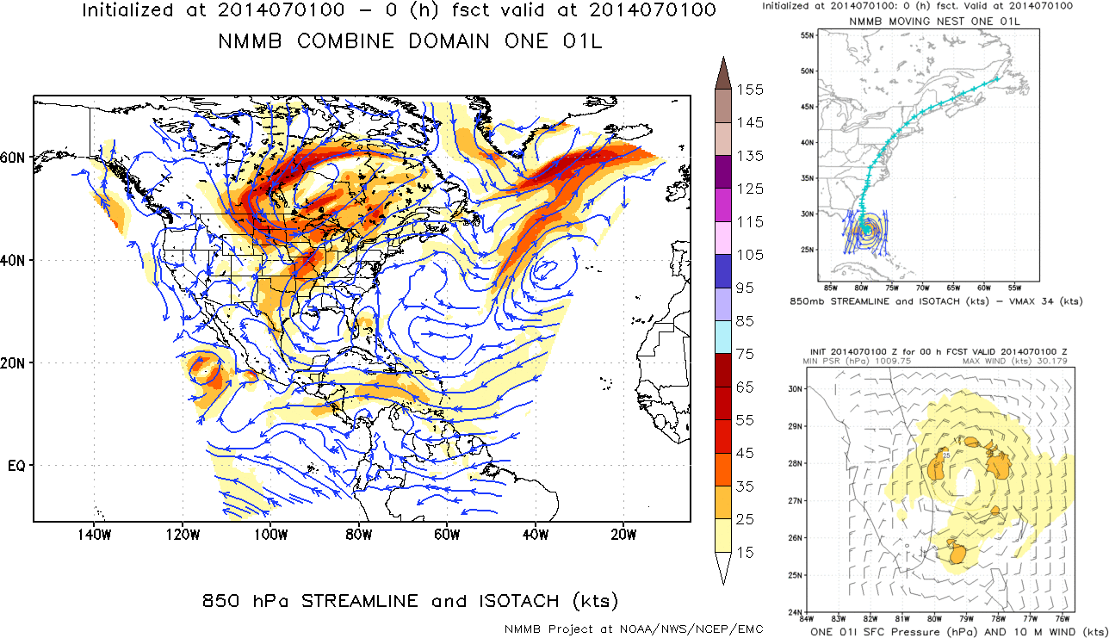
Issues:
Some issues for NMMB-hurricane still need to be addressed,
for example, nest motion
Nests do not move with vortex
Bad track

Slide 12
Plans:
Ongoing NMMB-hurricane tasks
Task | Status | note
Transition of HWRF physics suite to NMMB | DONE | Already In nems trunk Need extensive tests
HWRF nest motion algorithm to NMMB | ONGOING
HWRF vortex initialization to NMMB | ONGOING | We have old version working
HWRF data assimilation | Planned | GSI-EnKF ?
Ocean coupling | Planned | Use nems coupler if OK Add coupler for moving nests
Post processing | Planned | Add in-model diagnostic fields; OK to use ncep-post

Slide 13
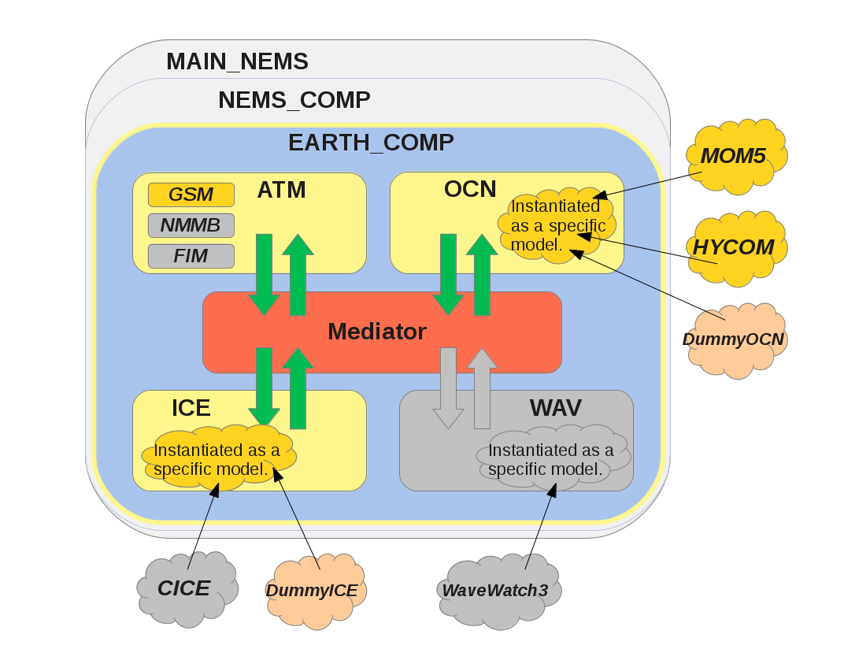
Plans:
NMMB-hurricane in NEMS
NMMB-hurricane
Coupled with many other components
http://cog-esgf.esrl.noaa.gov/projects/couplednems/architecture

Slide 14
Summary
With HWRF phys package, regional NMMB can well simulate hurricane structure, intensity and track, showing potential to further advance NCEP capability to hurricane forecast.
Comparison with physics options in NAM shows importance of using good physics parameterizations for hurricanes.
Future work: improve nest motion algorithm, other components (e.g., DA + init) from HWRF system, …, work with other components under nems

