Slide 1



The Basin Scale HWRF system: Verification and Analysis
Sundararaman gopalakrishnan (gopal)
noaa/aoml/Hurricane research division, Miami, FL, USA
Co-Authors: Ghassan Alaka, xuejin zhang, Thiago quirino, vijay tallapragada and frank Marks jr.
Acknowledgements: Bill Kuo & Ligia Bernardet, DTC, boulder & Christopher Williams, tcmt, boulder
Presented at 69th Interdepartmental Hurricane Conference,
March 2-5, 2015, Jacksonville, FL

Slide 2
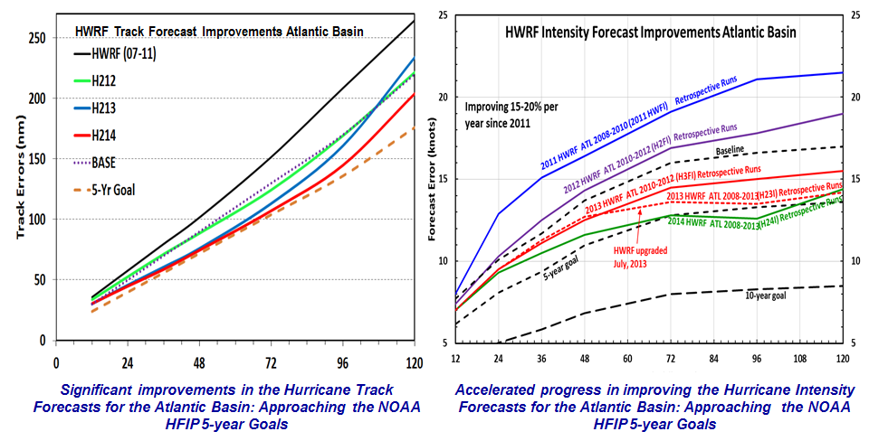
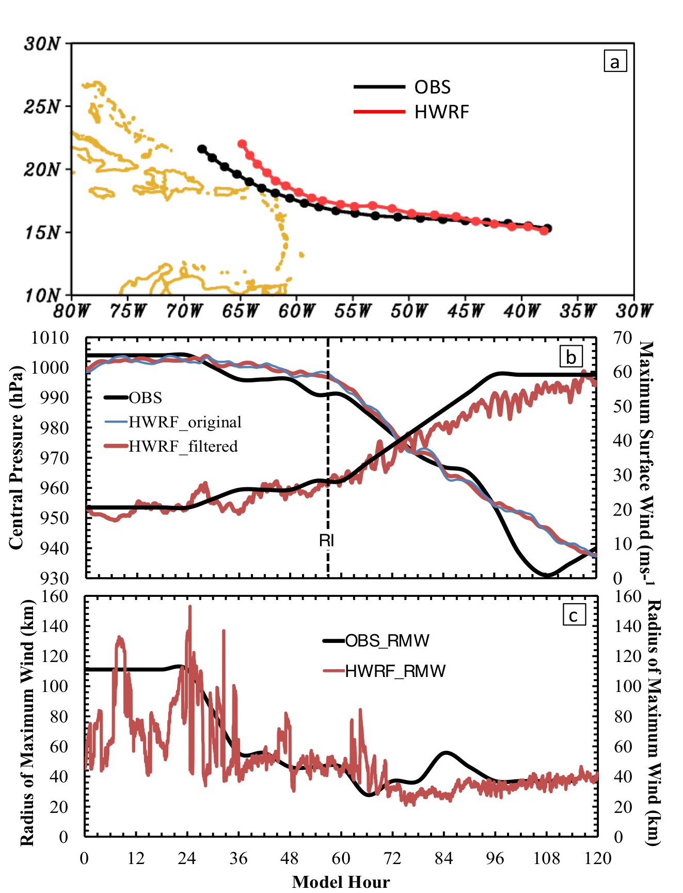
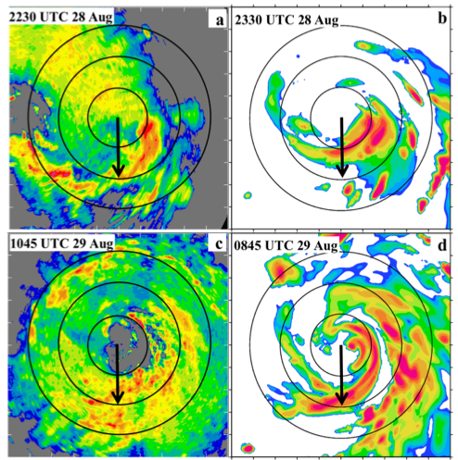

Operational HWRF: State of the art
Hurricane Earl 2010: An example of RI case in a sheared environment
P-3 Lower fuselage
HWRF (pre-RI)
P-3 Lower fuselage
HWRF (RI)
The High Resolution HWRF is starting to get the organized cloud at the right spot. This is critical for improved RI predictions (Chen and Gopal, JAS, 2015)
Notes:
Question arises on the validity of these forecast beyond the two numbers. We have been looking at some of these forecast in great details.

Slide 3
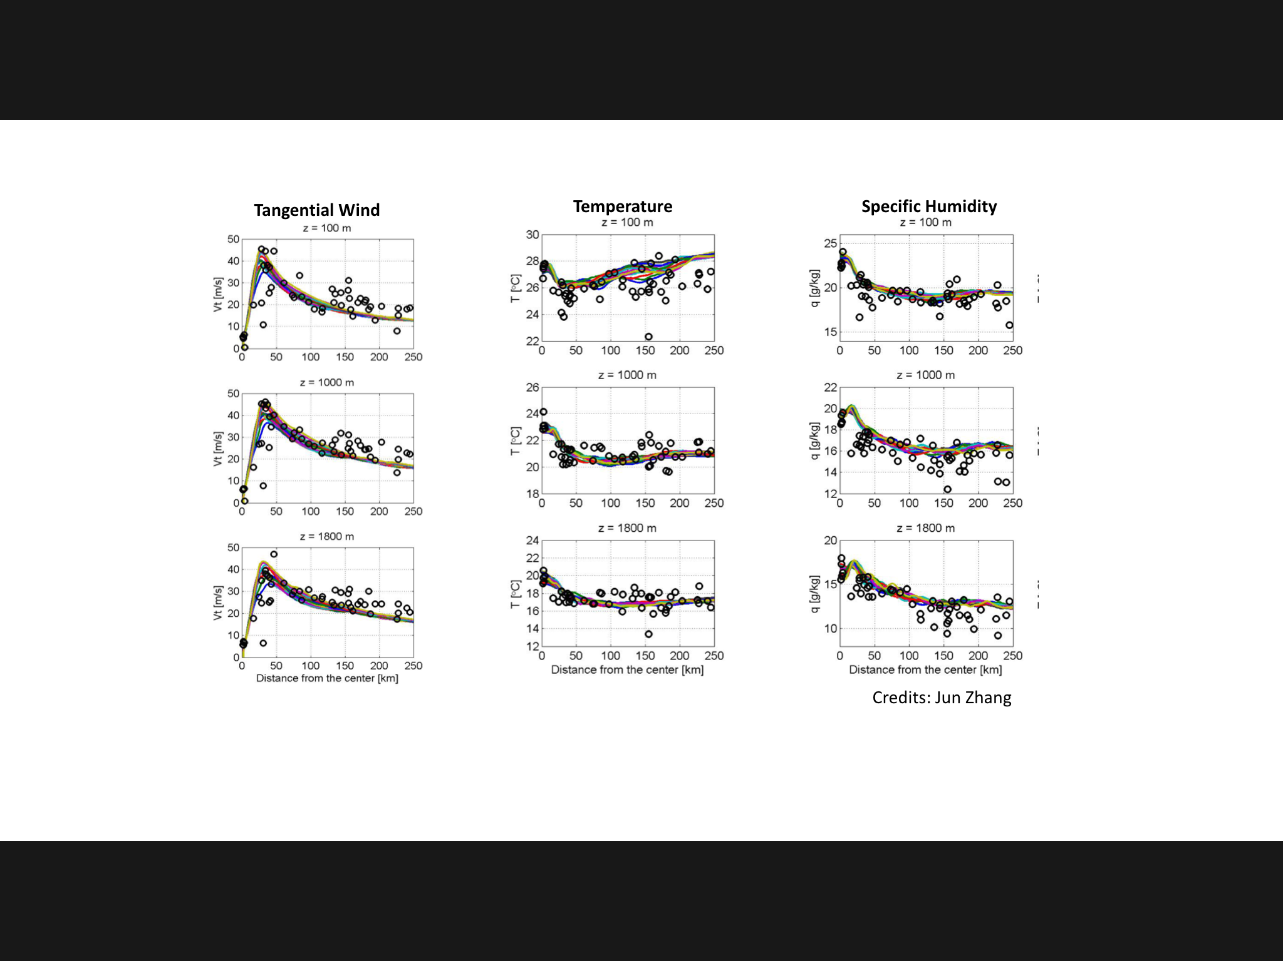
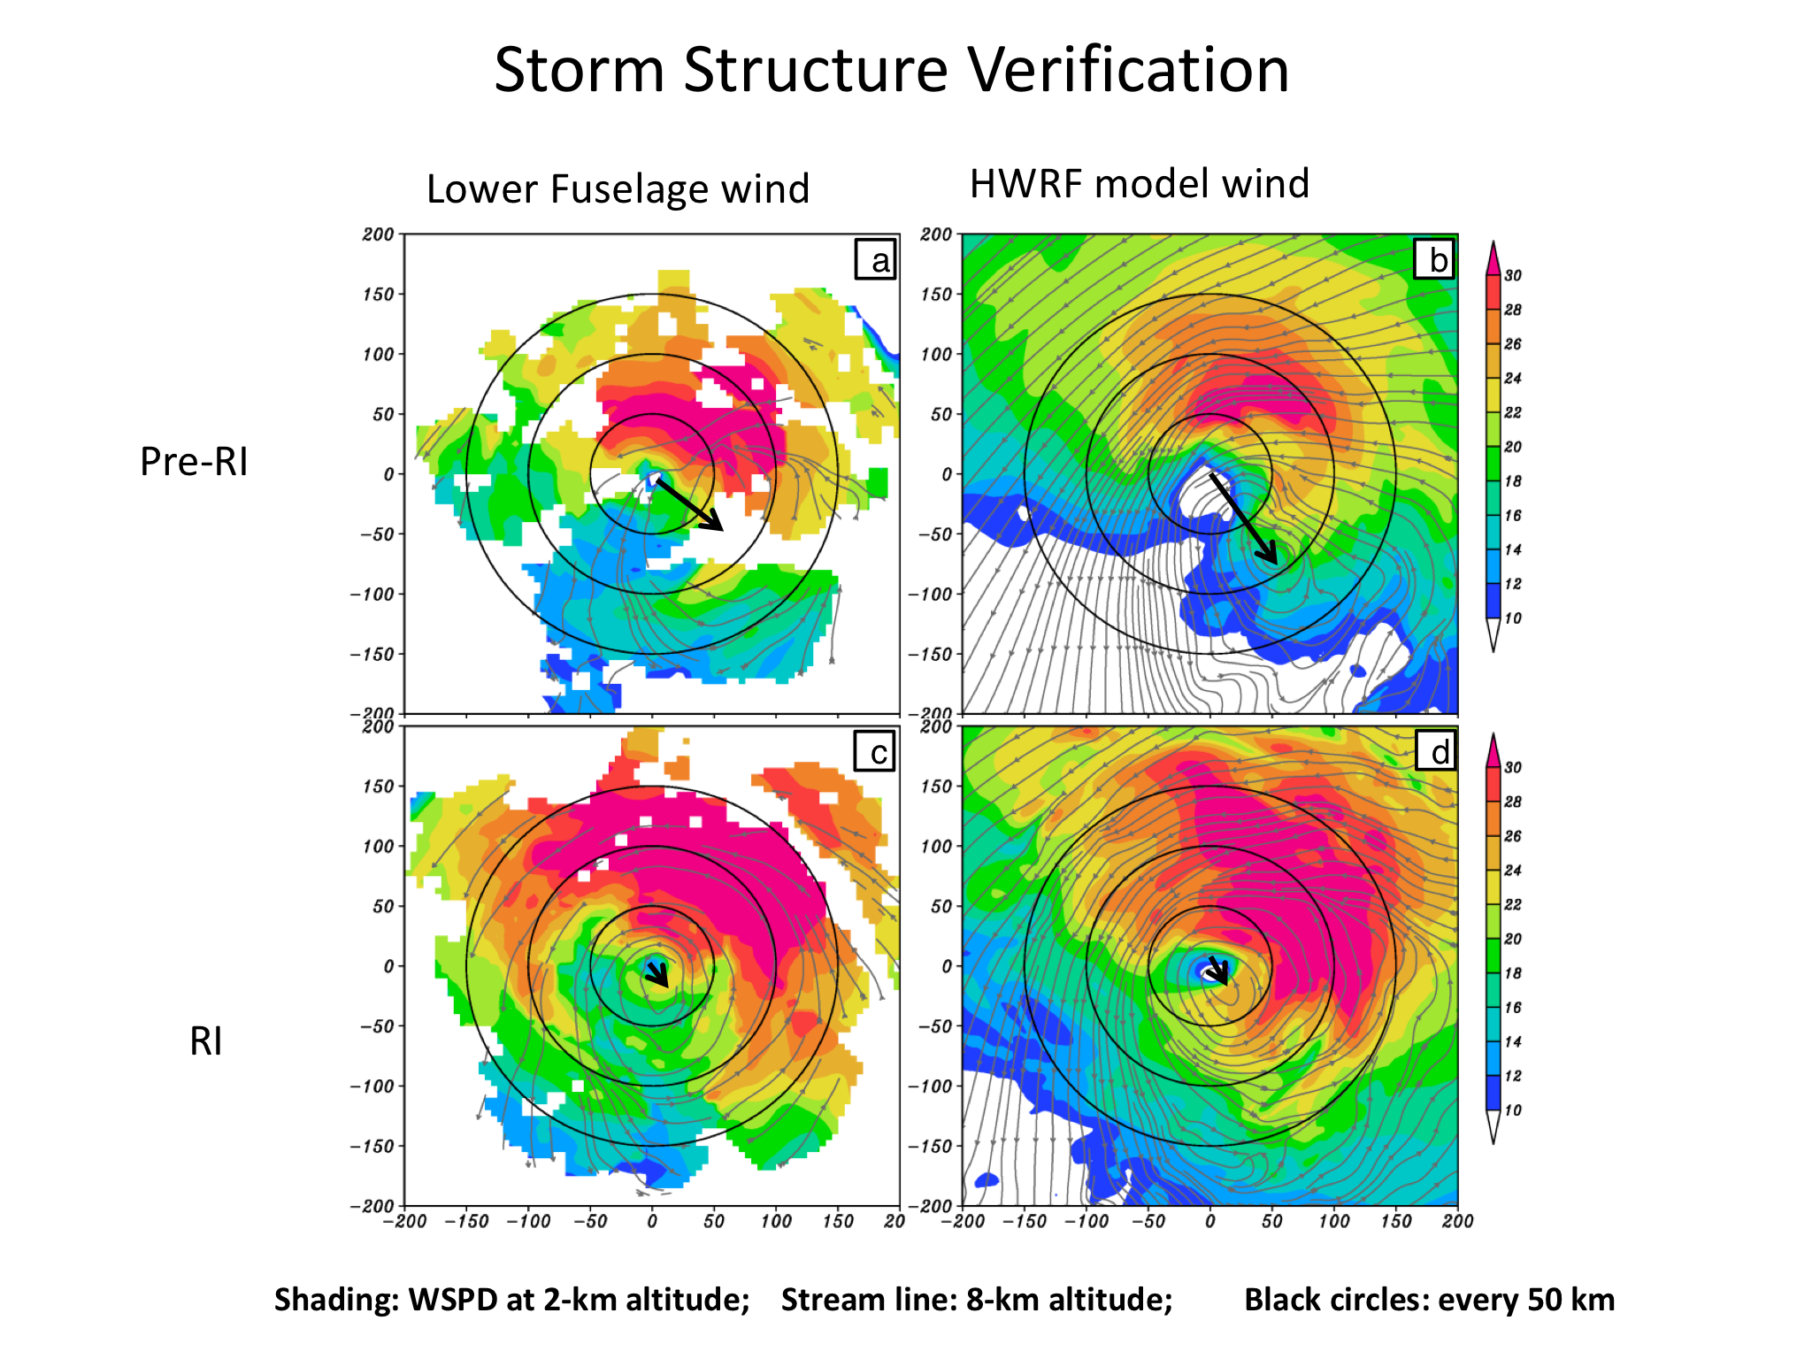
Hurricane Earl (2010): 3-km Forecast
P-3 Lower fuselage
HWRF simulated
Tilt
Pre RI
RI
From Chen and Gopal, JAS, 2015
Apart from the standard verification metrics (track and peak winds), HWRF reproduced the storm structure extremely well making this an unique data set
Notes:
Are all forecast this good?

Slide 4
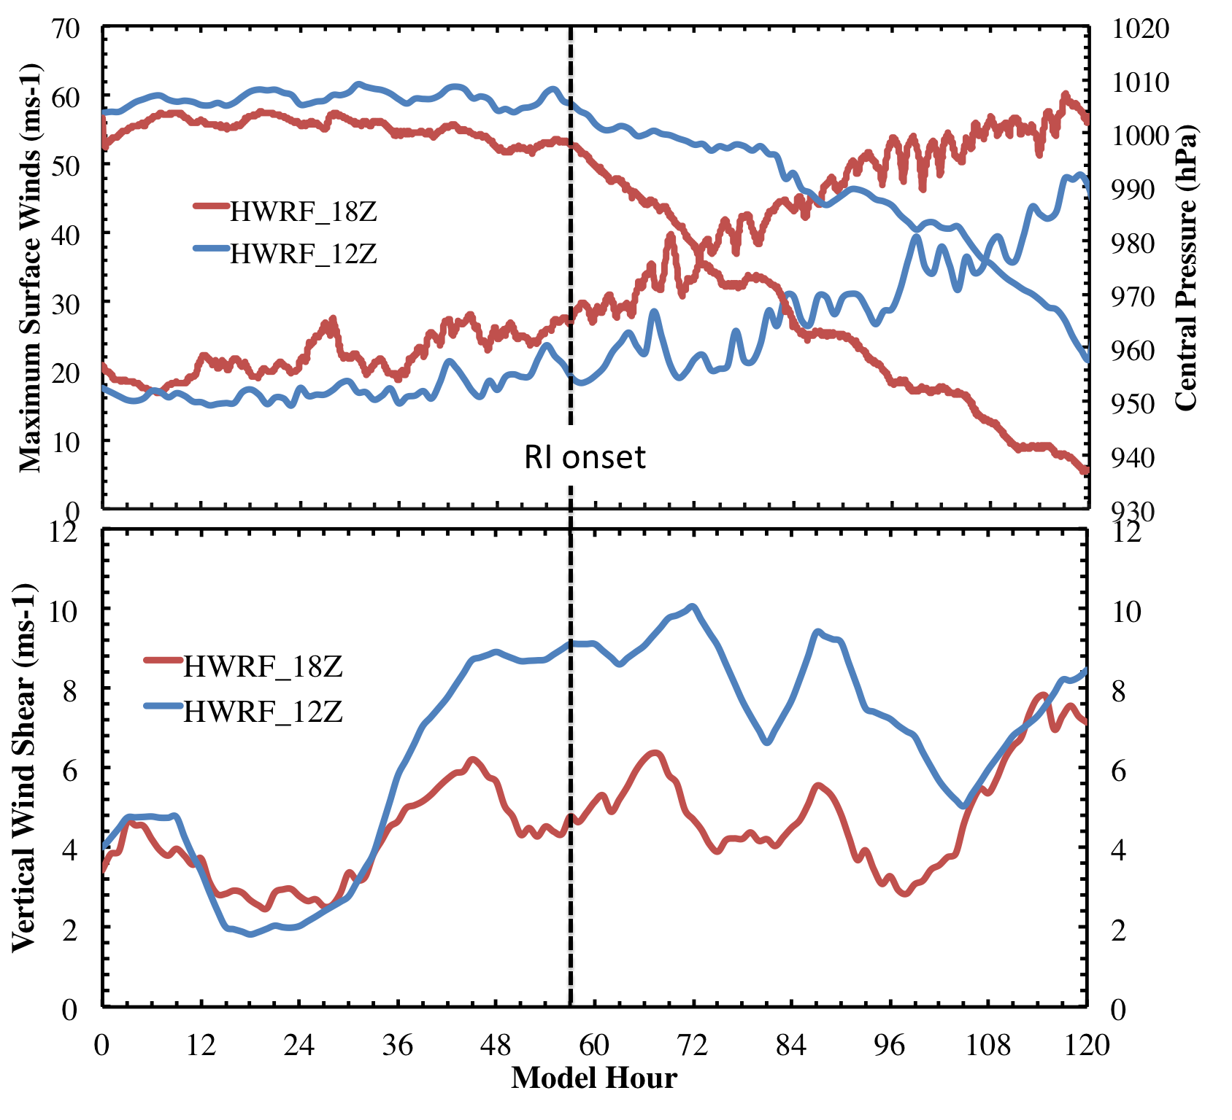
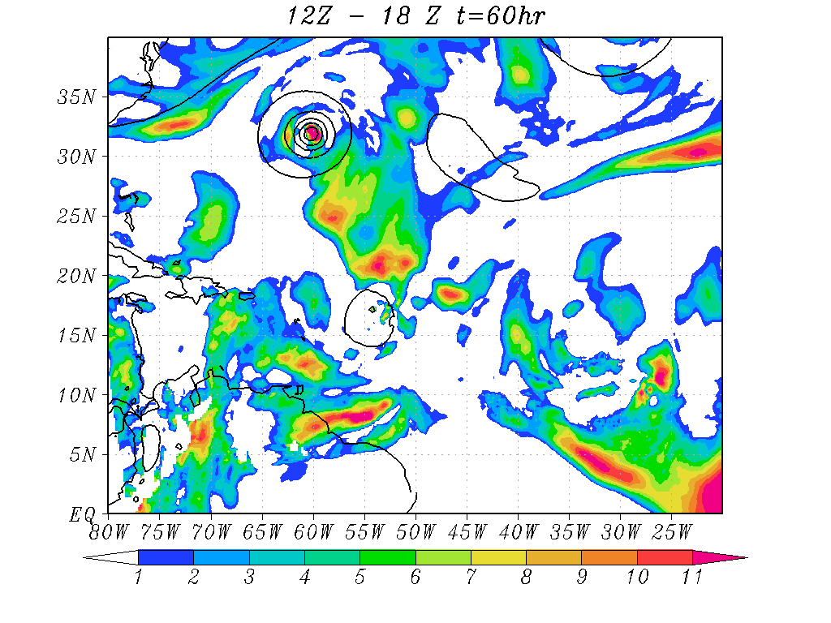
RI problem: Importance of Multi-Scale interactions
Shear vortex interactions during RI in Hurricane Earl (2010)
Shear difference between 12Z and 18Z runs at RI onset
Not all forecasts are as good as the 18Z run! The 12Z forecast was not impressive!
Larger Scale: Higher Shear mostly driven by outflow from Dannielle

Slide 5
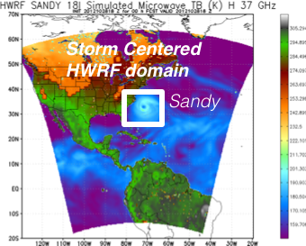
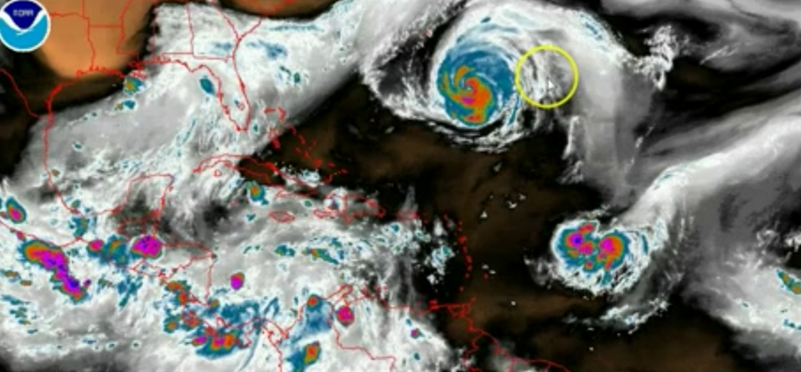
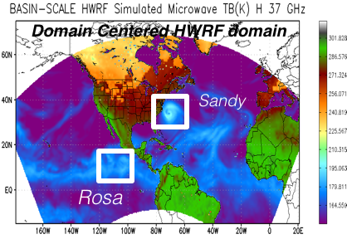
Addressing Our Immediate TC Prediction Needs
A Busy Day in the Tropics
Storm Centric -VS- Domain Centric Forecasts
- Tropical predictions system (Extended predictions)
- Improved storm-storm & multi-Scale interactions
- Landfall and post landfall (storm surge & rainfall)
- Genesis
- Regional ensembles
- Data assimilation

Slide 6
Basin Scale HWRF: Configuration
 | 2014 Operational HWRF | 2013 Basin-wide HWRF (H3WI)
Domain | 27 KM: 77.58˚ X 77.58˚ 9 KM: 10.56˚ X 10.2˚ 3 KM: 6.12˚ X 5.42˚ | 27 KM: 178.20˚ X 77.58˚ 9 KM: 10.56˚ X 10.2˚ 3 KM: 6.12˚ X 5.42˚
Vortex Initialization | Modified Vortex Initialization at 3 KM with 30ºx30º analysis domain One-way hybrid DA | 2013 multiple storm vortex initialization at 3KM with 30ºx30º analysis domain No DA outer domain
Cycling | Yes (3 KM vortex only) | Yes (3KM vortex only)
Ocean Coupling | 27-9 KM: Yes 3 KM: No, Downscaled | 27-9-3 KM: No
Physics schemes
Microphysics | Modified Ferrier (High Resolution) | Modified Ferrier (High Resolution)
Radiation | GFDL | GFDL
Surface | GFDL (High Resolution) | GFDL (High Resolution)
PBL Scheme | 2013 GFS (High Resolution) | 2013 GFS (High Resolution)
Convection | SAS (High Resolution), No CP (3 KM), Shallow Convection | SAS (High Resolution), No CP (3 KM), Shallow Convection
Land Surface | GFDL Slab | GFDL Slab
GWD | Yes(27 KM); No(9-3 KM) | No(27 KM); No(9-3 KM)
Basin Scale HWRF: same version of HWRF but operates with multiple moving nest, initialization, cycling and physics all consistent with operational HWRF, with 61 levels, w/o active ocean coupling. The system is being transition to DTC for research. http://storm.aoml.noaa.gov/realtime

Slide 7
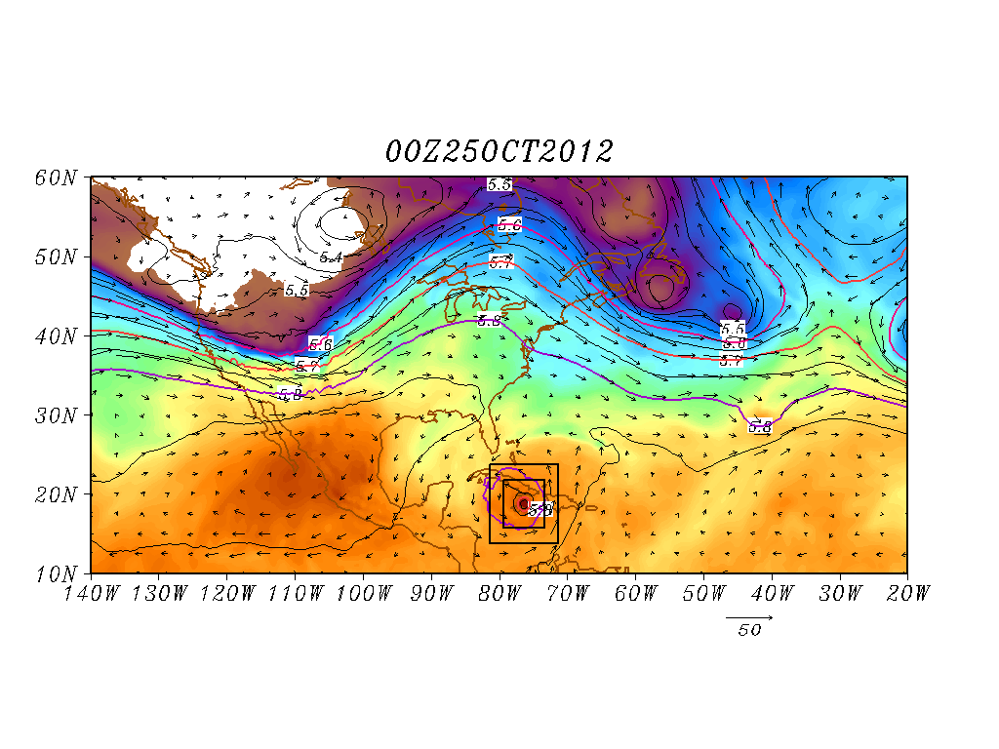
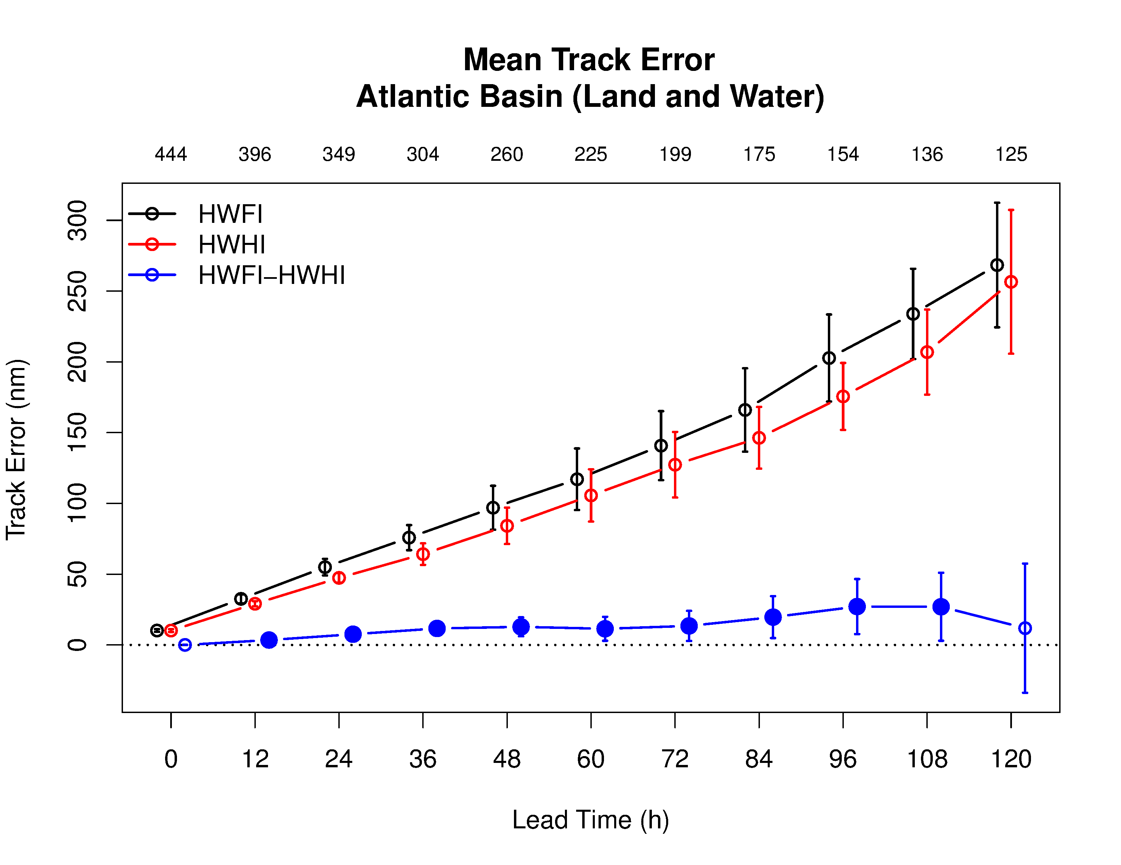
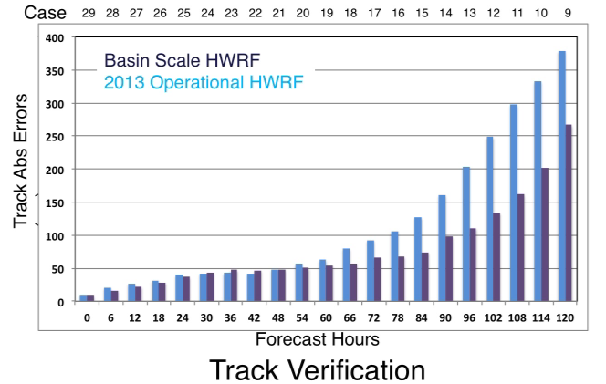
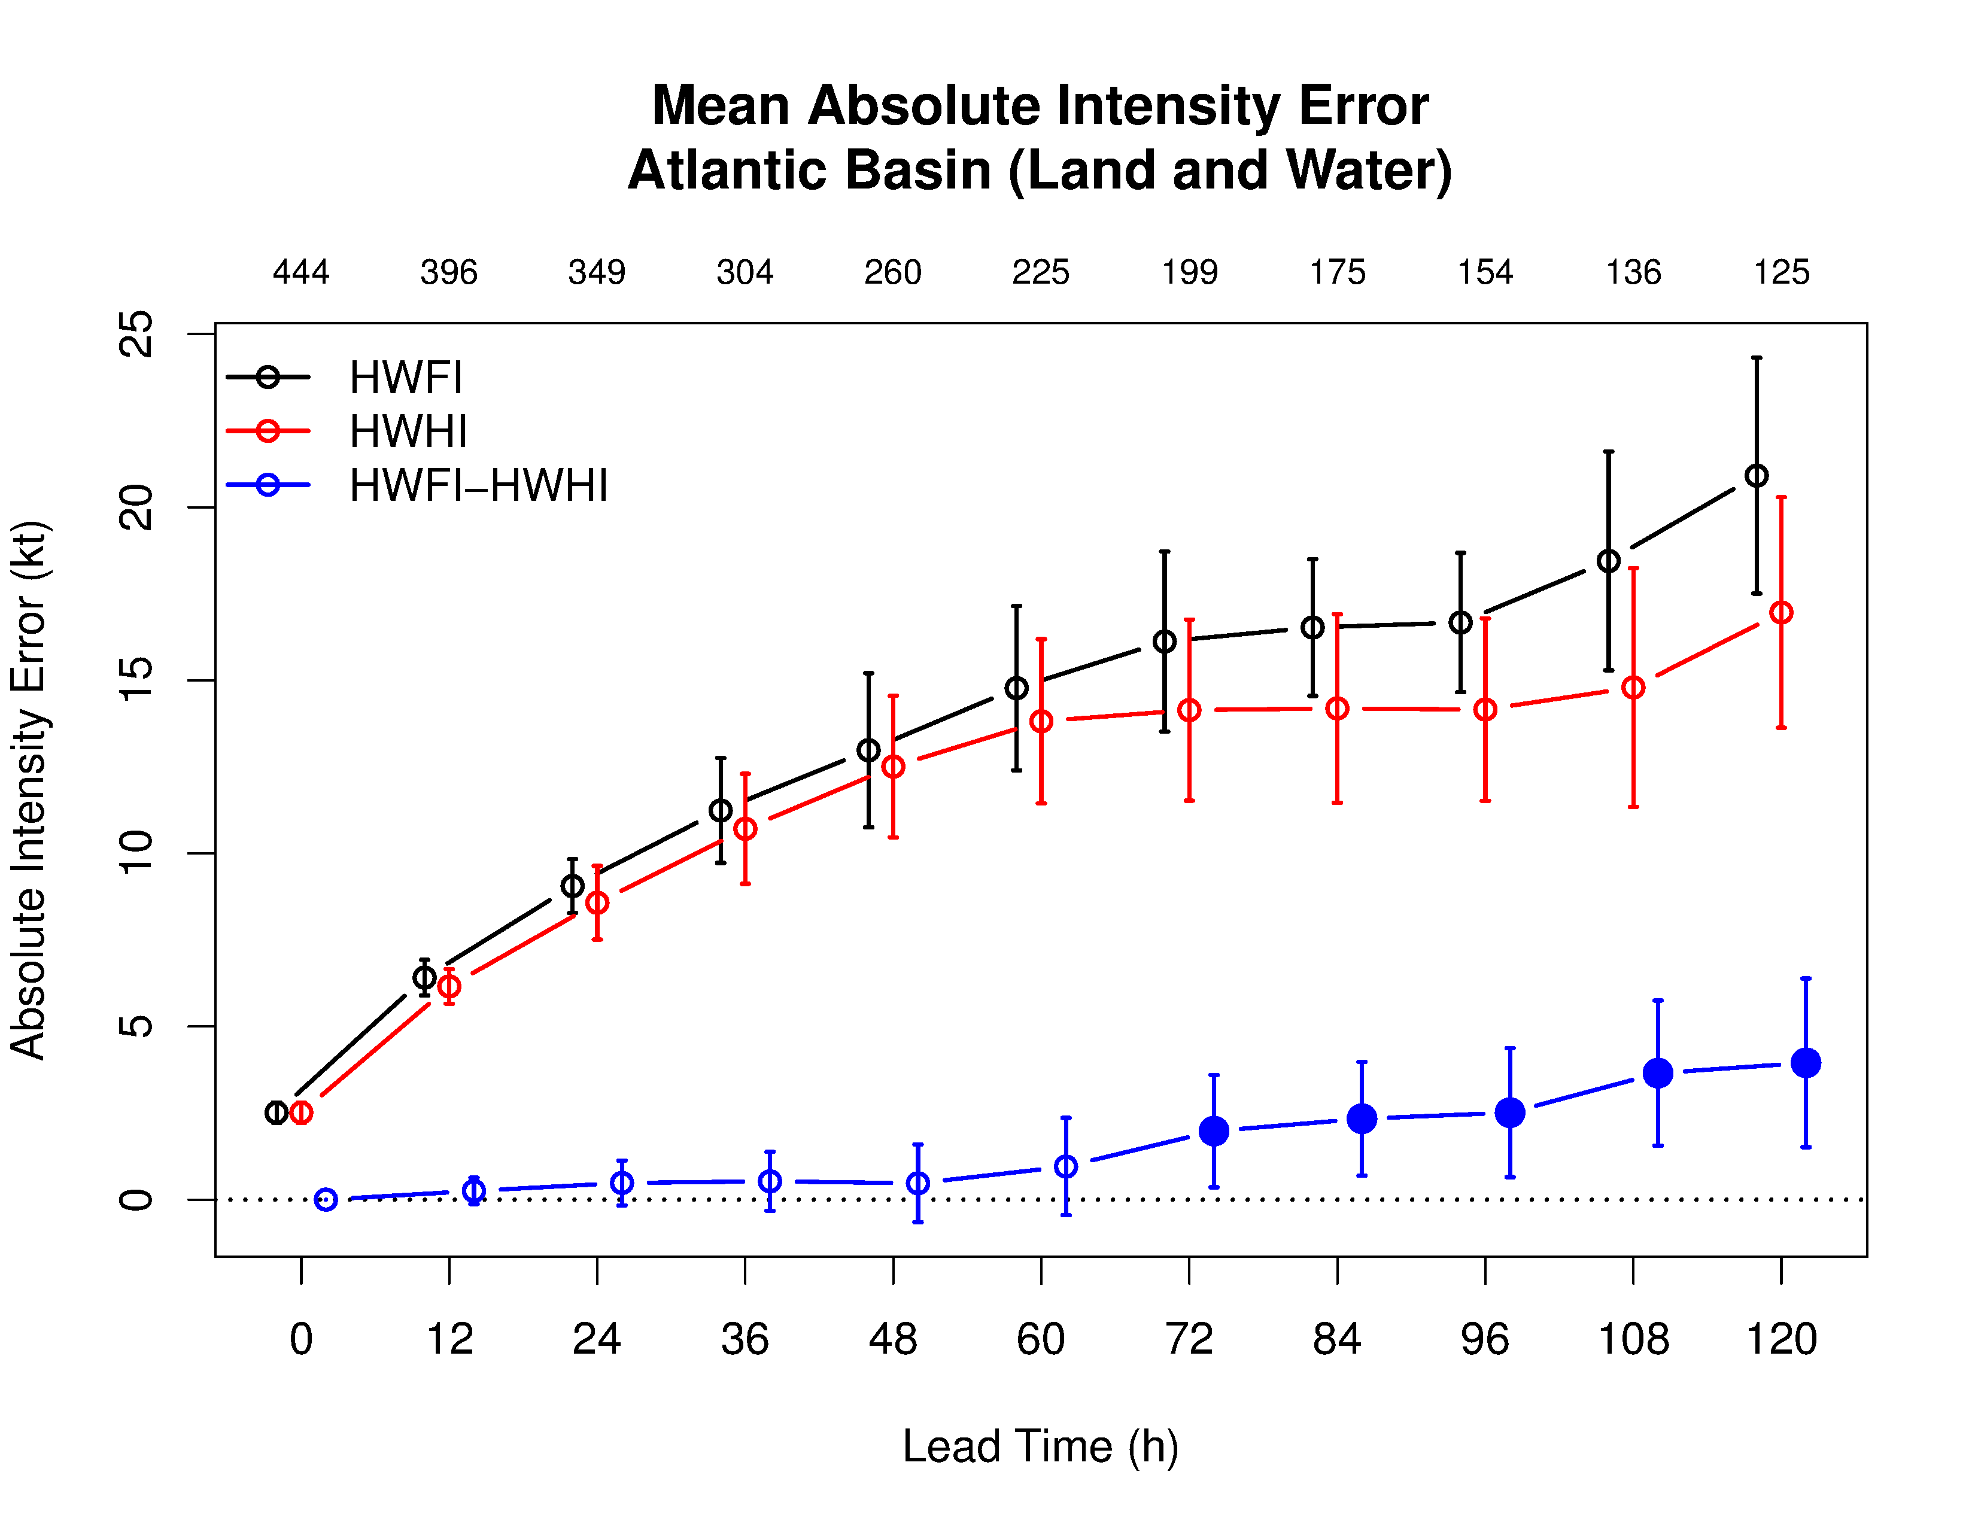
Basin Scale HWRF: Experimental Prediction System
Improved scale interactions and improved track & size forecasts (25 00Z Predictions)
Basin Scale HWRF
Shading: T at 500 hPa; Contour: GHT at 500 hPa
Vector: Flow averaged between 500 hPa and 200 hPa
Basin Scale HWRF
Performance of the Basin Scale HWRF (2013): Significant improvements over 2013 operational HWRF and comparable with 2014 HWRF
Hurricane Sandy Predictions: A classic example of Domain Size and Vortex- Mean Flow interactions

Slide 8
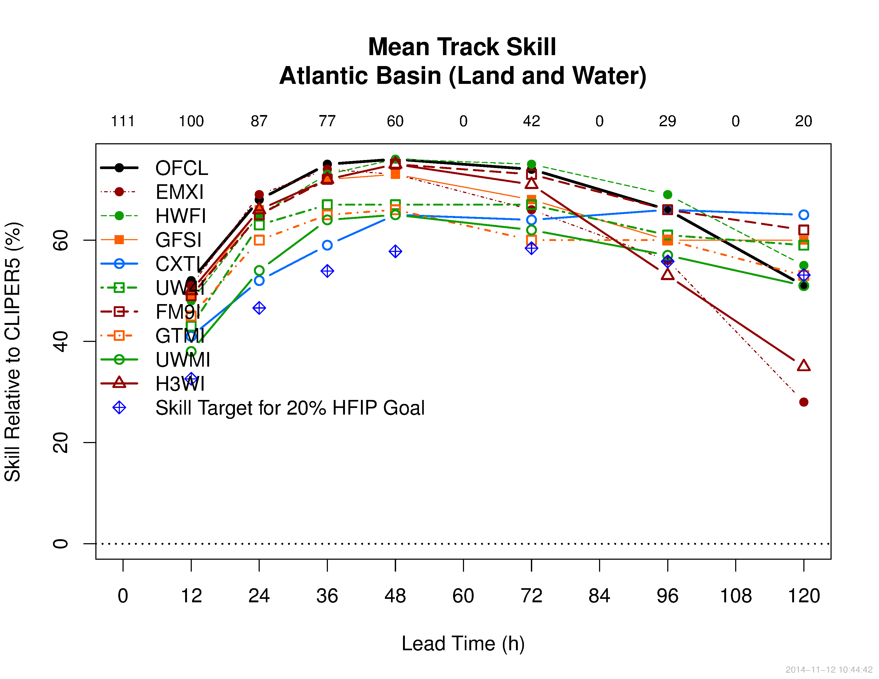
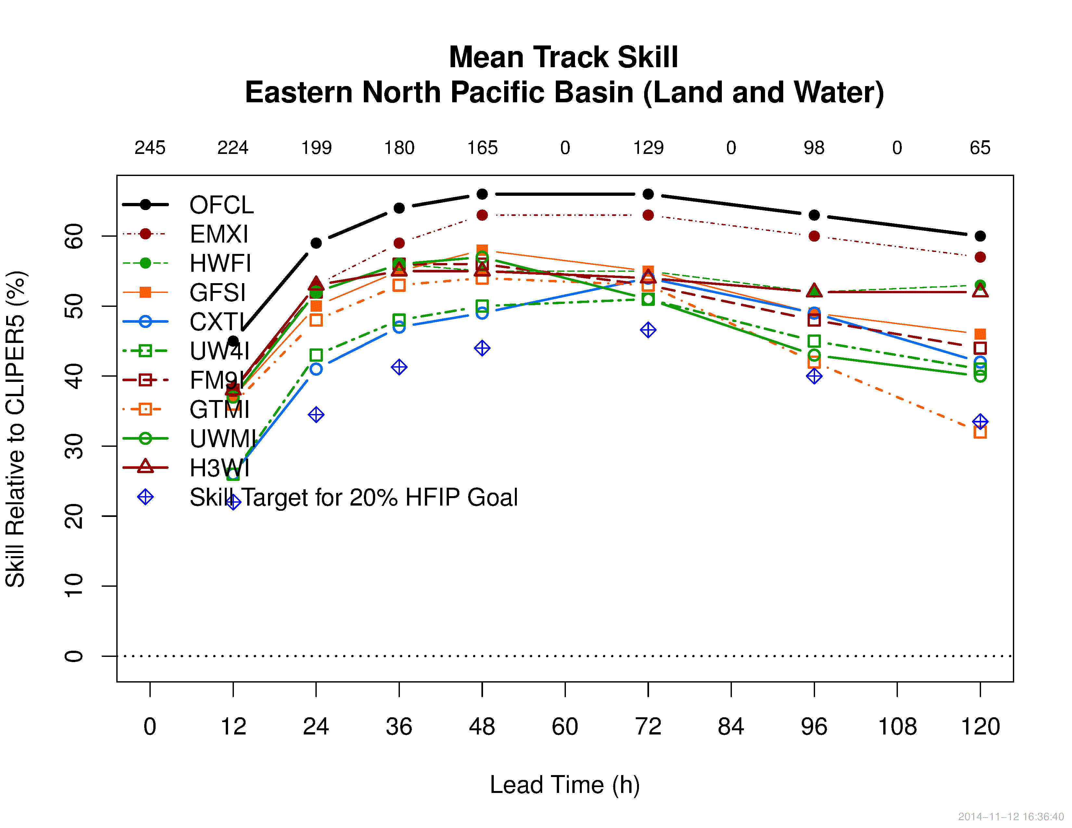
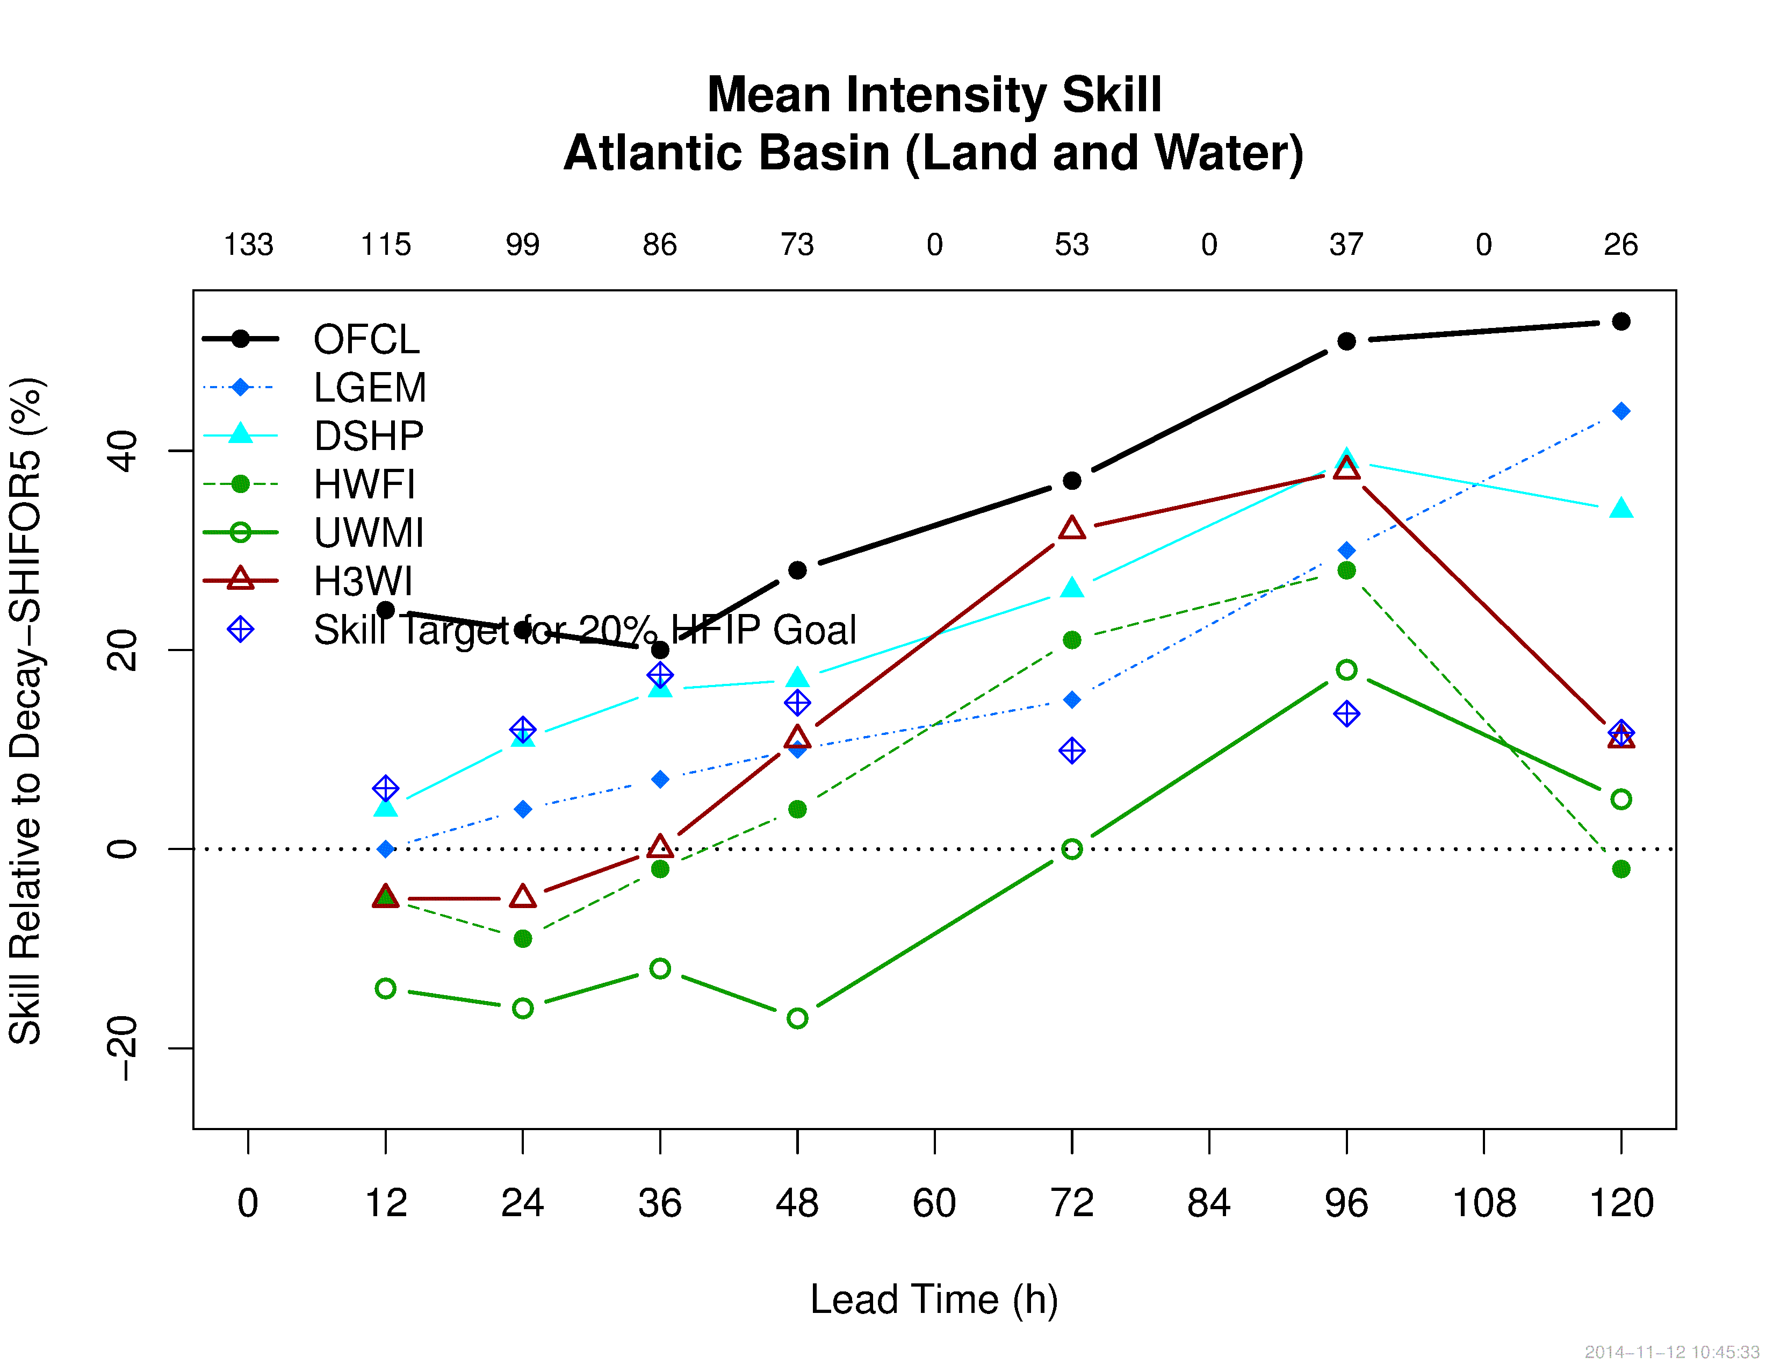
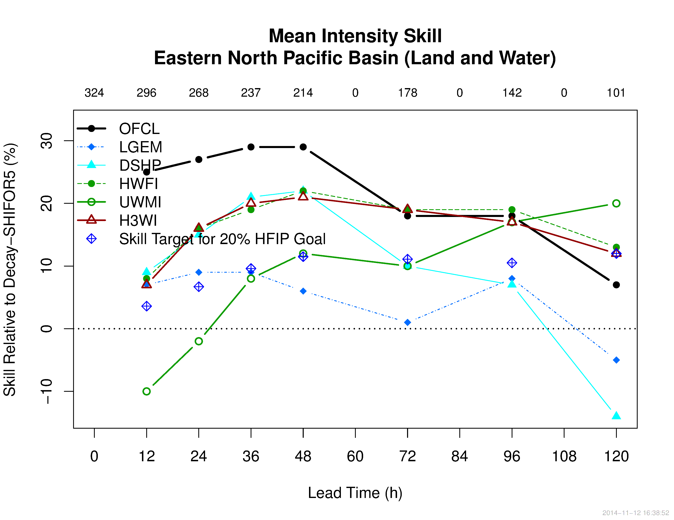
Basin Scale HWRF: 2014 Season Verification
  Track
  Basin Scale HWRF (H3WI) is close to top-performing models (HWFI, FM9I) between 12-72 h then degrade at 96 and 120 h in the Atlantic basin; H3WI is close to the top-performing models at 12 and 24 h then saturates the skill at 55% as HWFI does between 36-120 h in the E. Pacific basin
Track
Basin Scale HWRF
Basin Scale HWRF
  Intensity
  Basin Scale HWRF (H3WI) shows skill between 48-120 h. Better skill than HWFI all lead times in the Atlantic basin; H3WI is as good skill (8-20%, top-performing models except at 120 h) as HWFI all lead times in the E. Pacific basin
Intensity
Basin Scale HWRF
Basin Scale HWRF
* Basin Scale HWRF (H3WI) is not coupled to an active ocean. Work in progress
Notes:
Long range forecast improvement: LSM improvements

Slide 9
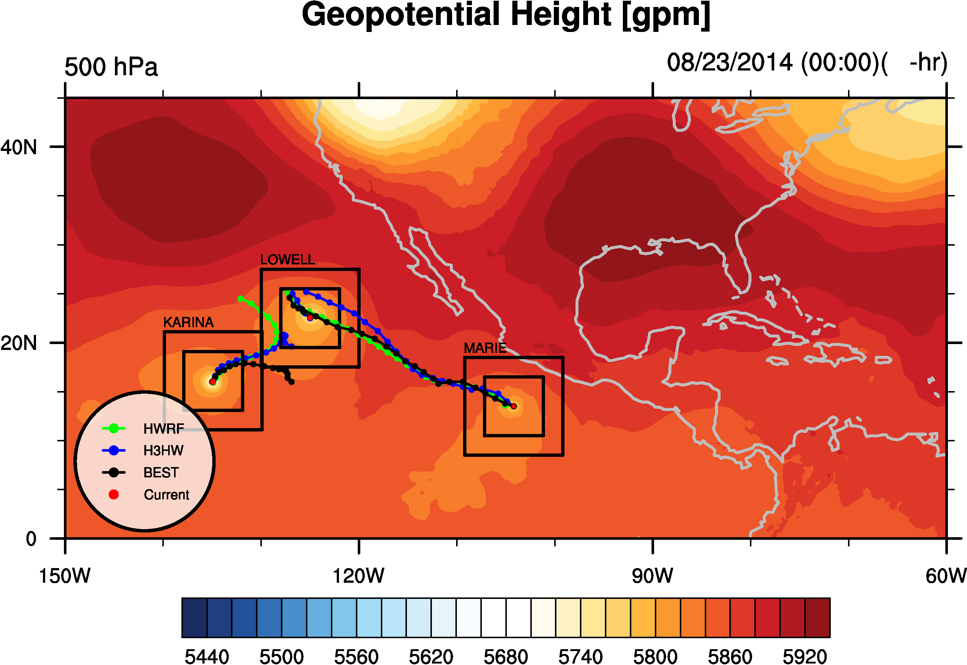
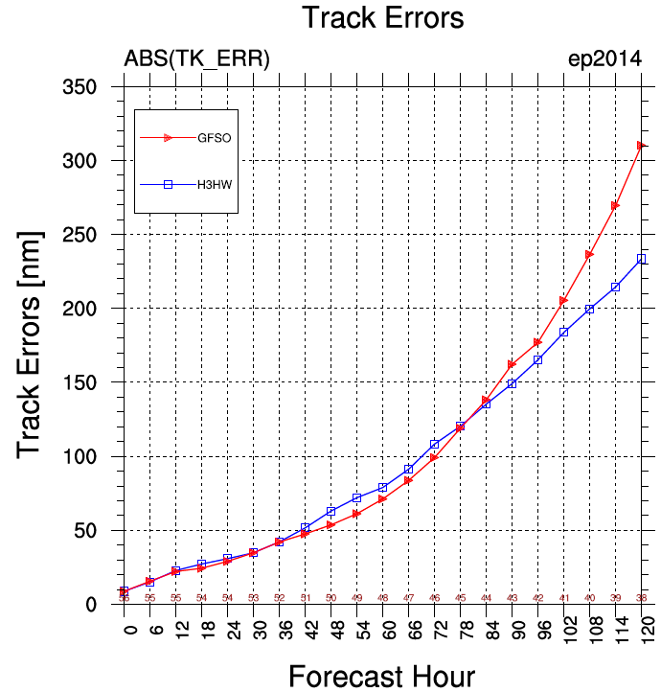
Basin Scale HWRF: Karina-Lowell-Marie interactions
Basin-scale HWRF (H3HW) handles the difficult track of Karina (EP11) as it interacts with 2 other TCs.
H3HW competes with the official GFS (GFSO) for Karina over all forecast cycles.
By simulating more than 1 TC in the same basin, H3HW reduces track errors by capturing complex interactions (like this one).
500 hPa Geopotential Height [gpm]

Slide 10

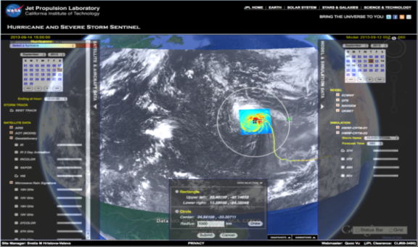
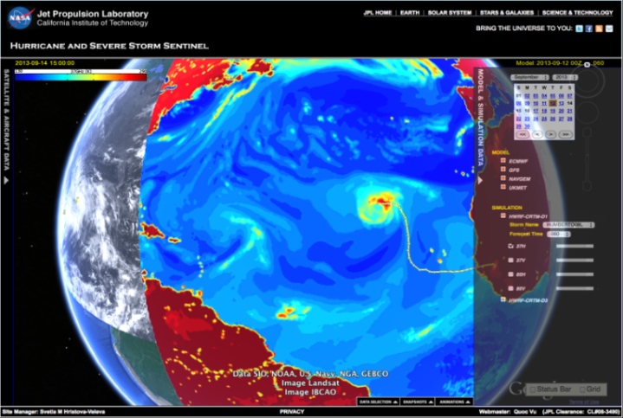
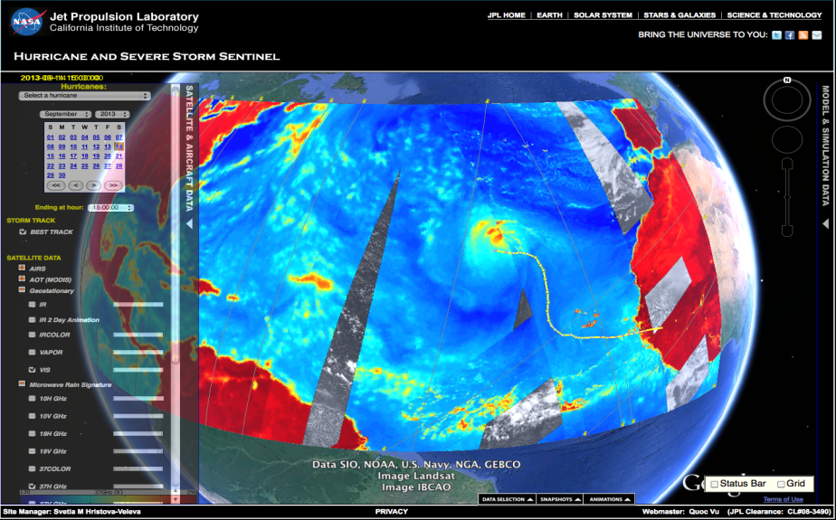
Summary and Conclusions
HWRF 2012
Key to further improving HWRF predictions may lie in modeling the multi scale interactions better – requires basin scale domain with 2-way interactive, high resolution nests
Basin Scale HWRF is showing significant promise in track, intensity and structure predictions.
Basin Scale HWRF is currently transitioned to the research community (DTC)
Coupling to active ocean is on going in this effort (EMC collaboration)
Challenge: scalability of nested grid models
Transitions to NEMS infrastructure is ongoing
NEMS-HWRF may be run eventually in a global configuration.
Sustained partnership between NOAA research and operations (NCEP) and other agencies and universities hold the key to our future success.
BASIN HWRF 2017
GLOBAL HWRF (Research)
High Impact Weather Prediction Project
Notes:
Picture shows Satellite equivalents from model and future Tropical Prediction system

Slide 11
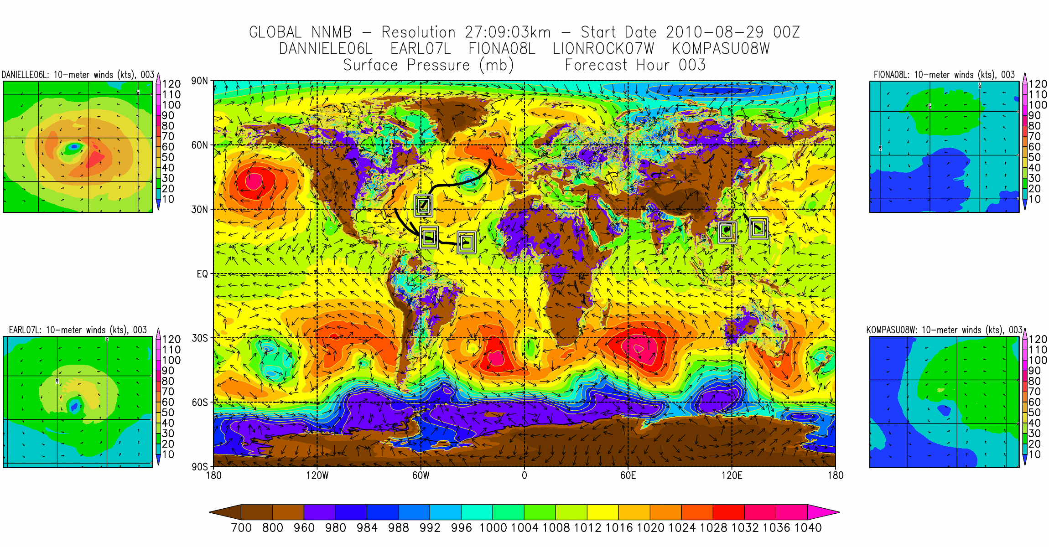
A Global2Local Scale Tropical Prediction System

