Slide 1




2015 Tropical Cyclone Research Forum /
69th Interdepartmental Hurricane Conference
2-5 March 2015
Session 4b. Observations and Observing Strategies, Part 2
4 March 2015
The NASA CYGNSS Satellite Constellation:
Probing the Inner Core of Hurricanes
Christopher Ruf¹, Aaron Ridley¹, Derek Posselt¹
Scott Gleason², Randy Rose², John Scherrer²
University of Michigan; (2) Southwest Research Institute

Slide 2
CYGNSS Mission Overview
The Cyclone Global Navigation Satellite System (CYGNSS) is the first NASA Earth Venture Mission
CYGNSS consists of 8 microsatellites, each with a 4-channel GPS bi-static radar receiver
  Mission lead/Science Ops (University of Michigan)
  Spacecraft/Integration/Mission Ops (Southwest Research Institute)
The driving science objective is rapid sampling of ocean surface winds in the inner core of tropical cyclones
CYGNSS uses a new measurement technique and a new satellite mission architecture
  Measure the distortion of GPS signals scattered from the ocean surface to determine ocean surface roughness and wind speed
  Use small satellites so many can be flown to improve sampling

Slide 3
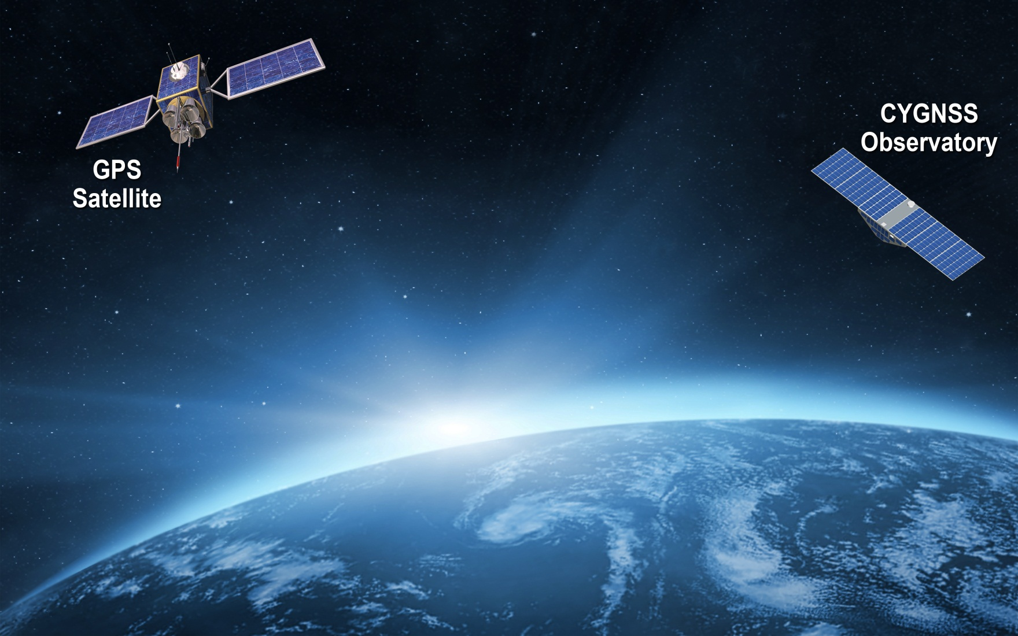

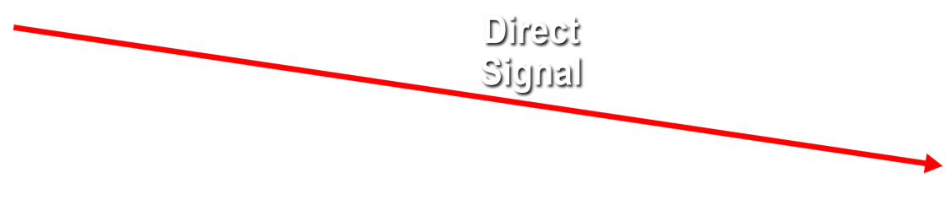
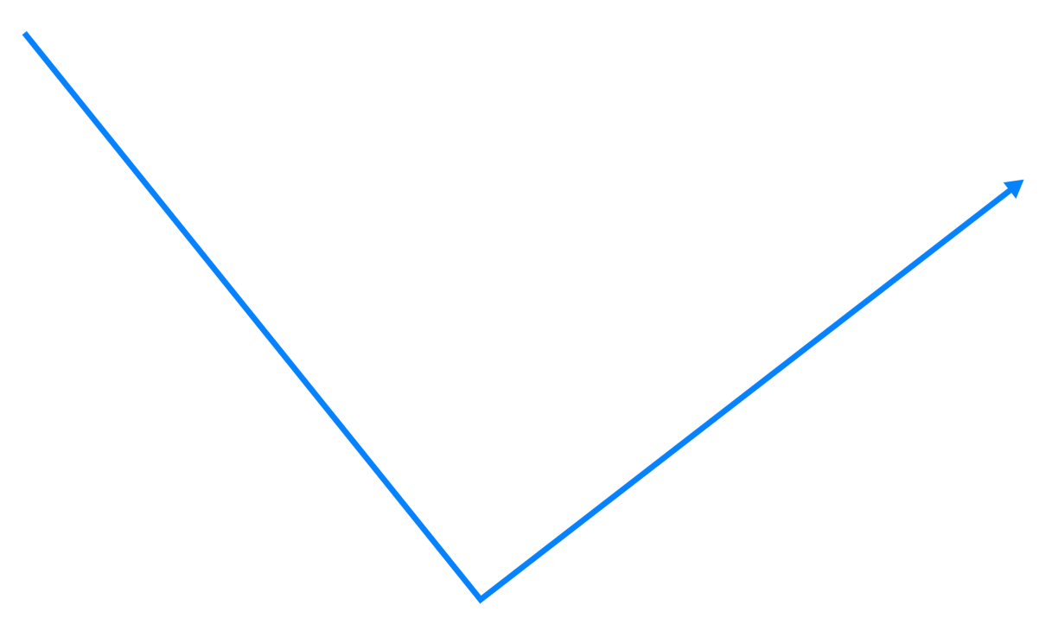

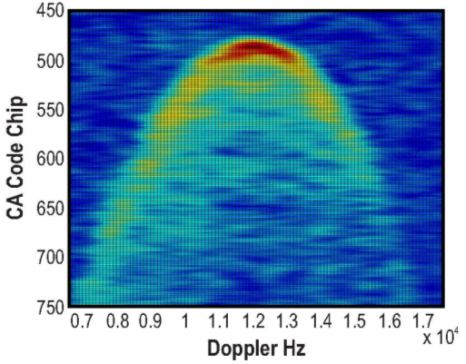
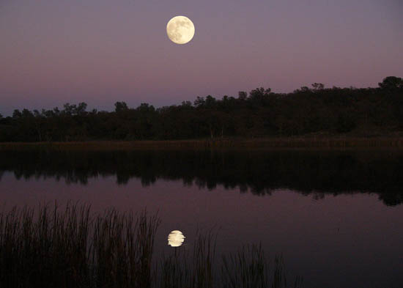
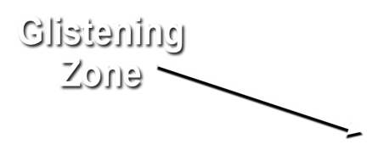
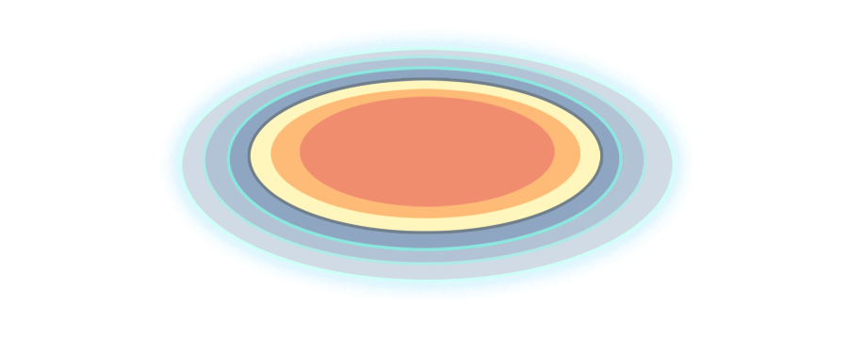
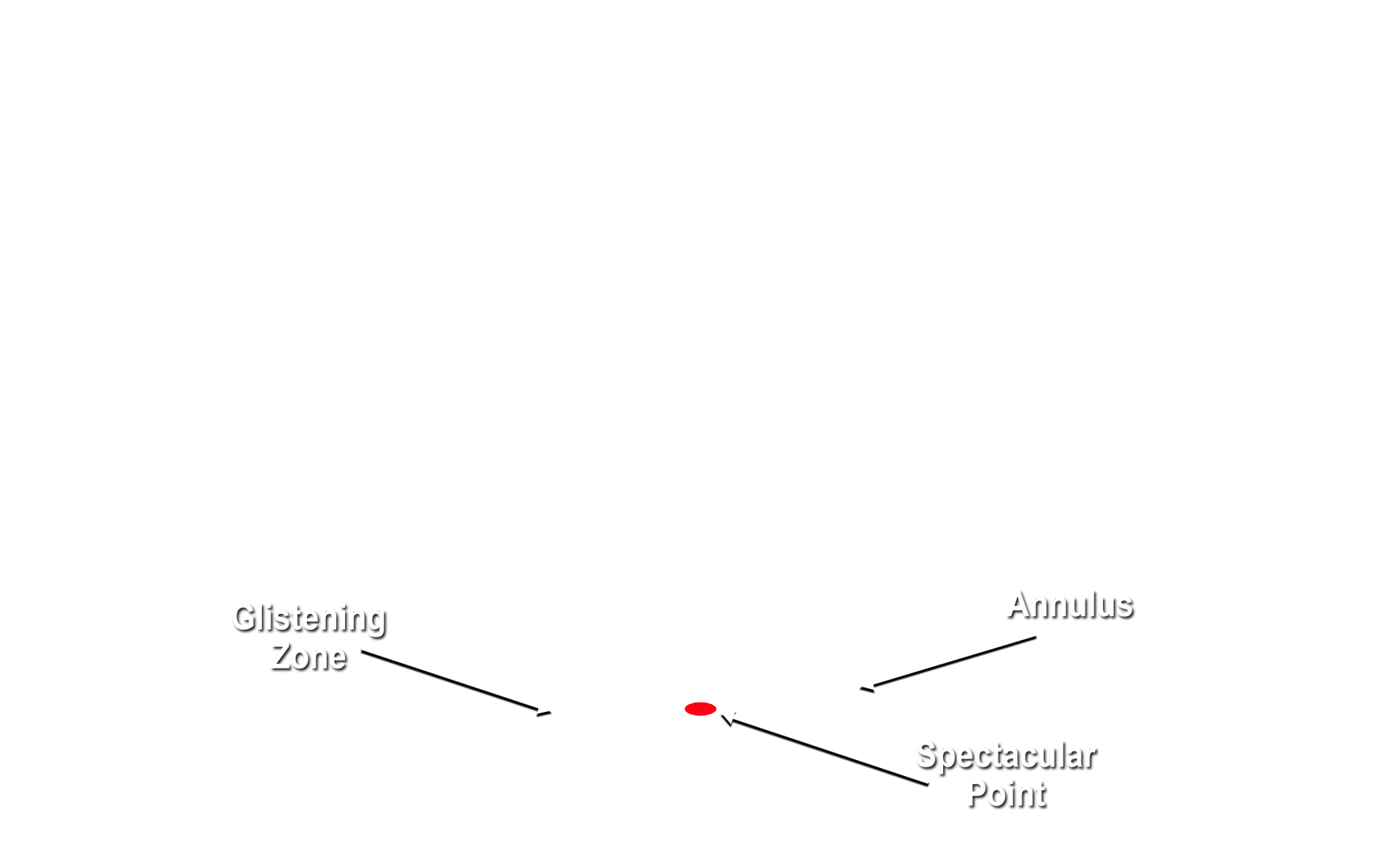
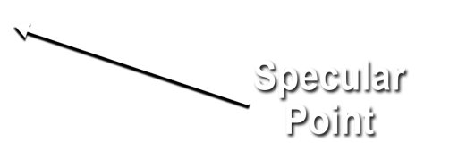
Notes:
Bi-static scattering geometry with GPS direct signal proving reference and quasi-specular forward scattered signal containing ocean surface roughness information
Animation illustrates – propagation and scattering geometries – GNSS bi-static scatterometry
quasi-specular forward scattered signal from the ocean surface -- received by nadir ant array
Ideal reflected signal (perfect ocean surface) -- mirror image of direct
scattered signal contains detailed information about surface roughness statistics
Glistening zone broadens from perfect surface to broad area given increase in surface wind speed.
Use example of Sun reflection while flying on airplane overwater to conference
direct GPS signal -- coherent reference for the coded GPS transmit signal – received by zenith ant
Inset: Image produced from data by the UK-DMC-1 demonstration spaceborne mission shows scattering cross-section
Two coordinates of the image:
Variable lag correlation (signal delay)
Doppler shift
The DDM enable the spatial distribution of the GPS signal surface scattering cross section to be resolved
Measurement of the ocean surface roughness and near-surface wind speed is possible from two properties of the DDM
The scattering cross-section can be related to surface roughness which corresponds to near surface wind speed
Wind speed can also be estimated from the shape of the scattering arc (the red and yellow regions)
The arc represents the departure of the actual bi-static scattering from the purely specular case that would correspond to a perfectly flat ocean surface

Slide 4
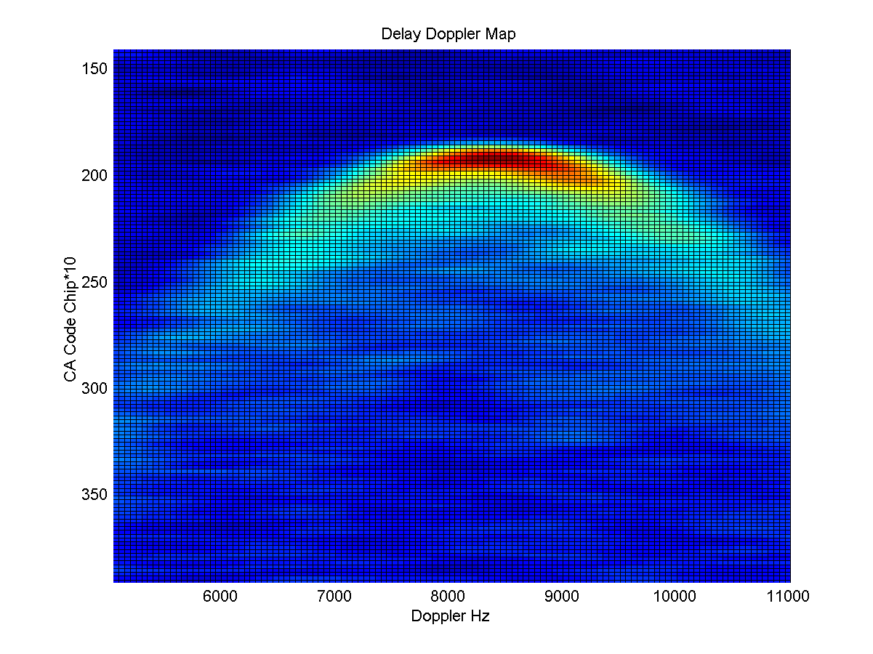
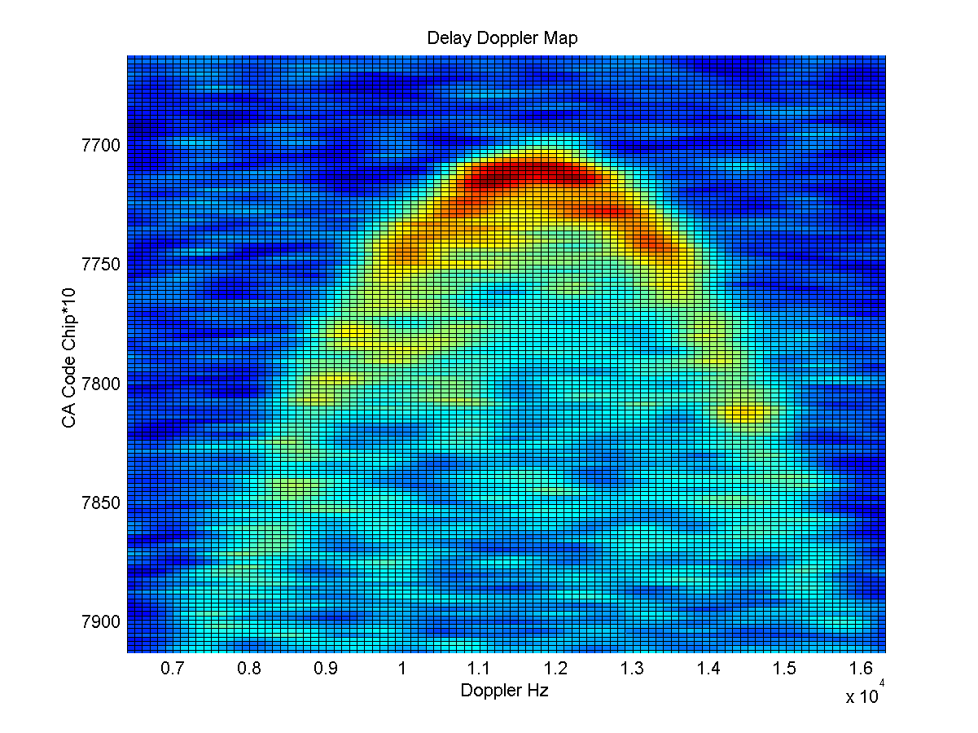
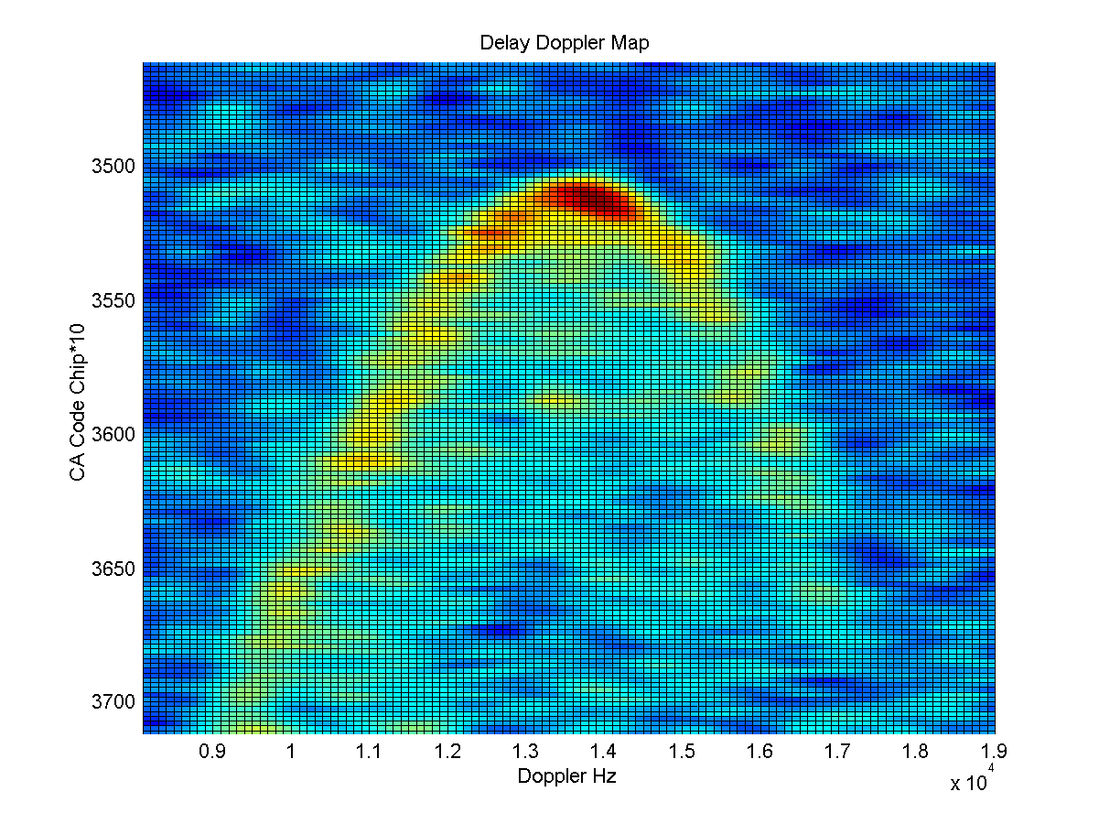
Spaceborne Empirical Demonstration of Ocean Wind Speed Retrievals by GNSS-R
GNSS-R instrument (early version of CYGNSS science payload) deployed on UK-DMC-1 mission, launch 2003
Winds ~ 2 m/s
Winds 7 m/s
Winds 10 m/s
Notes:
From Susan and Randy: Do we need this slide? Or, do we want to keep it just for completion.
from Chris: This slide is meant to replace the series of slides at SRR showing the successful previous airborne and spaceborne demonstrations of GNSS-R for winds. It’s our “science heritage” slide.

Slide 5
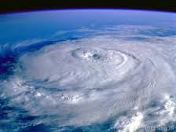
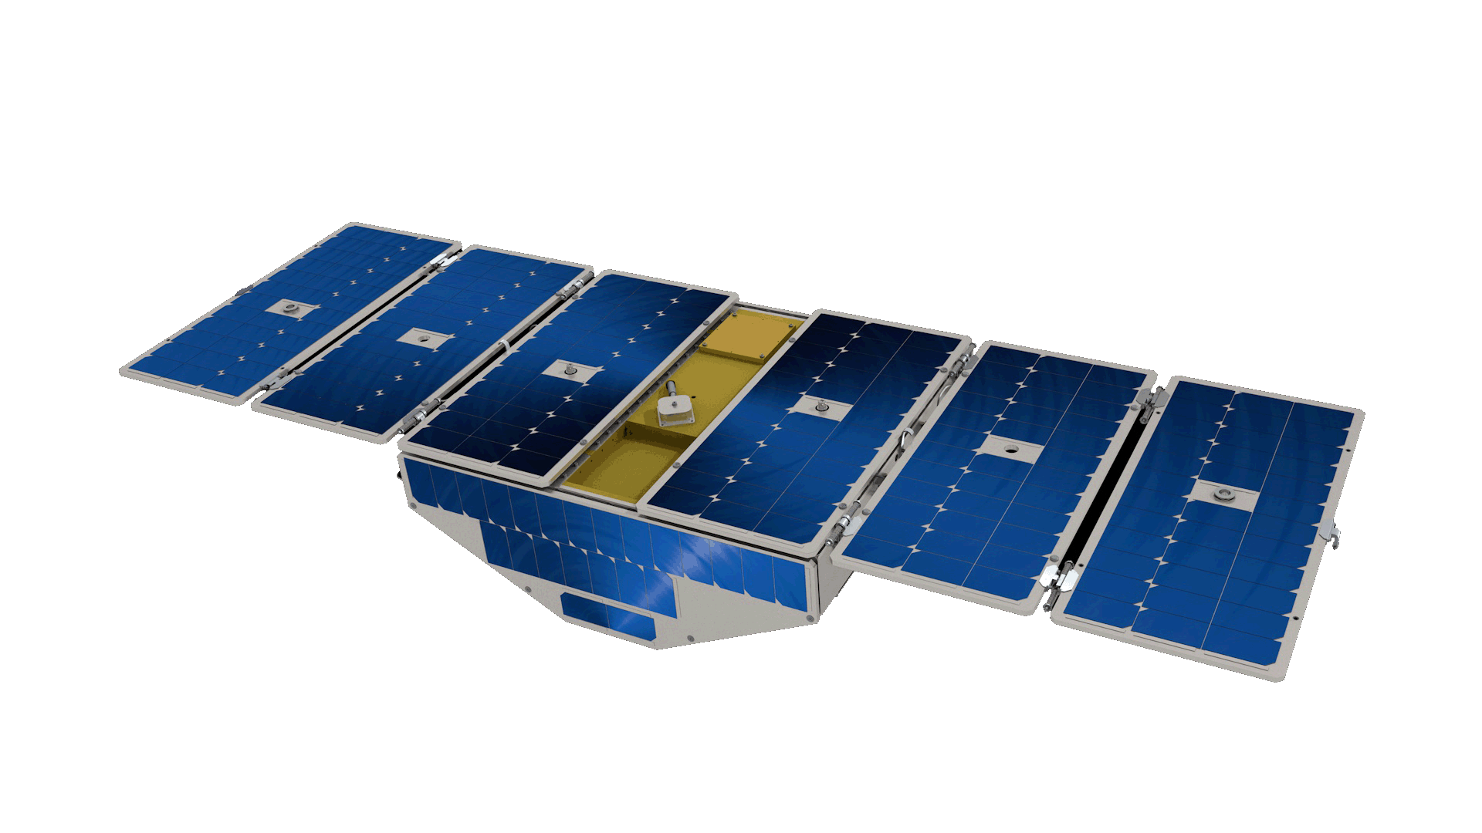
CYGNSS Observatory Key Characteristics
Power: 38.3 W
  Available: 70 W EOL
  Margin: 23%
Pointing
  Star tracker based attitude knowledge
  3-axis reaction wheel stabilized
  Full momentum management without payload duty cycle interruption
  Capable of nadir, LVLH, or inertial pointing
  1.3 deg (3σ) attitude knowledge
  2.2 deg (3σ) attitude control
Mass: 24.8 kg
Notes:
From Susan and Randy: Do we need this slide? Or, do we want to keep it just for completion.
from Chris: This slide is meant to replace the series of slides at SRR showing the successful previous airborne and spaceborne demonstrations of GNSS-R for winds. It’s our “science heritage” slide.

Slide 6
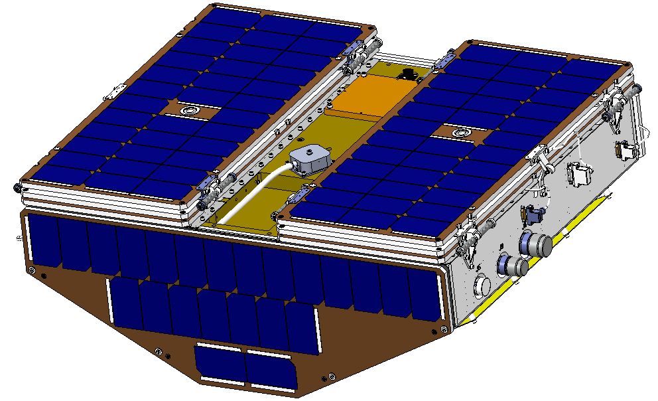
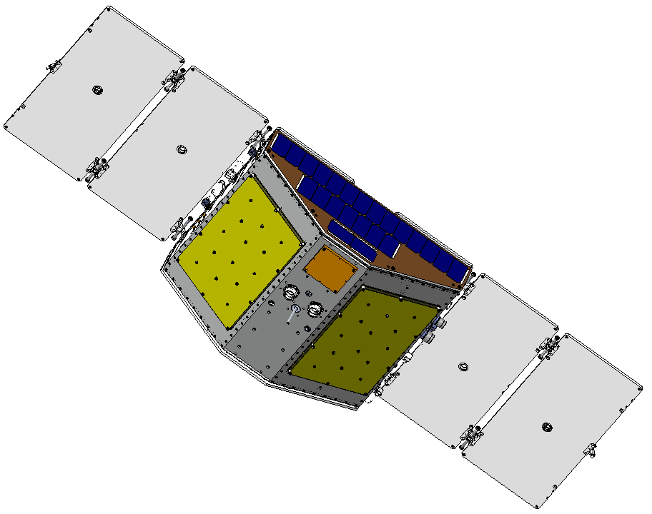
Observatory Design
2x Ram/Wake Solar Array
Redundant Hinges & Panel Sequencer
EGSE Connectors
2x Zenith Solar Array, Deployed State
2x L-Band Science Antenna
Deployment Module Interface

Slide 7
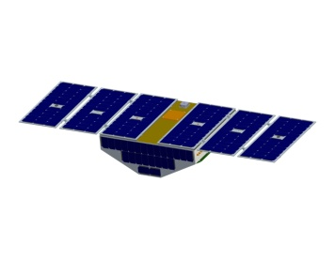

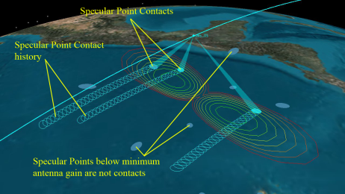
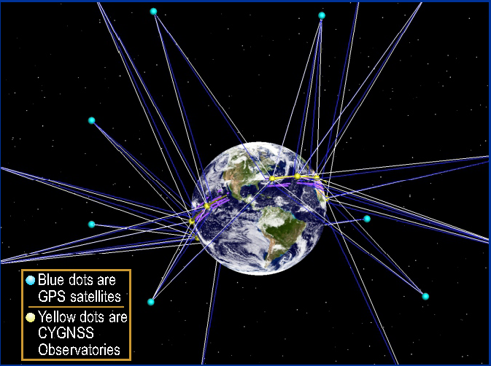
CYGNSS Specular Point Contacts and Spatial Sampling

Slide 8
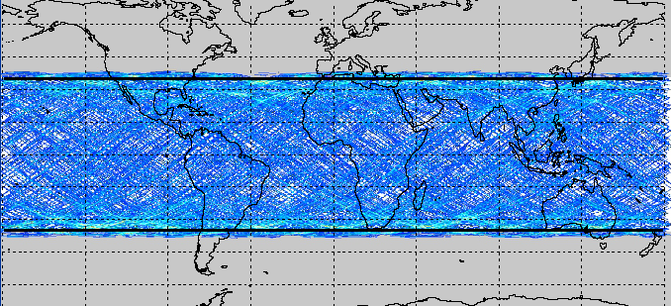
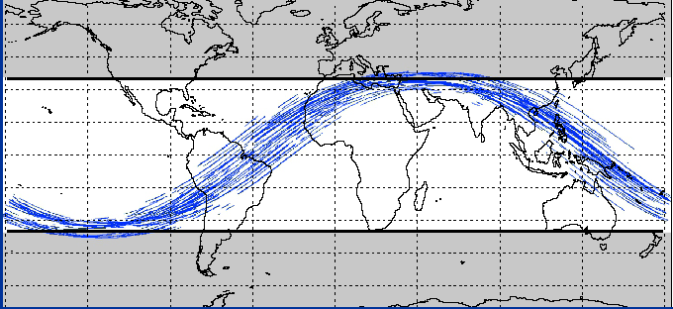
CYGNSS Earth Coverage
90 min (one orbit) coverage showing all specular reflection contacts by each of 8 s/c
24 hr coverage provides nearly gap free spatial sampling within +/- 35 deg orbit inclination

Slide 9
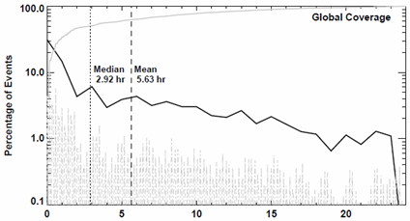
CYGNSS Revisit Time
Probability distribution of revisit time for all Earth samples within +/-35º
Revisit stats derived from PDF demonstrate 5.6 hr mean storm revisit (requirement is 12 hr)

Slide 10
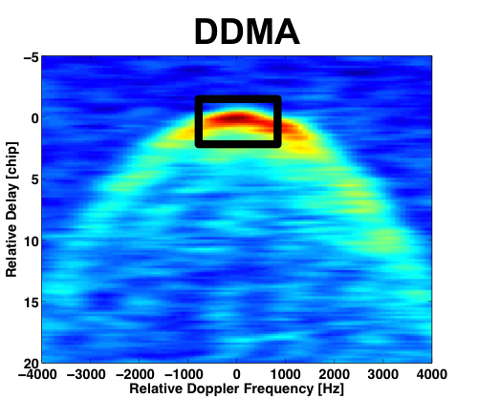
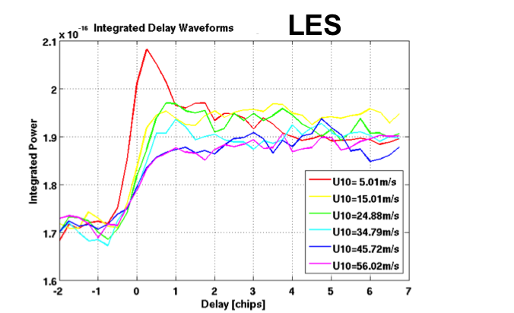
DDM Observables: DDMA and LES
DDM Average (DDMA) is the average value of the forward scattering cross-section over a delay-Doppler window
  The size of the window is equivalent to ~25 km spatial resolution
Leading Edge Slope (LES) is the slope of the leading edge off the Integrated Delay Waveform, obtained by integrating the DDM along the Doppler dimension
  The delay-Doppler window of the linear regression that gives the slope is equivalent to ~25 km spatial resolution

Slide 11
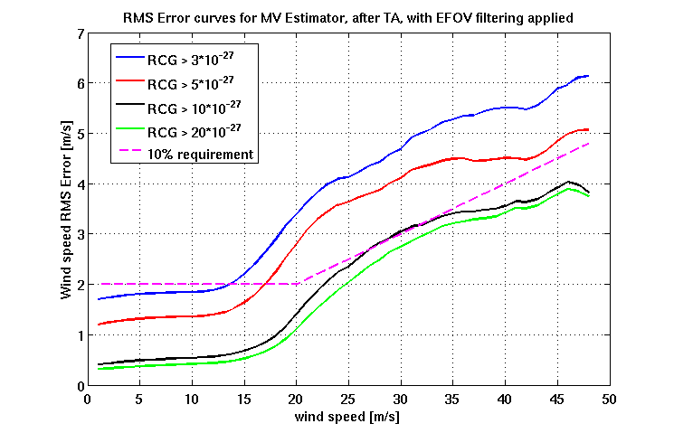
RMS Error for different RCG thresholds
(25 km spatial resolution)
Wind speed range | <20m/s | >20m/s
RCG lower bound | >5 | >10
Avg. RMS error | 1.4 m/s | 9.2%
RCG = Range Corrected Gain
Notes:
From Susan: Added definition for Range Corrected Gain

Slide 12
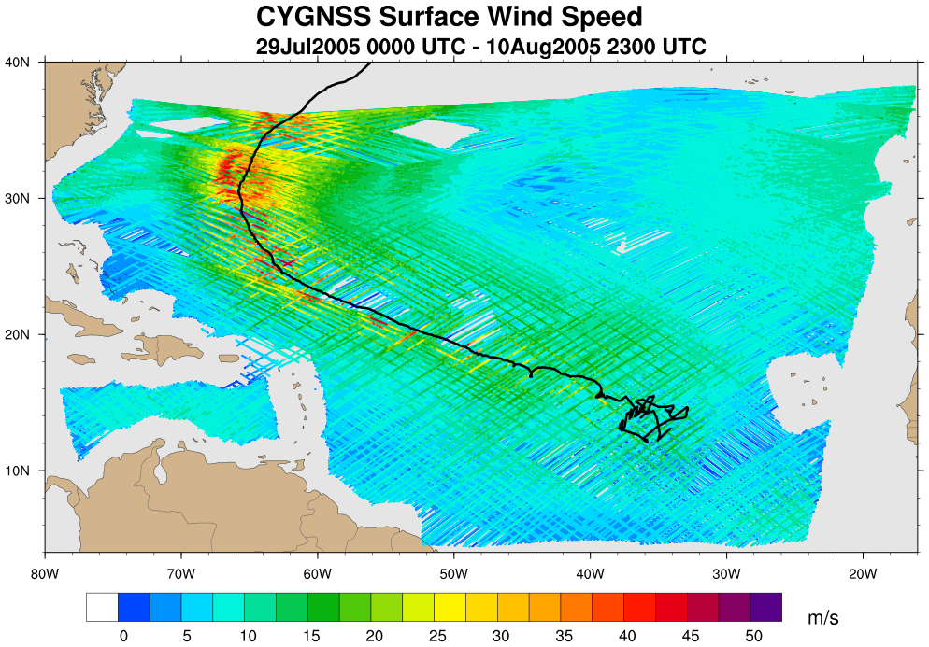
Nature Run Life Cycle Storm Track and 13-day CYGNSS Coverage

Slide 13
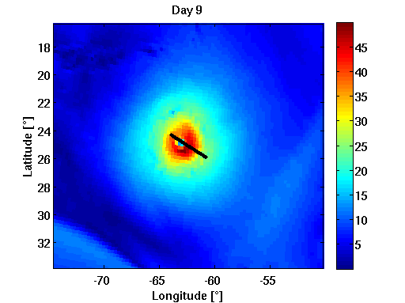
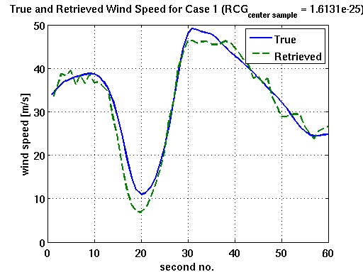
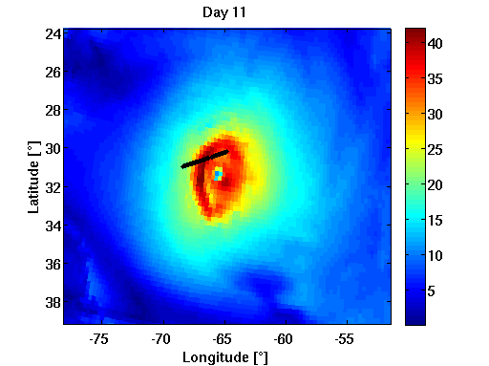
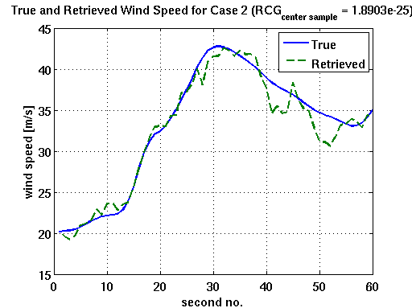
True vs. Retrieved Winds for Storm Center Transects

Slide 14
WRF/ARW 1 km Regional Nature Run
(on Aug 3, 4 and 6 at 00Z)

Slide 15
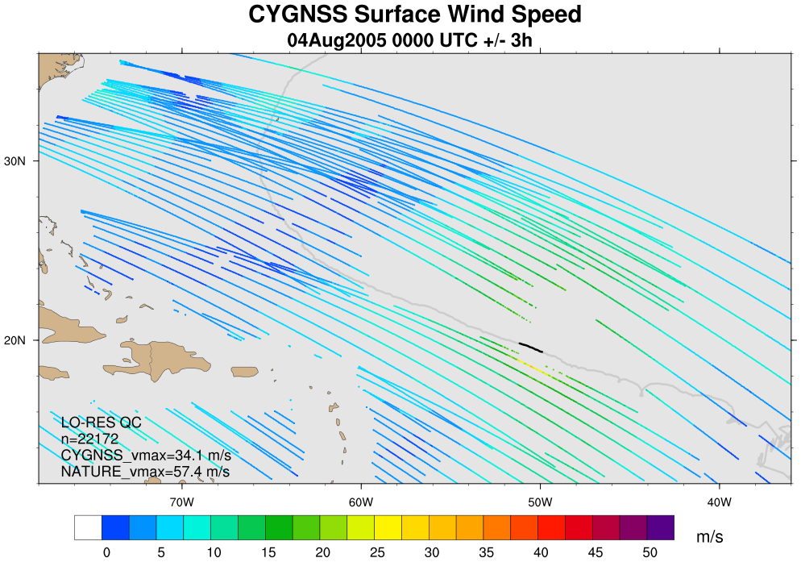
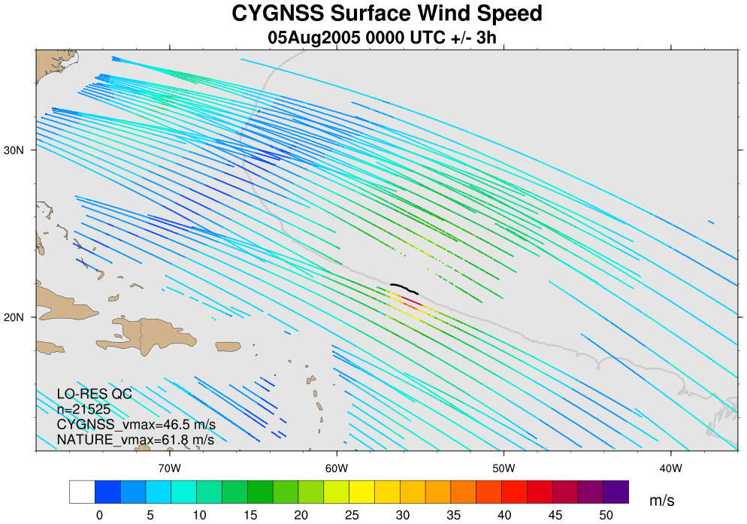
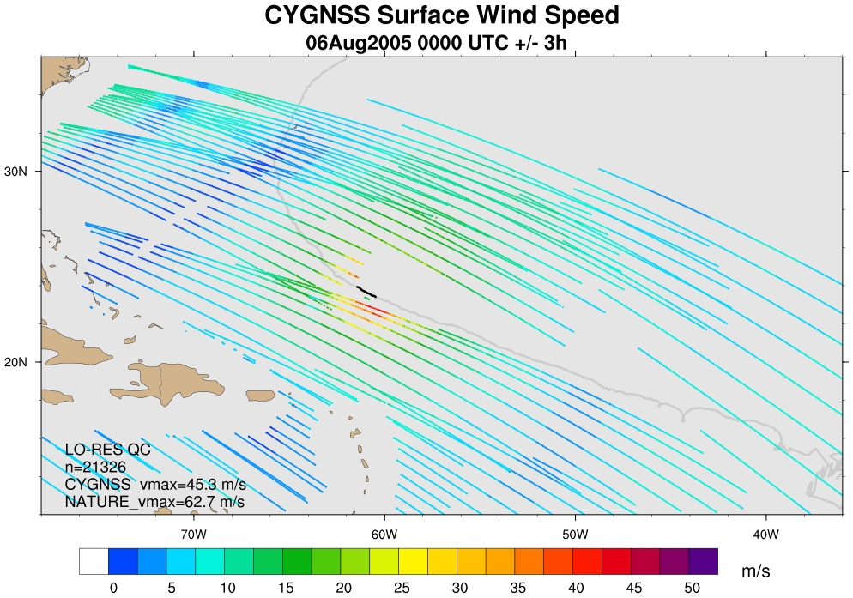
CYGNSS +/- 3 hr Samples of Nature Run
(on Aug 4, 5 and 6 at 00Z)

Slide 16
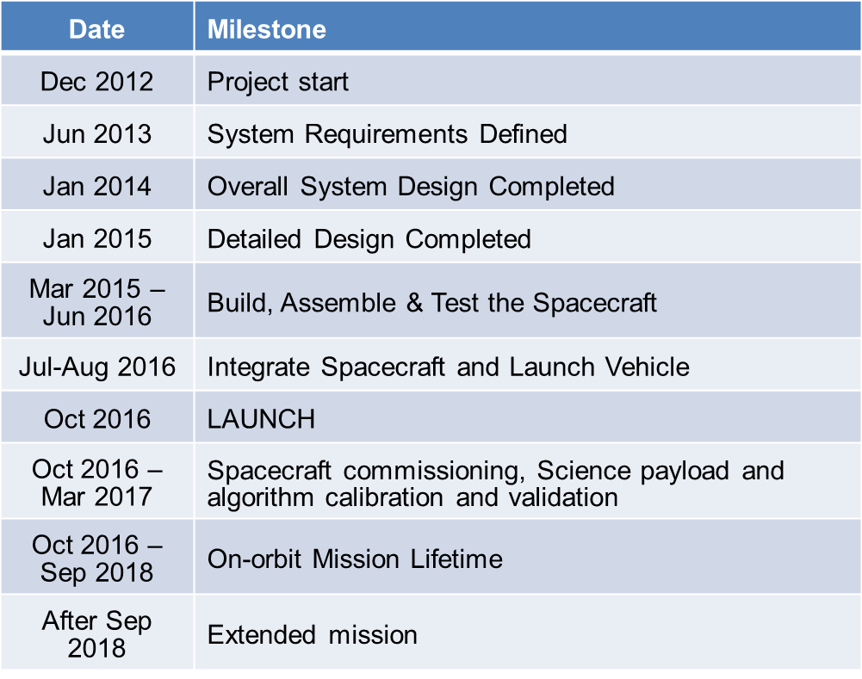
Project Schedule

