Slide 1







Air-Deployable Profiling Floats
Steven Jayne, Breck Owens and P.E. Robbins
Woods Hole Oceanographic Institution
Jim Dufour, MRV Systems
Elizabeth Sanabia, US Naval Academy
In collaboration with
US Air Force Reserve 53rd Weather Reconnaissance Squadron

Slide 2


The TEMPESTS Project
The Experiment to Measure and Predict
East Coast STorm Strength
Cooperation:
WHOI, Gulf of Maine Research Institute,
Rutgers Univ., Univ. of Maine, Univ. of Maryland,
Univ. Massachusetts Dartmouth & Salisbury Univ.
Period: September 2013 – August 2016
Instruments: air-deployed floats, gliders and moorings
Aims:
  Observe 2 hurricanes and 2 winter storms
  Understand the impacts of vertical temperature
  stratification, storm-induced mixing and sea
  level changes on storm intensity and inundation

Slide 3

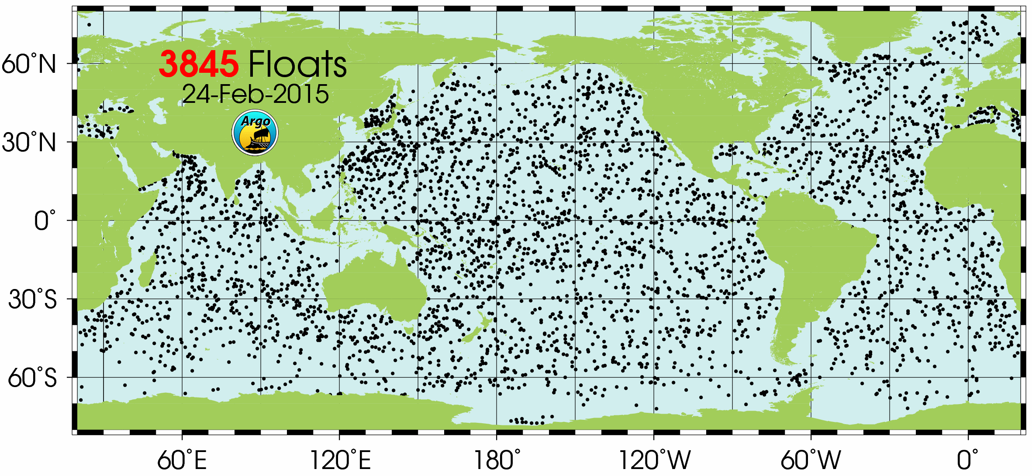
Argo program
Nearly global array of profiling floats
Measure temperature and salinity in the upper 2000 m on a 10 day cycle on a nominal 3x3 degree grid
Data is provided in near-real time via the GTS and DACs

Slide 4
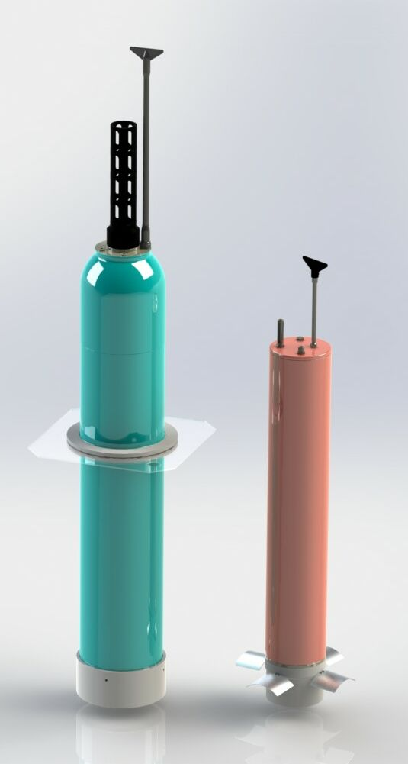
ALAMO
Smaller profiling float that will fit in the AXBT launcher and can be used operationally by the USAF and NOAA Hurricane Hunter planes.
Advantages over AXBT include: multiple profiles, more sensors (pressure, salinity, & accelerometer for surface waves), no VHF receiver equipment on planes
A-sized case
Weight ~10 kg
1200-meter depth rating
1–2 dbar bin-averaged data
Iridium data communication

Slide 5
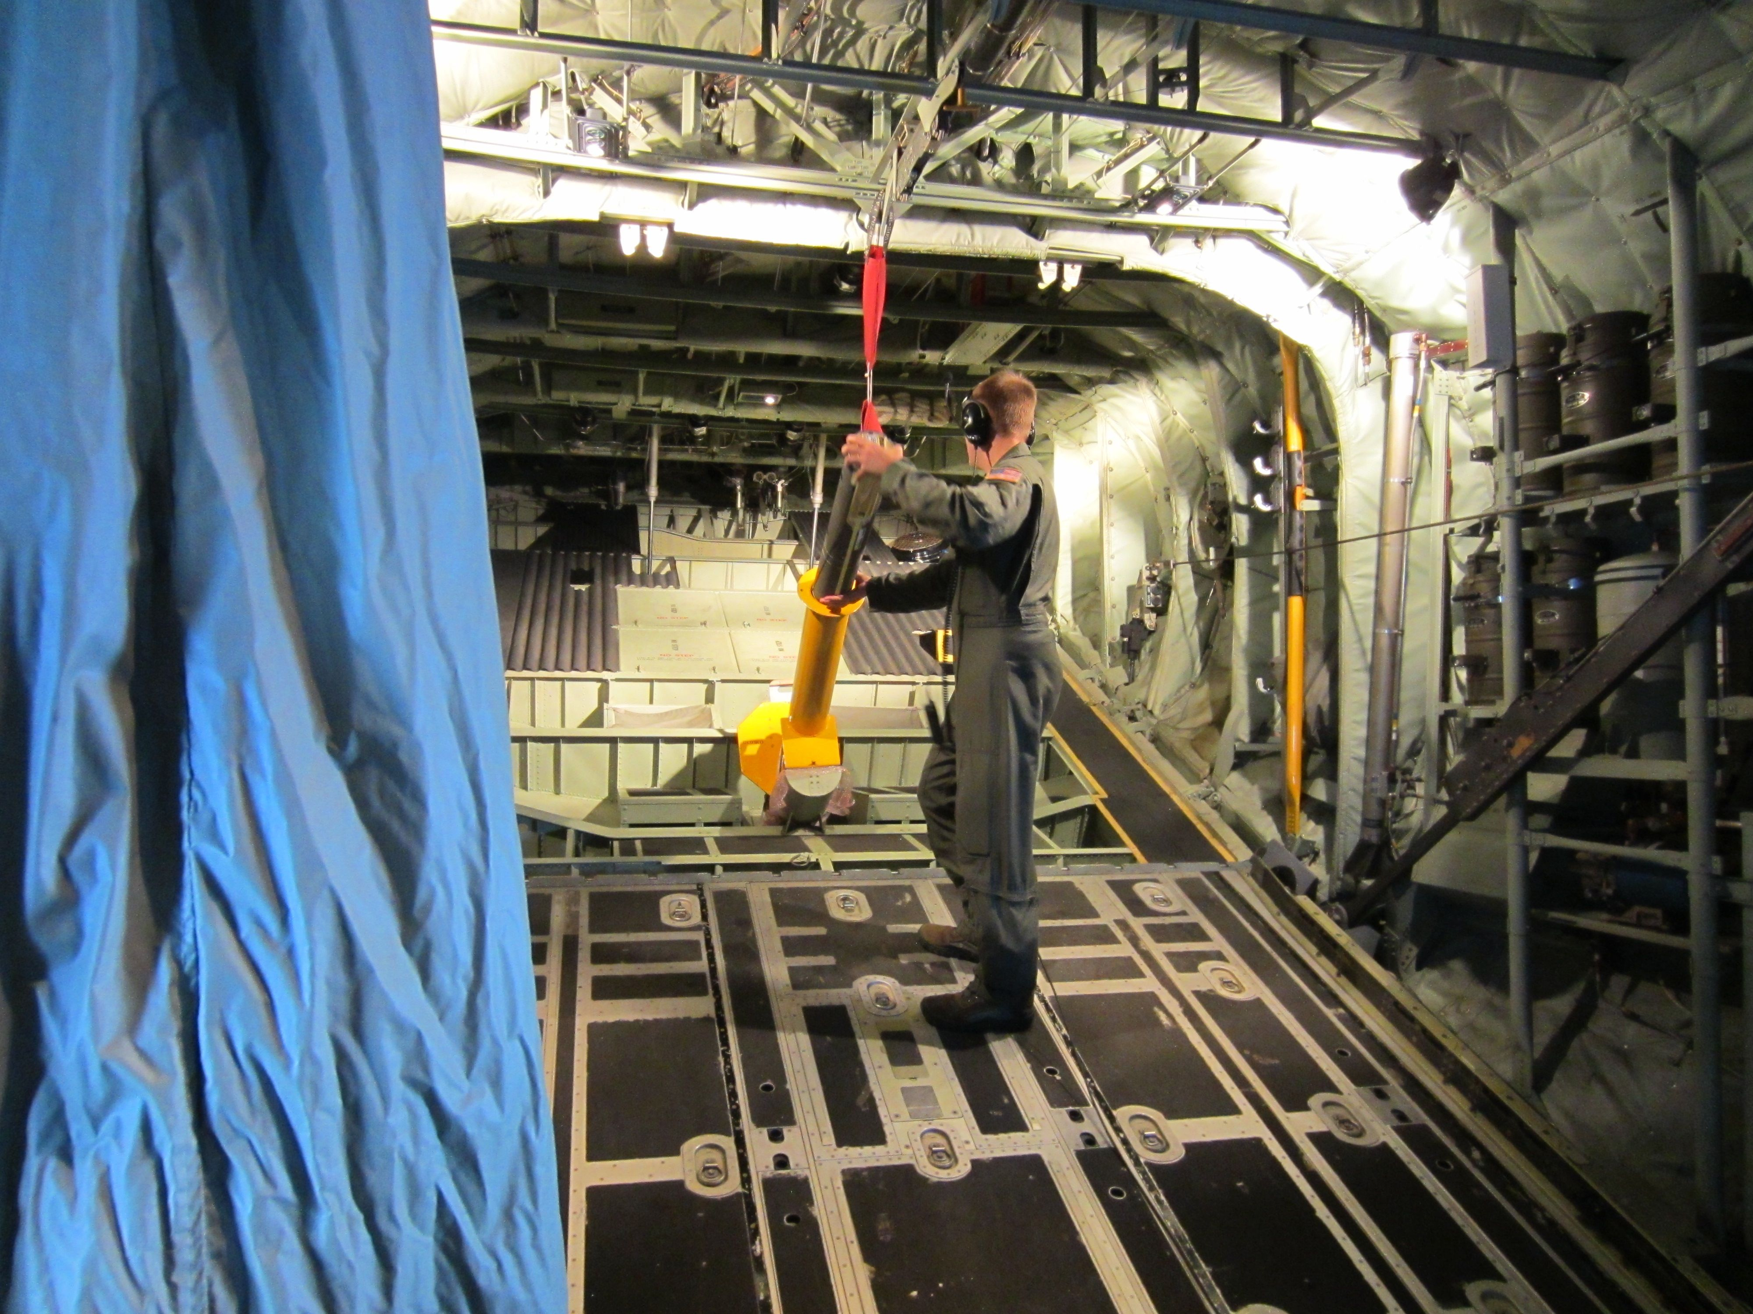
Deployed through the AXBT launch tube.
Previous air-deployed profiling floats have required opening tail ramp.

Slide 6
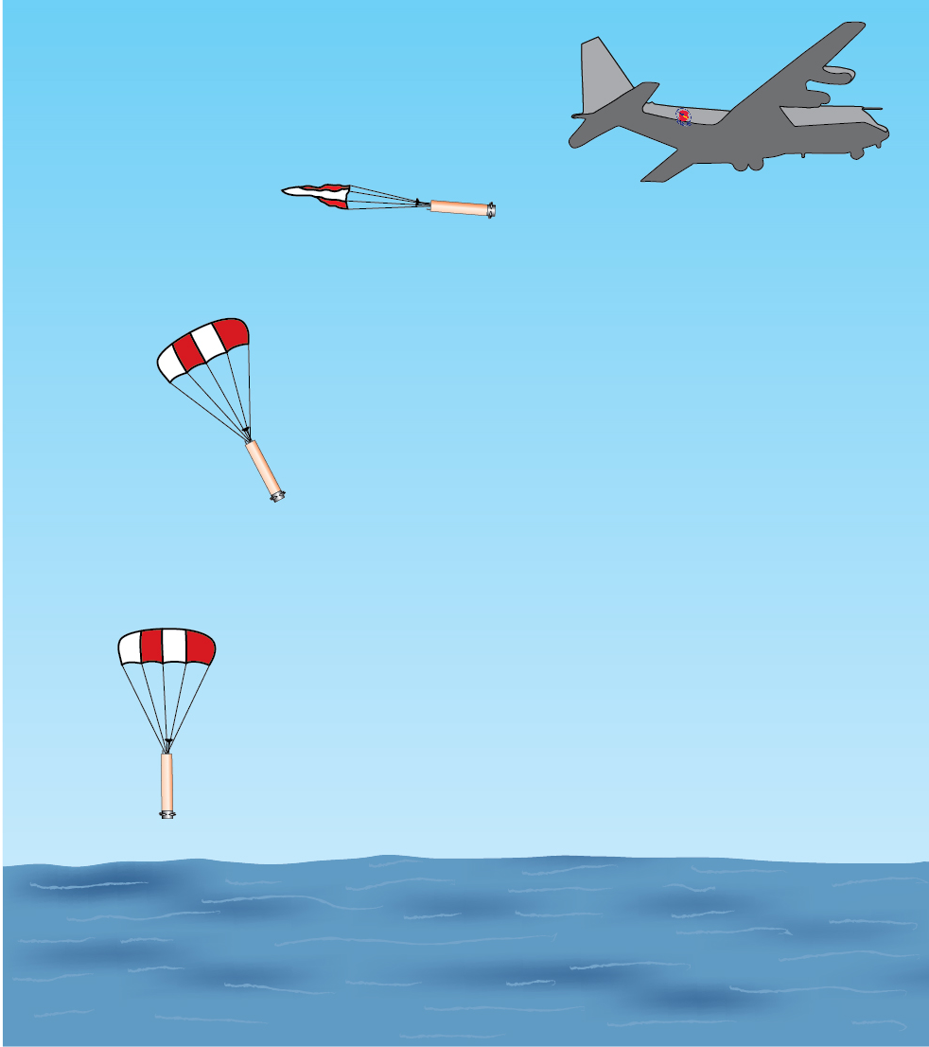
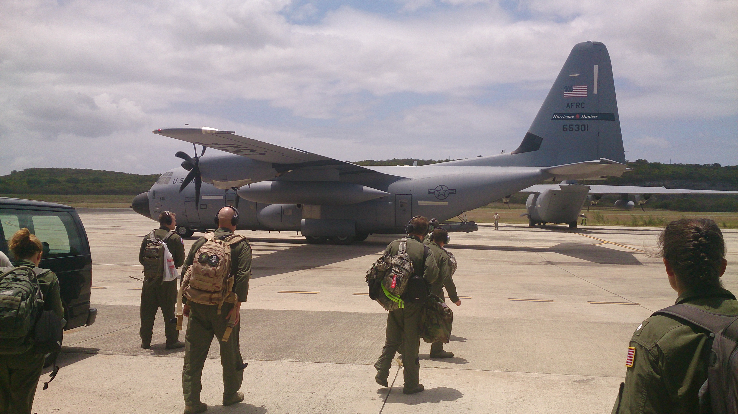
A-sized profiling floats were originally developed under funding from ONR, and redeveloped under NOAA Sandy Supplemental funding
The ALAMO floats have been tested and deployed in cooperation with USAFR 53rd WRS

Slide 7
2014 ALAMO deployments
WMO number | serial number | Deployment Date | Location, Storm | # of profiles | Longevity (days)
4901722 | 9038 | 2014-07-25 | Atlantic | 387 | 100
4901723 | 9035 | 2014-08-07 | Pacific Hurricane Iselle | 878 | 111
4901724 | 9036 | 2014-08-07 | Pacific Hurricane Iselle | 1013 | 128
4901725 | 9032 | 2014-08-18 | Gulf of Mexico | 268 | 100
4902037 | 9031 | 2014-08-21 | Atlantic TS Cristobal | 598 | 150
4902040 | 9043 | 2014-09-01 | Gulf of Mexico TS Dolly | 387 | 102

Slide 8
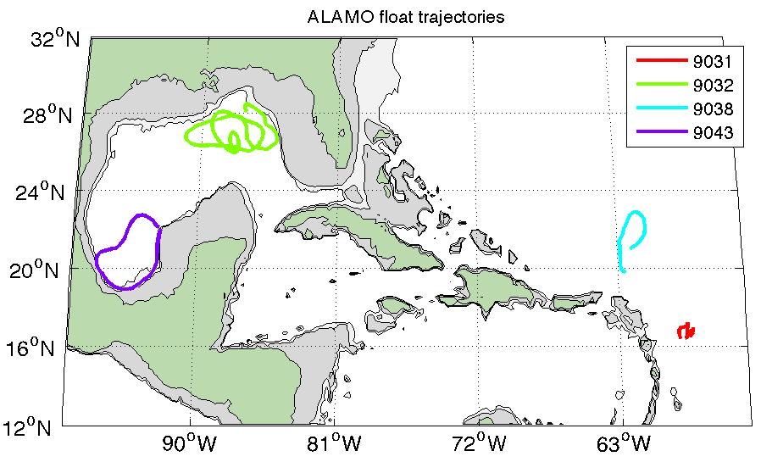
2014 Hurricane Season

Slide 9
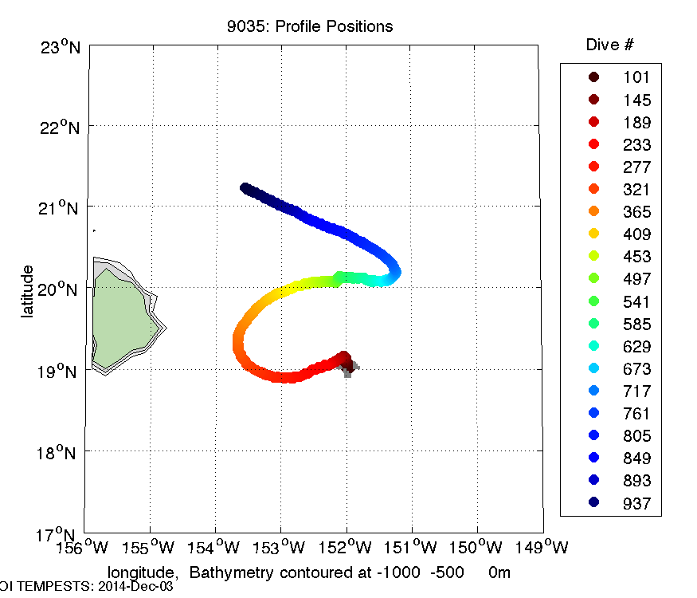
Float 9035, WMO #4901723
Deployed East of Hawaii, Hurricane Iselle
Reported 8 profiles per day from Aug 8 to Nov 25
Profile depth varied from 200 to 300 dbar

Slide 10
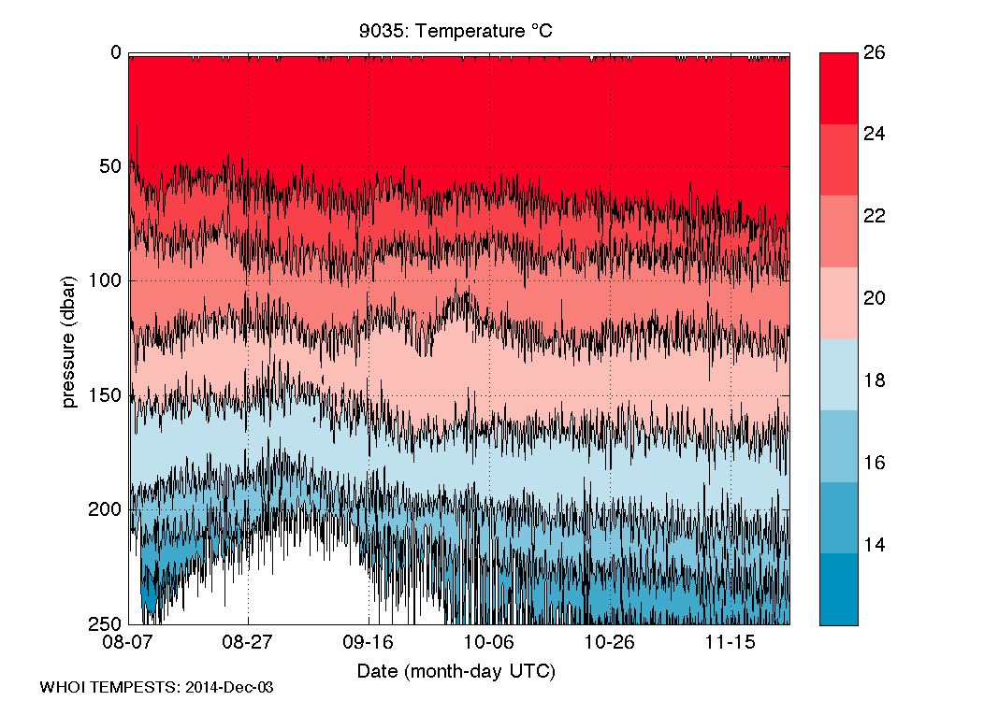
4901723 Upper Ocean Temperature

Slide 11
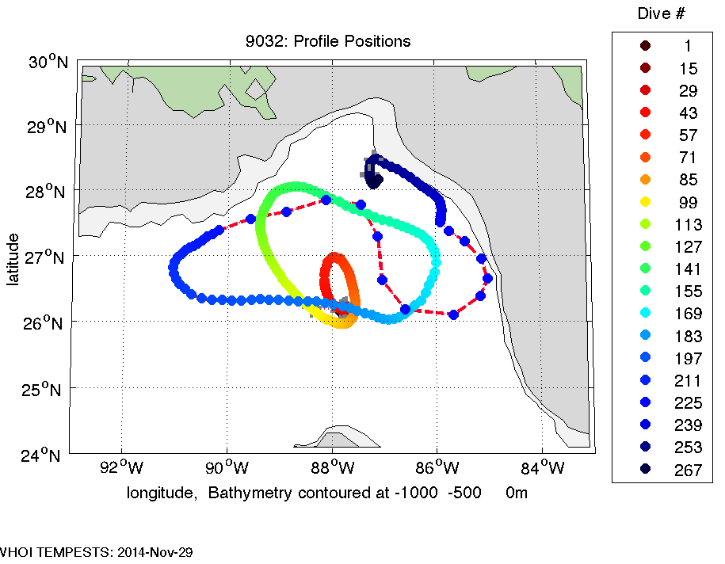
Float 9032, WMO #4901725
NE corner of
Gulf of Mexico
Initially 4 profiles per day then set to once per day
Aug 18 to
Nov 27

Slide 12
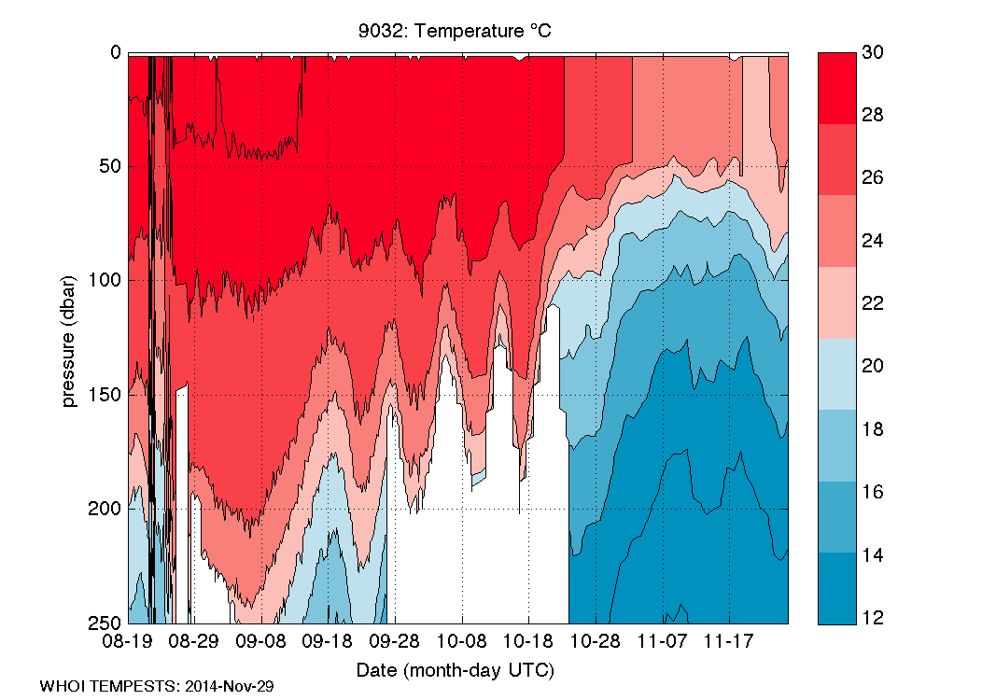
4901725 Upper Ocean Temperature

Slide 13
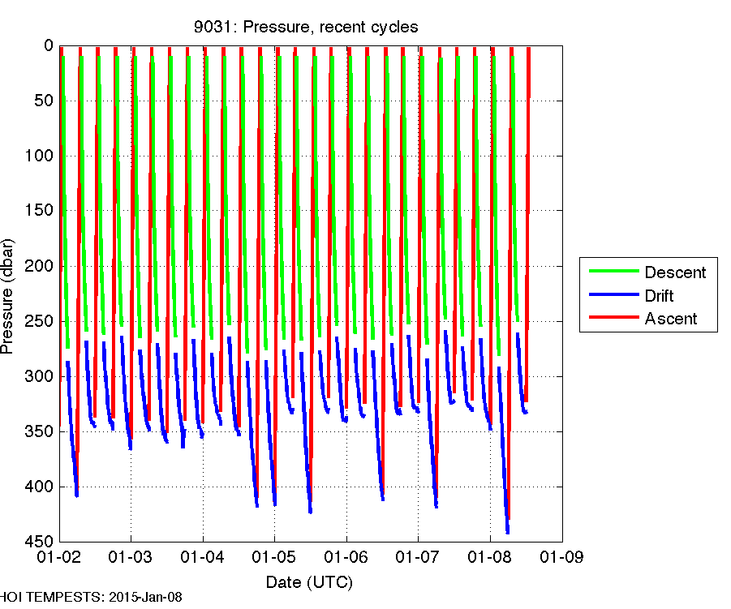
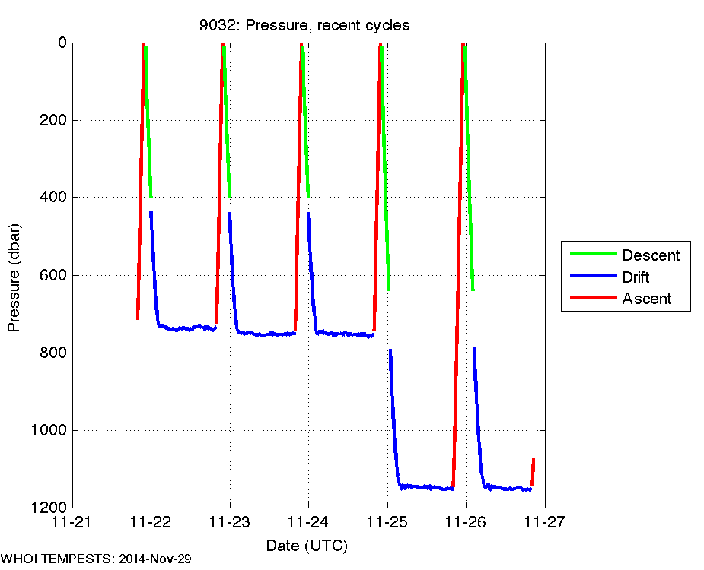
Sampling strategy:
Rapid sampling vs. longevity
How often to profile?
What depth?
Sawtooth sampling
4 profiles per day to 350 dbar
Daily profile to ~1000 dbar
deep drift between profiles
Constraints:
descent speed: 5–15 cm/s
ascent speed: 10–30 cm/s
5–15 minutes on surface for GPS & Iridium
More energy to go deep
More energy to ascend fast
500 meter profile requires about 4 hours

Slide 14
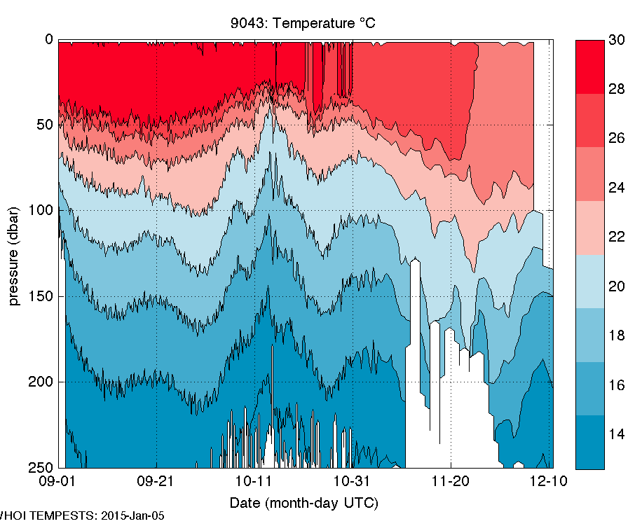
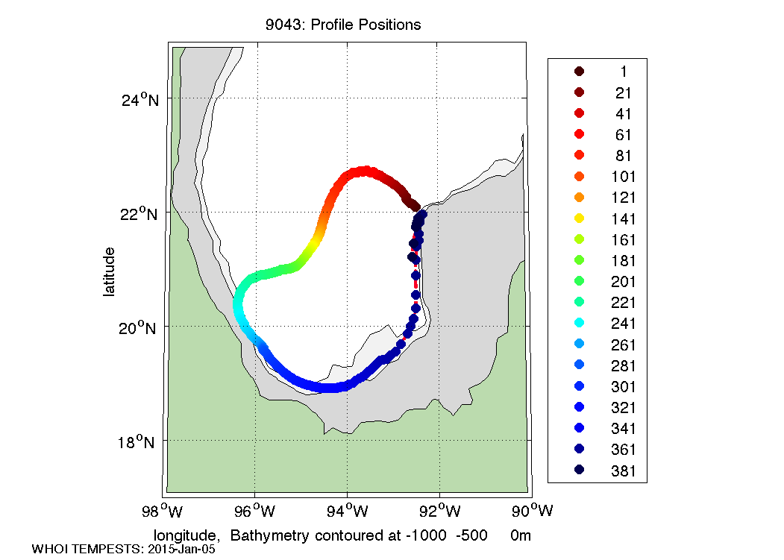
Float 9043, WMO #4902040
Gulf of Mexico – Bay of Campeche
Variable sampling strategy:
Initially ~10 profiles per day, set to daily profiles in November

Slide 15
ALAMO Data Management & GTS
Location, profile and engineering data sent by Iridium SBD (Short Burst Data) packets and received by email at WHOI
WHOI decodes telemetry, updates local database, makes data files and figures
WHOI FTPs data file to NOAA/AOML in previously defined Argo PHY format. AOML reformats data and submits to GTS
http://argo.whoi.edu/alamo/
Notes:
Using same file formats as Argo Program. Allows us to save everything we need in a standard documented format - facilities exchange with AOML.

Slide 16
ALAMO improvements for 2015
More robust parachute system for reliable deployment from aircraft at speeds up to 240 knots
Inductive salinity sensor in addition to temperature & pressure (5 floats)
Additional features in float firmware:
  Better algorithm for descent to park depth
  Multiple dive/mission configurations
  Accelerometer measurements of surface waves

Slide 17
Discussion
Where to deploy? (60 floats available)
How far in advance of a storm
Demonstrate the goal of improving intensity forecasts
Process studies
  Cold wake formation
  Recovery: surface fluxes vs. lateral mixing

