Slide 1
Airborne Phased Array Radar (APAR)
NCAR Earth Observing Laboratory
APAR Team
(Jim Moore Presenting)
2015 TCRF/IHC
Jacksonville FL
[ 1 ]

Slide 2
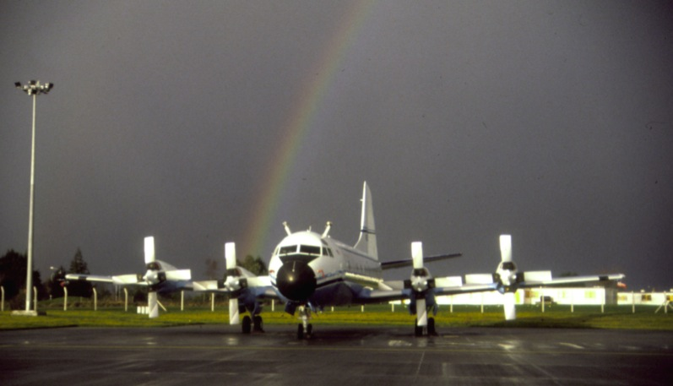
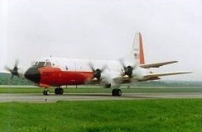
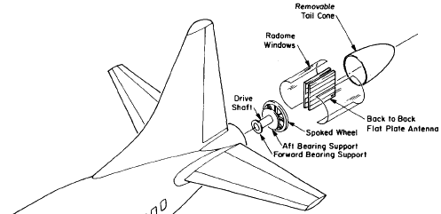
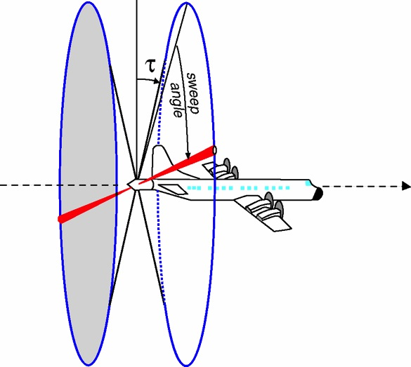
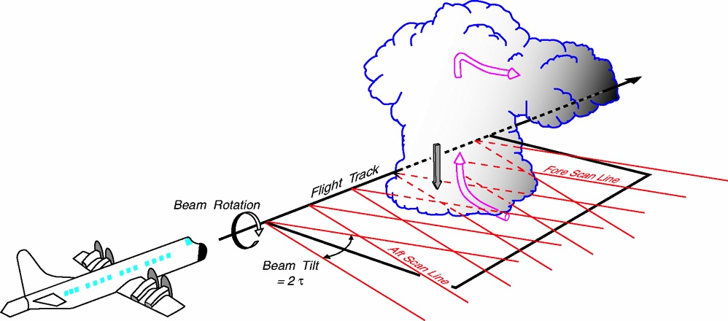
ELDORA in FASTEX, Shannon, Ireland, 1997
ELDORA in BAMEX, St. Louis, 2003
NSF/NCAR Electra (1992-2001)
NRL P3 (2002-2012)
ELDORA was the only airborne radar that resolved convective scale with certainty in Doppler velocity
[ 2 ]
Can synthesize 3-D wind field by flying by a phenomenon.
Sweep out 2 helical surfaces
Notes:
Mention 300 m along track resolution for ELDORA and 1500 m for NOAA P3 TDR.

Slide 3
Community Voices about APAR:
1. Lower Atmospheric Observing Facilities Workshop: Meeting the Challenge of Climate System Sciences (Smith et al. 2013)
2. NSF Community Workshop on Radar Technologies (Bluestein et al. 2014).
“A critical gap is that ELDORA (Electra Doppler Radar), which has been used by NSF-funded investigators to study mesoscale convective systems, fronts, other mesoscale phenomena and tropical cyclones, needs a new aircraft platform.”
“Airborne radar systems are relatively expensive to develop, put in the field, and maintain, but are critical for observations from areas otherwise not accessible.”
“…ELDORA-like airborne Doppler radars, …, polarimetric radars, …, are required to answer key current and emerging science questions.”
“The emerging radar technologies that would be most helpful in answering the key scientific questions are: phased-array technology, which can improve temporal resolution without reducing data quality …”
3
Notes:
Take advantage of the new technology, price is coming down, C-band phased array components and technology was not widely available 5 years ago
EOL wants to take advantages of these capabilities to develop a next generation radar for our community. The system has been designed to be placed on NSF/NCAR C-130 and does not require acquire a new airborne platform.

Slide 4
Scientific Frontiers for APAR:
Hazardous Weather – Hurricane, Tornado and severe weather, Winter storms, Flash flood
Weather/Climate Interface – Convection in tropics, MJO, Easterly waves
Radiation and Global Energy Cycle - Particle type/size and radiative transfer
Air Chemistry - Transport of aerosol, Water vapor and chemical species, Interaction of chemical species and cloud
Polar Frontier (Arctic & Antarctic) - Mixed phased clouds, Chemistry, Energy balance
Radar and NWP - Radar data assimilation, Model verification
Notes:
Understanding of polar regions’ influence on and response to global heat distribution in the ocean and atmosphere, adaptations of organisms to polar extremes, and the valuable records of past climates and atmospheric constituents in ice cores, polar ocean sediments, and other indicators.
Look at how many important science questions can be better addressed with the APAR system.

Slide 5
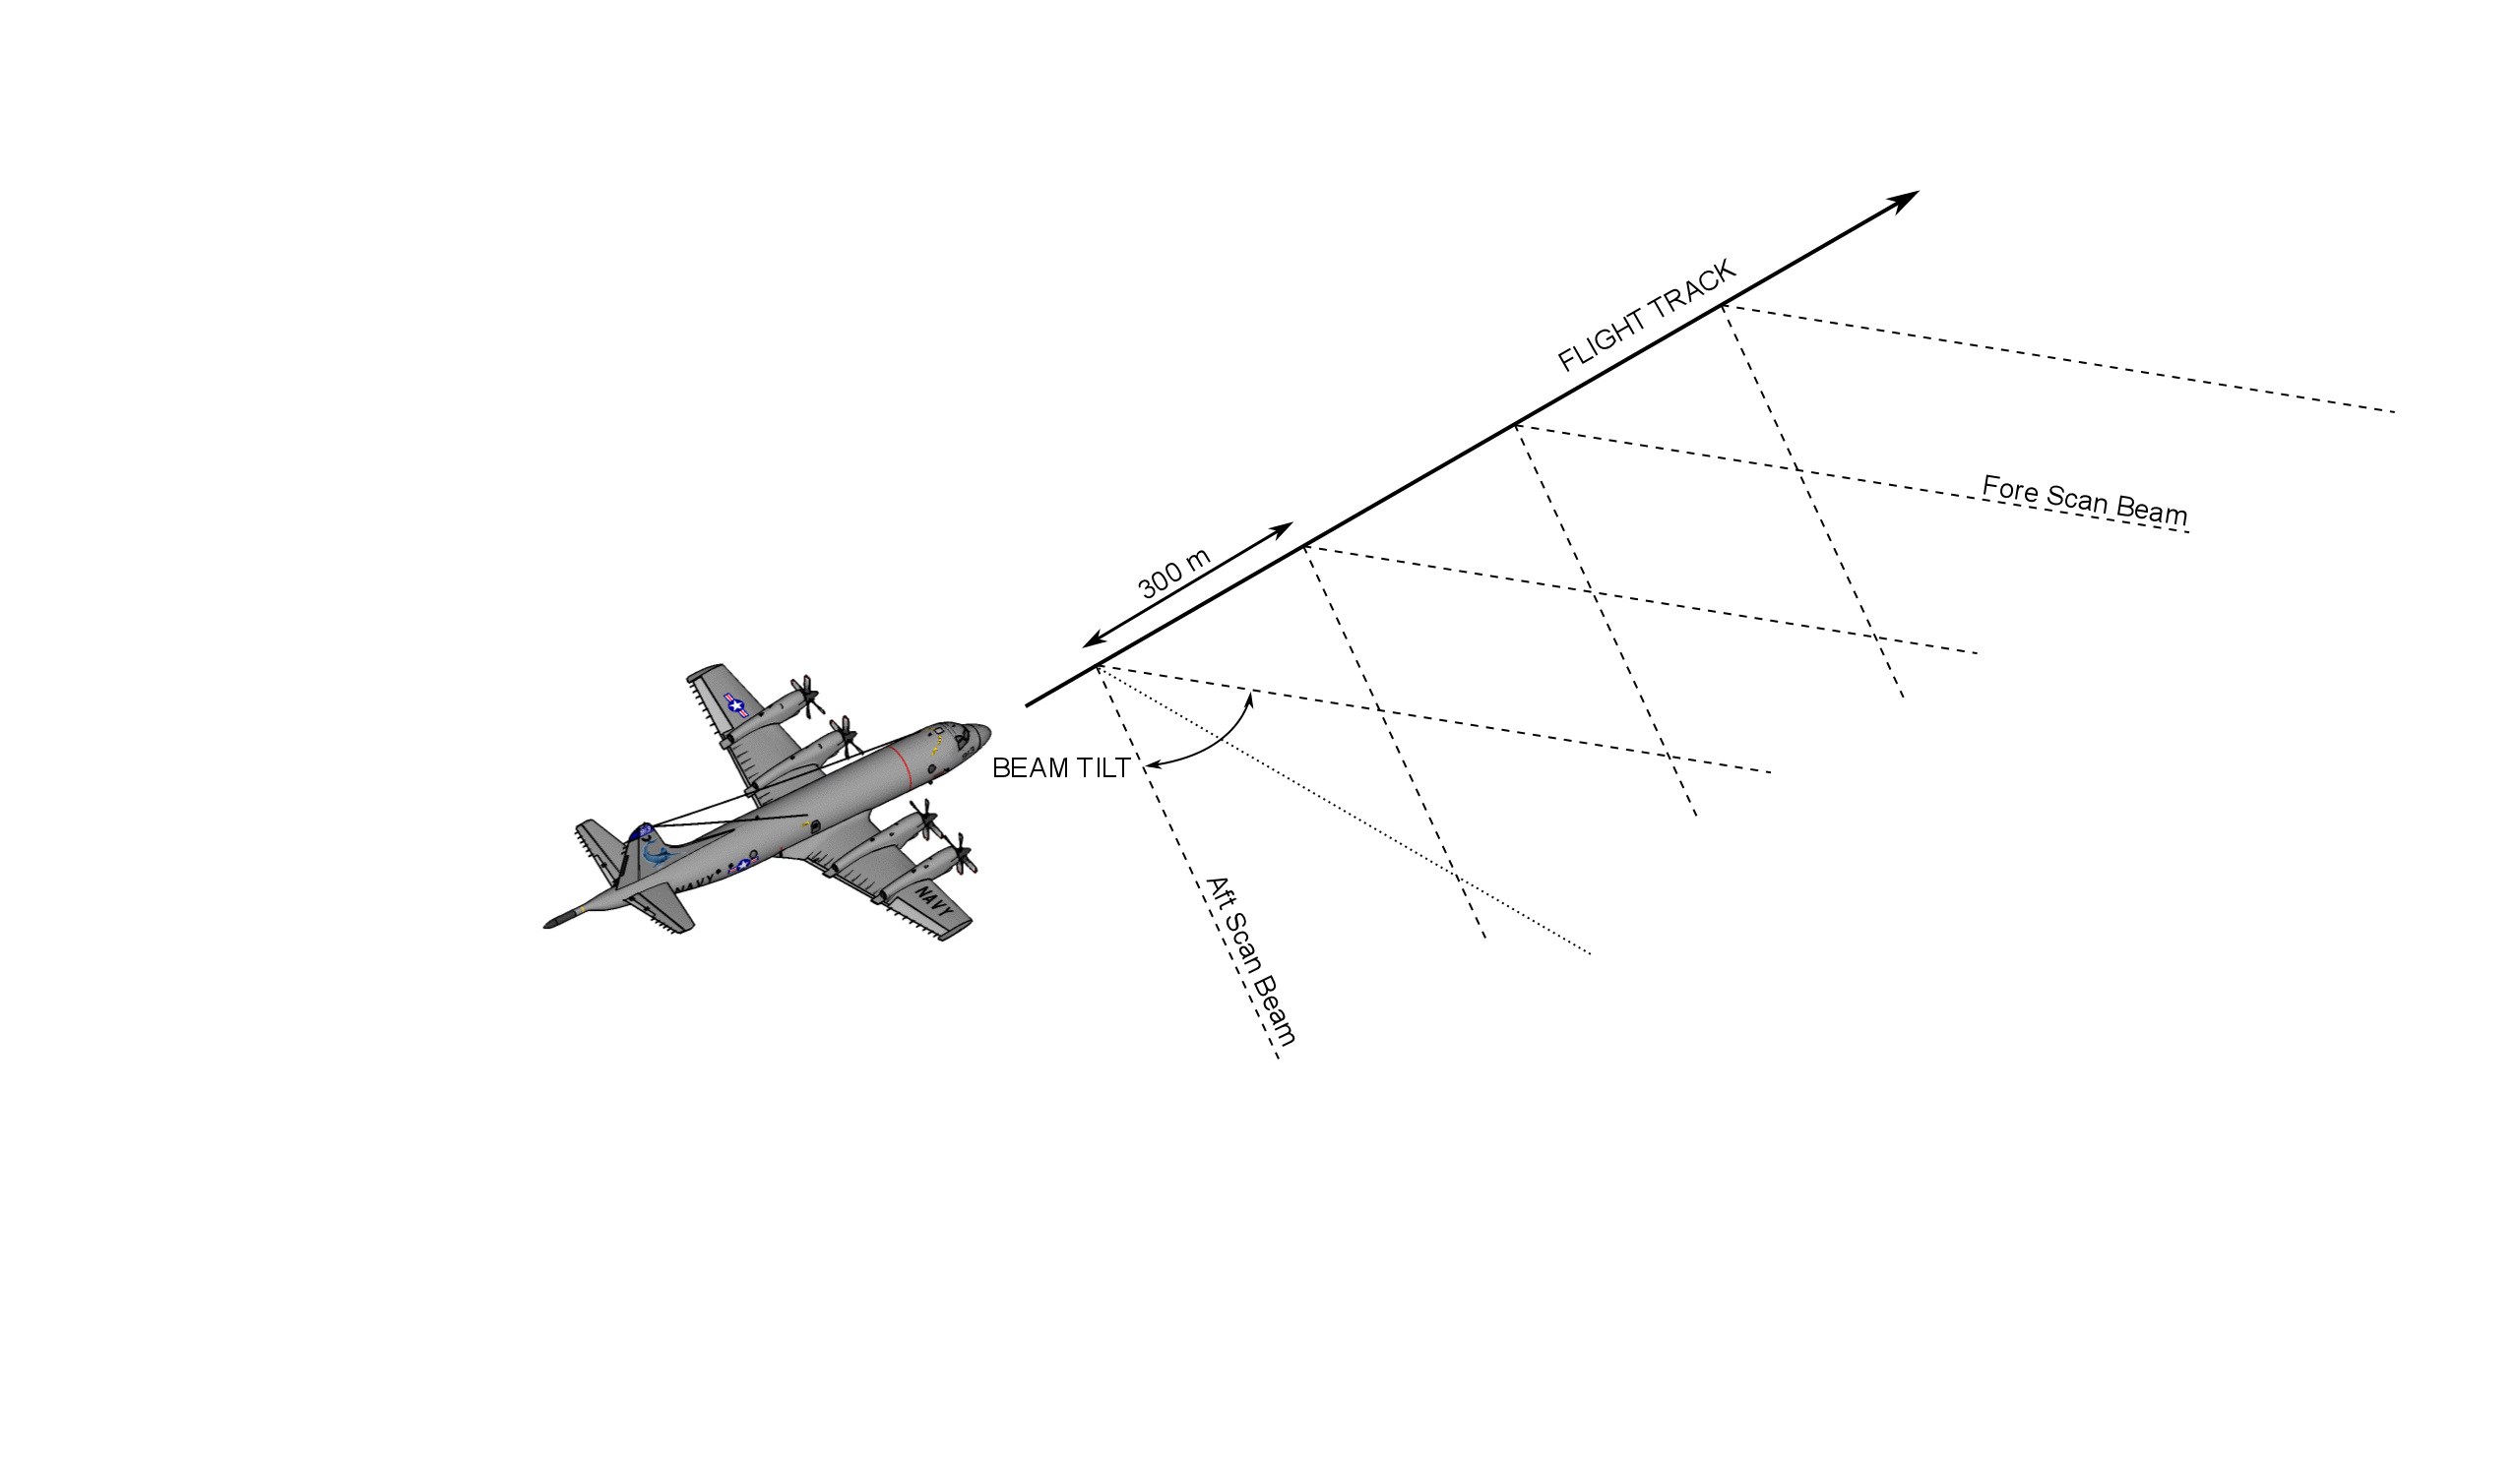
APAR Improvement in along track scanning resolution
Comparison of NOAA P-3 Tail Doppler Radar flat plate antenna 300m along-track fore/aft beam resolution (black dashed lines) and C-130 APAR designed 150m Active Electronically Scanned Array (AESA) along track resolution (red dashed lines)

Slide 6
Performance Comparison: Airborne Research Radars
Parameter | NOAA G-IV TDR | NOAA P-3 TDR | ELDORA | APAR
Frequency (GHz) | 9.3 | 9.3 | 9.3 – 9.8 | 5.35 – 5.45
# Elements (El/Az) | n/a | n/a | n/a | 64/56
# Total elements per panel | n/a | n/a | n/a | 3584
Beamwidth (El/Az) (degrees) | 2.7 | 1.35/1.9 | 1.8/2.0 | 1.6/1.8
Antenna Gain (dB) | 36.5 | 40 | 39 | 41
MDR @ 10 km (dBZ) | -9 | 0 | -11 | -15
Peak Transmit Power (KW) | 8 | 60 | 40 | 14.3
Polarization | Linear Horizontal | Vertical | Horizontal | Dual Linear
Spatial Resolution @ 10 km (m) | 471 | 314 | 314 | 314
Along track spacing (m) | 1125 | 1500 | 300 | 130
Pulse width (µsec) | .41 | 0.25-0.5 | 0.25 to 4.0 | 0.5 to 50
6

Slide 7
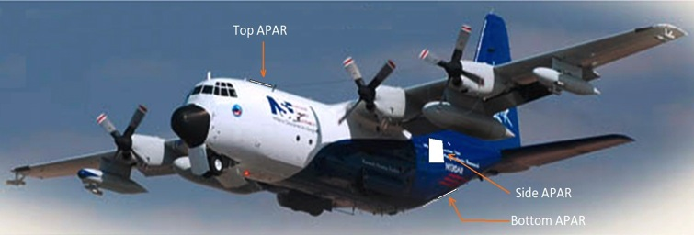
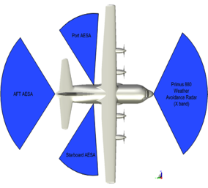
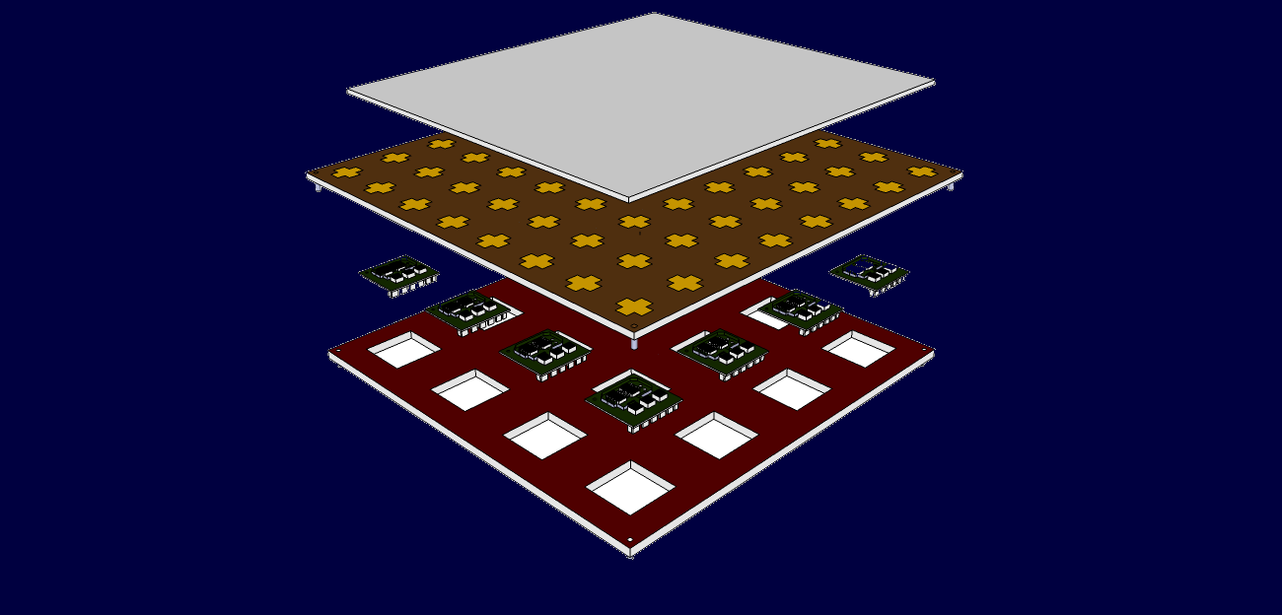
EOL Airborne Phased Array Radar (APAR)
Surveil-lance radar.
APAR faces
Antenna Radome
Electronically scanned (no moving parts)
4 Phased-array antennas on the aircraft
3-D Volume scanning from the aircraft
Operates at C-band (look deep into storms)
Dual polarization, high resolution
Antenna Array
Transmit/receive modules
(T/R) modules
Backplane
Enabling focused scientific research in high-impact weather, cloud microphysics, storm dynamics, radiation and climate
Compliment a suite of existing instruments on NSF/NCAR C-130
Addresses specific objectives in NSF and NCAR Strategic Plans
Data at spatial/temporal scales that match numerical models
Seven-year development schedule
University and industry partnerships key to successful design and build
Deployable on NSF/NCAR C-130 aircraft or similar platforms
20+ year operational lifetime
APAR can be implemented in operational storm measurements (e.g. flown on US Air Force C-130 Hurricane Hunters)
7

Slide 8
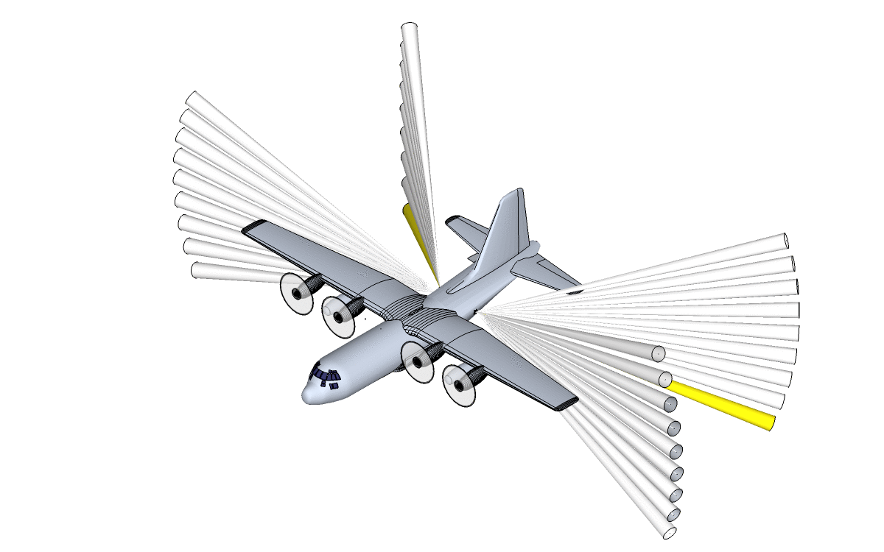
APAR combines reflectivity, velocity and dual-polarization measurements. Attenuation at C-band frequency is lower in heavy rain.
[ 8 ]

Slide 9
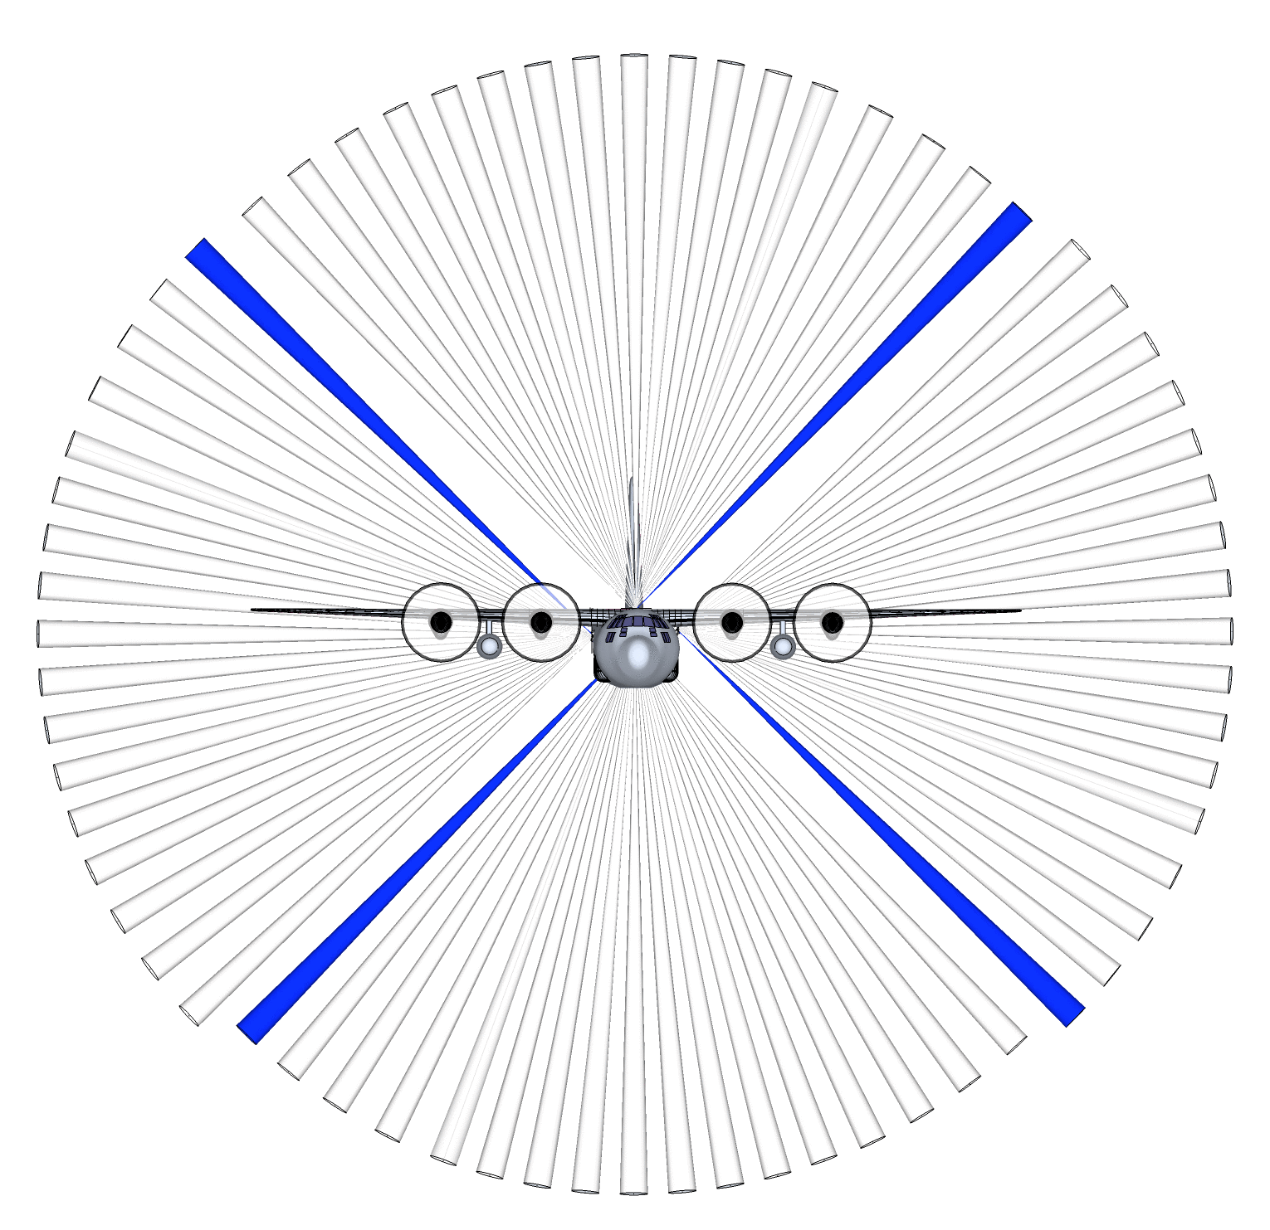

APAR Proposed Scan strategy from C-130. Simultaneous 4 beam transmit strategy for 3-D volume generation

Slide 10
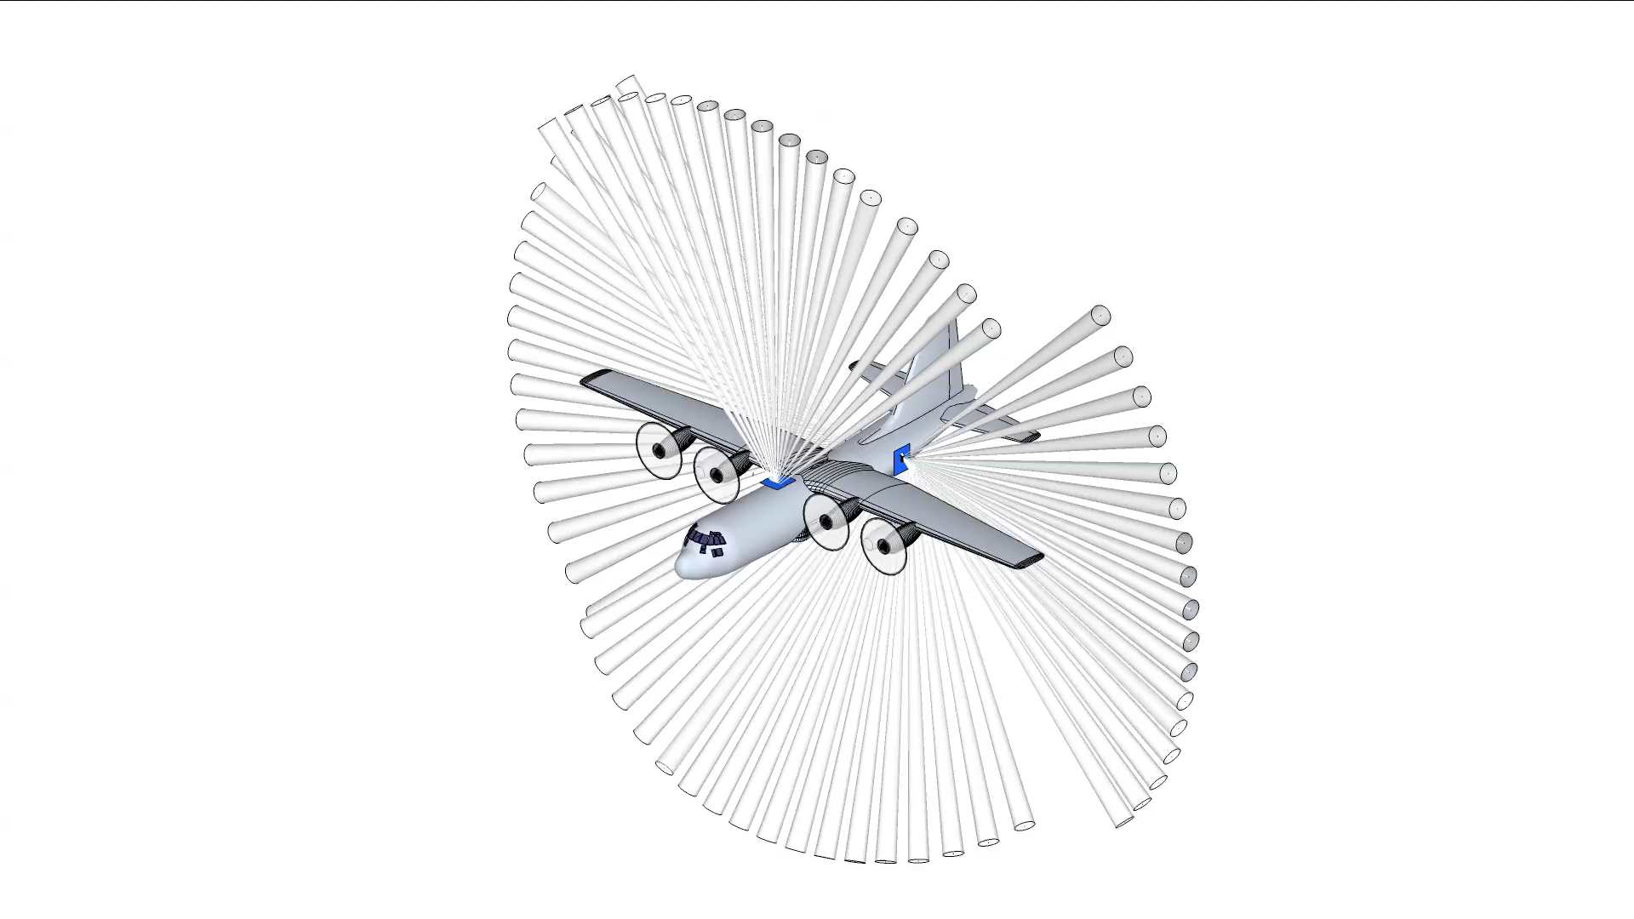
Animation of APAR single forward angle as it appears coming from 3 of the 4 APAR array faces. Maximum radar range ~75km depending on attenuation at C-band

Slide 11
APAR Timeline and Path Forward:
EOL provided White Paper to NSF in early 2014 for comment
Continue to seek community support for the development (Conferences,
Townhalls, Articles)
Coordinate project management protocols and procedures (reviews, risk assessment, resource allocation, etc.)
Convene APAR Advisory Panel first meeting
EOL internal resources supporting T/R module development and testing at this time
APAR Team and collaborators in the midst of LRU T/R PCB prototype testing
Redesign and fabrication of ‘improved’ PCB will be undertaken once testing is complete
EOL continues to seek NSF support and/or partner support via proposals collaborative agreements, etc. to proceed to the Phase 1 of the APAR development
EOL proposes to seek national and/or international partners with appropriate approval/coordination with NSF
Timing of the receipt of resource increments is critical to minimize loss of momentum from phase to phase (keep forward progress of critical staff and partners)
1/22/2015
EOL External Advisory Committee
11

Slide 12
Questions?
[12]

