Slide 1
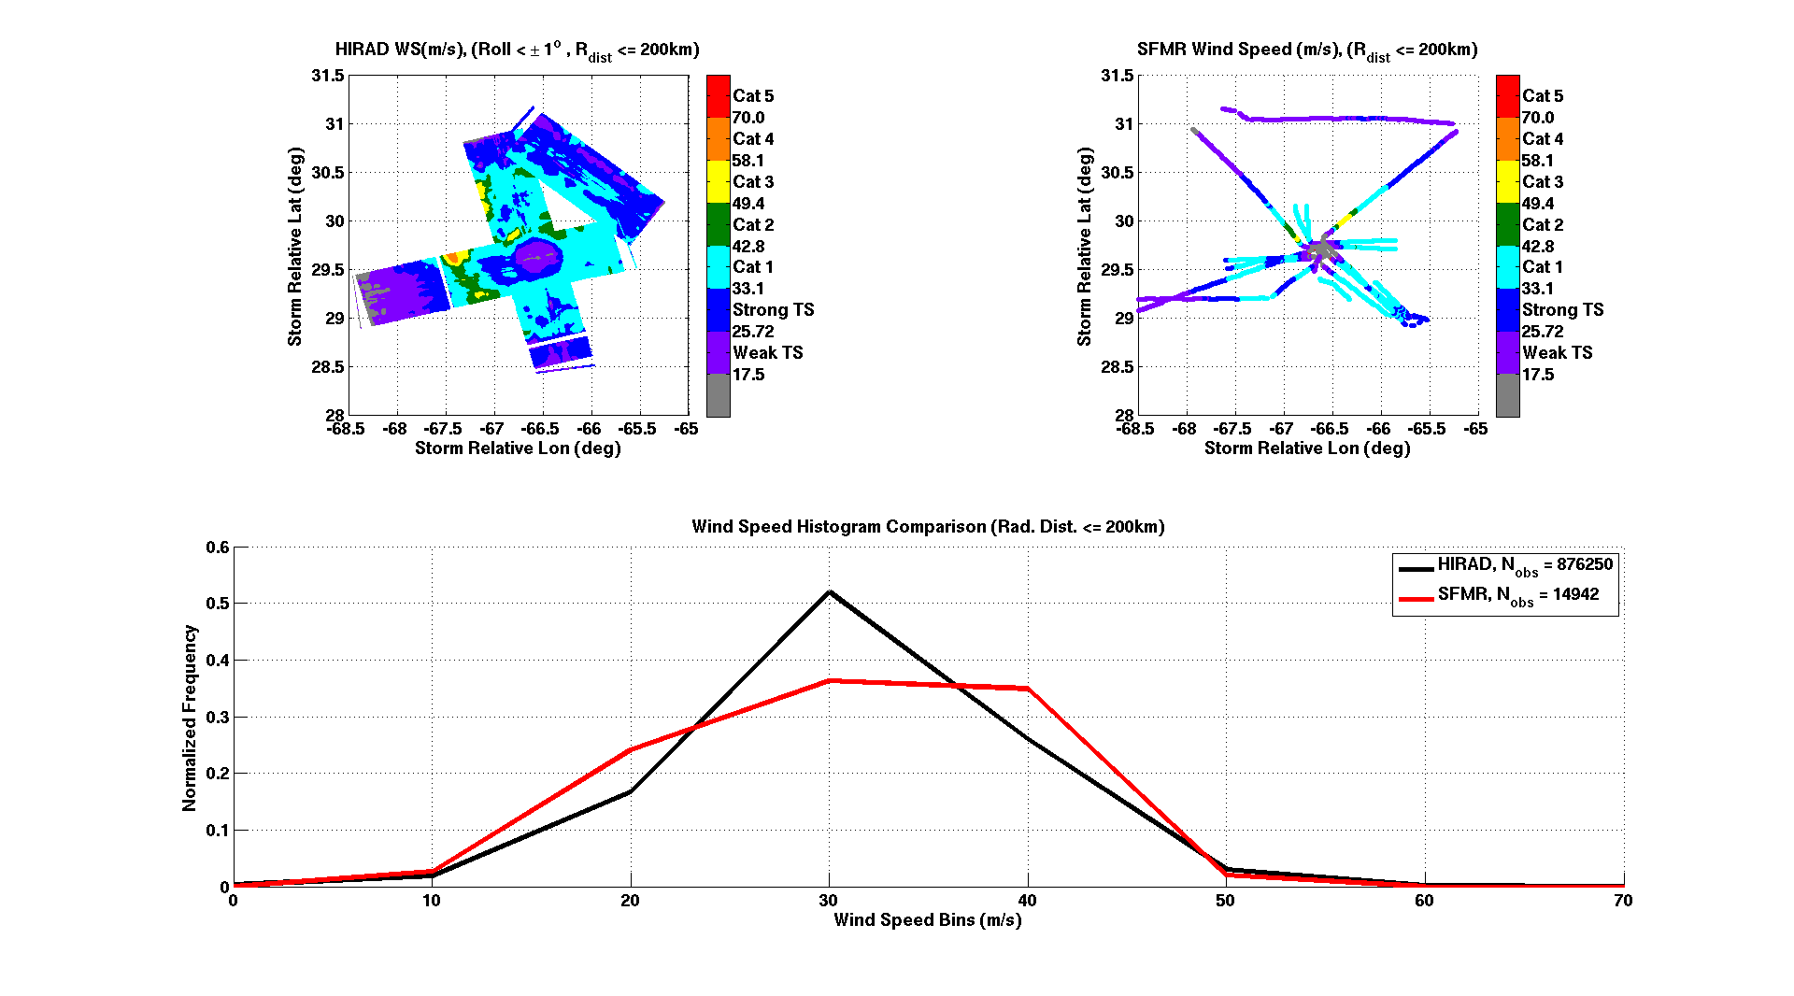
Hurricane Imaging Radiometer (HIRAD)
Daniel J. Cecil, NASA Marshall Space Flight Center
Sayak K. Biswas, Universities Space Research Association
W. Linwood Jones, University of Central Florida
Daniel.J.Cecil@nasa.gov

Slide 2
C-band (4, 5, 6, 6.6 GHz) radiometer
Retrieval concept similar to the operational Stepped Frequency Microwave Radiometer (SFMR)
Retrieve Wind Speed and Rain Rate over ocean, but over a wide swath
C-band frequencies have varying sensitivity to rain but ~equal sensitivity to wind speed (emission from foam on wind-roughened ocean surface)
HIRAD Background
HIRAD Tb
Tb7
Tb6
Tb5
Hurricane Karl (2010) example
WS
HIRAD Retrievals
RR
Scan#

Slide 3
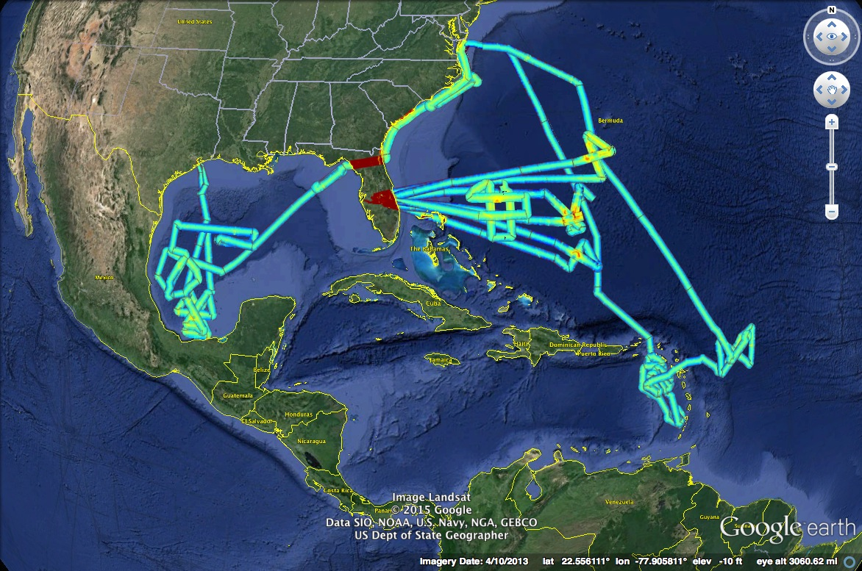
HIRAD Science Flights
Hurricane Earl 2010
Hurricane Ingrid 2013
Hurricane Gonzalo 2014 (3 flights)
Hurricane Karl 2010
Pre- TS Gabrielle 2013

Slide 4
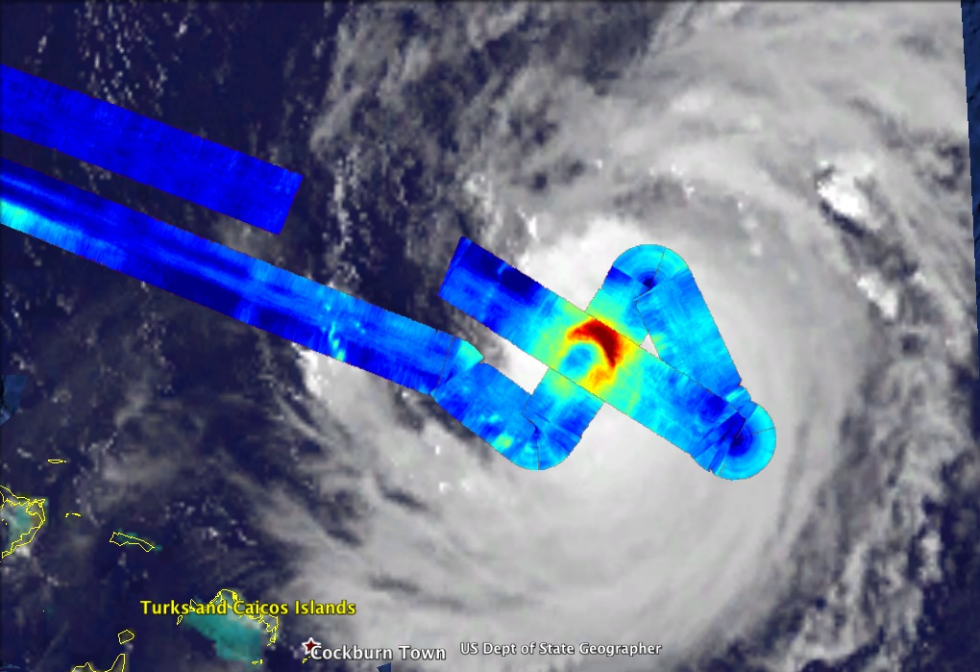
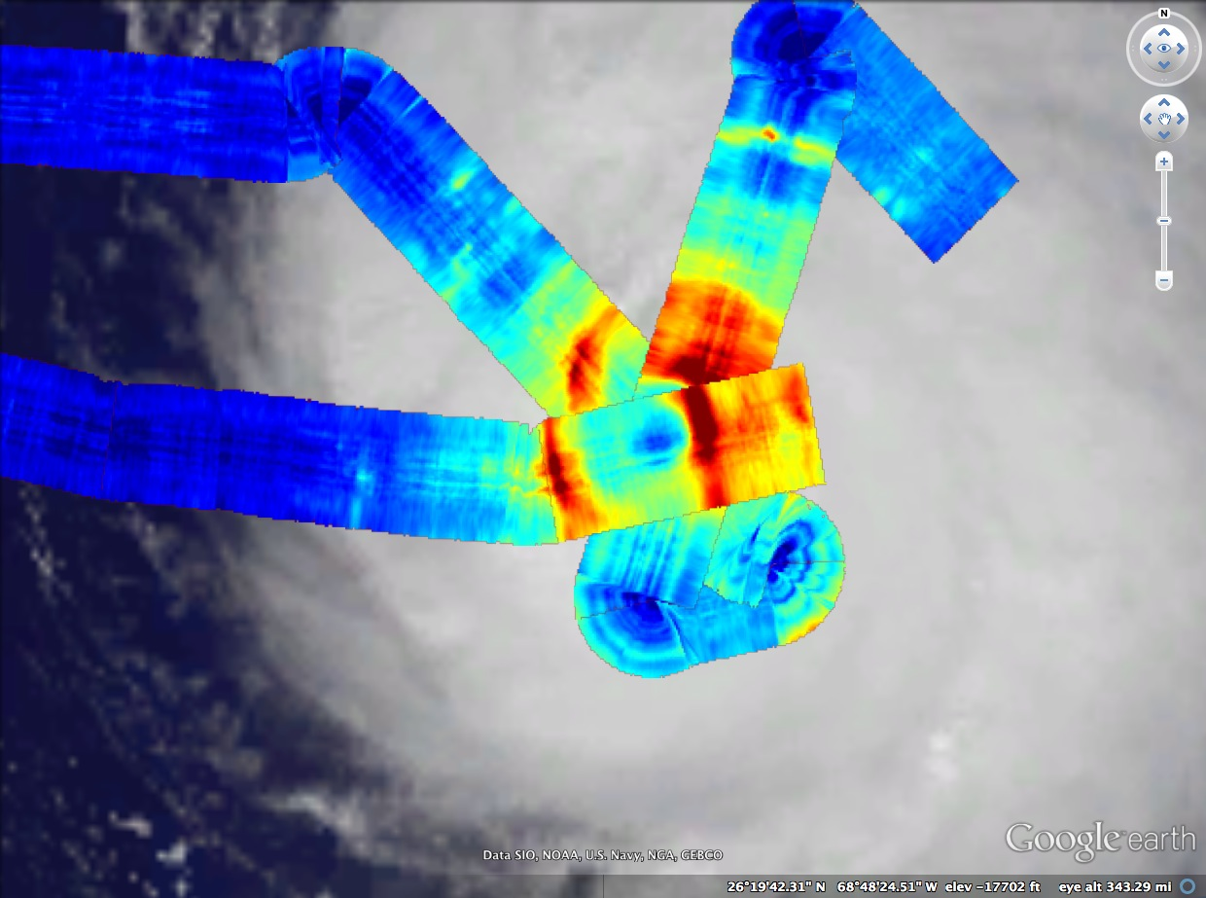
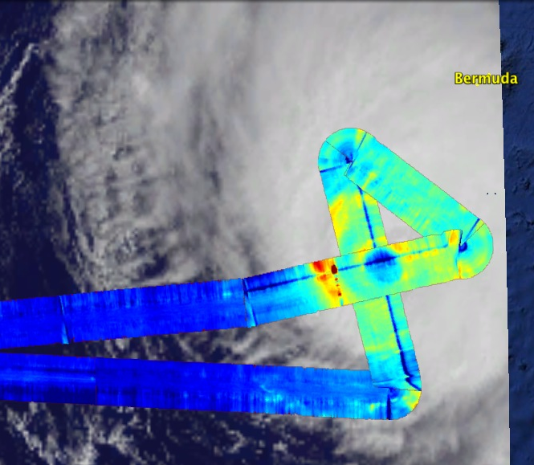
Hurricane Gonzalo (2014)
Oct 15
Oct 16
Oct 17
Storm motion not subtracted from these images
Flown on NASA WB-57 based out of Houston, forward-deployed to Tampa
Cooperation between NASA HS3 program and ONR TCI program
Instruments were integrated onto Global Hawk AV-1 in July for HS3, but AV-1 was unable to perform missions. WB-57 was available for hurricane flights because of the ONR program, so HIRAD and HIWRAP were moved from Global Hawk to WB-57. Kudos to all who made this switch possible!

Slide 5
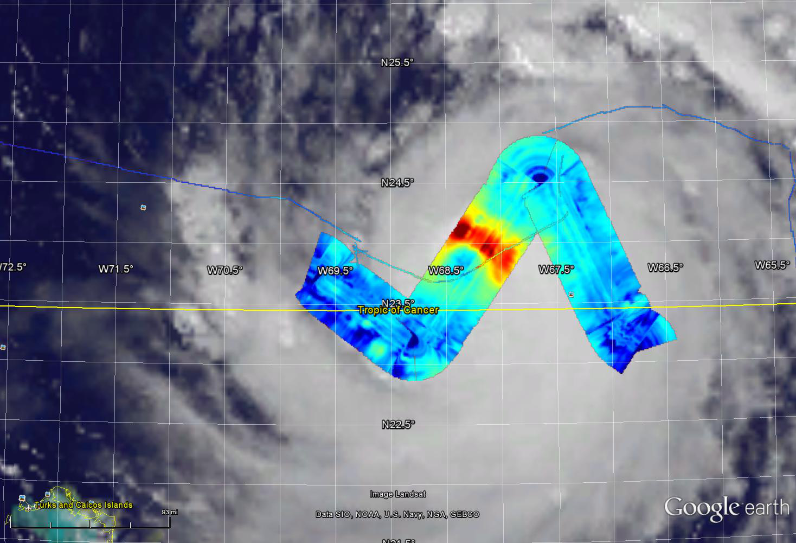
First Storm Center Crossing: 20:34 UTC
Retrievals here use 3 HIRAD channels – 5, 6, 6.6 GHz
Geophysical model based on El-Nimri et al. (2010), Uhlhorn et al. (2007), Uhlhorn and Black (2003)
WS
(m/s)
SFMR center Crossing Time : 14:43 UTC
GOES Cloud Image @ 18:15 UTC

Slide 6
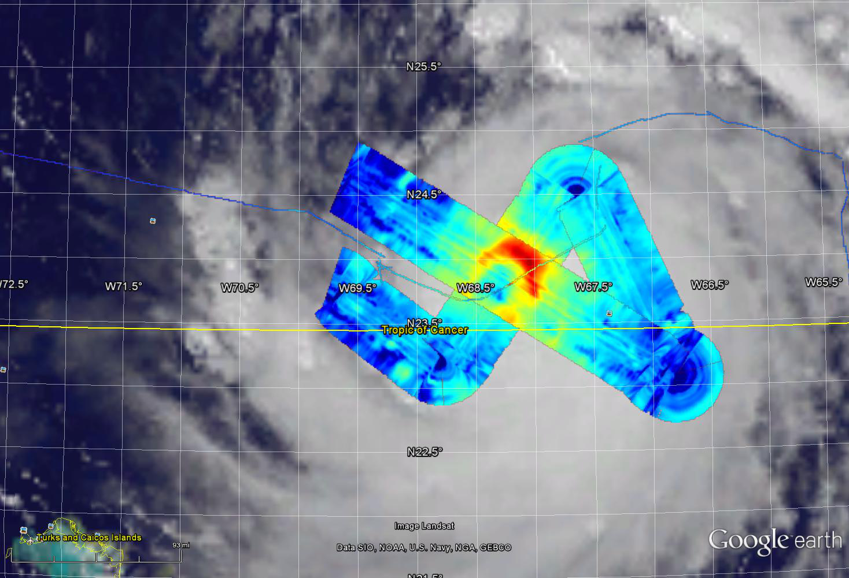
Second Storm Center Crossing: 21:12 UTC
Retrievals here use 3 HIRAD channels – 5, 6, 6.6 GHz
Geophysical model based on El-Nimri et al. (2010), Uhlhorn et al. (2007), Uhlhorn and Black (2003)
WS
(m/s)
SFMR center Crossing Time : 14:43 UTC
GOES Cloud Image @ 18:15 UTC

Slide 7
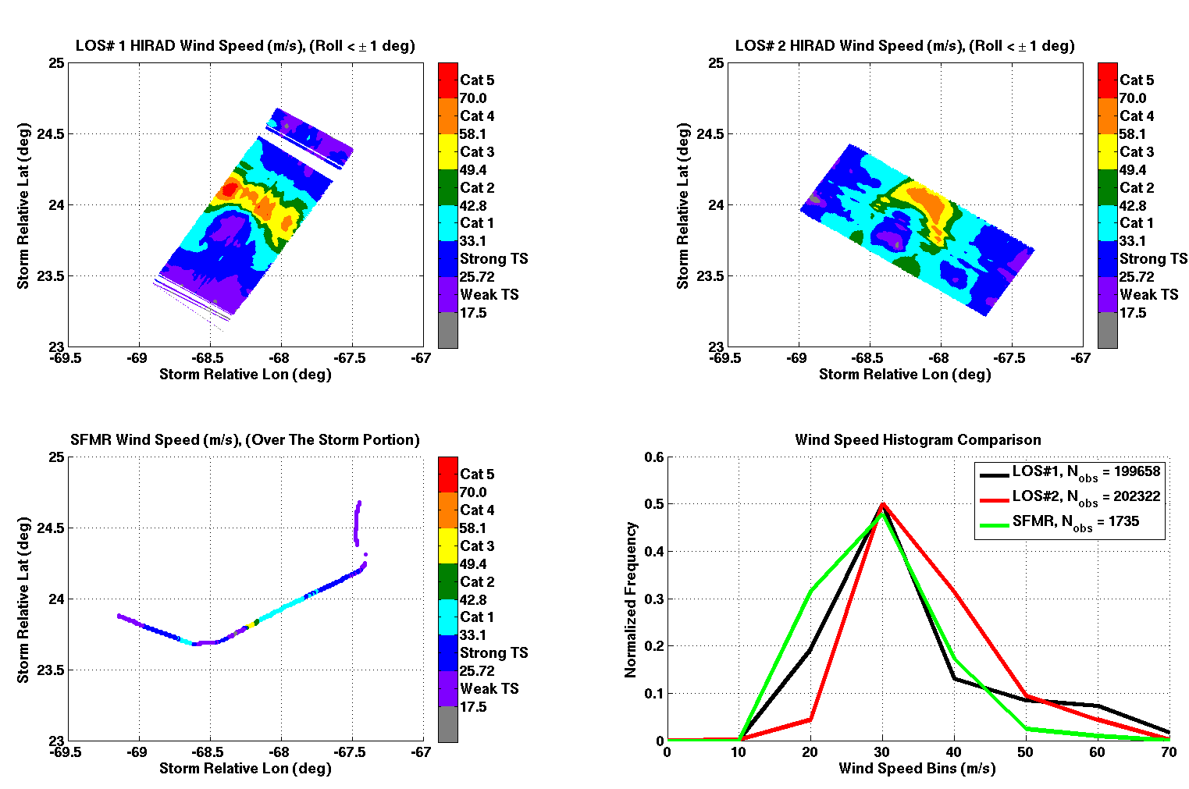
Wind Retrievals – Oct 15 Gonzalo
HIRAD has biases at some incidence angles, seen as along-track striping.
Also tends to be high-biased along left edge.
Work in progress
Retrievals here use 3 HIRAD channels – 5, 6, 6.6 GHz
Geophysical model based on El-Nimri et al. (2010), Uhlhorn et al. (2007), Uhlhorn and Black (2003)
20:34 UTC
HIRAD
21:12 UTC
HIRAD
14:43UTC
SFMR

Slide 8
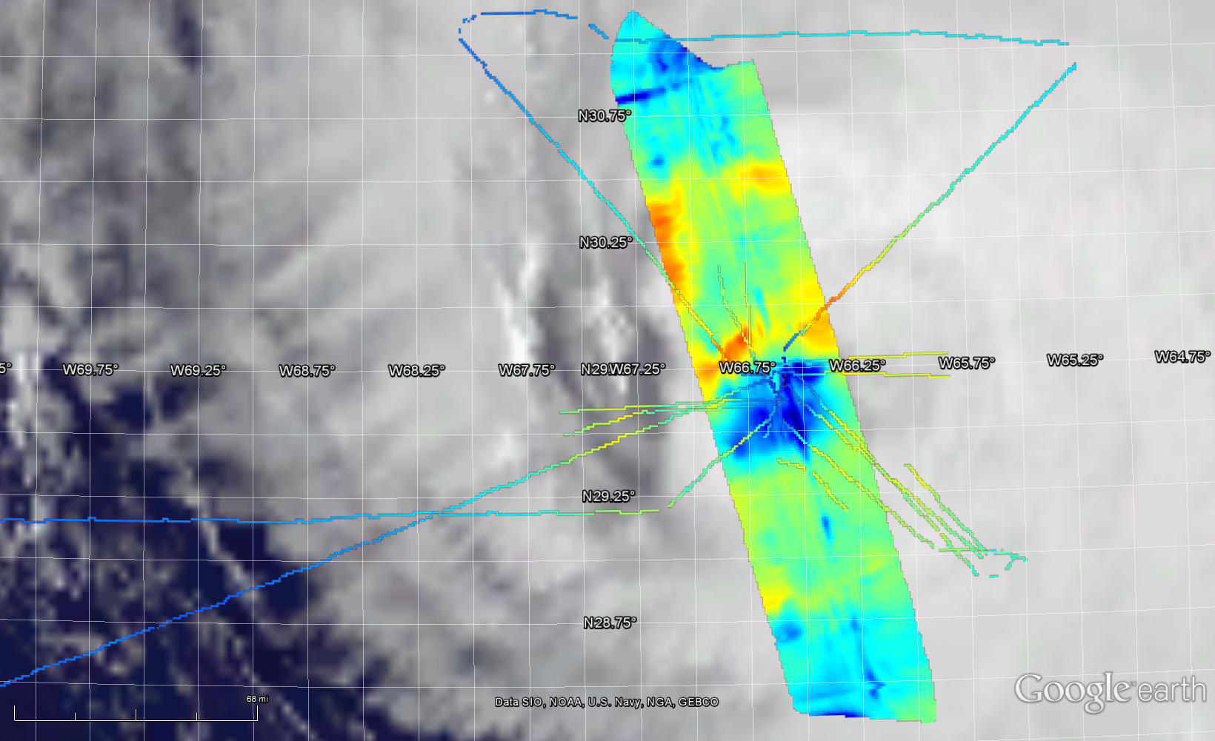
First Storm Center Crossing: 14:04 UTC
SFMR: 12:32 UTC
SFMR: 12:03 UTC
Concentric eyewalls, with Northern Inner Eyewall and Western Outer Eyewall appearing strongest
HIRAD: 14:15 UTC
SFMR: 14:15 UTC
SFMR: 14:40 UTC
SFMR: 13:57 UTC
WS
(m/s)
SFMR: 11:24 UTC
SFMR: 13:21 UTC
SFMR: 16:13 UTC
HIRAD: 13:53 UTC
GOES Cloud Image @ 12:15 UTC

Slide 9
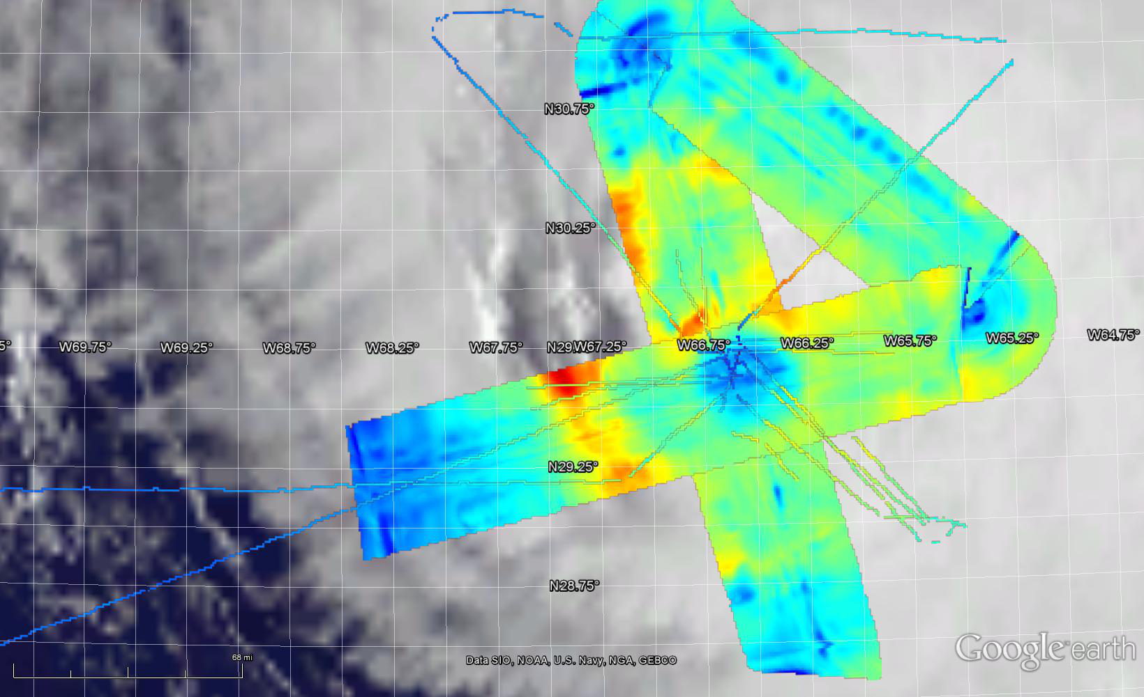
Second Storm Center Crossing: 14:41 UTC
SFMR: 12:32 UTC
HIRAD: 14:15 UTC
SFMR: 12:03 UTC
Concentric eyewalls, with Northern Inner Eyewall and Western Outer Eyewall appearing strongest
SFMR: 14:15 UTC
HIRAD: 14:32 UTC
SFMR: 14:40 UTC
SFMR: 13:57 UTC
WS
(m/s)
SFMR: 11:24 UTC
SFMR: 13:21 UTC
SFMR: 16:13 UTC
HIRAD: 15:54 UTC
HIRAD: 13:53 UTC
GOES Cloud Image @ 12:15 UTC

Slide 10
Wind Retrievals – Oct 17 Gonzalo

Slide 11
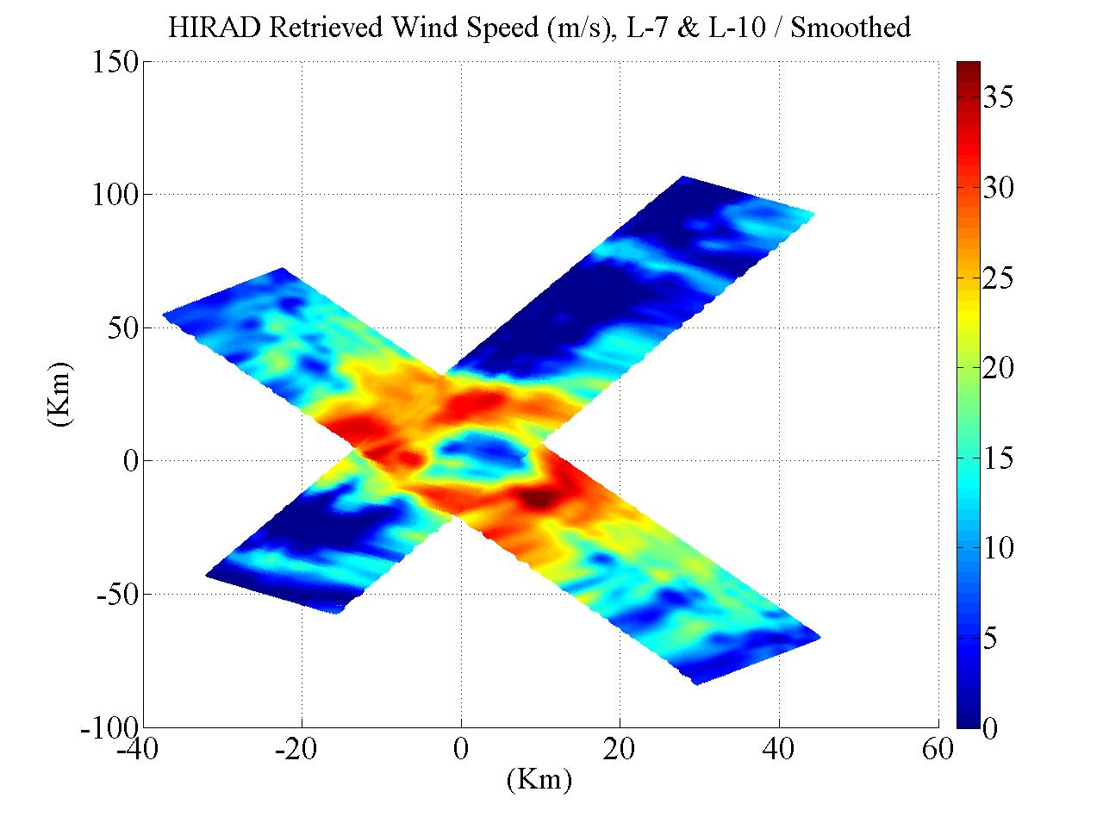
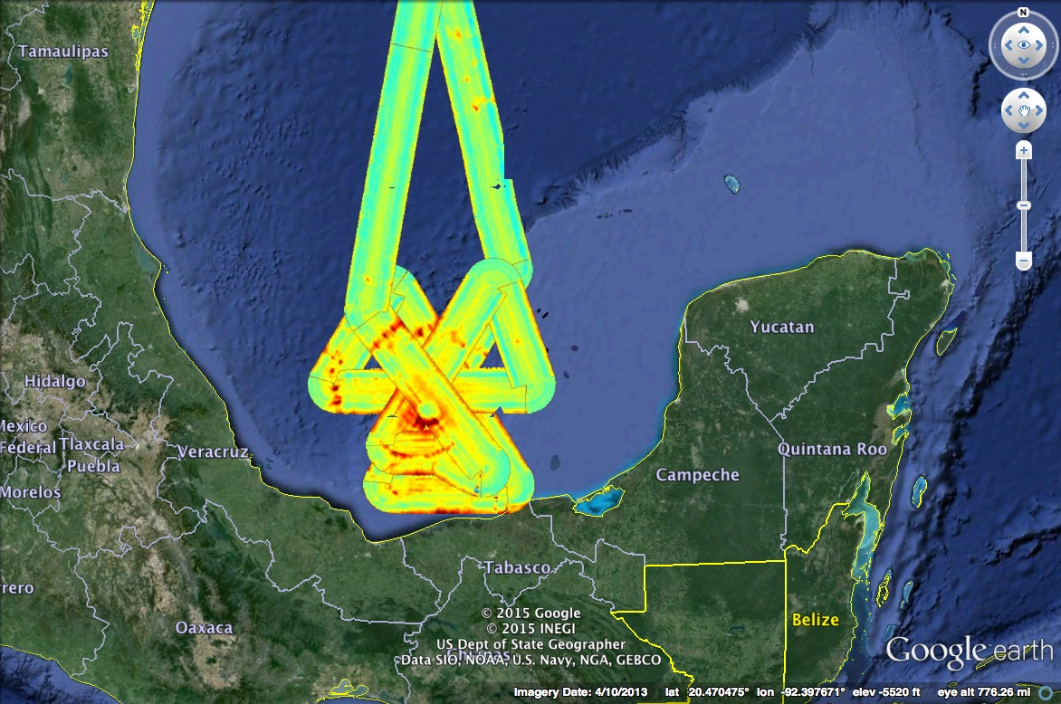
Hurricane Karl (2010) Brightness Temp and Wind Speed Retrieval
Surface Wind Speed
6.6 GHz TB

Slide 12
HIRAD Wind Retrieval, Assimilation for Hurricane Karl
Surface wind field in data assimilation experiments from Jason Sippel at GSFC
Adding HIRAD (bottom middle) improves characterization of asymmetric nature of wind field, and correctly reduces the horizontal extent of the wind field. Control and Control+HIWRAP(radar) experiments had Radii of 50-kt and 34-kt winds too large, compared to Best Track
Best results from assimilating Dropsonde, HIRAD, HIWRAP together
HIWRAP VAD wind assimilated
HIRAD surface wind and HIWRAP VAD wind assimilated
HIRAD surface wind, dropsonde wind, and HIWRAP VAD wind assimilated

Slide 13
Summary
3 Science Flights from WB-57 over Hurricane Gonzalo (2014)
Wide-swath data helps
paint a picture of hurricane structure
Initial retrievals from Oct 15, Oct 17
flights look good, some systematic
(scan-angle dependent) biases remaining
Oct 16 data needs more cleanup before retrievals, but hurricane structure is there
Hurricane Karl (2010) wind retrievals tested in assimilation with dropsondes and HIWRAP; improved structure of wind radii

