Slide 1
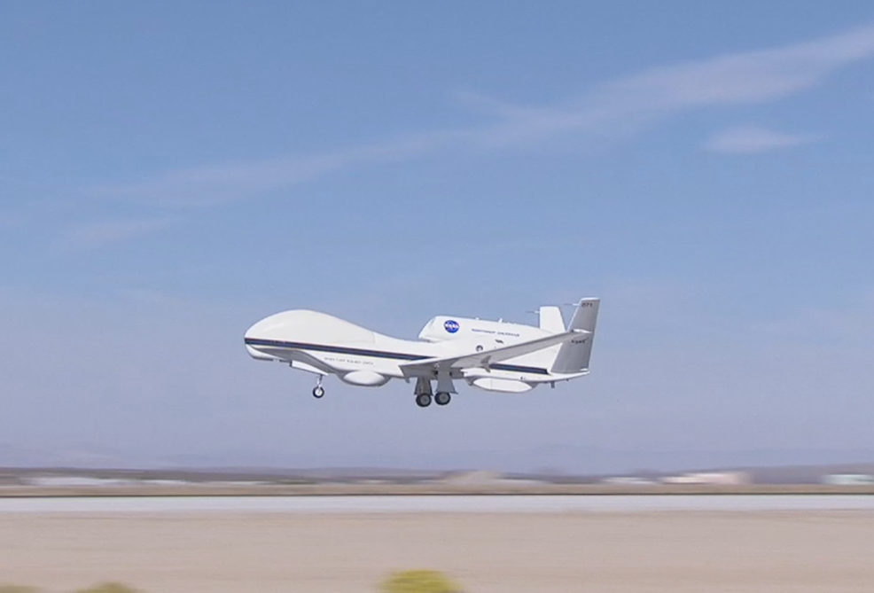
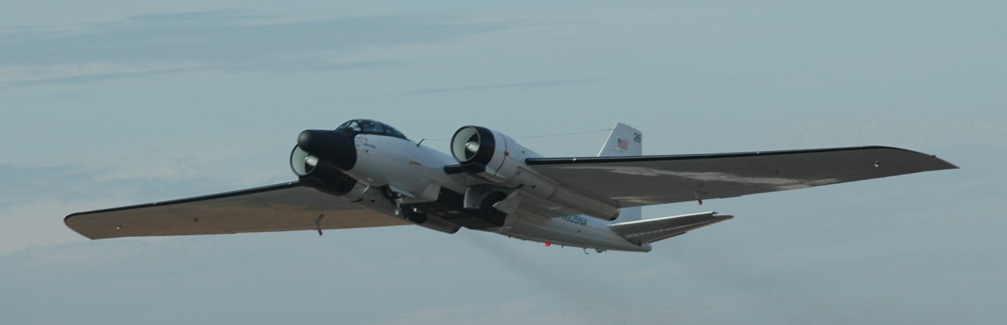


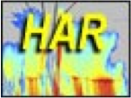
HIWRAP Status and Future Plans
Gerry Heymsfield NASA/Goddard Space Flight Center
Lihua Li, Matt Mclinden NASA/Goddard Space Flight Center
Stephen Guimond U. MD/ESSIC
Anthony Didlake NASA/ORAU
Lin Tian Morgan State Univ.
James Carswell Remote Sensing Solutions
HAMSR
HIWRAP
HIRAD
WB-57 in2014
Acknowledgements: NASA ESTO IIP
NASA HS3
NASA HSRP

Slide 2
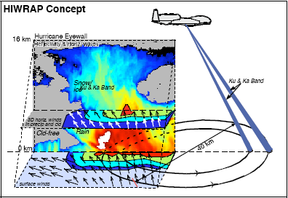
High-Altitude Imaging Wind and Rain Airborne Profiler (HIWRAP)
MEASUREMENTS GOALS:
Map the 3-dimensional winds and precipitation in precipitation regions associated with tropical storms.
Map ocean surface winds in clear to light rain regions using scatterometry.
HIWRAP Characteristics:
  Conically scanning.
  Simultaneous Ku/Ka-band & two beams @ 30 and 40 deg
  New technologies in radar: low power solid state transmitters with pulse compression, single antenna
  GPM radar frequencies.
Notes:
Increased sampling of storm temporally needed to capture RI and other events
Fills gaps in coverage from orbiting satellites.
Global Hawk new plane for science

Slide 3

Previous and Upcoming HIWRAP Flights
  Global Hawk – Hurricane Flights
  2010: GRIP AV-6
  2012: HS3 AV-1 -> 1 science/test flight
  2013: HS3 AV-1 -> 2 science flights
  2014: HS3 AV-1 -> WB-57 – HS3
  2015: (PLANNED) SHOUT (NOAA) AV-6
  ER-2 (mainly nadir look) GPM Validation/future missions
  2011: MC3E (OK in May, June)
  2014: IPHEX (NC, SC in May, June)
  2015 (UPCOMING): OLYMPEX (Olympic Peninsula, WA in Nov, Dec)
Notes:
3

Slide 4
HIWRAP Hardware
    Accomplishments 2014 flights:
    Onboard Pulse Pair processing.
    Ka-band transmitter power increased -> 12 dBZ sensitivity improvement.
      Improved pulse compression algorithms.
Upcoming hardware upgrades for 2015
    Ku-band transmitter power increase -> 10 dBZ sensitivity improvement.
    Improved pulse-compression algorithms.
    Improved real-time data products.

Slide 5
Processing Software Upgrades
Software became complicated with different HIWRAP configurations on 3 planes (Global Hawk, ER-2, and WB-57), and 2 new radars (Cloud Radar System; ER-2 X-band Radar).
New software more efficient, parallelized, and uses standarized file format (HDF).
Improved noise subtraction & despeckling for better sensitivity, improved Doppler unfolding algorithm.

Slide 6
HIWRAP Atmospheric Wind Retrievals
  Grid-point (3D-VAR) analysis -> 3 components of wind in 3D swath
    Guimond, S.R., L. Tian, G.M. Heymsfield and S.J. Frasier, 2014: Wind retrieval algorithms for the IWRAP and HIWRAP airborne Doppler radars with applications to hurricanes. J. Atmos. Ocean Technology., 31, 1189-1215.
  Grid-point 3D Coplane analysis:
    Anthony C. Didlake, Jr., Gerald M. Heymsfield, Lin Tian, Stephen R. Guimond, 2015: The Coplane Analysis Technique for Three-Dimensional Wind Retrieval Using the HIWRAP Airborne Doppler Radar. Pre-release: Journal of Applied Meteorology and Climatology Uses cylindrical coordinate system and integrates along circular paths.
  VAD analysis -> 2D curtain of horizontal winds
    Tian et al., 2014: VAD and Dual-Doppler analysis of Doppler velocity for HIWRAP. In review JAMC.

Slide 7
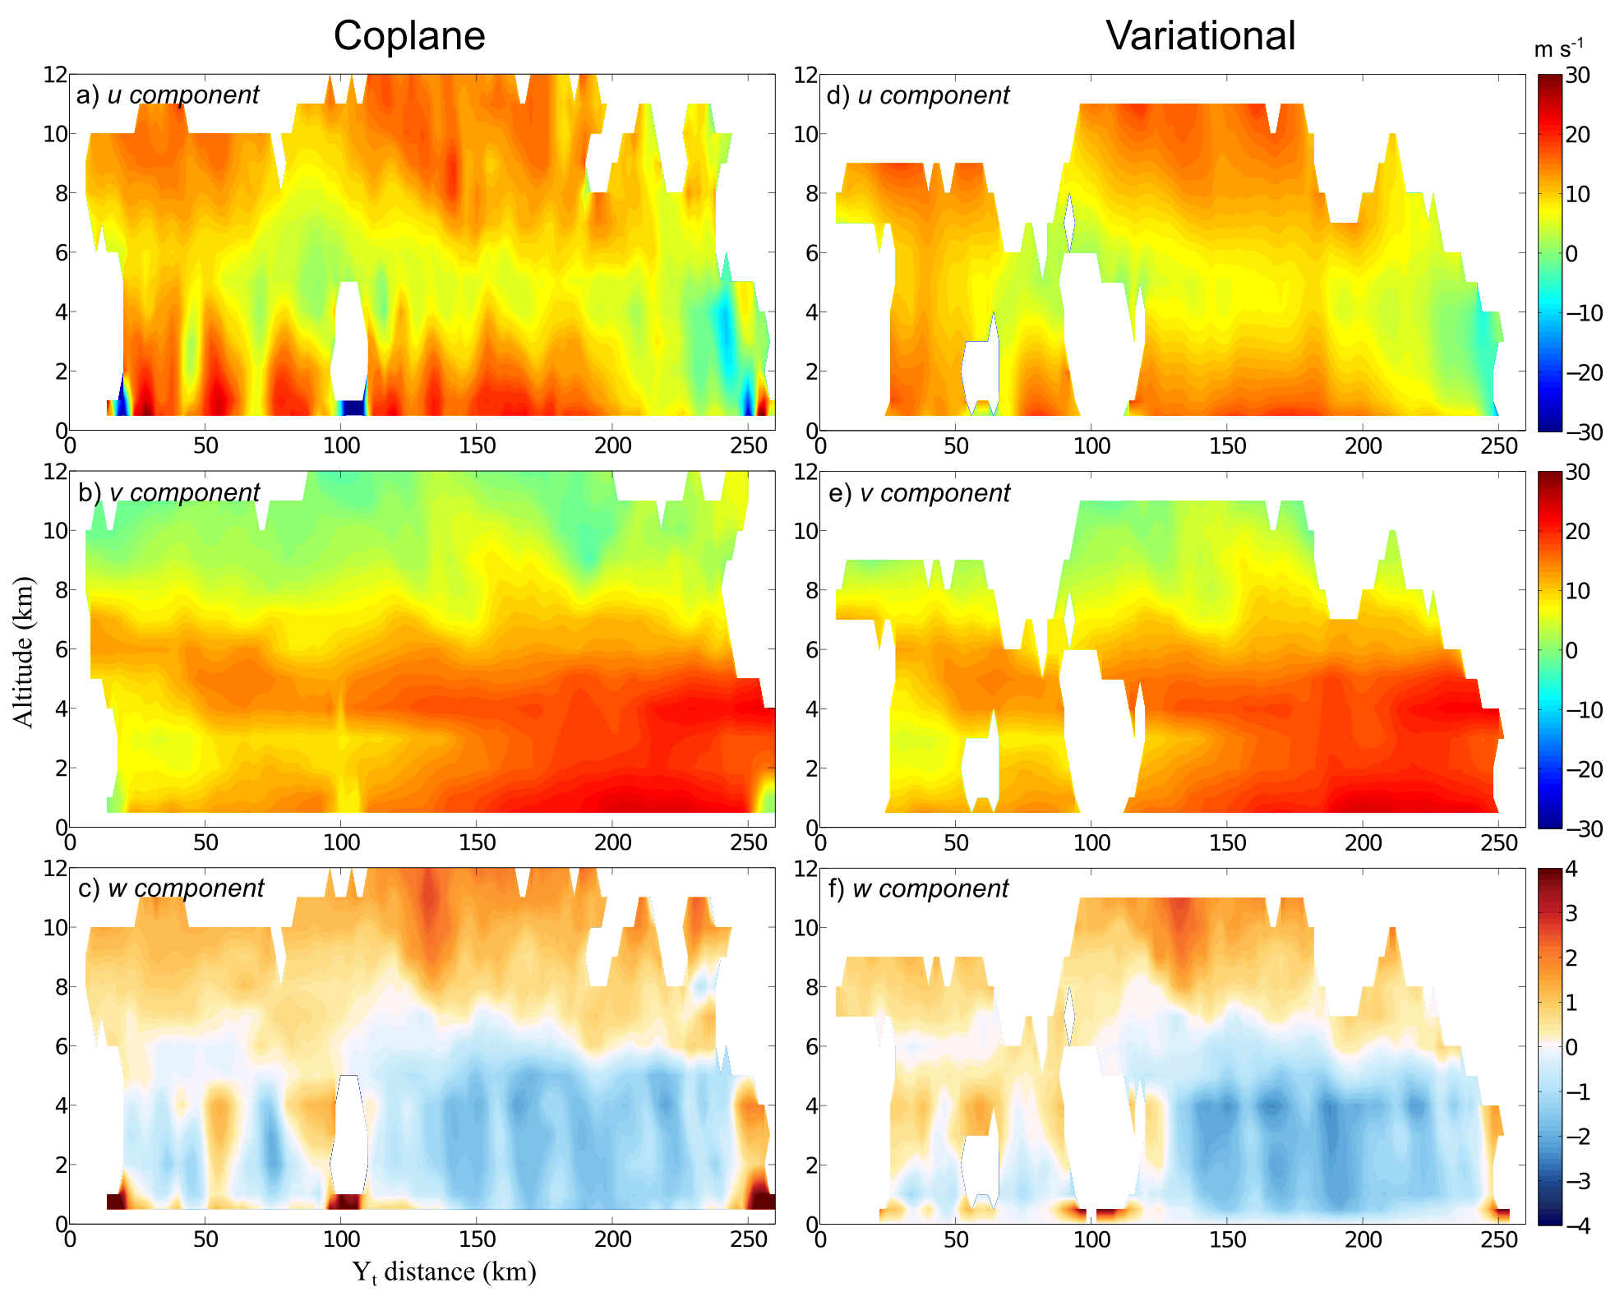
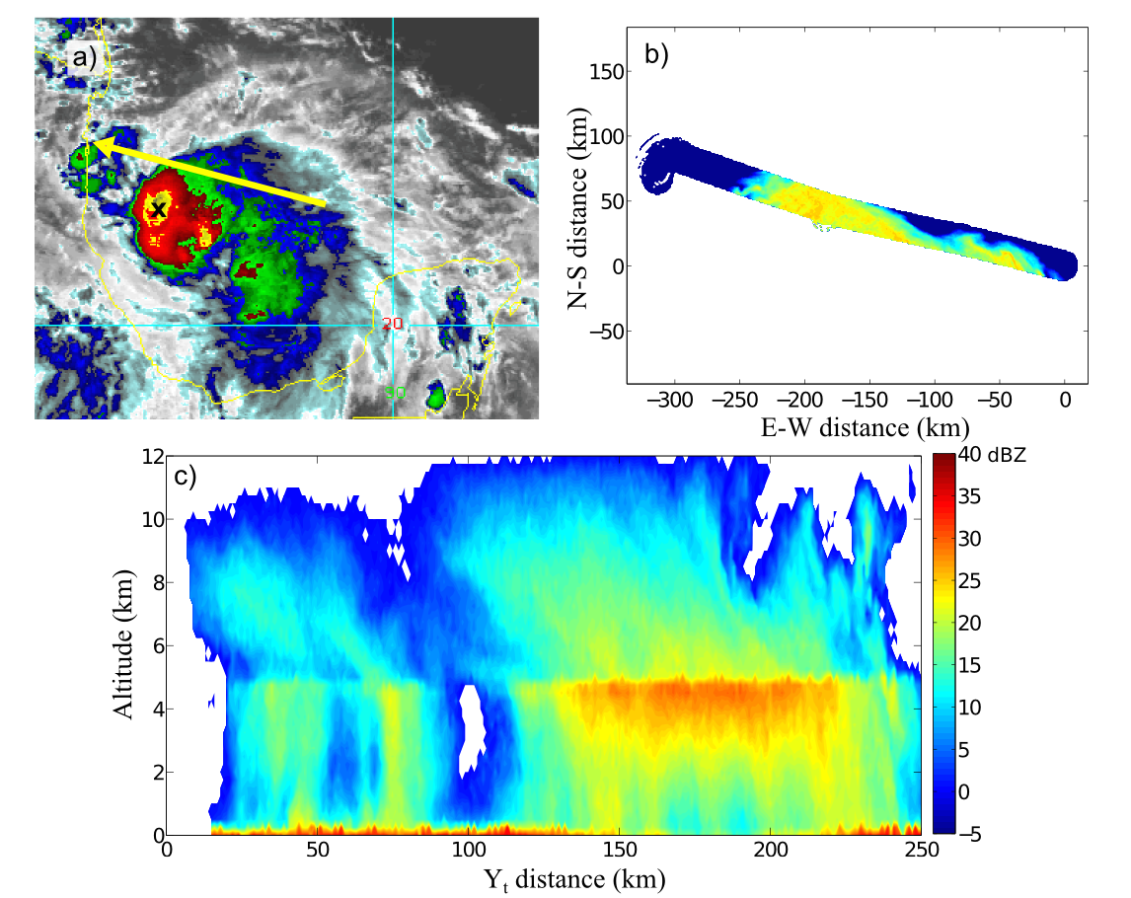
Hurricane Ingrid
Coplane analysis
15 Sept 2013 1836-1900Z
Cross-track velocity
Along-track velocity
Reflectivity (Ka band, outer beam)
Vertical velocity

Slide 8

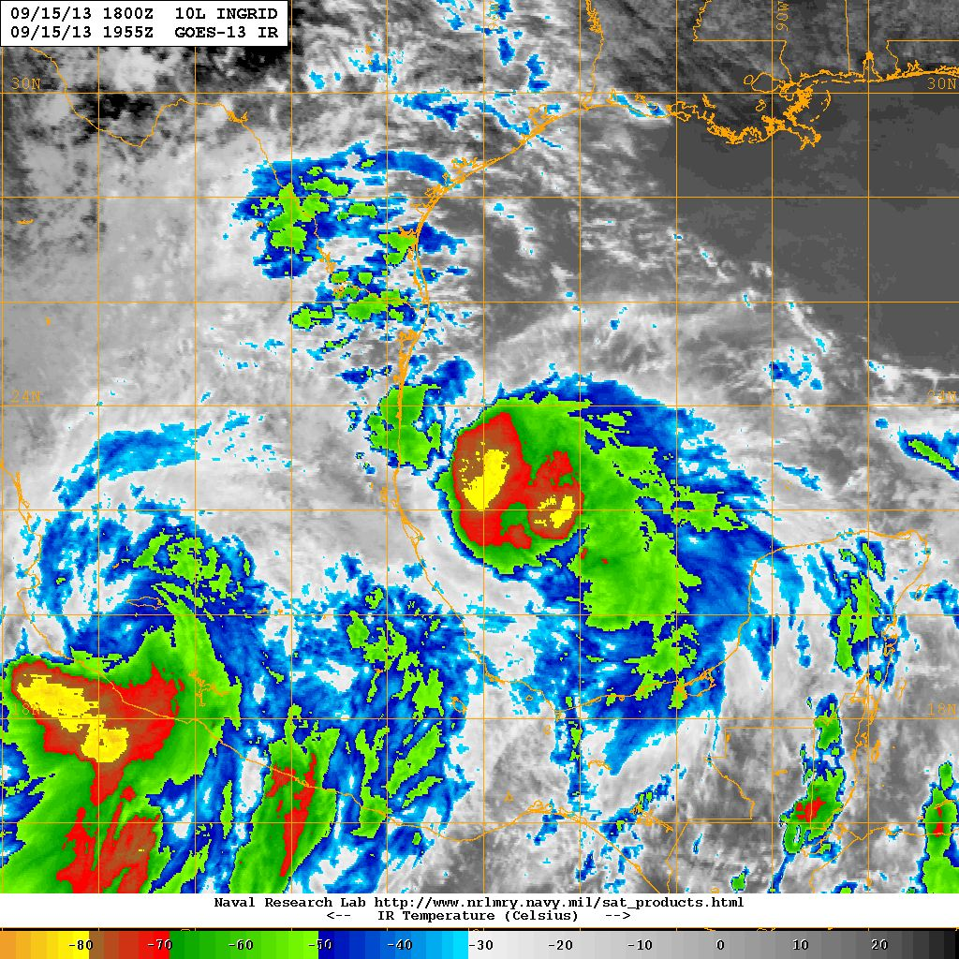
HIWRAP Analysis of Hurricane Ingrid (2013)
Observations: Sept. 15 1836 – 2057 UTC. NOTE: Analyses are preliminary.
Ku band reflectivity and wind vectors
20 m/s
25-30 m/s
10-15 m/s
Wind speed and wind vectors (zoom)
Ka band reflectivity at nadir
Wind maxima and convergence assoc. with weak convective tower.
3D-VAR from Steve Guimond/ESSIC.

Slide 9
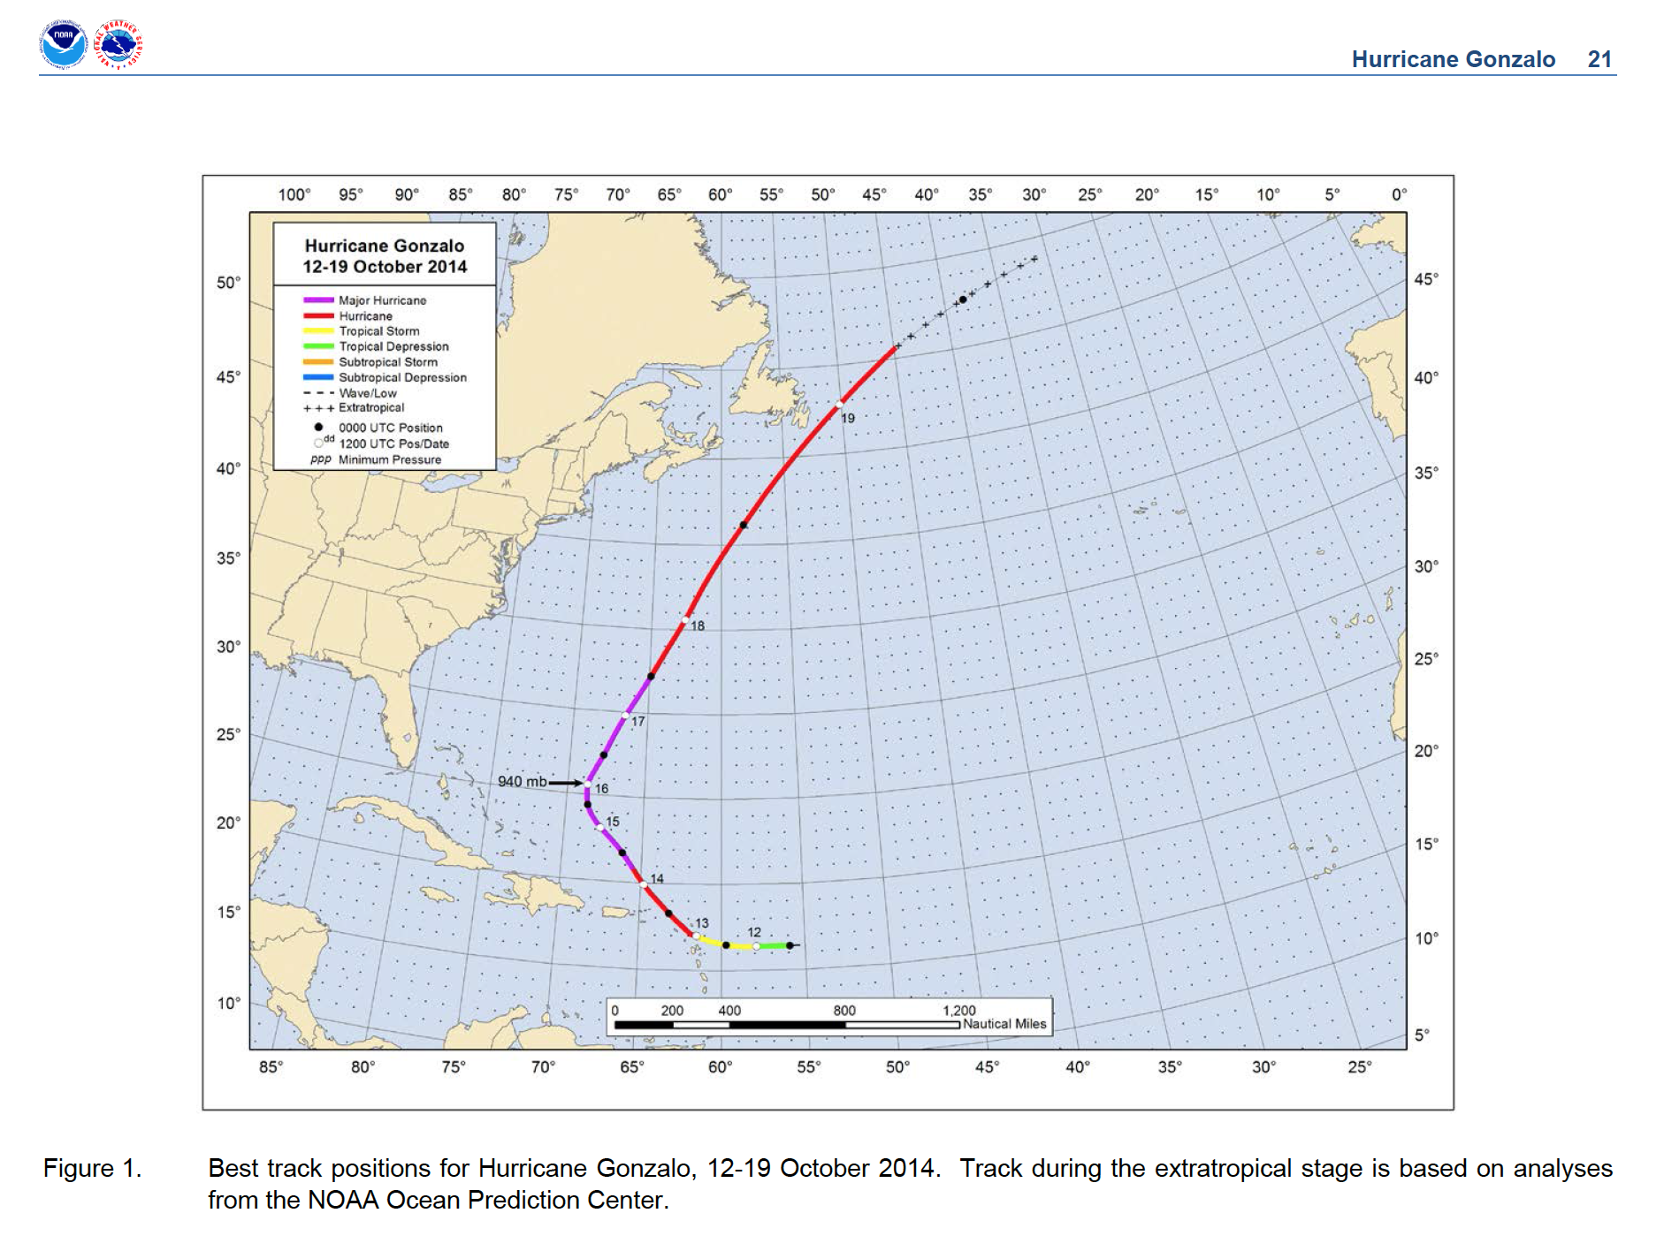
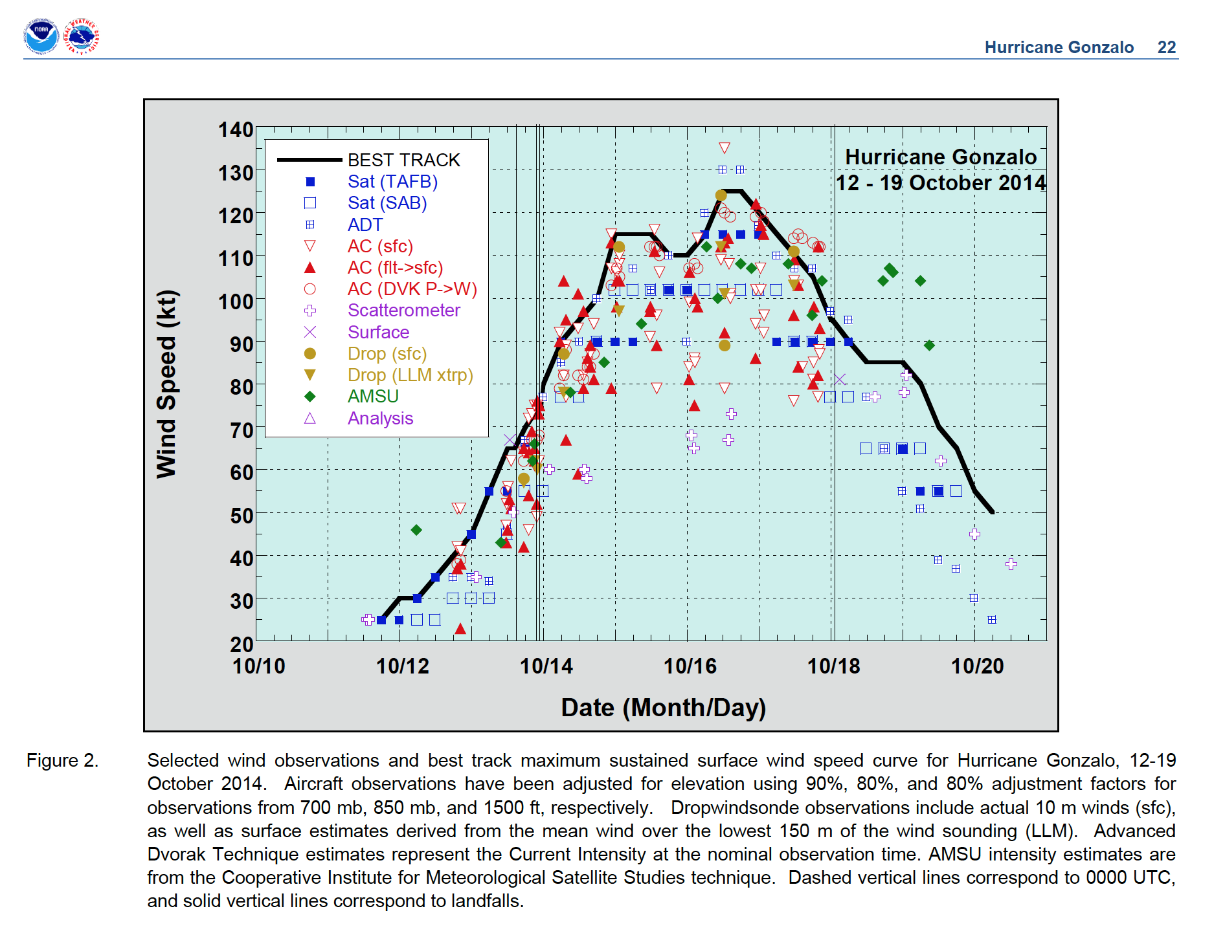
Hurricane Gonzalo – 3 WB-57 Flights
17
16
15

Slide 10
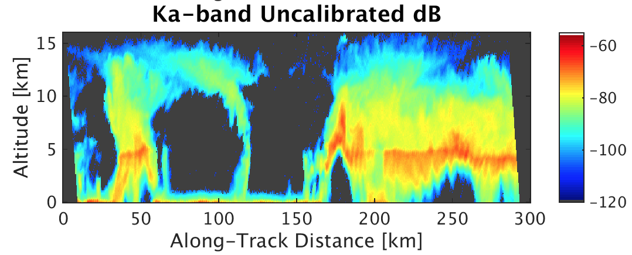
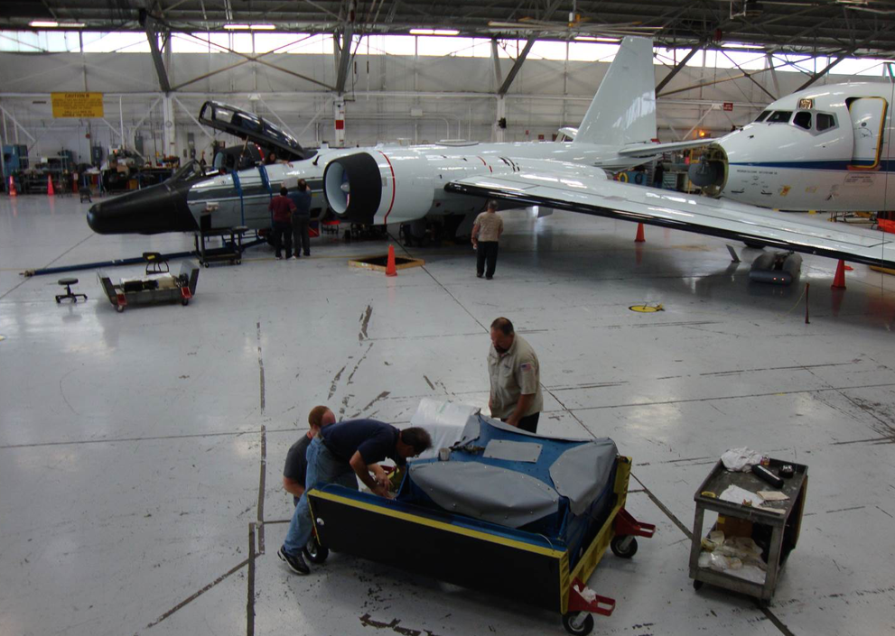
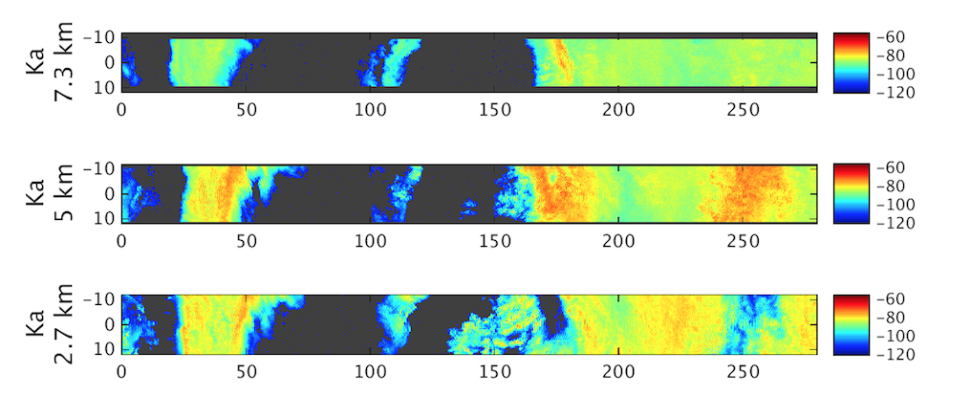
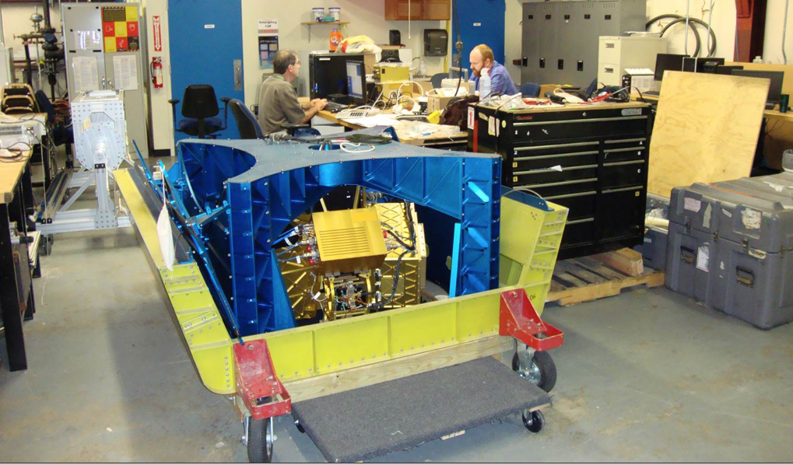
HIWRAP Data From Hurricane Gonzalo During HS3
HS3 flights on JSC WB-57.
3 flight days (15-17 Oct 2014)
7 total passes over Gonzalo
17 October 2014 Reflectivity Vert X-sect
17 October 2014 Reflectivity Swath
Inner and outer eyewalls in reflectivity.
HIWRAP in WB-57 pallet
Notes:
From G. Heymsfield/612 and Matt McLinden/555 (also in pictures) with HIWRAP and WB-57.
Gonzalo: Category 4 storm on first fliight on 15 October with 140 kt max winds; weakened to Category 3 on 17 October to 125 kts max winds.
Damaged Bermuda two days later (October 19) and moved onto to western and Central Europe to cause more damage.

Slide 11
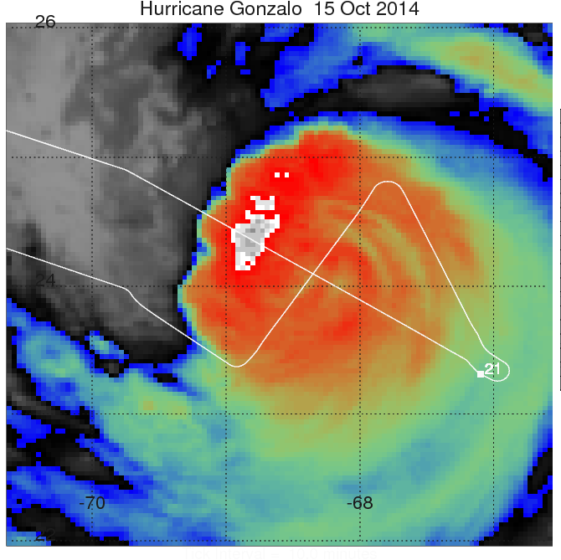
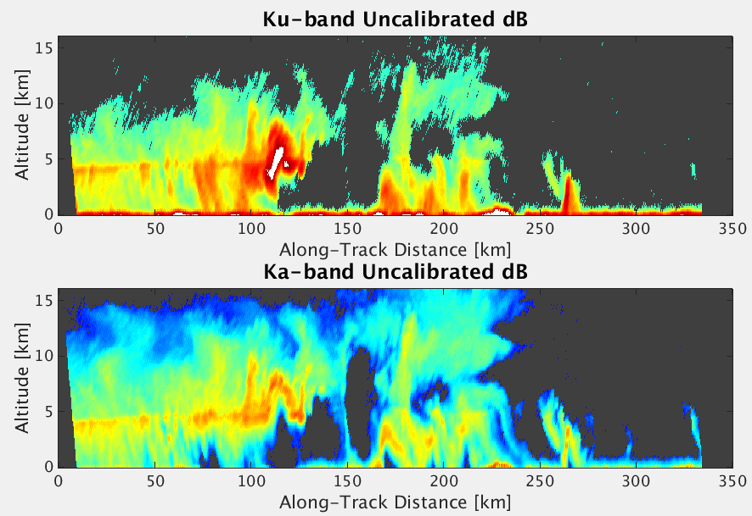
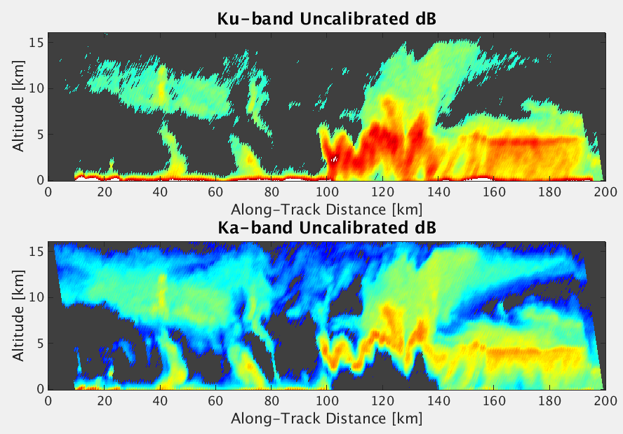
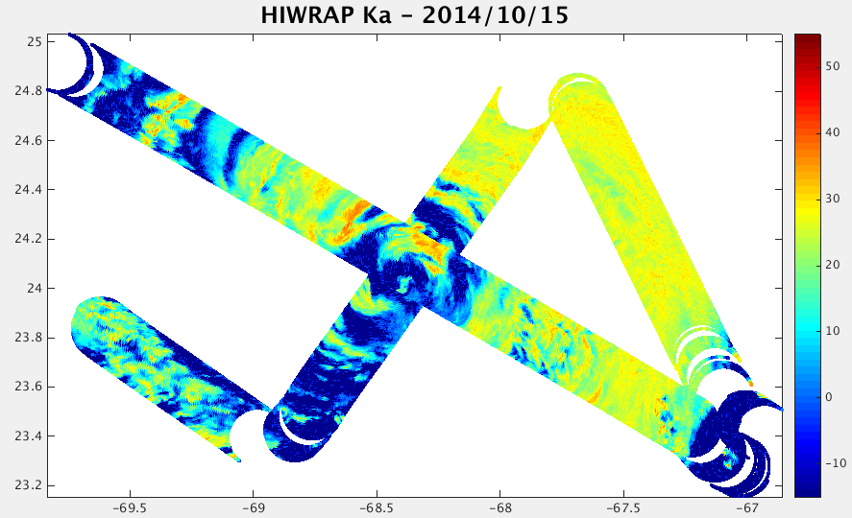
Gonzalo 15 October 2014

Slide 12
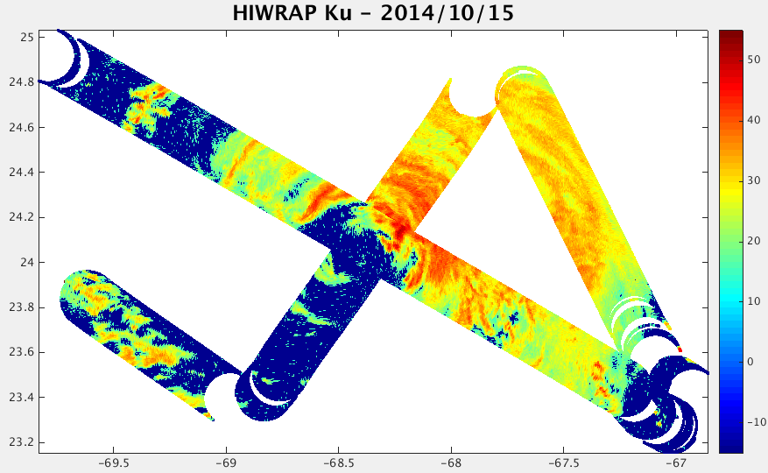
      HIWRAP GONZALO Ku & Ka Reflectivity
      15 October 2014
~3 km altitude
Ka-band about 3X resolution of Ku-band
Plans to do this sort of quasi-real-time plot for 2015 flights.
  -Current real-time data storage on plane is 1.0 GB/min
  -Telemetry limited to 1 Mbit/sec.

Slide 13
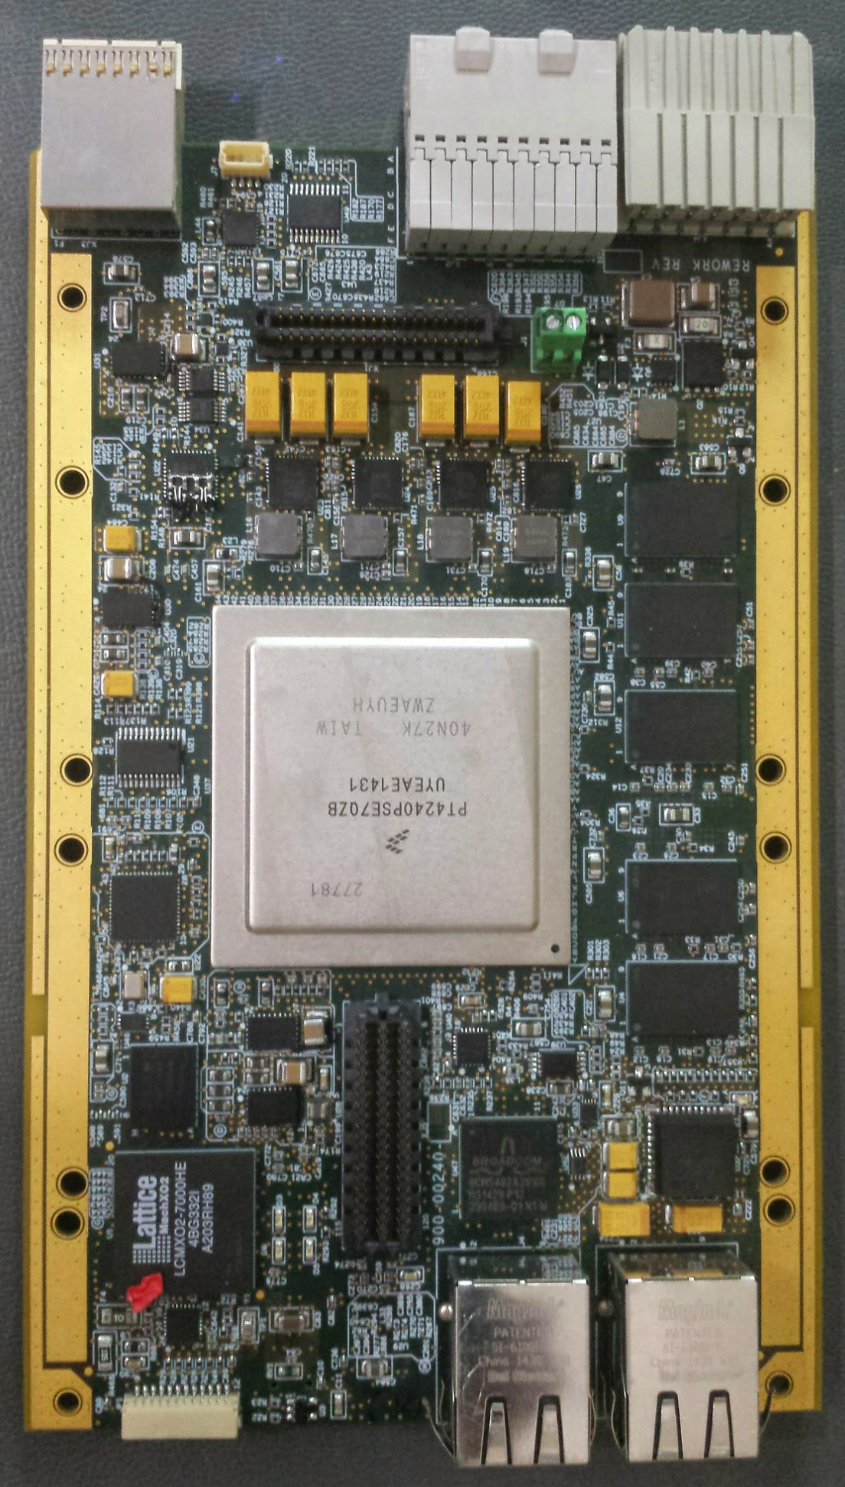
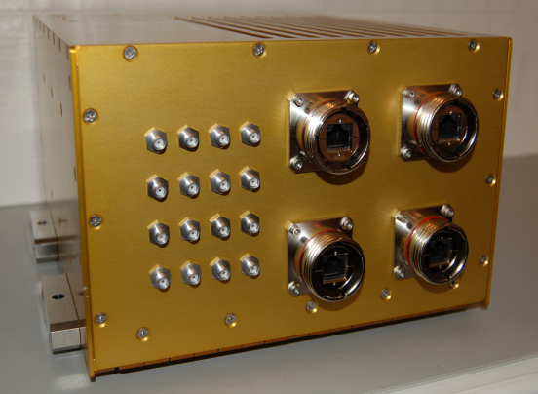
Remote Sensing Solutions (RSS) iRAP Multi-core Processor Module (uPM)
  Additional Real-time Data Processing Capability:
HIWRAP currently has very basic real-time capability [limited by downlink bandwidth].
  New uPM processor board will add real-time capability to perform more on-board processing to obtain products such : Ocean surface vector wind (OSVW) maps, volumetric mapping of 3D atmospheric winds and precipitation field.
  uPM will implement advanced spectral estimation algorithm to separate surface and volume scattering in precipitation thus allowing 3D wind vector retrieval in lower marine boundary layer and removal of rain contamination in OSVW retrievals.
NOAA-funded
New iRAP uPM being tested that will go in iWRAP and HIWRAP

Slide 14
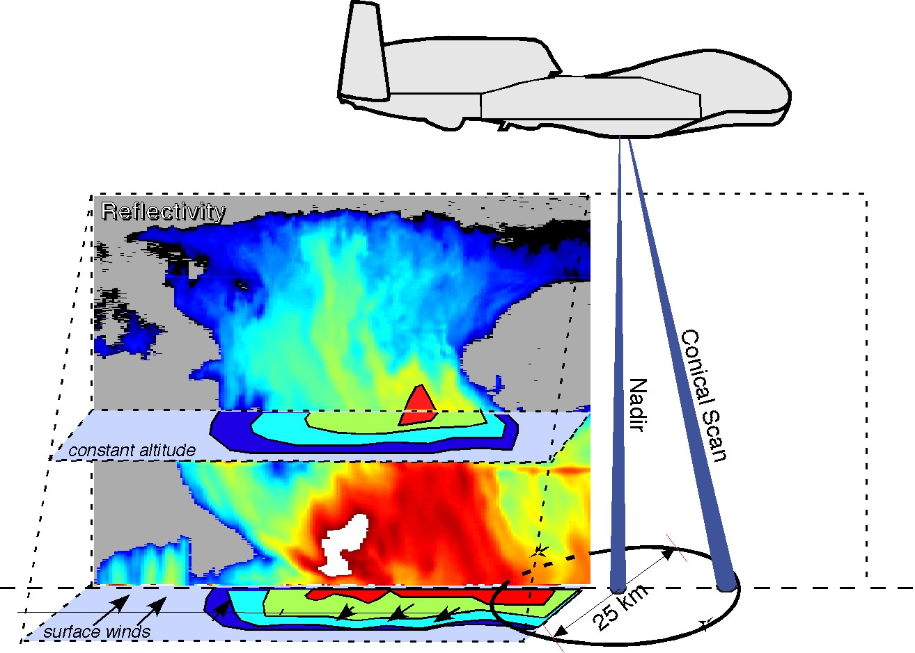
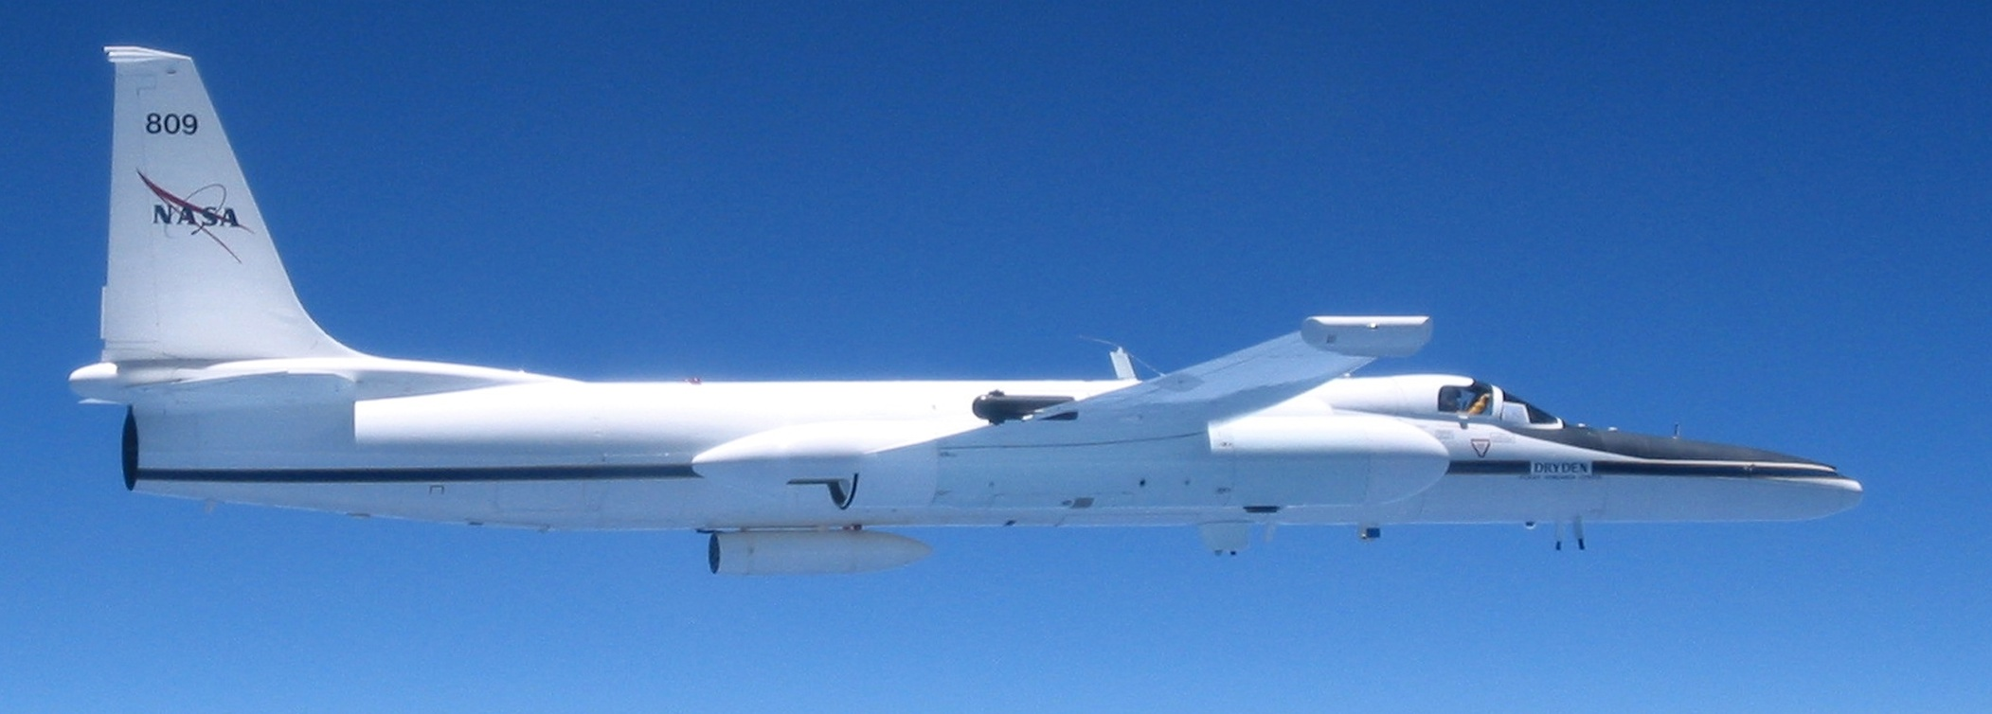
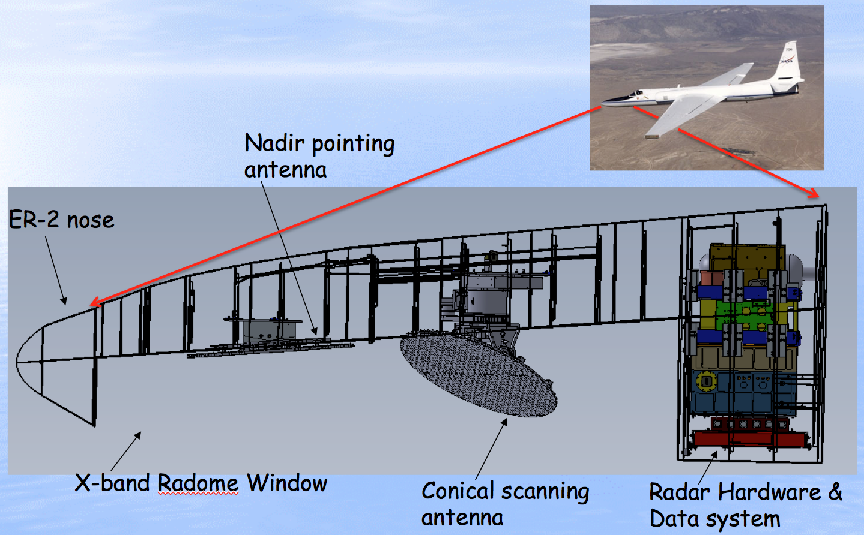
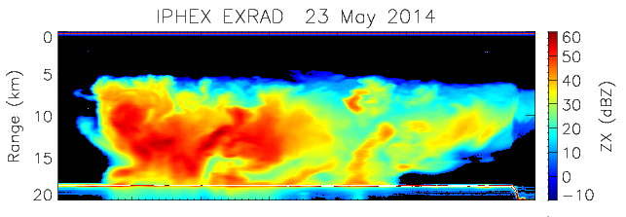
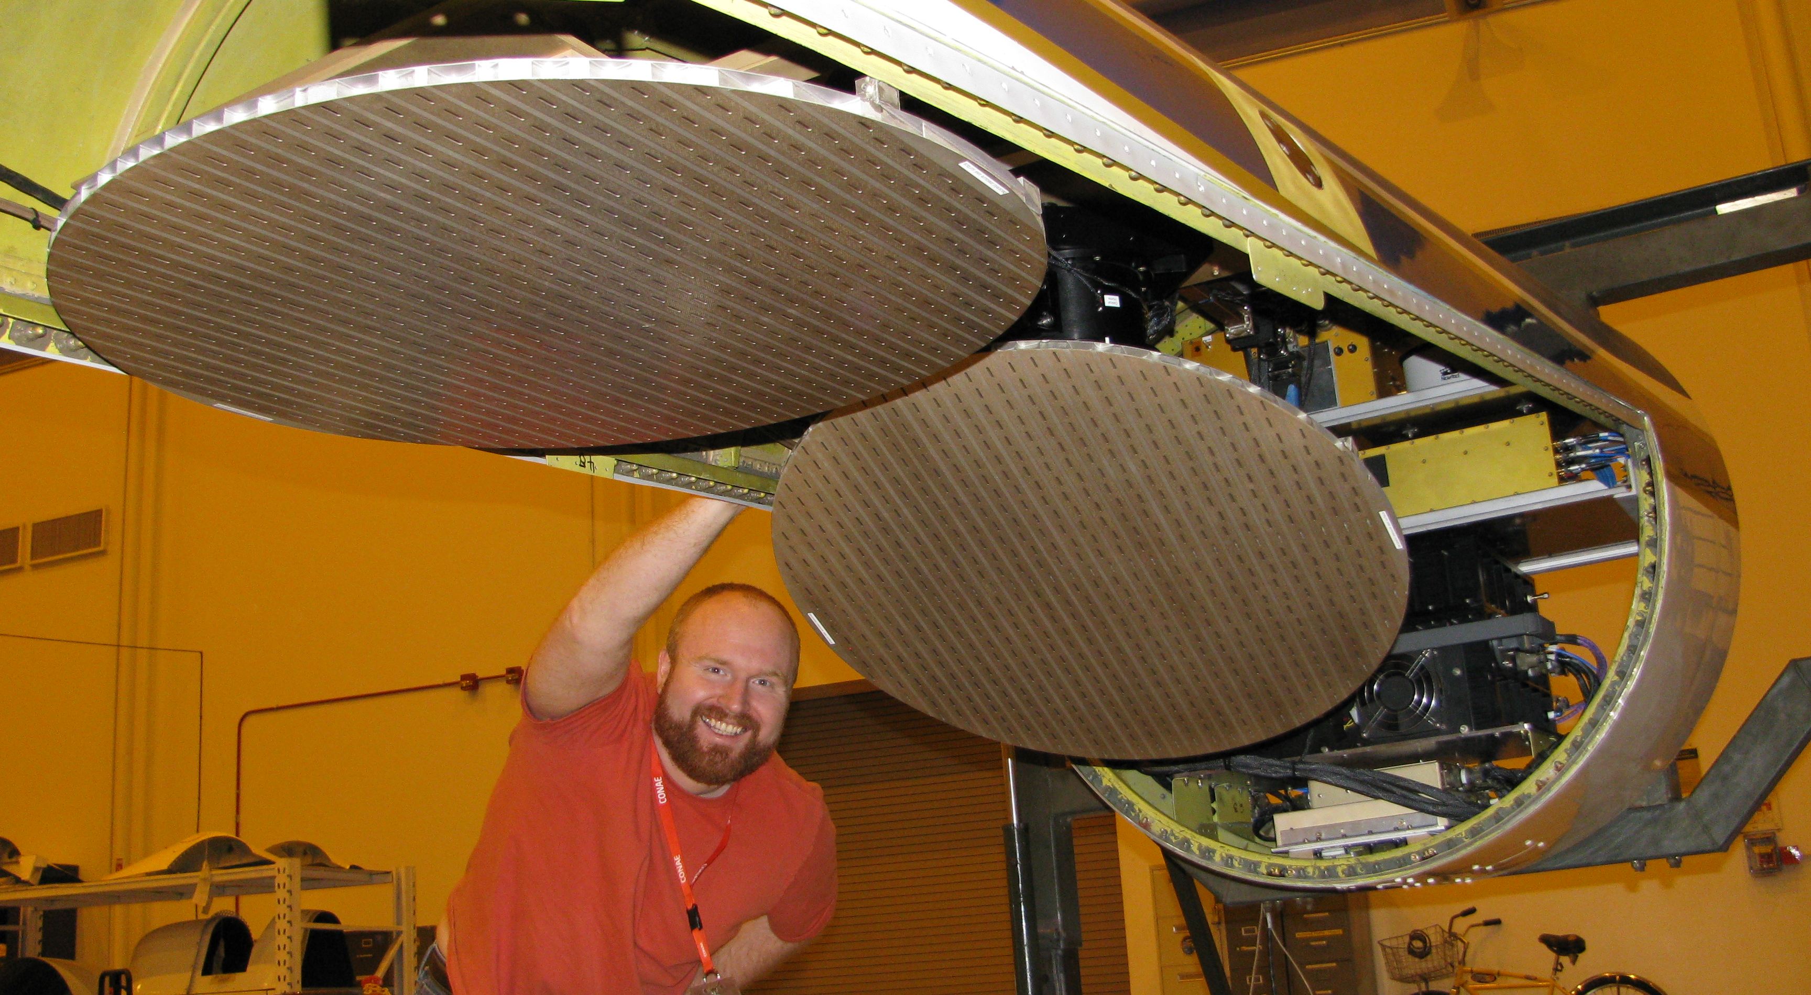
ER-2 X-band Radar (EXRAD)
An Alternative to HIWRAP
Designed for Global Hawk but flown on ER-2; predates HIWRAP. EDOP replacement.
Fixed nadir pointing beam and a cross track/conical scanning beam that will provide volumetric measurements of the cloud and precipitation regions.
First science flights May 2014.
X EXRad
Nadir Beam

Slide 15
Summary
HIWRAP performed well in past year.
Ka-band offers higher resolution and sensitivity, but suffers considerable attenuation in inner core.
HIWRAP swath limits can be limiting in some cases.
Improvements in onboard processing and real-time data before next flights in 2015.
Gonzalo data processing in progress, and hope to get first cut at calibrated data soon & then wind retrievals.
Planned: Ocean wind retrievals with past data.

Slide 16
Questions?

