Slide 1
Improved SFMR Surface Winds and Rain Rates
Eric W. Uhlhorn
NOAA/AOML/Hurricane Research Division
Bradley W. Klotz
University of Miami/RSMAS/CIMAS and HRD
2015 Tropical Cyclone Research Forum
4 March 2015

Slide 2
Acknowledgements
NOAA Office of Weather and Air Quality JHT
JHT Project POCs: Dan Brown, Eric Blake, Eric Christensen, Dr. Chris Landsea
Alan Goldstein (AOC), Lt Col Jon Talbot (53rd WRS), Drs. Ivan Popstefanija and Mark Goodberlet (Prosensing, Inc.)

Slide 3
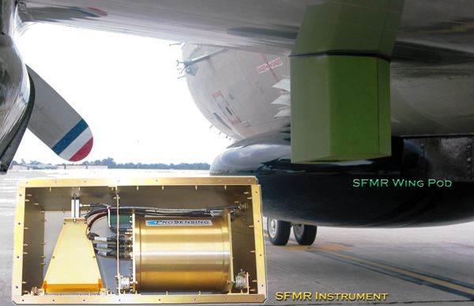
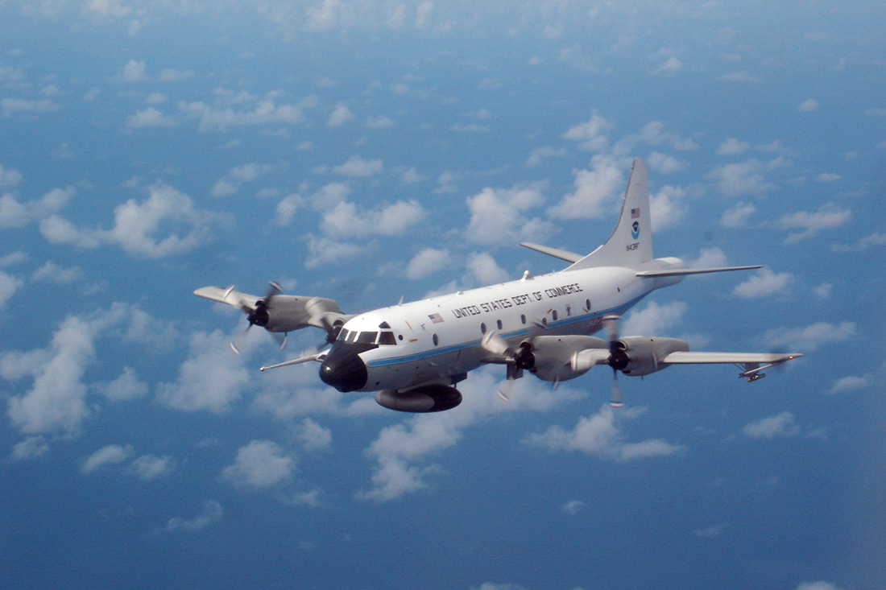

What is SFMR?
Stepped-Frequency Microwave Radiometer
Measures sea surface wind speed below aircraft
Installed on tropical cyclone-penetrating aircraft
  2 NOAA WP-3D since 2004
  10 Air Force Reserve WC-130J since 2009
  NOAA G-IV (currently not operational)
Must remove the impact of rain to accurately measure winds

Slide 4
The Problem
SFMR surface winds have shown a tendency to be high in heavy rain
  More pronounced at weaker wind speeds
  Negative impact diminishes at stronger wind speeds
Operationally-implemented algorithm developed in 2005
  Relatively few ground-truth (GPS dropsonde) observations available
  No evaluation of how rain impacted accuracy
  Primary focus was on hurricane-strength wind measurement
Installation of SFMRs on AFRC WC-130J greatly increased available observations
  More data in weaker systems

Slide 5
Project Review
Two-year project funded under NOAA/OWAQ Joint Hurricane Testbed (JHT) 2011-2013 cycle to understand and correct the high bias
Year-1
  Characterize wind speed bias (SFMR minus sonde) over full range of wind speeds and rain rates
  Develop a provisional bias correction to NHC for 2012 for real-time in-house use
HURRICANE SANDY DISCUSSION NUMBER 12
NWS NATIONAL HURRICANE CENTER MIAMI FL AL182012
500 AM EDT THU OCT 25 2012
EARLIER THIS MORNING...SANDY MADE LANDFALL JUST WEST OF SANTIAGO DE CUBA AS A STRONG CATEGORY TWO HURRICANE. CUBAN RADAR DATA AND REPORTS FROM AN AIR FORCE RESERVE RECONNAISSANCE AIRCRAFT INDICATED THAT SANDY HAD A WELL-DEFINED 20-24 N MI DIAMETER EYE WHEN IT MADE LANDFALL. THE AIRCRAFT REPORTED MAXIMUM 700-MB FLIGHT-LEVEL WINDS OF 117 KT AND BIAS-CORRECTED SFMR SURFACE ESTIMATES OF 91-92 KT.

Slide 6
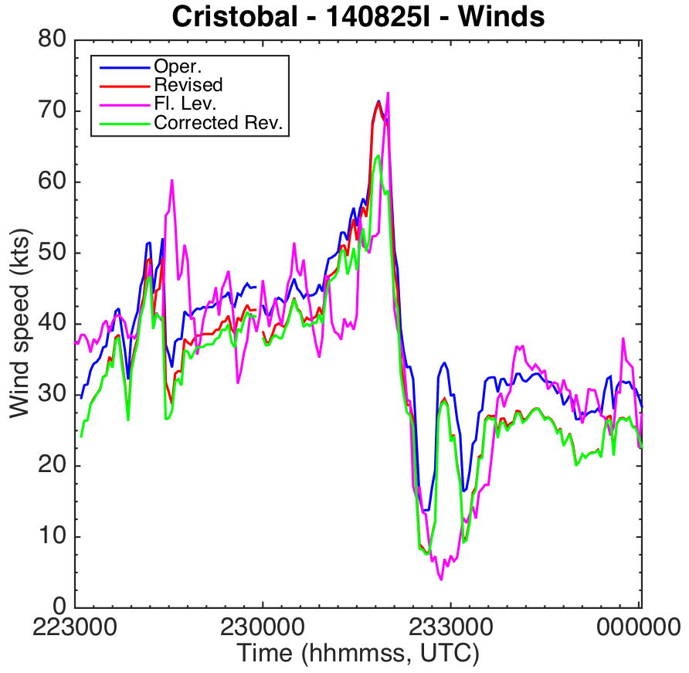
Project Review (cont.)
Year 2
  Revise the retrieval algorithm to better account for rain impact on measurements
  Evaluate wind speed accuracy semi-independently
  Develop a bias correction post-retrieval (if necessary)
  Upon acceptance, implement on-board aircraft for real-time operations
Accepted for operational transition beginning in 2015

Slide 7
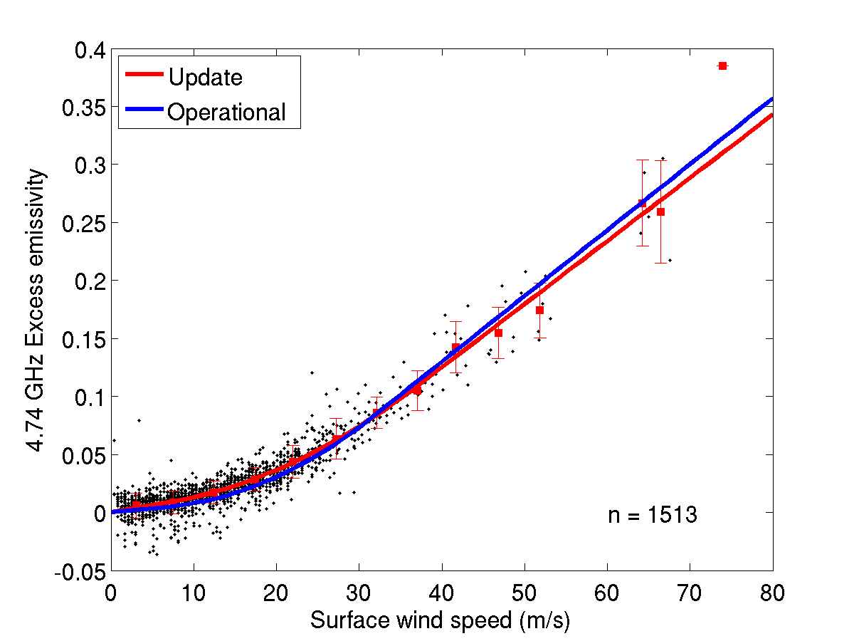
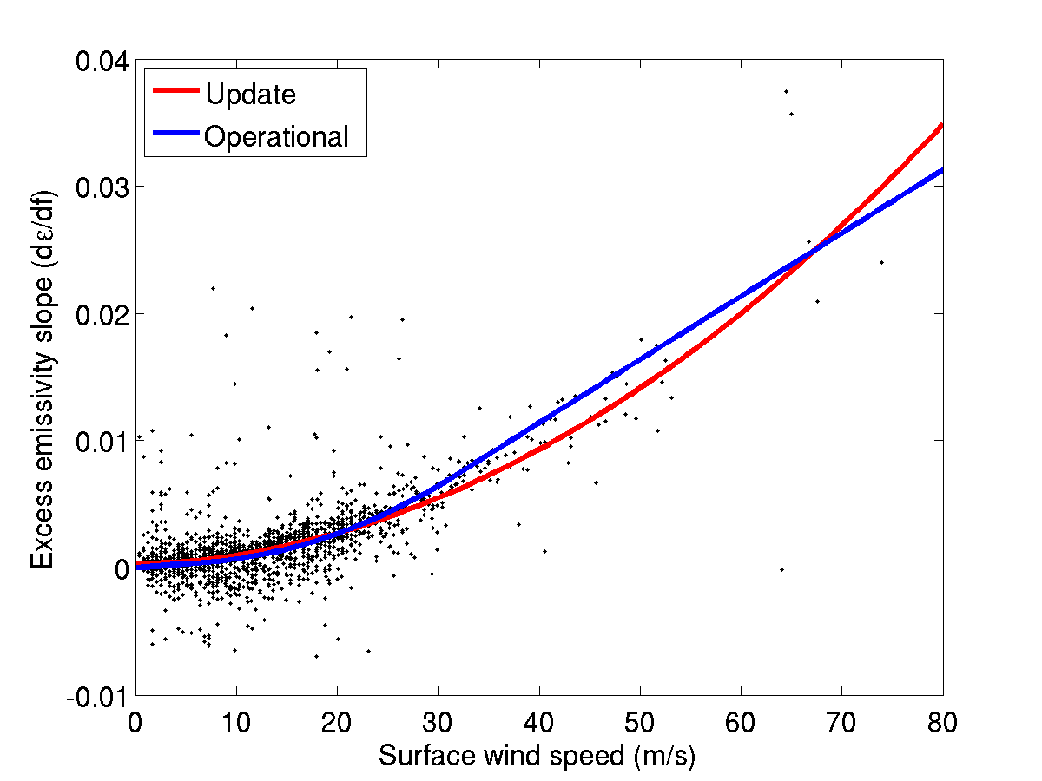
Summary of Modifications
Wind speed (U_{sfc}) vs SFMR sea-surface excess emissivity (ε_{w})
4.74 GHz
Frequency dependence

Slide 8
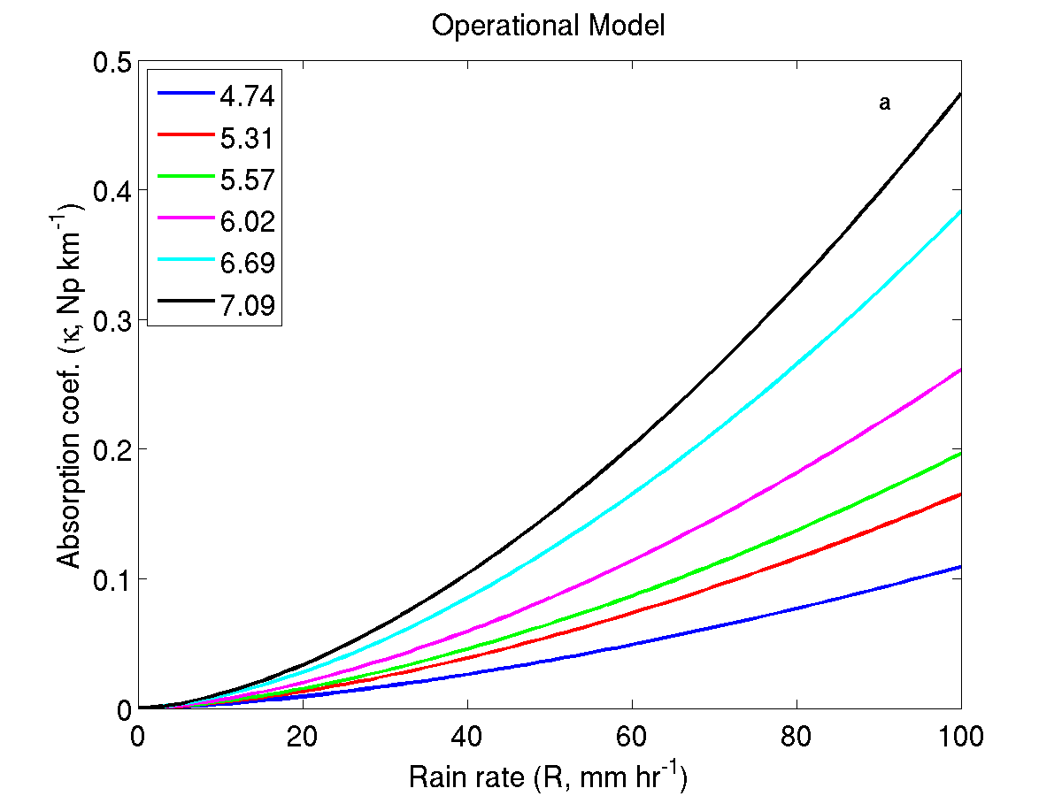
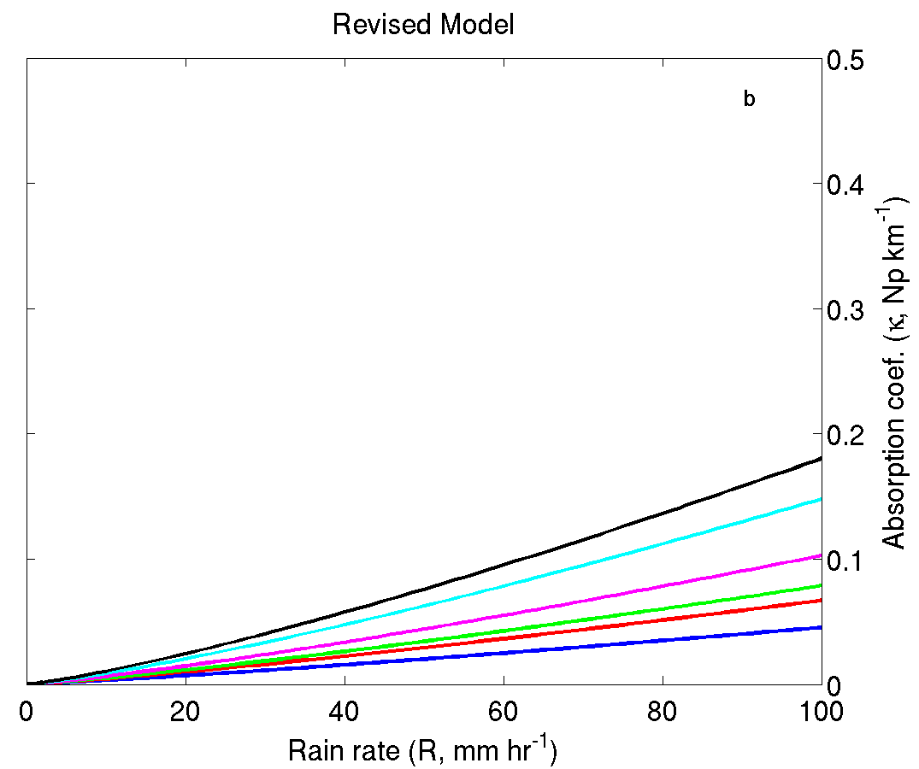
Summary of Modifications
Rain rate (R) vs. specific absorption coefficient (κ)
  Microwave absorption by rain lower than previously estimated
b = 1.15
b = 0.87

Slide 9
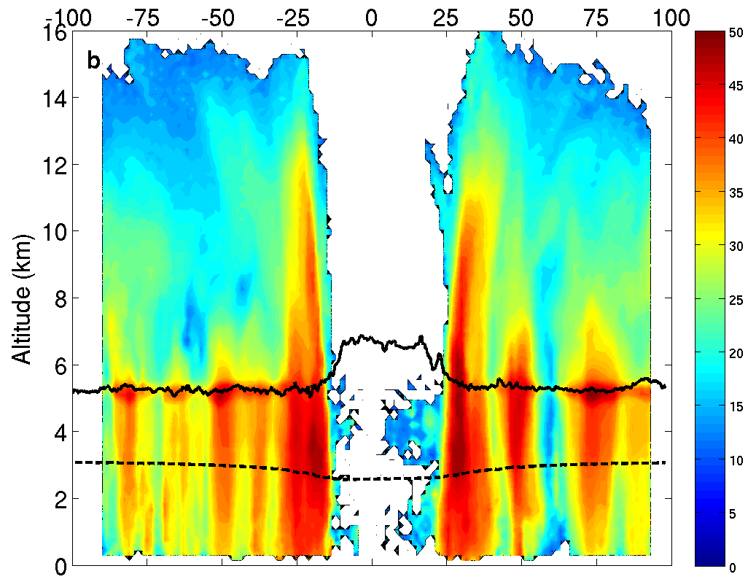
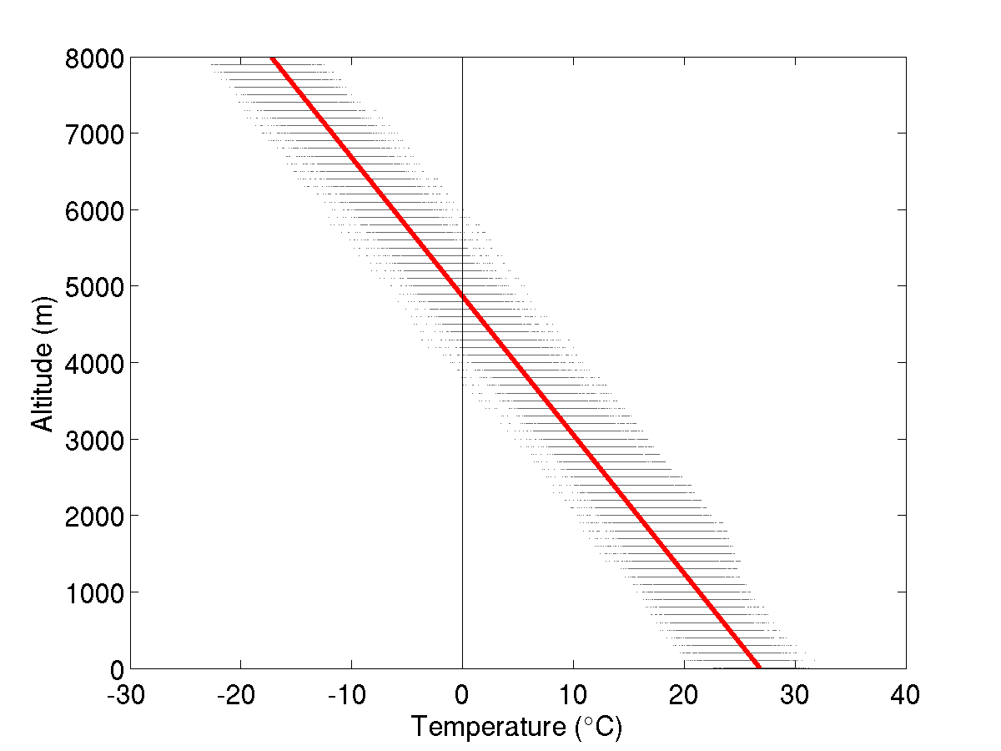
Summary of Modifications
Height of rain column (H_{Rain})
  Set to 4 km in operationally implemented version
  Revised to estimate from mean lapse rate (γ ) and flight altitude (h_{FL}) and temperature (T_{FL})
  γ ≈ -5.2 C km⁻¹ from
  mean T(z) profile in TCs
Hurricane Rita 09/21/2005 TDR Refl.

Slide 10
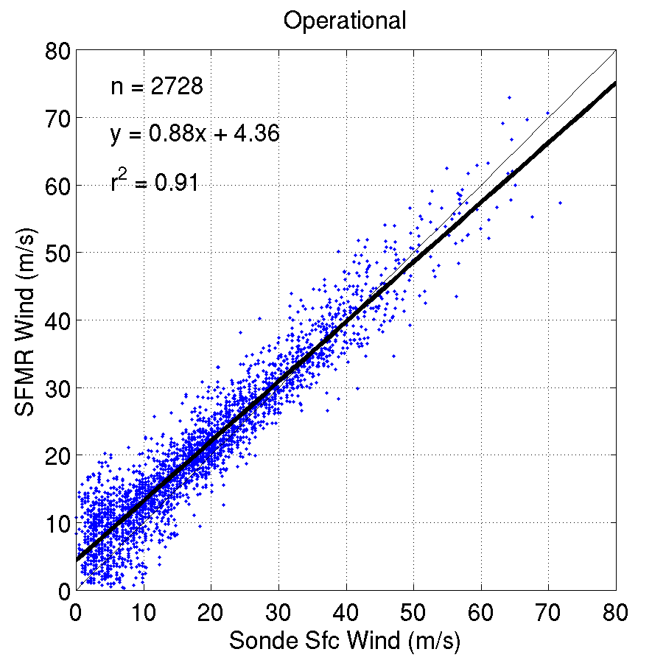
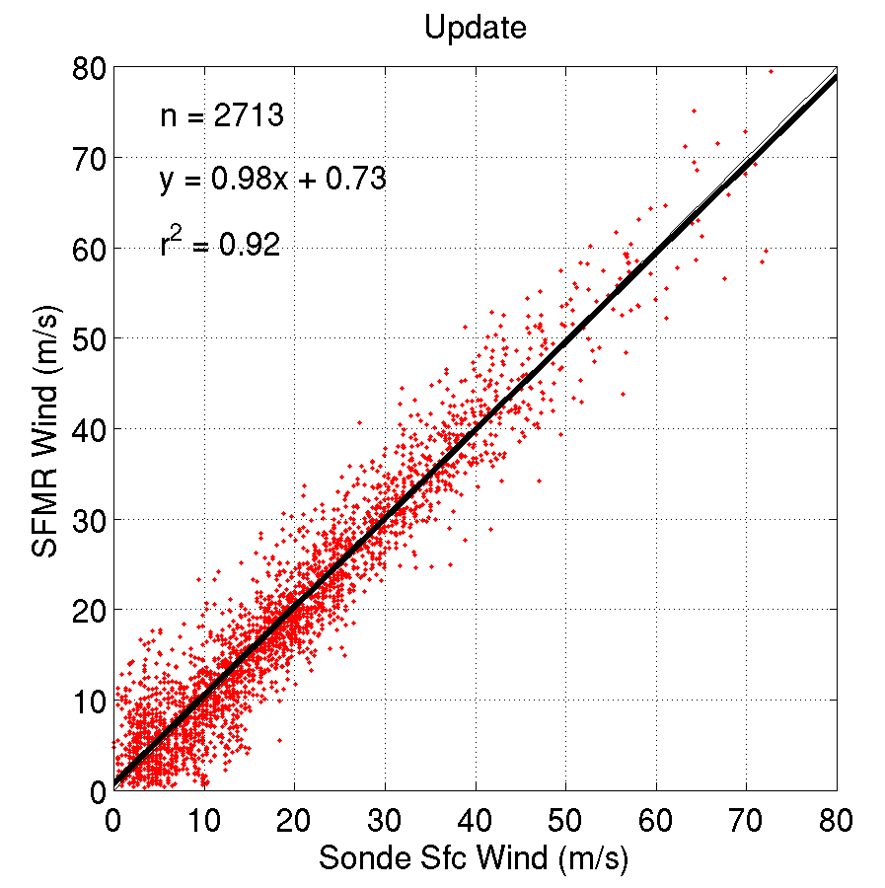
Evaluation of Results
Overall wind speed verification

Slide 11
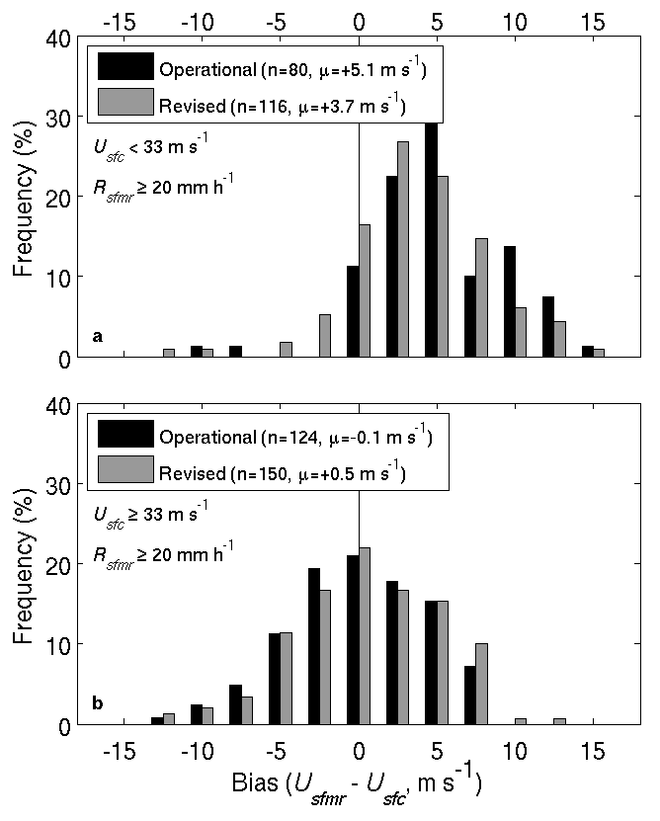
Evaluation of Results
Wind speed in heavy rain
  R > 20 mm hr⁻¹
Low wind speed (< 33 m/s)
High wind speed (> 33 m/s)

Slide 12
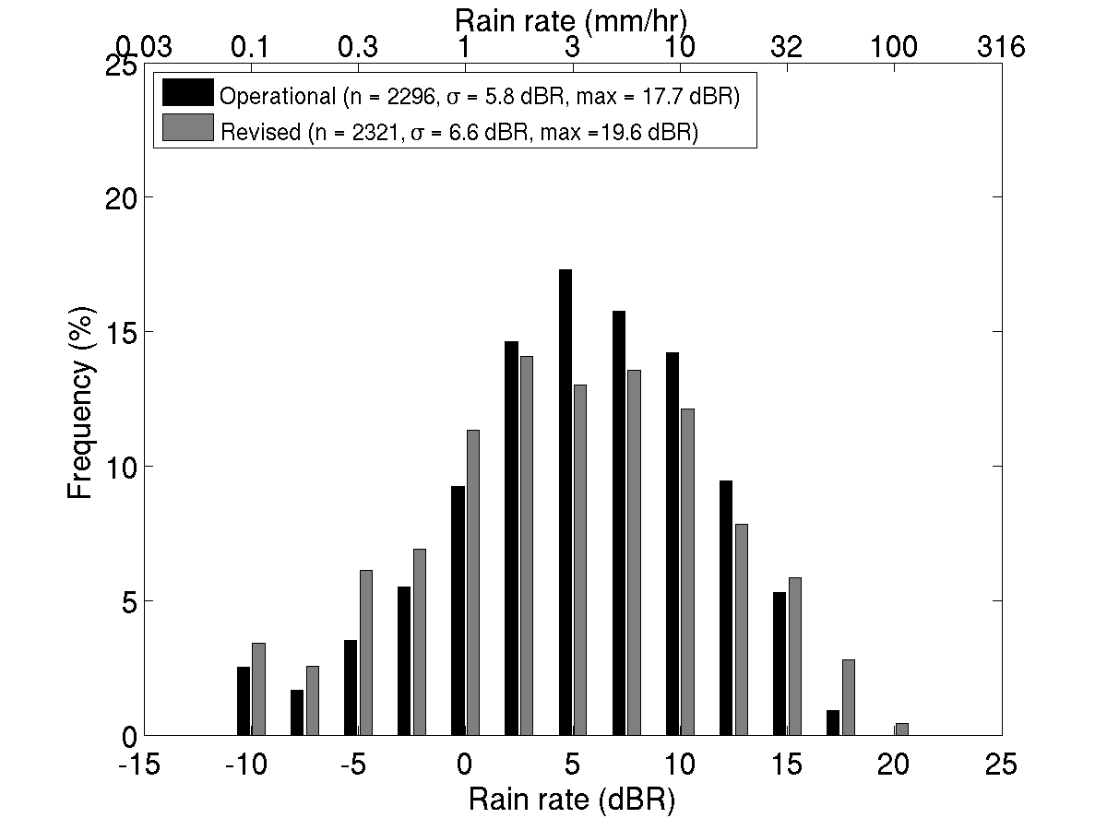
Evaluation of Results
Rain rate
Maximum retrieved rain rate increases from ~60 to
~90 mm hr⁻¹

Slide 13
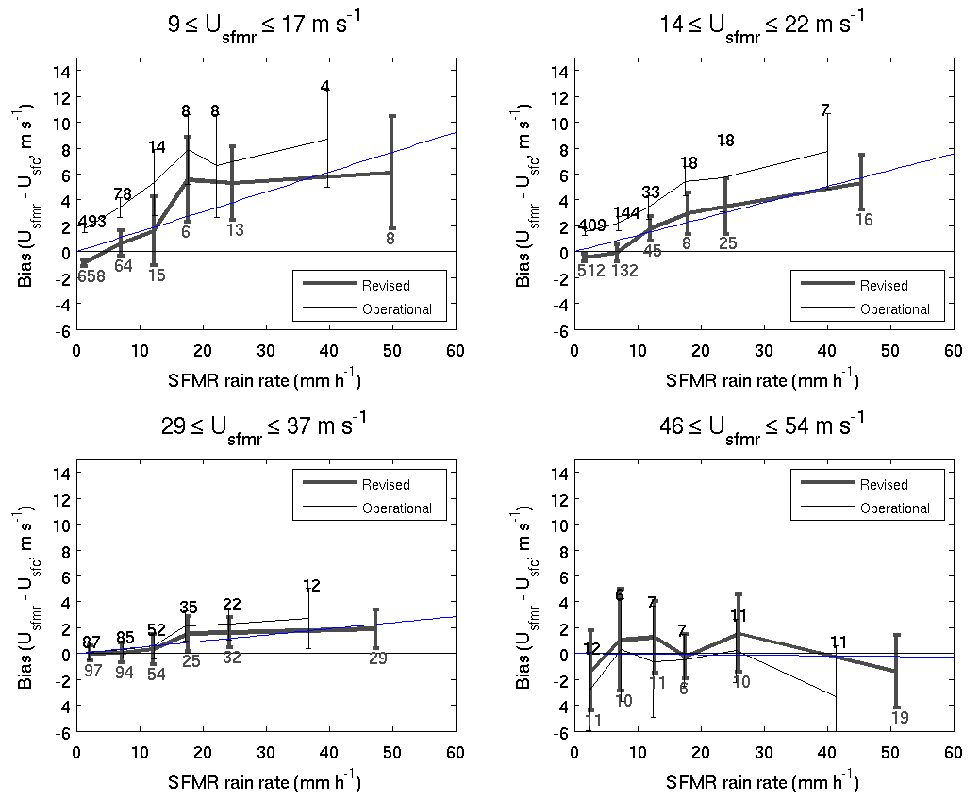
Evaluation of Results
TD
TS
H
MH

Slide 14
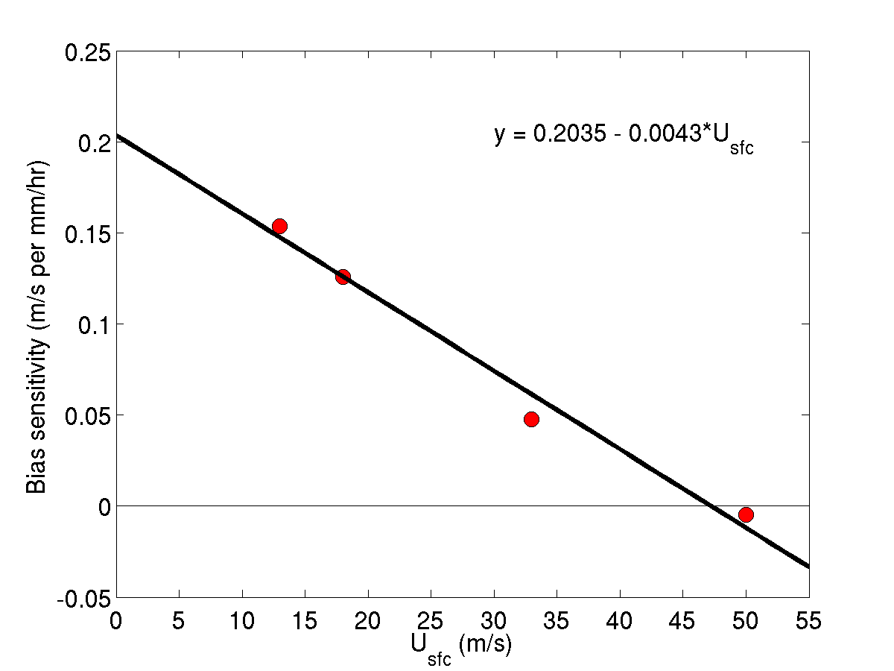
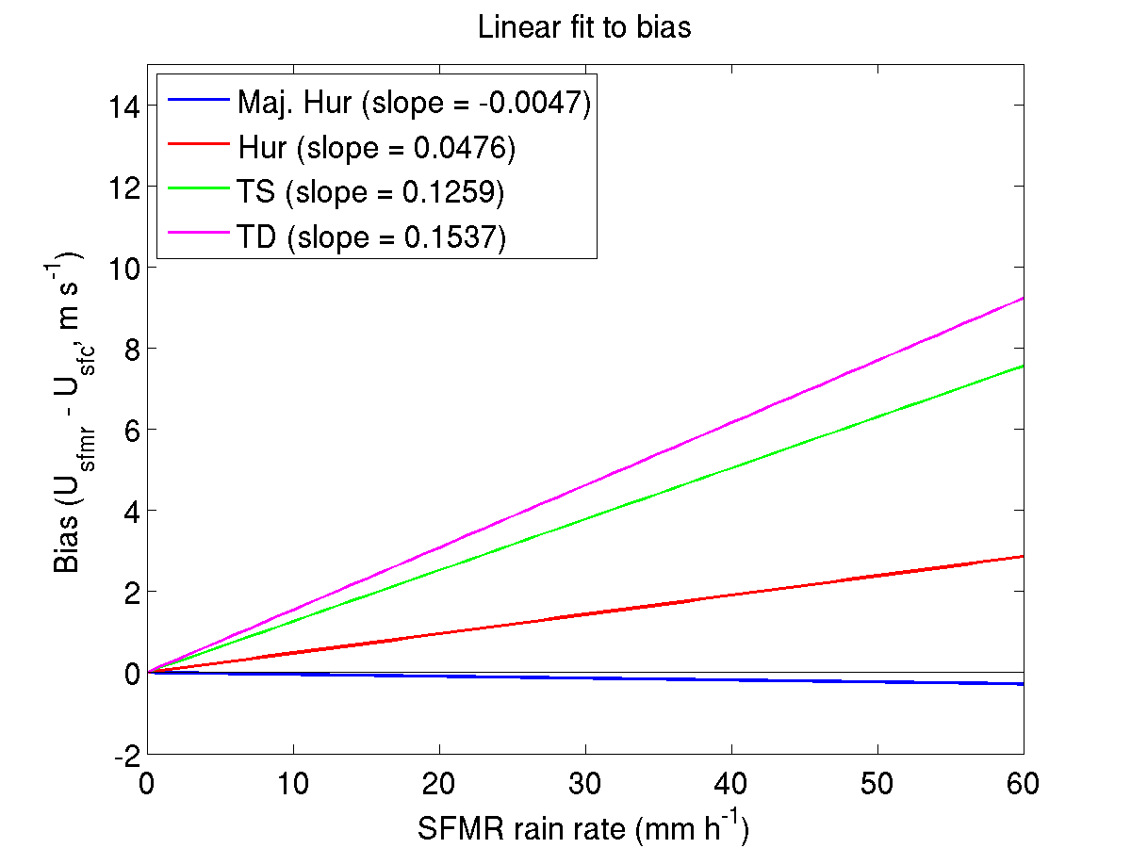
Real-time Bias Correction
Bias sensitivity (slope) with respect to rain rate
TD
TS
H
MH

Slide 15
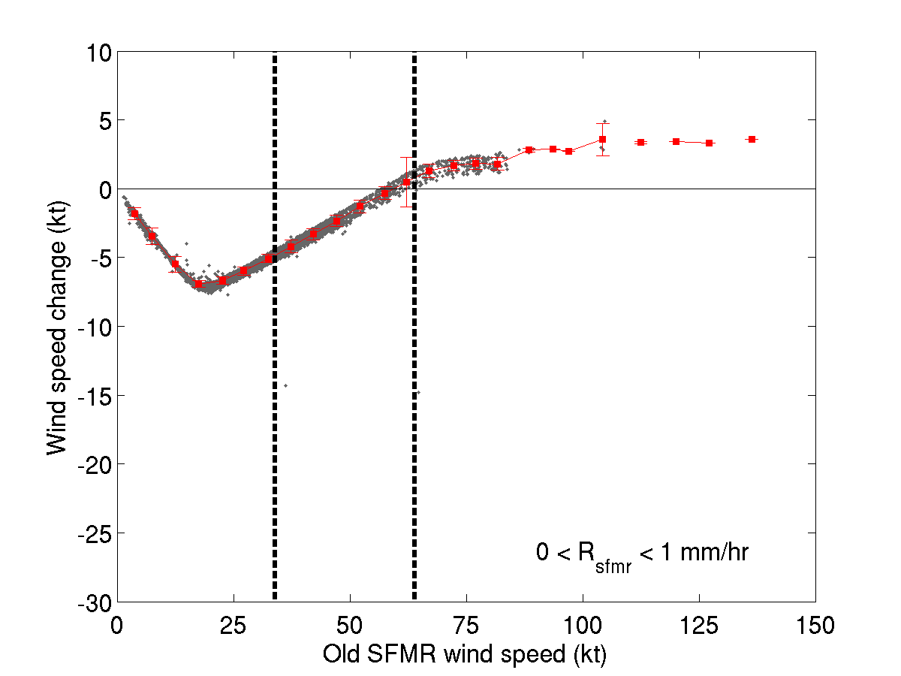
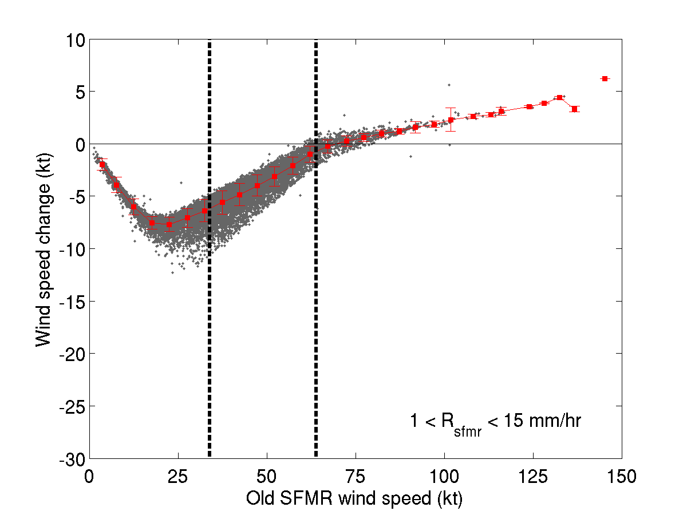
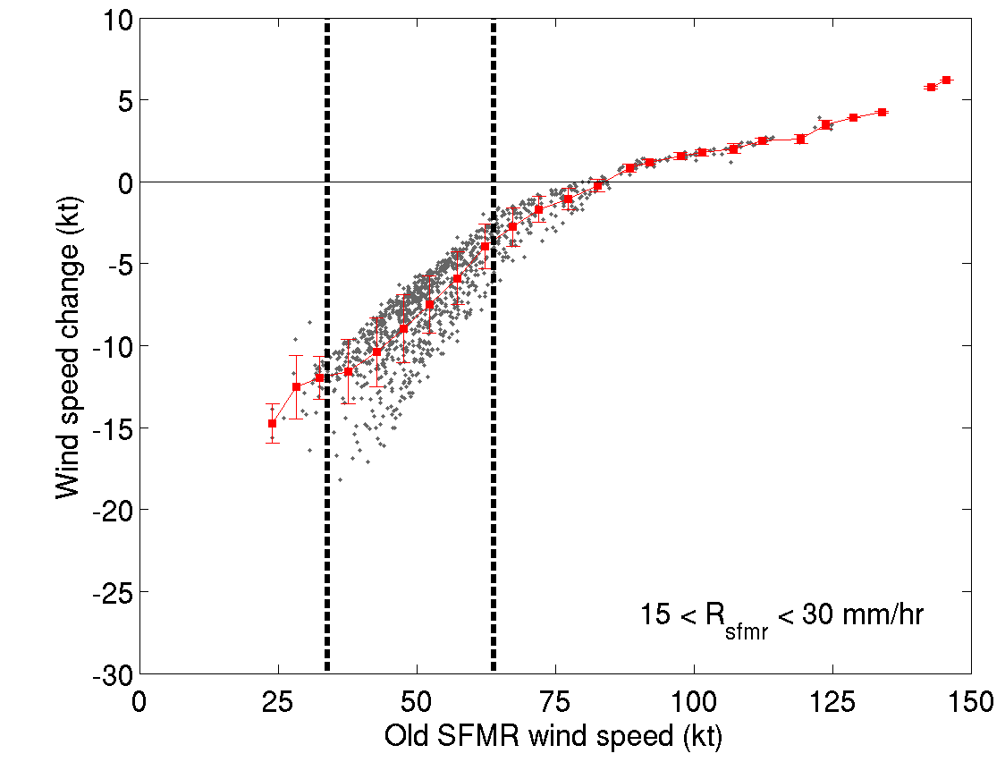
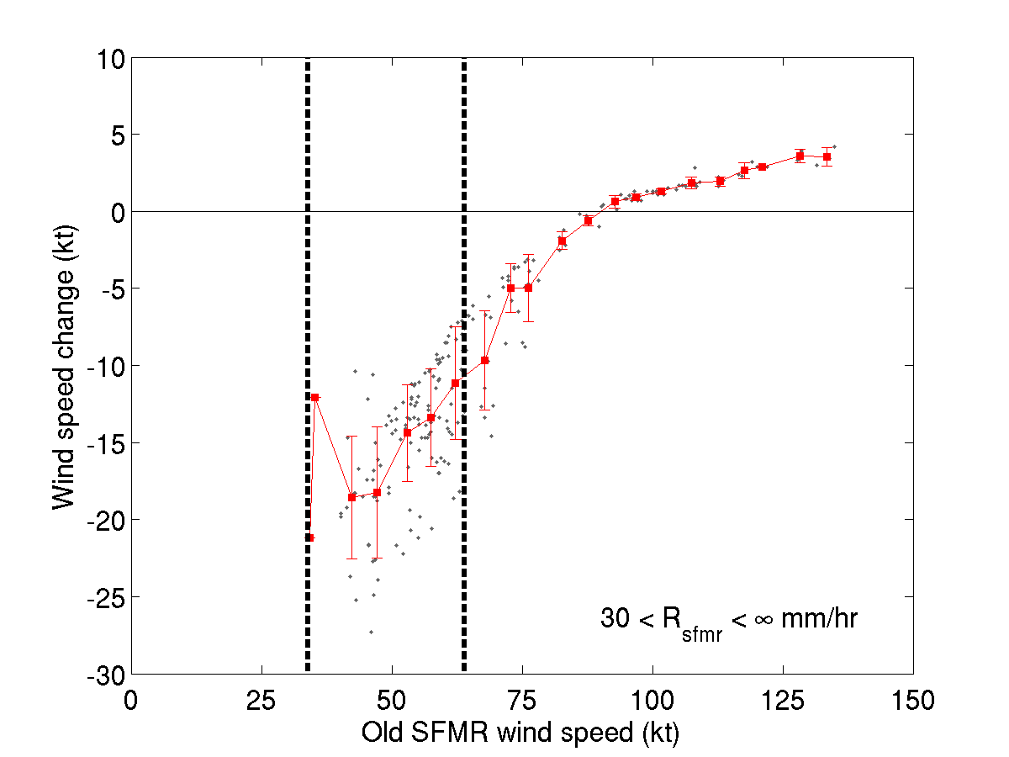
Practical Implications
SFMR Wind speed changes
  Winds <65 kts will be lower
  Winds ~65 kts will be roughly the same, except in heavy precip.
  Winds at major hurricane intensity will be 3-5 kts higher

Slide 16
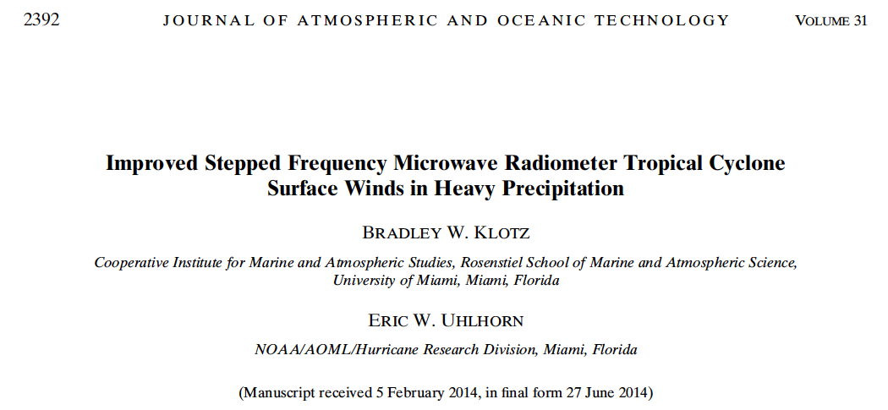
For further details…
JTECH November 2014

