Slide 1
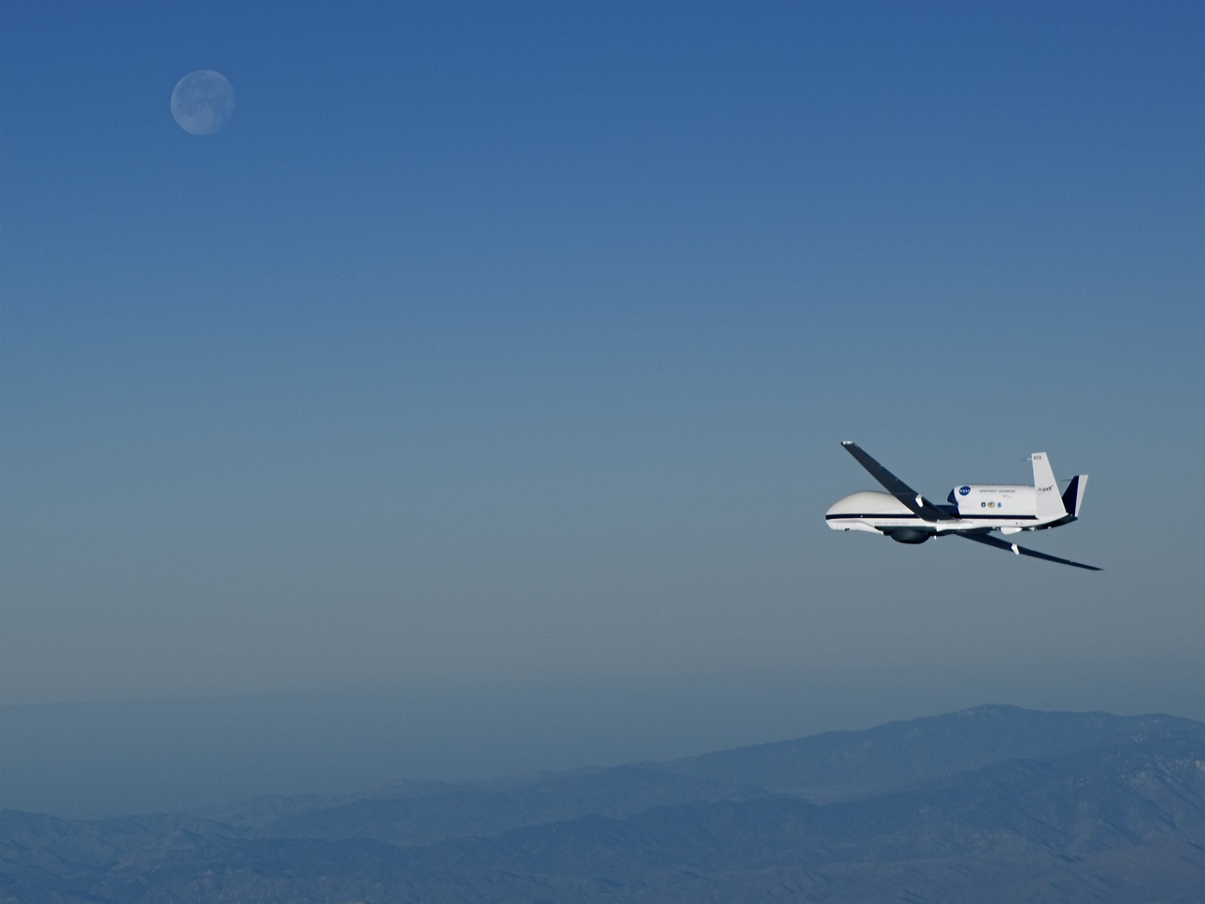

Hurricane and Severe Storm Sentinel (HS3): 2014 Results
Dr. Scott Braun, HS3 PI Paul Newman, HS3 Deputy PI
NASA Goddard Space Flight Center
IHC, Jacksonville, FL March 4, 2015

Slide 2

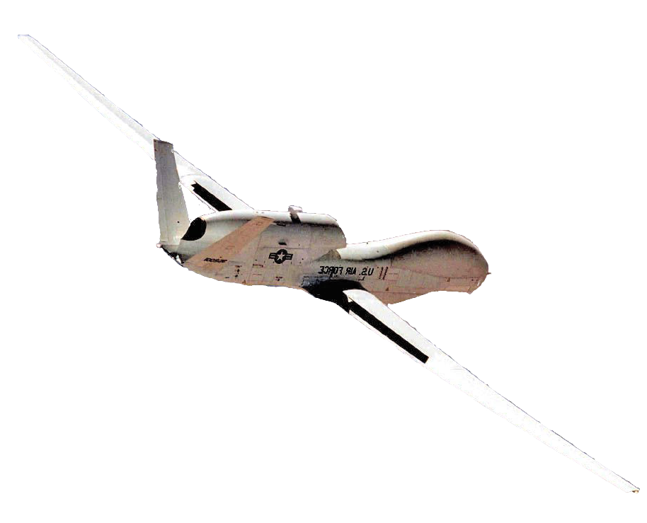


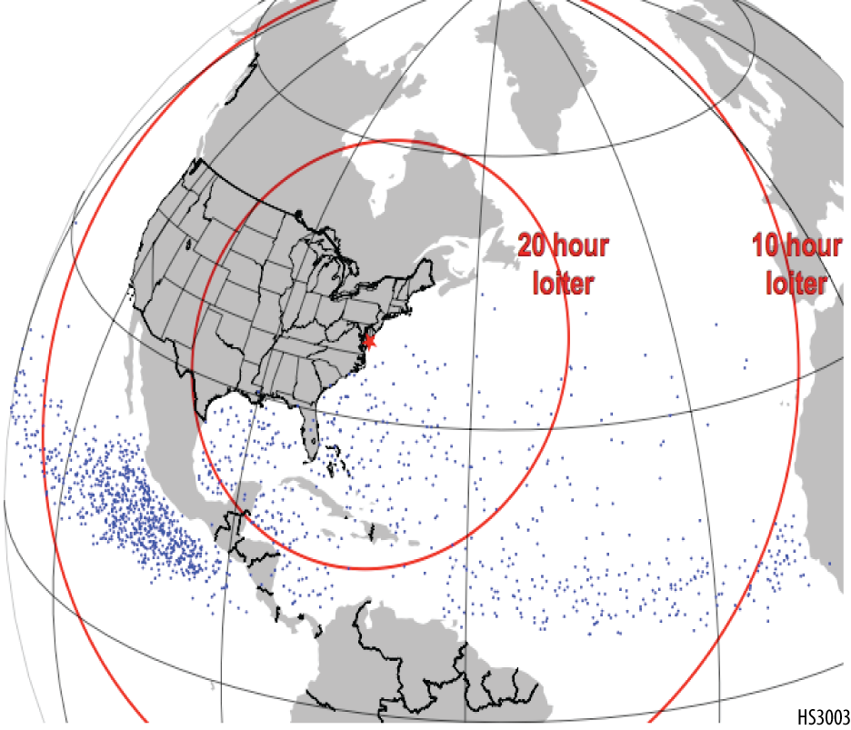
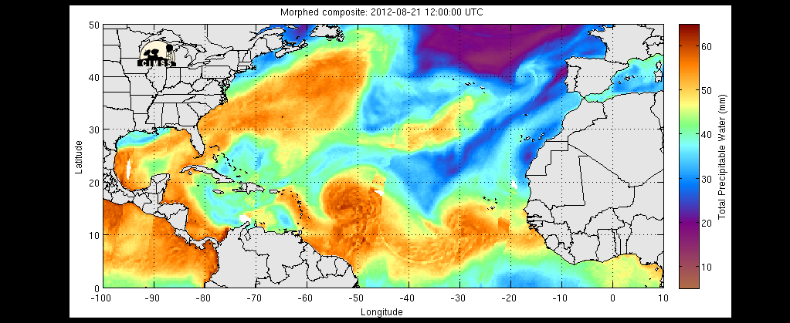
Hurricane and Severe Storm Sentinel (HS3)
Hurricane and Severe Storm Sentinel
HS³
Mission Details
Time on station
Science Goal: To understand hurricane genesis and intensification.
Key Science Questions:
• What is the impact of the large-scale environment, particularly the Saharan Air Layer?
• What is the role of storm internal processes such as deep convective towers?
• To what extent are these processes predictable?
16 h
loiter
6 h
loiter
Deployment Details:
5-week deployments in hurricane seasons of 2012-2014
Two Global Hawks based at NASA’s Wallops Flight Facility in Virginia
Dry Saharan air
Moist
tropical air
TS Isaac
Notes:
Summary of HS3, including science goals, deployment details, and instruments.

Slide 3
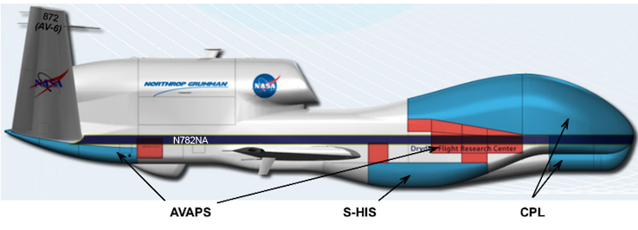
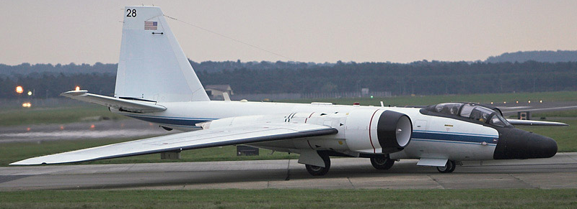
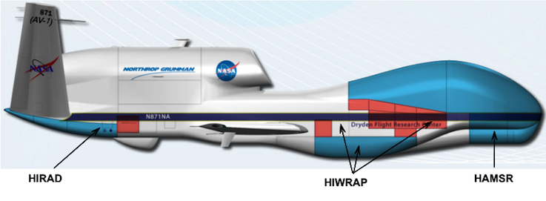
HS3 Aircraft and Instruments
Air Vehicle-6
The “Environmental” GH
WB-57 flew with HIRAD & HIWRAP
and ONR-funded dropsonde system
Air Vehicle-1
The “Over-Storm” GH

Slide 4

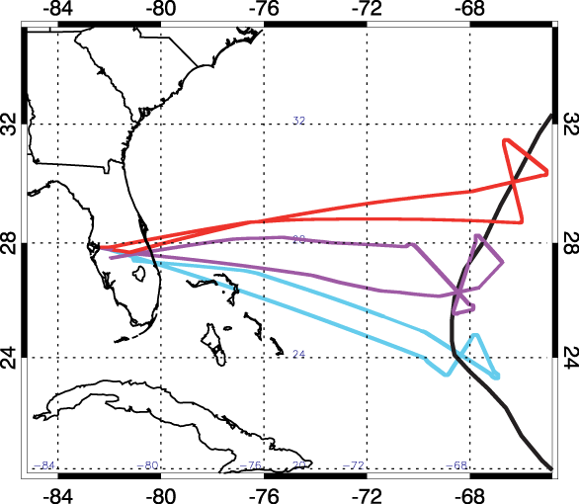
HS3 Flights Sampled 4 Named TCs
Four flights over the life cycle of Edouard, three over Gonzalo
WB-57 flight tracks
Gonzalo
AV-6 Flight Tracks
Green=Cristobal
Purple=Dolly
Orange=A90L
Red=Edouard
Yellow=NOAA MDR surveys

Slide 5
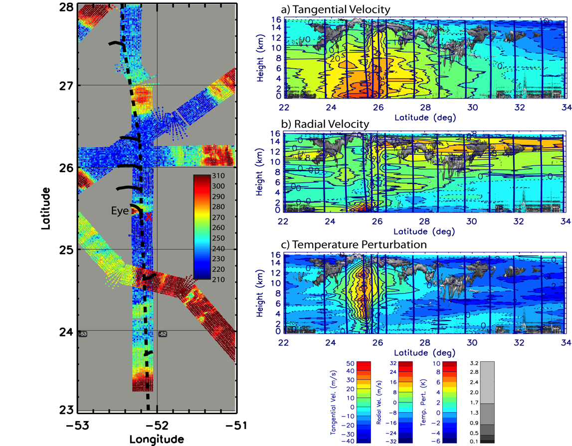
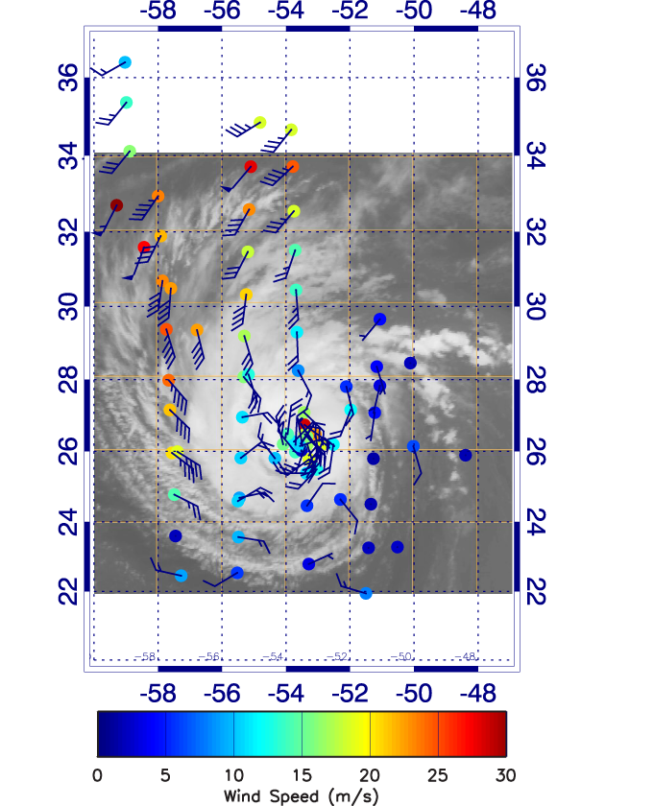
Edouard Intensifies On 14-15 September
Wind speed at 200 hPa
Notes:
Data from the second flight when Edouard underwent significant intensification. The plot on the level shows wind speed and wind barbs at 200 hPa, showing a strong outflow jet to the NW of the storm. The plots on the right show sea-level pressure (top) and surface wind speed (bottom). Minimum measured SLP is 967 hPa with a 40 m/s wind at 40 m, suggesting that the minimum pressure might be several hPa lower. Maximum measured sfc wind speeds are ~40 m/s, but the sparse sampling suggests that the maximum winds could be higher.

Slide 6
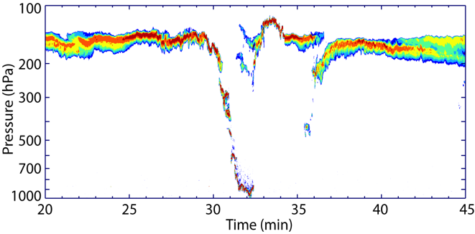
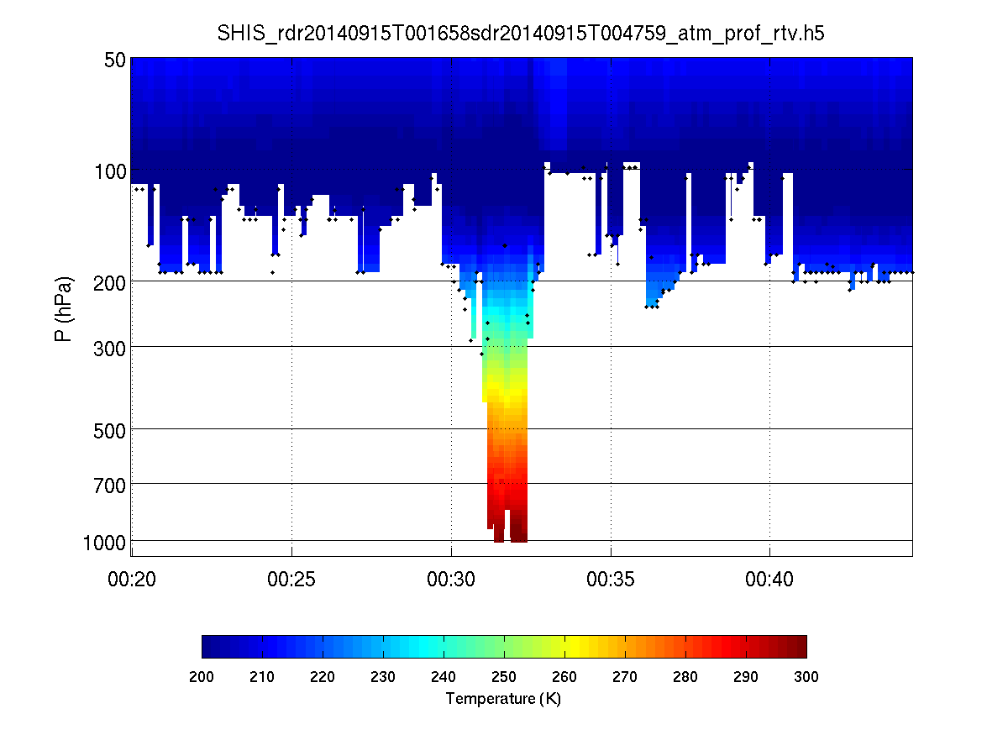
Bullseye For The Global Hawk on Second Pass Over Edouard (Sept. 14-15)
Warm S-HIS brightness temperatures near the eye
Overshooting
top
Eye
NE
SW
Notes:
Left figure shows S-HIS brightness temperature with blue areas being higher thick clouds, red being low clouds or the surface. S-HIS (and CP, upper right) suggest that we flew directly over the center with one dropsonde over the center (but entered the eyewall at lower levels). The CPL data shows an outward sloping eyewall on the NE side of the storm, but the lack of return at low-mid levels suggests an upright eyewall. A deep convective burst can be seen on the SW side of the storm. The break in the cloud deck on the SW side of the eyewall is associated with a gap between the eyewall and an outer rainband. S-HIS was able to measure temperature and humidity to very low levels in the eye.

Slide 7
Bullseye For The Global Hawk on Second Pass Over Edouard (Sept. 14-15)
Overshooting
top
Eye
2 mins=~11.5 nmi
NE
SW
Notes:
Left figure shows S-HIS brightness temperature with blue areas being higher thick clouds, red being low clouds or the surface. S-HIS (and CP, upper right) suggest that we flew directly over the center with one dropsonde over the center (but entered the eyewall at lower levels). The CPL data shows an outward sloping eyewall on the NE side of the storm, but the lack of return at low-mid levels suggests an upright eyewall. A deep convective burst can be seen on the SW side of the storm. The break in the cloud deck on the SW side of the eyewall is associated with a gap between the eyewall and an outer rainband. S-HIS was able to measure temperature and humidity to very low levels in the eye.

Slide 8
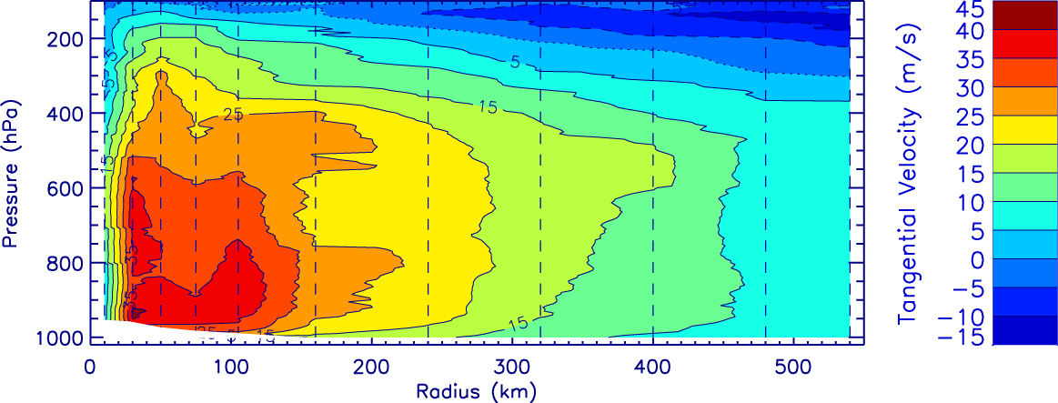
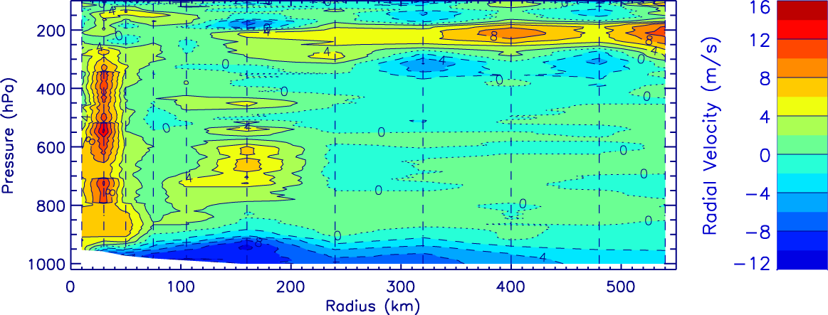
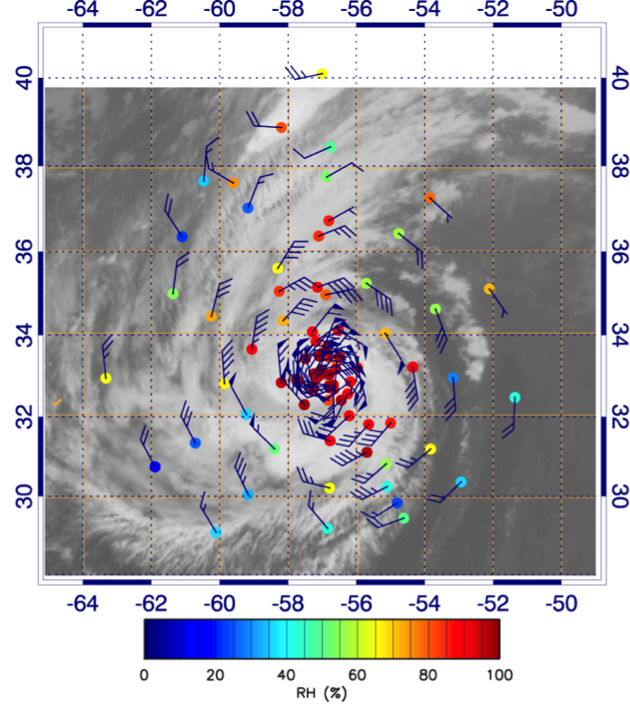
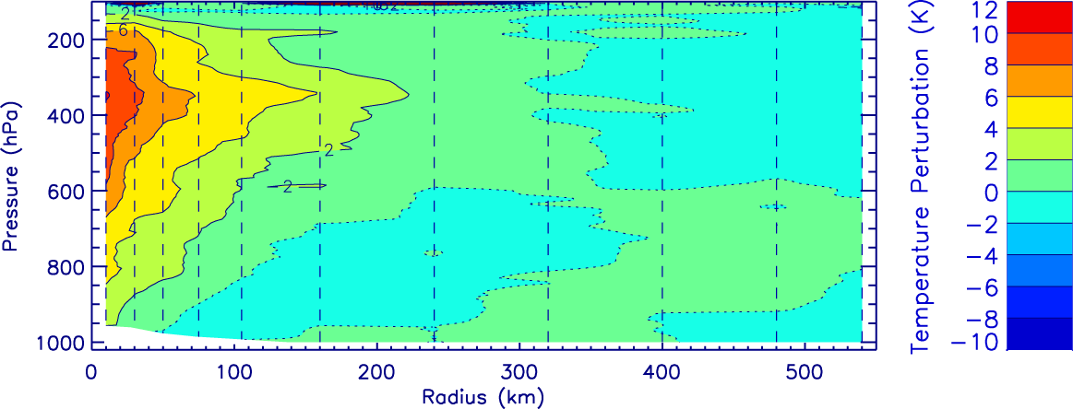
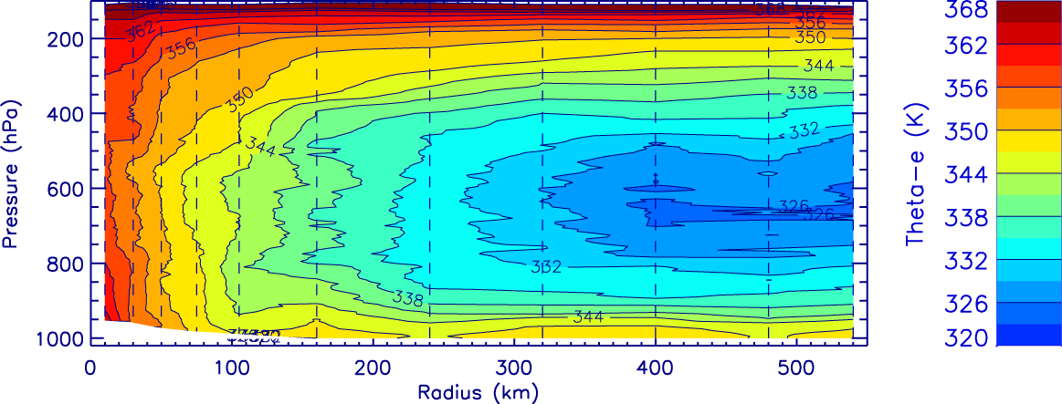
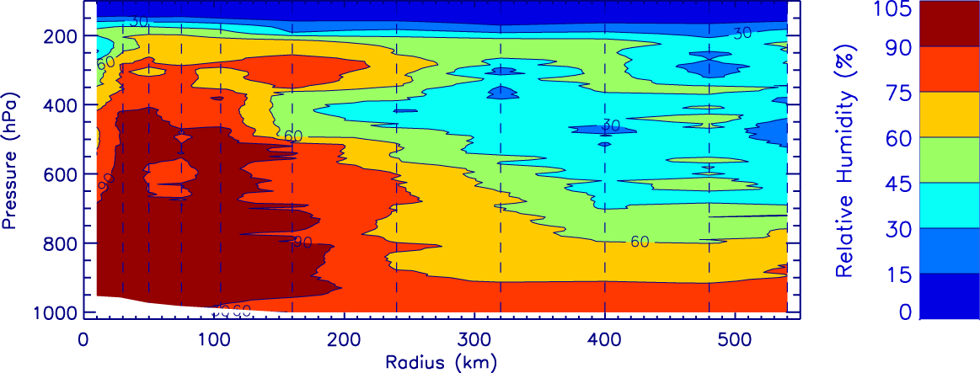
Composite Structure At Peak Intensity
Tangential Velocity
Hurricane Edouard on September 16-17
Relative Humidity at 700 hPa
Radial Velocity
Temperature Perturbation
Equiv. Pot. Temp.
Valid for reference time
of 00Z Sept. 17
Relative Humidity
Notes:
Data from the third Edouard flight when the storm was fairly steady at its maximum intensity. The distribution of sondes is shown to the left and is fairly evenly distributed about the center. RH data shows dry air in the storm environment, but no indication that it was getting into the protected core of the storm. The dropsondes were composited into radial bins with closer spacing in the core, wider spacing at larger radii (see vertical lines). The azimuthal mean fields of the indicated variables are shown. The tangential wind field suggests a secondary wind maximum near 100 km with mid-level outflow and a high altitude outflow region. Strong outflow is seen near the eyewall and may be the main contributor to the high-level outflow. The temperature perturbation (from the mean outside 200 km) peaks at 350 hPa. Temperature perturbation is with respect to the mean of all sondes at radii > 200km.
Contour labels are shown for most cross sections, but difficult to show for the radial velocities. There, the contour interval is 2 m/s, with positive (negative) contours indicated by solid (dashed) lines. The dotted line is the 0 contour.

Slide 9
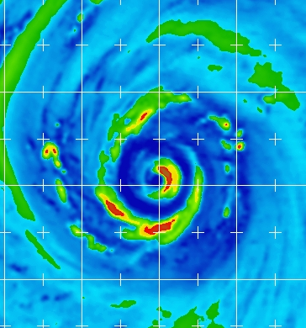
Composite Structure At Peak Intensity
Hurricane Edouard on September 16-17
Valid 0520Z
Sept. 17
Relative Humidity at 700 hPa
Tangential Velocity
Valid for reference time
of 00Z Sept. 17
Radial Velocity
Notes:
Data from the third Edouard flight when the storm was fairly steady at its maximum intensity. The distribution of sondes is shown to the left and is fairly evenly distributed about the center. RH data shows dry air in the storm environment, but no indication that it was getting into the protected core of the storm. The dropsondes were composited into radial bins with closer spacing in the core, wider spacing at larger radii (see vertical lines). The azimuthal mean fields of the indicated variables are shown. The tangential wind field suggests a secondary wind maximum near 100 km with mid-level outflow and a high altitude outflow region. Strong outflow is seen near the eyewall and may be the main contributor to the high-level outflow. The temperature perturbation (from the mean outside 200 km) peaks at 350 hPa. Temperature perturbation is with respect to the mean of all sondes at radii > 200km.
Contour labels are shown for most cross sections, but difficult to show for the radial velocities. There, the contour interval is 2 m/s, with positive (negative) contours indicated by solid (dashed) lines. The dotted line is the 0 contour.

Slide 10
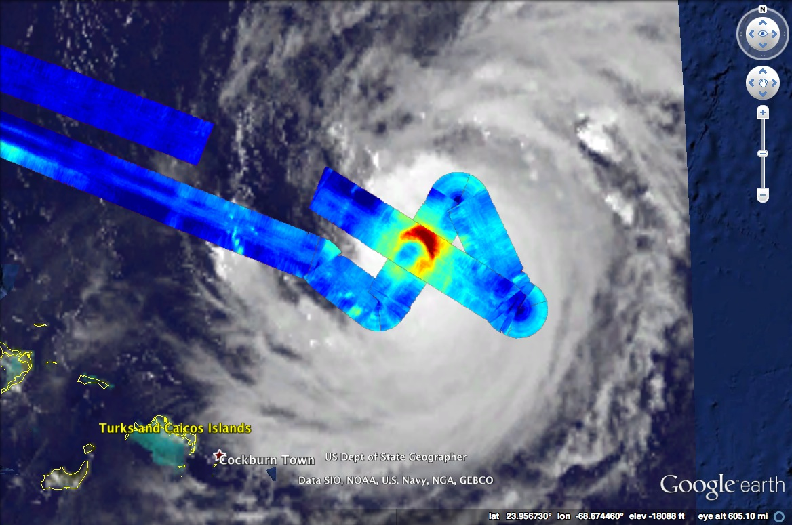
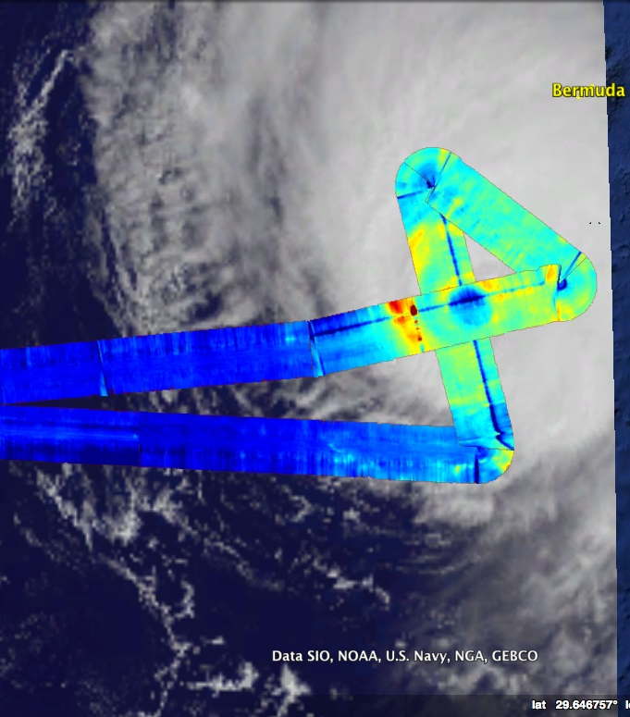
HIRAD Measurements in Hurricane Gonzalo
October 15 HIRAD 5 GHz Excess TB
October 17 HIRAD 5 GHz Excess TB
21 UTC 15 Oct Hurricane Gonzalo
NHC advisory: 110 kt
15 UTC 17 Oct Hurricane Gonzalo
NHC advisory: 110 kt, weakening
Initial HIRAD data shows development of concentric eyewalls, with substantial weakening of the inner eyewall over the three days.
Final calibration and data processing still in progress.
Courtesy of Dan Cecil, NASA/MSFC

Slide 11
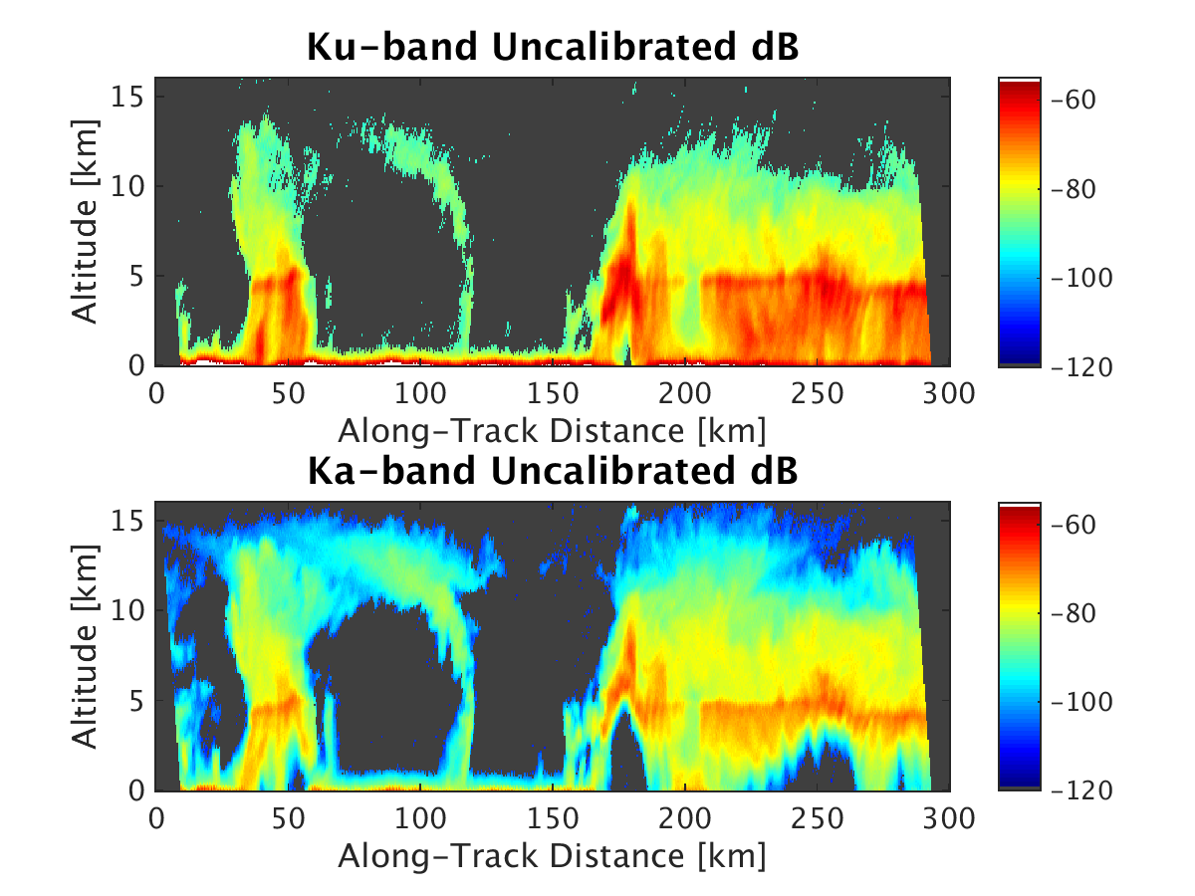
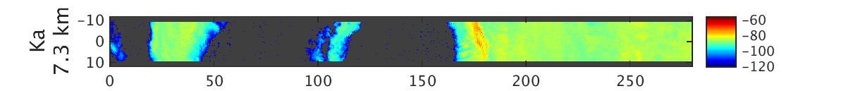
HIWRAP Vertical Cross sections
Inner eyewall
Vertical cross sections of Ku and Ka reflectivity
SOUTH
NORTH
Horizonal cross section of Ka dB
Courtesy of Matt McClinden, Gerry Heymsfield, NASA/MSFC

Slide 12

HS3 Has Completed Its 3 Deployments!
• HS3’s best cases: Nadine (2012); Edouard and Gonzalo (2014)
• Two non-developers: A95L (2013), A90L (2014)
• Several Saharan Air Layer cases
• Data analysis and modeling on-going
Website and data links: espo.nasa.gov/hs3

