Slide 1
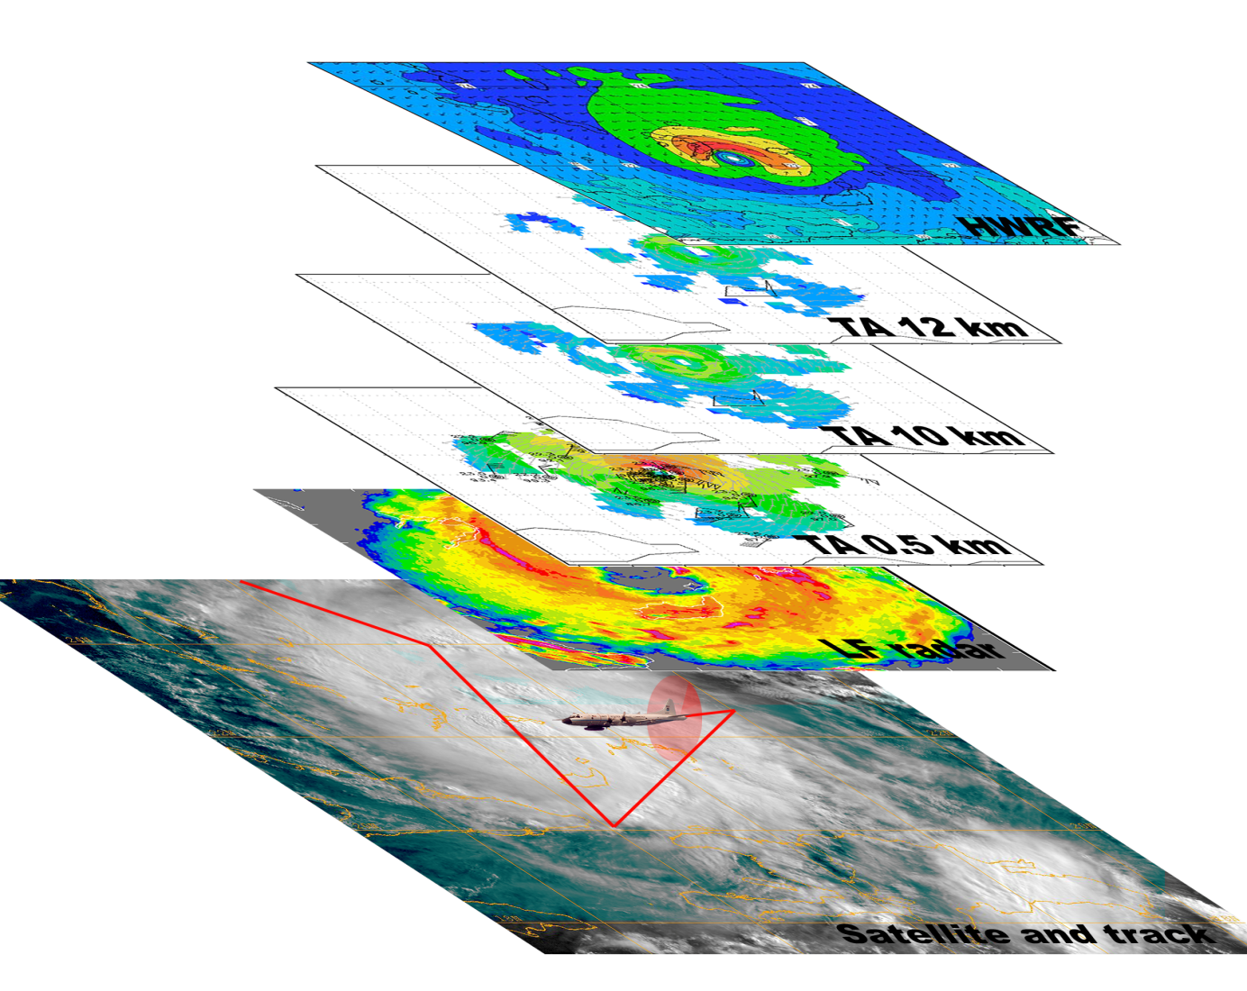
NOAA’s Intensity Forecasting Experiment (IFEX)
Robert Rogers
NOAA/AOML Hurricane Research Division
Miami, FL

Slide 2
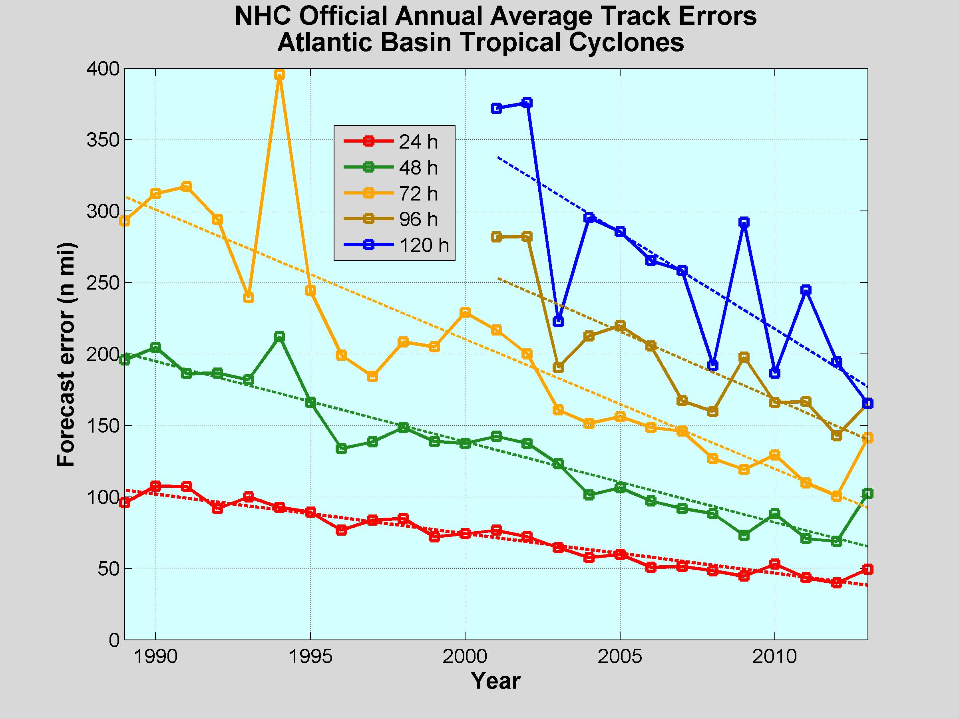
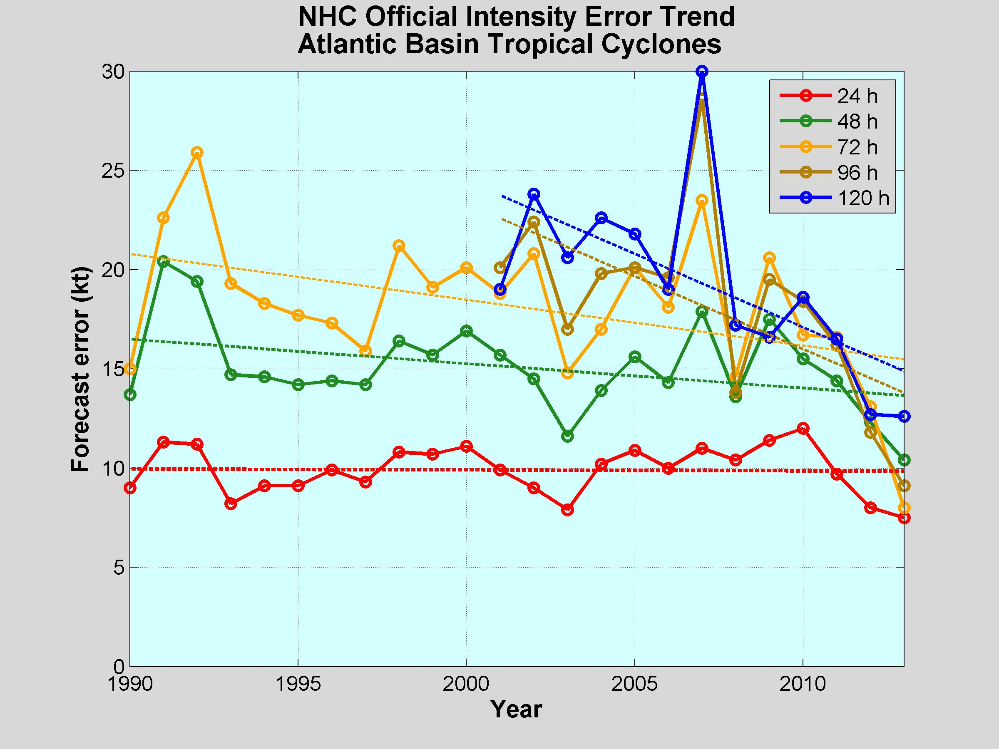
The challenge: TC intensity forecasting
Advances in forecasts of TC intensity lag advances in TC track forecasts
Multiscale nature of processes are major reason
  Environmental - O(1000 km) - troughs, shear
  Vortex - O(1-100 km) - symmetric/asymmetric dynamics, VRWs
  Convective - O(1 km) - convective bursts, vortical hot towers
  Turbulent - O(1-100 m) - surface fluxes, PBL mixing, entrainment
  Microscale - O(1mm) - hydrometeor production, latent heating
NOAA is addressing this challenge with modeling,
data assimilation, observations, and theory
  Hurricane Forecast Improvement Project (HFIP) – modeling, data assimilation
  Intensity Forecasting Experiment (IFEX) – observations, theory
Track
Intensity
  Forged over decades of field work, IFEX supports HFIP by serving as the key observational resource for initialization and evaluation of the model guidance

Slide 3
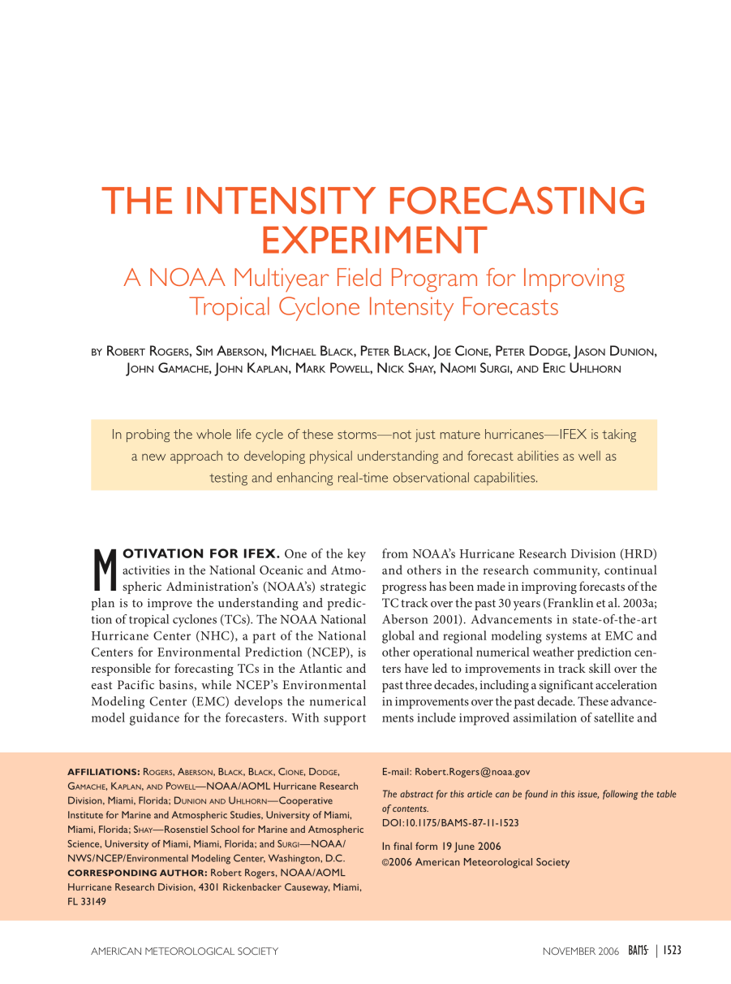
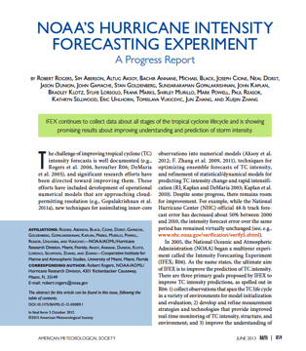
Intensity Forecasting Experiment (IFEX)
Rogers et al., BAMS, 2006
Rogers et al., BAMS, 2013
IFEX intended to improve prediction of TC intensity change by addressing three goals:
Collecting observations that span TC life cycle across scales for model initialization and evaluation
Developing and refining measurement technologies that provide improved real-time monitoring of TC intensity, structure, and environment
Improving understanding of physical processes important in intensity change for a TC at all stages of its life cycle
These goals provide the linkage between observations, modeling, DA, and theory that form the foundation of the work done at HRD

Slide 4
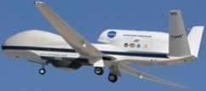
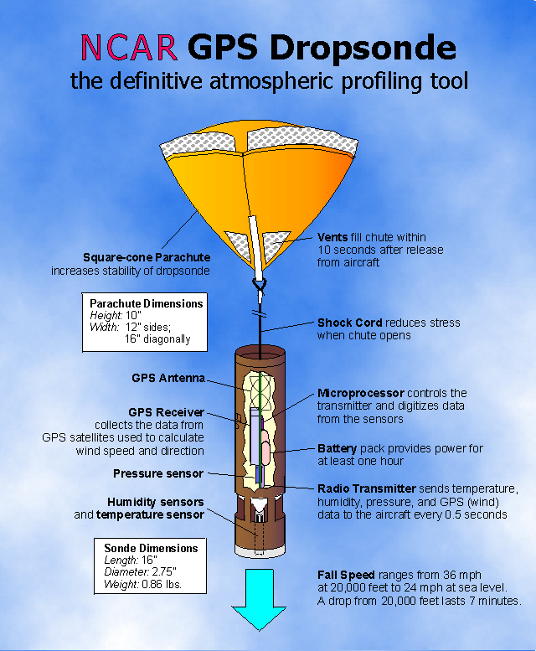
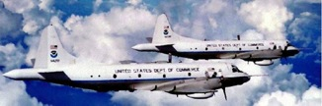
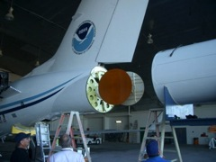

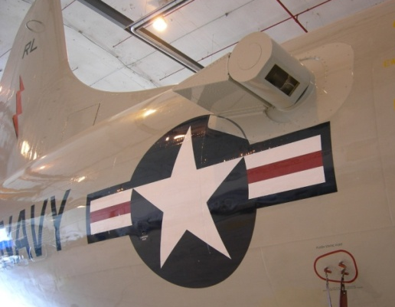
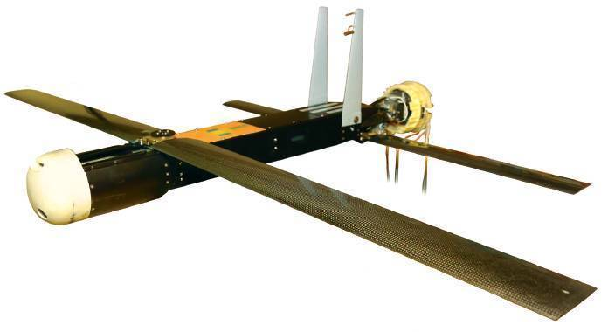
Intensity Forecast Experiment
Observing platforms and instruments
In-situ
  Wind, press., temp.
Expendables
  Dropsondes
  AXBT, AXCP, buoy
Remote Sensors
  Tail Doppler Radar(TDR)
  SFMR/HIRAD
  WSRA
  Scatterometer/profiler
  UAS
NOAA P-3s
NASA Global Hawk
NOAA G-IV
GPS Dropsonde
G-IV Tail Doppler Radar
Coyote UAS
Doppler Wind Lidar
4
Notes:
UR image depicts dropsonde profiles in eyewall of Hurricane Guillermo (1997)
LR image is Doppler Wind Lidar profiles from TCS-08
See IFEX paper (Rogers et al 2006): http://dx.doi.org/10.1175/BAMS-87-11-1523
HRD IFEX website: http://www.aoml.noaa.gov/hrd/HFP2011/index.html

Slide 5



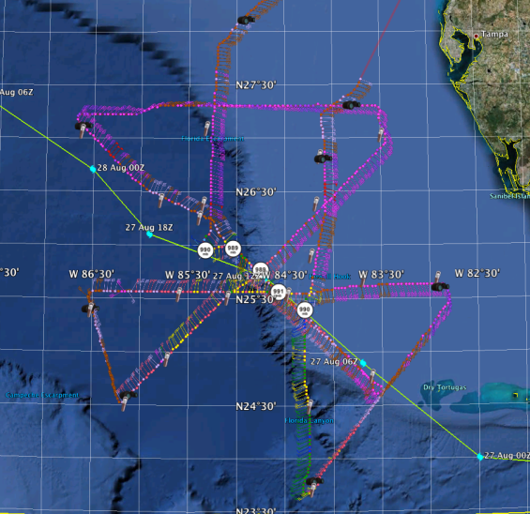
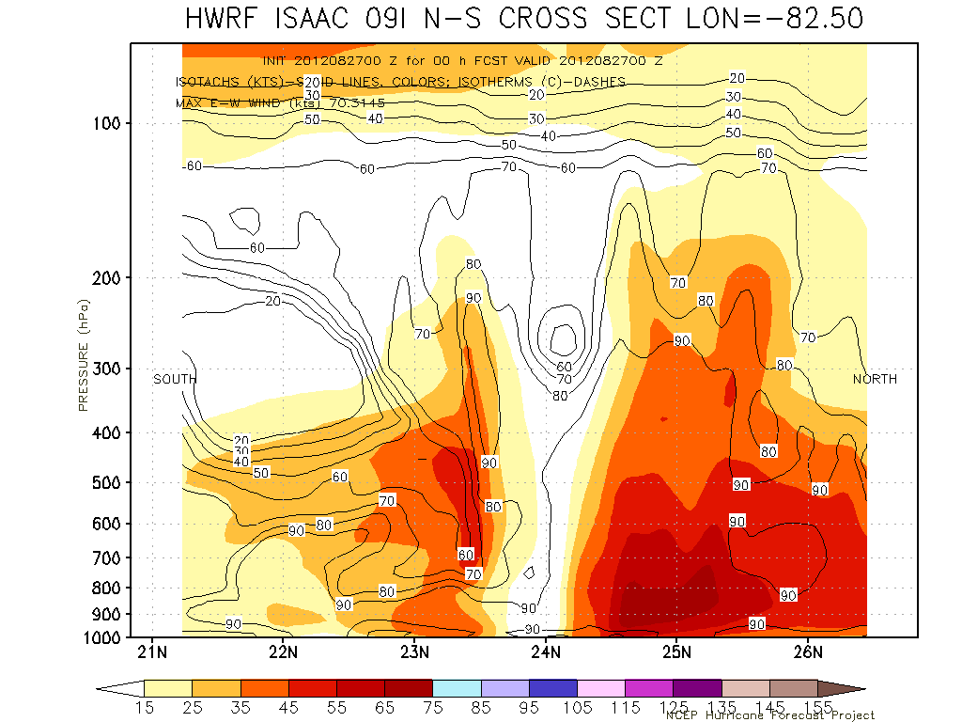
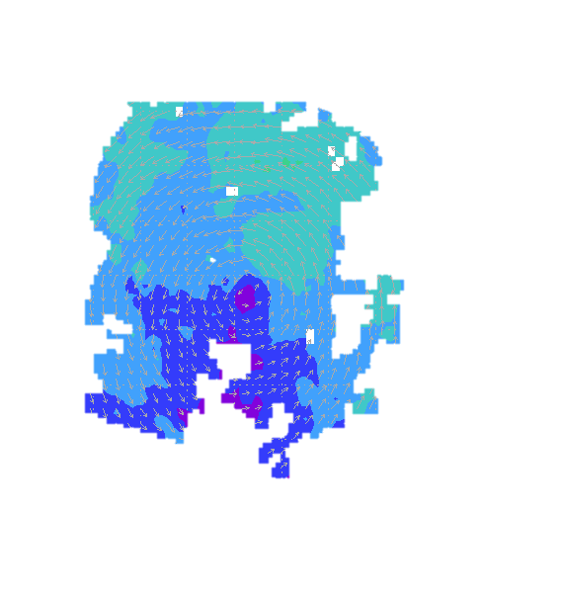
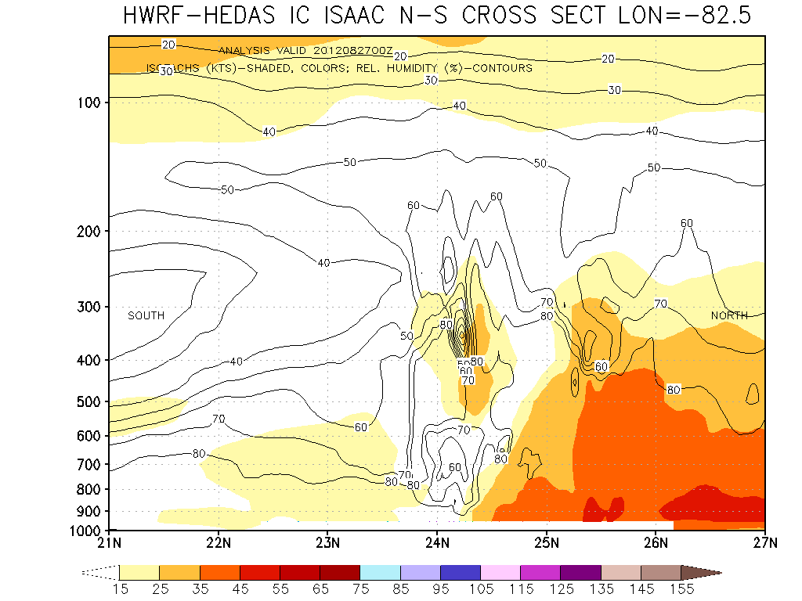
IFEX Goal 1: Assimilation of data into models
NOAA G-IV flies
above and around
the hurricane
Impact Of Aircraft Observations On HWRF Forecast
- Improving Storm Structure At Initial Time -
NOAA P-3
samples inside
the hurricane
The Hurricane Research Division of AOML developed a state-of the-art inner core data assimilation system for HWRF (HEDAS)
[Runs in real-time under HFIP]
ISAAC Initial vortex (wind)
Operational HWRF
(No Data Assimilation)
ISAAC (2012): Intensity Errors (kt)
Forecast Hrs | 12 | 24 | 36 | 48
Operational HWRF | 13 | 16 | 26 | 26
With P-3 Data | 8 | 3 | 9 | 20
# Cases | 9 | 7 | 5 | 3
ISAAC Initial vortex (wind)
with assimilation of observations
Sheared
vortex
Notes:
Example of impact of observations on numerical model intensity forecasts. Observations improve model forecasts through improved initial conditions via data assimilation, in this case using the HRD-developed Ensemble-based Data Assimilation System (HEDAS).
Example of forecasts using the HWRF model with and without HEDAS. HWRF forecast with HEDAS (using observations from the P-3 flights in the data assimilation system) showed improved vertical structure of T.S. Isaac compared with HWRF forecast without HEDAS (two cross sections on right side of figure).
Statistics of the intensity forecast errors for Isaac show that runs with HEDAS produced significantly reduced intensity forecast errors (table in bottom left of figure).

Slide 6
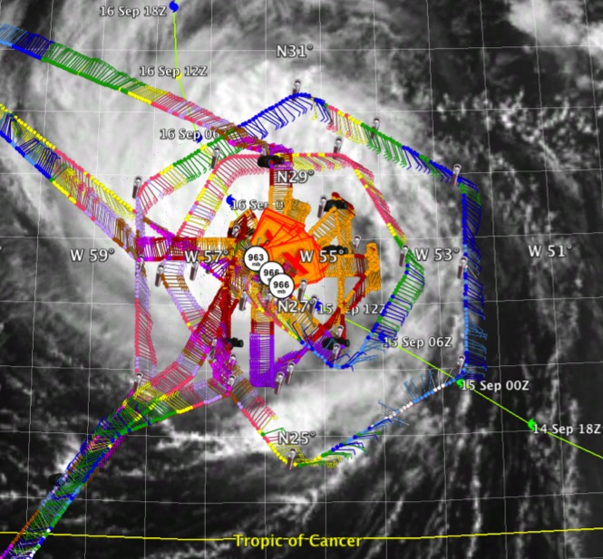
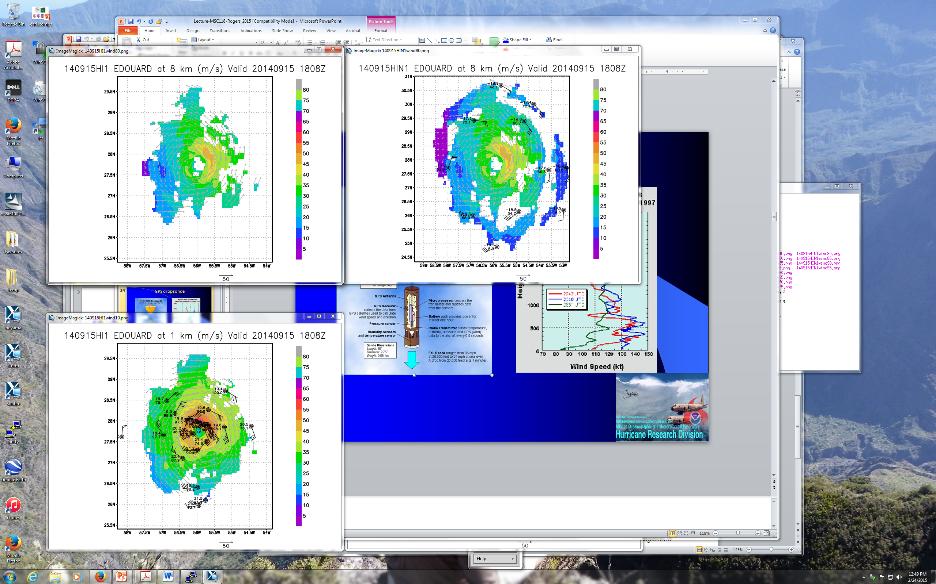
  IFEX Goal 2: Develop & refine observing technologies: G-IV TDR
2 P-3 Doppler analysis at 8 km altitude
2 P-3 & G-IV Doppler analysis at 8 km altitude
2 P-3 and G-IV flight track in Hurricane Edouard 15 September 2014
G-IV Doppler can provide enhanced coverage, especially at higher altitude
G-IV can be flown further from center to sample environment and supplement P-3, or closer to center to “replace” P-3
6

Slide 7
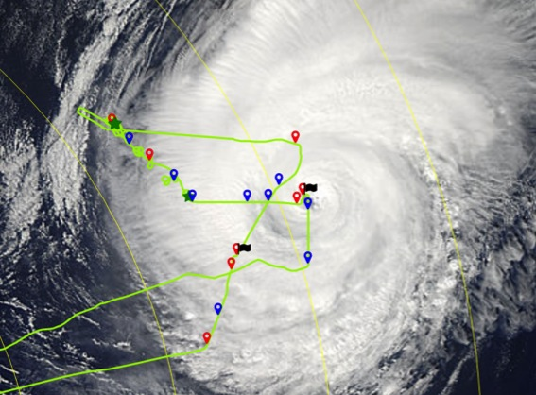
  IFEX Goal 2: Develop & refine observing technologies: Coyote low-level UAS
Coyote measurements in Hurricane Edouard (2014)
17 September 2014
MODIS
1640Z
1420Z
1341Z
1638Z
1316Z
1259Z
released from P-3 like a dropsonde, can be controlled for ~2 h
can get measurements down to surface, where manned aircraft can not safely reach
7

Slide 8
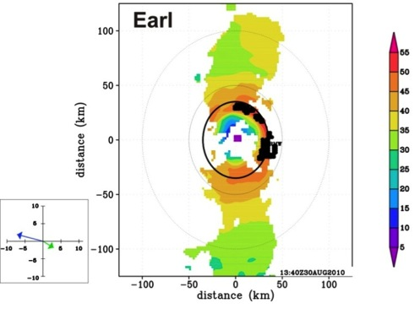
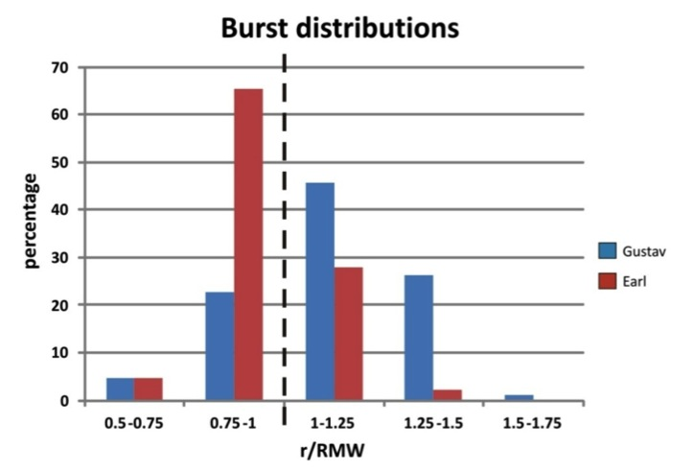
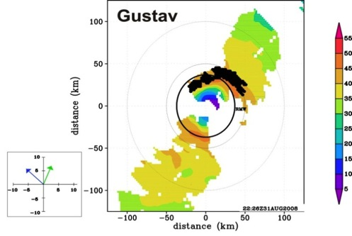
  IFEX Goal 3: Improve understanding of physical processes: Rapid Intensification
TDR observation of wind speed at 2 km (shaded, m/s) and burst locations
Radial distribution of convective bursts
Convective bursts
RMW
RMW
RMW
13:40 UTC Aug 30 2010
shear
motion
both storms ~ 50 m/s hurricane, RMW of ~35 km
convective burst distribution peaked inside RMW for Earl, outside RMW for Gustav
what causes differences in radial distributions of deep convection?
22:26 UTC Aug 31 2008
shear
motion
8

Slide 9
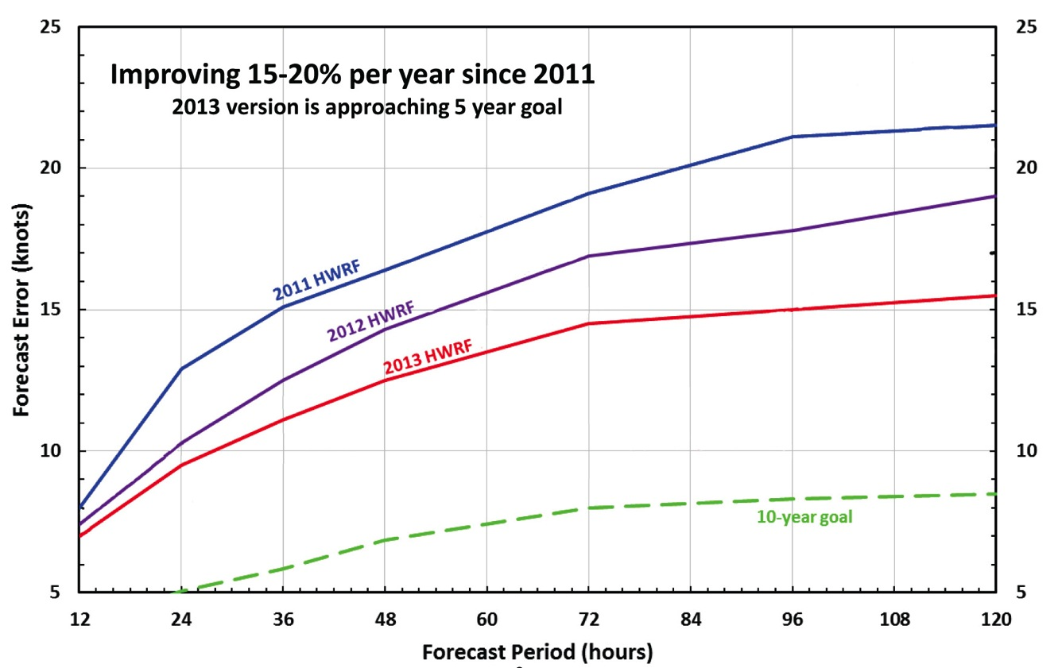
HWRF intensity forecast improvements
HWRF intensity forecast error
Intensity forecast error for HWRF has decreased markedly over three years of model developments, but still more work to do
http://www.emc.ncep.noaa.gov/gc_wmb/vxt/

Slide 10
HWRF intensity forecast improvements
Forecast 24-h intensity change
Forecast 24-h intensity change
HWRF
2012-2013
RI “hits”
JTWC
2012-2013
RI “hits”
Observed 24-h intensity change
Observed 24-h intensity change
HWRF Probability of Detection for RI is ~ 22% , much higher compared to operations and other models (previous analysis of RI for WPAC in 2012 showed <10% skill).
http://www.emc.ncep.noaa.gov/gc_wmb/vxt/
Notes:
If one define an RI event as >30 kt / 24 h, then HWRF RI POD skill is ~ 23 % and by far
has higher POD index as compared to other models and in other basins (previous
analysis of RI for WPAC from 2012 HWRF showed <10% skill).

Slide 11
IFEX plans for 2015
Continue addressing IFEX/HFIP goals
    IFEX Goal 1:
      TDR missions
    IFEX Goal 2:
      Coyote deployment
      Doppler Wind Lidar testing
      Interactions with NOAA unmanned field campaign, Sensing Hazards with Operational Unmanned Technology (SHOUT)
    IFEX Goal 3:
      RI processes, especially early in lifecycle
      TC intensification in shear
Sustain our partnerships with EMC and NHC
G-IV and one P-3 available
Encourage greater awareness in broader TC community

Slide 12
NOAA SHOUT 2015
GOAL: Test prototype UAS concept of operations that could mitigate the risk of diminished high impact weather warnings in case of polar-orbiting satellite observing gaps
Global Hawk
Flight level: ~55-60,000 ft
Duration: ~24 h
Range: 11,000 nm
Payload: 1500+ lbs
Deployment site: NASA Wallops Flight Facility, VA
5 week deployment (late Aug through Sep)
Instrumentation: AVAPS, HAMSR, & HIWRAP

Slide 13




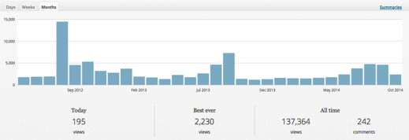
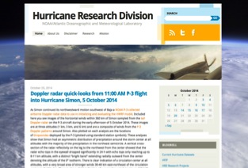
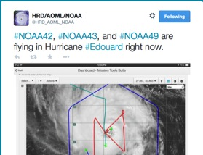
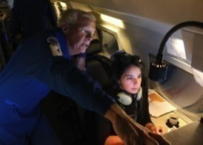
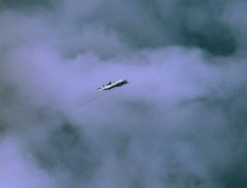
Outreach
Our blog
http://noaahrd.wordpress.com
HRD Web page
http://www.aoml.noaa.gov/hrd
Facebook (3,475 likes)
http://www.facebook.com/noaahrd
Twitter (12,900 followers)
http://twitter.com/#!/HRD_AOML_NOAA
Tweets from the eye
Visiting scientist program
13
Notes:
13
Since 15 May 2010 HRD has maintained our Blog on Wordpress which supports a RSS feed, Twitter, and Facebook accounts.
Wordpress Stats: 854 posts (18-19 posts per month), 179 comments. Most posts are during the hurricane season where we post our updates on field activities whenever we are operating.
Wordpress Blog Views by Month and Year
Months and Years
Jan Feb Mar Apr May Jun Jul Aug Sep Oct Nov Dec Total
2010 152 753 1,790 3,463 5,521 2,047 1,479 1,019 16,224
2011 1,028 927 1,152 1,143 1,417 1,495 1,959 7,195 2,588 1,885 1,659 1,231 23,679
2012 1,139 1,179 1,305 1,456 1,754 1,855 1,929 14,433 4,537 5,302 3,179 2,770 40,838
2013 3,702 1,880 1,687 1,323 2,264 1,736 2,622 4,619 7,276 1,369 1,167 1,292 30,937
2014 1,250 1,250
Since late September 2013 HRD has tracked web pages using Google Analytics:
HRD Web site Stats: Since late September 2013 a total of 188,460 visits or 47,000 visits per month with 383,873 page views
Twitter Stats: 1,334 tweets of which 854 are directly from the Wordpress Blog and the rest from “Tweets from the Eye” which we do directly to Twitter from the NOAA aircraft during missions. “Tweets from the Eye” are a very effective and popular outreach tool helping educate the Public to what NOAA does.

Slide 14
Thank you!

Slide 15
Extra slides

Slide 16
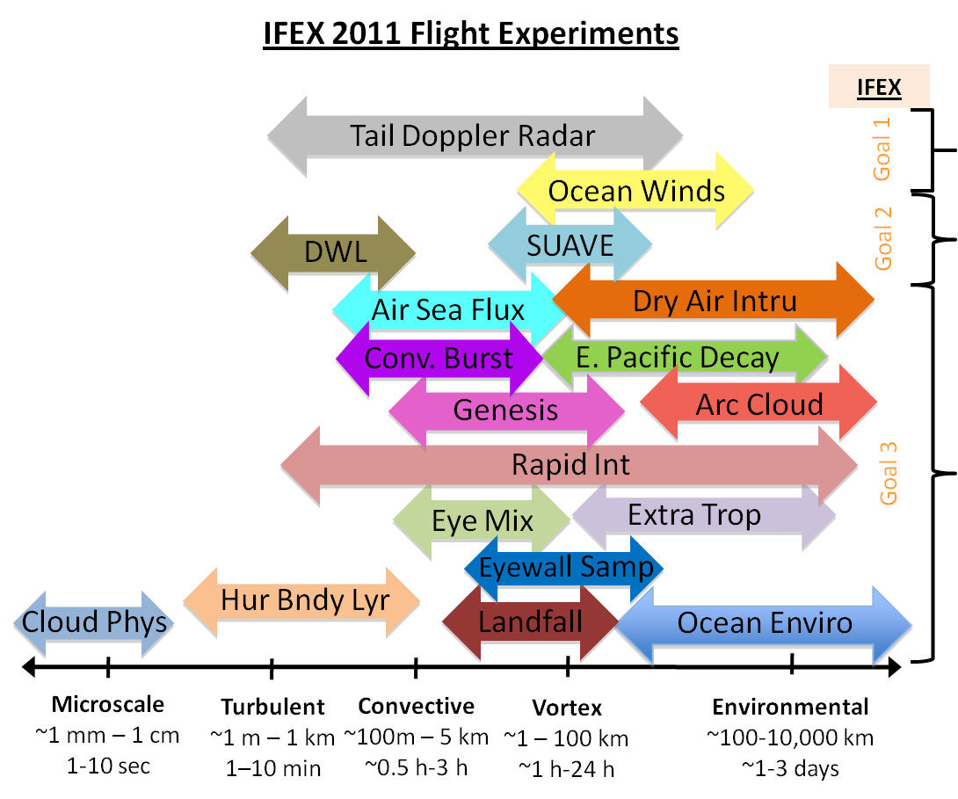
Goal 1: Collecting observations across scales
Spatial/temporal scales of IFEX flight experiments
IFEX experiments span the multitude of spatial and temporal scales important in TC intensity change
Notes:
Schematic of field experiments from 2012 HFP and where they fit in the statio-temporal spectrum. You don’t need to read over every experiment; just make the point that IFEX experiments are designed to cover wide spectrum of scales, in keeping with multiscale nature of TC intensity change.

Slide 17
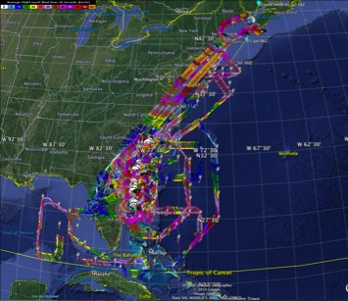

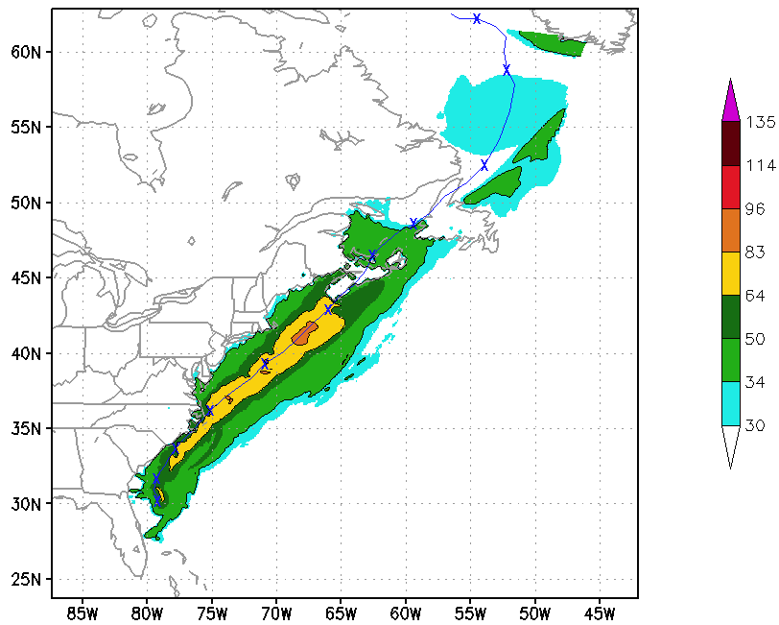
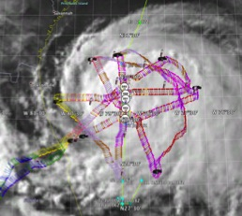
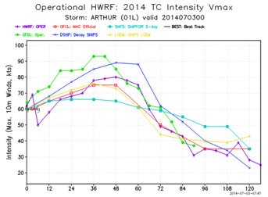
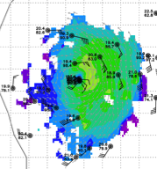
  IFEX Goal 1: Assimilation of data into numerical models: Arthur 2014
5 P-3 Flights
2 July – 5 July 2014
Doppler data transmitted in real-time for assimilation into HWRF
5 P-3 missions from 2-5 July 2014 at 12 h Doppler sampling (HEDAS/GSI) & 3 G-IV missions
Sampled Arthur as a tropical storm to hurricane at landfall in NC, to extra-tropical transition in Nova Scotia
17
Notes:
Map shows flight tracks for all of the NOAA missions (color coded are the flight level winds for the P-3 missions, dropsonde symbols denote G-IV patterns)
Flight track plots courtesy of Tropical Atlantic - http://tropicalatlantic.com/recon/
Model data available at: http://www.emc.ncep.noaa.gov/gc_wmb/vxt/RT_ATLANTIC/ARTHUR01L/

Slide 18
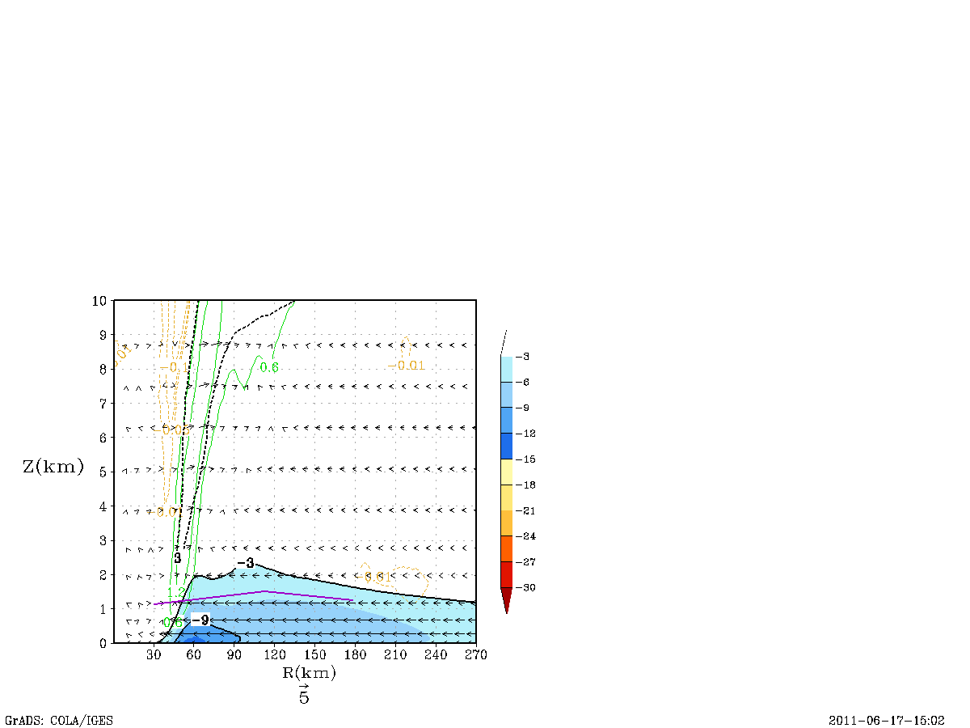
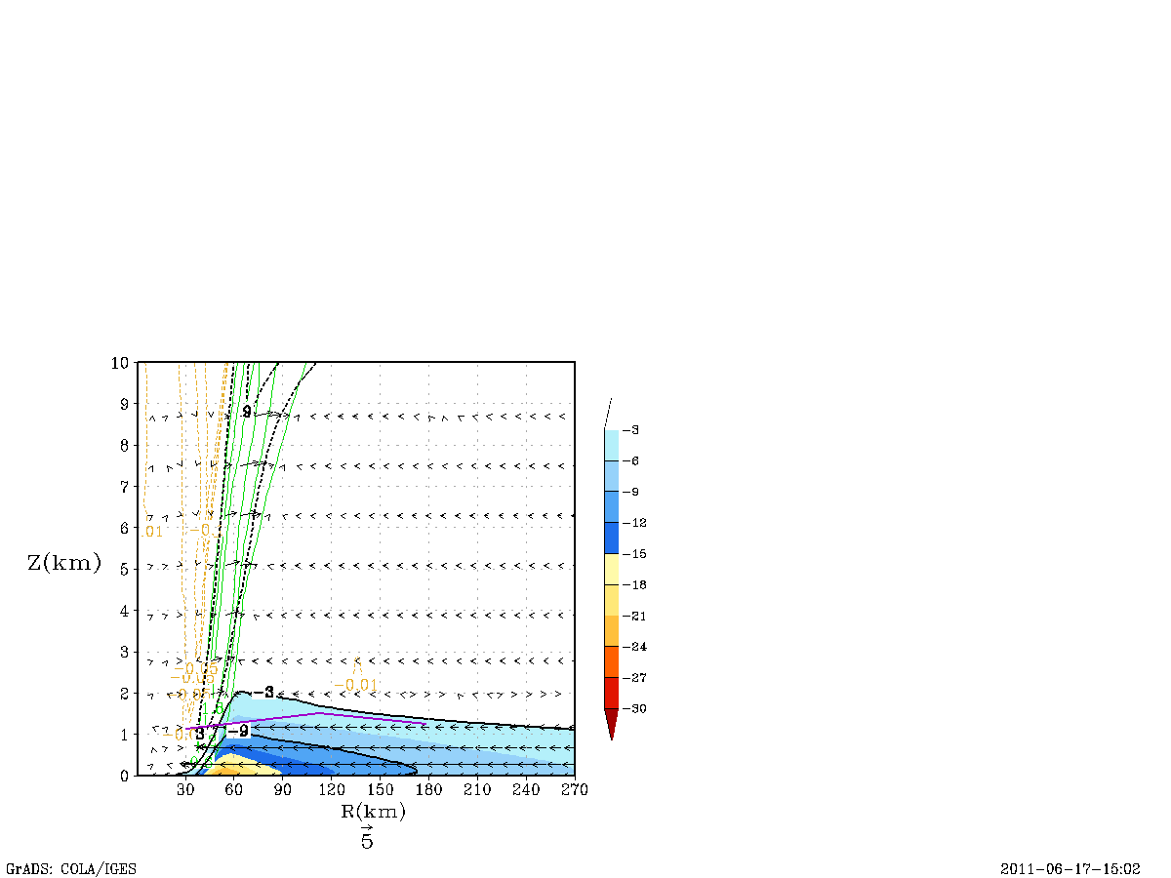
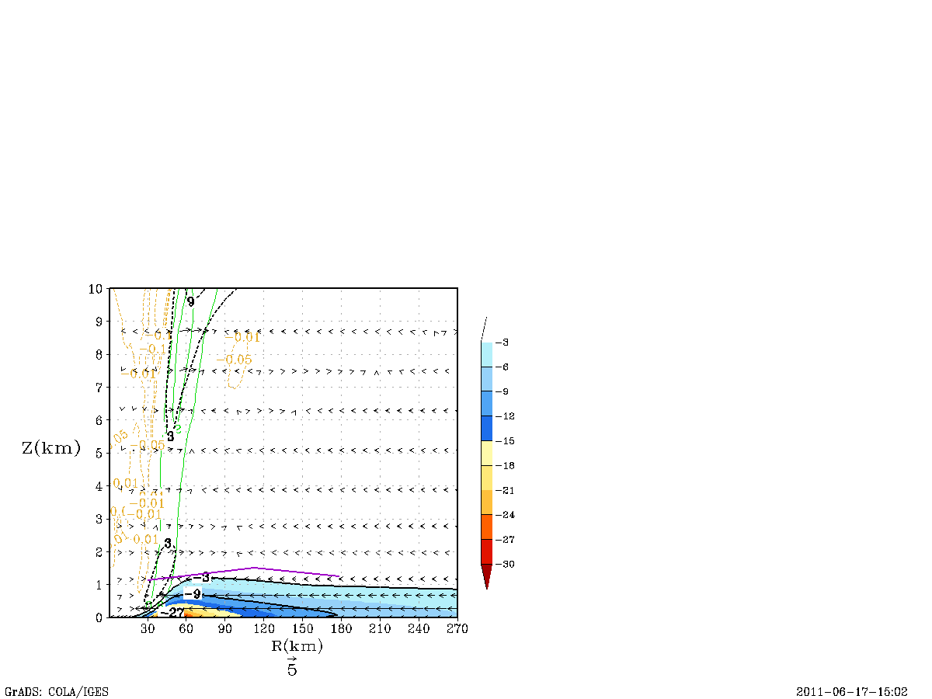
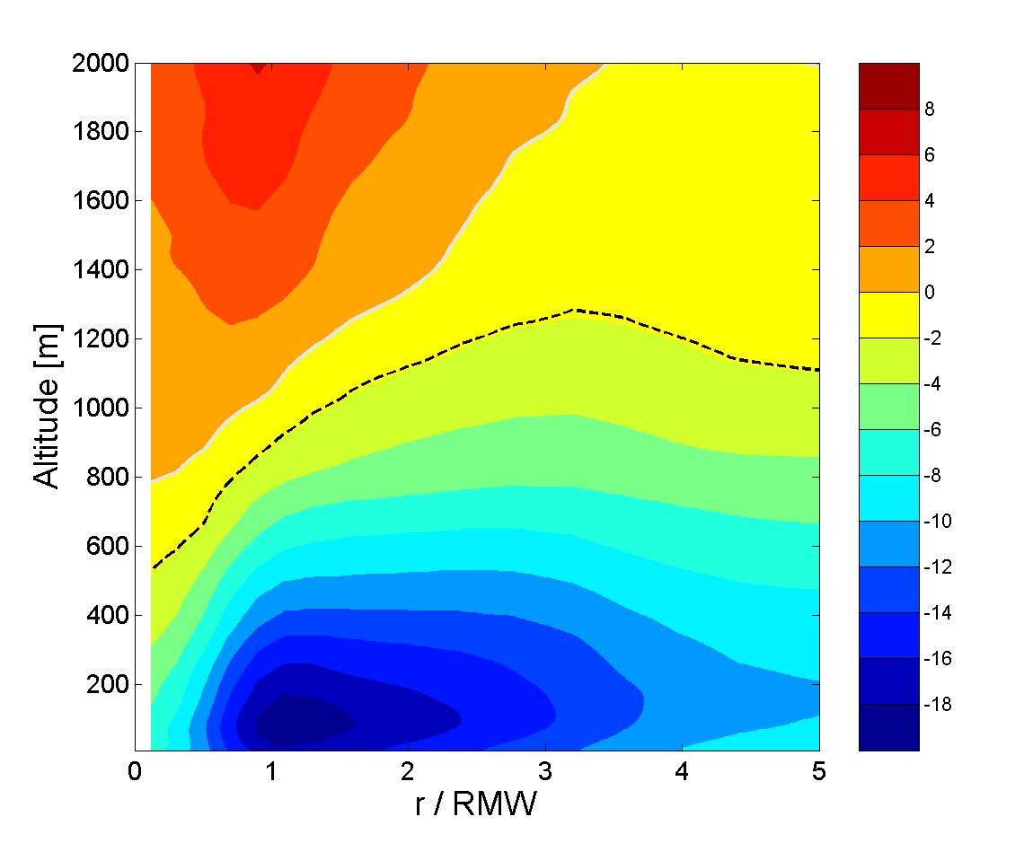
Goal 1: Numerical model evaluation
Sensitivity of radial wind (shaded, m s⁻¹) to vertical eddy diffusivity (K_{m})
original K_{m}
K_{m} reduced 50%
K_{m} reduced 75%
(most accurate)
2
Observed
Observed
Observed
height (km)
1
0
30
90
150
210
270
30
90
150
210
270
30
90
150
210
270
radius (km)
radius (km)
radius (km)
Gopal et al. 2012
2
Dropsonde
composite
Peak radial inflow stronger with more accurate K_{m}
Depth of inflow layer more consistent with dropsonde composites using more accurate K_{m}
height (km)
1
Dashed line is inflow layer depth from dropsonde composite
0
0
1
2
3
4
5
Zhang et al. 2011
radius (r/RMW)
Notes:
Comparison of the azimuthally-averaged radial flow from three different idealized HWRF simulations. First panel shows the original value for Km, middle panel shows Km reduced by 50%, last panel shows Km reduced by 75% (and in best agreement with observations from previous slide). Depth of inflow layer is defined by -3 m/s contour, indicated by the light blue shading in all three figures. Bottom-right figure shows azimuthally-averaged radial flow from a composite of dropsonde observations in multiple tropical cyclones. Purple line in top three figures denotes approximate height of inflow layer defined by dropsonde composites. Depth of inflow layer from idealized simulations shows that the run where Km is reduced by 75% is in best agreement with the dropsonde-derived inflow layer depth, strength, and radial variation.

Slide 19
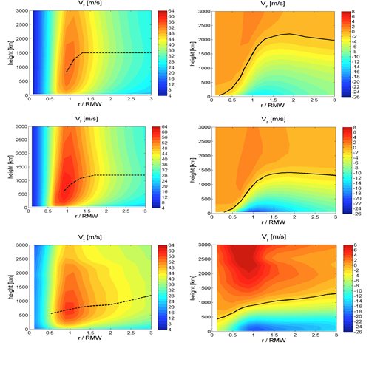
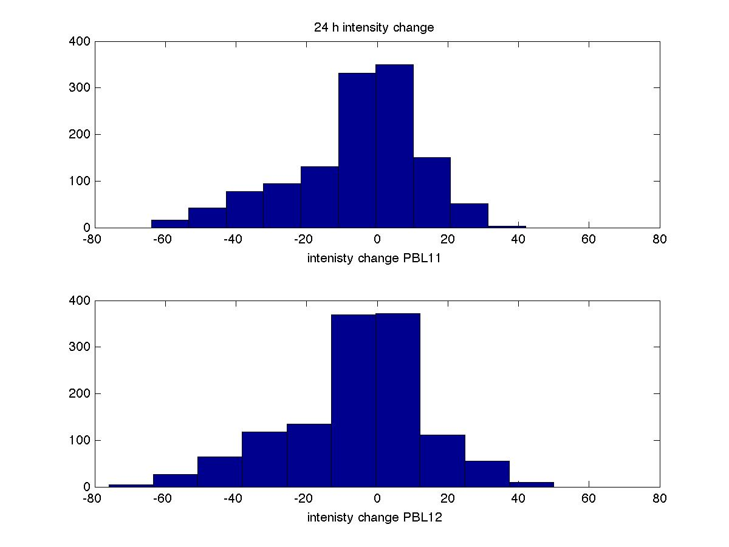
  Goal 3: Improve understanding of physical processes: PBL processes and RI
Impact of vertical eddy diffusivity (K_{m}) on HWRF RI prediction
Radial flow
original K_{m}
PBL11
improved K_{m}
PBL12
observations
Intensity change histogram
24-h intensity change
24-h intensity change
PBL11
RI
9 RI cases
PBL12
RI
40 RI cases
# cases
# cases
using smaller (and more realistic) K_{m} improves inflow depth
smaller K_{m} produces more RI cases
Zhang et al., MWR, 2015 (under review)

