Slide 1

Testing Hurricane WRF with Alternate Radiation and Partial Cloudiness Schemes
Christina R. Holt^{1,2,3}, Greg Thompson^{1,4}, Ligia Bernardet^{1,2,3},
Mrinal Biswas^{1,4}, Craig Hartsough^{1,2,3}
Developmental Testbed Center
NOAA ESRL GSD
CIRES/University of Colorado
National Center for Atmospheric Research

Slide 2
Outline
Background
Experiment configuration
Verification of track and intensity
Verification of large scale fields
Conclusions

Slide 3
DTC’s role in HWRF development: connecting the pieces
2013
DTC tests HWRF w/ RRTMG/Thompson – mixed results w/ degradation in the eastern North Pacific
2014
Fovell (UCLA-DTC visitor) works with DTC to performs diagnostics and suggests improvements to physics that also change storm size, intensity, and motion
DTC performs diagnostics, implements subgrid-scale cloudiness scheme to address lack of shortwave attenuation in RRTMG, and tests in several storms
2015
Physics improvement, RRTMG, and subgrid-scale cloudiness schemes delivered to EMC and included in 2015 pre-implementation test plan
Fovell (UCLA-HFIP award) diagnoses problems with longwave tendencies in HWRF’s operational radiation parameterization (GFDL scheme)
EMC tests RRTMG – poor results for bundled tests
Notes:
What do you think of this slide instead of previous one? A bit more visual?

Slide 4
Background
The investigation of DTC tests revealed two important deficiencies of the configuration of the RRTMG radiation scheme used in those experiments
  Only explicit clouds from the mp scheme are visible to the RRTMG – subgrid cumulus clouds (from SAS) are transparent
  Under representation of stratus clouds in coarse resolution (horizontal and vertical) outer domain
DTC worked to implement a scale-aware partial cloudiness scheme for RRTMG
  By Sundqvist et al. (1989 ), tested by Mocko and Cotton (1995)
  Simulates liquid- and ice-water content based on humidity and temperature to represent a “cloud” with radiative properties

Slide 5
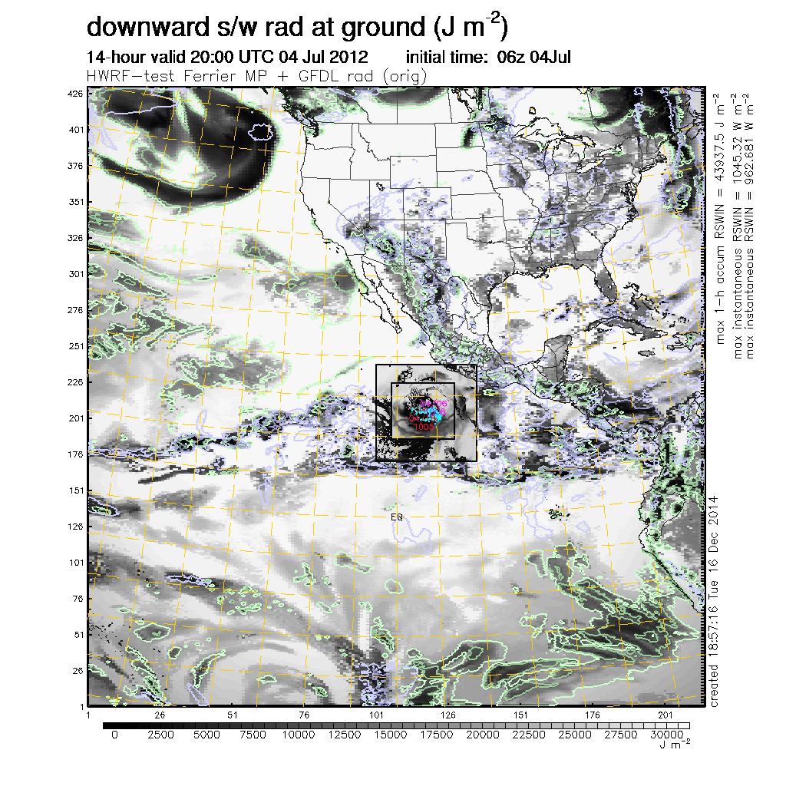
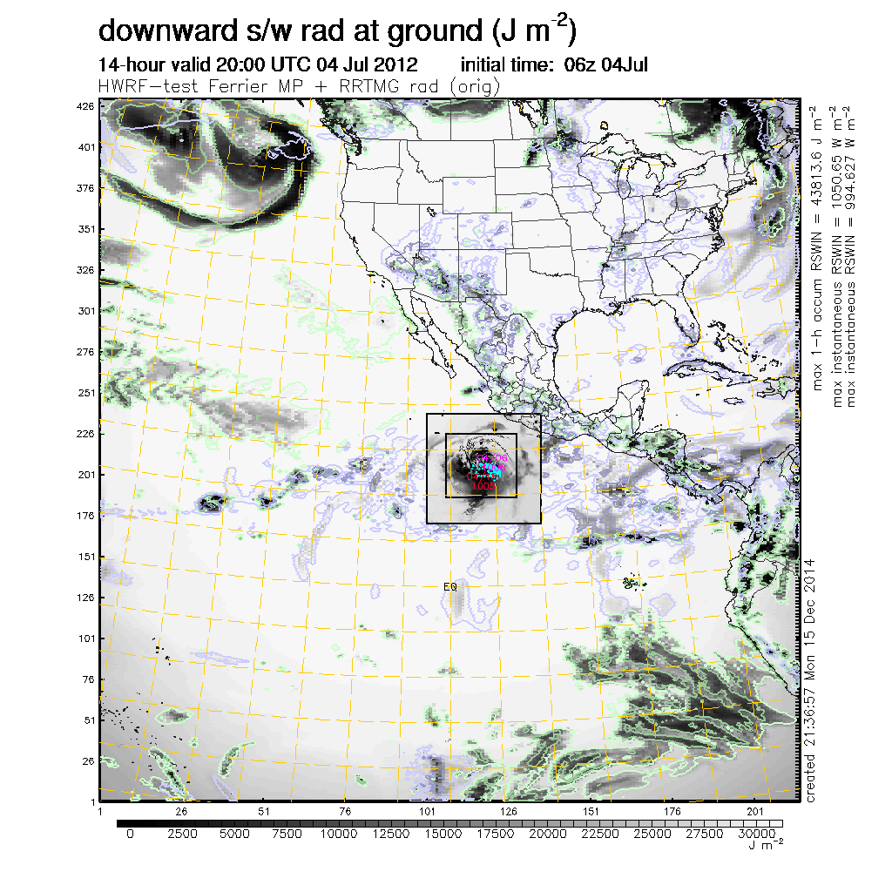
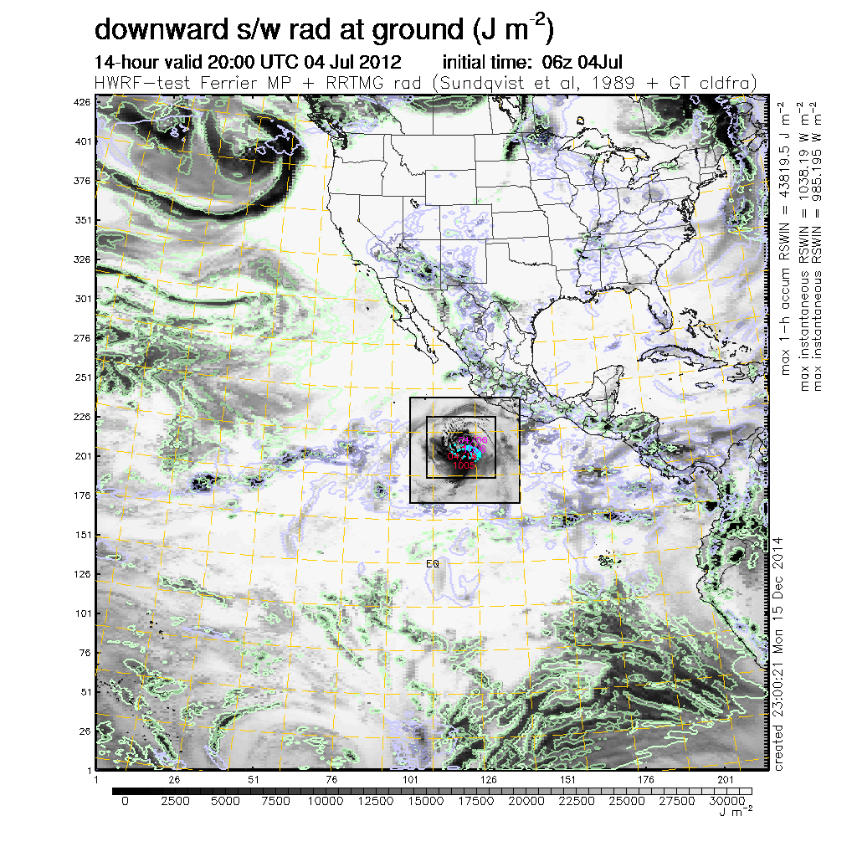
Addressing issues in RRTMG-cloud connection
Ferrier/GFDL radiation
Ferrier/RRTMG radiation
Ferrier/RRTMG/part cloud
Control: Reasonable SW attenuation but documented problems in LW
Excessive SW radiation reaching surface: SAS clouds transparent to RRTMG radiation and lack of stratus representation
Reasonable SW attenuation with partial cloudiness scheme implemented by DTC
Notes:
Left: The SW radiation reaching the ground for the operational HWRF physics (Fer+ GFDL rad) seems reasonable.
Right: When Fer+RRTMG is used, the SW at the ground is unrealistic. SW is attenuated by explicit clouds (shown as green contours for liquid water and blue contours for solid water). But SW is not attenuated over the large areas in the Pacific where there are no explicit clouds, only convective SAS clouds (not shown).
Disabling convective cloud influence for GFDL results in SW radiation at the ground is similar to RRTMG – confirming RRTMG is not responding to the SAS clouds.
The gray shades in d01 are 1-h accumulated SW radiation on the ground. The d02 and d03 are showing the instantaneous RSWIN value and are scaled 0 to 1100 W/m2 (roughly max) using the same color scale as bottom of graphic and its done with linear scale. So there should NOT be an identical match in color between d01 and the nests.

Slide 6
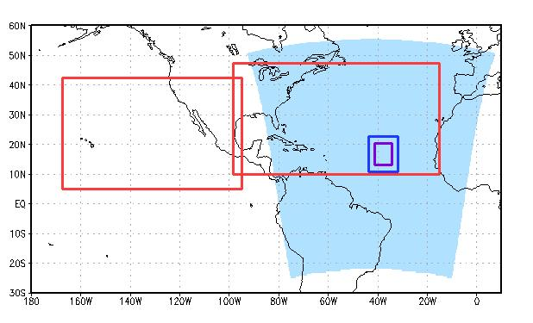
Configuration
ATL Ocean Domain
9 ATL Storms
101 Cases
EP Ocean Domain
9 km
1/16°
3 km
27 km
Ops Suite
 | HDGF | HDRF
Microphysics | Ferrier | Ferrier
Radiation | GFDL | RRTMG
Rad. Δt | 1 hour | 15 mins
Partial Clouds | no | yes
Convection | SAS | SAS
PBL/Sfc Layer Phys | GFS/GFDL | GFS/GFS
9 EP Storms
97 Cases

Slide 7
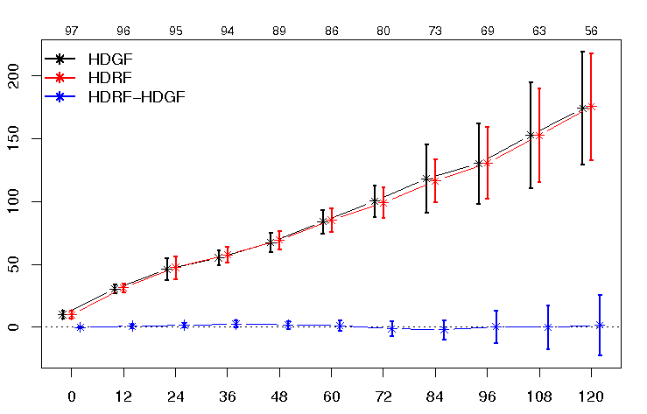
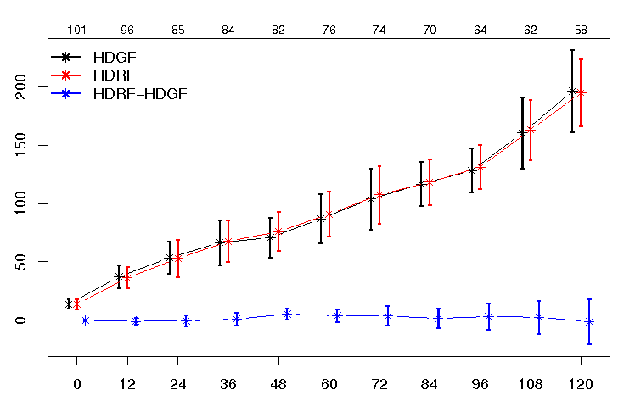
EP Track Error
AL Track Error
97 96 95 94 89 86 80 73 69 63 56
101 96 85 84 82 76 74 70 64 62 58
HDGF
Distance (km)
HDRF-HDGF
HDRF
+ better HDGF
- better HDRF
Neutral track impact for both basins

Slide 8
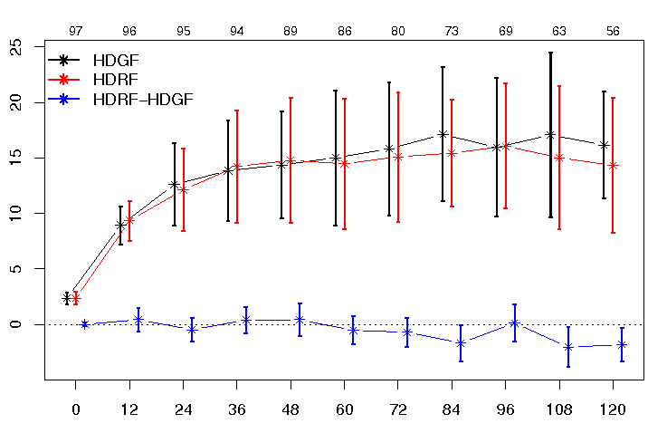
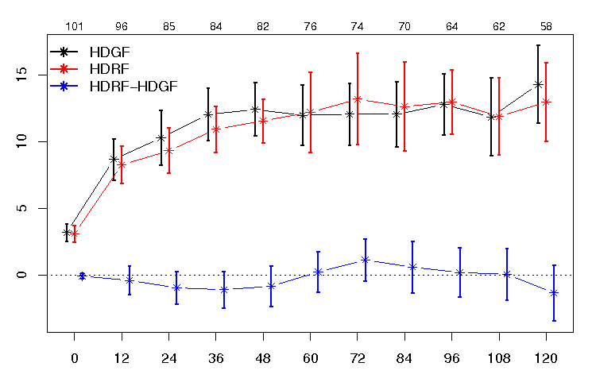
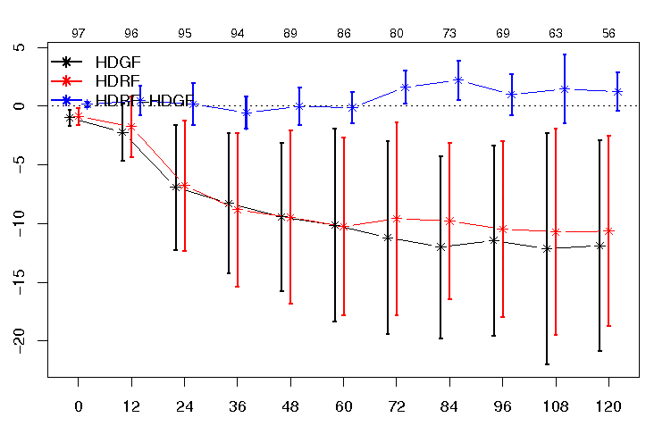
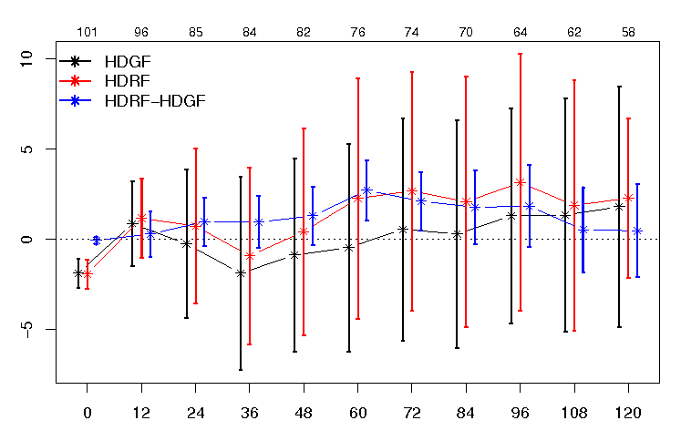
EP Intensity Error
AL Intensity Error
97 96 95 94 89 86 80 73 69 63 56
101 96 85 84 82 76 74 70 64 62 58
HDGF
Max Wind (kt)
Max Wind (kt)
+ better HDGF
- better HDRF
HDRF
EP Intensity Bias
AL Intensity Bias
97 96 95 94 89 86 80 73 69 63 56
101 96 85 84 82 76 74 70 64 62 58
Max Wind (kt)
Max Wind (kt)
+ stronger HDRF
- stronger HDGF

Slide 9
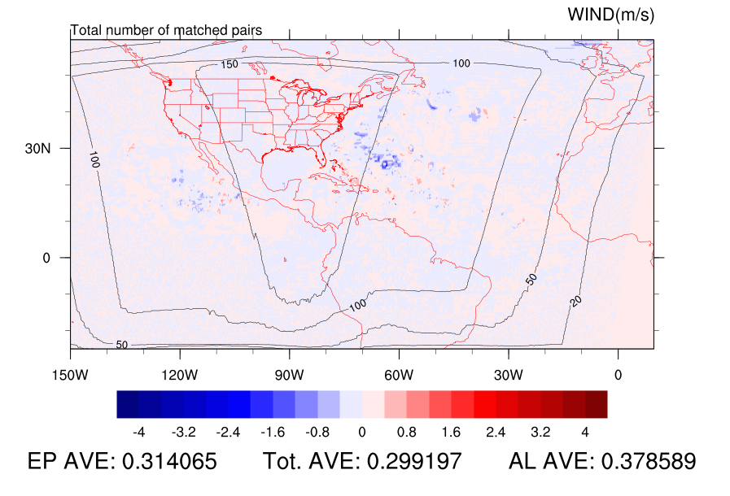
Mega Domain
0.25°× 0.25°
Verification against GFS Analysis

Slide 10
Mega Domain
HDRF –HDGF Bias
Mega Domain
HDGF Bias
Experiment has higher heights aloft, lower heights a low levels
HGT
Too low at upper levels and too high at low levels
Pressure Level (hPa)
TMP
Experiment is warmer
Pressure Level (hPa)
Less warm, more humid at 850
Too cold and humid in lower troposphere
Pressure Level (hPa)
RH
Forecast Hour
Forecast Hour
Notes:
Experiment is decreasing static stability at near the surface and in middle troposphere.

Slide 11
RMSE Percent Error
Mega Domain
Height is improved at upper levels and 1000 hPa, but degraded in mid trop.
HGT
Control Error – Experiment Error
Control Error
Mid tropospheric Temp is degraded
TMP
Low-level heat and moisture are improved
RH

Slide 12
EP Area
ATL Area
Percent Error
HGT
More improvement, or less degradation in EP than ATL
TMP
RH

Slide 13
HDGF BIAS
HDRF BIAS
HDGF RMSE
DIFF RMSE
(HDGF-HDRF)

Slide 14
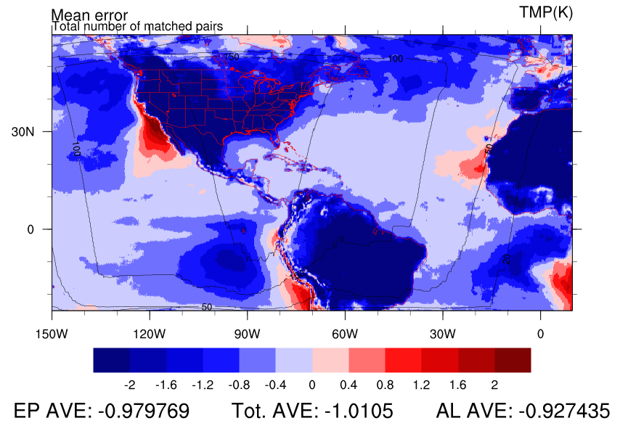
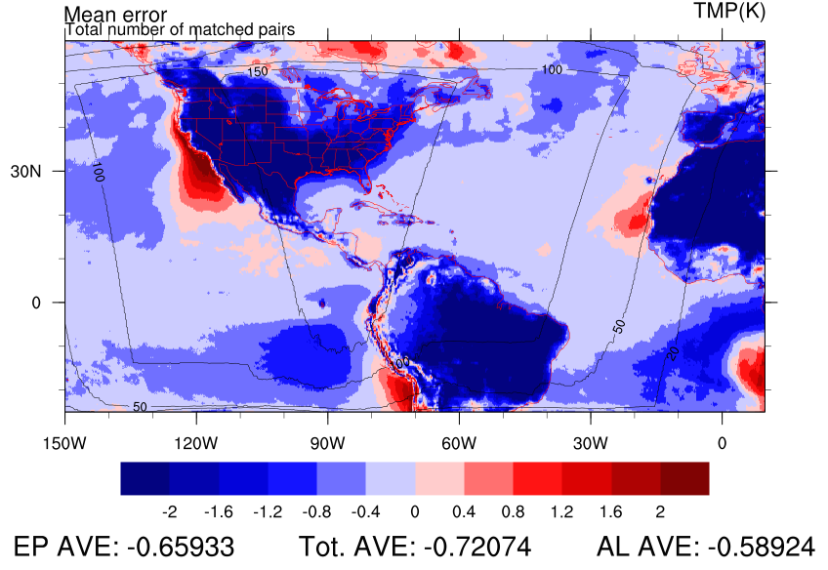
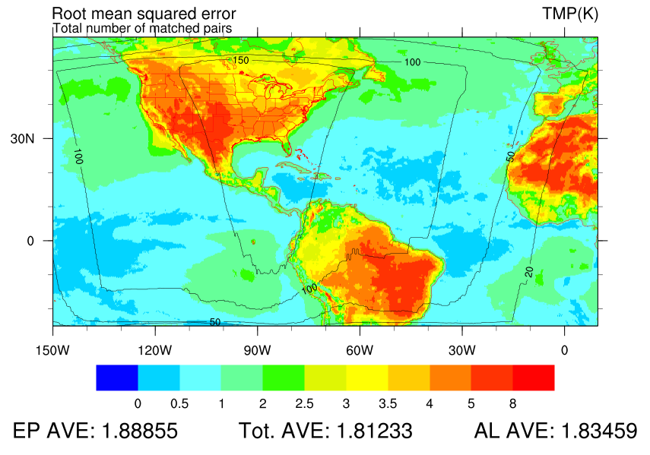
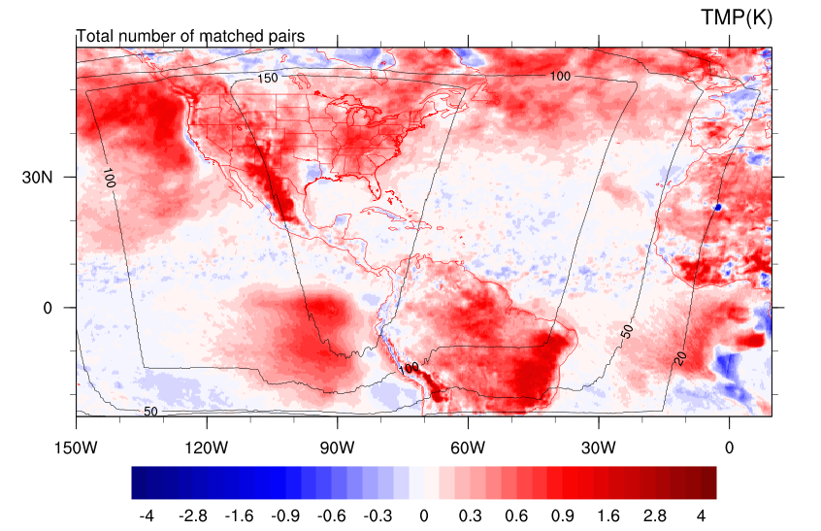
1000 hPa Temp (K)
HDGF BIAS
HDRF BIAS
HDRF improves low-level temp
HDGF RMSE
DIFF RMSE
HDRF Degrades HDRF Improves
Notes:
Negative bias in general.
Off west coasts of NA and SA where stratus decks set up

Slide 15
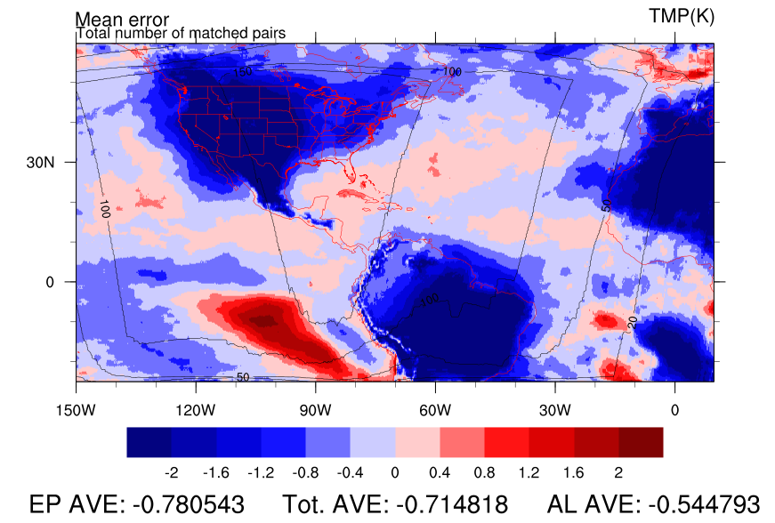
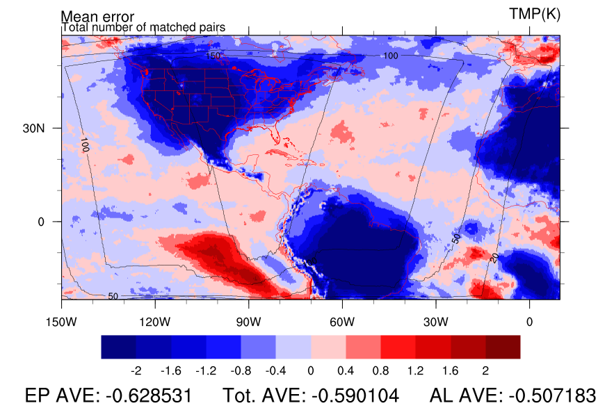
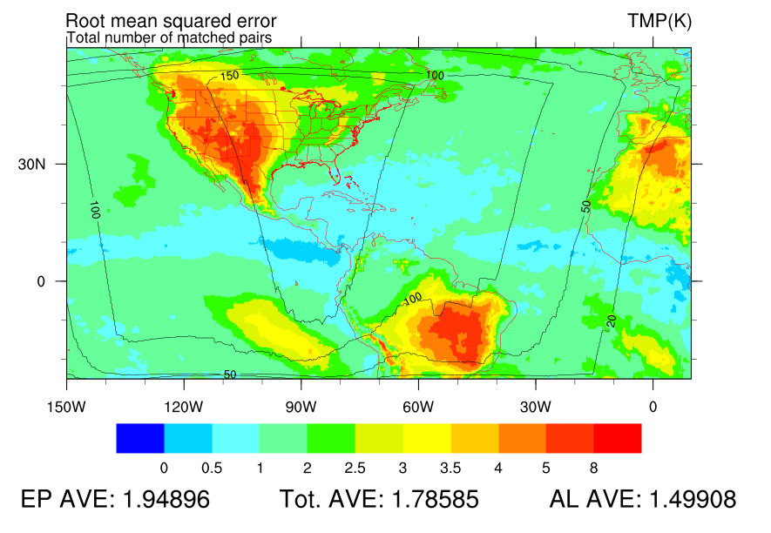
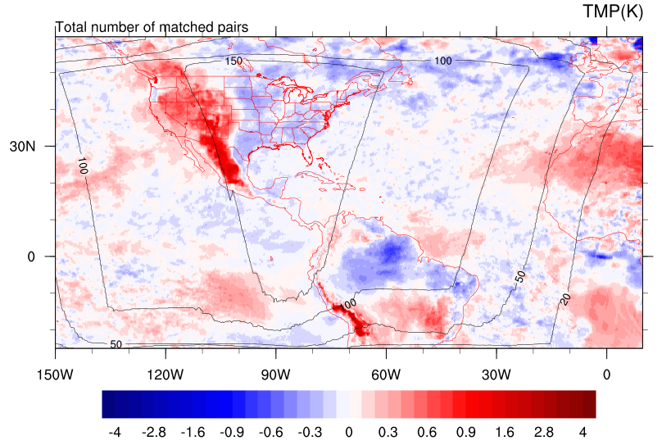
850 hPa Temp (K)
HDGF BIAS
HDRF BIAS
HDGF RMSE
DIFF RMSE
HDRF Degrades HDRF Improves

Slide 16
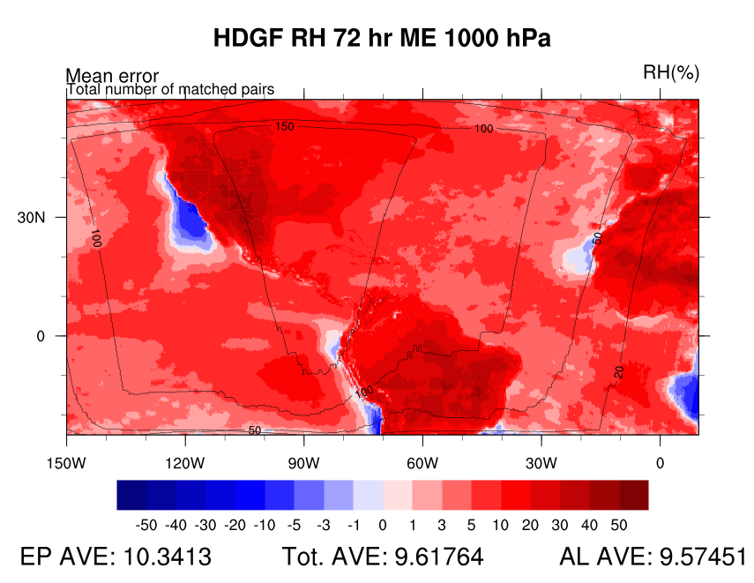
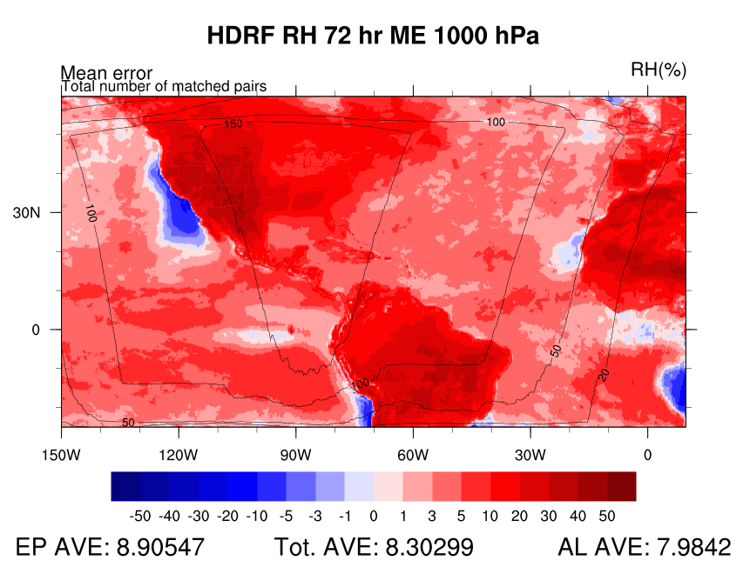
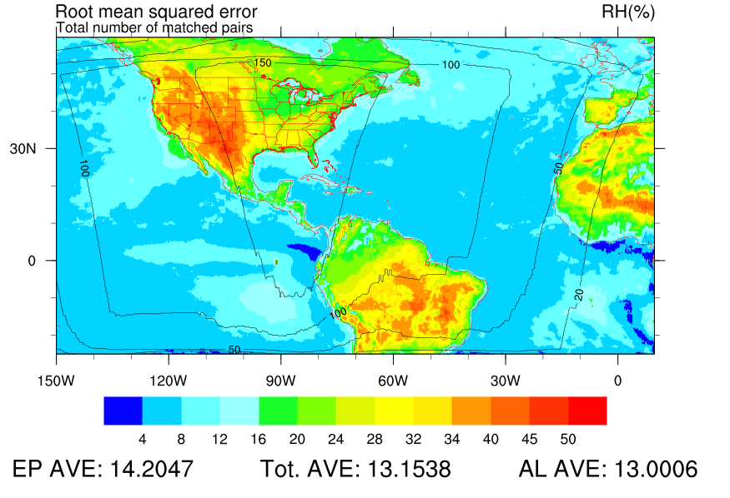
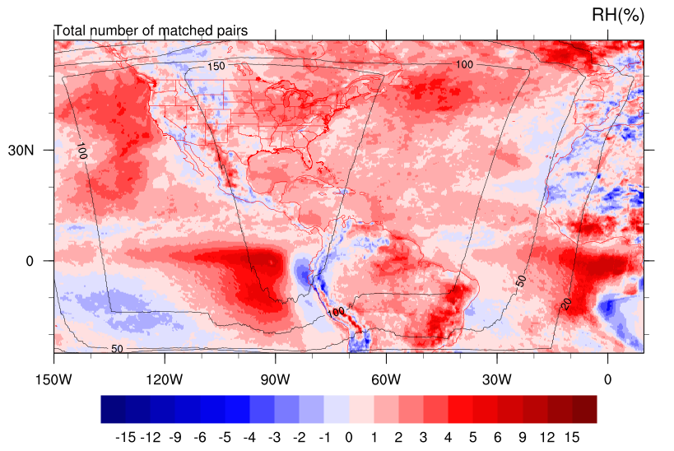
1000 hPa RH (%)
HDGF BIAS
HDRF BIAS
HDRF improves low level RH nearly everywhere by decreasing RH
HDGF RMSE
Improvement
DIFF RMSE
HDRF Degrades HDRF Improves

Slide 17
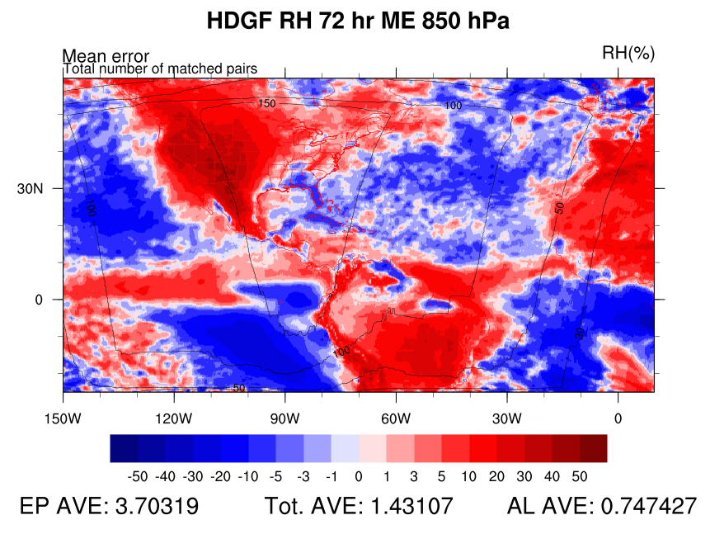
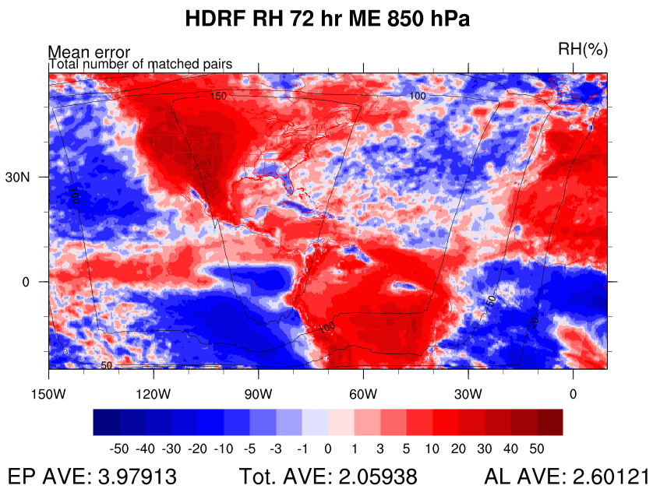
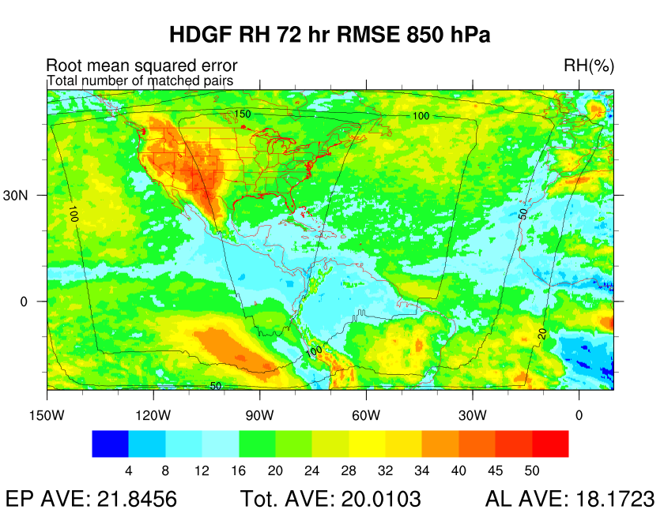
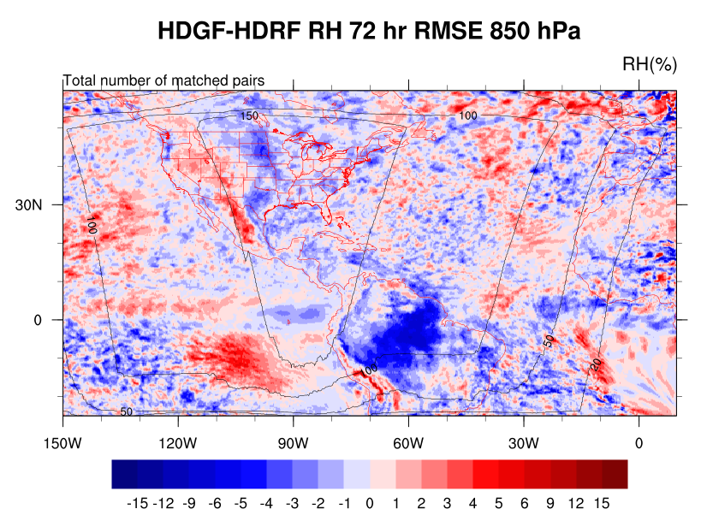
850 hPa RH (%)
HDGF BIAS
HDRF BIAS
HDGF RMSE
HDRF Improves moisture in EP
DIFF RMSE
HDRF Degrades HDRF Improves
Notes:
The experiment improves the drastic difference between 1000 and 850 of west coasts

Slide 18
Conclusion
HWRF was tested with an alternate radiation package, exchanging the GFDL radiation scheme for the RRTMG scheme, partial cloudiness, and a more frequent physics time step
TC intensity forecasts improved very slightly in HDRF at longer lead times in the EP, and had mixed results for ATL storms
TC track forecasts were left virtually unchanged from the control experiment

Slide 19
Conclusion
Large scale verification shows the greatest sensitivity in low level heat and moisture fields, which may play a major role in the improved intensity forecasts
The experiment had fairly neutral impacts except in the lowest levels for temperature and RH, while height at most levels was better in the control
We expect that the HDRF cloud structure is more realistic and will continue with further diagnostic
…RRTMG with partial cloudiness was delivered to EMC and is being tested for 2015 implementation

