Slide 1
Demonstration Testbed for the Evaluation of Experimental Models for Tropical Cyclone Forecasting in Support of the NOAA Hurricane Forecast Improvement Project (HFIP)
Paul A. Kucera, Barb G. Brown, Christopher L. Williams, and Louisa Nance
NCAR/Research Applications Laboratory
69th Interdepartmental Hurricane Conference
Jacksonville, FL
03 March 2015

Slide 2
Hurricane Forecast Improvement Project (HFIP)
HFIP was created to provide a framework for NOAA and other agencies to coordinate hurricane research into operations
HFIP overarching goals:
  Improve the accuracy and reliability of hurricane forecasts
  Extend lead time for hurricane forecasts with increased certainty
  Increase confidence in hurricane forecasts
HFIP specific goals:
  Reduce the average errors of hurricane track and intensity forecasts by 20% within five years and 50% in ten years with a forecast period out to 7 days

Slide 3
HFIP Research to Operations (R2O) Process
HFIP process to bring Research to Operations (R20) is conducted through annual testing and evaluation
Stream 2 | Experimental NWP models that have new research enhancements for tropical storm forecasting Evaluation of forecast systems occurs during the annual HFIP Demonstration Study (Aug-Oct)
Stream 1.5 | Experimental models have shown improved compared to current operational models that are available at the National Hurricane Center (NHC) Models are evaluated during the annual HFIP retrospective experiment (Apr-May) using observed tropical cyclones (TC) for the past 3 hurricane seasons Forecasts are available in real-time during hurricane season
Stream 1 | This is last step of transitioning new research capabilities to operations (R2O) Includes new or improved operational NWP systems
Notes:
-.

Slide 4
Tropical Cyclone Modeling Team (TCMT)
Tropical Cyclone Modeling Team:
  Serves as the honest broker for verification for the Hurricane Forecast Improvement Project (HFIP) by providing independent, consistent testing / evaluation of experimental models
  Provides a testbed for the HFIP community to evaluate new experimental model capabilities to improve TC forecasting
  Develops new verification methods and metrics to help NHC choose which models will be in the operational suite each year
  A main goal of the TCMT is to support of HFIP’s effort to transition new tropical cyclone research capabilities into operations (R2O) through testing, evaluation, and new method development

Slide 5

Model Evaluation Tools-Tropical Cyclone (MET-TC)
Replicates functionality of the current NHC verification software
Provides flexible framework for performing evaluations without needing to reprocess data for different aggregations
Modular set of tools that utilize the MET software framework
  Allows for additional capabilities and features to be added in future releases
MET-TC is available as an open source community verification package through the Developmental Testbed Center (DTC):
  http://www.dtcenter.org/met/users/
MET-TC used for TCMT evaluations: graphics scripts provided in community release

Slide 6
New Display and Diagnostic Tools
TCMT is building the next generation display and diagnostic system for the U.S. National Hurricane Center (NHC) and for the hurricane community
Display is developed using modern and flexible methods:
  OpenLayers Mapping tools
    Platform independent, no license requirements
  MySQL database
Diagnostic evaluation tools
Consensus forecasts
Future capabilities
  Gridded fields
    Forecast products
    Satellite observations

Slide 7
Interactive Capabilities

Slide 8
Interactive Capabilities

Slide 9
Multi-Model Display
Able to modify display of specific models or groups of models
Click for popup with more information at a given forecast time
Ability to zoom and pan domain

Slide 10
Intensity display

Slide 11
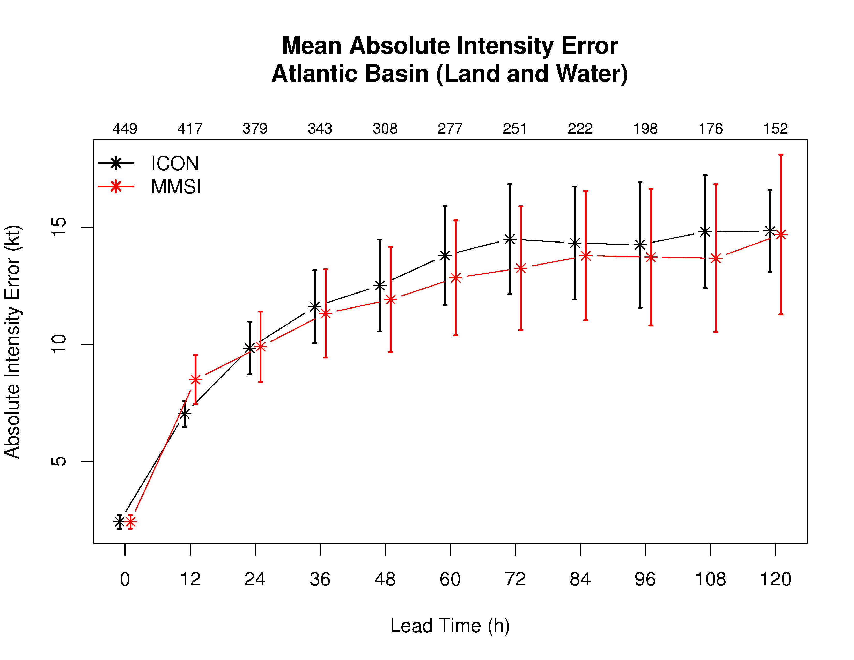
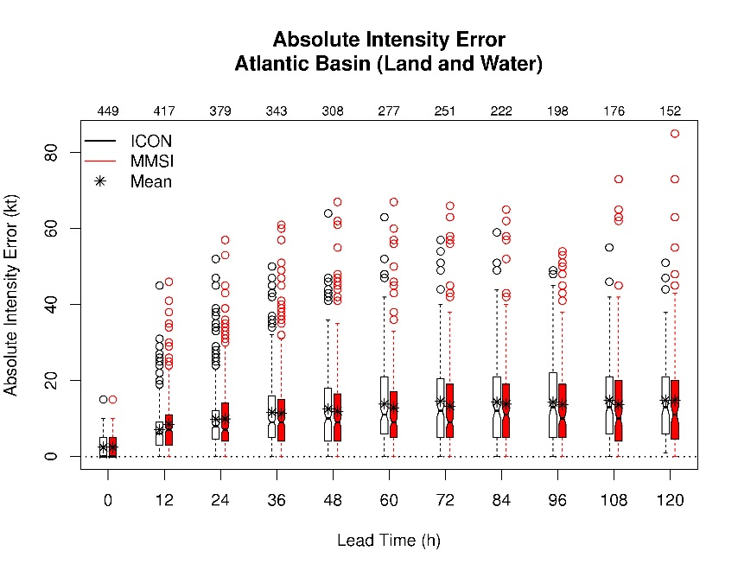
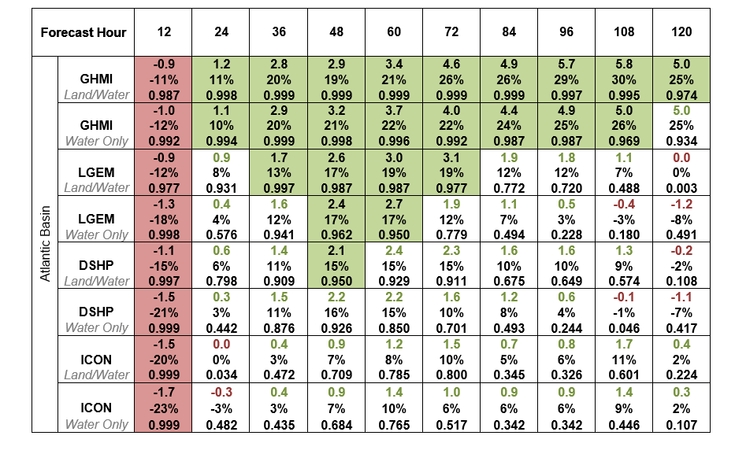
Example Statistical and Diagnostic Evaluation Results
Distribution of Errors
Mean Error Comparison
S
Statistical Significance Evaluation
(green – improvement; red – degradation)

Slide 12
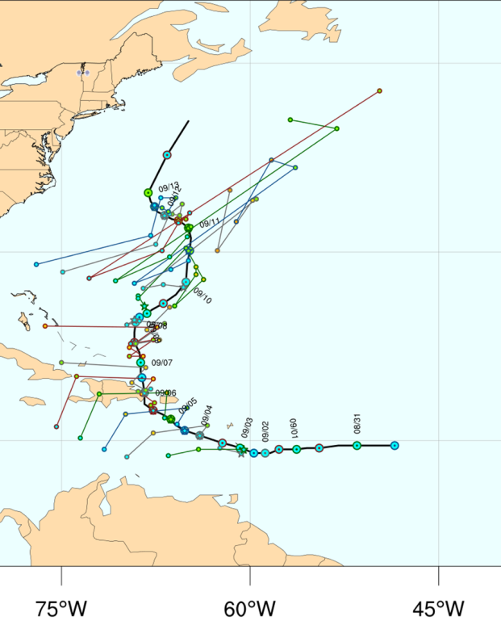
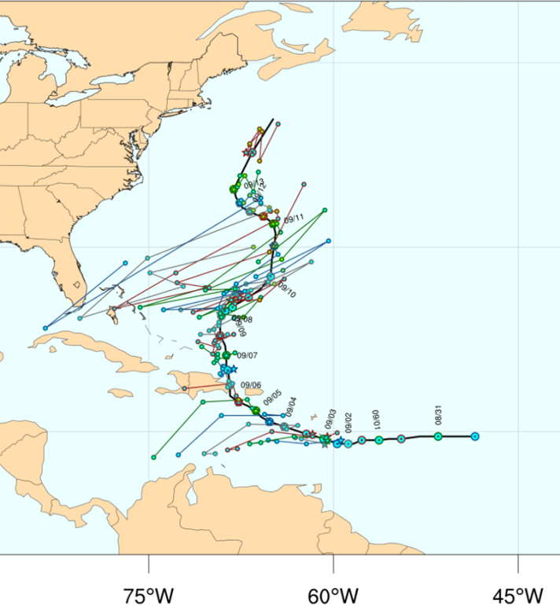
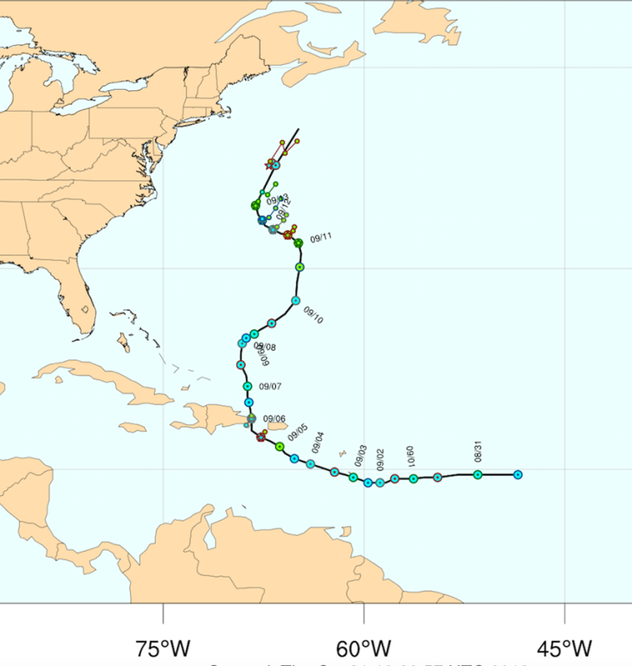
Diagnostic Evaluation: Revision Series
Model A
Model B
Official forecasts
Inconsistent
adjustments
Consistent adjustments
Provides a method to examine forecast consistency
Provides evaluation of whether forecast errors are random or consistent across each new forecast cycle for a valid time
Developing summary measures for these series
Notes:
Hurricane Gabrielle

Slide 13
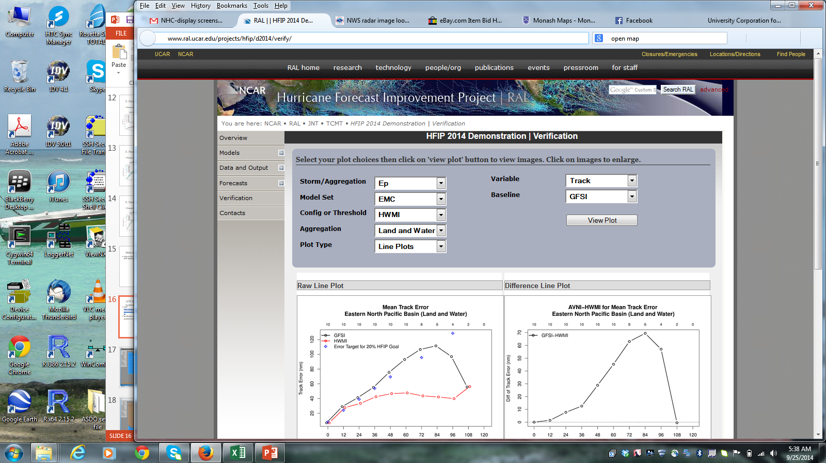
HFIP Demonstration Evaluation Approach
The HFIP Demonstration Experiment is conducted for storms observed in the Atlantic and Eastern North Pacific Basins during the experimental period of 1 August – 31 October
Stream 2, stream 1.5, and operational forecasts are evaluated in near real-time and post-season assessment
Evaluation studies are conducted using the MET-TC statistical and diagnostic tools
http://www.ral.ucar.edu/projects/hfip/d2014/verify/

Slide 14
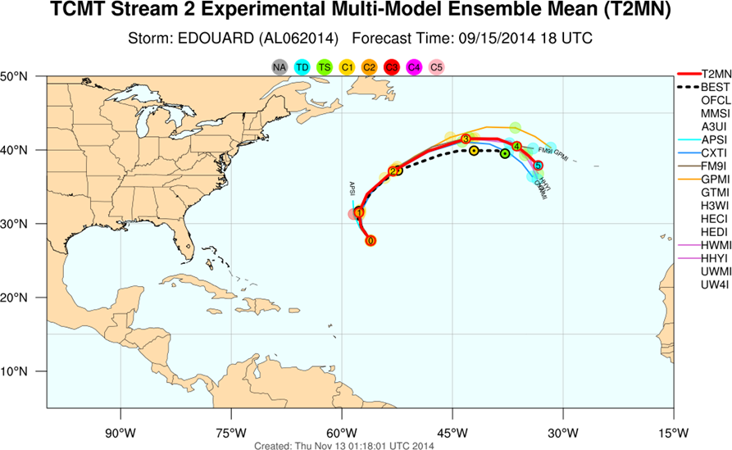
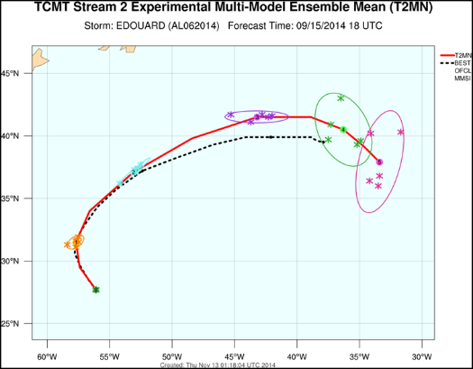
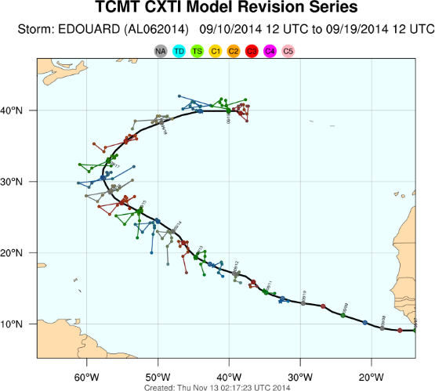
2014 HFIP Demonstration Participants
Stream 1.5
NRL: CXTI
  intensity, intensity consensus
GFDL: GPMI
  Track, Track Consensus, Intensity, Intensity Consensus
U Wisconsin: UW4I
  Intensity consensus
CIRA: SPC3
  Intensity
Stream 2
GSD: FM9I
U. Utah: A3UI
PSU: APSU, PnnI (nn=01, …, 10)
GFDL: GTMI
HRD: H3WI, HECI, HEDI
EMC: HWMI
UW-Madison: UWMI
FSU: MMSI
A total of 12 configurations were evaluated for the 2014 HFIP Demonstration

Slide 15
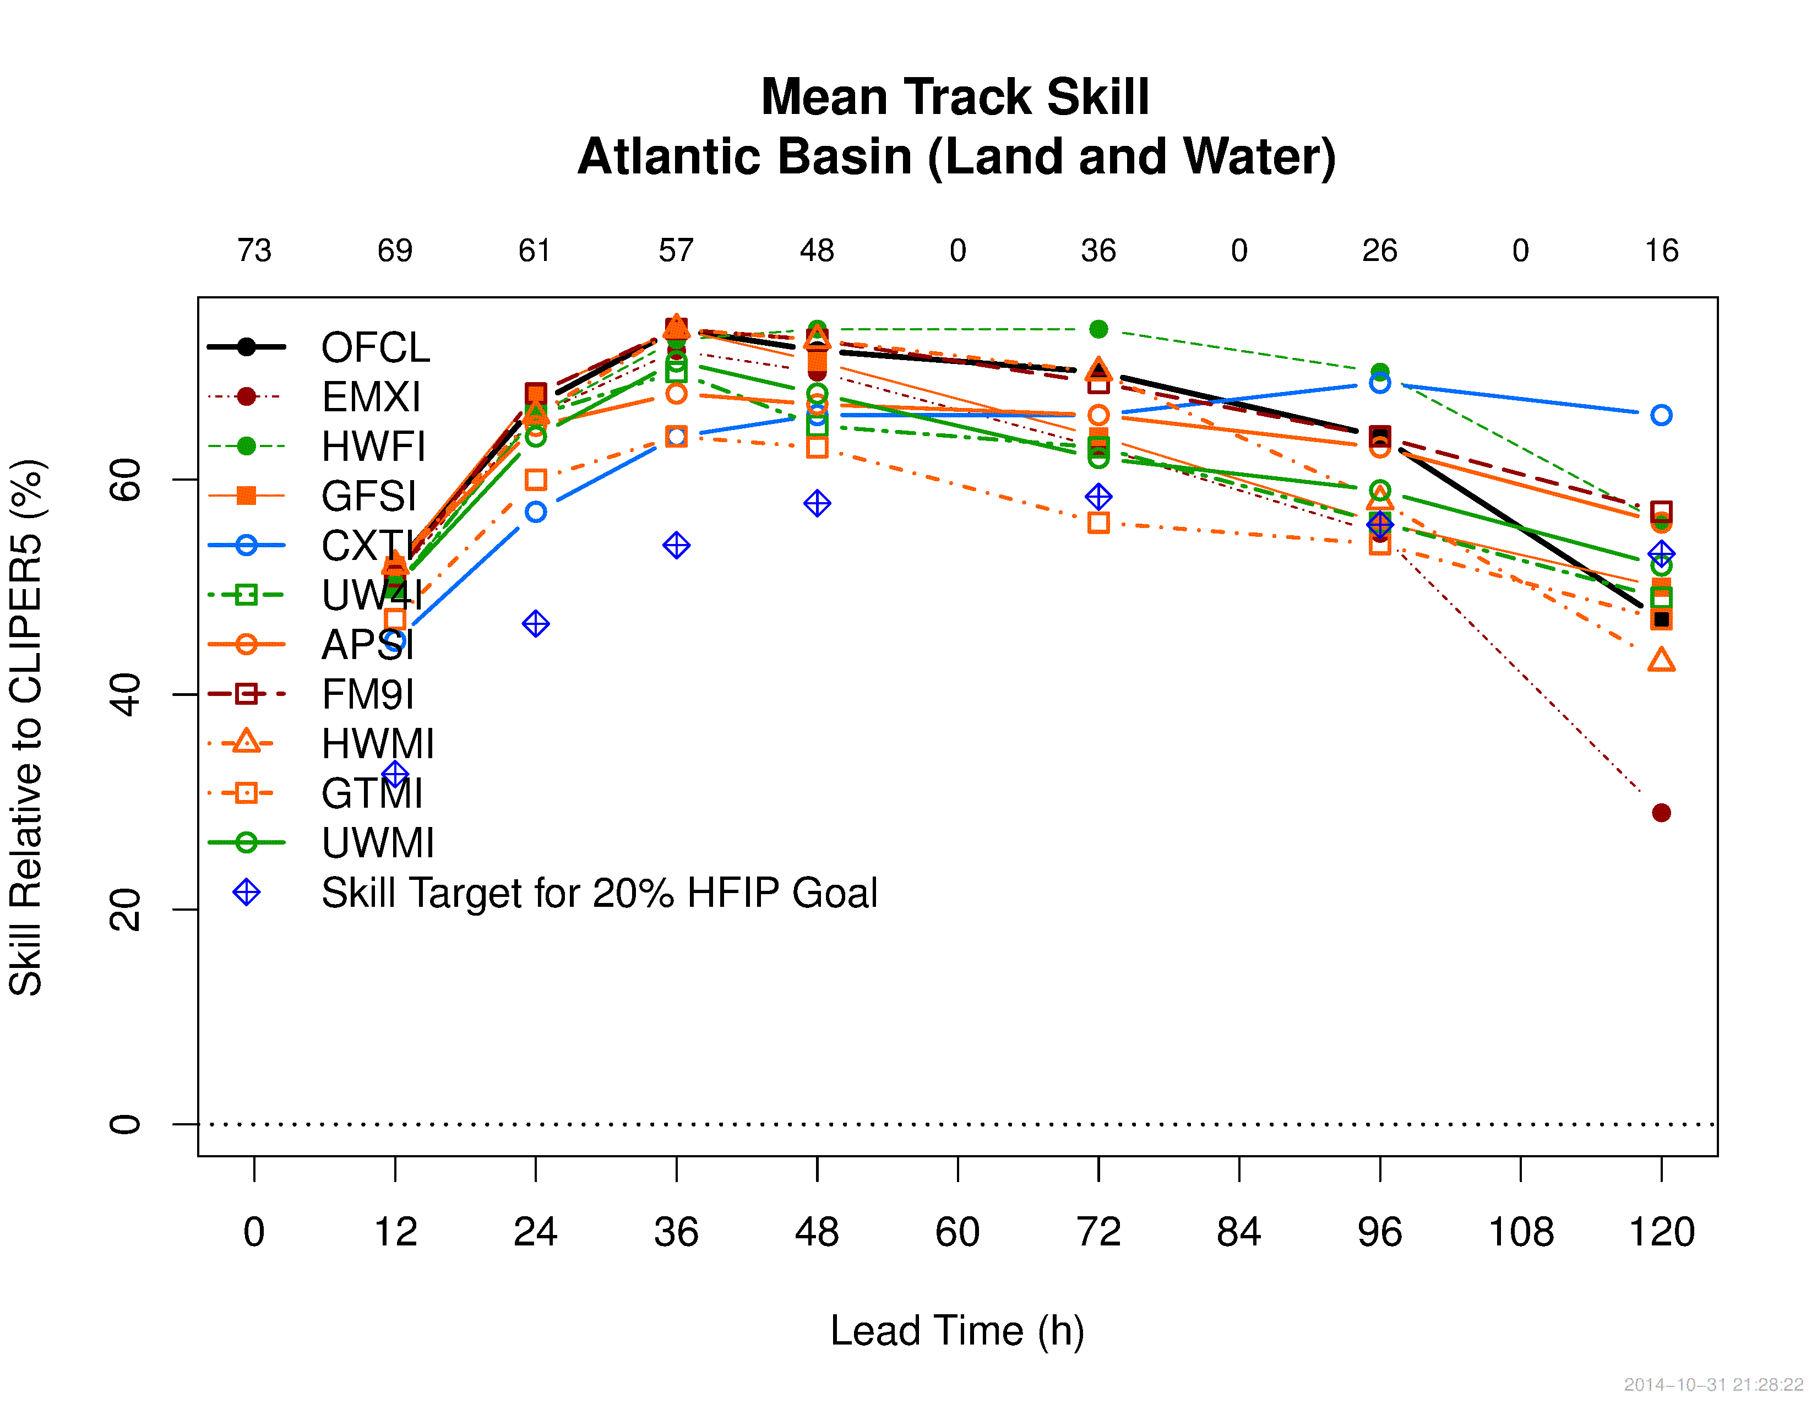
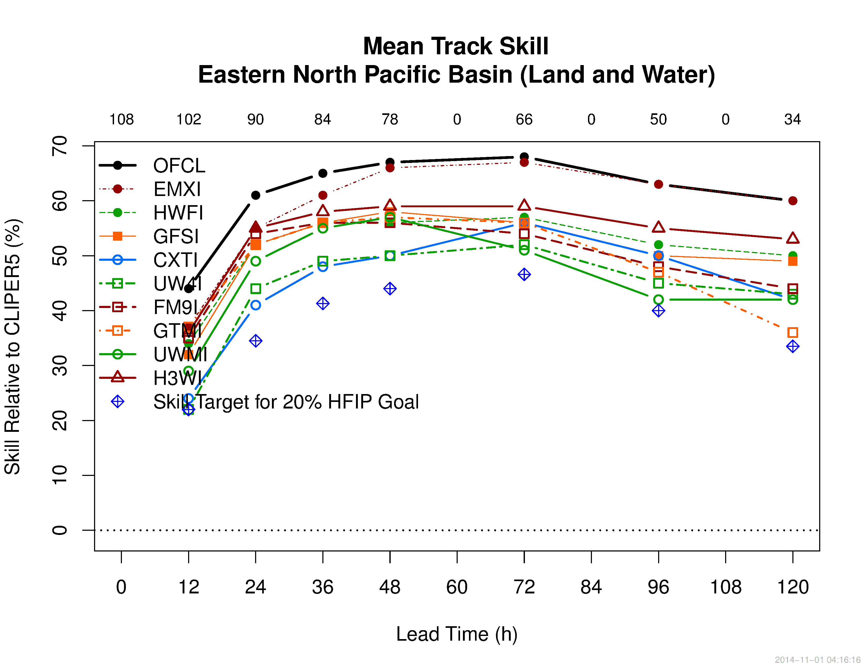
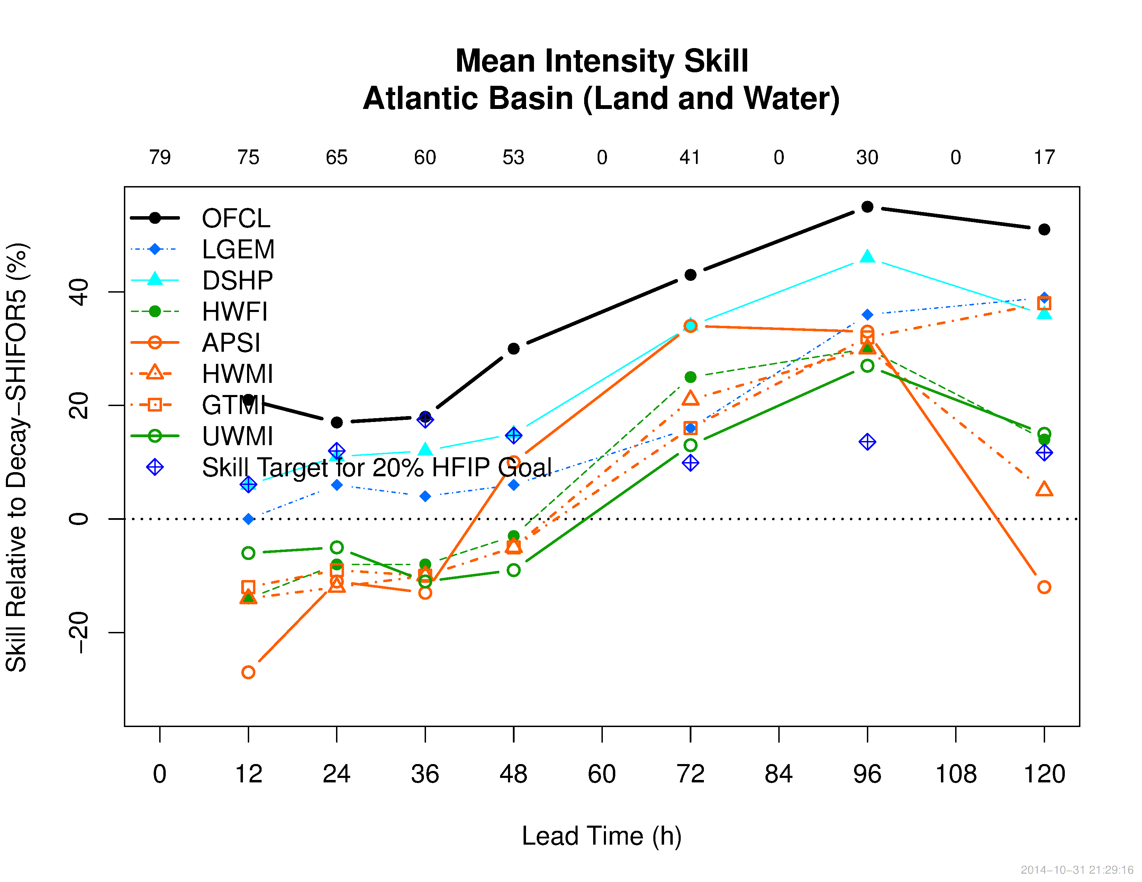
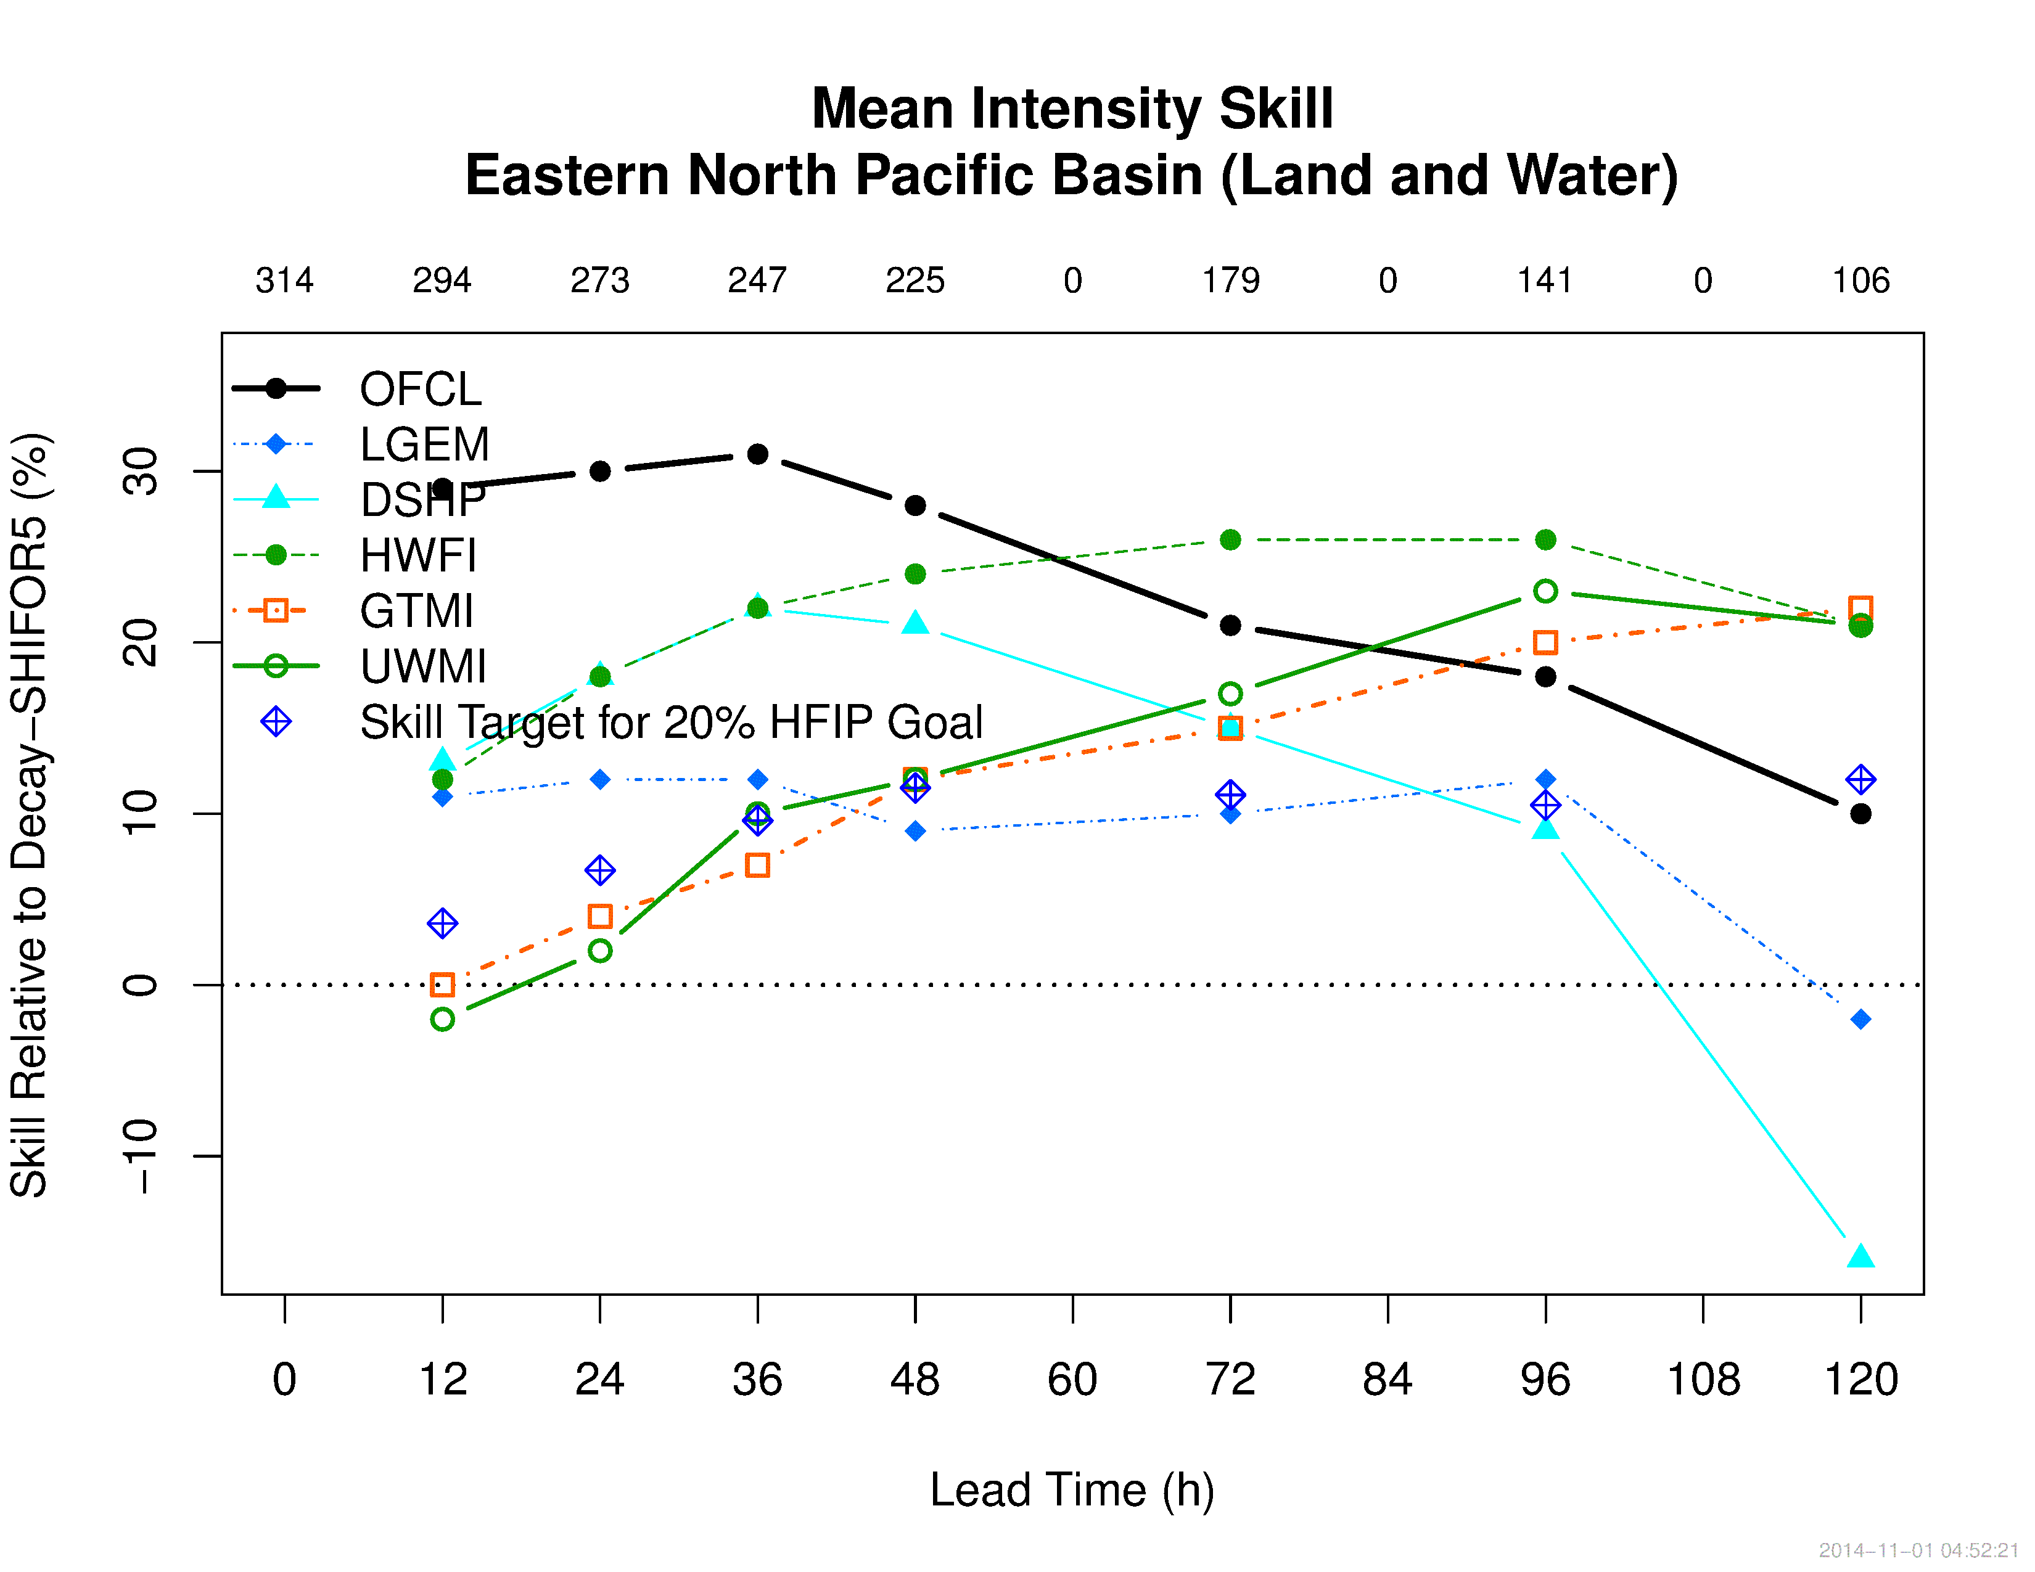
2014 Demonstration Summary
Atlantic Basin
Eastern Pacific Basin
Summary
AL Basin:
  Track - HWRF and FIM configurations show highest skill; HFIP 5-yr skill goal surpassed for most models
  Intensity – Statistical model, SHIPS, shows highest model skill
EP Basin:
  Track - HWRF Basin Scale shows highest skill after ECMWF; HFIP 5-yr skill goal surpassed for most models
  Intensity - HWRF displays highest model skill

Slide 16
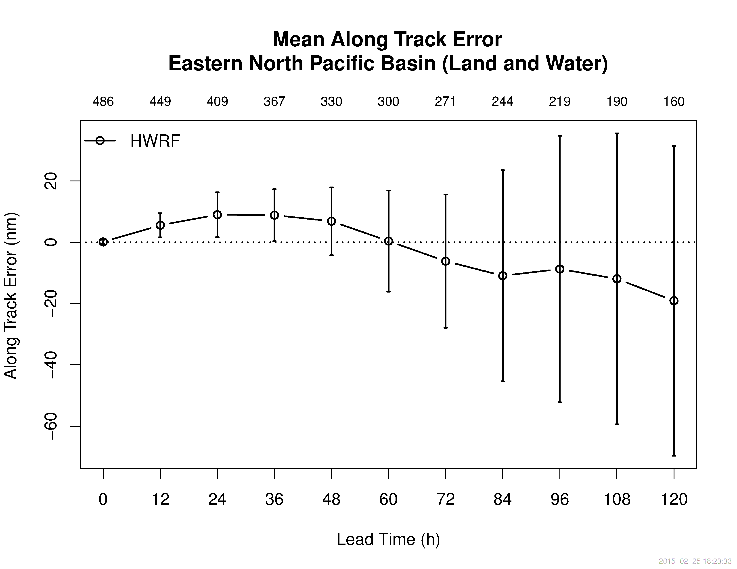
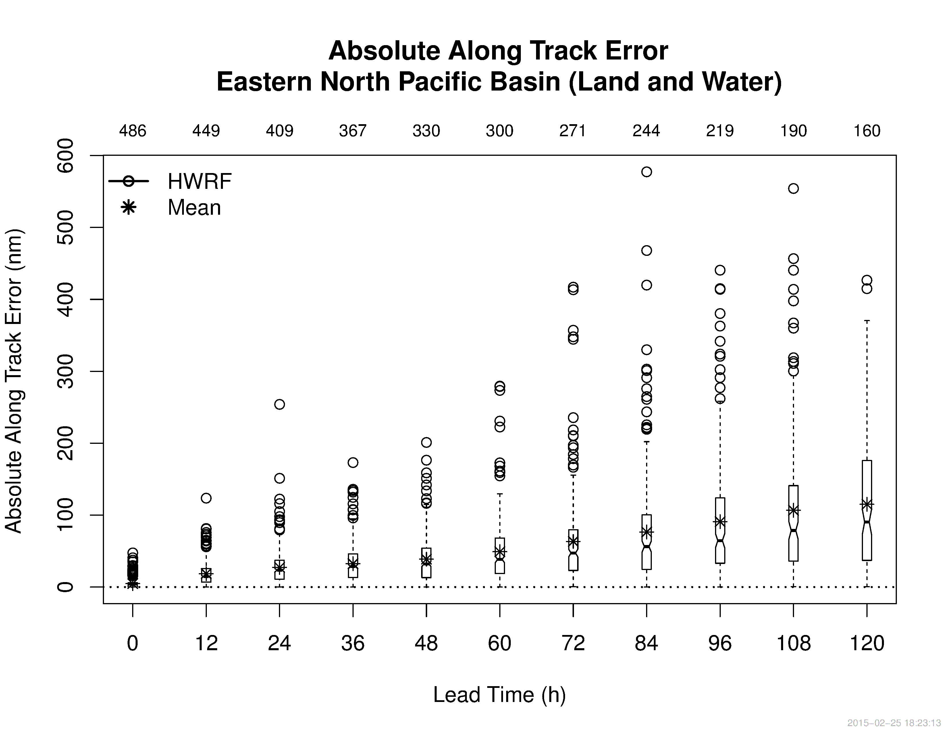
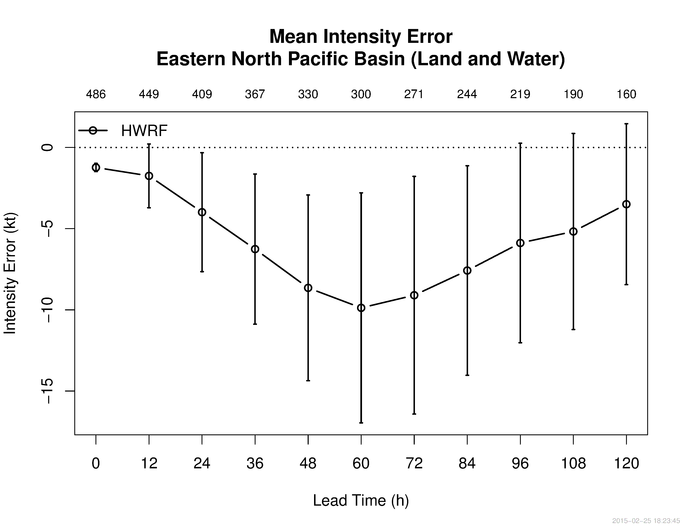
2014 HFIP Demonstration Diagnostic Evaluation
Diagnostic evaluation is ongoing to understand the source of both outliers and trends in forecast track and intensity

Slide 17
Summary
TCMT
  Provides independent, consistent, testing / evaluation of experimental models
  Develops new verification methods and metrics
  Supports the transition of research enhancements to operations through testing and evaluation
Methods developed for HFIP evaluations are useful for other types of evaluations
  Evaluate model improvements with time
  Compare alternative modeling systems (e.g., impacts of parameterizations, observations)
New methods could be applied to other global basins
  Testbed framework available to evaluate TC forecast systems in other global basins

Slide 18
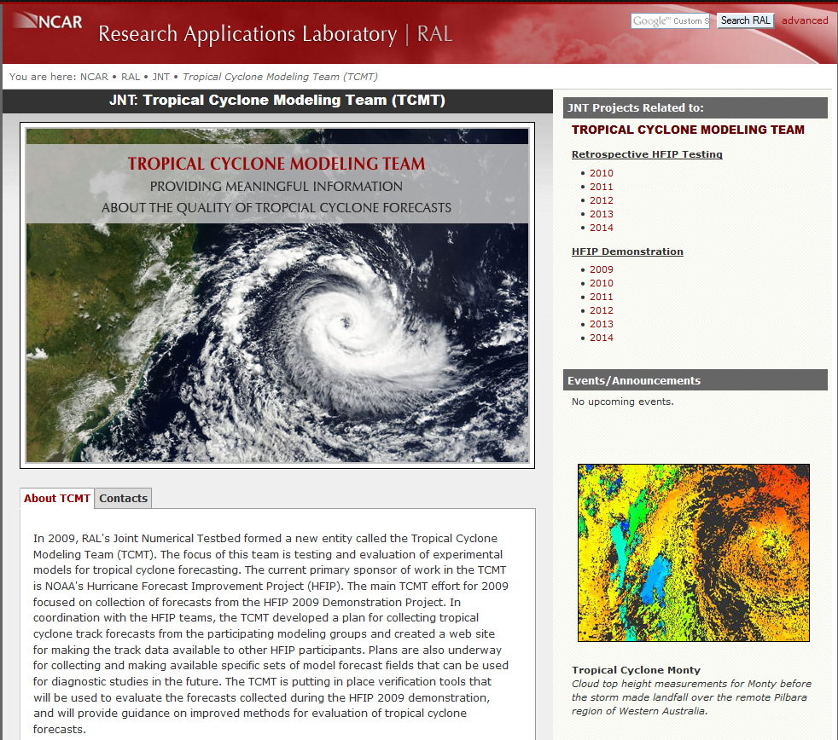
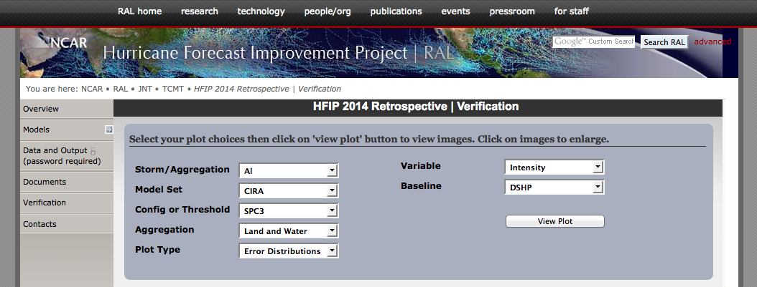
Web Resources
2014 HFIP Retrospective Results
http://www.ral.ucar.edu/jnt/tcmt/
http://www.ral.ucar.edu/projects/hfip/h2014/verify/
2014 HFIP Demonstration Results
http://www.ral.ucar.edu/projects/hfip/d2014/verify/

