Slide 1
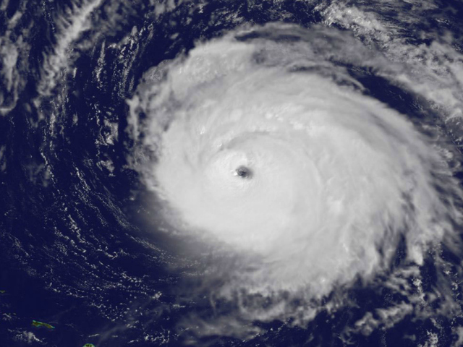
Upgrades to the GFDL/GFDN Operational Hurricane Models Planned for 2015
(A JHT Funded Project)
Morris A. Bender, Matthew Morin, and Timothy Marchok (GFDL/NOAA)
Isaac Ginis and Biju Thomas (University of Rhode Island)
Robert E. Tuleya (Old Dominion University)
69th Interdepartmental Hurricane Conference
Jacksonville, Florida, March 3rd ,2015

Slide 2
Summary of Proposed Upgrades
Upgraded version of GFS
Increase of vertical sigma levels from 42 to 60
Similar Configuration to HWRF levels
Improved Initialization of Moisture Field (r)
Using improved moisture specification:
reintroduction of Vortex Specification for all storms (e.g. TD, and weak TS) except Nameless systems
New Specification of Storm size (Rb)
Modified filter depth in vortex specification (Tested, but rejected due to unfavorable impact)
Modified criterion for large-scale condensation
Bug Fix in GFDL coupler
Bug Fix in Surface Current Specification

Slide 3
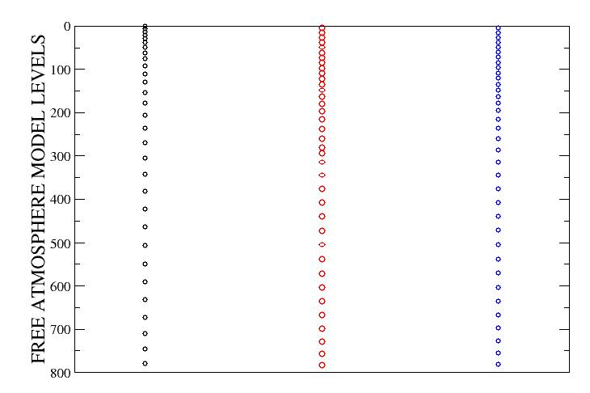
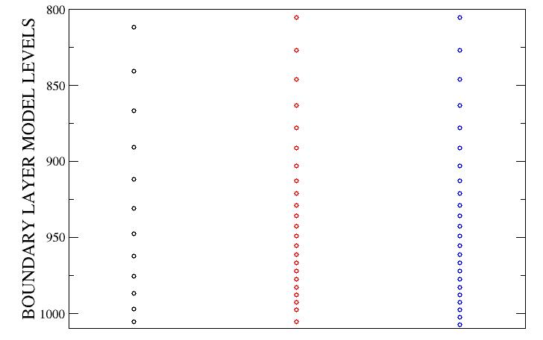
VERTICAL LEVEL CONFIGURATION
42 Level GFDL 60 Level GFDL 60 Level HWRF

Slide 4
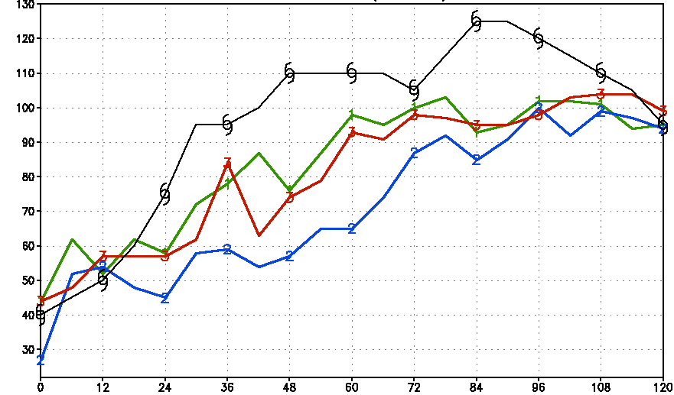
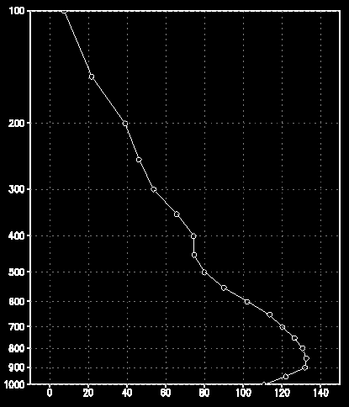

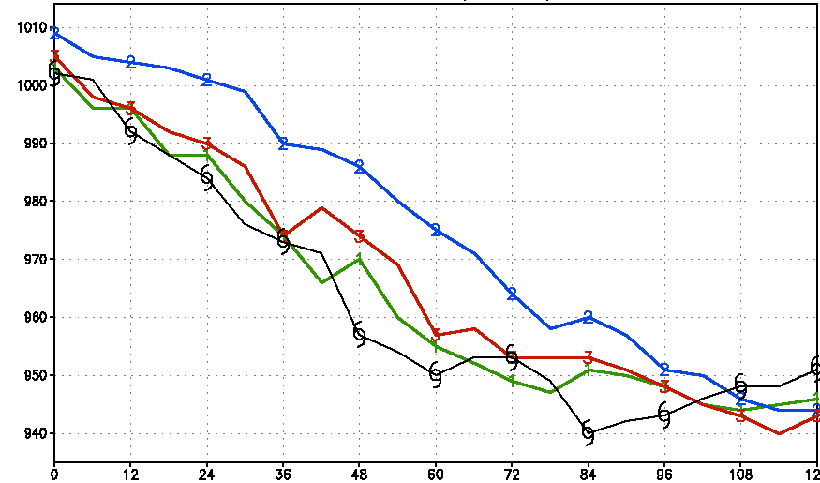
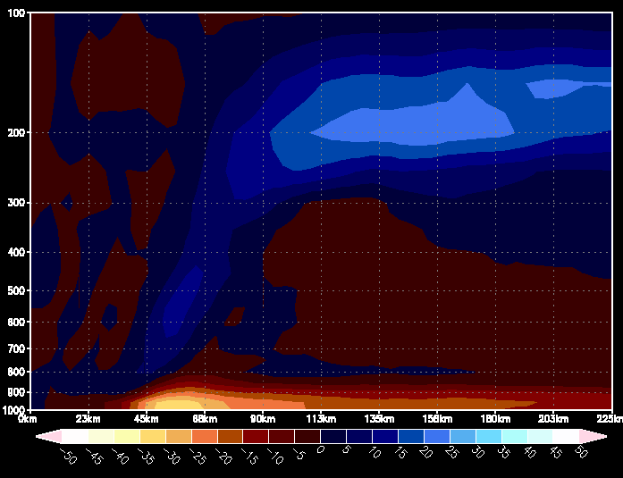
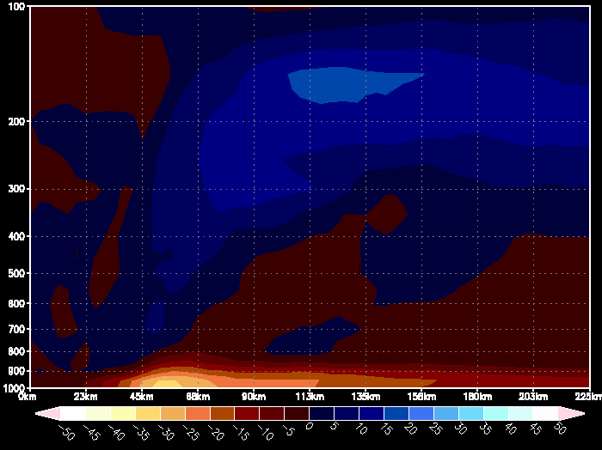
Hurricane Gonzalo (0000 UTC 13 October)
Max Winds
42 Level Model
Wind (knots)
60 Level Model
Wind (knots)
Current GFDL
42 Level GFDL
60 Level GFDL
Current GFDL
42 Level
60 Level
Northeast eyewall
96 hours
Northeast eyewall
96 hours
MSLP
Circular Averaged
Radial Wind
(96 hours)
42 level model
enhanced secondary circulation
42 Level Model
60 Level Model

Slide 5
Improved Moisture Initialization
Current Scheme :
(U, V, T, r, p*) = (U, V, T, r, p*)_{Envr} + (U, V, T, r, p*)_{axi-sym vortex}
r_{axi-sym vortex} defined with respect to the Environmental moisture field
(Environment is determined by moisture field outside the filter radius)
Lead to Unrealistic drying in middle troposphere
(Limited RI for weak, developing systems)
Revised Scheme :
(U, V, T, p*) = (U, V, T, p*)_{Envr} + (U, V, T, p*) _{axi-sym vortex}
r = r _{gfs} + r_{vortex}
More realistic Initial Moisture lead to significantly Improved Intensification in RI situations

Slide 6
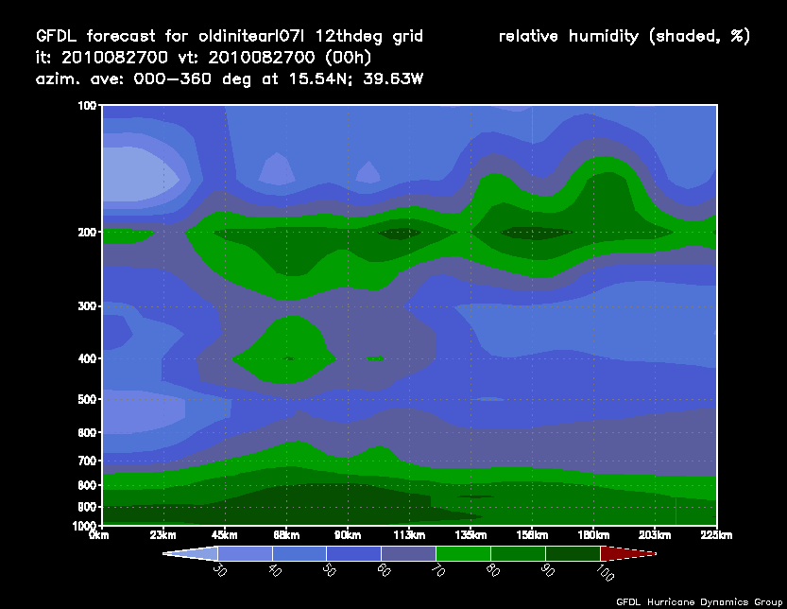
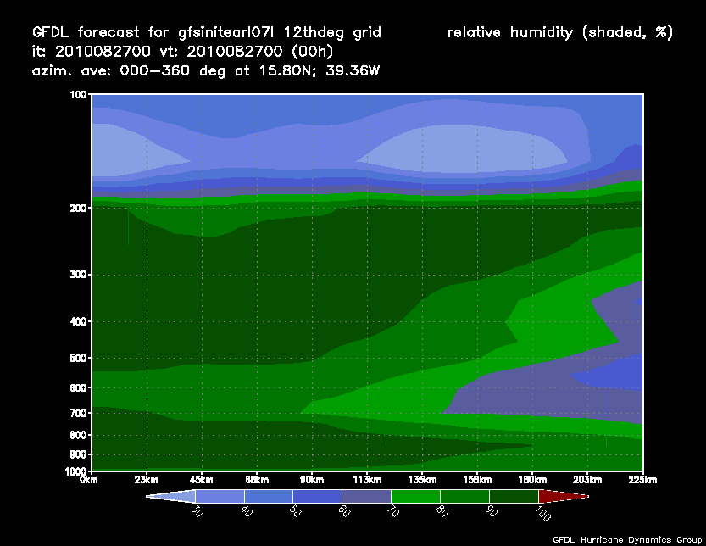
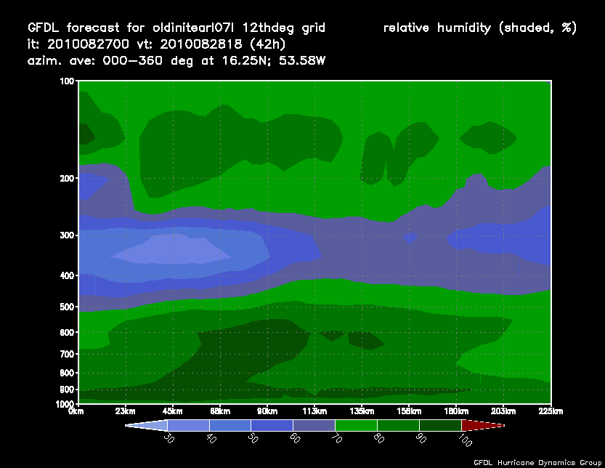
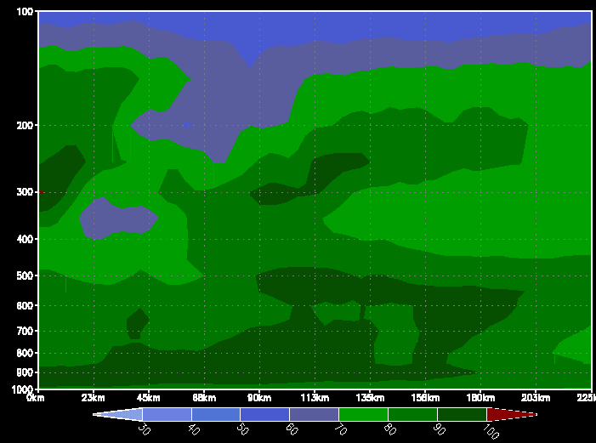
Impact of Improved Moisture Initialization
Hurricane Earl (Initial time: 0000 UTC 27 August, 2010)
OLD MOISTURE INITIALIZATION
NEW MOISTURE INITIALIZATION
CIRCULAR-AVERAGED HUMIDITY
CIRCULAR-AVERAGED HUMIDITY
HOUR 0
FORECAST
HOUR 42

Slide 7
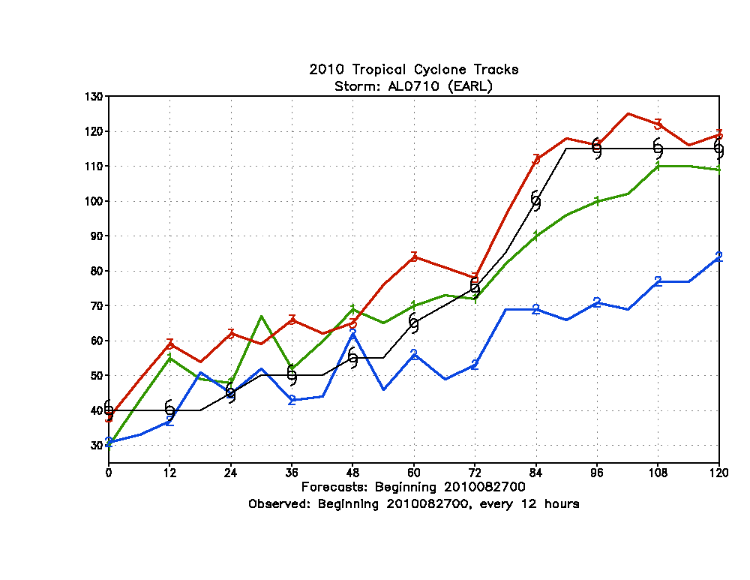
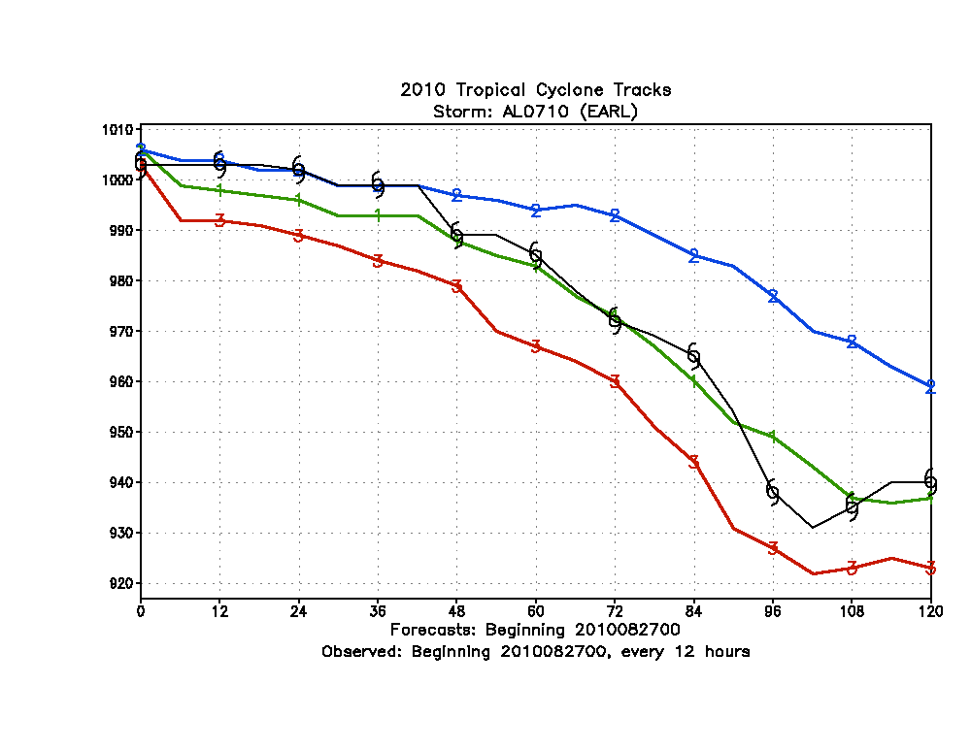
Impact of Improved Moisture Initialization
MAXIMUM SURFACE WINDS (KTS)
CENTRAL PRESSURE (hPa)
OPERATIONAL GFDL (Unbogused)
NEW MOISTURE INIT
OLD MOISTURE INIT
NEW INIT
OLD INIT
OPERATIONAL GFDL
NEW INIT
OPERATIONAL GFDL
NEW MOISTURE INIT
OLD MOISTURE INIT
OLD INIT
HURRICANE EARL (INITIAL TIME: 000 UTC 27 AUGUST, 2010)

Slide 8

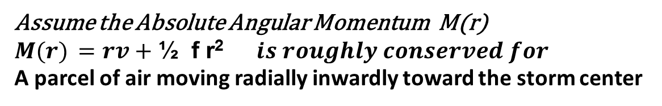
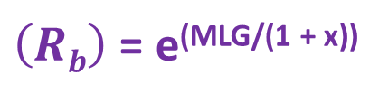
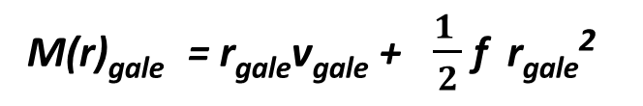

Formulation of New Storm Size (R_{b})
(radius where the tangential wind of specified vortex goes to 0)
In current vortex initialization we assume R_{b} is a simple function of the Radius of the Last closed Isobar (RLCI) from the tcvitals file (R_{b} = 1.5 * RLCI)
Assume the Absolute Angular Momentum M(r)
$M(r) =rv+$ ½ f r² $is roughly conserved for$
A parcel of air moving radially inwardly toward the storm center
$V\left(r\right)tan=\frac{M\left(p\right)}{rx} −\frac{1}{2} f r Carr and Elsberry, MWR (1997)$
Where: (x = .4)
$M(p) =$ $M\left(r\right)/$r ^{(1-x)}
$M\left(p\right)=\frac{1}{2}f \left(Rb\right)\left(1+x\right)$ Assuming R_{b} = Radius where tangential wind vanishes
The Absolute Angular Momentum (M_{gale}) at the radius of Gale winds can be determined from the tcvitals :
M(r)_{gale} = r_{gale}v_{gale} + $\frac{1 }{2}$ f r_{gale}²
r_{gale} averaged sum of radIi of
gale winds v_{gale} at each of the
4 storm quadrants
MLG = $log$(2(M(r))_{gale}/f r_{gale}^{(1-x)}
New Estimate for R_{b} :
$\left(Rb\right)$ = e^{(MLG/(1 + x))}

Slide 9
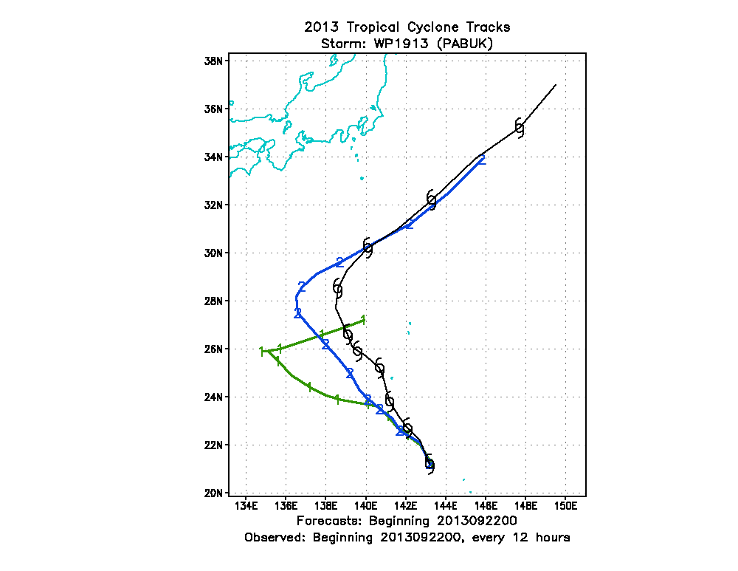
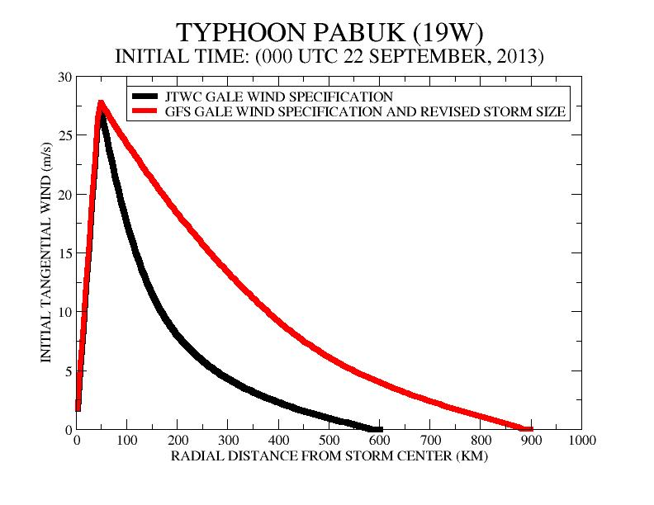
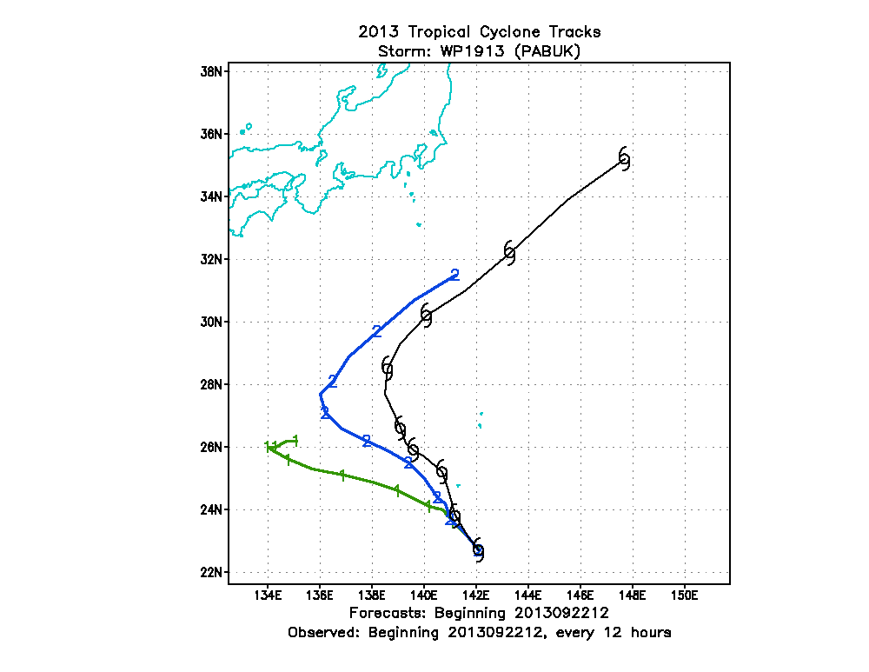
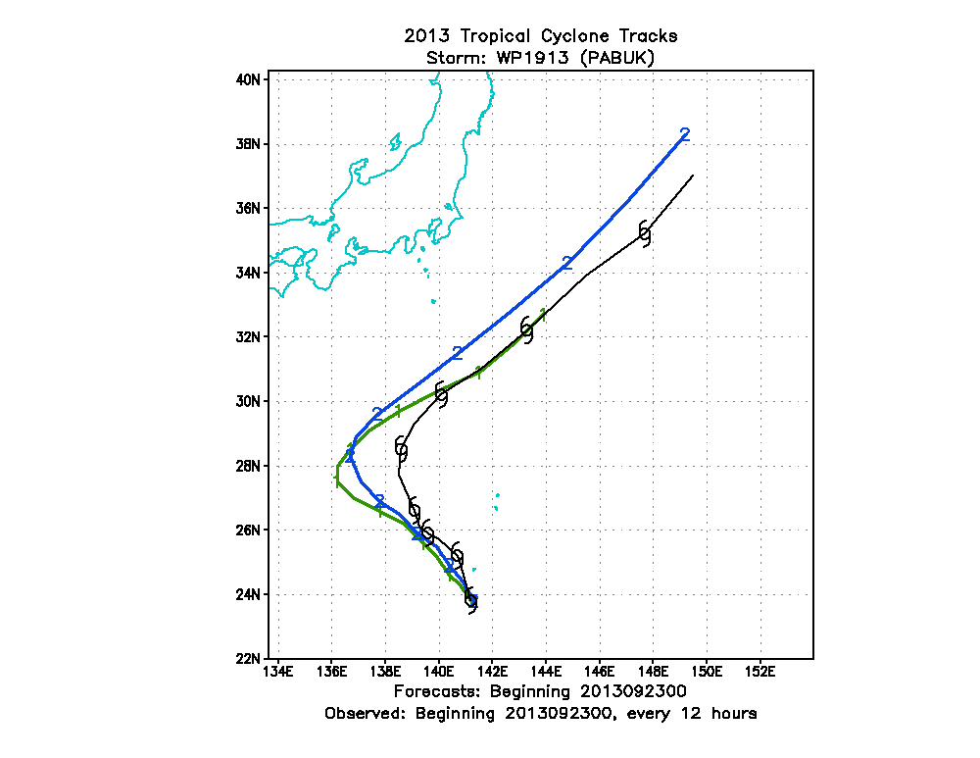
Typhoon Pabuk
New Storm Size
New Storm Size
Old Storm Size
OLD Storm Size
Based on JTWC
1200 UTC 22 September
New Storm Size
New Storm Size
Old Storm Size
Old Storm Size
0000 UTC 23 September
1200 UTC 23 September

Slide 10
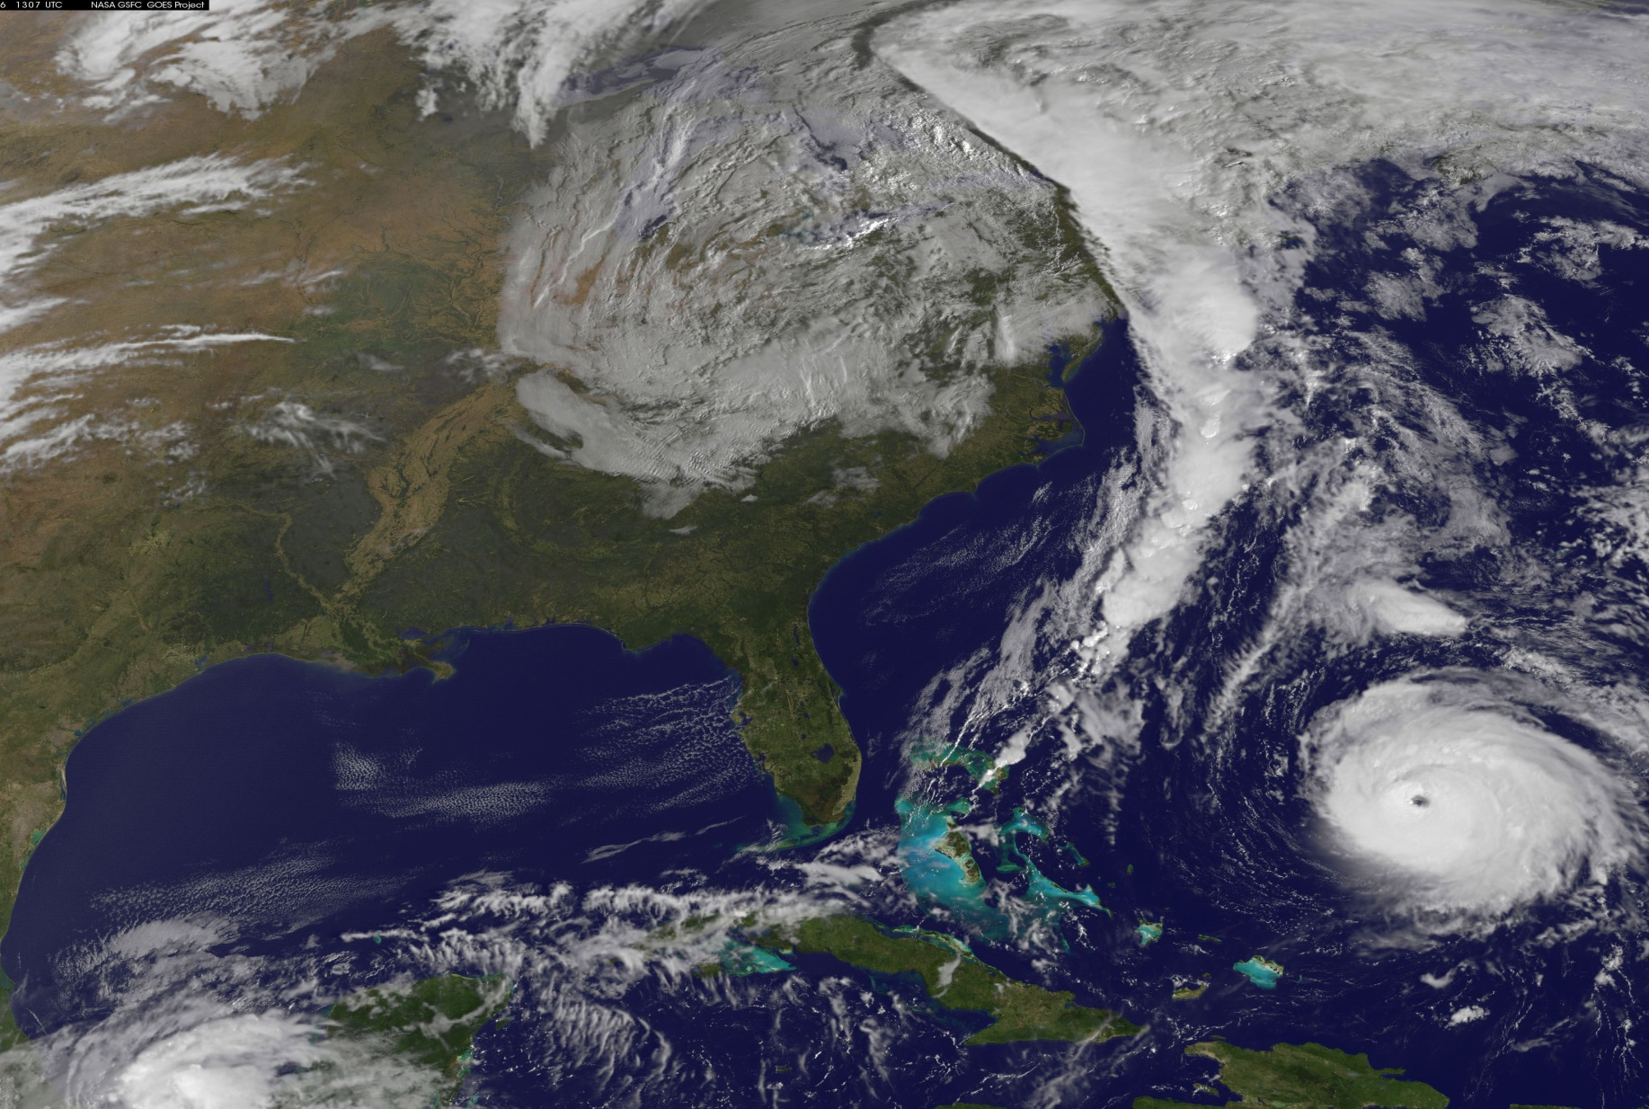
Performance Evaluation of Upgraded Model with Previous GFS

Slide 11
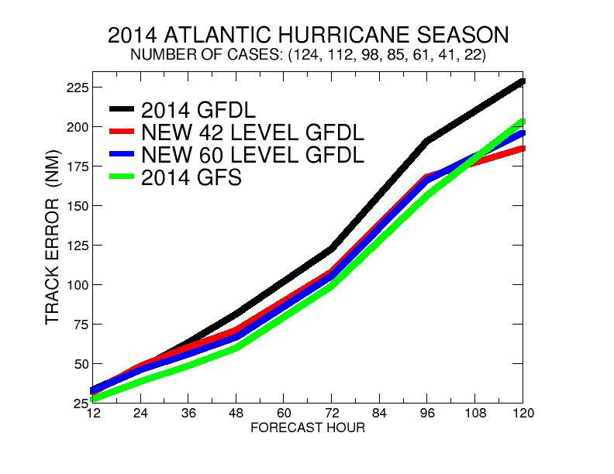
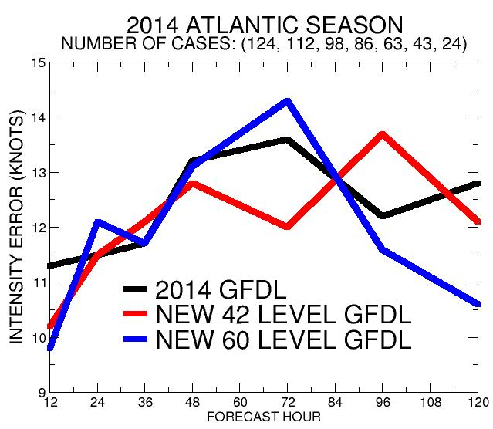
2014 Atlantic Season with 2014 GFS
TRACK ERROR (NM)
INTENSITY ERROR (KNOTS)
16-18% Reduced Track Error for
2-5 Days for Both Upgraded Models
New Models Comparable to GFS
INTENSITY PERFORMANCE MIXED
42 LEVEL IMPROVED EARLY TIME
60 LEVEL IMPROVED LATER TIME

Slide 12
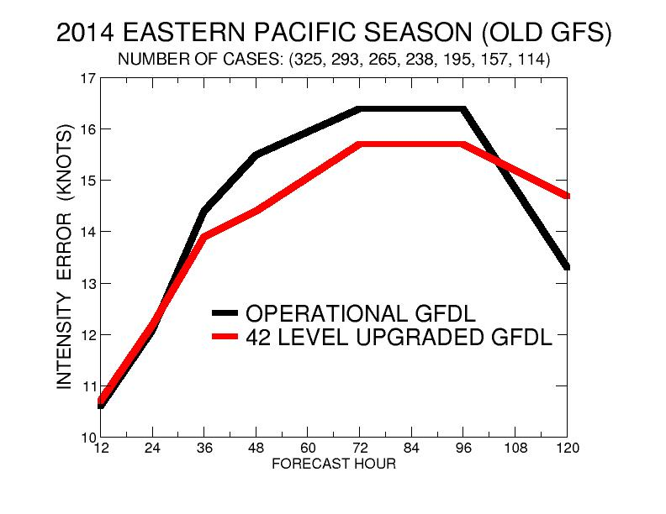
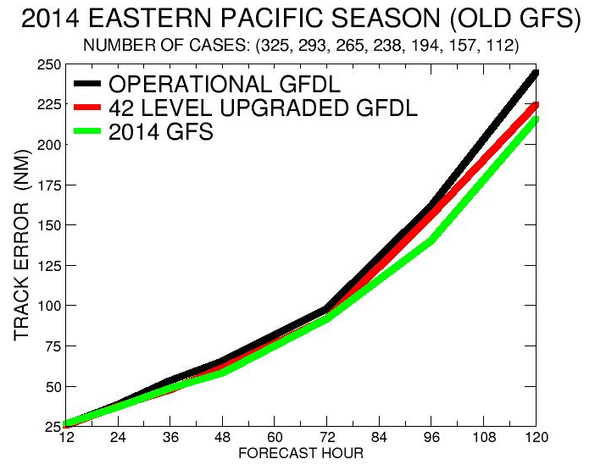
2014 Eastern Pacific Season with 2014 GFS
Only 42 Level Upgrade Run
TRACK ERROR (NM)
INTENSITY ERROR (KNOTS)
7% Reduced Track Error for 42 level model 2-5 Days
New 42 Level Model Comparable to GFS through day 3 and at day 5
7% Reduced Intensity Error Days 1-4
Degraded Day 5

Slide 13
Preliminary Performance Evaluation With New GFS
(sample size in East Pacific limited by major Jet outage and not included)

Slide 14
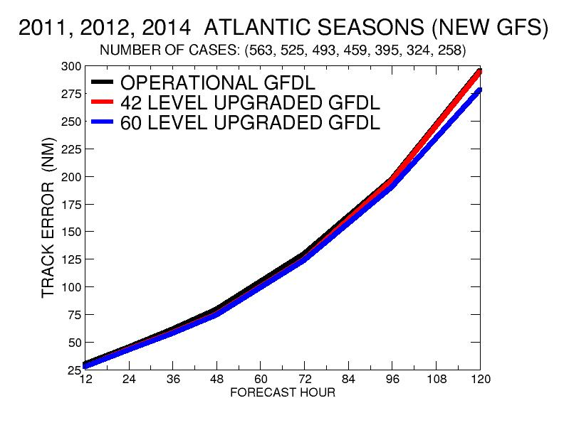
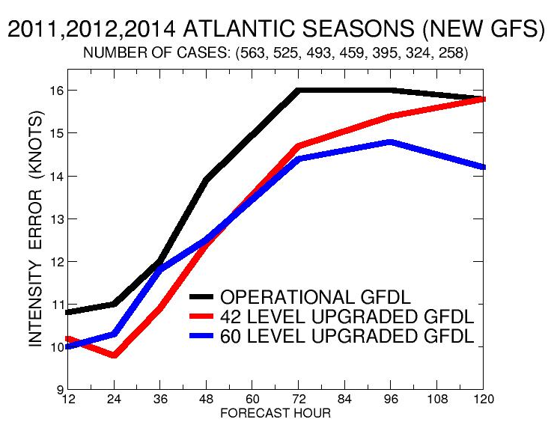
2011, 2012, 2014 Atlantic Seasons
TRACK ERROR (NM)
INTENSITY ERROR (KNOTS)
42 Level Model performed slightly better then 60 Level Model through 36 hours.
(9% reduced intensity error compared to current model)
60 Level Model performed best for 3-5 Days
(11% reduced intensity error)
60 Level Model performed best all time periods
(6% reduced track error compared to
Current GFDL model)

Slide 15
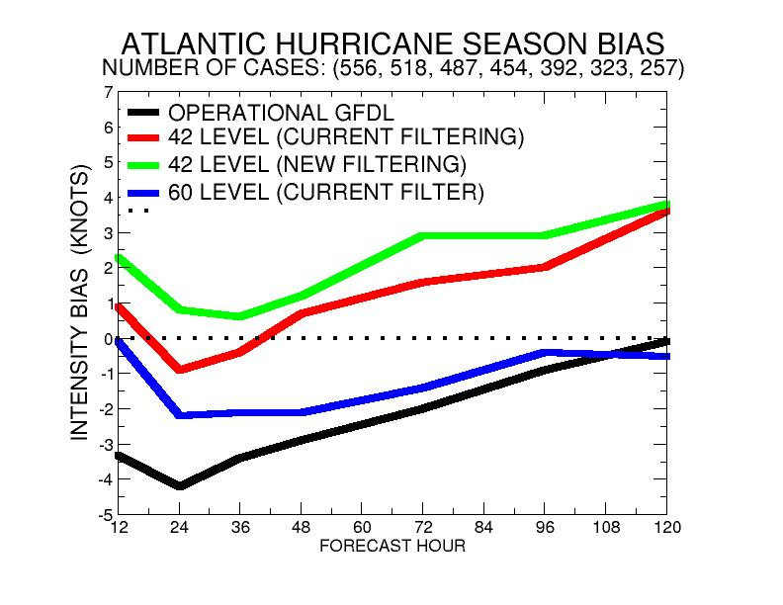
1. Improved Moisture initialization had large impact on early negative Intensity bias of current model.
2. 60 level model much improved overall bias while 42 level model has large positive bias beyond 48 hours
3. Modified filter increased positive bias in 42 level model by retaining too much of the GFS outflow and enhancing the secondary circulation

Slide 16
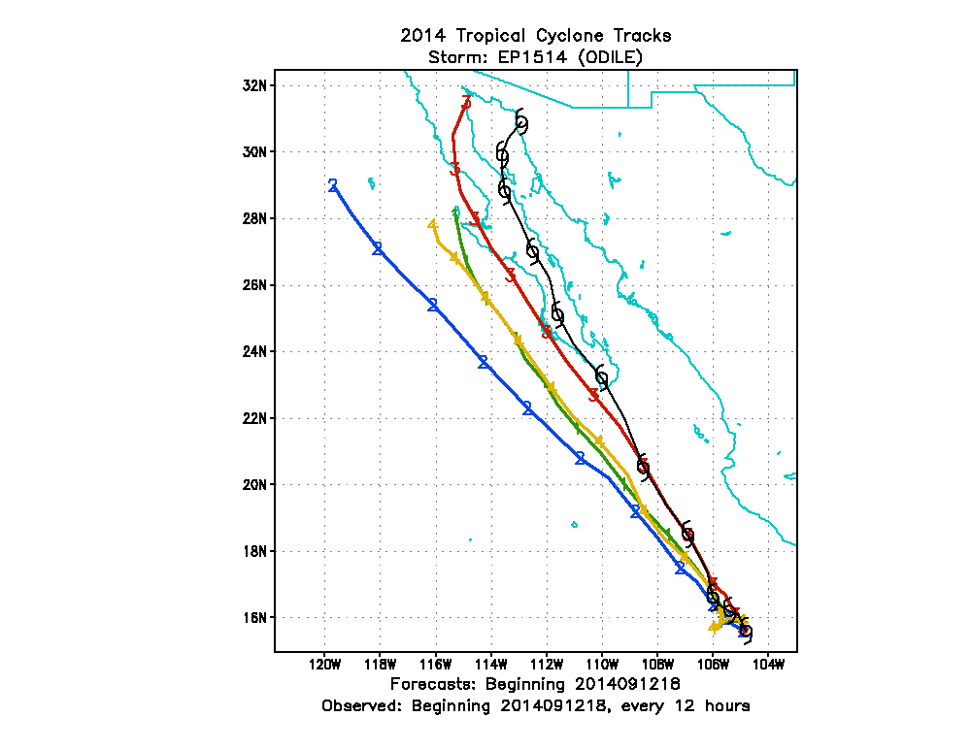
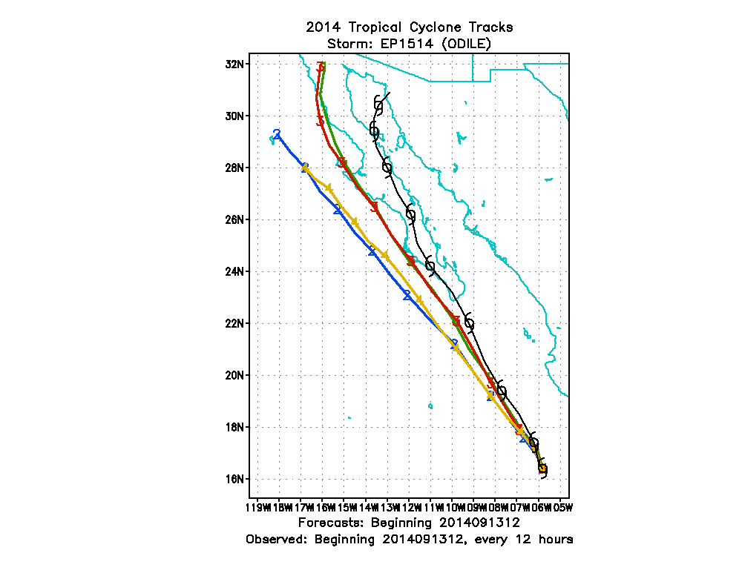
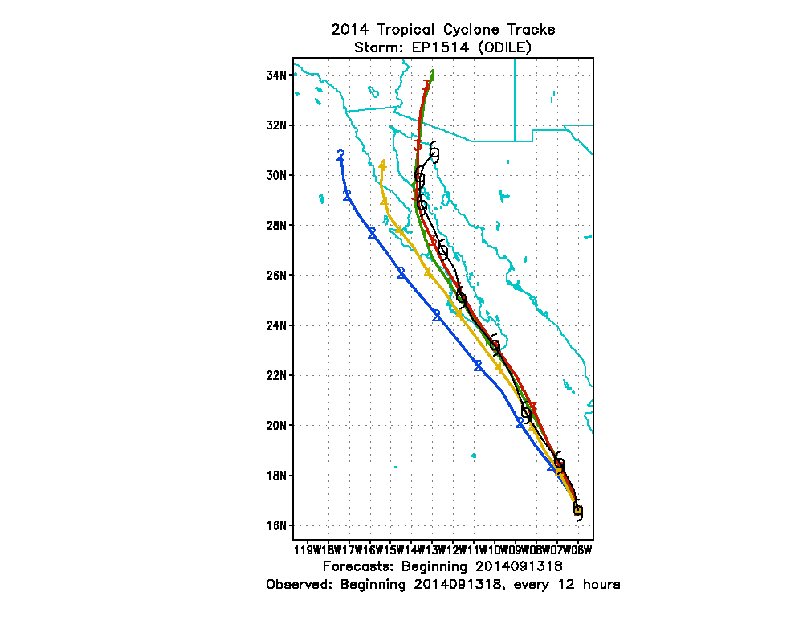
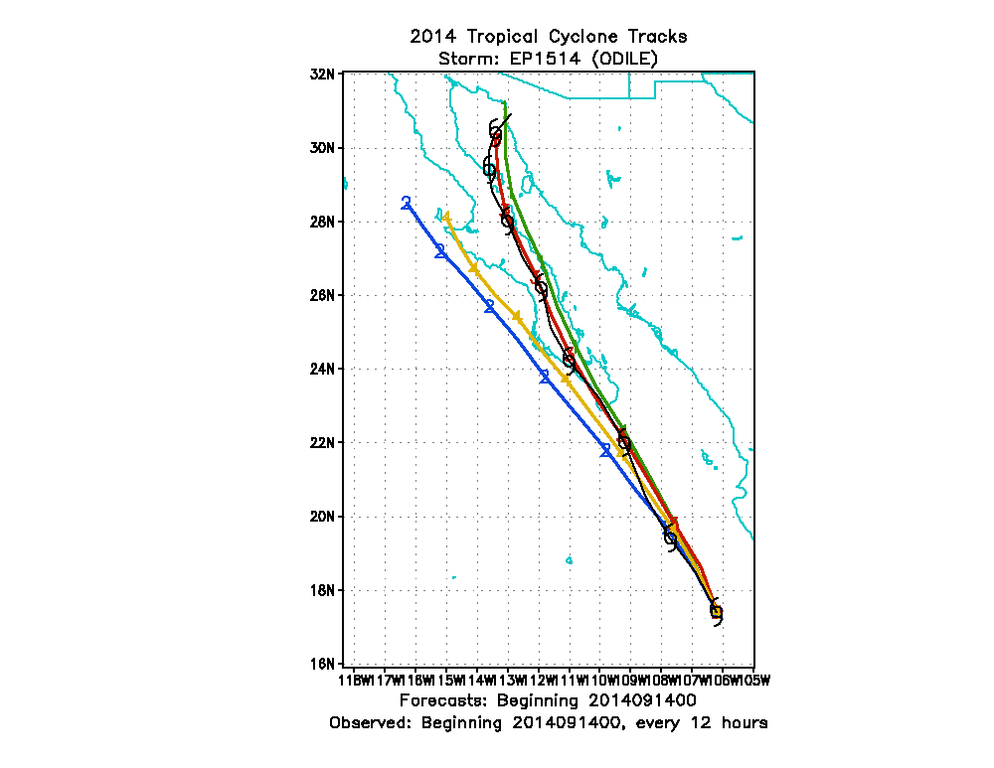
New GFS had modest positive impact on Track of Hurricane Odile
Combination with GFDL Upgrades had much improved tracks
60 Level Upgrade
Old GFDL
(New GFS)
42 Level
Old GFDL
(Old GFS)
OLD GFDL (OLD GFS)
OLD GFDL (NEW GFS)
60 Level Upgrade
42 Level Upgrade
1800 UTC 12 September, 2014
1200 UTC 13 September, 2014
Old GFDL
(Old GFS)
60 Level Upgrade
Hurricane Odilia
42 Level Upgrade
1200 UTC 9 October, 2011
Old GFDL
(Old GFS)
Old GFDL
(Old GFS)
Old GFDL
1800 UTC 13 September, 2014
0000 UTC 14 September, 2014

Slide 17
Summary of GFDL upgrade
GFDL model upgrade demonstrates improved track and intensity guidance with both old and upgraded version of GFS for 2011, 2012 and 2014 Atlantic Hurricane Seasons.
Upgraded version with increased vertical resolution (60 vertical levels) performed best.
60 level version demonstrated smallest intensity bias compared to current and 42 level model.
EastPac sample size still too small with new GFS to be included in preliminary evaluation.

