Slide 1


StormSurgeViz: A Visualization and Analysis Application for Distributed ADCIRC-based Coastal Storm Surge, Inundation, and Wave Modeling
Brian Blanton
Renaissance Computing Institute
University of North Carolina at Chapel Hill
Rick Luettich
Institute of Marine Sciences
DHS-Coastal Hazards Center
University of North Carolina at Chapel Hill
69th Interdepartmental Hurricane Conference
3 March, 2015
Funded by NOAA Joint Hurricane Testbed (2013) Program
Notes:
Brian Blanton (PI), Rick Luettich, Corbitt Kerr
University of North Carolina at Chapel Hill
Jason Fleming
Seahorse Coastal Consulting
AMS 2014
Modeling Analysis and Forecasting: Part I

Slide 2
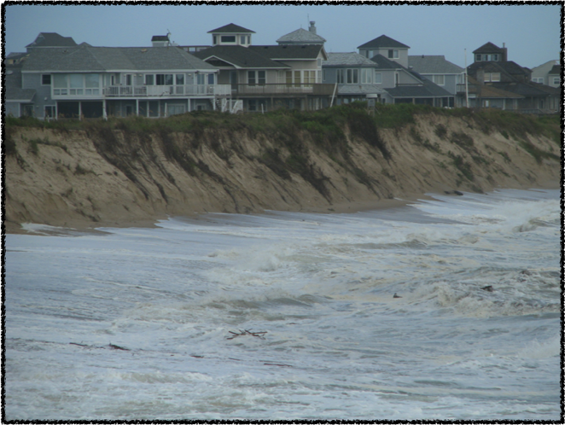
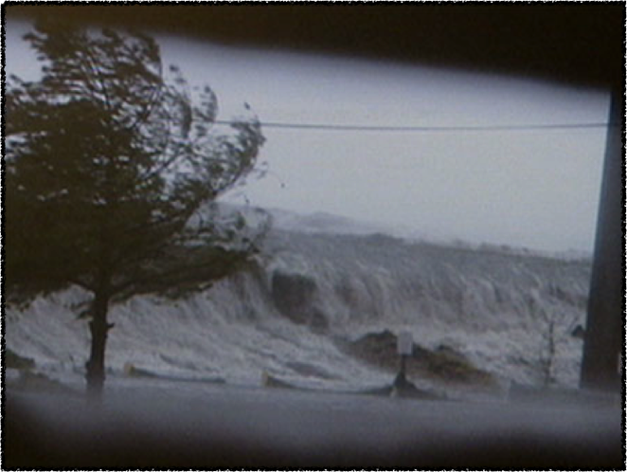
Motivation
Hazards to coastal areas a major concern
  Extreme weather events
  Sea level variability and rise
Critical need for detailed hazard/threat assessment information
Detailed → high spatial resolution
Real-time operational forecast products
Research → operations challenges
Courtesy: J. Hanson, USACE/FRF/Duck
Photo by: Don McClosky

Slide 3

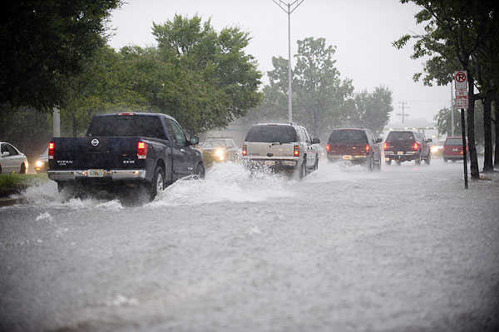
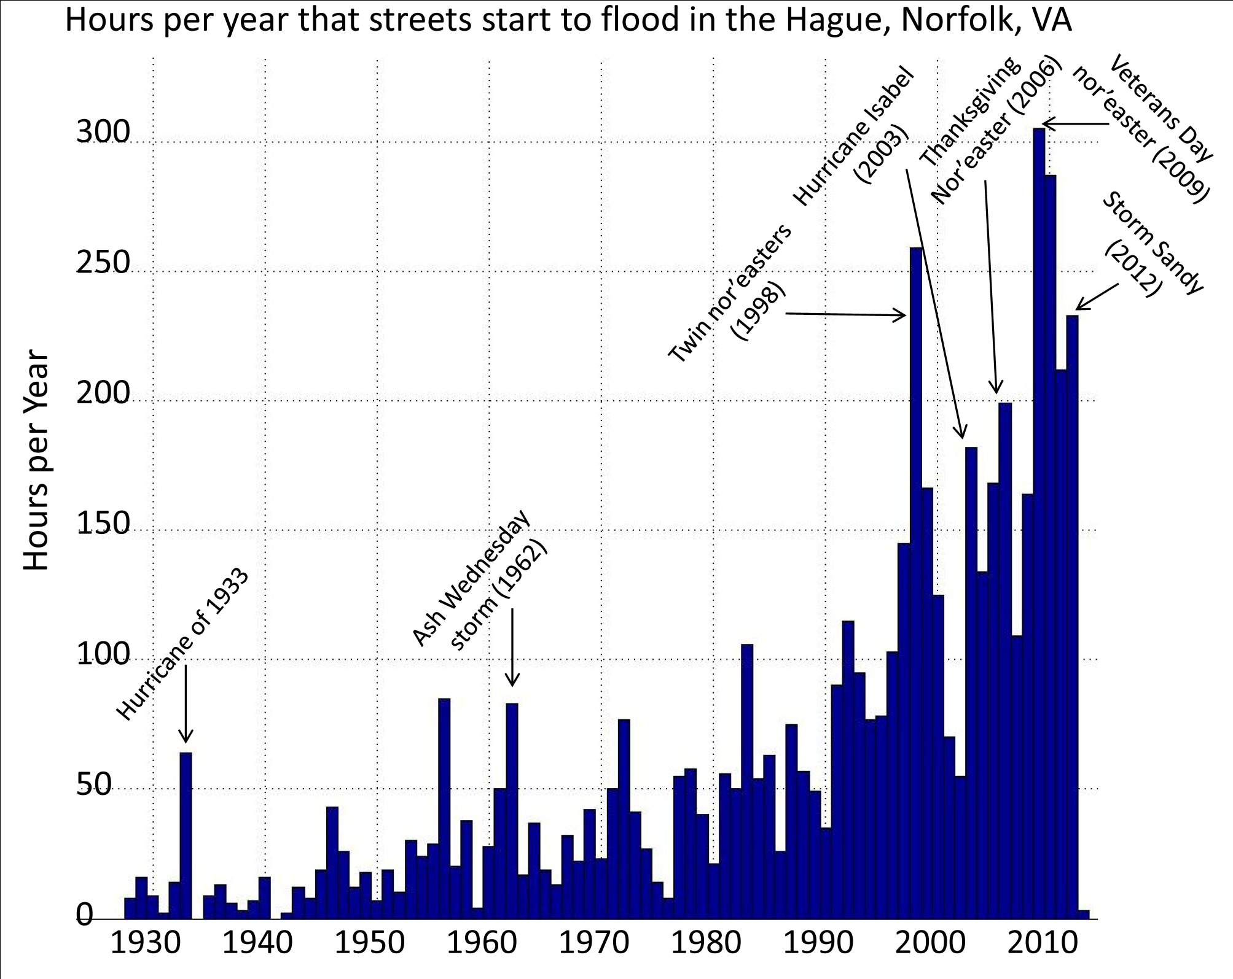
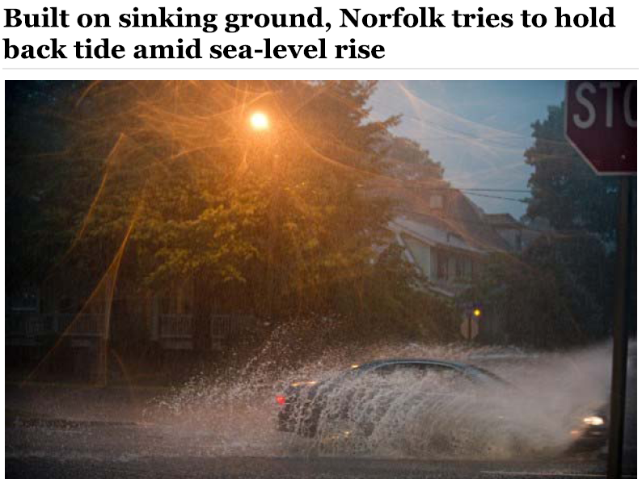
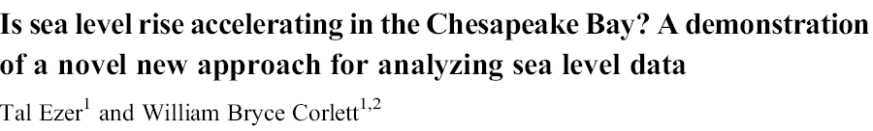
Motivation
Is Coastal Flooding a Problem…….
Acknowledgement
Pictures lifted from presentation by Larry Atkinson, ODU

Slide 4
Motivation
How can the research community make information more easily available to end-users, decision-makers, planners ...
And particularly
NHC/SSU Forecasters

Slide 5
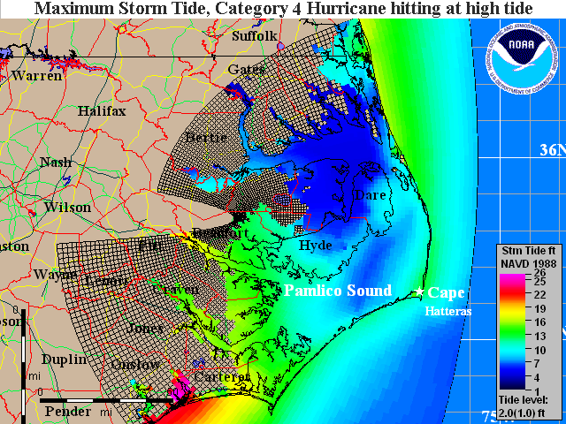
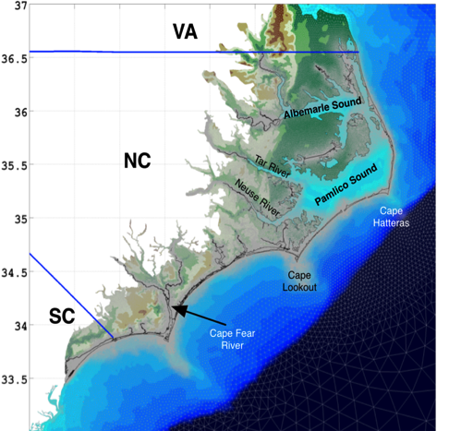
Many Storm Surge Tools Used
GIS
Statistical models
Numerical models (Dynamic)
  SLOSH
    Operational at NOAA, NHC
    Curvilinear, orthogonal grid
    Can run easily on a PC/laptop
    Ideally suited for rapid ensembles
  FVCOM, SELFE
  ADCIRC
    Research forecasting modes
    Operational at NCEP
    Finite element (triangular)
    Very high spatial resolution
    Concomitant high computational cost
    Not suited (yet) for large dynamic ensembles
SLOSH NC basin
ADCIRC NC grid

Slide 6
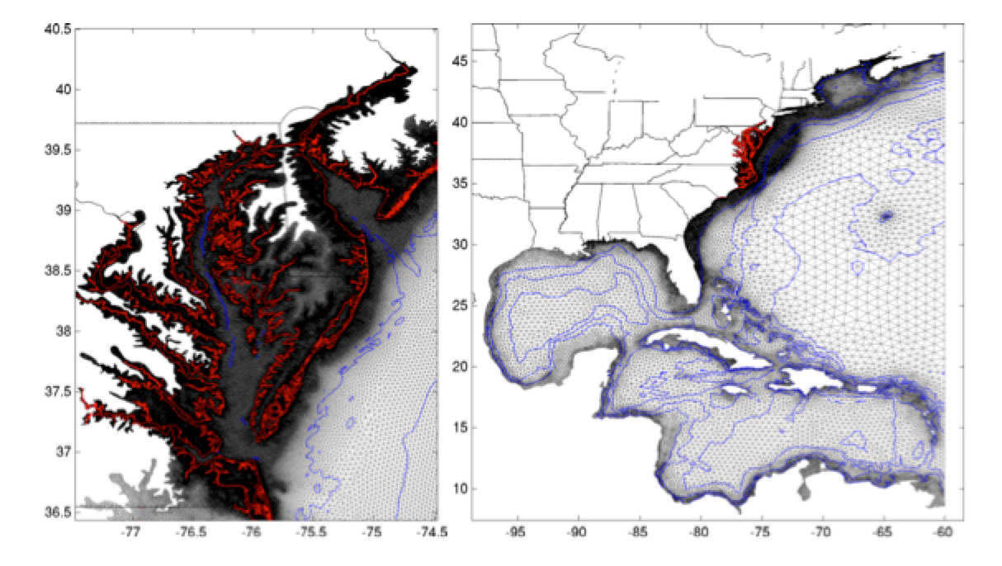
ADCIRC (http://www.adcirc.org)
Triangular Finite Elements

Slide 7
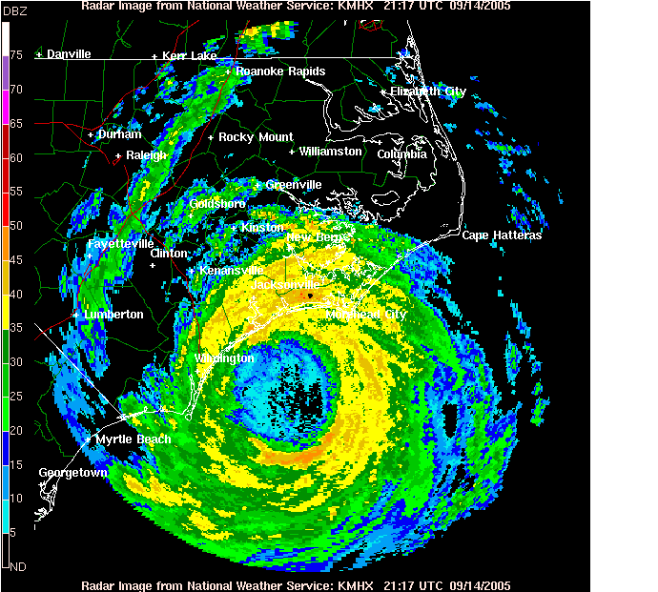
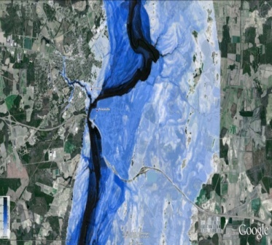
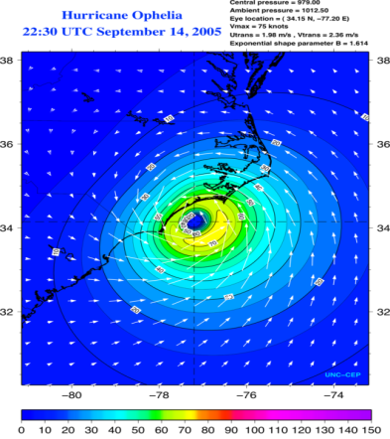
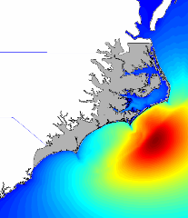
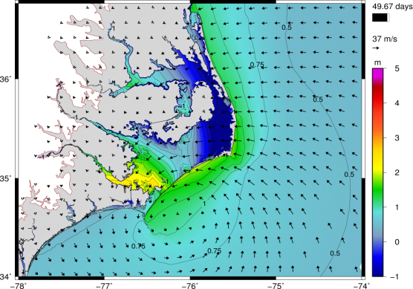
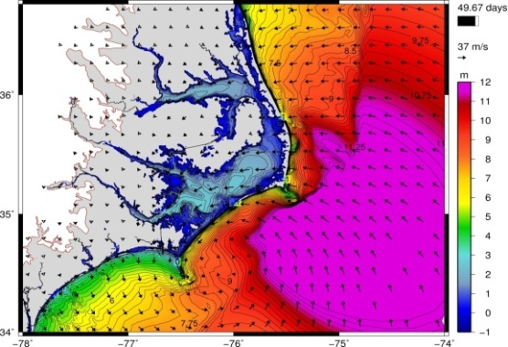
ADCIRC Surge Guidance System (ASGS)
Precipitation
Hydrologic Model
Atmospheric Model
Wave Model
Surface BCs
Pressure
Wind Forcing
Surface BCs
Wave Forcing
River BCs
Discharge
Hydrodynamic Model (ADCIRC)
Total Water Levels
Precipitation Source: QPE/QPF
Atmospheric Model: NAM or NHC track
Hydrologic Model: HL-RDHM
Wave Model: unstructured SWAN
Sig. Wave Heights

Slide 8
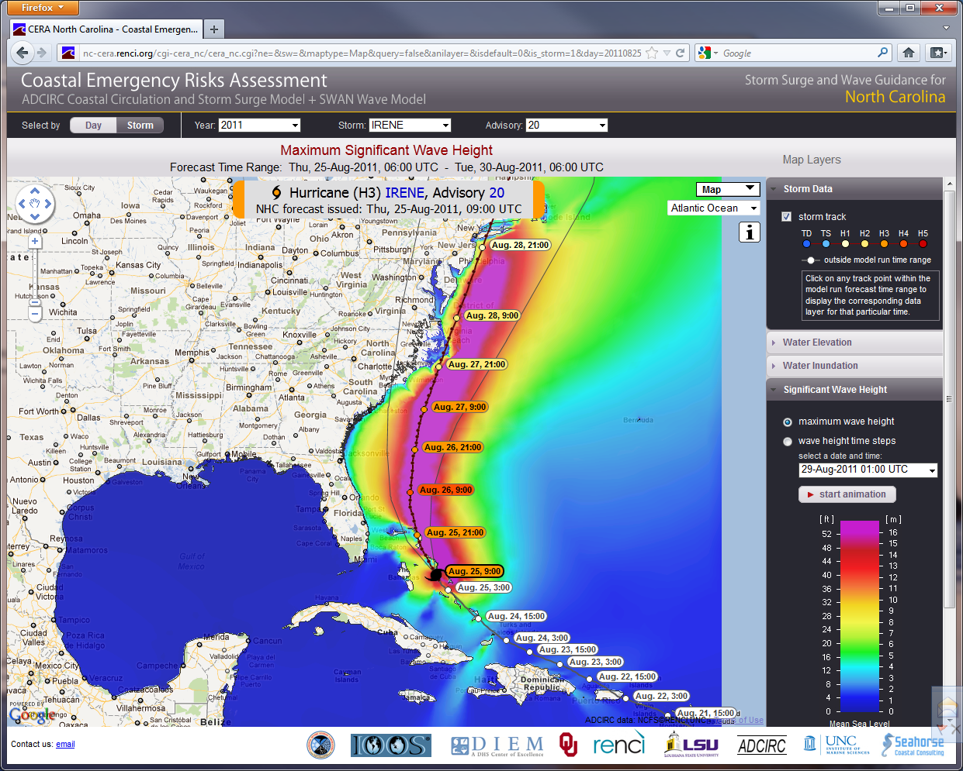
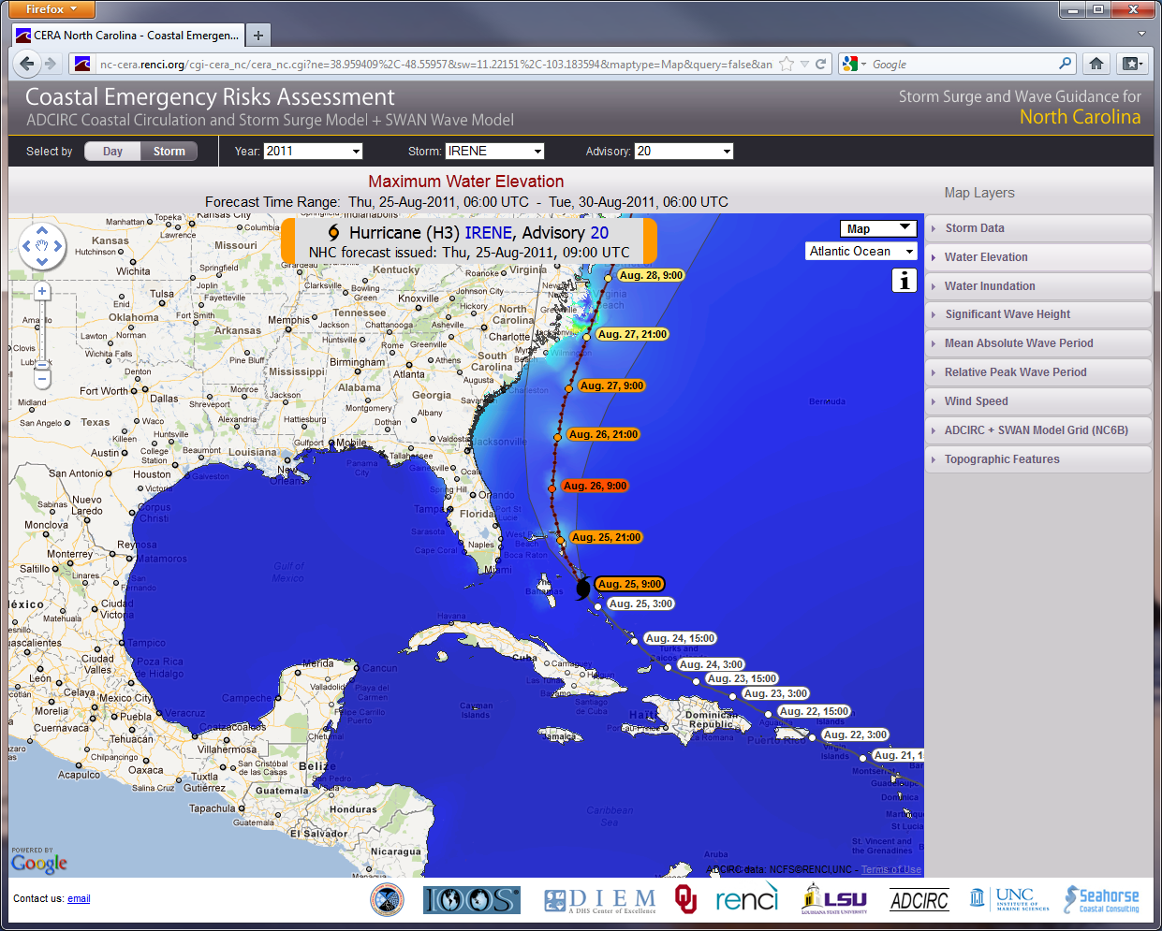
ADCIRC Surge Guidance System (ASGS)
Primary Outputs
http://nc-cera.renci.org
Significant Waves
Total Water Level
Hurricane Irene (2011)

Slide 9
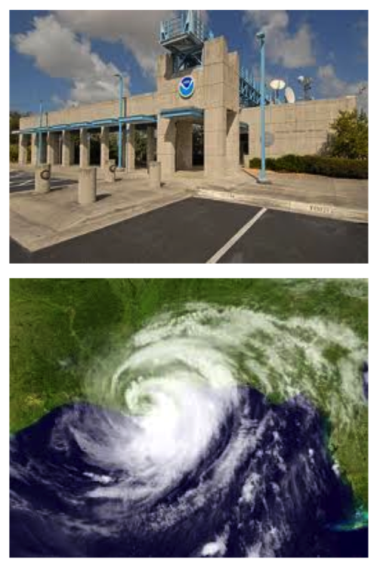
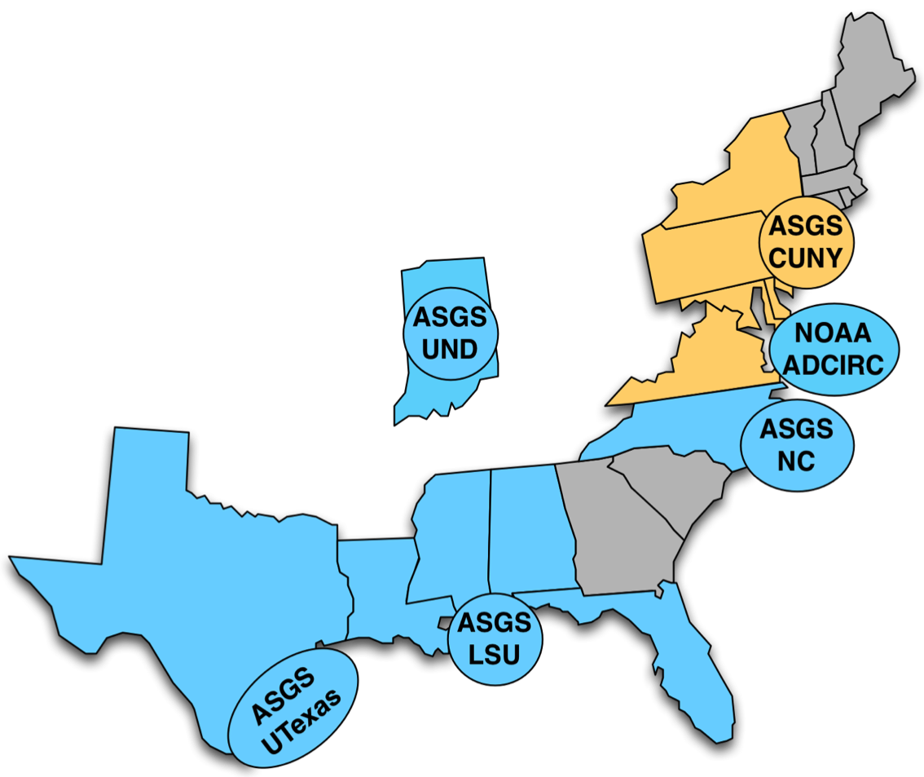
Project Purpose
Enable NOAA/NHC to access and visualize ADCIRC results in a consistent and robust way
    different ADCIRC-based systems
    run by different groups
    on different ADCIRC grids
Desktop application (MATLAB)
Leverage community efforts:
  NOAA IOOS Coastal Ocean Modeling Testbed
Funded by NOAA’s Joint Hurricane Testbed (2013) Program

Slide 10
Year 1
Delivered AdcircViz to NHC/SSU
Extended AdcircViz to:
  wind vectors
  output of Shapefiles
  Multiple catalogs
Moved code to Github for dissemination, documentation, and issue tracking

Slide 11
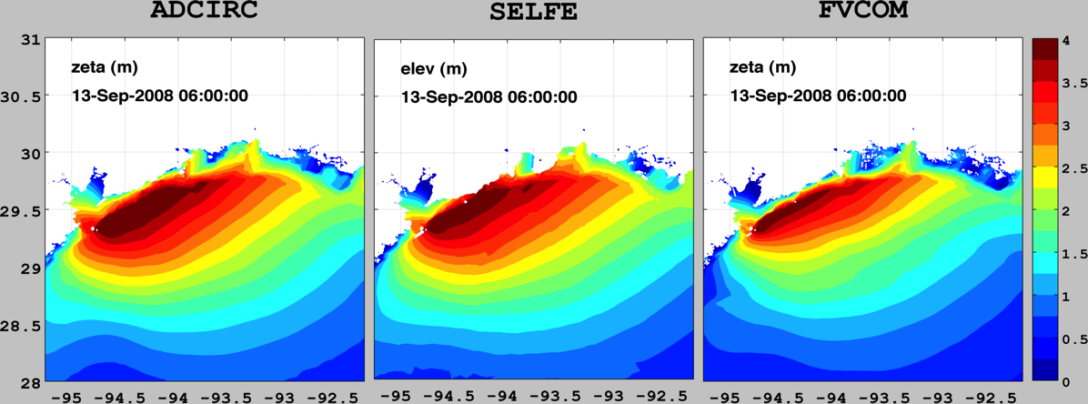
Standardization
NCTOOLBOX: a MATLAB toolbox that provides access to common data model datasets
NetCDF-Java as access layer
NetCDF, OPeNDAP, HDF5, GRIB, GRIB2
Any UGRID-compliant model output can be handled by exactly the same method.
Example from NOAA IOOS Coastal Ocean Modeling Testbed
Hurricane Ike Hindcast

Slide 12

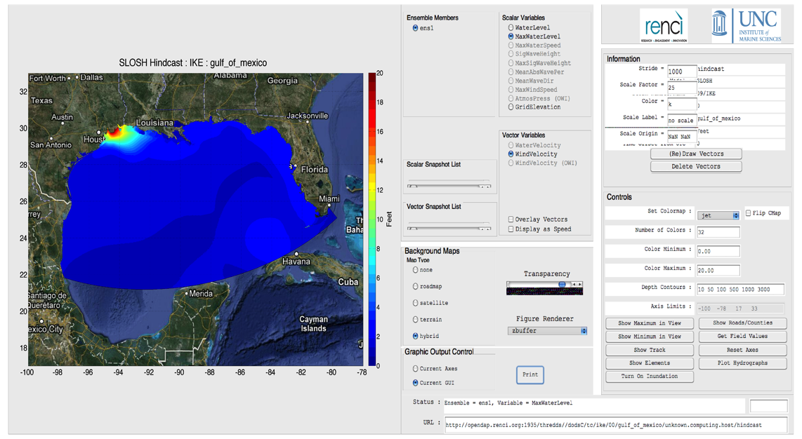
SLOSH in AdcircViz
Any regular-grid can be trivially mapped to CF-UGRID
Makes available all of the existing finite element analysis tools
Data from NOAA IOOS Coastal Ocean Modeling Testbed

Slide 13
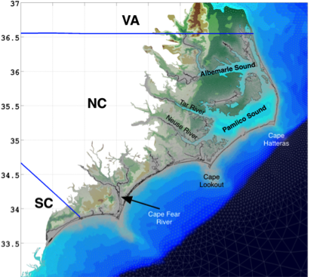
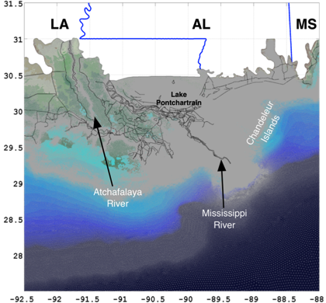
AdcircViz Requirements
Application needs to:
  Provide unified view of operating ADCIRC forecast system outputs
  Allow user-driven data analysis
  Allow user control of visualization
  Minimize data transfers
Embrace many models by requiring conformance to community standards and conventions
FVCOM, SELFE
ADCIRC
SLOSH

Slide 14
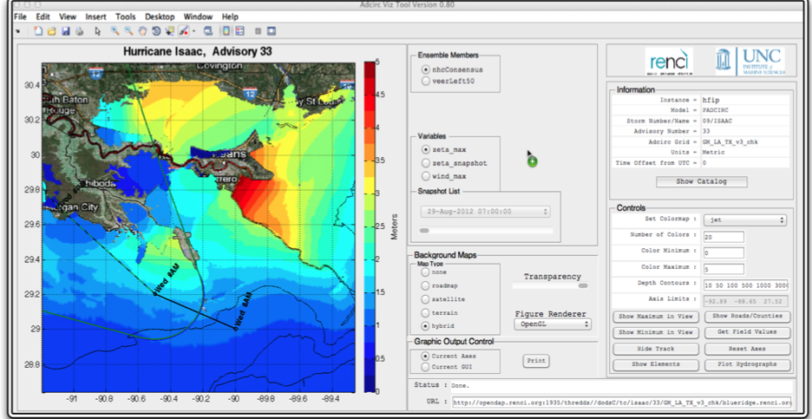
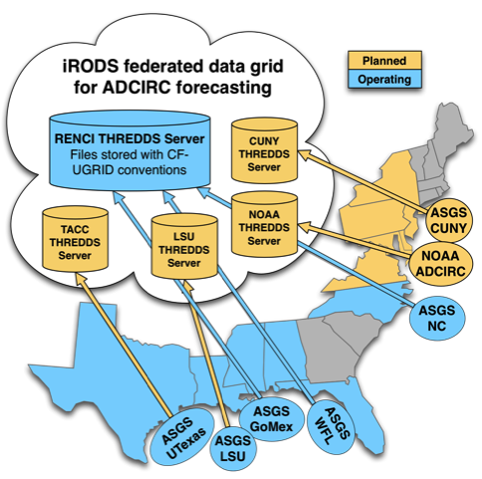
AdcircViz App
Hurricane Isaac (2011)
OPeNDAP data
connections
Winds
Waves
Water Level
Get Catalog
and metadata
Data Grid
MATLAB GUI populated by metadata in netCDF files
OPeNDAP, netCDF-Java
Only accesses data as it is needed

Slide 15
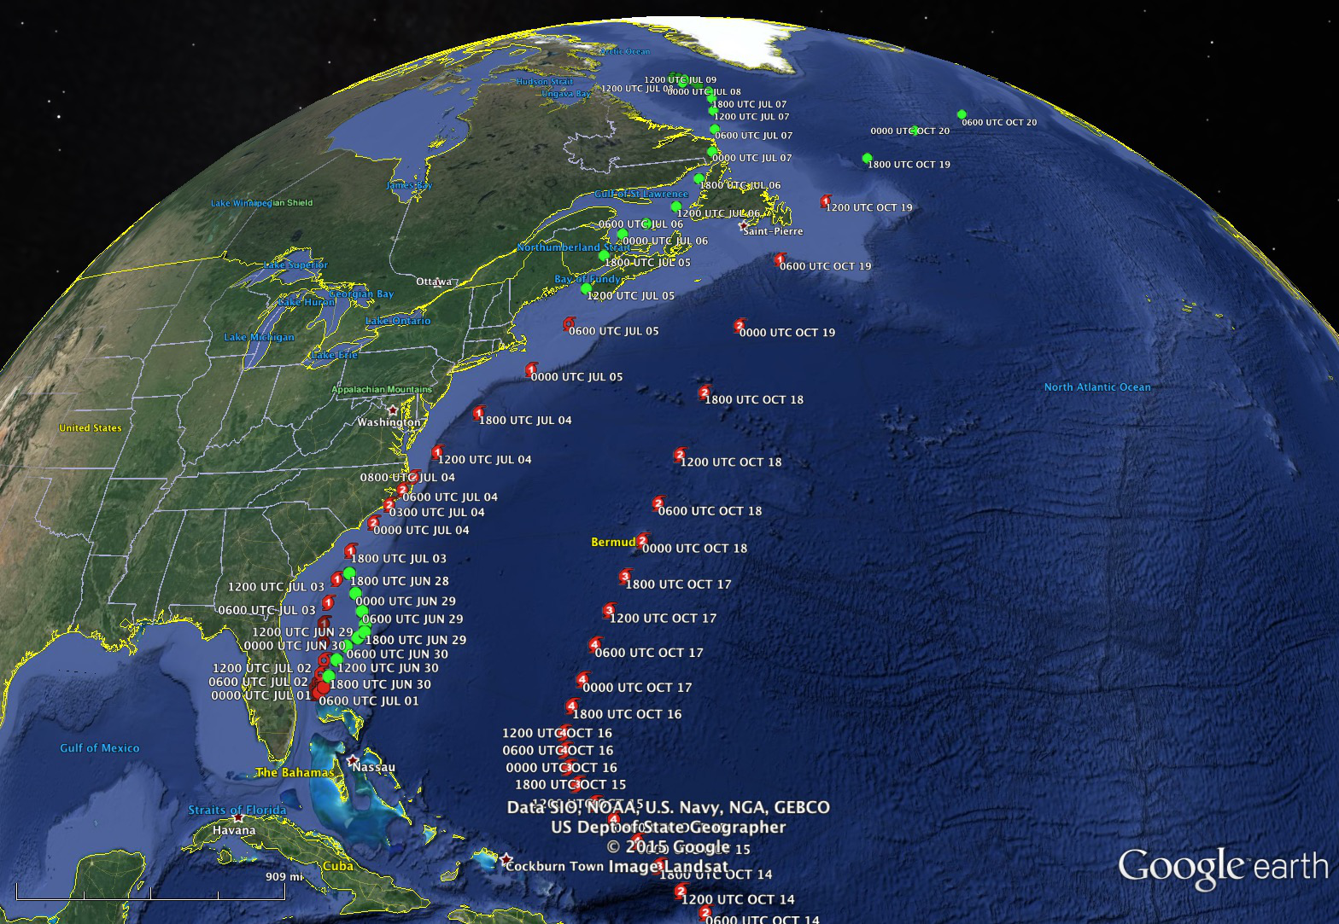
Year 1 (2014) Field Tests
Hurricane Arthur
  North Carolina impacts (small)
  AdcircViz used by researchers (us) to monitor forecast system activity
Hurricane Gonzalo
  Impacted Bermuda
  Used to test AdcircViz at NHC/SSU
  Application responsiveness considered too slow for operational/real-time use

Slide 16
Year 2 Activities
Shift focus to provide a mechanism for other models (not just UGRID/ADCIRC) to be accessed/viz’d in a consistent manner
Develop community onboarding process
  Extension of existing data dissemination methods to include gridded/regular model output
  “Build it and they will come”
Renamed application StormSurgeViz

Slide 17
Year 2 Activities
Extend StormSurgeViz to gridded models
SLOSH, ROMS, sEcom, CEST (from FIU)
Still requires netCDF/CF/THREDDS compliance
Variables (e.g., water level) must be described identically (via CF conventions)

Slide 18
Community Onboarding Process
Onboarding is a protocol for broad participation
A concrete set of How-To steps to follow
Expressed in documentation
  More extensive than end-user documentation
  But inclusive of end-user documentation
3 Main Steps:
FORMAT | Package model output in NetCDF format
METADATA | Make model output CF-compliant (for both CGRID and UGRID data)
DISSEMINATION | Publish model output to known data server (THREDDS or HYRAX) Specified file and directory structure

Slide 19
Community Onboarding Process
http://renci-unc.github.io/StormSurgeViz/

Slide 20
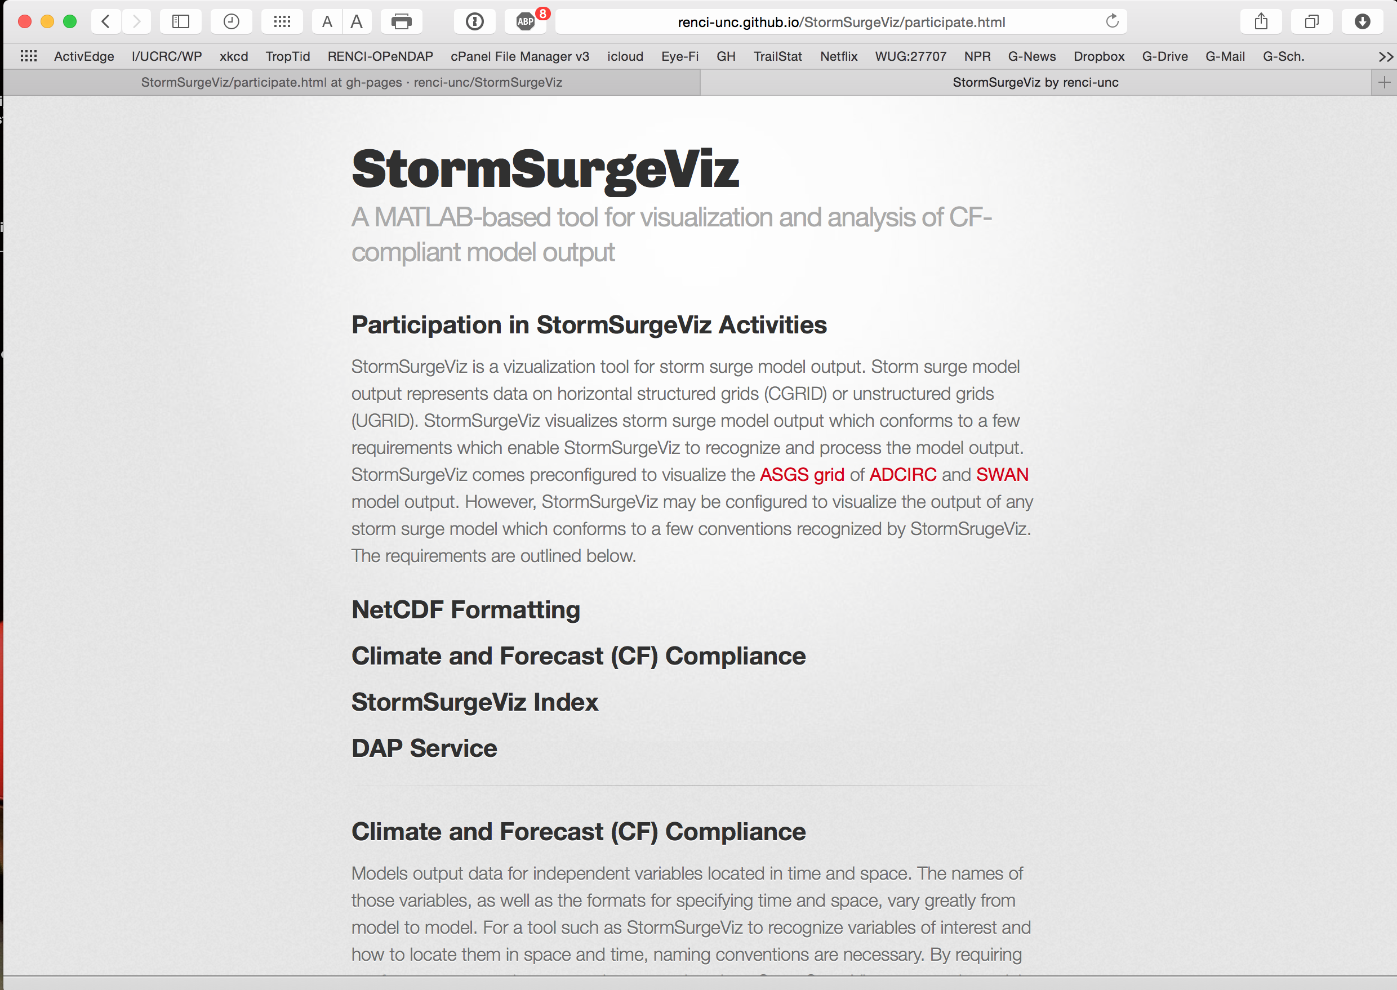
Community Onboarding Process

Slide 21
Immediate next steps
Delivery of onboarding documents by end of next week (13 Mar)
Test onboarding procedure with some other model/group
Evaluate effectiveness/utility to NHC/SSU

Slide 22
Final Thoughts
Despite challenges with very high-resolution models like ADCIRC,
  Still think AdcircViz StormSurgeViz can provide value to NHC/SSU
  Assuming, of course, other groups will embrace the onboarding concept and contribute model outputs to the “data grid”
Standards enable innovation
  Community standards and conventions are essential for “unifying” distributed efforts
  Community standards exist ... So USE them!
Funded by NOAA’s Joint Hurricane Testbed (2013) Program

Slide 23
  Thank you very much

Slide 24
Main Point
Critical need for detailed hazard assessment information
Unstructured grid models can provide very detailed assessments
But, Unstructured models can greatly complicate information dissemination and end-user usage
Many non-federal/research modeling efforts can be leveraged
But NOT easily without community standards

Slide 25
ADCIRC Surge Guidance System (ASGS)
2 – 4 x daily, 365 days / year for North Carolina and Lower Virginia
Includes tides and major rivers
Run ADCIRC + SWAN for duration of meteorological forecast to generate time sequence of wave, surge and inundation conditions for forecast.
Post output to community-accessible data servers
Visualization at CERA website:
  nc-cera.renci.org; cera.cct.lsu.edu
Also Running as needed for TX, LA, West FL, NY/NJ

Slide 26
Standardization
Need | Technology | Maintainer
Data and Metadata | netCDF4 files | Unidata
 | CF with UGRID (0.9.0) extensions for non-rectangular grids | Community
Discovery/Cataloging | Data Servers | Unidata/Hyrax
Access | OPeNDAP | OPeNDAP.org
 | NCTOOLBOX in MATLAB | Community

Slide 27
Standardization
Standards enable innovation
  Community standards and conventions are essential for “unifying” distributed efforts
  Allows for Rapid application development
Community standards exist
  in coastal ocean modeling
    NOAA IOOS Coastal Ocean Modeling Testbed
  ... So USE them!
  Leveraging Prior and Ongoing efforts, NCTOOLBOX, CF-UGRID, etc...

Slide 28
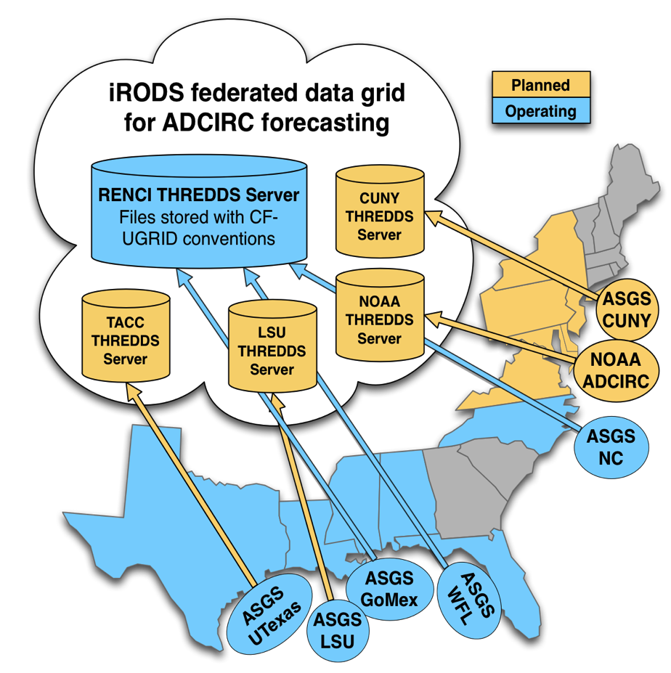
Current Model output collection
Collection of THREDDS Data Servers
Simple harvester aggregates THREDDS server content into master catalog
Catalog replicated across sites
Applications retrieve catalog to get available simulations and metadata
ADCIRC Data Grid
----------------------------------------------------------------------------------------
Storms : Advisories : Grids : Machines : Instances
----------------------------------------------------------------------------------------
nam : 2013100100 : nc6b : croatan.renci.org : rentest
nam : 2013100112 : nc6b : croatan.renci.org : rentest
nam : 2013100200 : nc6b : croatan.renci.org : rentest
nam : 2013100212 : nc6b : croatan.renci.org : rentest
nam : 2013100200 : sl15_2010_HSDRRS_2012_v9 : garnet.erdc.hpc.mil : corpsbench
nam : 2013100300 : nc6b : croatan.renci.org : rentest
nam : 2013100300 : sl15_2010_HSDRRS_2012_v9 : garnet.erdc.hpc.mil : corpsbench
nam : 2013100318 : nc6b : croatan.renci.org : rentest
nam : 2013100400 : nc6b : croatan.renci.org : rentest
nam : 2013100400 : sl15_2010_HSDRRS_2012_v9 : garnet.erdc.hpc.mil : corpsbench
karen : 04 : sl15_2010_HSDRRS_2012_v9 : garnet.erdc.hpc.mil : corpsmain
karen : 04 : sl15_2010_HSDRRS_2012_v9 : garnet.erdc.hpc.mil : corpsmain
karen : 04 : sl15_2010_HSDRRS_2012_v9 : garnet.erdc.hpc.mil : corpsmain
karen : 05 : sl15_2010_HSDRRS_2012_v9 : garnet.erdc.hpc.mil : corpsmain
karen : 05 : sl15_2010_HSDRRS_2012_v9 : garnet.erdc.hpc.mil : corpsmain
karen : 05 : sl15_2010_HSDRRS_2012_v9 : garnet.erdc.hpc.mil : corpsmain
karen : 06 : sl15_2010_HSDRRS_2012_v9 : garnet.erdc.hpc.mil : corpsmain
karen : 06 : sl15_2010_HSDRRS_2012_v9 : garnet.erdc.hpc.mil : corpsmain
karen : 06 : sl15_2010_HSDRRS_2012_v9 : garnet.erdc.hpc.mil : corpsmain
karen : 07 : sl15_2010_HSDRRS_2012_v9 : croatan.renci.org : corpsbackup2
karen : 08 : sl15_2010_HSDRRS_2012_v9 : hatteras.renci.org : corpsbackup3
karen : 08 : sl15_2010_HSDRRS_2012_v9 : hatteras.renci.org : corpsbackup3

Slide 29
Essential CF-UGRID Components
dimensions: // Triangles
node = 185409
nele = 369032
nvertex = 3
variables: // Mesh topology and node coordinates
int adcirc_mesh(mesh)
adcirc_mesh:long_name = "mesh_topology”
...
int element(nele, nvertex)
element:long_name = "element”
...
double x(node)
x:long_name = "longitude”
x:units = "degrees_east”
...
double y(node)
y:long_name = "latitude”
y:units = "degrees_north”
...
NetCDF Climate and Forecast (CF) Metadata Conventions
UGRID = unstructured grid extension
Unstructured grids don’t have simple parametric descriptions
Complete grid description contained in EACH netCDF file

Slide 30
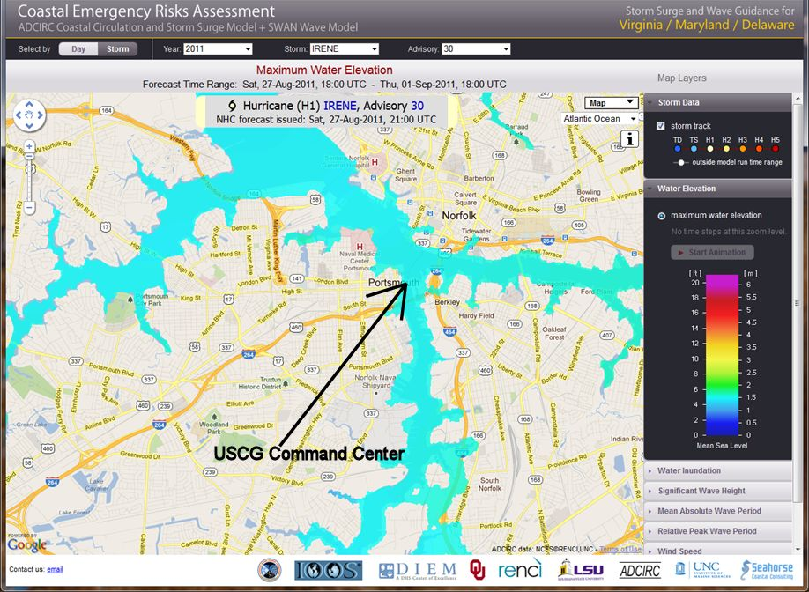
ADCIRC Surge Guidance System (ASGS)
  Results available as images through nc-cera.renci.org
Hurricane Irene
August 25 – 29, 2011

Slide 31
ADCIRC Forecasting Systems
Distributed geographically:
There are currently 5-6 ADCIRC-based forecast systems running for the US East and Gulf of Mexico coasts.
Typically from Adcirc Surge Guidance System (ASGS, J. Fleming)
Output files are large and distributed across academic and federal data centers
Event-based:
Usually run for tropical cyclone events
How can we provide uniform access to
  different ASGS system outputs
  run by different groups
  on different ADCIRC grids

Slide 32

Use Case: Development Driver
Is there a way to get ADCIRC results without dealing with the grid?
What does ADCIRC say about this?
Forecaster

Slide 33
JHT-funded project to address this
Develop methods that allow Operations to access Research results
Methods must be robust, stable, and easy to use
Minimal bandwidth usage
R→O
And
O→ R

Slide 34
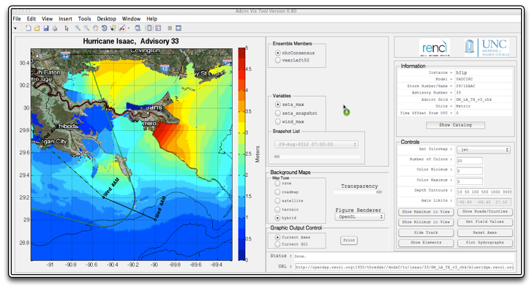
AdcircViz App
Rapid development enabled by standards
Variable Selection
Animation Control
Simulation Details
Map/Viz
Controls
OPeNDAP
URL

Slide 35
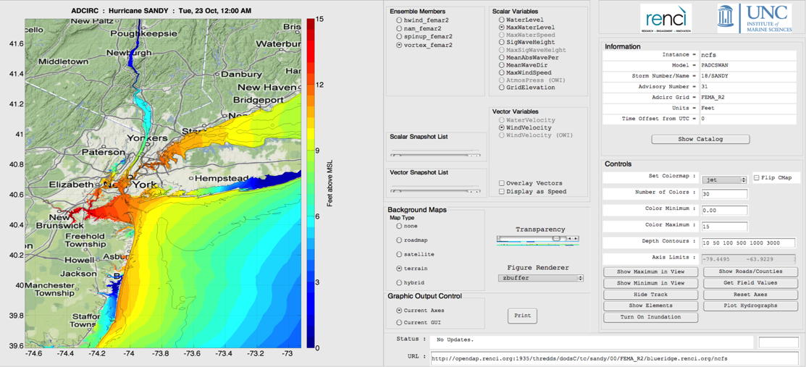
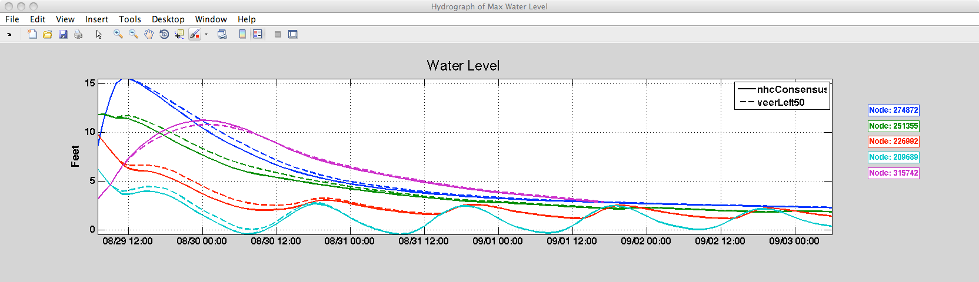
AdcircViz “Clients”
SS Sandy (2012)
Nat’l Hurr. Cen.
NOAA/CSDL
US Coast Guard
USACE
Time Series for several locations
Mini-ensemble from ADCIRC

Slide 36
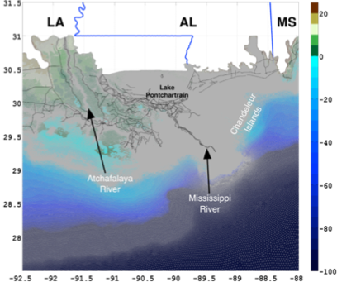
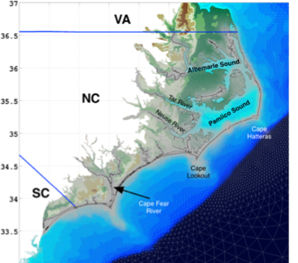
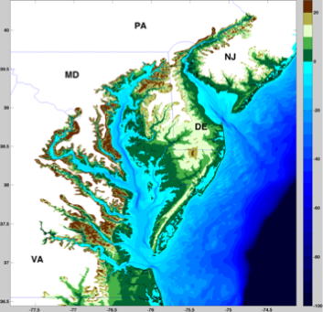
Which Grid?
Applications do not have to ask:
“Which ADCIRC grid was this solution
file computed on?”
Grid extracted from each solution file when needed.
Southern Louisiana (3M nodes)
North Carolina (NCFS) 600K nodes
FEMA Region 3 (1.8M nodes)

