Slide 1


The ARCHER automated TC center-fixing algorithm: Updates on real-time operations, accuracy and capabilities
Anthony Wimmers and Christopher Velden
Cooperative Institute for Meteorological Satellite Studies
University of Wisconsin - Madison
R&D supported by the Naval Research Lab and Office of Naval Research;
Operational evaluation by the NOAA Joint Hurricane Testbed

Slide 2
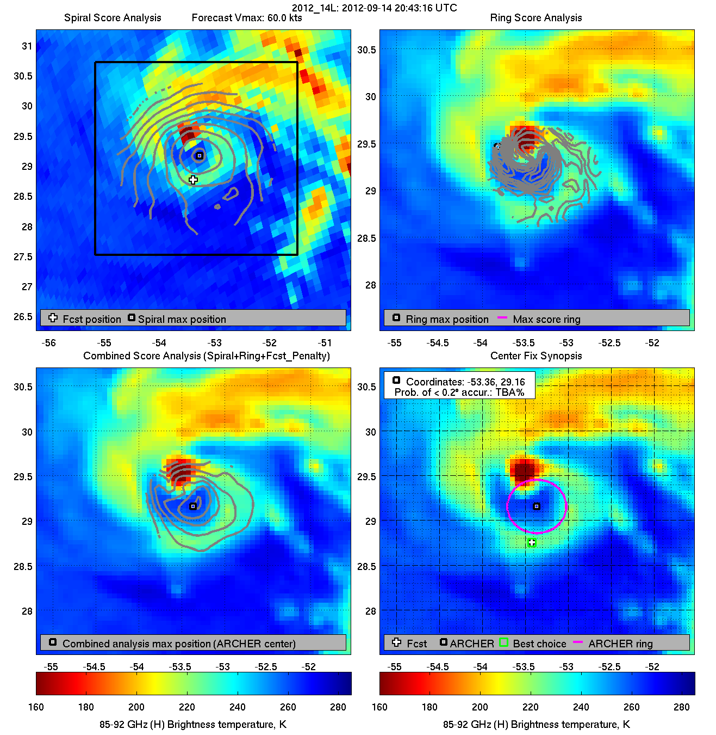
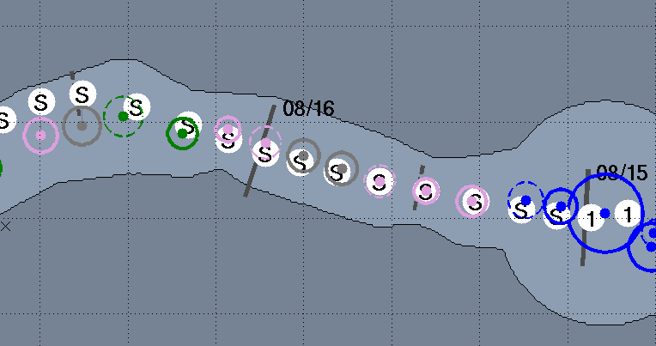
Background: The ARCHER algorithm
Two main components:
  Image analysis
    Parallax adjustment
    Determination of center-fix
    Determination of center-fix certainty (confidence)
    Additional metrics (prob. of eye, eye size, coarse intensity estimate)
  Integration into storm track
    Adjust polar observations to a common timestep, in line with geostationary observations (0245, 0545, etc in NATL)
    Selection of the best observation
    Clean presentation of output

Slide 3

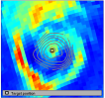
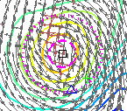
Real-time data sources
Processes imagery in real-time and near real-time from:
  Geo imagers (Visible, IR, SWIR)
  Microwave imagers (37, 85-92 GHz)
    SSMI, SSMIS, TMI, AMSR2, GMI, Windsat
  Scatterometer
    ASCAT
    RapidSCAT (TBA)

Slide 4
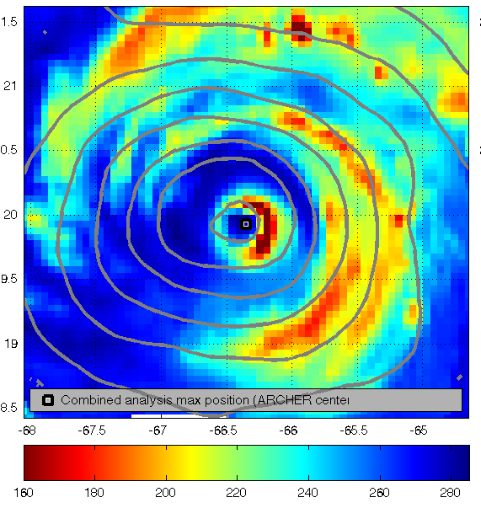
Connections to other research/applications
Rapid intensification (37 GHz – Jiang & Kieper, 85 GHz - Rozoff et al)
Automated Dvorak Technique (Velden et al)
Visualization (MIMIC - Wimmers & Velden)
Center fix
TC structure (Cossuth et al)
Climatology (Knapp et al)
85 GHz (H) Bright. Temp.

Slide 5
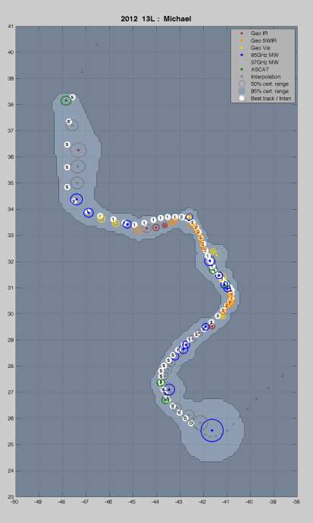
JHT Project
R&D of ARCHER supported by NRL/ONR
The two-year project with the Joint Hurricane Testbed includes:
  Implement an experimental version of ARCHER within JHT framework
  Evaluation and adaptations toward providing an operational, real-time algorithm
  Validation of the ARCHER scheme under simulated real-time conditions
Notes:
We are in Year 2. Last year we presented a validation (#3), but we have more results to share here…

Slide 6
Real-time product features
Main menu
ARCHER product description wiki
TC data/imagery archive
Active TCs
Announcements

Slide 7
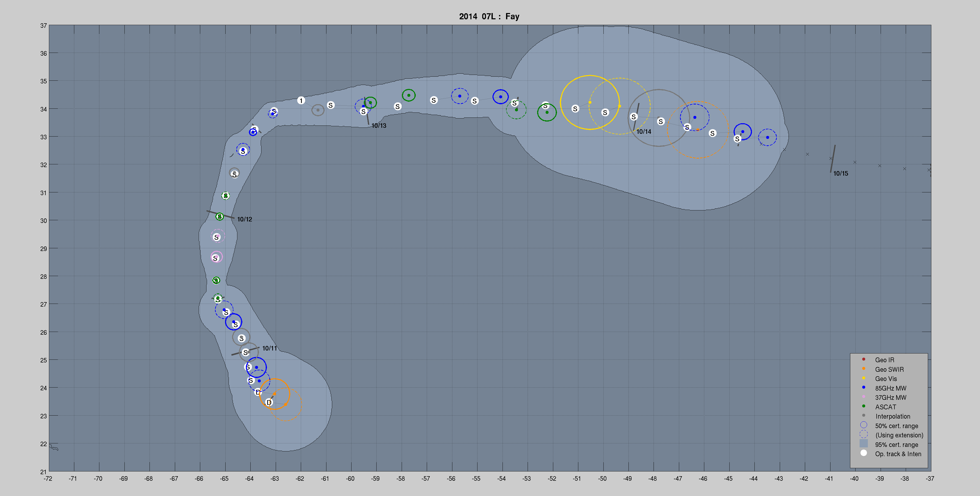
Real-time product features
Track guidance page
Fay (2014)

Slide 8
Real-time product features
Text output

Slide 9
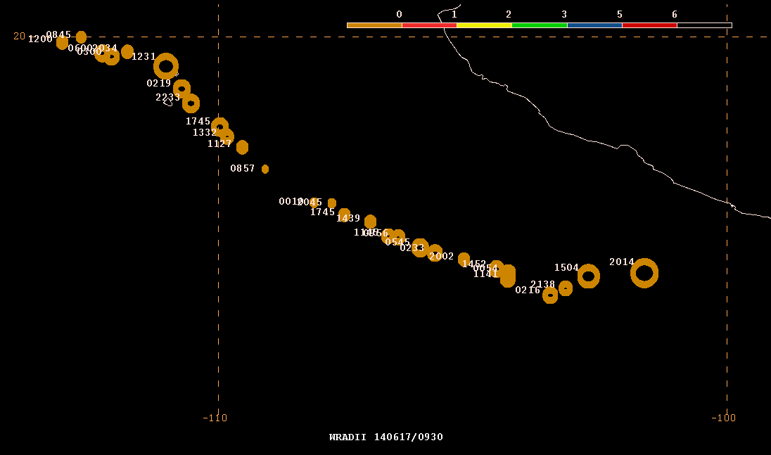
Real-time product features
Text output
NMAP2 Display
Christina (2014)

Slide 10
Real-time product features
Track guidance page
Fay (2014)

Slide 11
Real-time product features
ARCHER image diagnostics
[4x4 diagnostic image]

Slide 12
Real-time product features
ARCHER image diagnostics
[4x4 diagnostic image]

Slide 13
Real-time product features
ARCHER image diagnostics
[4x4 diagnostic image]

Slide 14
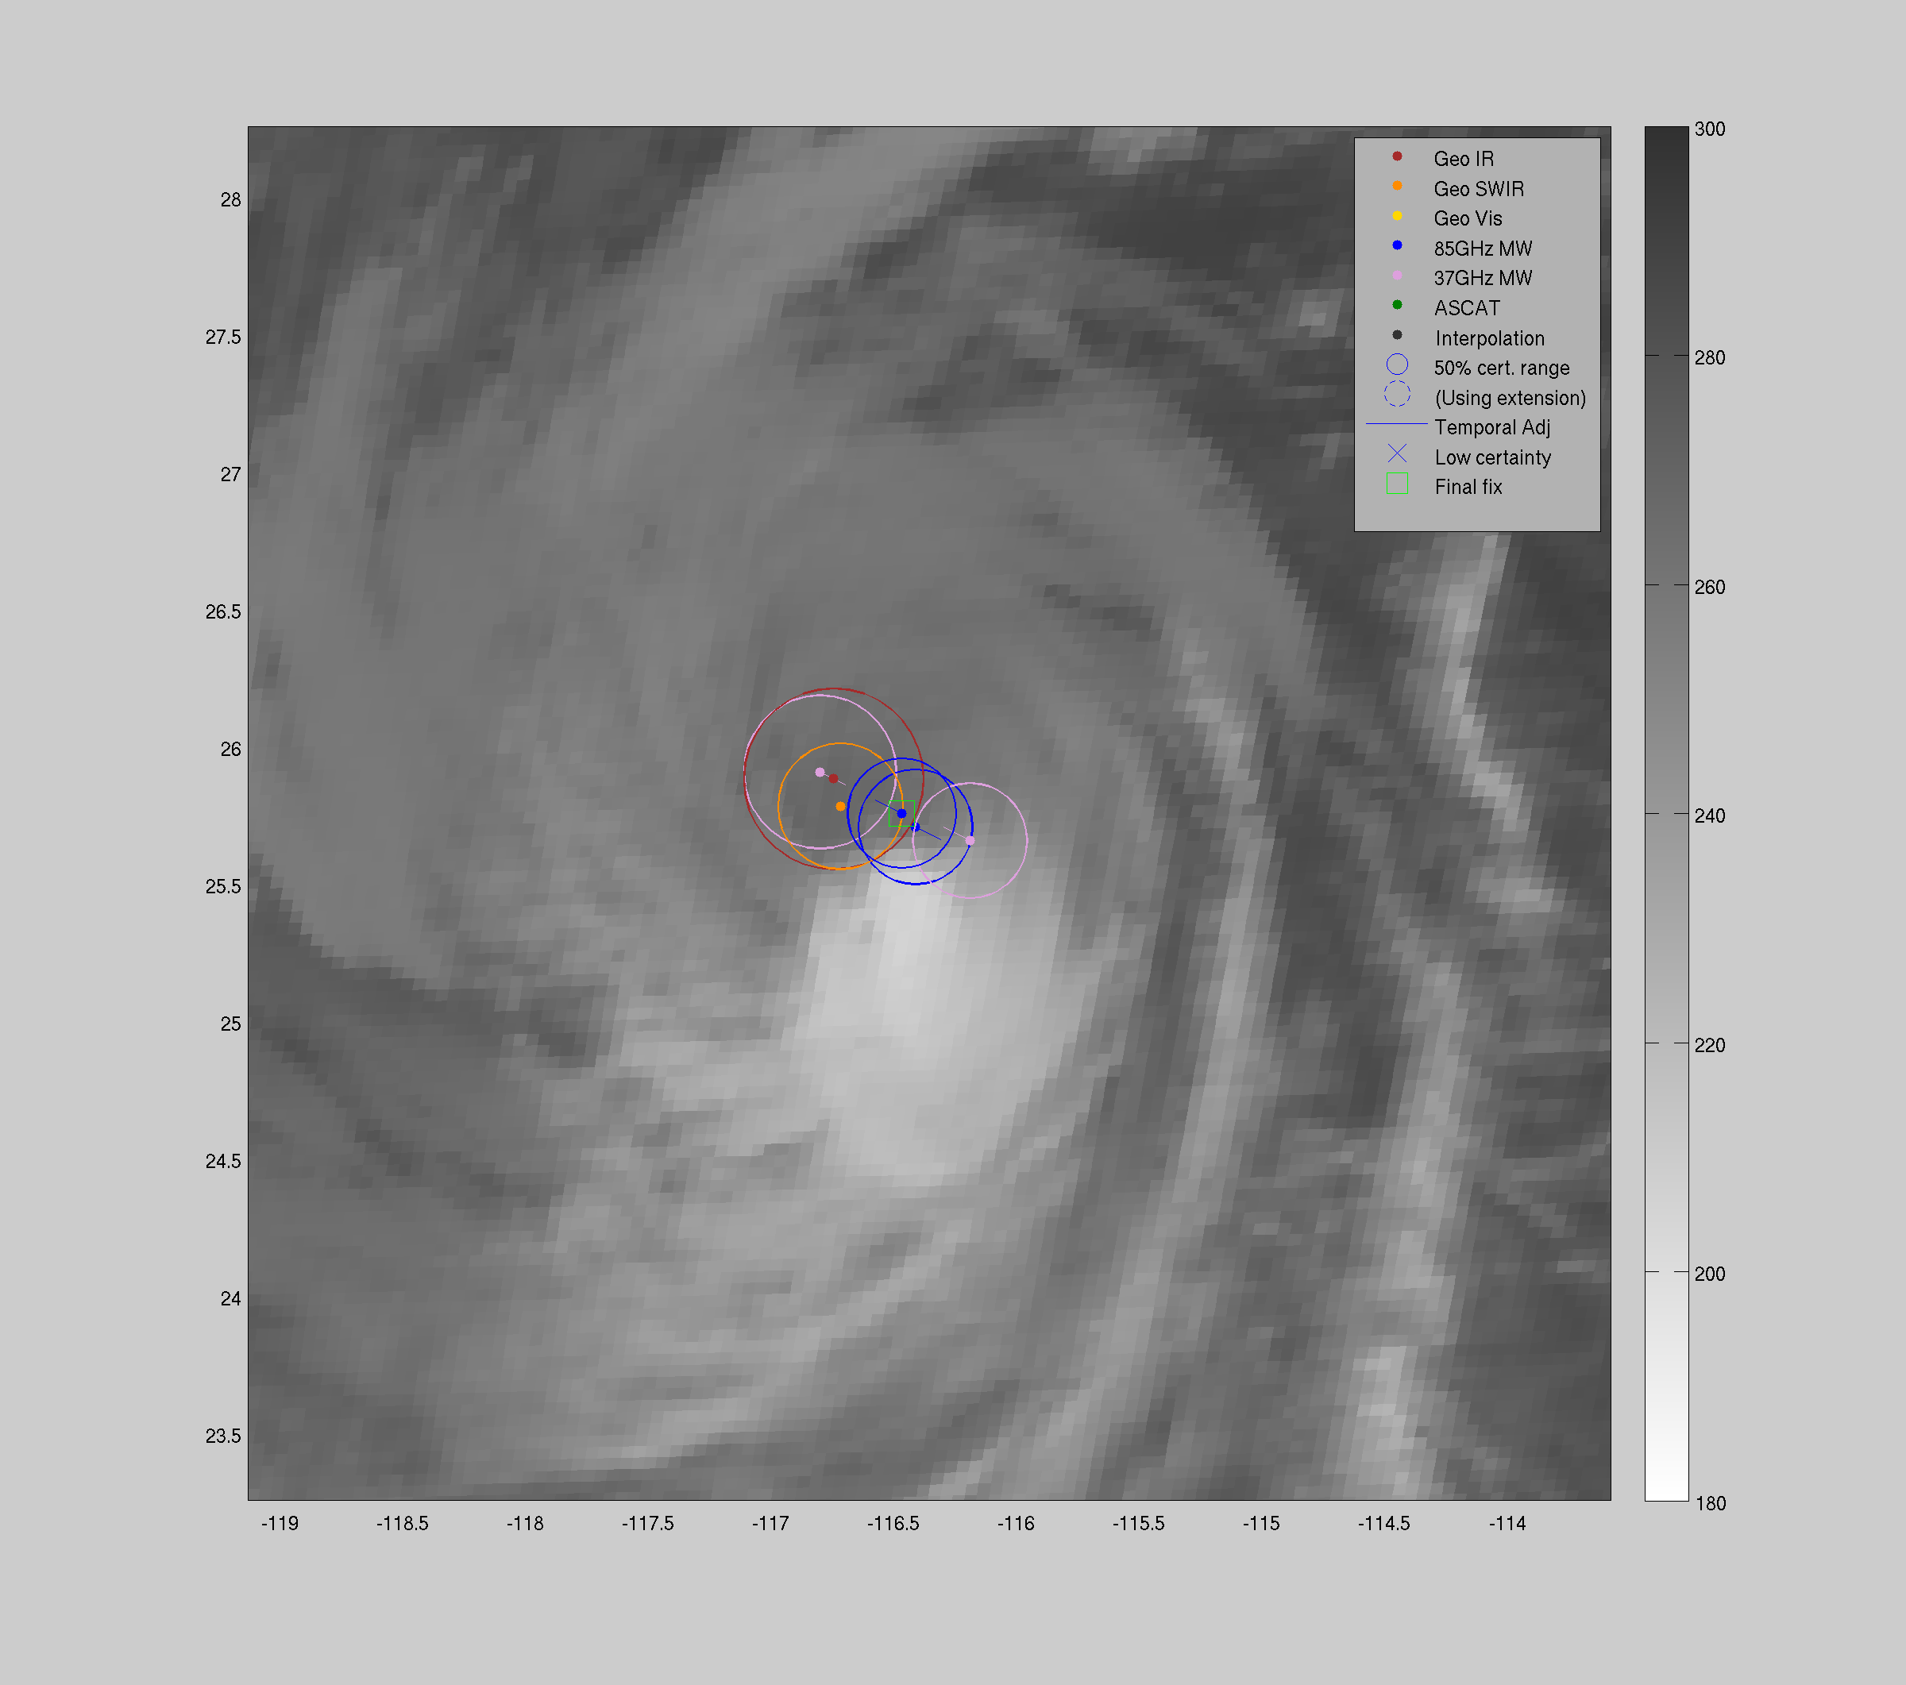
Real-time product features
ARCHER “best-center” selection diagnostic

Slide 15
Real-time product features
ARCHER “best-center” selection diagnostic

Slide 16
Real-time product features
ARCHER “best-center” selection diagnostic

Slide 17
Real-time product features
ARCHER “best-center” selection diagnostic
Geo IR
37 GHz
Geo SWIR
85 GHz

Slide 18
ARCHER: Performance
Fay (2014)

Slide 19
ARCHER: Performance
Fay (2014)

Slide 20
ARCHER: Performance
85 GHz
Fay (2014)
(interpolation)
ASCAT
37 GHz
ASCAT
85 GHz

Slide 21
ARCHER: Performance
Fay (2014)

Slide 22
ARCHER: Performance
Fay (2014)
85 GHz
(interpolation)
85 GHz
Geo SWIR

Slide 23
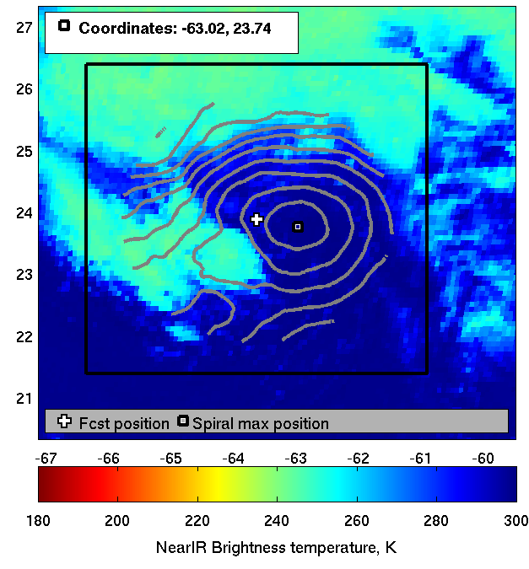
ARCHER: Performance
Fay (2014)
85 GHz
(interpolation)
85 GHz
Geo SWIR

Slide 24
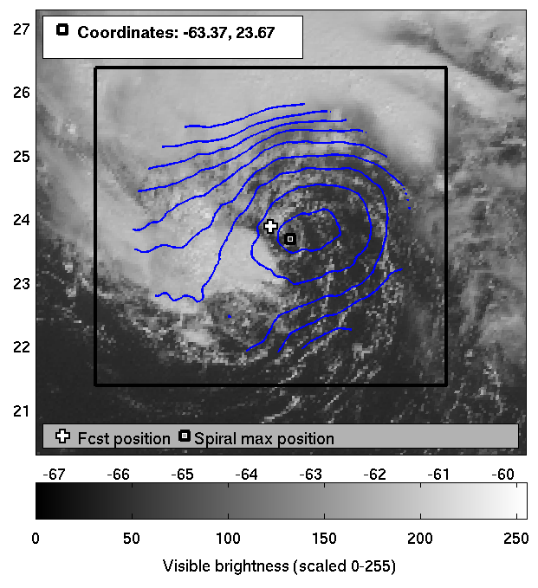
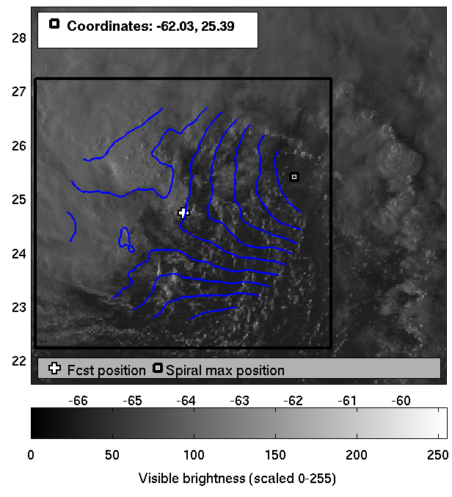
ARCHER: Performance – Visible imagery
GOOD: Fay (2014)
BAD: Bertha (2014)

Slide 25
Validation: Quantitative results
What is the median ARCHER position error with respect to the best track? (2012 NATL)
 | TD - TS | Cat 1 | Cat 2-5
Real-time | 38 km | 29 km | 18 km
Near real-time | 32 km | 24 km | 17 km

Slide 26
Validation: Quantitative results
How often does ARCHER outperform alternative center-fixing methods?
 | TD - TS | Cat 1 | Cat 2-5
SAB fix | 31% / 40% | 25% / 42% | 21% / 26%
TAFB fix | 37% / 43% | 25% / 44% | 26% / 21%
We will be submitting these results for publication: Wimmers and Velden, “Advancements in objective multi-satellite tropical cyclone center-fixing”
Notes:
We expect improved results for 2014 because of the introduction of 1) 37 GHz data 2) More scatterometer data, and 3) AMSR2 & GMI

Slide 27
On the Horizon
Validation for 2014 season
Addition of RapidSCAT (definite), VIIRS DNB (if possible)
Improvement of Visible channel center-fixing
Improvement in the data ingestor for the first 6 hours of a TC
Final decision to go operational with ARCHER at NHC/TAFB is expected from JHT management at the end of 2015

