Slide 1
Developing a tropical cyclone genesis forecast tool: Preliminary results from 2014 quasi-operational testing
Daniel J. Halperin¹, Robert E. Hart¹, Henry E. Fuelberg¹, Joshua H. Cossuth²
¹ Florida State University, ² Naval Research Laboratory
This research is supported by the Joint Hurricane Testbed

Slide 2
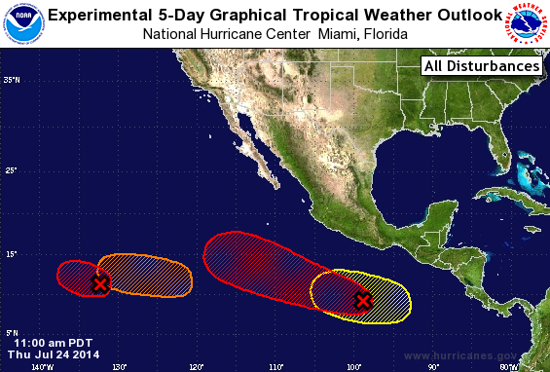
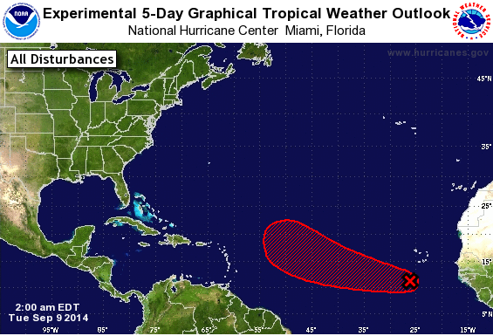
Goal
To create an automated, objective tool that provides probabilistic TC genesis guidance based on global model genesis forecasts.

Slide 3
Background
Our prior research verified tropical cyclone (TC) genesis forecasts out to 5 days in 5 global models over the NATL and EPAC during 2004-2013 (Halperin et al. 2013).
Using results from prior study, developed multiple logistic regression equations of TC genesis probability based on output from each global model.
  Forecast tool provides probabilistic forecasts of TC genesis at 2 and 5 days.
  Tested quasi-operationally during 2014 at http://moe.met.fsu.edu/modelgen

Slide 4
Product examples

Slide 5
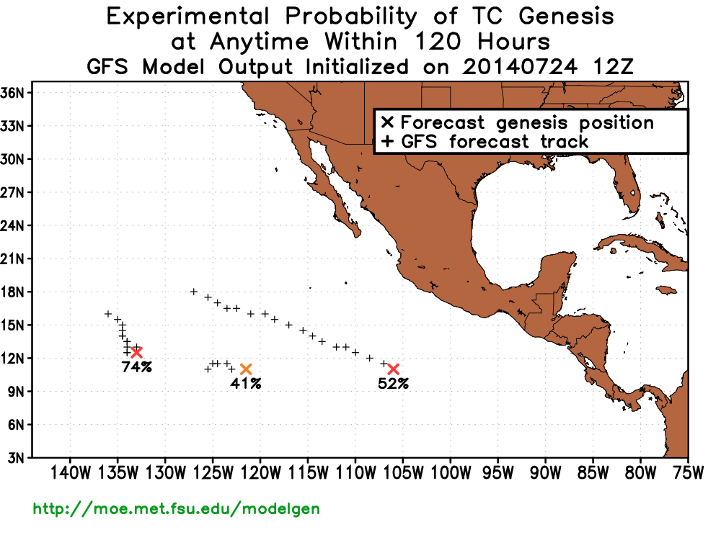
Probability of TC genesis within 120 h – GFS
74%
41%
52%
#1
#3
#2
How to calculate genesis probability:

Slide 6
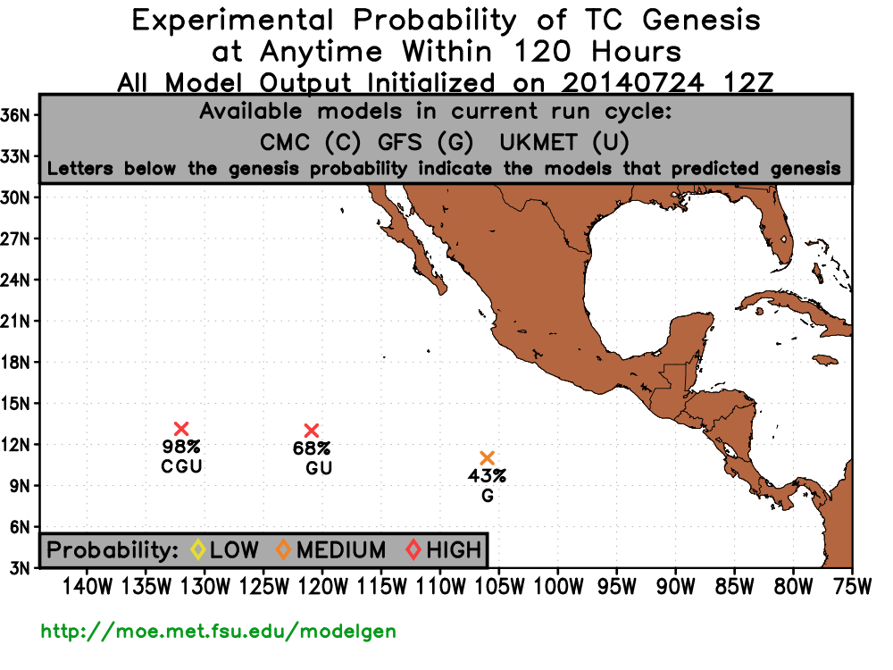
Probability of TC genesis within 120 h – CON
98%
68%
CGU
GU
43%
G
How to calculate consensus forecast:

Slide 7
2014 Preliminary Verification

Slide 8
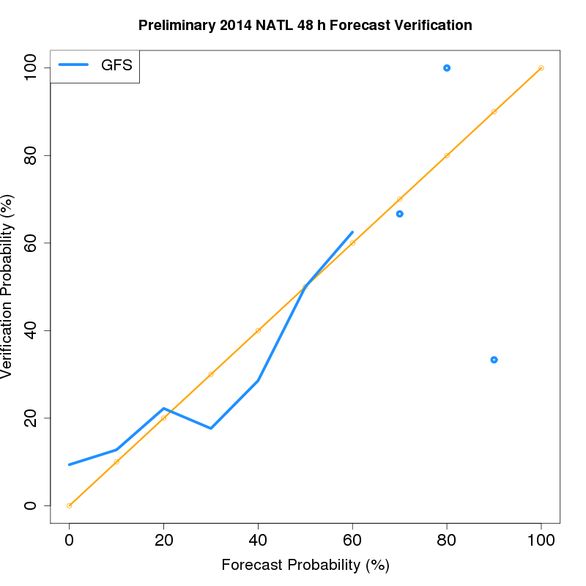
NATL 48 h preliminary 2014 verification
Underprediction
Overprediction

Slide 9
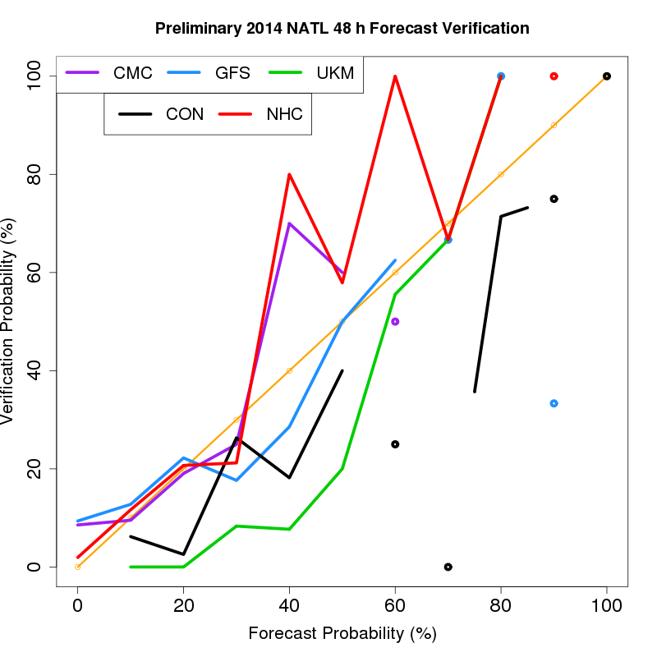
NATL 48 h preliminary 2014 verification (non-homogeneous)
NHC, GFS, and CMC well calibrated at lower probability bins.
NHC and CMC underpredict at higher probability bins.
CON and UKM overpredict at all probability bins.
Small sample size (points/breaks in lines) at higher forecast probability bins.
Underprediction
Overprediction

Slide 10
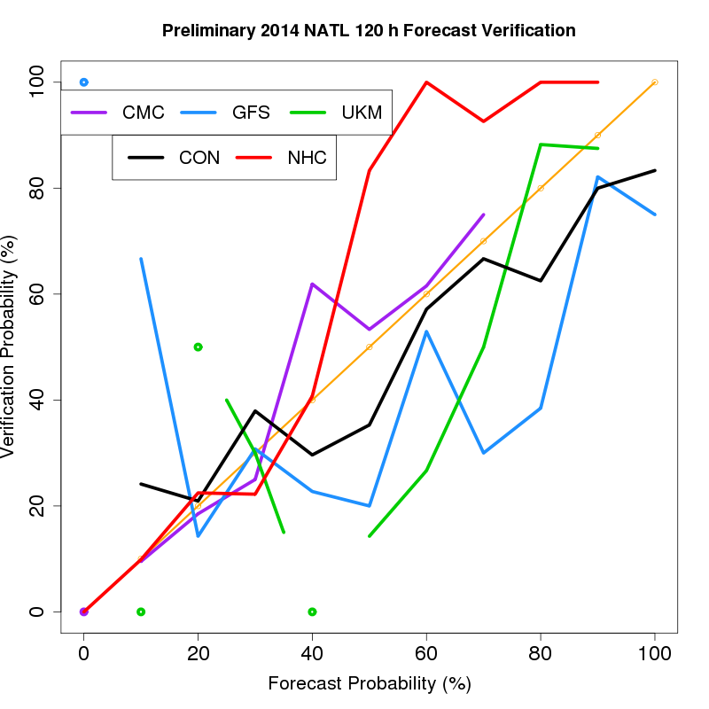
NATL 120 h preliminary 2014 verification (non-homogeneous)
NHC well calibrated at lower probability bins, underpredicts at higher bins.
CON and CMC fairly well calibrated.
GFS and UKM overpredict at most probability bins.
Underprediction
Overprediction

Slide 11
Potential explanations for performance
Below average activity over NATL.
Dry air impacting several AEWs over MDR.
Despite relatively high number of false alarms, CMC may have more consistent biases which regression was able to correct.
UKM model upgrade (horizontal resolution, dynamical core).
Poor predictor selection and higher false alarm rate compared to 2010-2013 for GFS.

Slide 12
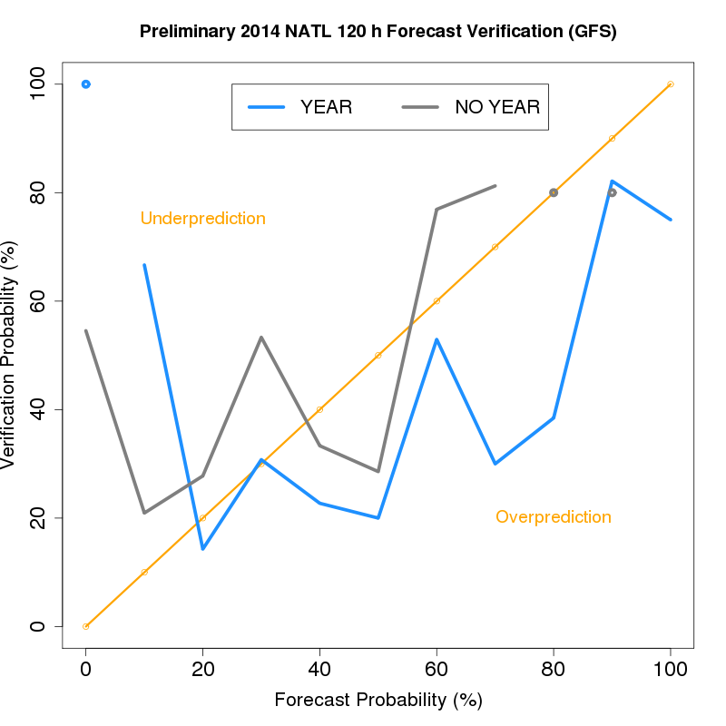
NATL 120 h preliminary 2014 verification (GFS)
Quasi-operational regression equation overpredicted genesis at most forecast probability bins.
Regression equation with year removed as a predictor shows a general shift to lower forecast probabilities.

Slide 13
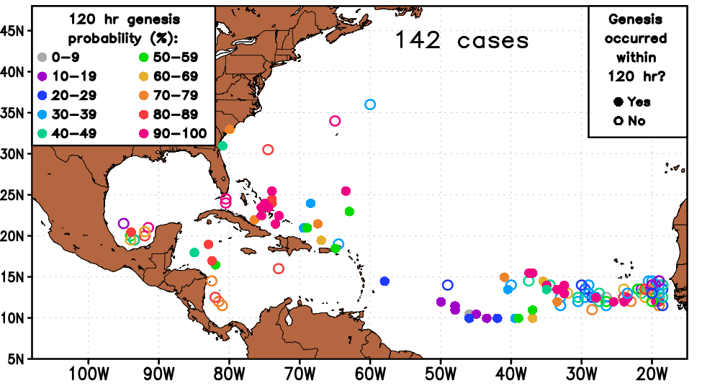
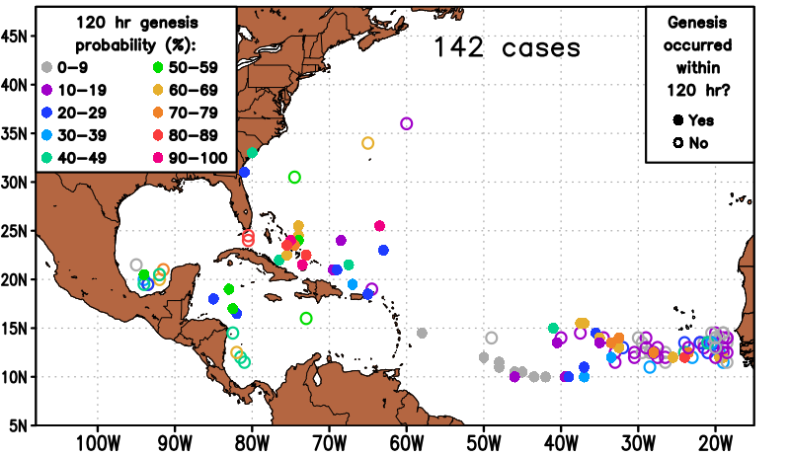
2014 GFS TC Genesis Forecasts
N=142
Quasi-operational (top) probabilities relatively higher overall. Note many of the false alarms over MDR were mid-range probabilities.
Probabilities with year removed (bottom) lower over MDR, W CARIB, GOM. But, lower probabilities for Bertha.
Quasi-operational
(year included)
Year removed

Slide 14
Summary
Automated, objective statistical-dynamical TC genesis guidance products were tested quasi-operationally during 2014.
With some exceptions, the logistic regression equations generally provide well calibrated guidance.
Year-to-year changes in model configurations and large-scale basin conditions prevent potentially higher reliability.
Homogeneous comparisons of NHC TWO and the consensus regression model forecast verification indicate that the guidance products provide added value at the higher forecast probability bins (not shown).

Slide 15
Plans for 2015
Update regression equations with 2014 cases included in the historical dataset.
If real-time data are available, add ECMWF based products to the guidance suite.
Test products quasi-operationally this season.
http://moe.met.fsu.edu/modelgen

Slide 16
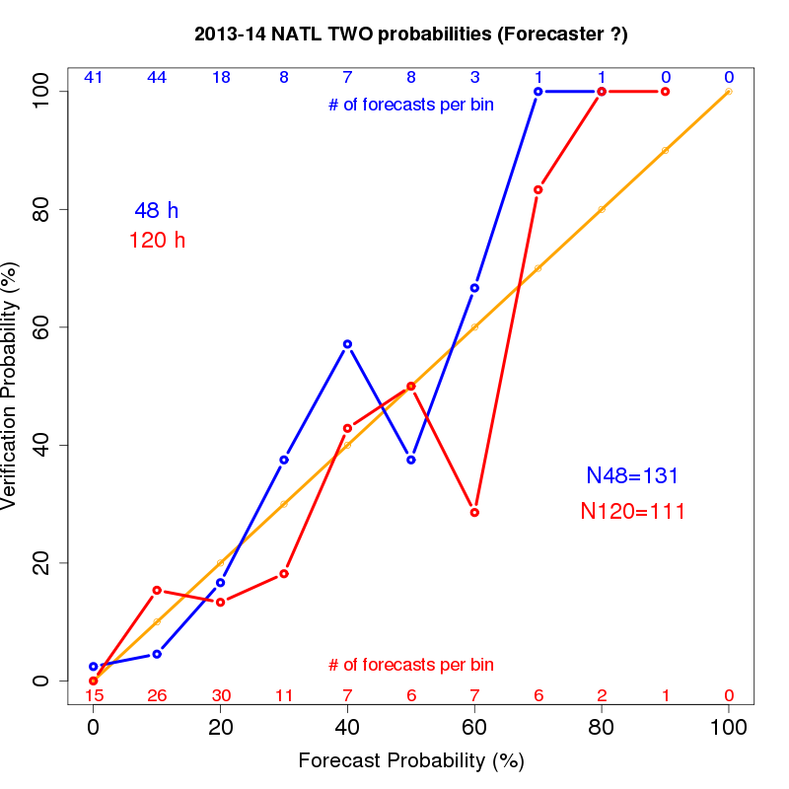

Slide 17
Backup Slides

Slide 18
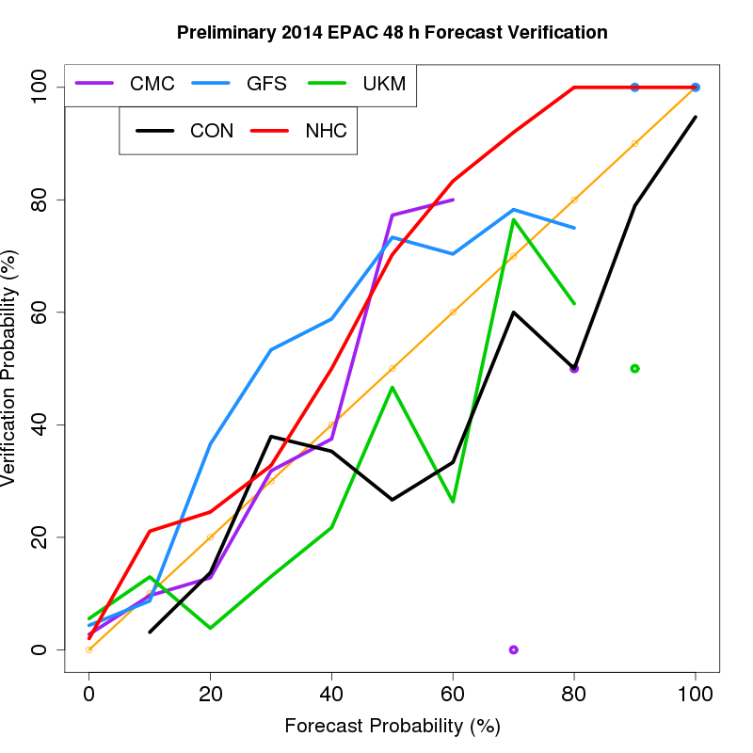
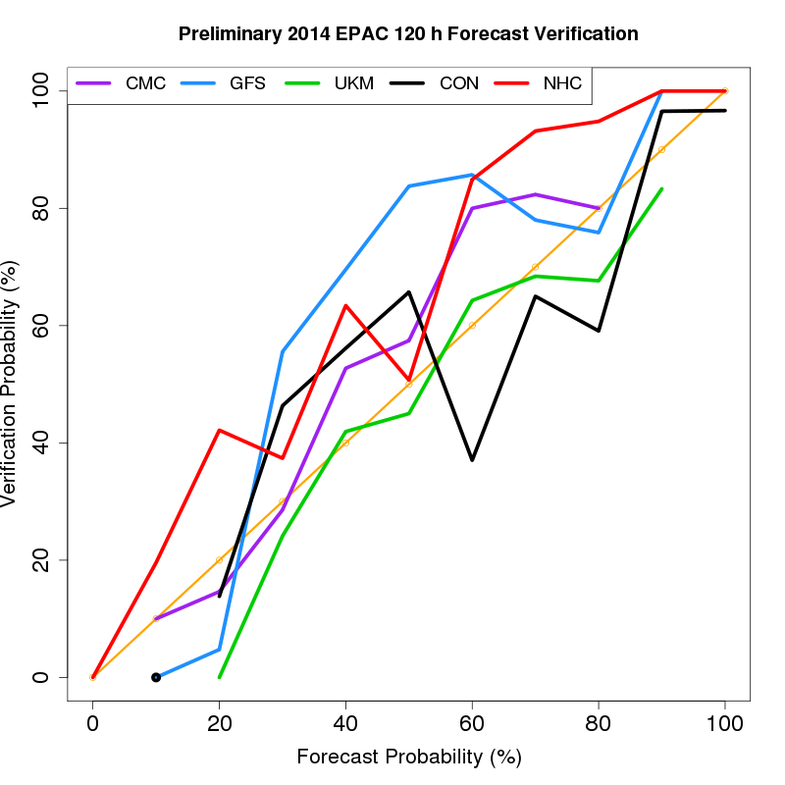
EPAC 48 h preliminary 2014 verification (non-homogeneous)
EPAC 120 h preliminary 2014 verification (non-homogeneous)
Underprediction
Underprediction
Overprediction
Overprediction

Slide 19
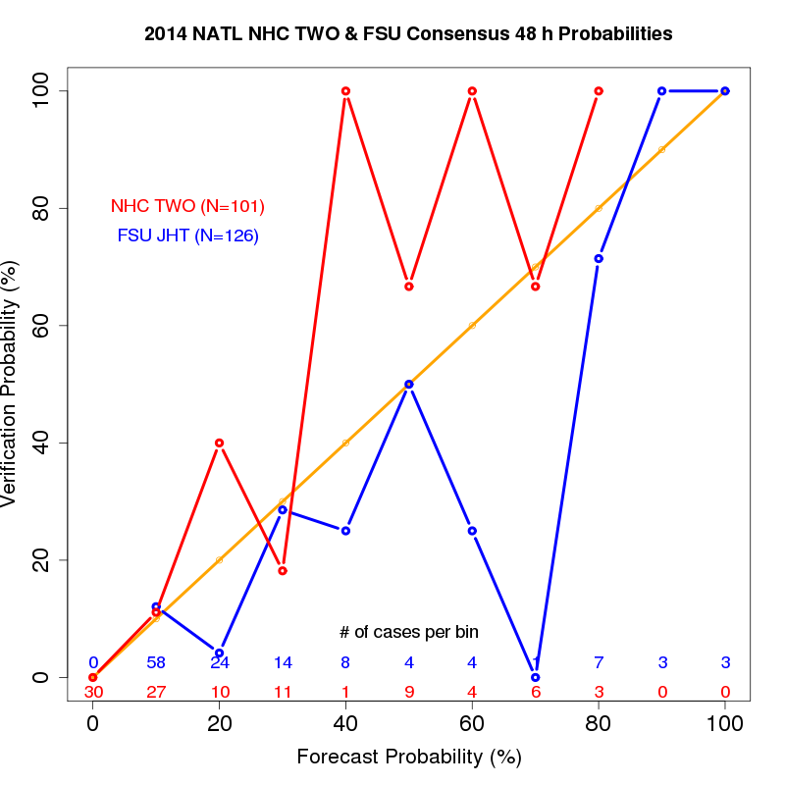
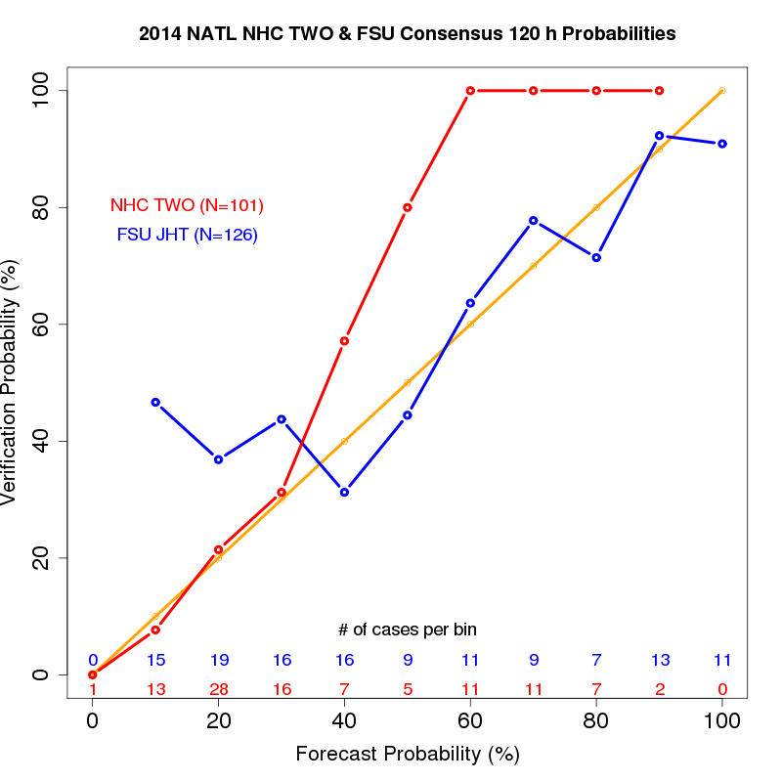
NATL 48 h preliminary 2014 verification (homogeneous)
NATL 120 h preliminary 2014 verification (homogeneous)
Underprediction
Underprediction
Overprediction
Overprediction

Slide 20
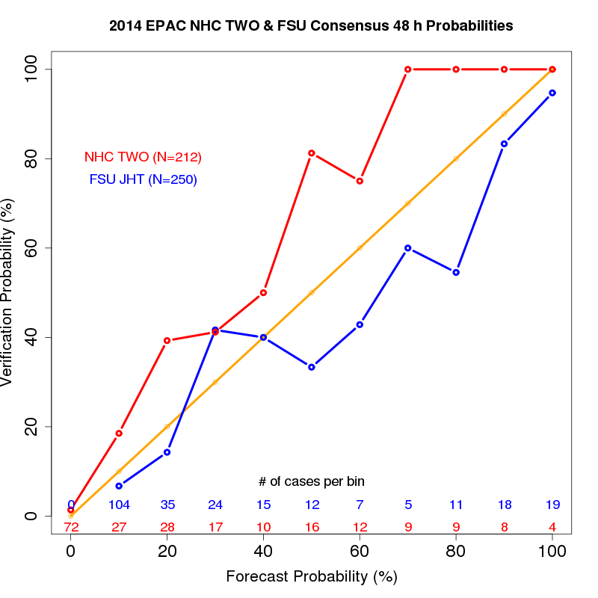
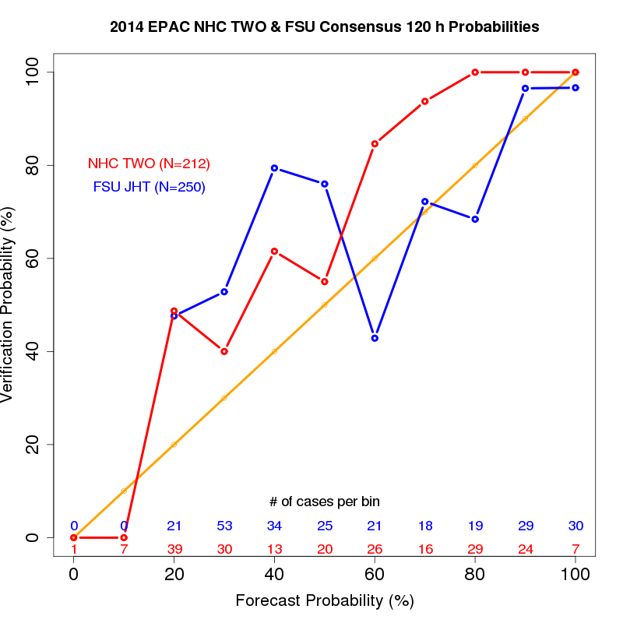
EPAC 48 h preliminary 2014 verification (homogeneous)
EPAC 120 h preliminary 2014 verification (homogeneous)
Underprediction
Underprediction
Overprediction
Overprediction

Slide 21
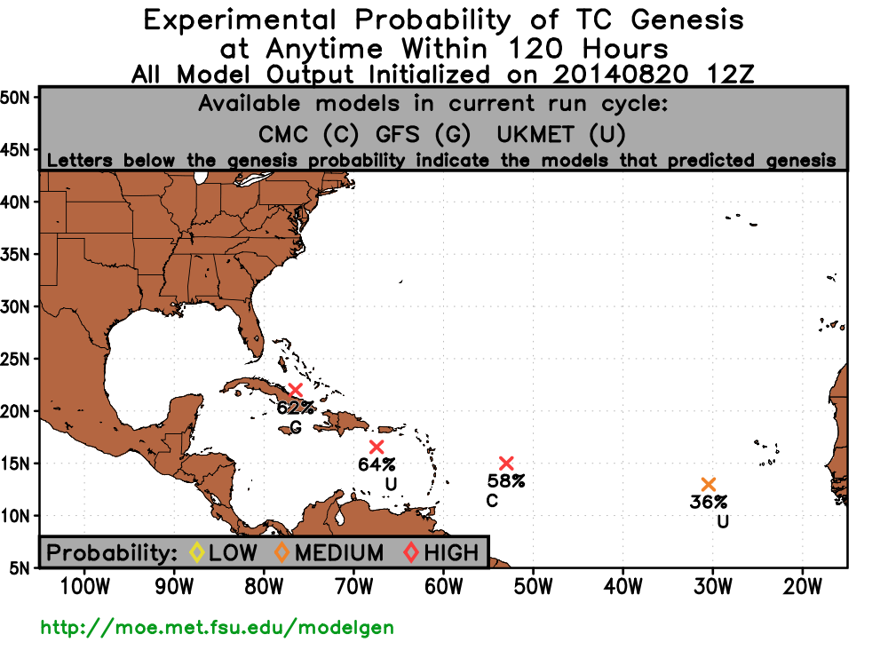
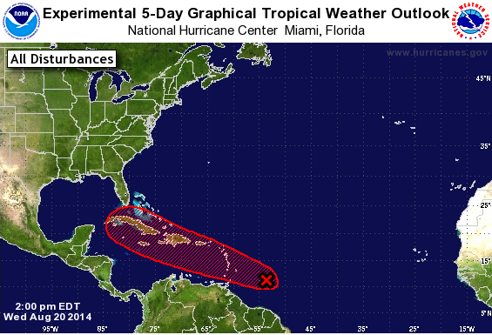

Slide 22
BRIER SCORES (NON-HOMOGENEOUS DATASET)
BASIN/TIME | NHC TWO | FSU JHT Consensus
NATL48 | 0.088 | 0.097
NATL120 | 0.129 | 0.209
EPAC48 | 0.116 | 0.103
EPAC120 | 0.194 | 0.198
BRIER SCORES (HOMOGENEOUS DATASET)
BASIN/TIME | NHC TWO | FSU JHT Consensus
NATL48 | 0.119 | 0.131
NATL120 | 0.152 | 0.225
EPAC48 | 0.131 | 0.139
EPAC120 | 0.176 | 0.224

Slide 23
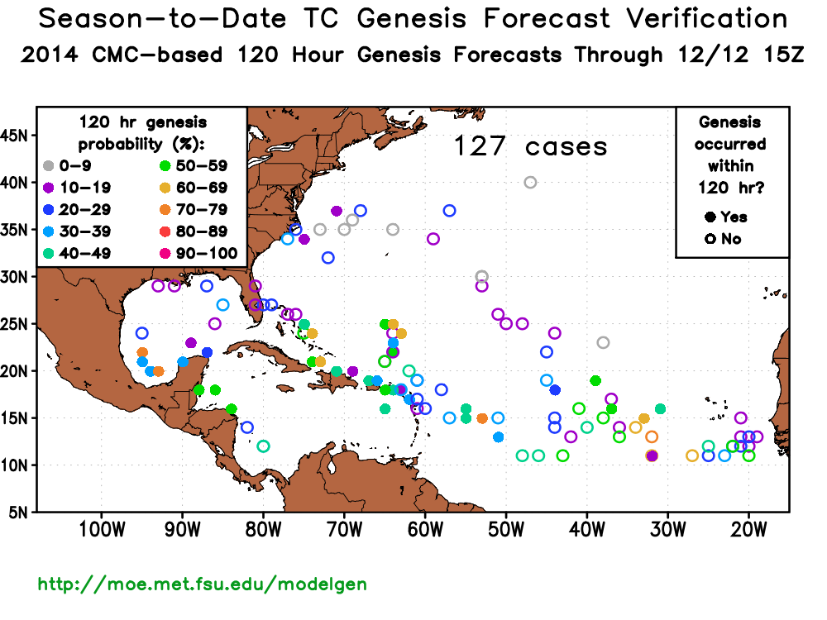

Slide 24
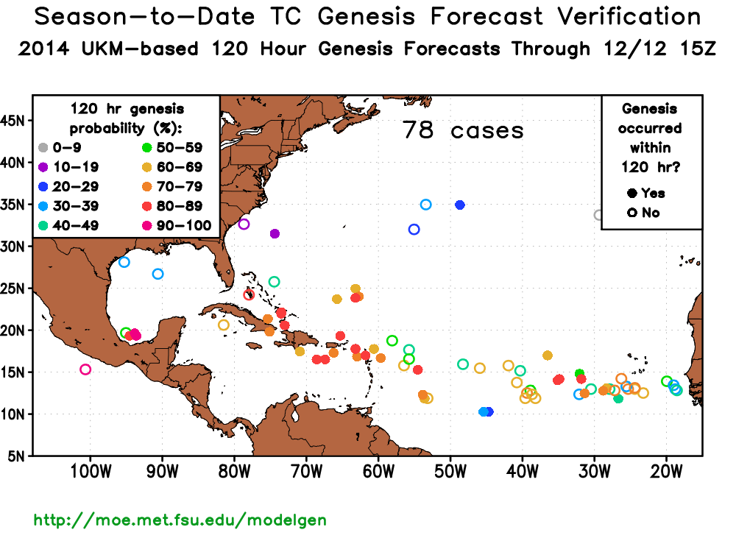

Slide 25
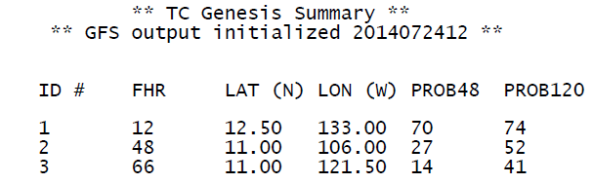
(%)
(%)
Probability of TC genesis within 120 h – GFS
74%
41%
52%
#1
#3
#2

Slide 26
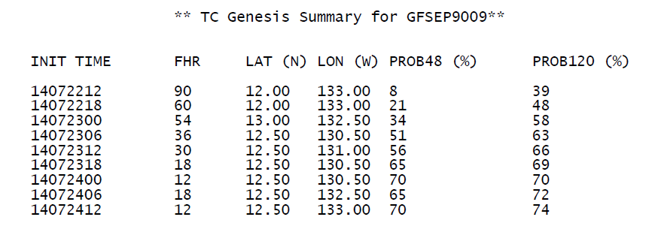
Probability of TC genesis within 120 h – GFS
74%
41%
52%
#1
#3
#2

Slide 27
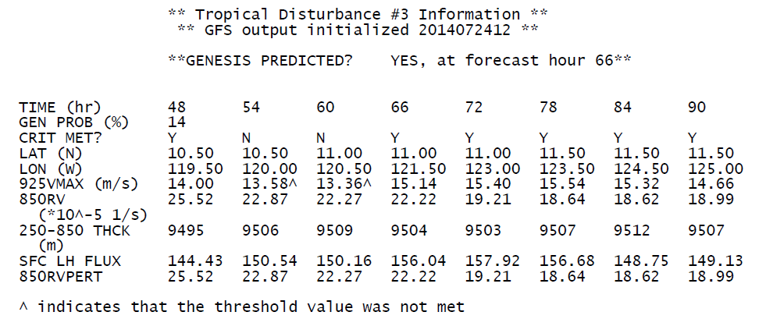
#1
#2
74%
41%
52%
#3

