Slide 1


Upgrades to the operational Monte Carlo wind speed probability program
A. Schumacher, CIRA/Colorado State University
NHC Points of Contact: M. DeMaria, D. Brown, M. Brennan, R. Berg, C. Ogden, C. Mattocks, and C. Landsea
Joint Hurricane Testbed Update
Tropical Cyclone Research Forum/69th IHC, 2-5 March 2015
Presenter email: andrea.schumacher@colostate.edu

Slide 2
Outline
Proposed 7 improvements / updates to MC model that reflect feedback from NHC forecasters
  Improve time interpolation scheme
  Apply bias-correction to model track error statistics
  Apply bias-correction to radii-CLIPER model when official radii forecasts exist
  Integrated GPCE guidance for NHC forecasters
  Arrival and departure estimates of 34, 50, and 64-kt winds
  Extend MC model to 7 days (April-May 2015)
  Software upgrade (May-June 2015)
Impacts on MC model performance
Plans for 2015 season

Slide 3
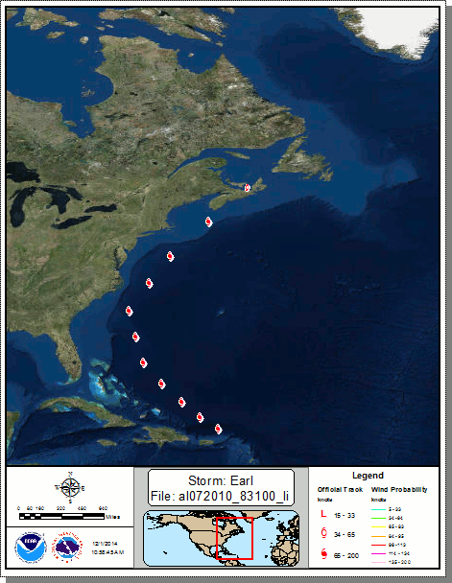
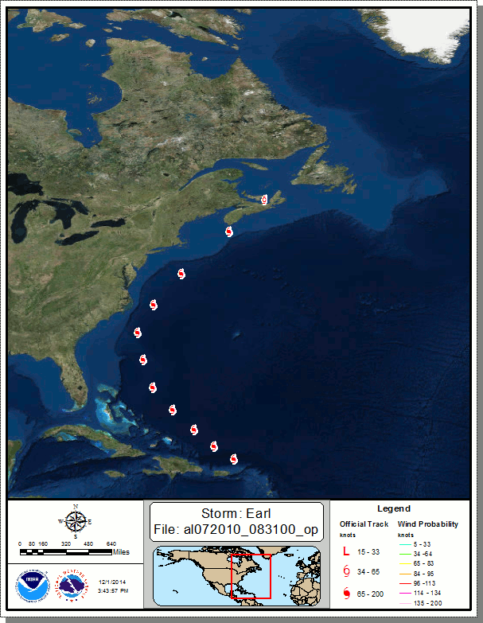
1. Improve time interpolation scheme
Linear interpolation between time steps introduces track errors
  Slight eastward bias for recurving TCs
  On order of ±1-5%
Replaced with spline fit to generate smoother, more realistic tracks
Spline interpolation option added for
  official forecast
  forecast realizations
Implemented in 2015 operational MC model
Earl on 31 Aug 2010 at 0Z – using linear interpolation (left) vs. spline (right)
*Images courtesy of Casey Ogden, NHC

Slide 4
2. Bias correction to error statistics
Error statistics used to develop wind speed probabilities are slightly different than the official NHC errors
  Include non-tropical systems (extratropical, post-tropical)
Updated MC model error statistics to match NHC errors statistics
Benefits
  Improve consistency between NHC uncertainty products
  In future, can create cone that can increase and decrease based on GPCE parameter
Serial correlation still introduces a small bias

Slide 5
How this effected MC model error statistics
Average track errors were decreased 10-15% at all forecast times in both basins
Average intensity errors were increased ~10% in the Atlantic and 15-30% in the E. Pacific at all forecast times

Slide 6
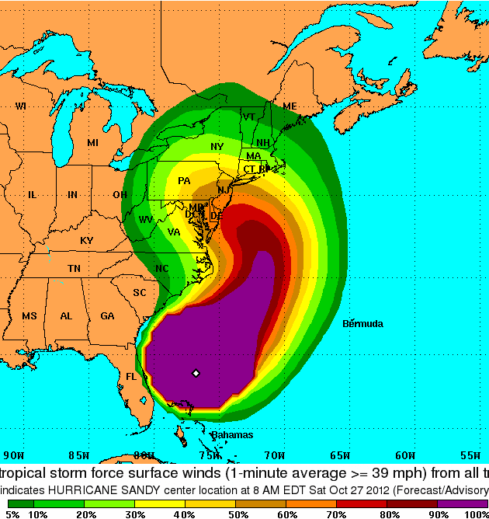
3. Radii bias correction
Official wind radii not available for all forecast periods to 5 days
  72 h for R34 and R50
  36 h for R64
MC model uses radii-CLIPER for 34, 50, and 64-kt wind radii estimates at all times
  Contribution of persistence has e-folding time of 32 h (DeMaria et al. 2009)
  For TCs much smaller (larger) than climatology, radii-CLIPER potentially overestimates (underestimates) radii for t > 32 h
Introduces bias to wind speed probabilities
  Eg. Hurricane Sandy (right)
  R34 much larger than climatology
  Along NJ coast, probabilities 50-60% (left)
  With bias correction, probs 70-80% (right)
Fix (In Progress)
  Develop method to use all available wind radii from NHC forecast to consistently bias correct radii-CLIPER
  Use error serial correlation to extend influence beyond NHC radii forecast
Sandy, 10/27/12 12Z

Slide 7
Proposed radii bias correction
For 34, 50, or 64-kt wind thresholds…
r_{e} = ensemble mean radius
r_{o} = official forecast radius
t_{last} = last time official radius forecast available
BC(t) = w(t) * [r_{e}(t) – r_{o}(t)]
For t ≤ t_{last}, w(t) = 1.0
For t > t_{last},
w(t) = e^{-[(t-tlast)/D]}
where D is the e-folding time

Slide 8
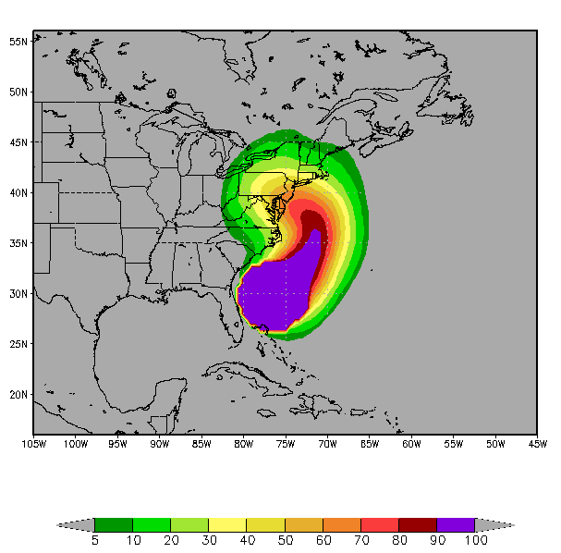
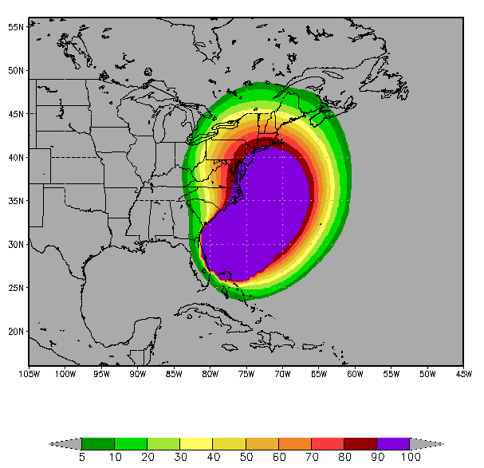
Example of radii bias correction incorporated into mc model
With Radii Bias Correction
e-folding time of 32 h
Current Algorithm
Sandy, 10/27/12 12Z

Slide 9
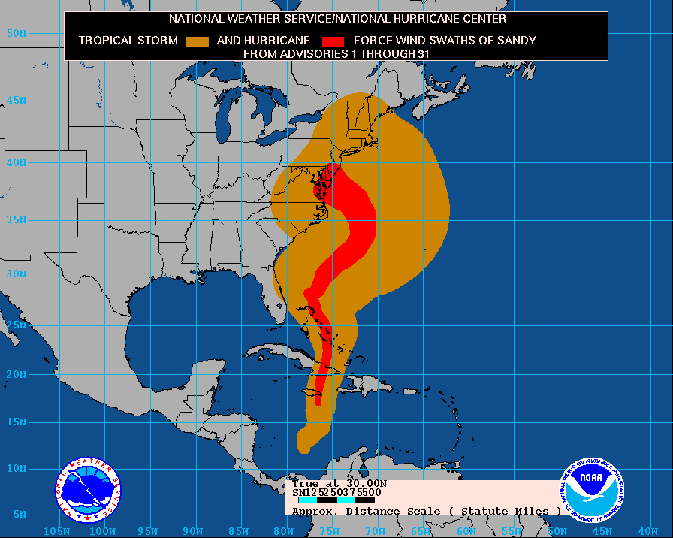
Example of radii bias correction incorporated into mc model
With Radii Bias Correction
e-folding time of 32 h
Current Algorithm
Sandy, 10/27/12 12Z

Slide 10
Impacts of updates on WSP Brier scores, 2011-2013 Atlantic sample
Spline interpolation and radii bias correction improve WSPs at all forecast times
Matching error statistics to NHCs improves WSP at early times but degrades verification after 1.5-2 days

Slide 11
4. Time-Integrated GPCE Guidance
DeMaria et al. 2013 showed relationship between GPCE terciles and track forecast error distribution
  Low (high) GPCE values correspond to less (more) spread
  Motivated use of GPCE parameter to modify MC model
Developed time-integrated measure of GPCE information used in MC model
  Provide forecasters 3-category measure of confidence for entire track forecast (low/med/high)
Time-averaged normalization
  Normalize all GPCE values and forecast error by their standard deviation at that forecast time
  Then, average over selected range of time (here 0-5 days, 0-2 days, and 3-5 days)
Examined 2008-2012 Atlantic cases
  Both forecast errors and GPCE must be available to 5 days (N=718)

Slide 12
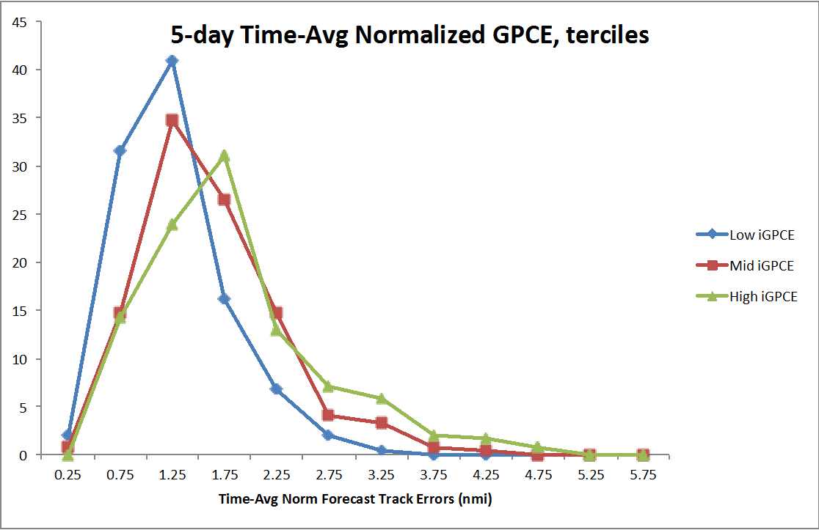
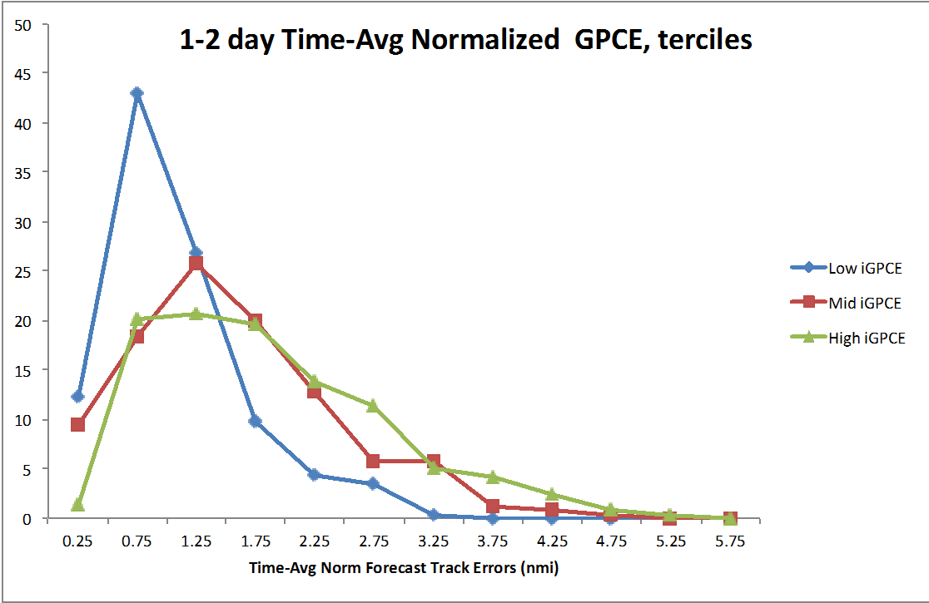
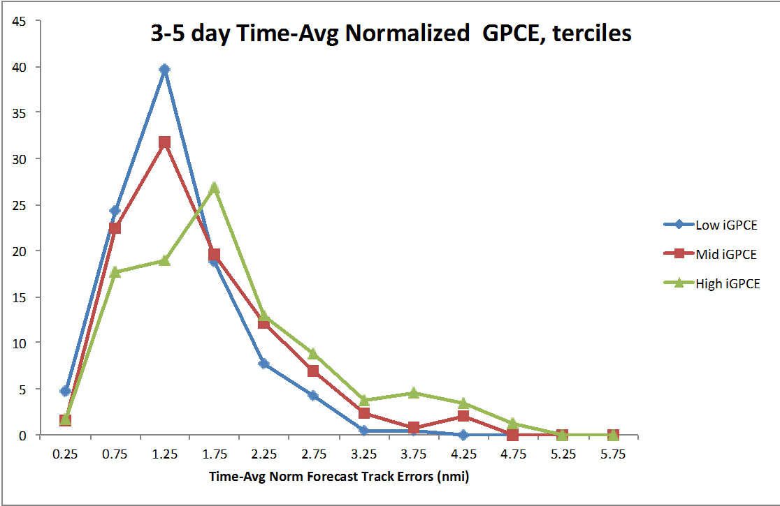
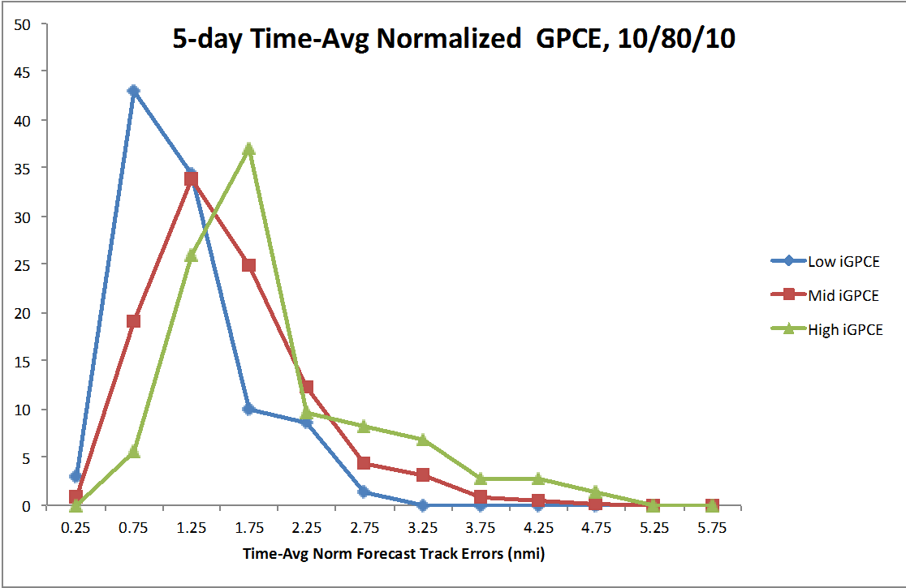
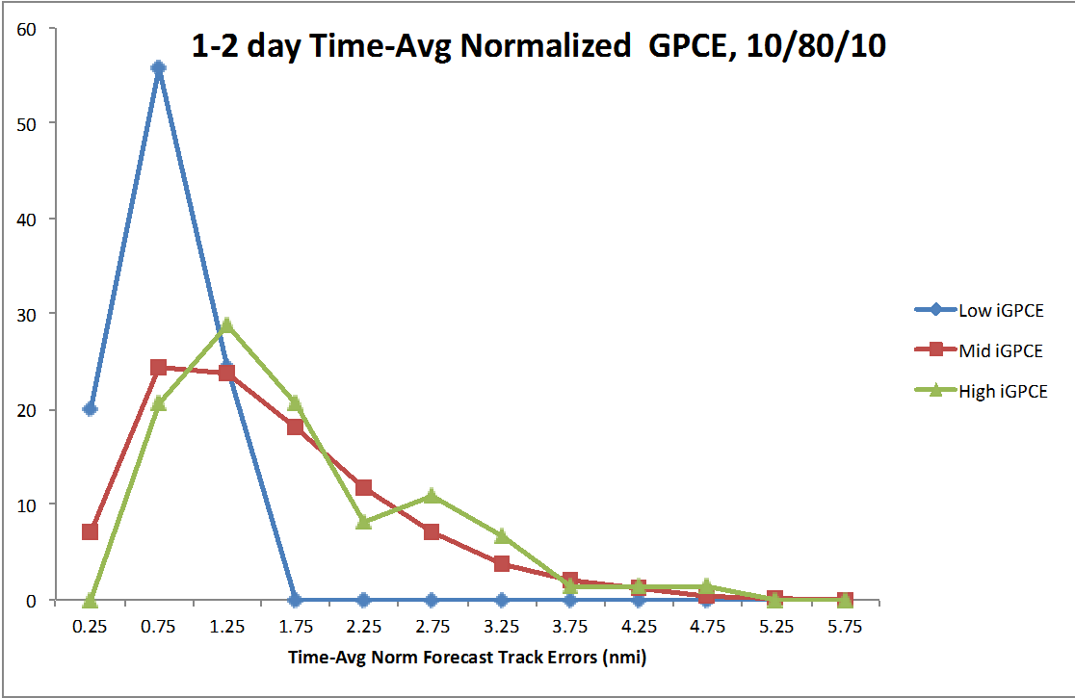
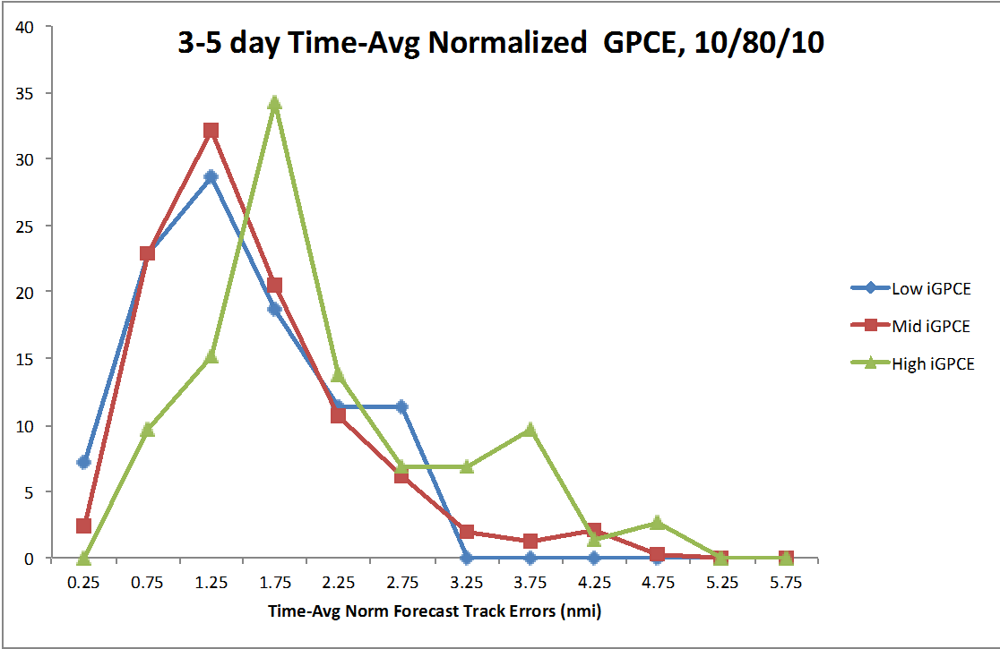
Time-Averaged Normalized GPCE (TANG) parameters, 2008-2012 ATL
Terciles (33/33/33)
Days 1-5
Days 1-2
Days 3-5
10/80/10
Days 1-5
Days 1-2
Days 3-5

Slide 13
TANG classification examples
Low GPCE Days 1-2, High GPCE Days 3-5 |  |  |  |  |  |  |  |  |  |  | TANG 1-2day |  | TANG 3-5day |  | TANG 0-5day
Fcst Hr | 12 | 24 | 36 | 48 | 60 | 72 | 84 | 96 | 108 | 120 | 10/80/10 | 33/33/33 | 10/80/10 | 33/33/33 | 10/80/10 | 33/33/33
AL172012 101512 | 33 | 54 | 69 | 86 | 130 | 174 | 240 | 306 | 382 | 458 | M | L | M | H | M | H
AL182011 102606 | 23 | 42 | 66 | 97 | 154 | 211 | 333 | 455 | 607 | 759 | L | L | H | H | H | H
AL162011 093006 | 26 | 46 | 71 | 100 | 148.5 | 197 | 279 | 361 | 427.5 | 494 | M | L | H | H | M | H
AL062010 082706 | 21 | 42 | 65 | 100 | 137.5 | 175 | 226 | 277 | 328 | 379 | L | L | M | H | M | M
High GPCE Days 1-2, Low GPCE Days 3-5 |  |  |  |  |  |  |  |  |  |  | TANG 1-2day |  | TANG 3-5day |  | TANG 0-5day
Fcst Hr | 12 | 24 | 36 | 48 | 60 | 72 | 84 | 96 | 108 | 120 | 10/80/10 | 33/33/33 | 10/80/10 | 33/33/33 | 10/80/10 | 33/33/33
AL032012 062100 | 41 | 66 | 122 | 154 | 153 | 152 | 177.5 | 203 | 229.5 | 256 | H | H | M | L | M | H
AL162011 092112 | 42 | 70 | 96 | 122 | 127.5 | 133 | 162.5 | 192 | 230.5 | 269 | M | H | M | L | M | M
AL052011 080706 | 52 | 97 | 149 | 165 | 152.5 | 140 | 166.5 | 193 | 216 | 239 | H | H | M | L | M | H
AL062010 082118 | 63 | 112 | 146 | 168 | 160 | 152 | 168 | 184 | 189 | 194 | H | H | M | L | M | H

Slide 14
5. Time of wind arrival / departure estimates
Realizations created by MC model can be used to provide estimates of the time of arrival & departure of 34, 50, and 64-kt winds for various threshold (e.g., 10th, 50th, 90th, 95th percentiles)
TOA/TOD estimates currently available in Hurricane Landfall Probability Application (HuLPA), with limitations
  Computed at single breakpoints
  Accessible via GUI after MC model has run (inefficient)
Numerous uses for TOAs/TODs
  Emergency managers (e.g., road closures, evacuation timing)
  Utilities (e.g., response planning)
NHC POCs (e.g., M. DeMaria, C. Ogden, R. Berg) have taken the lead on developing and refining this upgrade

Slide 15
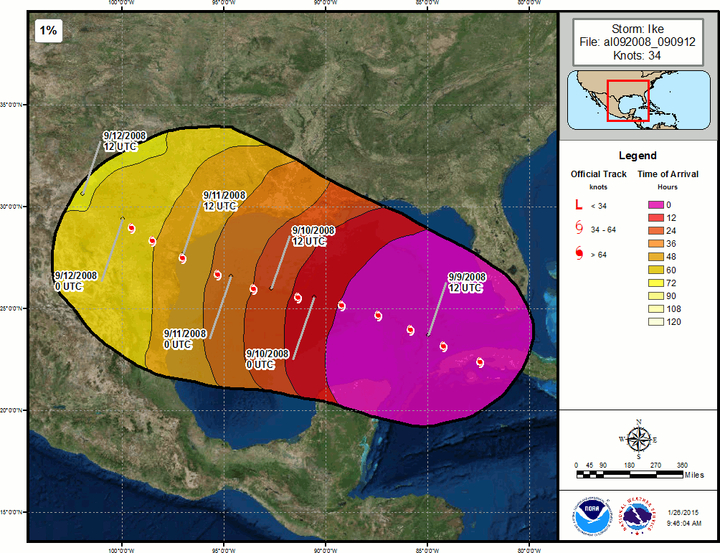
Example: TOA - Ike

Slide 16
Remaining updates
#6 (April-May 2015) – Extend wind speed probabilities to 7 days
  Create developmental dataset of 7-day forecasts
    2012, 2013, 2014 – NHC forecasts
    Prior to 2012 – GFS tracks and trajectory-CLIPER intensity
#7 (May-June 2015) – Software update
  Consolidate code and scripts for seasonal updates

Slide 17
Plans for the rest of Year 2
By August 2015
  Finalize updates based on NHC POC feedback
  Implement all upgrades (Atlantic and N.E. Pacific) into experimental MC model
  Run experimental MC model for the 2015 Atlantic & N.E. Pacific seasons
  Display wind speed probabilities and difference plots
    http://rammb.cira.colostate.edu/realtime_data/nhc/mc_model/

Slide 18
Thank you! Questions?
References:
Goerss, J. S., 2007: Prediction of consensus tropical cyclone track forecast error. Mon. Wea. Rev., 135, 1985–1993.
Knaff, J. A., C. R. Sampson, M. DeMaria, T. P. Marchok, J. M. Gross, and C. J. McAdie, 2007: Statistical tropical cyclone wind radii prediction using climatology and persistence. Wea. Forecasting, 22, 781–791.
DeMaria, M., J.A. Knaff, R.D. Knabb, C.A. Lauer, C.R. Sampson, and R.T. DeMaria, 2009: A New Method for Estimating Tropical Cyclone Wind Speed Probabilities. Wea. Forecasting, 24, 1573–1591.
DeMaria.M., J.A. Knaff, M.J. Brennan, D. Brown, R.D. Knabb, R.T DeMaria, A. Schumacher, C.A. Lauer, D.P. Roberts, C.R. Sampson, P. Santos, D. Sharp, and K.A. Winters, 2013: Improvements to the operational tropical cyclone wind speed probability model. Submitted to Wea. Forecasting.

