Slide 1
Guidance on Intensity Guidance
Kieran Bhatia, David Nolan, Mark DeMaria,
Andrea Schumacher
This project is supported by the NOAA Joint Hurricane Testbed.
IHC Presentation
03-03-2015
Notes:
Today I am going to talk about how predicting tropical cyclone intensity forecast error can improve the value of intensity forecasts. Reliable error predictions give end users guidance on how much confidence they should put in an individual forecast. The satellite image I included here is an image of Typhoon Haiyan from last week, which can serve as a reminder during this very quiet season in our neck of the woods how amazing these storms can be and at the same time, the destruction can remind us how important improving intensity forecasts remains.

Slide 2
Project Outline
Real-time guidance of intensity forecast error
Applications of error predictions

Slide 3
Project Motivation
Bhatia and Nolan (2013) showed that intensity forecast error is often related to the nature of the particular storm and surrounding atmospheric environment.
Parameters representing initial condition error and atmospheric stability (“proxies”) are also linked to forecast error.
These proxies and environmental conditions can serve as independent variables in a regression formula to predict intensity forecast error.

Slide 4
Data Sample
Dataset Detail | Data Used
Hurricane Seasons | 2007-2013 (Atlantic Basin)
Forecast Hours | 12-120 (12-hour increments)
Models Evaluated | LGEM, DSHP, HWFI, and GHMI
Predictors | GFS output obtained from SHIPS text files and proxies
Verification criteria | Excludes “LO”, “EX”, and INVESTS. All models must have verification and all predictors for particular time to be included (homogeneous). Land and no land cases combined.
Notes:
RETROSPECTIVE RUNS
DISTURBANCES/SUBTROPICAL STORMS EXCLUDED
Mention which track models
Dynamical Predictors
Initial Condition Error and Atmospheric Stability Proxies
(“early” models)
Note that NHC excludes, DISTURBANCES/SUBTROPICAL … we include that here

Slide 5
Dynamical Predictors
Initial and forecast intensity
Initial % GOES Cold Pixels
GOES IR Brightness Temperature
Forecast average and 0 hour:
  700-500 hPa RH
  200 hPa divergence
  850 hPa vorticity
  Potential intensity
  Storm speed
  Latitude
  Longitude
  Sin(shear direction)
  Shear magnitude (850-200 hPa)
  Ocean heat content

Slide 6
Initial Condition Error and Atmospheric Stability Predictors:
Standard deviation of ensemble forecast intensity
Deviation of the intensity forecast from ensemble mean (absolute value for AE)
Deviation of the track forecast from ensemble mean
Forecasted intensity change (absolute value for AE)
Previous 12-hour intensity change
Previous 12-hour error
Initial and forecasted distance to land
Notes:
33 predictors total

Slide 7
Methodology: Multiple Linear Regression
Independent variables (x’s) are proxies and synoptic parameters
Dependent variable (y) is absolute error (AE) or bias
M is the number of predictors
μ is an intercept included to account for model biases
y = β₁ * x₁ + β₂ * x₂ + … + β_{M} * x_{M} + μ
Notes:
Mention that predictors are not all predictors
RH, Lat 2, sin shear direction
20 best 15 best 10 best etc.
These proxies and environmental conditions can serve as independent variables in a regression formula to predict intensity forecast error based on the situation.
M is the number of predictors
μ is an intercept included to account for model biases
The five hurricane seasons between 2007-2011 are used to train the regression formula and weight the predictors and very importantly, the regression formula is verified on an independent dataset, the 2012 hurricane season.

Slide 8
Methodology: Multiple Linear Regression
Dependent and independent variables are normalized
Separate regressions performed for each forecast interval (12, 24, …, 120 hr), model, and training period
Backward-stepping used: predictor is used in regression model if the probability that the regression coefficient is different from zero exceeds 95% (F statistic)
Dependent and independent verification (cross-validated)
Notes:
Dependent validation and cross-validation tested
Cases without land compared land cases
so the regression coefficients for different variables and forecast intervals can be compared
or 99%

Slide 9
Predictor and Predictand Transformations
AE is bounded by 0, which leads to a positively skewed distribution
Box-Cox transformation applied to AE to make it approximately Gaussian before regression is applied
To account for non-linear relationships between predictors and forecast error, low order polynomials and Gaussian functions are applied to the predictors and tested
For example, 0-hour relative humidity (RH) is fitted using a Gaussian to account for peak error at medium RH values
Notes:
Choose the power transformation exponent to maximize the log-likelihood function for the Gaussian distribution
used to eliminate scenes in MAE distribution

Slide 10
Results
ALL RESULTS FOR INDEPENDENT DATASET, CROSS VALIDATION USED FOR 2007-2014
Notes:
NOTE THAT FOR DSHP AND LGEM, RETROSPECTIVE RUNS WERE USED TO TRAIN THE DATA (THE RESULTS ARE FOR 2008-2014 DATA)
NOTE THAT FOR HWFI AND GHMI, REAL-TIME RUNS WERE USED TO TRAIN THE DATA (THE RESULTS ARE FOR 2007-2014 DATA)

Slide 11
R^2 of AE Predictions
# of Cases | Hours | DSHP | LGEM | HWFI | GHMI
1884 | 12 | 0.06 | 0.05 | 0.09 | 0.11
1683 | 24 | 0.07 | 0.07 | 0.06 | 0.10
1483 | 36 | 0.06 | 0.07 | 0.08 | 0.12
1297 | 48 | 0.06 | 0.09 | 0.10 | 0.10
1138 | 60 | 0.09 | 0.11 | 0.11 | 0.10
1003 | 72 | 0.11 | 0.13 | 0.15 | 0.11
870 | 84 | 0.18 | 0.16 | 0.18 | 0.10
746 | 96 | 0.26 | 0.16 | 0.15 | 0.12
652 | 108 | 0.24 | 0.10 | 0.17 | 0.17
570 | 120 | 0.23 | 0.12 | 0.20 | 0.19

Slide 12
R^2 of Bias Predictions
# of Cases | Hours | DSHP | LGEM | HWFI | GHMI
1884 | 12 | 0.16 | 0.18 | 0.18 | 0.16
1683 | 24 | 0.24 | 0.23 | 0.22 | 0.22
1483 | 36 | 0.23 | 0.25 | 0.26 | 0.32
1297 | 48 | 0.22 | 0.25 | 0.30 | 0.32
1138 | 60 | 0.25 | 0.27 | 0.31 | 0.33
1003 | 72 | 0.28 | 0.29 | 0.35 | 0.33
870 | 84 | 0.32 | 0.28 | 0.38 | 0.31
746 | 96 | 0.36 | 0.26 | 0.40 | 0.31
652 | 108 | 0.37 | 0.22 | 0.43 | 0.28
570 | 120 | 0.39 | 0.24 | 0.46 | 0.34

Slide 13
Percent Improvement Over AE Climatology Forecasts
Hours | DSHP | LGEM | HWFI | GHMI
12 | 7.7 | 6.1 | 7.7 | 8.9
24 | 9.2 | 7.9 | 8.1 | 8.6
36 | 8.3 | 6.3 | 9.5 | 9.7
48 | 6.8 | 6.9 | 11.0 | 10.0
60 | 8.5 | 10.0 | 10.0 | 10.8
72 | 10.0 | 10.1 | 11.5 | 9.9
84 | 15.0 | 12.5 | 11.5 | 10.4
96 | 17.8 | 11.2 | 10.6 | 12.5
108 | 11.9 | 8.1 | 11.0 | 16.0
120 | 10.5 | 9.5 | 12.0 | 18.2
Notes:
in

Slide 14
Percent Improvement Over Bias Climatology Forecasts
Hours | DSHP | LGEM | HWFI | GHMI
12 | 8.0 | 8.6 | 9.7 | 11.4
24 | 14.9 | 13.0 | 11.3 | 13.9
36 | 14.2 | 15.8 | 14.2 | 19.4
48 | 13.9 | 14.8 | 15.0 | 20.4
60 | 17.9 | 15.1 | 16.1 | 20.9
72 | 22.1 | 16.3 | 20.9 | 21.1
84 | 23.8 | 15.4 | 23.1 | 18.6
96 | 25.7 | 12.3 | 25.1 | 16.6
108 | 25.2 | 9.8 | 26.8 | 15.5
120 | 23.2 | 11.0 | 30.2 | 22.8

Slide 15
Applications

Slide 16
Motivation
If model error can be successfully anticipated in certain situations, can we bias-correct the models or weight an ensemble accordingly?
Two first attempts to create unequally weighted ensembles can be derived from AE and bias predictions.
Notes:
would a postprocessing weighting procedure for a multimodel ensemble lead to more skillful forecasts than current
Predictions of forecast error can help forecasters and end users know whether a particular forecast will be more or less skillful than average in real time.
(Bhatia and Nolan 2013)
Based on results by BN2013, a more appropriate unequal weighting scheme for multimodel ensembles would prescribe model weights relating to the synoptic environment surrounding the TC as well as some of the storm’s features (intensity, translation speed, etc.). The discrepancy in model performance due to these situation dependent characteristics is significantly larger than the differences in performance among models. Krishnamurti et al. (2000) claimed that equal weighting degrades the overall results of multimodel ensembles because poor models are treated in the same way as good models in the ensemble mean. However, evaluating models irrespective of the particular atmospheric state defined by the TC appears to be a bigger flaw than weighting a weak model the same as a strong model (BN2013).

Slide 17
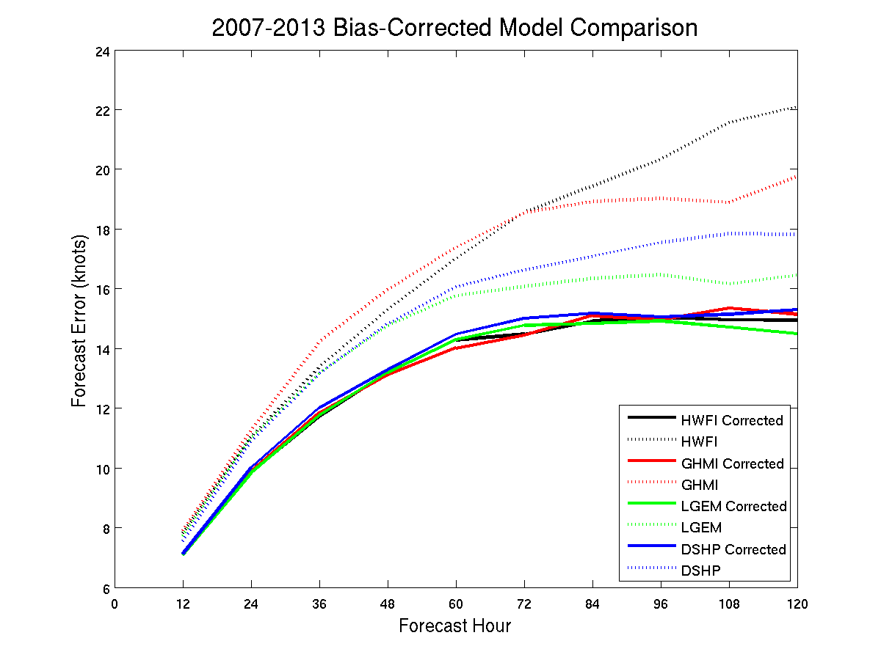

Slide 18
Methodology For Unequally Weighted Ensemble
Technique 1
  Bias-correct individual models using bias forecasts and use the mean of the bias-corrected models
Technique 2
  Inverse-weight individual models using AE forecasts and use the inverse-weighted average as the ensemble mean
  i.e. if LGEM is predicted to have 20 knots of AE and DSHP is predicted to have 10 knots of AE, trust DSHP’s forecast more

Slide 19
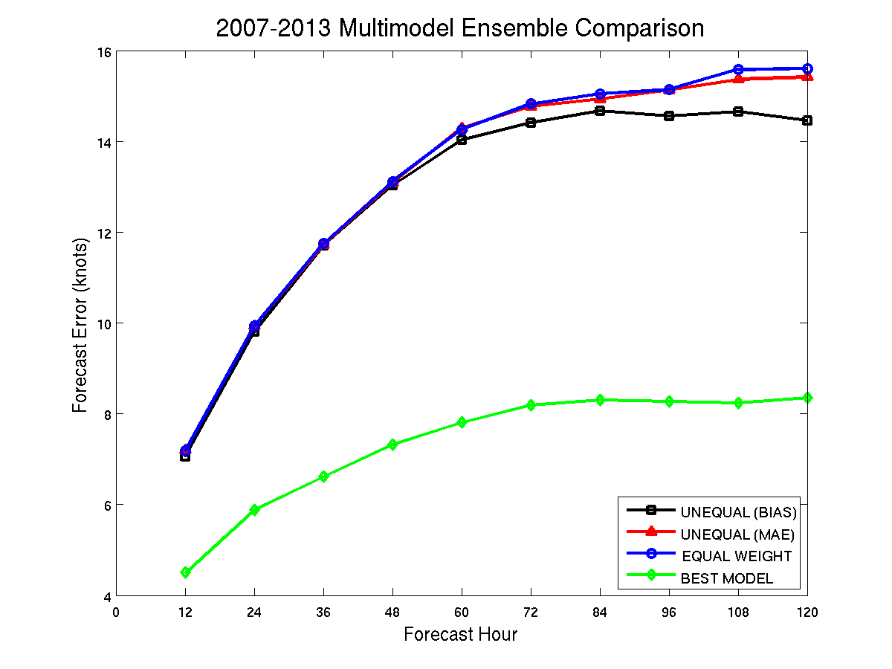

Slide 20
Conclusions
Predictor pool selected using results of Bhatia and Nolan (2013) and added proxies
Inputted into a modified multiple linear regression model
Multiple linear regression techniques are promising with 2007-2014 independent results showing percent improvement over climatology ranging from 6%-18% for AE and 8%-30% for bias

Slide 21
Extra Slides

Slide 22
Future Work
Testing more proxies
Developing nonlinear relationships between predictors and forecast error
Varying the length of training period
Producing error predictions using probabilistic forecasts
Neural networking and nonlinear regression methods may be considered
Notes:
The POT predictor in SHIPS is the difference between the maximum POT (MPI) and the current storm intensity (DeMaria and Kaplan 1994b). The MPI is determined empirically (DeMaria and Kaplan 1994) and sometimes differs considerably from the theoretical MPI of Bister and Emanuel (1998). The shear predictor is the difference between the 850- and 200-hPa wind vectors. The horizontal wind components used to determine shear were computed from a spatial average (vortex removed) of all the GFS model grid points within 500 km of the 850 hPa storm center while vorticity and divergence use averaged points within 1000 km (at the appropriate height levels). The RH predictor is an average over all grid points between 200 km and 800 km from the storm center.

Slide 23
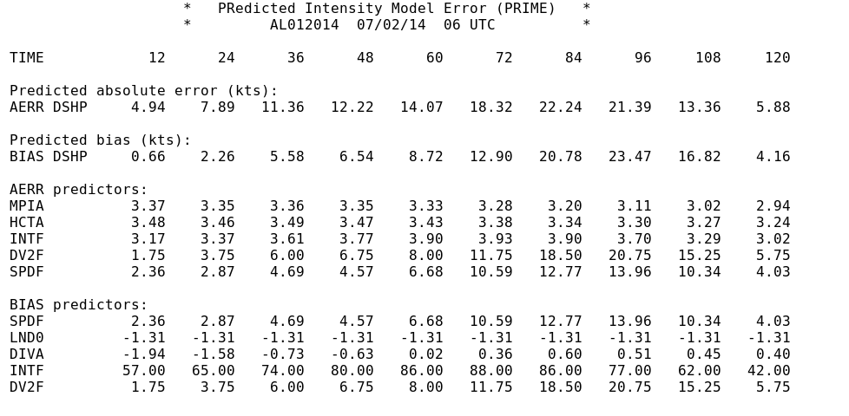
Sample Output File

Slide 24
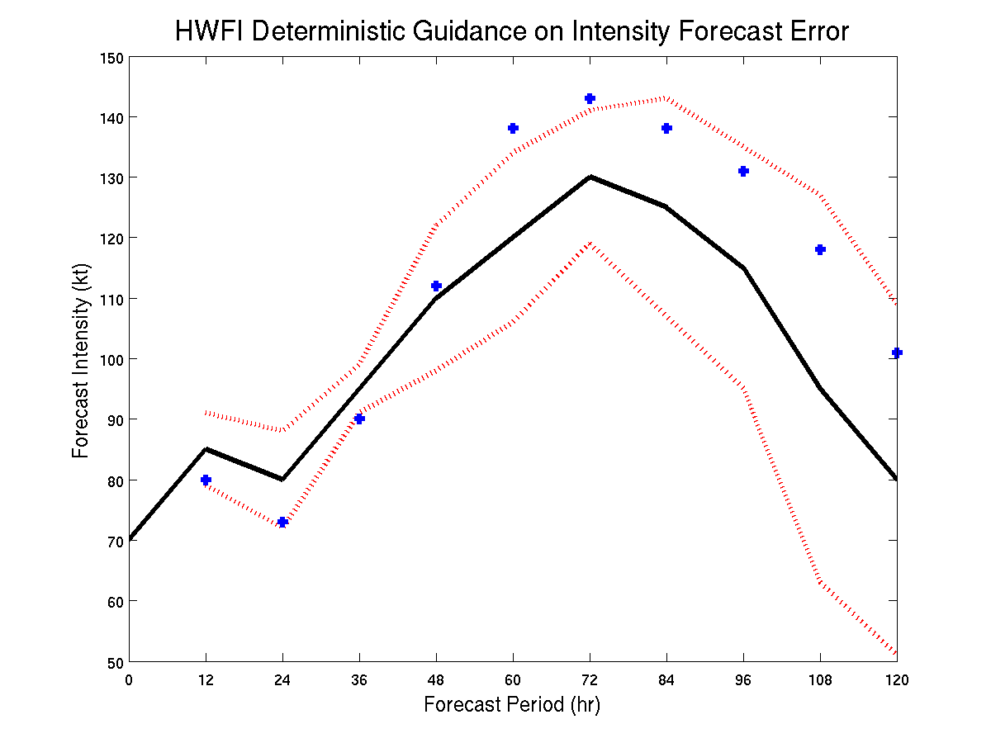
Potential Output Product 1

Slide 25
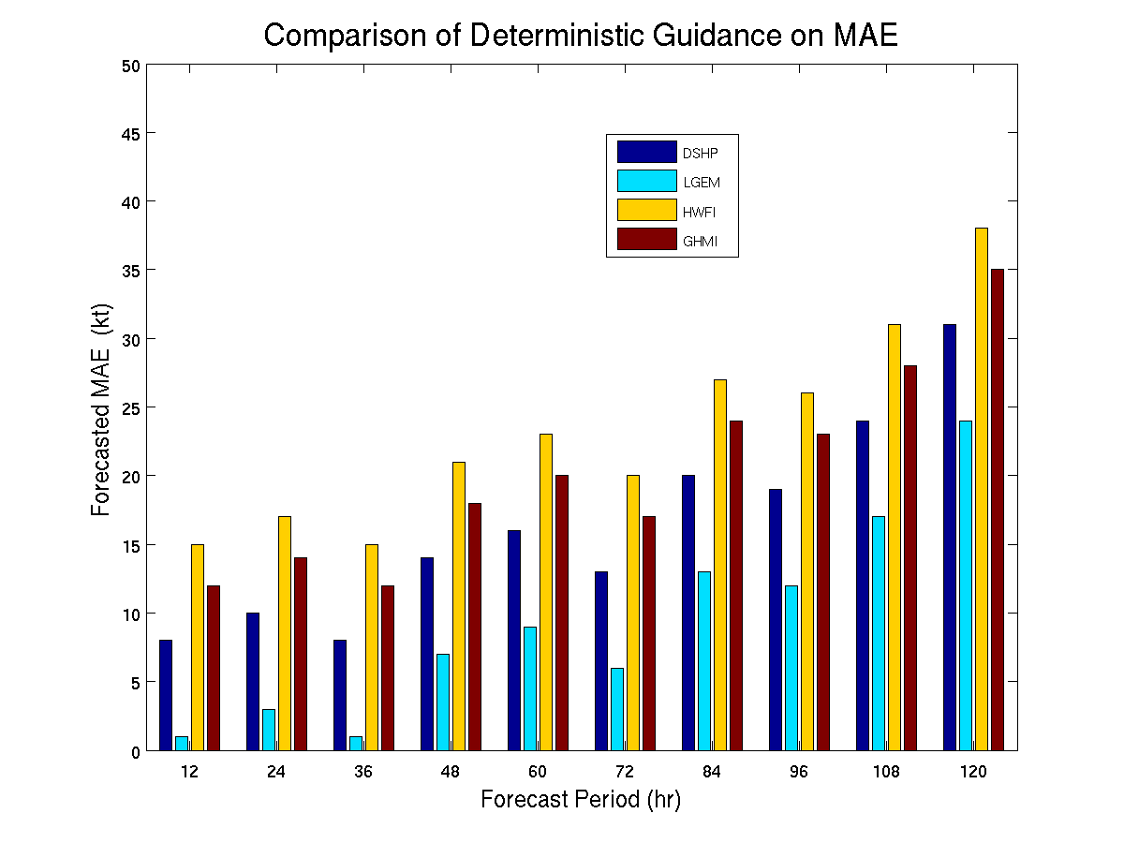
Potential Output Product 2

Slide 26
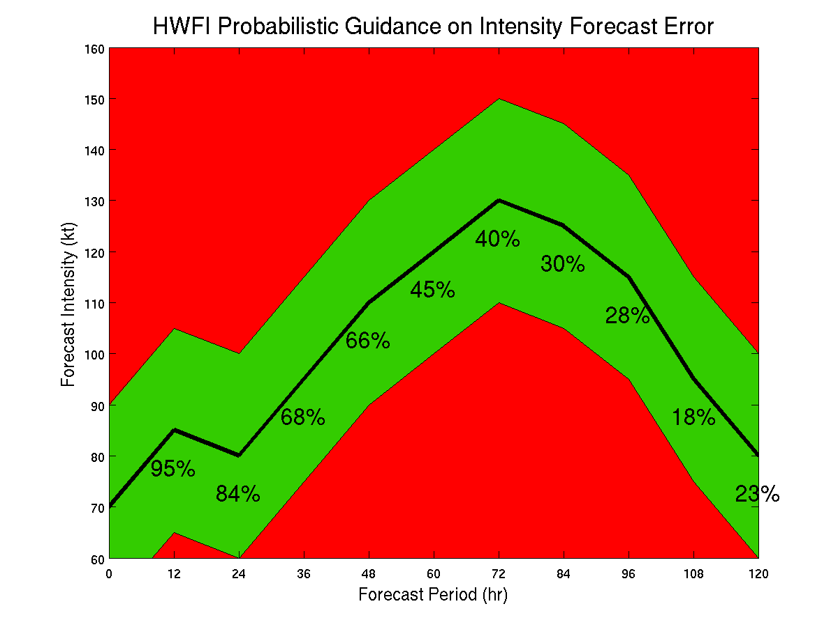
Potential Output Product 3a

Slide 27
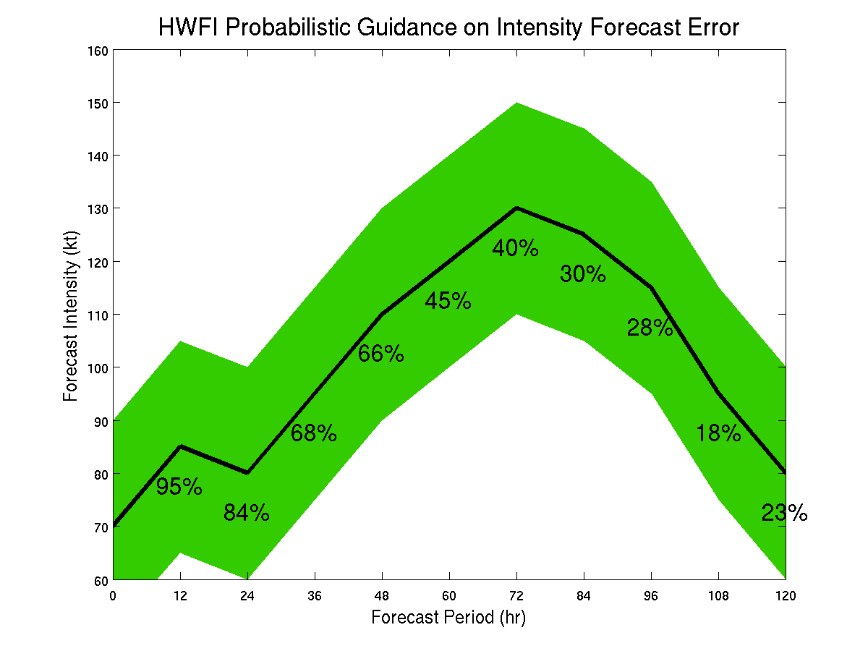
Potential Output Product 3b

Slide 28
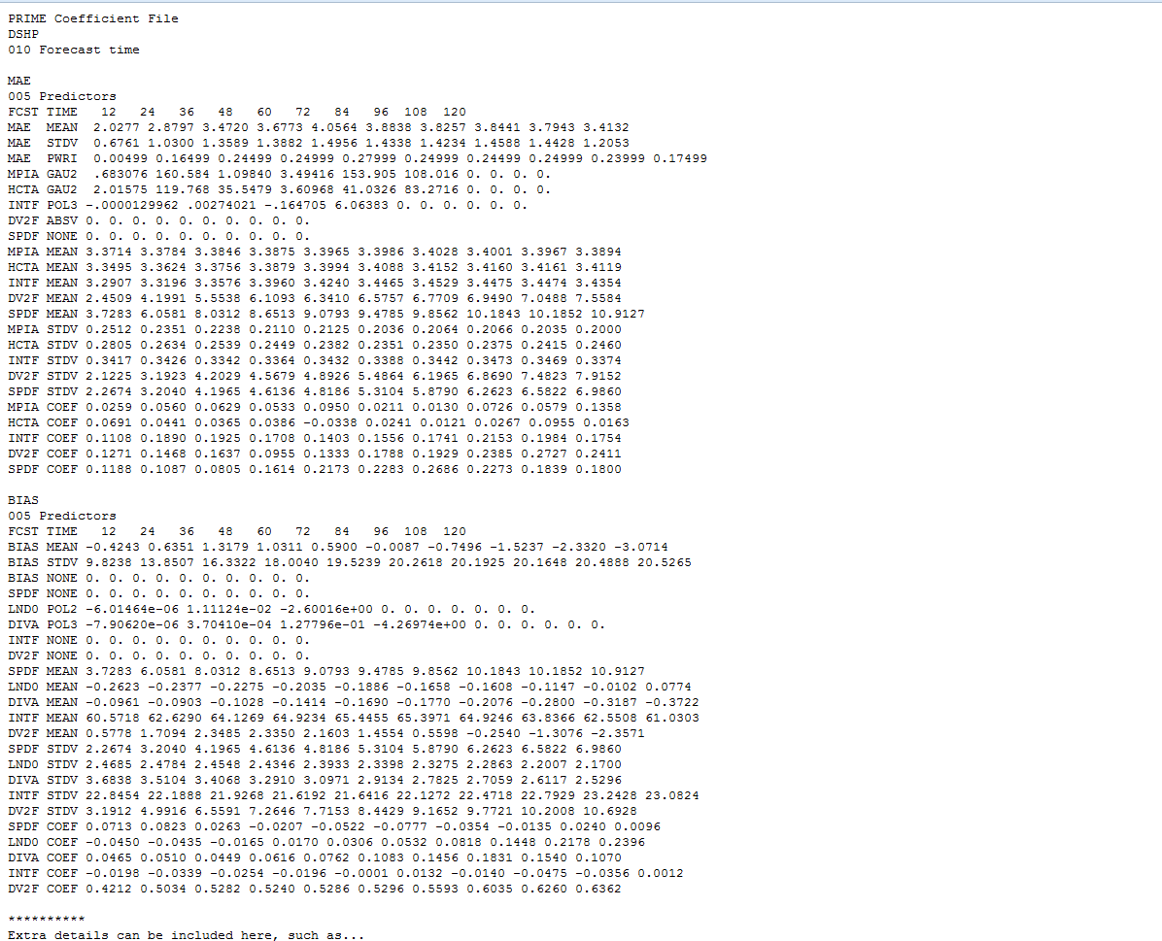
COEFFICIENT FILE

Slide 29
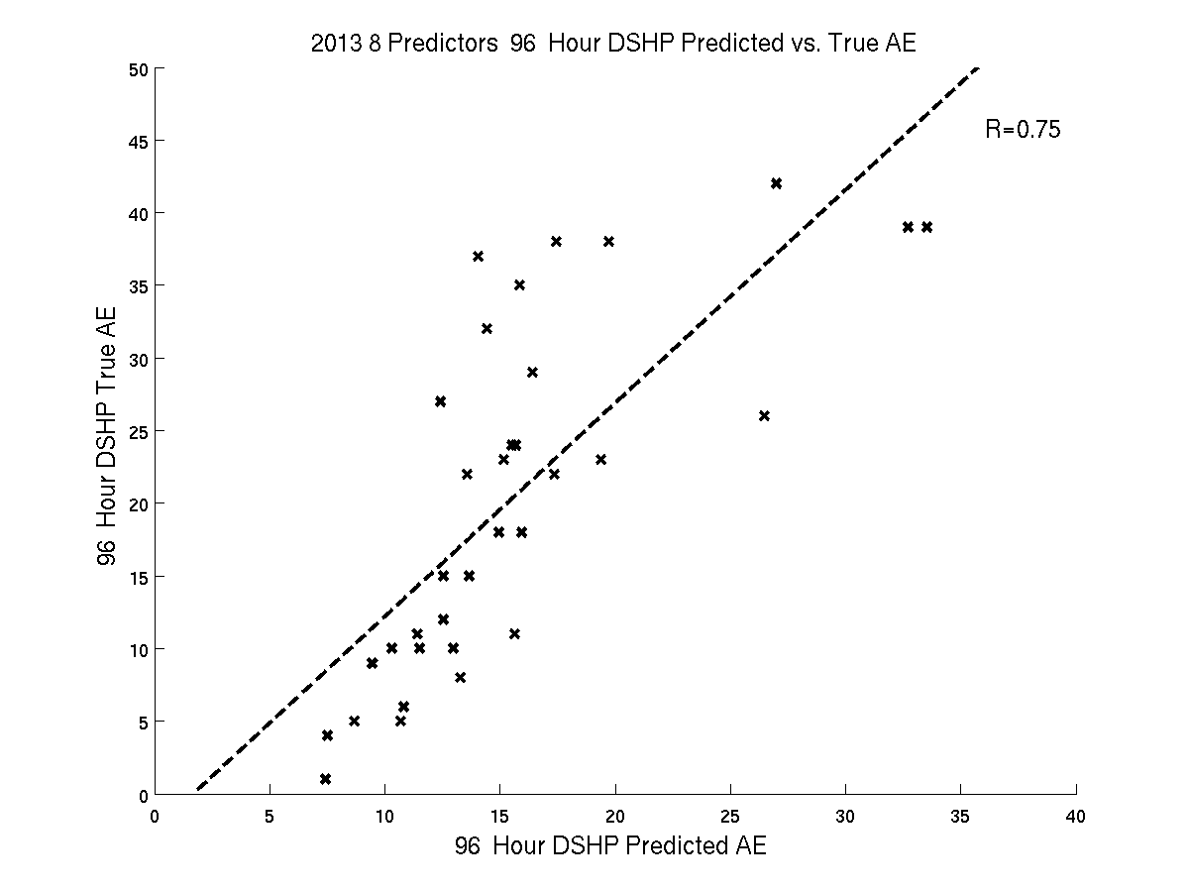
R=0.75, Skill Score = 31%
Absolute Error = -0.16 X (Avg Lat) + 0.1 X (Prev 12 Hr Int Chng) + 0.14 X (Abs. Val. Of Forecasted Intensity Change) + 0.28 X (Dev From Ensemble Mean)
Notes:
0.750000000000000 7.15958143088569 10.3529411764706 0.308449520880360

Slide 30
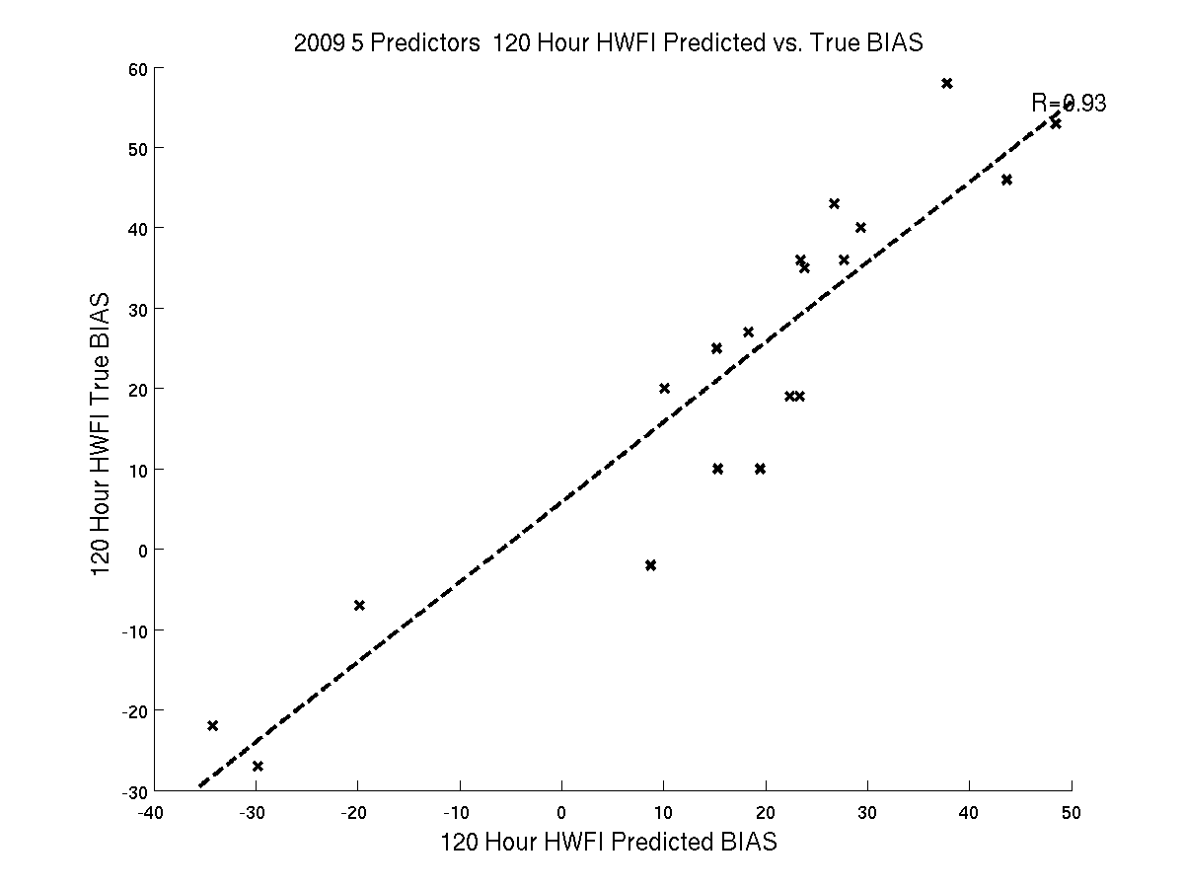
R=0.93, Skill Score = 64%
Bias = 0.14 X (0 hr Int)+ 0.15 X (Avg Div) + 0.09 X (Fcst Int) + 0.57 X (Dev From Ensemble Mean)
Notes:
0.930000000000000 9.23993777738081 25.3351112005636 0.635291208937923

Slide 31
Probabilistic Forecasts of AE and Bias

Slide 32
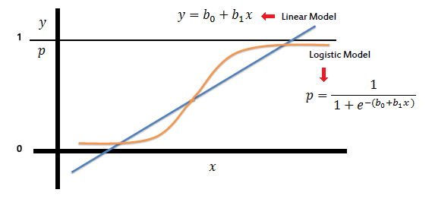
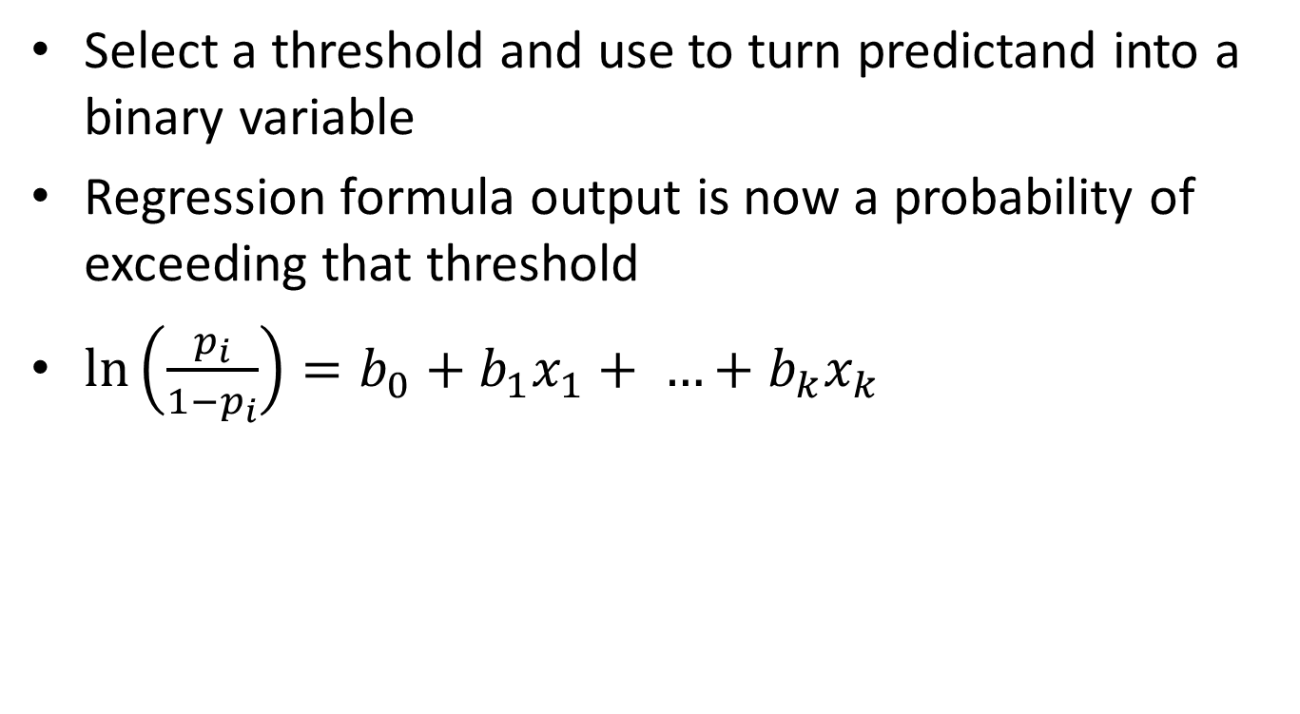
Logistic Regression
Select a threshold and use to turn predictand into a binary variable
Regression formula output is now a probability of exceeding that threshold
$\ln\left(\frac{p_{i}}{1−p_{i}}\right)=b_{0}+b_{1}x_{1}+ …+b_{k}x_{k}$
Notes:
You transform a predictand to a binary variable by selecting a threshold,
if it exceeds the threshold, you get a 1, no then 0
Estimate regression parameters by maximizing log likelihood, iterative process of seeing what parameters fit the data best for the training data
Properly bounded, no variance assumption

Slide 33
Methodology: Probabilistic Forecasts
AE and Bias were converted to binary and ternary variables
AE: Binary threshold = 20 knots, Ternary thresholds= 10 knots and 20 knots
Bias: Binary threshold = 0 knots, Ternary thresholds= -20 knots and 20 knots

Slide 34
Reliability Diagram
Graphical device that shows the full joint distribution of the forecasts and observations
Observed frequency of an event is plotted against the forecast probability of an event
A perfect forecast system will result in forecasts with a probability of X% actually occurring X% of the time (diagonal line on the graph)
Notes:
Note the discrepancy between RPSS and reliability (omission of middle tercile?)

Slide 35
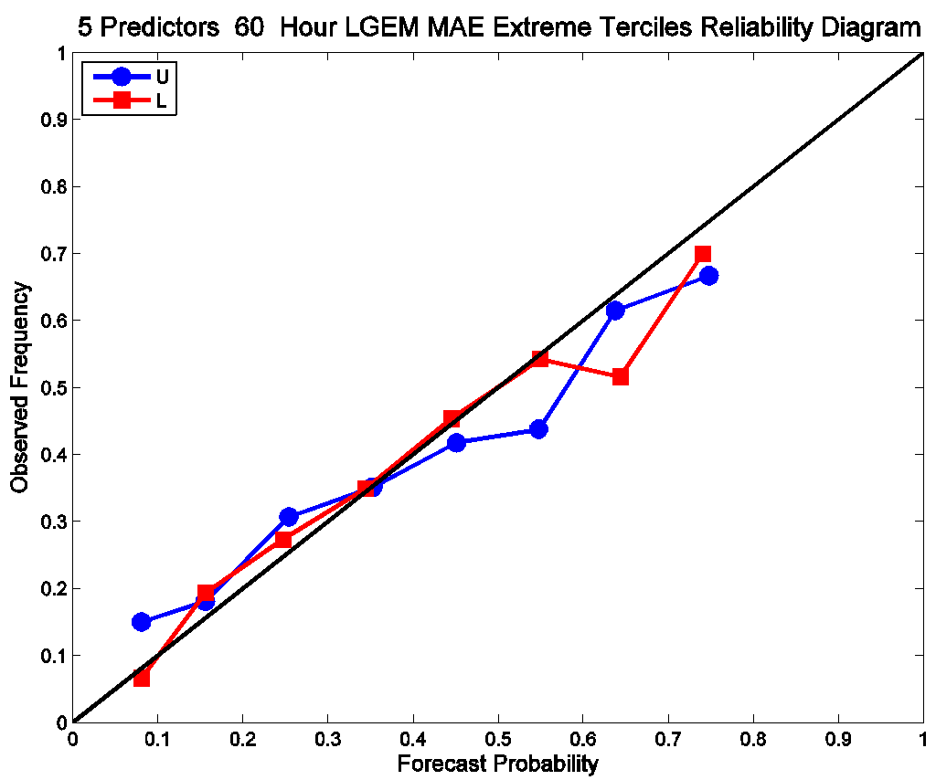
60-Hour LGEM AE Tercile Forecast

Slide 36
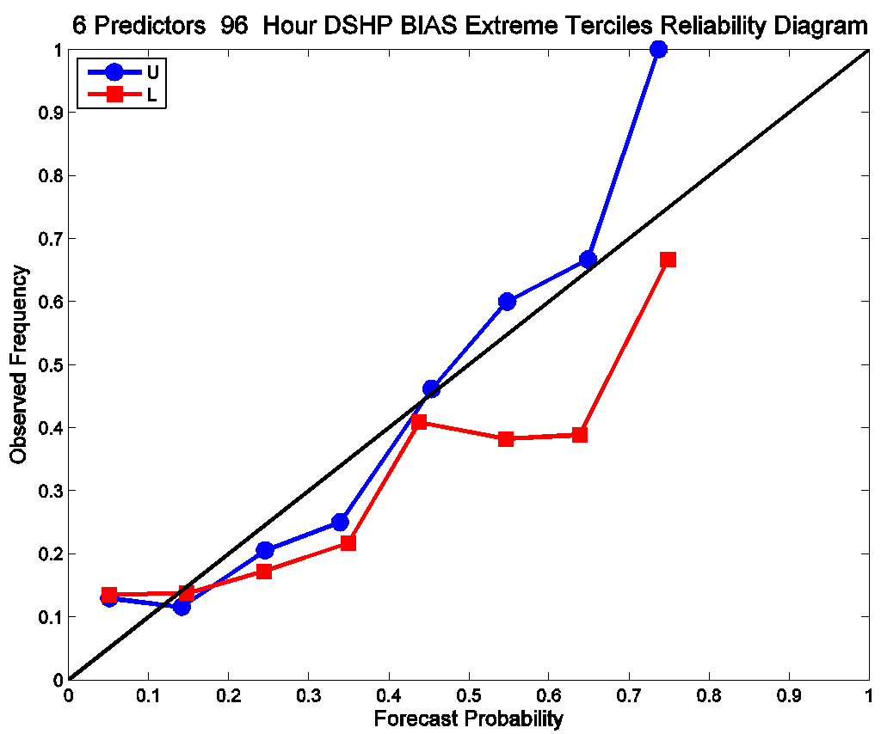
96-Hour DSHP BIAS Tercile Forecast

Slide 37
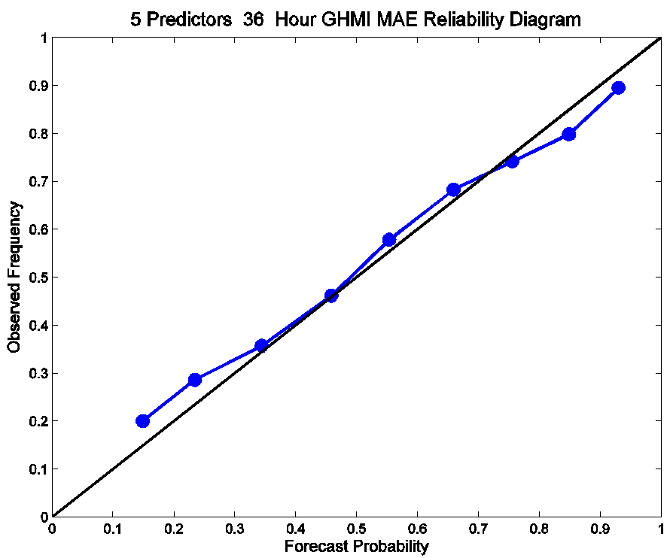
36-Hour GHMI AE Binary Forecast

Slide 38
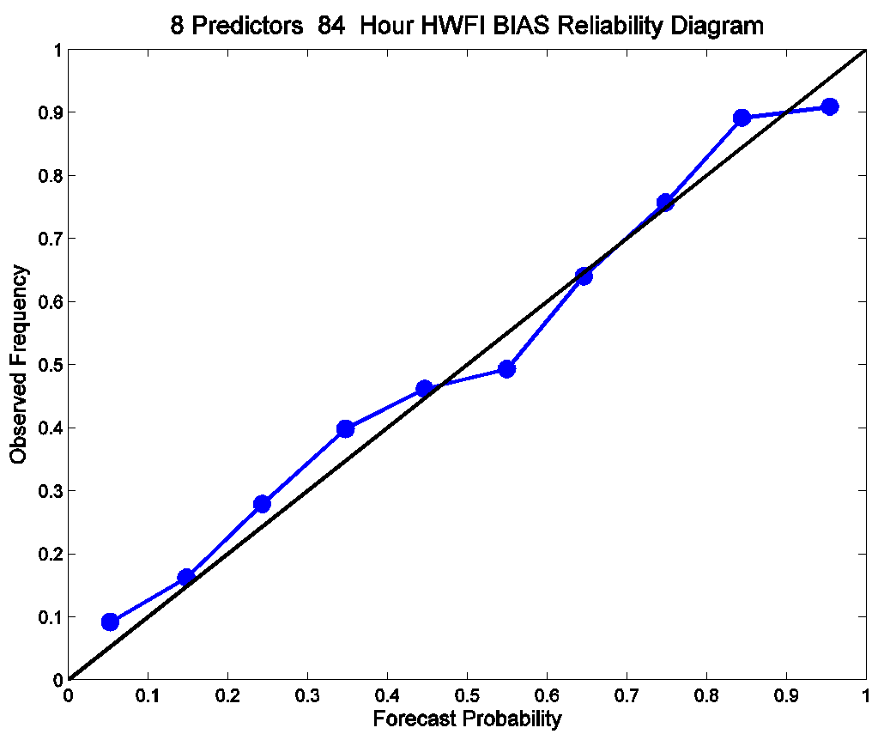
84-Hour HWFI BIAS Binary Forecast

Slide 39
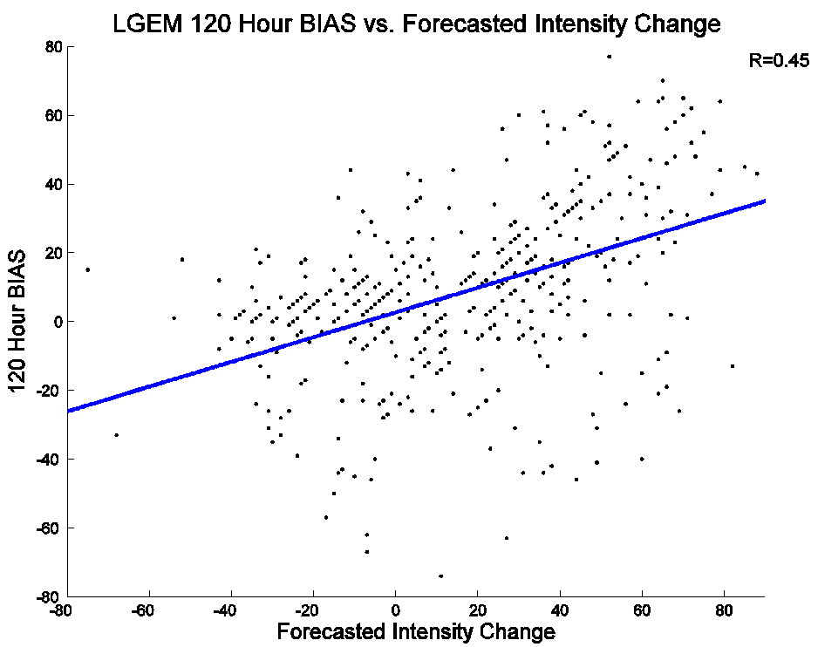
Example of Atmospheric Instability Proxy

Slide 40
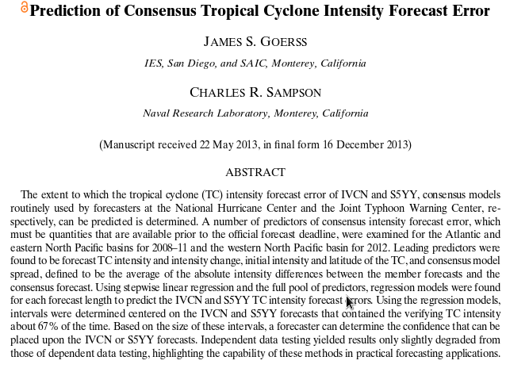
Goerss and Sampson (2014) Results
Notes:
Study focused on prediction of consensus intensity models’ (IVCN and S5YY) forecast error in Atlantic and Pacific basins

Slide 41
“For the Atlantic basin, the percent variance of IVCN TC absolute intensity forecast error that could be explained for this independent sample ranged from 2-5% compared with 4-6% for the dependent sample”
Notes:
Independent data testing
Evaluating performance on dependent data is good, but forecast guidance should be evaluated on independent data whenever possible. We cannot evaluate our western North Pacific guidance on independent data since S5YY has only been running one season; however, we can do this for our IVCN guidance in the Atlantic and eastern North 203 Pacific basins. For each forecast length, regression equations were computed using stepwise linear regression and the pool of predictors from the two basins for 2008-2011. The predicted TC absolute intensity forecast errors were then computed for the 2012 Atlantic and eastern North Pacific seasons. For the Atlantic basin, the percent variance of IVCN TC absolute intensity forecast error that could be explained for this independent sample ranged from 2-5% compared with 4-6% for the dependent sample. Just as was done previously, predicted intervals were constructed to be centered on the IVCN forecast intensities. The results of the independent testing for the 2012 Atlantic season are summarized in Table 4.

Slide 42
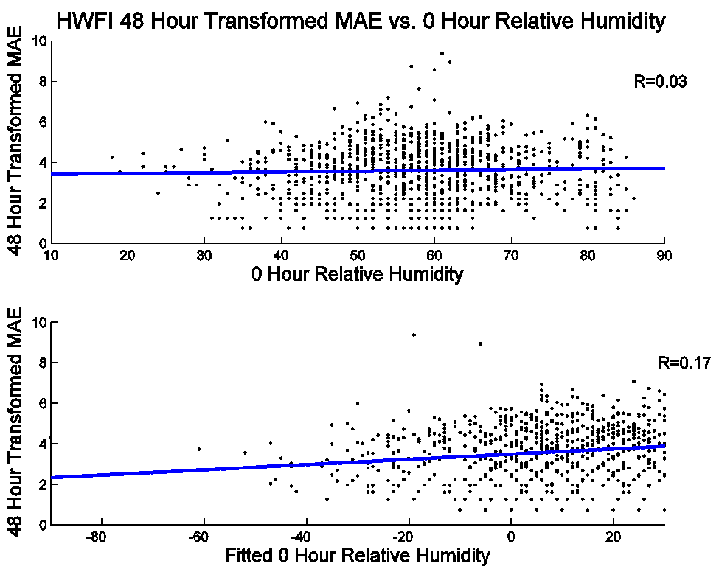
Boutique Predictors: Gaussian Fit of Relative Humidity vs. AE
Notes:
No 2008
GAUSS

Slide 43
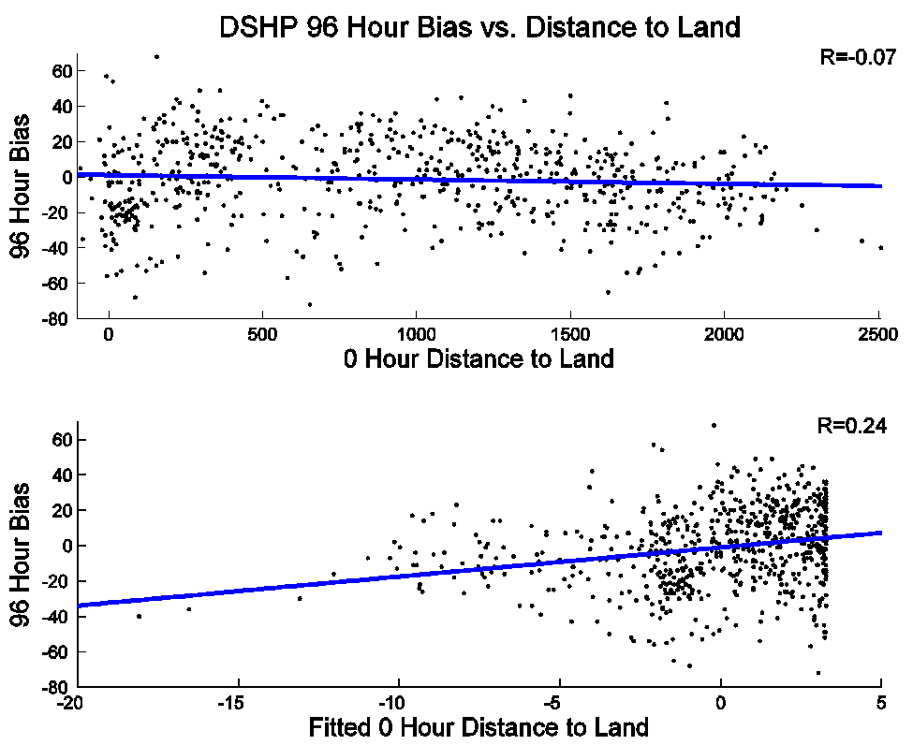
Boutique Predictors: 2nd Order Polynomial Fit of Dist. To Land vs. Bias
Notes:
No 2007. poly 2

Slide 44
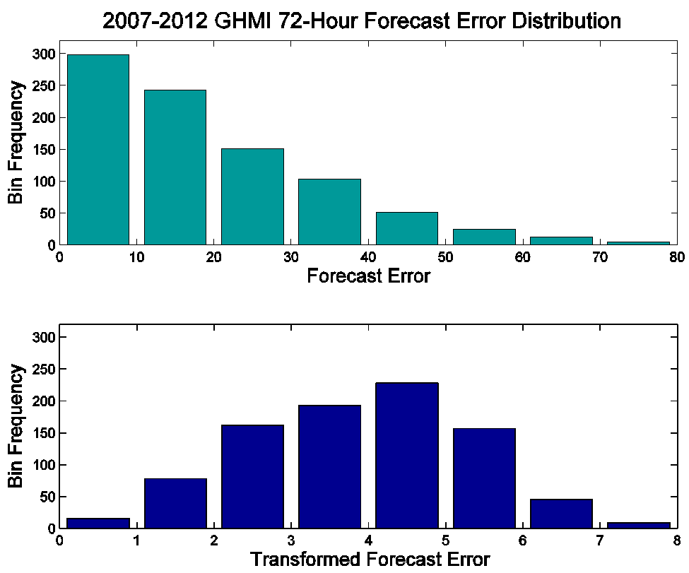
Example of AE Transformation

Slide 45
Methodology: Nonlinear Fits of Predictors
Several predictors exhibiting nonlinear relationships with error were empirically fit
Functions tested: Gaussian, second order Gaussian, second order polynomial, and third order polynomial
0-Hour Latitude, 0-Hour distance to land, and 0-Hour Relative Humidity exhibited the strongest non-linear relationships

Slide 46
2014 RESULTS

Slide 47
Percent Improvement Over AE Climatology Forecasts
# of Cases | Hours | LGEM | DSHP | HWFI | GHMI
133 | 12 | 12.3 | 13.2 | 14.8 | 14.4
117 | 24 | 19.3 | 15.8 | 12.9 | 13.8
102 | 36 | 16.3 | 19.5 | 8.2 | 10.7
86 | 48 | 14.0 | 12.6 | 9.6 | 10.2
74 | 60 | 17.3 | 17.7 | 28.9 | 28.3
64 | 72 | 6.1 | 8.1 | 16.4 | 14.7
53 | 84 | 6.1 | 6.4 | 13.1 | 11.1
42 | 96 | 8.5 | 7.6 | 17.3 | 18.0
34 | 108 | 11.3 | -8.9 | 30.2 | 28.8
28 | 120 | 18.7 | 8.5 | 43.5 | 39.7

Slide 48
Percent Improvement Over Bias Climatology Forecasts
# of Cases | Hours | LGEM | DSHP | HWFI | GHMI
133 | 12 | -1.1 | -1.5 | 1.5 | 0.7
117 | 24 | 5.0 | 3.4 | 11.1 | 9.8
102 | 36 | 13.4 | 2.4 | 15.6 | 14.1
86 | 48 | 16.4 | 4.3 | 7.8 | 6.4
74 | 60 | 18.0 | 5.4 | 5.9 | 5.2
64 | 72 | 28.9 | 8.6 | 6.4 | 6.2
53 | 84 | 23.9 | 9.0 | 7.9 | 7.4
42 | 96 | 15.3 | 0.9 | 15.2 | 14.7
34 | 108 | 8.0 | -1.4 | 19.6 | 20.3
28 | 120 | -1.2 | 7.4 | 47.3 | 47.2

