Slide 1
Measuring gaps in tropical cyclone rainbands using Level II radar reflectivity data
Corene Matyas
Department of Geography, University of Florida
Funding: NSF CAREER Award BCS1053864

Slide 2
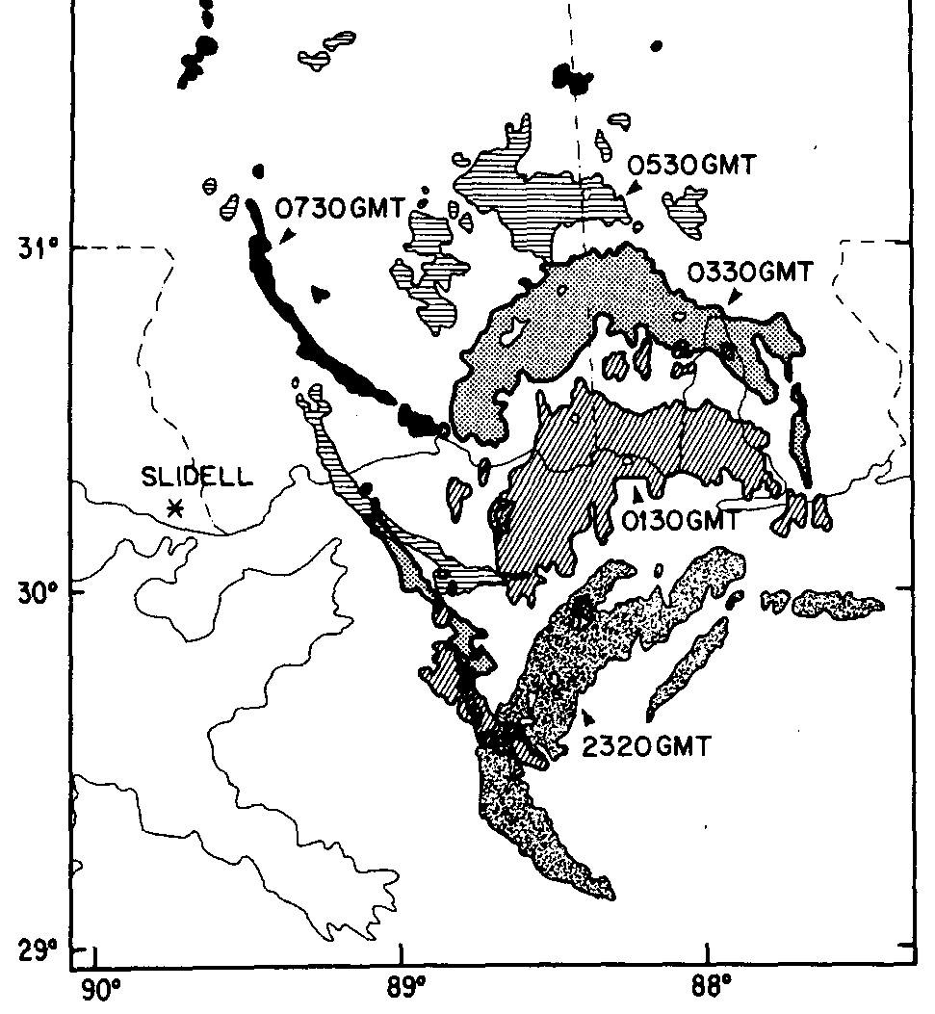
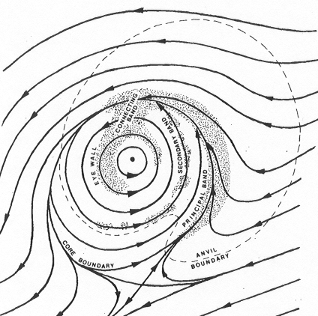
Early Work on Spatial Patterns of TC Rain Fields
41 dBZ regions of H. Frederic (1979)
Parrish, Burpee, Marks, Grebe (1982)
Mon. Wea. Rev.
Stationary Band Complex schematic
Willoughby, Marks, and Feinberg (1984) J. Atmos. Sci.
Notes:
Changes in vertical wind shear speed / direction
Changes in storm motion speed and direction
De-intensification of the inner core
Dry air entrainment or moisture advection from low-level jet
Convergence along the coastline
Orographic uplift and land surface properties such as soil moisture/ land cover type
Selected citations: Blackwell (2000), Corbosiero and Molinari (2002, 2003), Powell (1987), Chen et al. (2006), Lonfat et al. (2007), Konrad et al. (2002), Bluestein and Hazen (1989), Andersen and Shepherd (2013), Rogers et al. (2003), Elsberry (2002), Marks and Shay (1998)

Slide 3
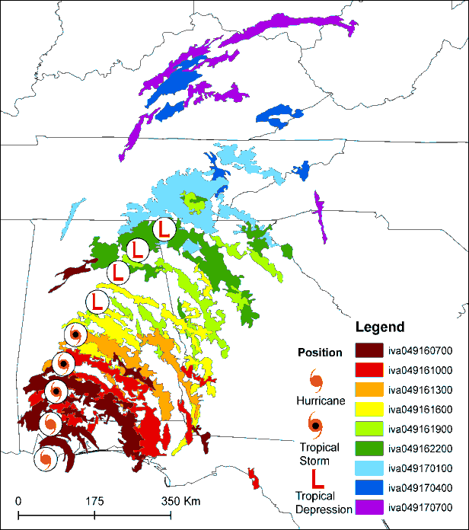
Using a Geographic Information System for TC Rain Field Analysis
40 dBZ regions Ivan (2004)
Matyas (2010)
International Journal of Applied Geospatial Research
30, 35, and 40 dBZ regions
Hurricane Charley (2004) over Florida
Matyas (2009, JAMC)

Slide 4
Broad Research Goals
Construct a 3D mosaic of interpolated Level II radar reflectivity returns*
Calculate metrics relating to the spatial dimensions of TC rain fields
Use metrics to compare TCs and relate patterns to environmental forcings
Use metrics to compare observational and model-derived TCs
*Tang and Matyas to be submitted to JTECH March 2015

Slide 5
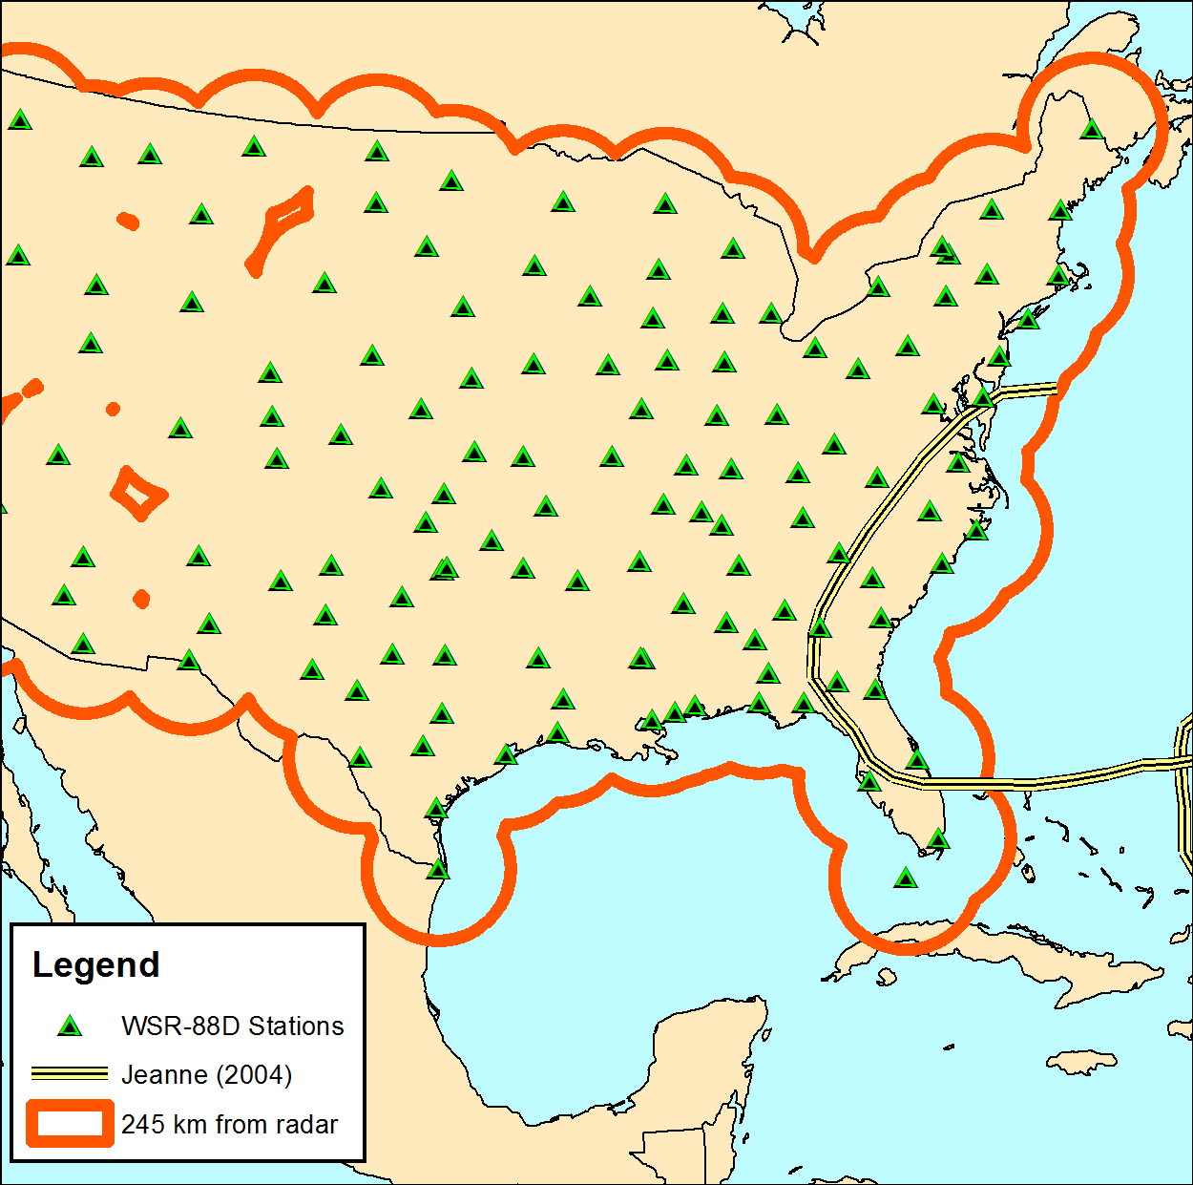
Data and Analytical Tools
Level II reflectivity data: NCDC
Tool to preview and order data from ArcGIS http://hurricane.geog.ufl.edu/products/
WDSSII (Univ. of Oklahoma) – QC
3.5 km altitude slice
Extended Best Track dataset (Kimball and Mulekar 2004)
SHIPS dataset (DeMaria and Kaplan 1994)

Slide 6
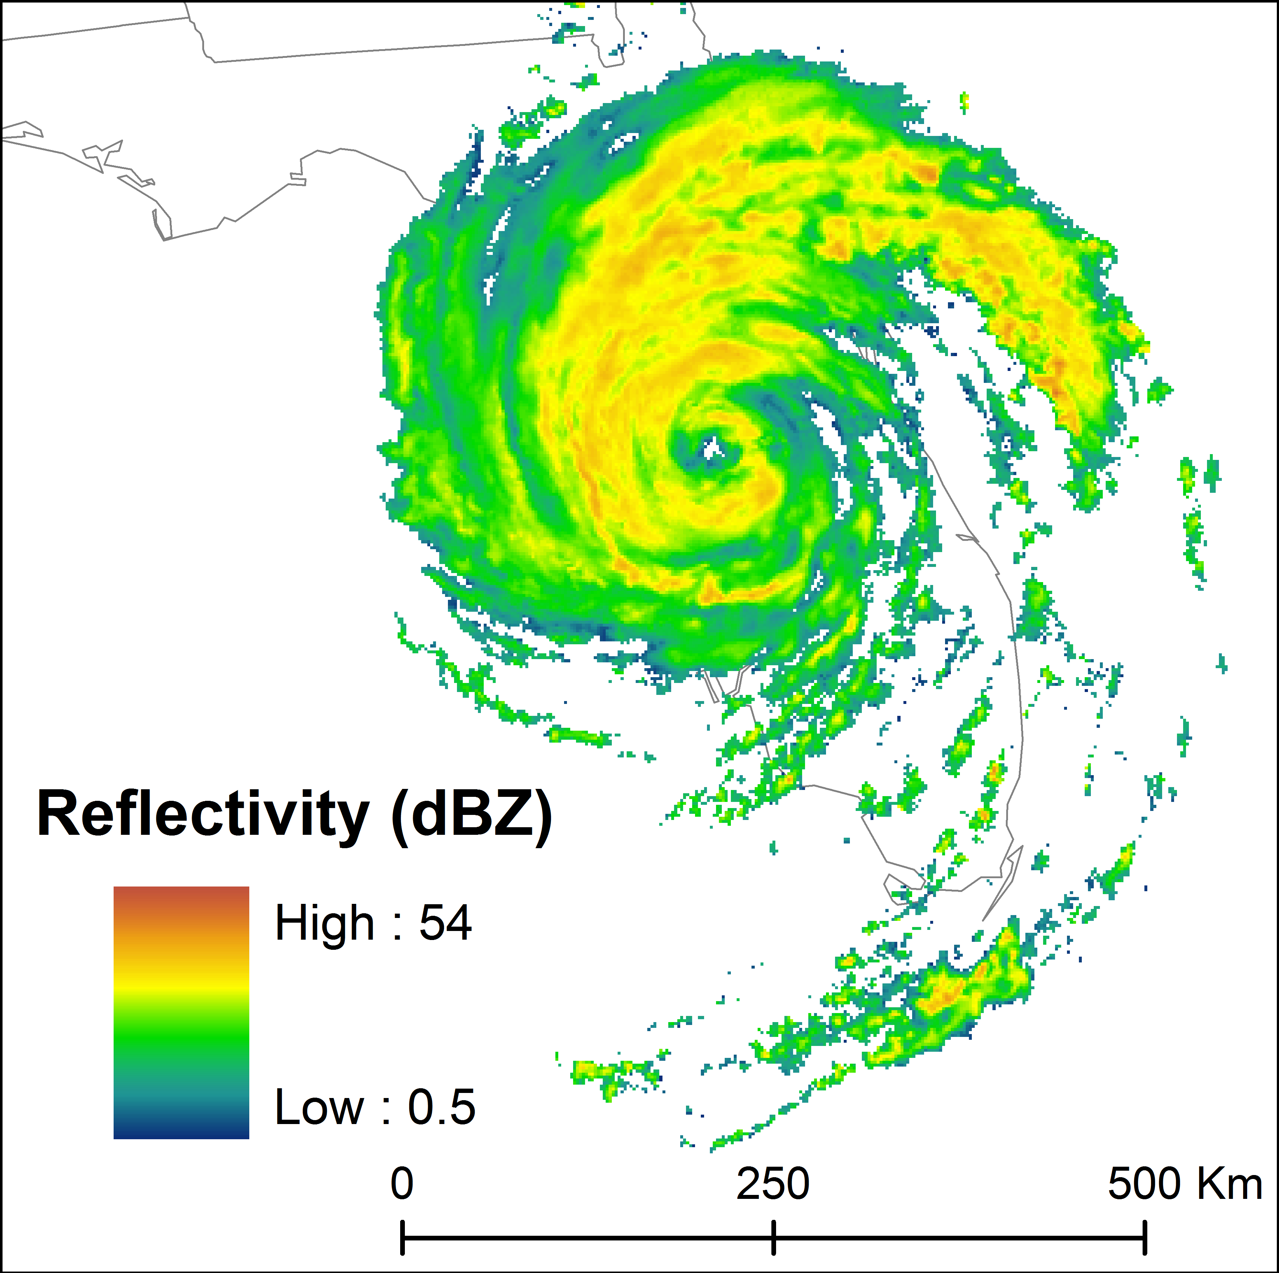
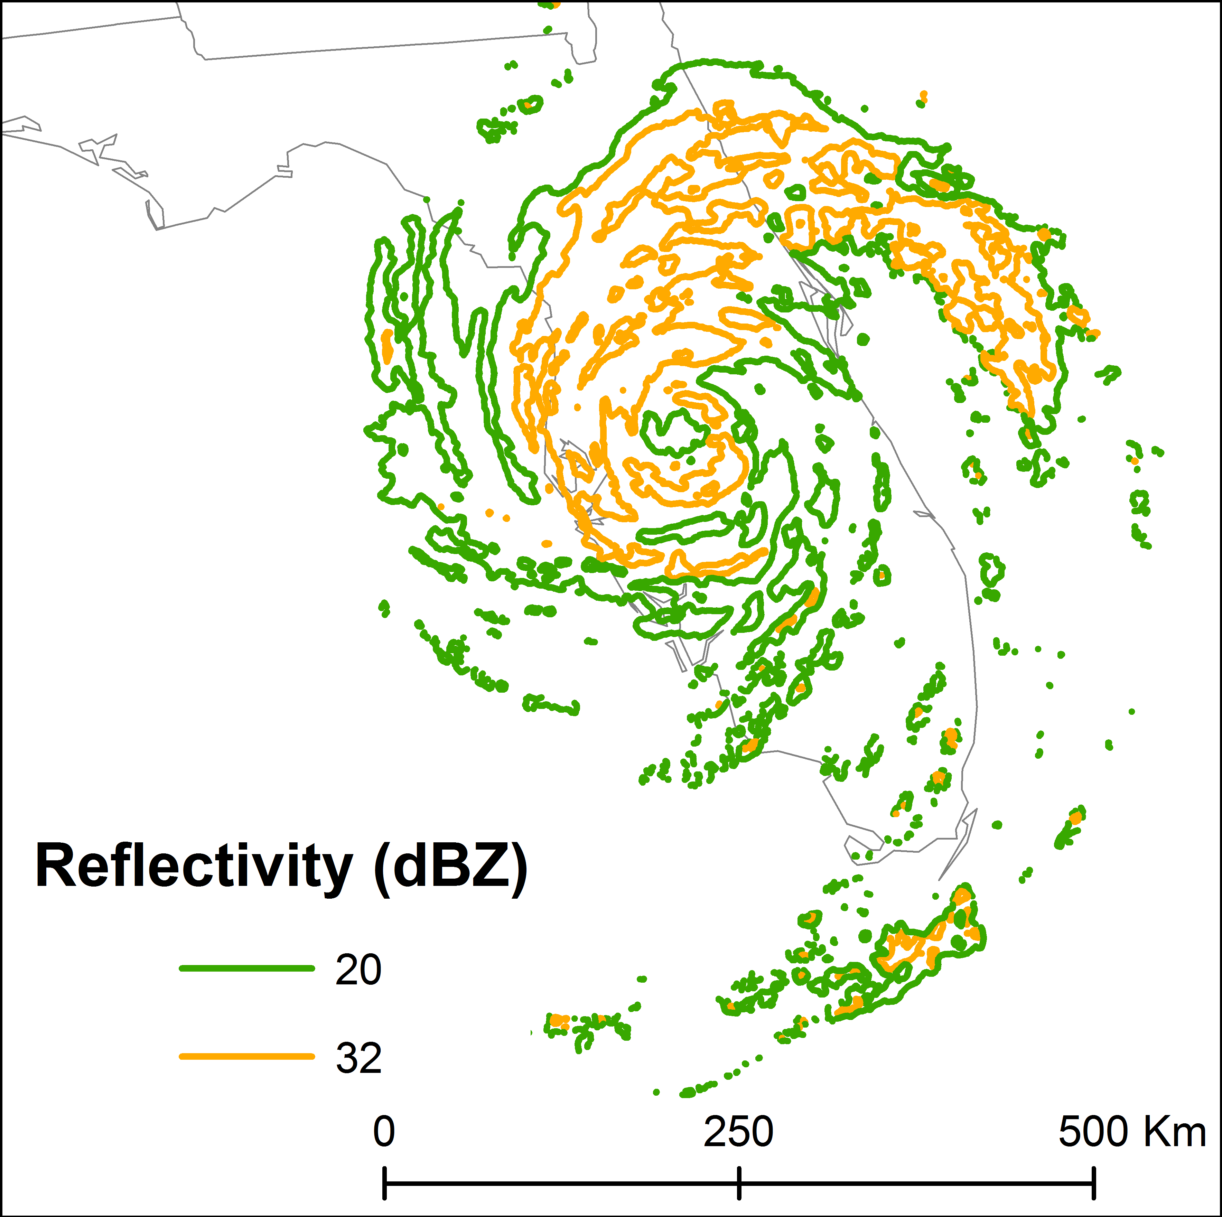
Hurricane Jeanne (2004)
Use storm size to subdivide
Inner region: Eye Diameter
Middle region: ½ ROCI Outer region: ROCI + 100 km
At landfall - Eye Diameter: 74 km; ROCI: 370 km
Notes:
Locate circulation center
Extend lines outward every 1°
Record intersection with 20 and 32 dBZ contours
Use 2x radius of eye for eyewall region
Out to 1/2 ROCI for middle region
Out to ROCI + 100 km for outer region
If no intersection, then a gap is present – must be 10 degrees wide to count
Record start, end angles, distance from center for symmetry

Slide 7
Delimitations to Establishing Gaps
Gap must be at least 10° wide
Reflectivity-filled regions between gaps must be at least 10° wide
Gap must last at least 30 minutes
30 minute smoothing window applied

Slide 8
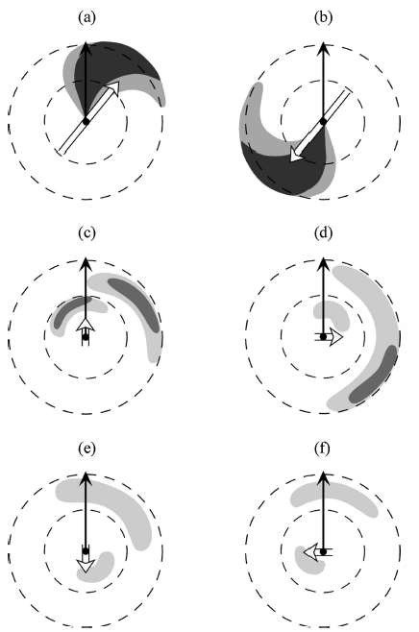
Storm Motion and 200-850 hPa Vertical Wind Shear
Chen et al. (2006,) Fig. 14

Slide 9
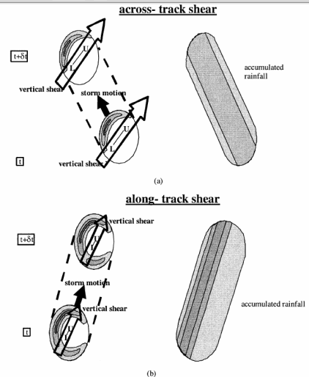
32 dBZ Contour Intersections
Storm Motion
200-850 hPa Shear
9/26 1500 UTC
9/28 1500 UTC
9/27 1500 UTC
Rogers et al. (2003)
Fig. 21

Slide 10
32 dBZ Outer Region (222 – 545 km)
east
south
Main Gap
west
north
Gap
Gap
Gap
Gap
east
south

Slide 11
32 dBZ Middle Region (74-222 km)
east
south
west
Filled Area
north
Filled
Gap
east
Gap Area

Slide 12
Findings
Gaps in reflectivity correspond well to motion and shear vectors (Corbosiero and Molinari 2002, 2003; Chen et al. 2006; Lonfat et al. 2007)
Outer region exposed to west landfall - end
Middle region shrinks in coverage from 360° to 90°
Outer region offset from middle until shear and motion align/ velocities increase
Size measures good approximation for division

Slide 13
Future Work
Relate moisture, change in shear, and intersection with land to erosion of outer region
9/26 0300 UTC
9/25 2100 UTC
9/25 1500 UTC

Slide 14

Future Work
Look at Frances (2004) for comparison (Matyas and Cartaya 2009, Southeastern Geographer)
Role of moisture (NARR) – Zick and Matyas (2015, JGR-A), paper 2 in analysis
Use to assess accuracy of rainband representation in WRF
Thanks to Jingyin Tang for computer code

Slide 15
References
Chen, S. Y. S., J. A. Knaff, and F. D. Marks, 2006: Effects of vertical wind shear and storm motion on tropical cyclone rainfall asymmetries deduced from TRMM. Mon. Wea. Rev., 134, 3190-3208.
Corbosiero, K. L., and J. Molinari, 2002: The effects of vertical wind shear on the distribution of convection in tropical cyclones. Mon. Wea. Rev., 130, 2110-2123.
Corbosiero, K. L., and J. Molinari, 2003: The relationship between storm motion, vertical wind shear, and convective asymmetries in tropical cyclones. J. Atmos. Sci., 60, 366-376.
DeMaria, M., and J. Kaplan, 1994: A statistical hurricane intensity prediction scheme (SHIPS) for the Atlantic basin. Wea. Forecasting, 9, 209-220.
Kimball, S. and S. Mulekar, 2004: A 15-year climatology of North Atlantic tropical cyclones. Part I: Size parameters. J. Clim, 17, 3555-3575.
Lonfat, M., R. Rogers, T. Marchok, and F. D. Marks, 2007: A parametric model for predicting hurricane rainfall. Mon. Wea. Rev., 135, 3086-3097.
Matyas, C. J., 2009: A spatial analysis of radar reflectivity regions within H. Charley (2004). J. Appl. Meteorol. Climatol., 48, 130-142.
Matyas, C. J., 2010: A geospatial analysis of convective rainfall regions within tropical cyclones after landfall. International Journal of Applied Geospatial Research, 1, 69-89.
Matyas, C. J., and M. Cartaya, 2009: Comparing the rainfall patterns produced by Hurricanes Frances (2004) and Jeanne (2004) over Florida. Southeastern Geographer 49, 132-156.
Parrish, J. R., R. W. Burpee, F. D. Marks, and R. Grebe, 1982: Rainfall patterns observed by digitized radar during the landfall of Hurricane Frederic (1979). Mon. Wea. Rev., 110, 1933-1944.
Rogers, R. F., S. S. Chen, J. Tenerelli, and H. E. Willoughby, 2003: A numerical study of the impact of vertical shear on the distribution of rainfall in Hurricane Bonnie (1998). Mon. Wea. Rev., 131, 1577-1599.
Willoughby, H., F. Marks, R. Feinberg, 1984: Stationary and moving convective bands in hurricanes. J. Atmos. Sci., 41, 3189 - 3211.
Zick, S. E., and C. J. Matyas, 2015: Tropical cyclones in the North American Regional Reanalysis: An assessment of spatial biases in location, intensity, and structure. Journal of Geophysical Research: Atmospheres, DOI: 10.1002/2014JD022417

