Slide 1
Towards Developing a Guidance Product for Tropical Cyclogenesis Probabilities Using a Comprehensive Historical Dataset of Precipitation and Environmental Properties
Jonathan Zawislak¹, Brandon Kerns², Haiyan Jiang¹,
Shuyi Chen², and Ed Zipser³
¹ Florida International University, Miami, FL
² Rosenstiel School of Marine and Atmospheric Science, Univ. of Miami, Miami, FL
³ University of Utah, Salt Lake City, UT
69th Interdepartmental Hurricane Conference,
Tropical Cyclone Research Forum, March 3, 2015 S2_04
1

Slide 2
Objectives
Using a 10-year dataset of satellite and model analysis statistics (TC-PMW), IR cloud cluster longevity:
Identify the differences between developing and nondeveloping “invests”
Identify the most important “precipitation” predictors
Identify the most important “environmental” predictors
For each predictor, quantify genesis probability for TC genesis in short- (0-48 hr) and medium-range (0-120 hr)
Ultimate goal….
Develop a genesis guidance product, the
Tropical Cyclogenesis Satellite Guidance Product (TCGSatP)
2

Slide 3
Tropical Cyclone - Passive Microwave (TC-PMW) Dataset
Satellite | Total Passes | % of Total | Passes with 100% Data Coverage in 3deg | % of Total Sat Passes | Passes with 100% Data Coverage in 1deg | % of Total Sat Passes | NONDEV Passes | % of Total Sat Passes | PRE Passes | % of Total Sat Passes | POST Passes | % of Total Sat Passes
ATL | 19295 | 40.4 | 9210 | 47.7 | 15030 | 77.9 | 3506 | 18.2 | 3457 | 17.9 | 12332 | 63.9
EPAC | 13305 | 27.9 | 6221 | 46.8 | 10330 | 77.6 | 1863 | 14.0 | 2605 | 19.6 | 8837 | 66.4
CPAC | 1565 | 3.3 | 729 | 46.6 | 1197 | 76.5 | 729 | 46.6 | 206 | 13.2 | 630 | 40.3
WPAC | 11835 | 24.8 | 5806 | 49.1 | 9276 | 78.4 | 0 | 0.0 | 1670 | 14.1 | 10165 | 85.9
(N)OI | 1710 | 3.6 | 801 | 46.8 | 1327 | 77.6 | 0 | 0.0 | 280 | 16.4 | 1430 | 83.6
 | 47710 | 100.0 | 22767 | 47.7 | 37160 | 77.9 | 6098 | 12.8 | 8218 | 17.2 | 33394 | 70.0
2003-2012 Atlantic (ATL) & East Pacific (EPAC)
DEV: 497 (256 ATL; 241 EPAC)
NONDEV: 273 (172 ATL; 101 EPAC)
5369 are NONDEV (16.5% of dataset)
6062 are PREGENESIS (18.5% of dataset)
47% full data coverage within a 3° of center
78% full data coverage within a 1° of center
WP, SH, IO → soon
DEV: 1998-2012 (soon 2013)
NONDEV: 2003-2012 (soon 2013)
Centers adjusted to 1x1° NCEP FNL interpolated 3-hourly location for “ENVIRONMENTAL PREDICTORS”
PMW SENSORS:
“PRECIPITATION PREDICTORS”:
AMSR-E
TMI
SSMI-11, -13, -14, -15
SSMIS-16, -17, -18
Minimum PCT at 85-91, 37 GHz
Fractional area of 250 K, 210 K, 160 K PCT at 85-91 GHz
Fractional area of 270 and 235 K PCT at 37 GHz
3

Slide 4
“Environmental” Predictors
DEV & NONDEV DGP identical
DEV slightly lower VWSH
DEV higher midlevel RH
PREGEN
PREGEN
PREGEN
NONDEV
NONDEV
NONDEV
Within 3°
of center
NONDEV
PREGEN
NONDEV
PREGEN
NONDEV
PREGEN
DEV slightly higher midlevel MR
RVOR nearly identical
SST nearly identical
4

Slide 5
“Environmental” Predictors
This figure separates by TWO short-range categorized genesis probability
Midlevel RH increases w/ increasing
probability
No/
Low
Med/
High
VWSH decreases w/ increasing
probability
DGP increases
w/ increasing
probability
Midlevel MR increases
w/ increasing
probability
RVOR increases
w/ increasing
probability
No/
Low
SST unchanged
w/ probability
Med/
High
5

Slide 6
“Precipitation” Predictors
“Convective Intensity”
“Convective Intensity”
“Raining Fraction”
NONDEV
PREGEN
PREGEN
NONDEV
NONDEV
No difference in convective intensity
No difference in convective intensity
PREGEN
DEV have more raining area
NONDEV
PREGEN
NONDEV
NONDEV
PREGEN
PREGEN
DEV have more raining area
DEV have more “moderate
convective” area
No difference in
“intense convective” area
“Raining Fraction”
“Moderate Conv. Fraction”
“Intense Fraction”
6

Slide 7
Genesis Probabilities
Genesis probability
= *** number of cases that satisfy a given threshold ÷
combined number of PREGEN and NONDEV cases meeting the threshold criteria.
***i.e., the number of cases that, when the threshold is satisfied,
form within 48 hours and within 120 hours
threshold = mean value within +/- 12 hours of genesis
“Environmental” Predictor Thresholds
Mean threshold for | midRH [%] | midMR [g kg⁻¹] | VWSH [m s⁻¹] | DGP [s⁻¹] | RVOR850 [s⁻¹] | SST [C]
within 12 hr of genesis | 76 (84) | 5.8 (6.8) | 6.7 (5.2) | 5.0 (4.9) | 4.9 (4.3) | 27.8 (28.1)
AL (EP)
“Precipitation” Predictor Thresholds
Mean threshold for | frac250_hi [%] | frac210 _hi [%] | frac270 _lo [%] | frac160 _hi [%] | minPCT _hi [K] | minPCT _lo [K]
within 12 hr of genesis | 7.4 (9.7) | 0.85 (0.90) | 4.5 (5.3) | 0.09 (0.08) | 161 (162) | 256 (256)
AL (EP)
‘hi’ = 85-91 GHz
‘lo’ = 37 GHz
7

Slide 8
Genesis Probabilities
“Environmental” Predictor Probabilities
Probability | midRH [%] | midMR [g kg⁻¹] | VWSH [m s⁻¹] | DGP [s⁻¹] | RVOR850 [s⁻¹] | SST [C]
0-48 hr | 36 (49) | 36 (52) | 36 (46) | 37 (47) | 40 (60) | 30 (40)
0-120 hr | 52 (67) | 52 (67) | 52 (62) | 50 (54) | 49 (68) | 47 (63)
DEV | 56 (68) | 57 (68) | 55 (64) | 51 (54) | 51 (68) | 50 (64)
NONDEV | 44 (32) | 43 (32) | 45 (36) | 49 (46) | 49 (32) | 50 (36)
8

Slide 9
Genesis Probabilities
“Precipitation” Predictor Probabilities
Probability | Frac250_hi [%] | Frac210 _hi [%] | Frac270 _lo [%] | Frac160_hi [%] | minPCT _hi [K] | minPCT _lo [K]
0-48 hr | 43 (53) | 38 (43) | 42 (52) | 34 (37) | 35 (40) | 34 (40)
0-120 hr | 60 (67) | 56 (57) | 58 (67) | 51 (51) | 50 (55) | 50 (55)
DEV | 64 (69) | 58 (59) | 61 (69) | 54 (54) | 53 (57) | 52 (57)
NONDEV | 36 (31) | 42 (41) | 39 (31) | 46 (46) | 47 (43) | 48 (43)
9

Slide 10
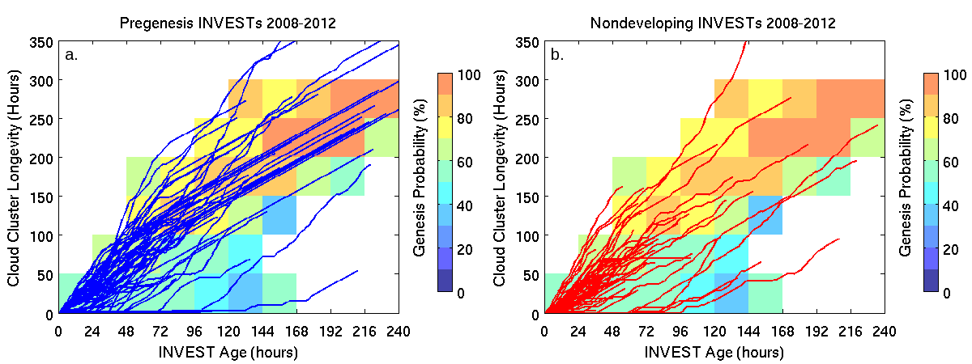
Genesis Probabilities from Cloud Cluster Longevity
Kerns and Chen (2013) used an objective cloud cluster tracking algorithm based on Chen et al. (1996)
Cloud clusters are identified as contiguous areas of <208 K IR T_{B}
Tracked forward and backward in time (e.g., “time clusters”) when they overlap by 50% between consecutive hourly IR images
DEV
NONDEV
Highest probabilities (yellow and orange shading)….
accumulated cloud cluster longevity reaches…
100 hours for invests tracked for less than 5 days, and
150 hours for invests tracked for longer than 5 days.
10

Slide 11
Summary
Most important “environmental” predictors are midlevel RH and mixing ratio
Most important “precipitation” predictors are any proxy for
raining area (fractional coverage of 250 K at 85-91 GHz)
Longer the cloud cluster longevity (single or multiple clusters), the higher probability of genesis
Dataset provides a useful tool to determine the probability of genesis in the short- and medium-range by placing an “invest” in a historical context
- Additional real-time tool (TCGSatP) to be used in conjunction with current operational methods for genesis probabilities
11

