Slide 1
Deterministic TC Genesis Prediction in a Suite of Operational Global NWP models
Mike Fiorino
Commander, United States Navy (retired)
B.S. (’75 PSU), M.S. (’78 PSU), Ph.D. (’87 NPS) all in Meteorology michael.fiorino@noaa.gov
Earth System Research Laboratory, Boulder CO
MAS/EMB/GSD/ESRL/OAR/NOAA/DoC
National Hurricane Center, Miami FL
Joint Typhoon Warning Center, Pearl Harbor HI
Lawrence Livermore National Laboratory, Livermore CA
European Centre for Medium-Range Weather Forecasts, Shinfield Park, Berskshire, UK
Meteorological Research Institute – Japan Meteorological Agency, Tsukuba JAPAN
Space and Naval Warfare Systems Command, Arlington VA
NASA Goddard Space Flight Center, Greenbelt MD
National Centers for Environmental Prediction, Camp Springs MD
Naval Postgraduate School, Monterey CA
Fleet Numerical Meteorology and Oceanography Center, Monterey CA
Naval Research Laboratory, Monterey CA
Atlantic Oceanographic and Meteorological Laboratory, Miami FL
Pennsylvania State University, University Park PA

Slide 2
Slide Wars – ROE I
1a
The Peter* Principle
*Pete Black aka Pedro Negro circa 1978

Slide 3
Slide Wars – ROE I
1
The Peter* Principle
One Slide per Minute
*Pete Black aka Pedro Negro circa 1978

Slide 4
Slide Wars – ROE II
2a
The Alan Weinstein Principle
When briefing the Admiral you only have ONE slide…

Slide 5
Slide Wars – ROE II
2b
The Alan Weinstein Principle
When briefing the Admiral you only have ONE slide…
the ONE slide must:
  never, never, EVER show equations

Slide 6
Slide Wars – ROE II
2c
The Alan Weinstein Principle
When briefing the Admiral you only have ONE slide…
the ONE slide must:
  never, never, EVER show equations
  be a cartoon – the simpler the better – NO squiggly lines!

Slide 7
Slide Wars – ROE II
2
The Alan Weinstein Principle
When briefing the Admiral you only have ONE slide…
the ONE slide must:
  never, never, EVER show equations
  be a cartoon – the simpler the better – NO squiggly lines!
  no more than 10 words

Slide 8
Slide Wars – ROE III
3a
FNMOC – ‘you’re only as good as what you measure’
  FNMOC = Fleet Numerical Meteorology and Oceanography Center
  pronounced ‘FinMock’ != jokes about the Finns

Slide 9
Slide Wars – ROE III
3b
FNMOC – ‘you’re only as good as what you measure’
  FNMOC = Fleet Numerical Meteorology and Oceanography Center
  pronounced ‘FinMock’ != jokes about the Finns
ONR – answer the ‘So What? Who Cares?’

Slide 10
Slide Wars – ROE III
3c
FNMOC – ‘you’re only as good as what you measure’
  FNMOC = Fleet Numerical Meteorology and Oceanography Center
  pronounced ‘FinMock’ != jokes about the Finns
ONR – answer the ‘So What? Who Cares?’
CNE-C6F
  make maximum use of local acronyms
    so that no one, especially the CO, fully understands…
    so as to be the SME
  local quality of brief proportional # of WOFs
    WOF != Warn On Forecast

Slide 11
Slide Wars – ROE III
3d
FNMOC – ‘you’re only as good as what you measure’
  FNMOC = Fleet Numerical Meteorology and Oceanography Center
  pronounced ‘FinMock’ != jokes about the Finns
ONR – answer the ‘So What? Who Cares?’
CNE-C6F
  make maximum use of local acronyms
    so that no one, especially the CO, fully understands…
    so as to be the SME
  local quality of brief proportional # of WOFs
    WOF != Warn On Forecast
    WOF = Warheads On Foreheads

Slide 12
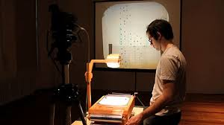

Slide Wars – ROE III
3
FNMOC – ‘you’re only as good as what you measure’
  FNMOC = Fleet Numerical Meteorology and Oceanography Center
  pronounced ‘FinMock’ != jokes about the Finns
ONR – answer the ‘So What? Who Cares?’
CNE-C6F
  make maximum use of local acronyms
    so that no one, especially the CO, fully understands…
    so as to be the SME
  local quality of brief proportional # of WOFs
    WOF != Warn On Forecast
    WOF = Warheads On Foreheads
MF rule – because of the Bill-Steve wars – no .ppt(x) only (simple).pdf
  progressing forward to the 1980s – .pdf = digital acetate slides

Slide 13
So What? Who Cares?
4
WHO? | WHAT? | WHY? | Comments
JTWC | TCFA Tropical Cyclone Formation Alert deterministic D+1 forecast that a pTC (INVEST or 9X) will become a TC | PACOM | pTC analysis procedure similar to JMA EDA (Early Dvorak Analysis)
NHC | GTWO Graphical Tropical Weather Outlook probabilistic D+2 and D+5 of TC dev/form | NHOP non-GPRA goal | 1st true forecaster (HS) probability product
MF | TCgen2 http://ruc.noaa.gov/hfip/tcgen deterministic D+1,2,3,4,5 forecast | Bob Gall | developed a validated set of pre/potential TCs (pTCs) based on operations genesis window based on operations
AMS 31st Hurr Trop Conf | 4 sessions on TC genesis | NSF? NHC? ONR? – somebody must be funding TCgen research | no consistent definition of genesis – “I don’t know how to define *.*, but I know it when I see it” no consistent definition and/or use of pTCs
Notes:
Potter Stewart Stewart wrote, "I shall not today attempt further to define the kinds of material I understand to be embraced within that shorthand description; and perhaps I could never succeed in intelligibly doing so. But I know it when I see it, and the motion picture involved in this case is not that." (emphasis added)

Slide 14

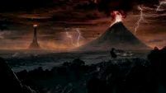
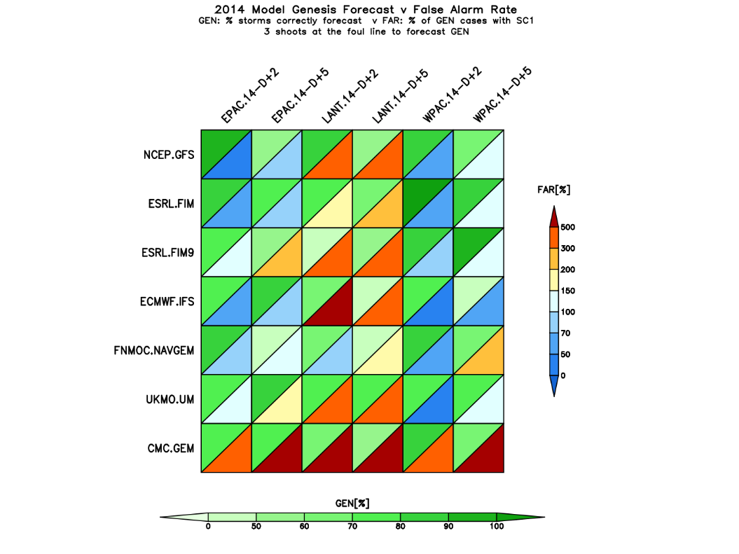

One Slide to rule them all and in the…
5a
2014 NHEM Season
GEN%
FAR%
Notes:
Potter Stewart Stewart wrote, "I shall not today attempt further to define the kinds of material I understand to be embraced within that shorthand description; and perhaps I could never succeed in intelligibly doing so. But I know it when I see it, and the motion picture involved in this case is not that." (emphasis added)

Slide 15
One Slide to rule them all and in the…
5b
the greener the better
are the genesis forecasts
GEN%
FAR%
the redder the worse
are the false alarms, i.e., more spuricanes
Notes:
Potter Stewart Stewart wrote, "I shall not today attempt further to define the kinds of material I understand to be embraced within that shorthand description; and perhaps I could never succeed in intelligibly doing so. But I know it when I see it, and the motion picture involved in this case is not that." (emphasis added)

Slide 16
One Slide to rule them all and in the…
5
ECMWF lowest FAR
except in the gulf of Mosquitos
USN best FAR in the LANT; other models have more spuricanes
UKMO consistent and good GEN
.ca – very high FAR
in all basins, eh?
Notes:
Potter Stewart Stewart wrote, "I shall not today attempt further to define the kinds of material I understand to be embraced within that shorthand description; and perhaps I could never succeed in intelligibly doing so. But I know it when I see it, and the motion picture involved in this case is not that." (emphasis added)

Slide 17
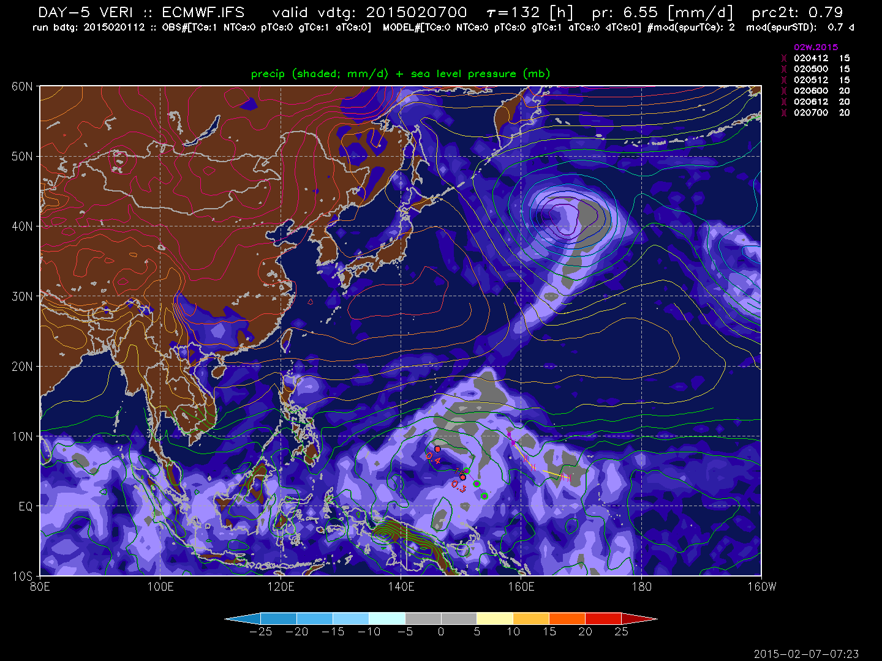
STEP 1: generate a WxMAP with model v obs cyclones genesis of 02W.15 (TC) on 2015020700 – developed from 94W (pTC)
6a
started as 94W on 020406
1st JTWC warning on 020706
72 h as a pTC
Notes:
Potter Stewart Stewart wrote, "I shall not today attempt further to define the kinds of material I understand to be embraced within that shorthand description; and perhaps I could never succeed in intelligibly doing so. But I know it when I see it, and the motion picture involved in this case is not that." (emphasis added)

Slide 18
STEP 1: generate a WxMAP with model v obs cyclones genesis of 02W.15 (TC) on 2015020700 – developed from 94W (pTC)
6b
started as 94W on 020406
1st JTWC warning on 020706
72 h as a pTC
genesis track close to posit at 020706 = ‘HIT’
Notes:
Potter Stewart Stewart wrote, "I shall not today attempt further to define the kinds of material I understand to be embraced within that shorthand description; and perhaps I could never succeed in intelligibly doing so. But I know it when I see it, and the motion picture involved in this case is not that." (emphasis added)

Slide 19
STEP 1: generate a WxMAP with model v obs cyclones genesis of 02W.15 (TC) on 2015020700 – developed from 94W (pTC)
6c
these two genesis tracks NOT close to posit at 020706 = ‘MISS’ =
class I Spuricane (SC1)
started as 94W on 020406
1st JTWC warning on 020706
72 h as a pTC
genesis track close to posit at 020706 = ‘HIT’
Notes:
Potter Stewart Stewart wrote, "I shall not today attempt further to define the kinds of material I understand to be embraced within that shorthand description; and perhaps I could never succeed in intelligibly doing so. But I know it when I see it, and the motion picture involved in this case is not that." (emphasis added)

Slide 20
STEP 1: generate a WxMAP with model v obs cyclones genesis of 02W.15 (TC) on 2015020700 – developed from 94W (pTC)
6d
these two genesis tracks NOT close to posit at 020706 = ‘MISS’ =
class I Spuricane (SC1)
started as 94W on 020406
1st JTWC warning on 020706
72 h as a pTC
strength of SC1 = sTDd = 0.4
scaled TD (25 kt) days
genesis track close to posit at 020706 = ‘HIT’
Notes:
Potter Stewart Stewart wrote, "I shall not today attempt further to define the kinds of material I understand to be embraced within that shorthand description; and perhaps I could never succeed in intelligibly doing so. But I know it when I see it, and the motion picture involved in this case is not that." (emphasis added)

Slide 21
STEP 1: generate a WxMAP with model v obs cyclones genesis of 02W.15 (TC) on 2015020700 – developed from 94W (pTC)
6
statistics of
TCs
pTCs
gTCs
sTDd
stored in a .pypdb file
these two genesis tracks NOT close to posit at 020706 = ‘MISS’ =
class I Spuricane (SC1)
started as 94W on 020406
1st JTWC warning on 020706
72 h as a pTC
strength of SC1 = sTDd = 0.4
scaled TD (25 kt) days
genesis track close to posit at 020706 = ‘HIT’
Notes:
Potter Stewart Stewart wrote, "I shall not today attempt further to define the kinds of material I understand to be embraced within that shorthand description; and perhaps I could never succeed in intelligibly doing so. But I know it when I see it, and the motion picture involved in this case is not that." (emphasis added)

Slide 22
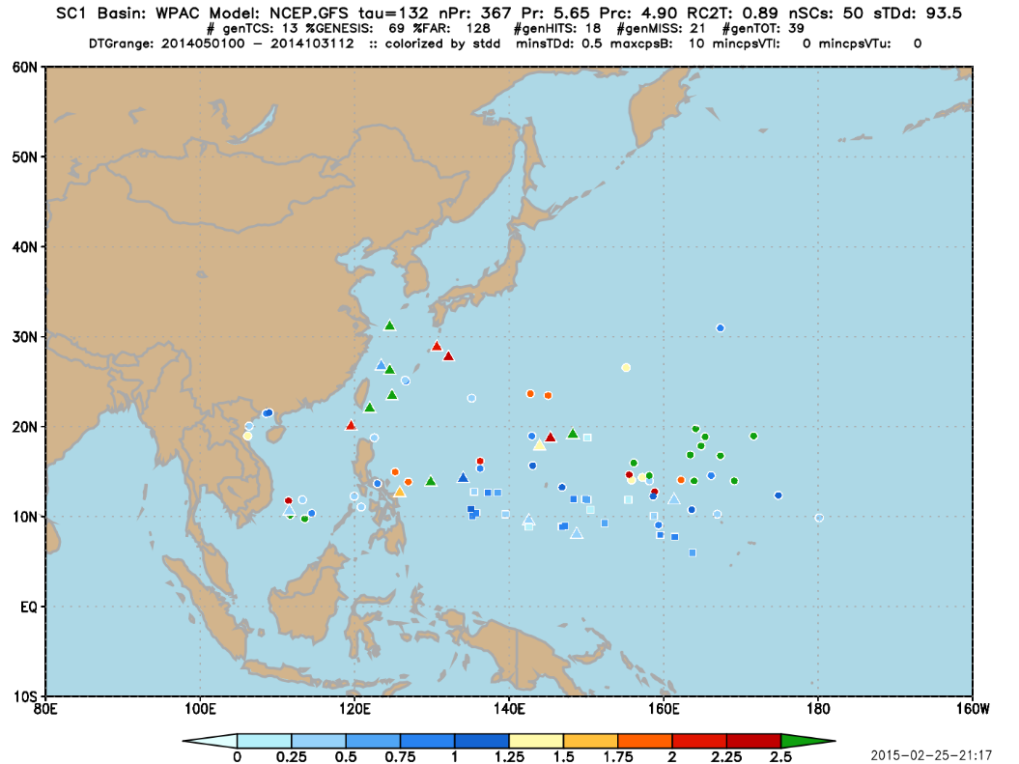
STEP 2: analyze stats from the WxMAPs
May-October for NHEM seasons, by model and forecast – GFS D+5 WPAC
7a
triangles are correct genesis forecasts
dots are SC1s
squares are missed
genesis forecasts
colorize by sTDd [d]
Notes:
Potter Stewart Stewart wrote, "I shall not today attempt further to define the kinds of material I understand to be embraced within that shorthand description; and perhaps I could never succeed in intelligibly doing so. But I know it when I see it, and the motion picture involved in this case is not that." (emphasis added)

Slide 23
STEP 2: analyze stats from the WxMAPs
May-October for NHEM seasons, by model and forecast – GFS D+5 WPAC
7
Genesis Rate
% correct genesis forecasts
False Alarm Rate
#SC1/#genTC points
# dots/(#triangles+#squares)
Notes:
Potter Stewart Stewart wrote, "I shall not today attempt further to define the kinds of material I understand to be embraced within that shorthand description; and perhaps I could never succeed in intelligibly doing so. But I know it when I see it, and the motion picture involved in this case is not that." (emphasis added)

Slide 24
Critical Factors...
8
the TIM (Tcs In Models – GFDL) tracker locates/forms cyclones during the model forecast…but model cyclone max wind (in sTDd) is insufficient to identify spuricanes…but the Hart CPS (Cyclone Phase Space) can…but FAR is sensitive to CPS thresholds…
used sTDd threshold to define significant model cyclones for making a yes/no forecast of genesis…but need to include CPS…still need to improve the calibration…

Slide 25
Conclusions and Takeaways
9
the global models DO forecast genesis
  higher success rates at D+2 v D+5
  increase in FAR from D+2 to D+5 not as large as between basins
  2014 LANT spuricanes mostly a gulf of Mosquitoes problem
  2014 WPAC had fewer spuriphoons (lower FAR)
next step – probability of genesis from the multi-model ensemble when calibration improved
whenever you can make a WxMAP – Just Do It!
http://ruc.noaa.gov/hfip/tcgen

