Slide 1
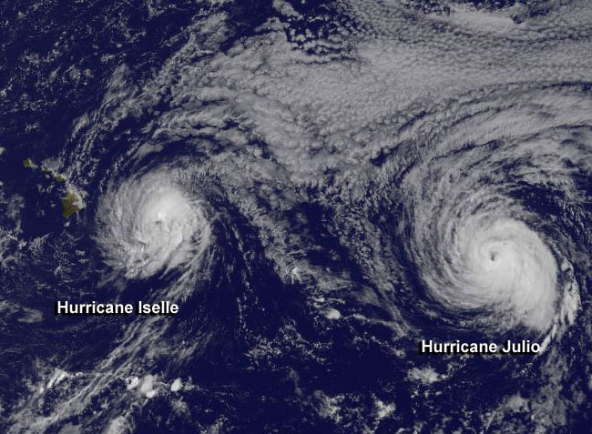



2014 AXBT Demonstration Project:
Operations Summary and Research Update
1800 UTC 7 August 2014
GOES WEST
Image courtesy NASA/NOAA
Elizabeth R. Sanabia¹ and Peter Black²
¹United States Naval Academy ²Naval Research Laboratory,
Monterey, CA and SAIC
1
03 Mar 15 2015 Interdepartmental Hurricane Conference Jacksonville, FL

Slide 2

The AXBT Demonstration Project
  Incremental Objectives:
  Collect, process, and transmit AXBT data to coupled modeling centers in near-real time
  Assimilate AXBT data into coupled models
  Demonstrate improvement to ocean model initializations and forecasts
  Demonstrate improvement to hurricane track and intensity forecasts
  Overall Objective:
  Increase hurricane forecast accuracy by assimilating ocean observations from beneath tropical cyclones into coupled numerical models in near-real time
2
03 Mar 15 2015 Interdepartmental Hurricane Conference Jacksonville, FL

Slide 3
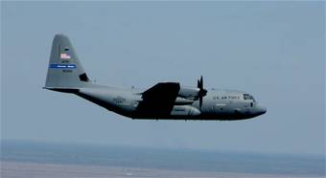
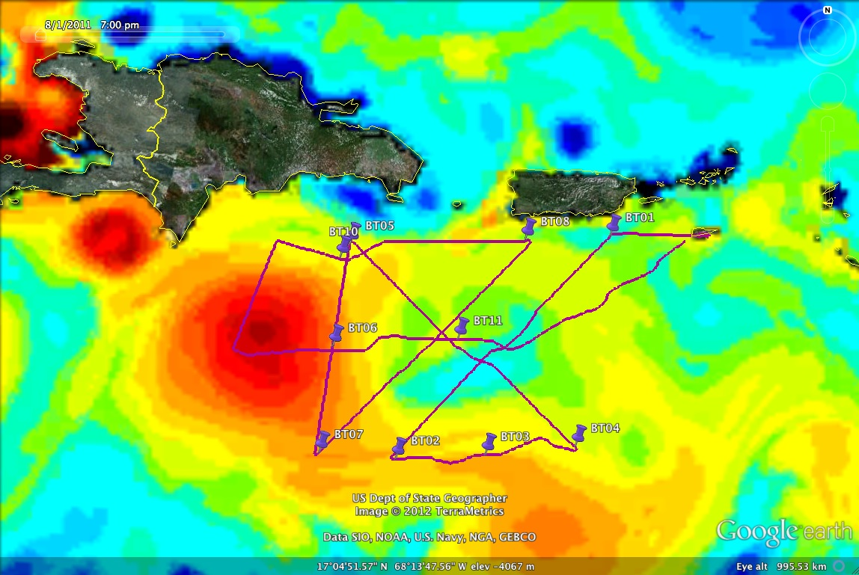
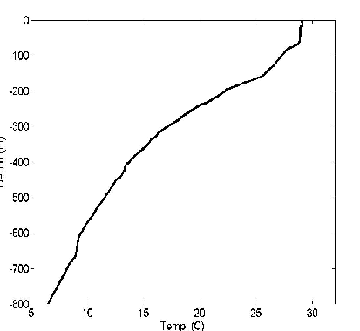
WC-130J in flight
AXBT Data Path
AXBT Demonstration Project
Deploy → Collect → Process → Transmit
53rd SATCOM
Ground Station
NAVO
NRL MRY
Disseminate
JJVV
RTDHS → NCODA → NCOM
COAMPS-TC
National Hurricane Center
NDBC
NCEP/EMC
Upload
GTS
HWRF
AXBT 06
JJVV Message
AXBT 06
Profile
JJVV 03081 0741/ 716360 069460 88888
51099 00291 00291 00291 14291 19289
57289 66287 72284 80278 99901
08270 30265 39261 56256 73242
83234 90228 93224 99902 00222
14216 33206 36202 51194 59190
69185 73183 80181 99903 15163
26162 36157 48154 56152 88140
99904 00138 06134 26133 42129
48126 65123 99905 04115 31108
48105 74099 99906 11092 65089
87084 99907 11080 97066 99908
48065 AF306
3
03 Mar 15 2015 Interdepartmental Hurricane Conference Jacksonville, FL
Notes:
NDBC’s contribution
Vertical resolution – no mandatory levels in the ocean

Slide 4
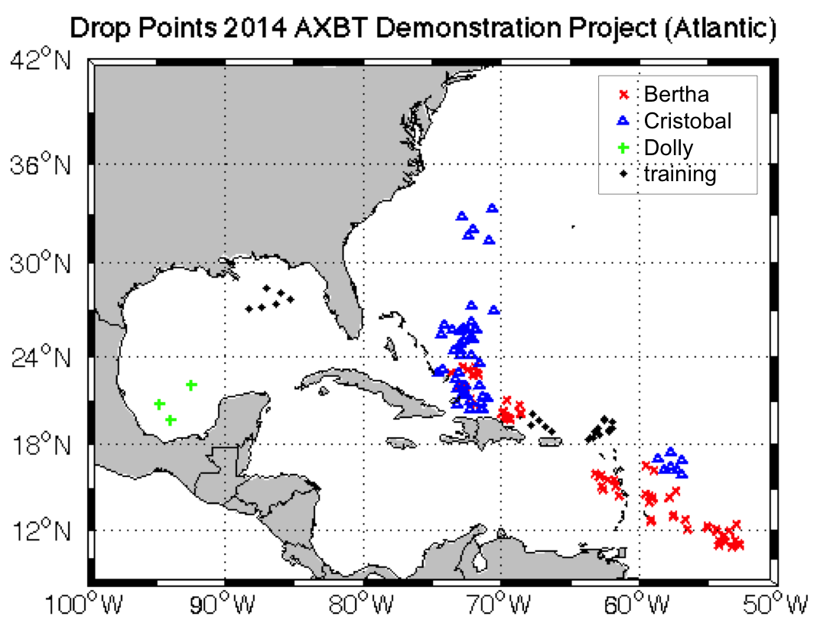
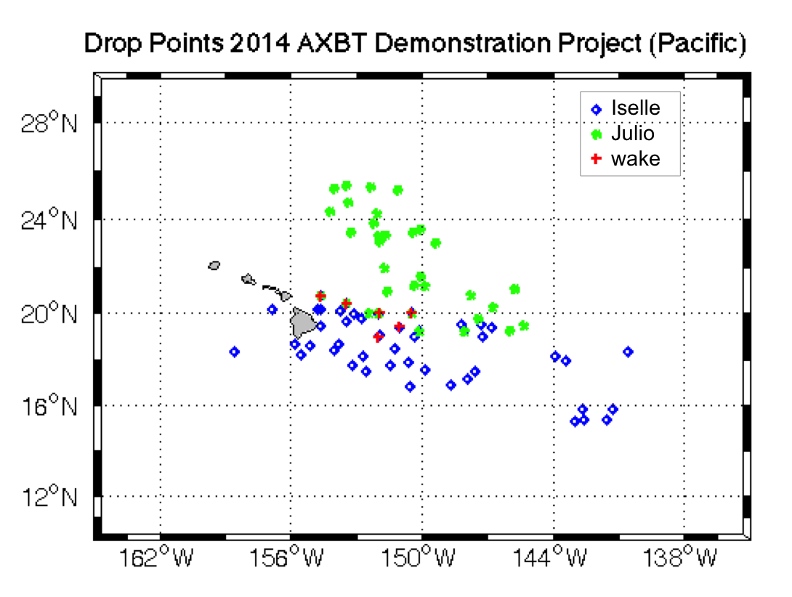
Deployment Activity during the 2014 Season
42 flights with 53rd WRS
20 July – 15 September 2014
6 personnel
  3 Midshipmen, 2 Officers, 1 NCO
257 AXBTs deployed
  Hurricane Bertha (5)
  Hurricane Iselle (7)
  Hurricane Julio (5)
  Hurricane Cristobal (10)
  Other invests (2)
  Transits/Training (13)
4
03 Mar 15 2015 Interdepartmental Hurricane Conference Jacksonville, FL

Slide 5
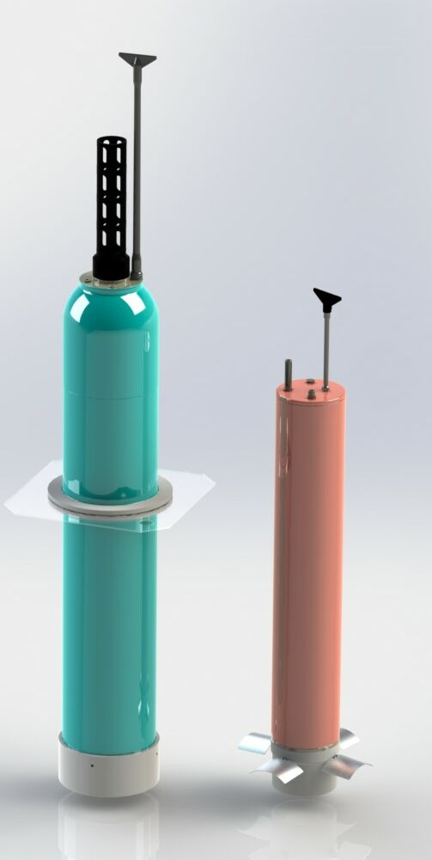

Operational Progress
ALAMO
Smaller profiling float that fits in the AXBT launcher and can be used operationally by NOAA and USAF Hurricane Hunters planes.
Advantages include: multiple profiles, more sensors (salinity & accelerometer for surface waves), no VHF receiver equipment on planes & data will go automatically in near-real time to GTS.
A-sized case
Weight ~10 kg
100−150 profiles
1200-meter depth rating
(2300-m sensor to be next)
1-2 dbar bin-averaged data
Iridium data communication
Increased coordination with NOAA HRD and AOC
  Consolidated staging of AXBTs at 53rd WRS St. Croix Operations Center
  Developed a coordinated observation plan
Deployment of a new profiling float (ALAMO)
  Developed by MRV Systems in conjunction with WHOI
  Deployed in western Atlantic and Gulf of Mexico during training flights
  Deployed ahead of Hurricanes Iselle and Julio
  Presentation by Steve Jayne (S4b-05) 11:15 Wednesday 04 March
5
03 Mar 15 2015 Interdepartmental Hurricane Conference Jacksonville, FL

Slide 6
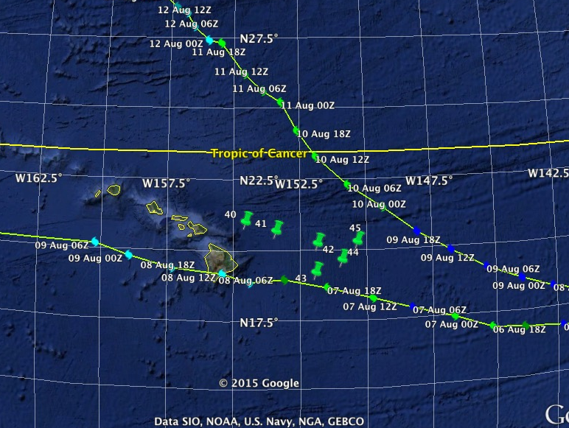
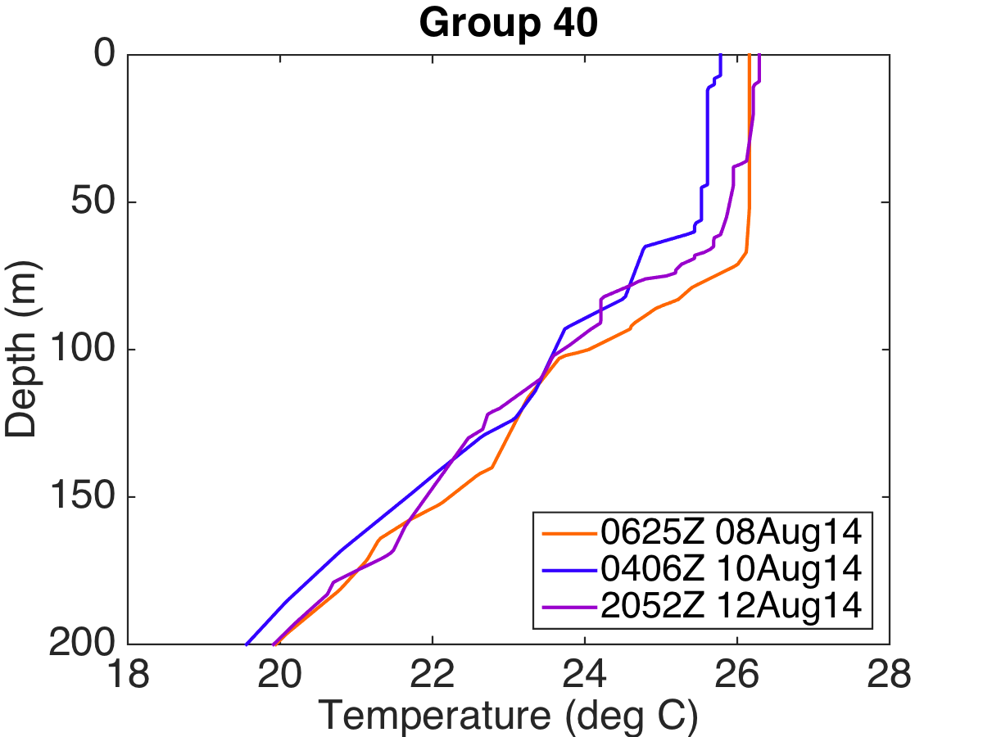
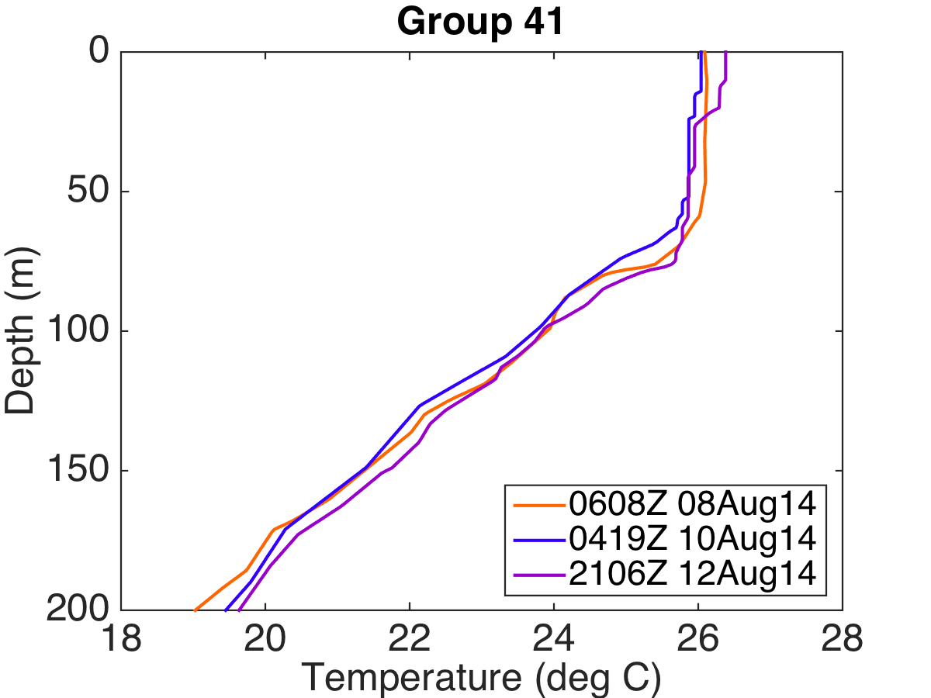
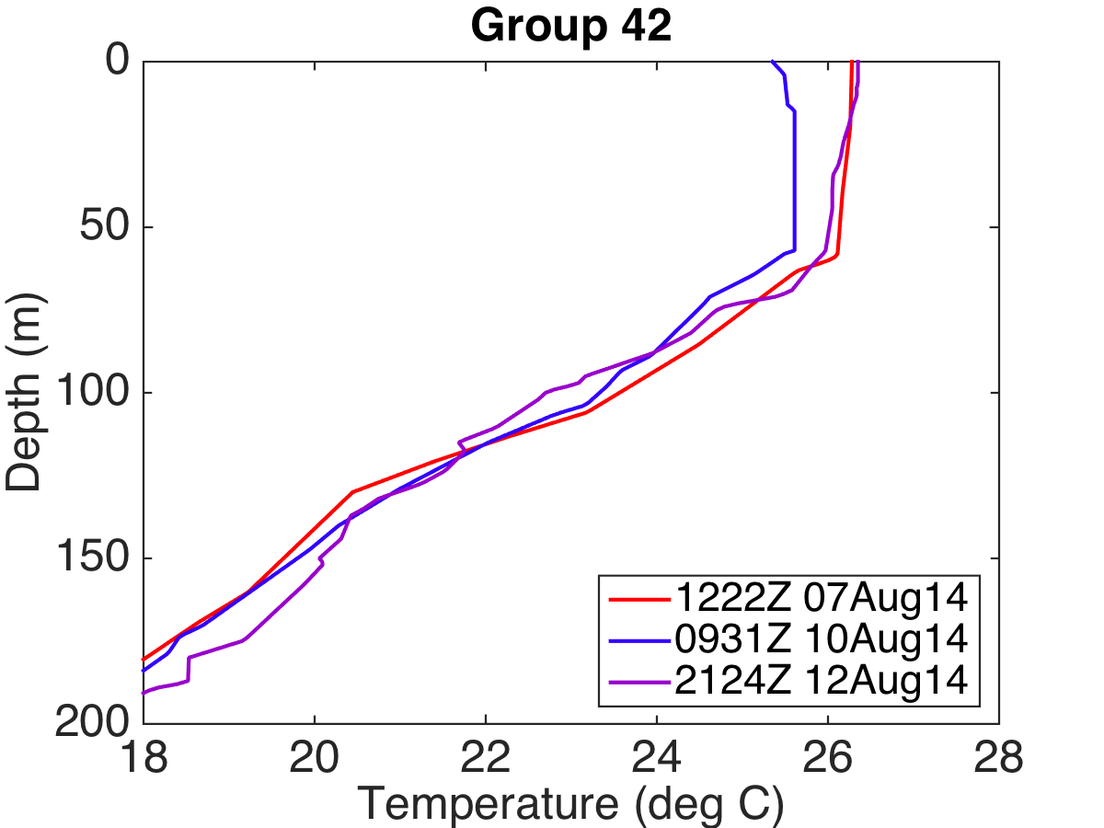
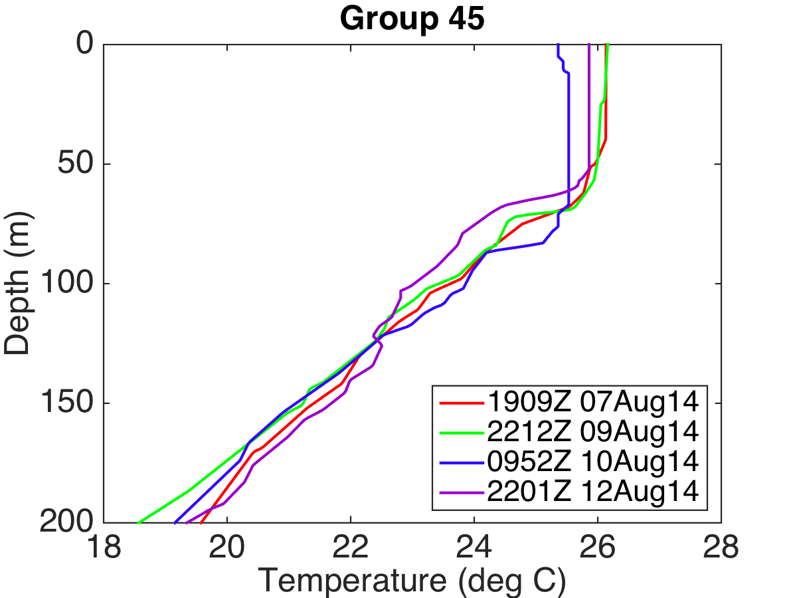
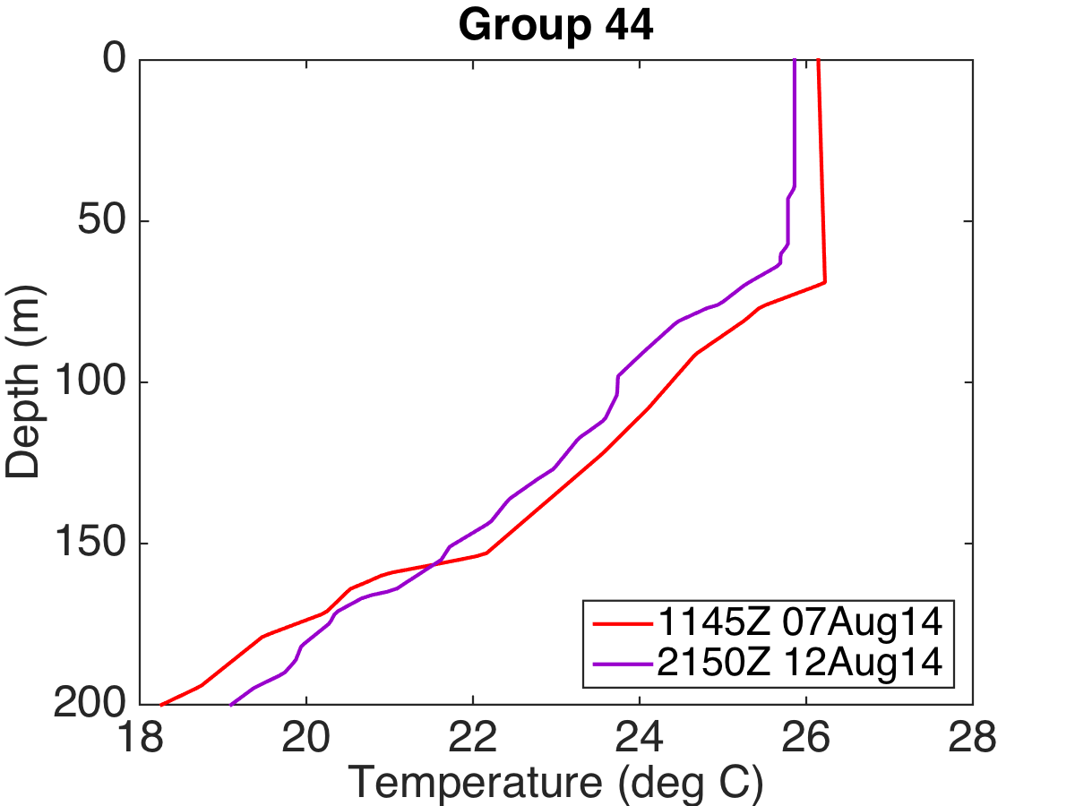
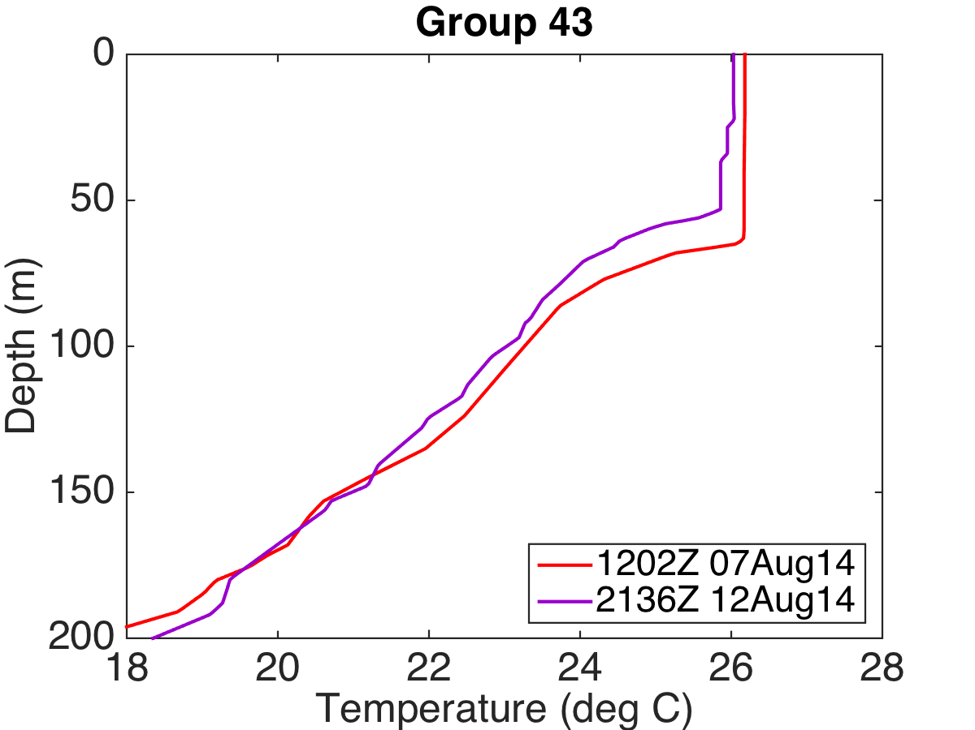
Changes in Ocean Temperature during Iselle and Julio
Upper-ocean temperature characteristics
  Close proximity of the storm tracks provided a unique opportunity to repeatedly sample multiple locations
Generally, SST: 25-26.5ºC and MLD: 50-75m
Mixed layer cooled up to 1ºC and depth varied by 20m between 7-10 August, then warmed prior to the 12 August wake flight.
6
03 Mar 15 2015 Interdepartmental Hurricane Conference Jacksonville, FL

Slide 7
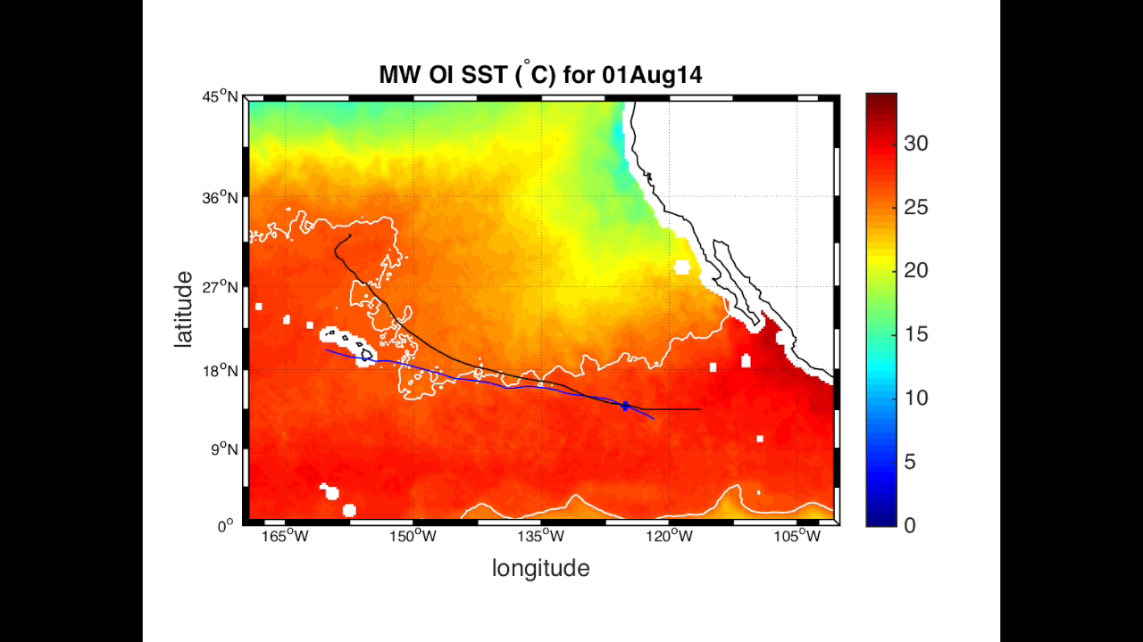
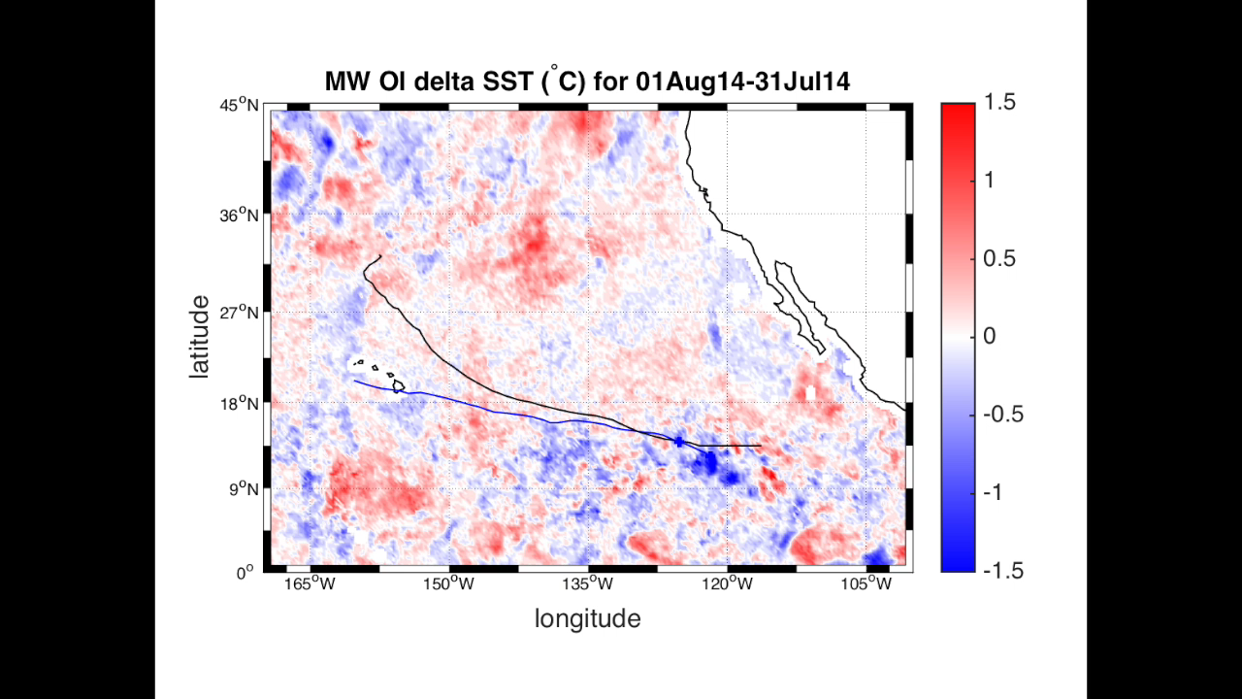
Observations on a larger scale: SSTs
Data: MW OI SSTs
  Remote Sensing Systems
  1200 UTC each day
  25-km resolution
SST Characteristics
  Both TCs pass along the edge of the 26ºC isotherm (white contour)
  Reduced temperatures are evident and variable along the TC tracks
  Cold wake often present for more than one day
1-day Delta SST Characteristics
  Cooling is variable along the TC tracks
  Cooling typically only visible for one day
  Warming often noted on second day
7
03 Mar 15 2015 Interdepartmental Hurricane Conference Jacksonville, FL

Slide 8
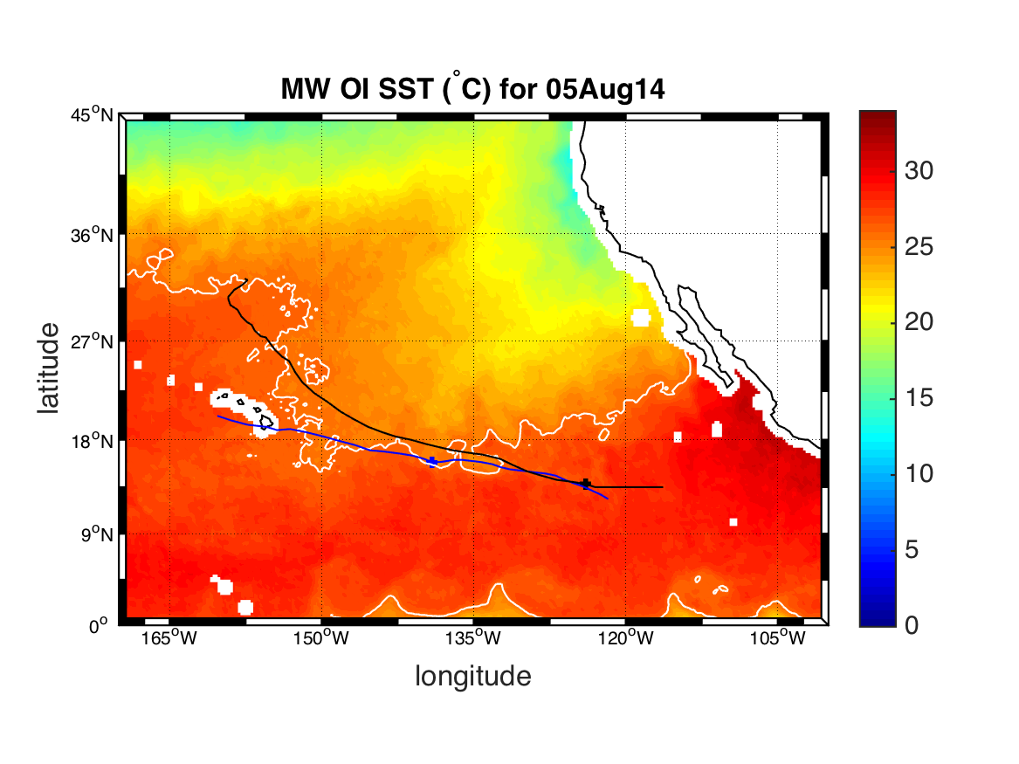
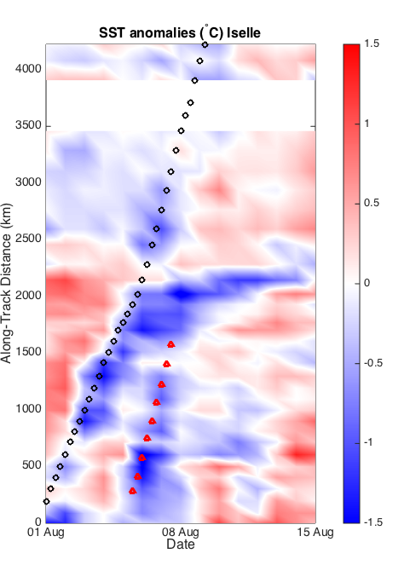
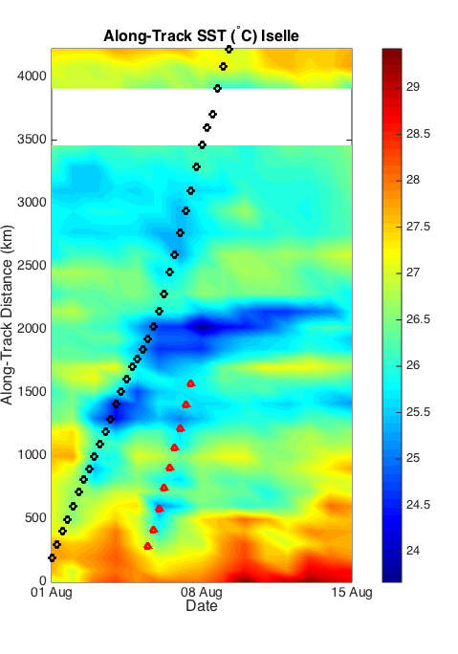
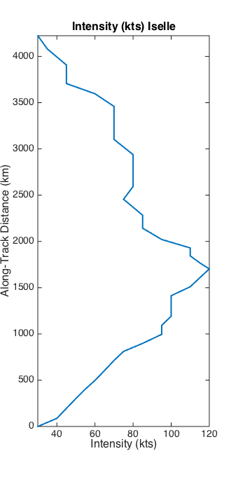
Hurricane Iselle
Storm-Track SSTs
Method: SST anomalies
  SSTs at each TC center locations averaged over the 15-day period
  Departures from the average shaded
Iselle
Cooling most evident during intensification and maximum intensity
Cooling greater when storm speed is slower;
Speed increased at 2000 km (west of 140W)
Post-TC warming followed by subsequent cooling as Julio crossed wake
8
03 Mar 15 2015 Interdepartmental Hurricane Conference Jacksonville, FL

Slide 9
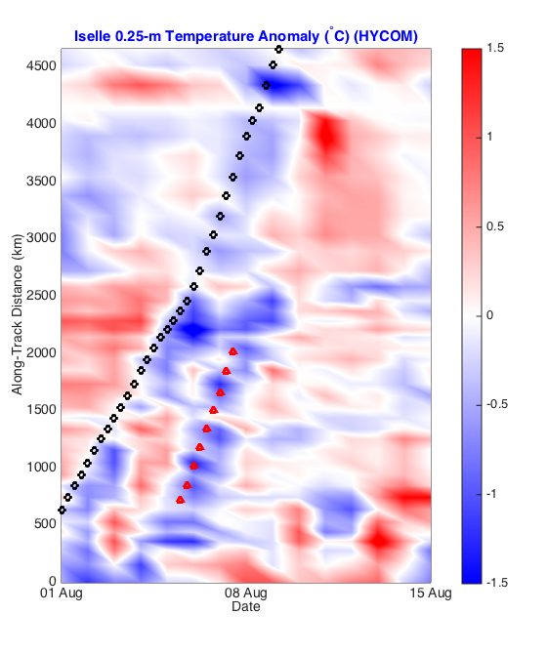
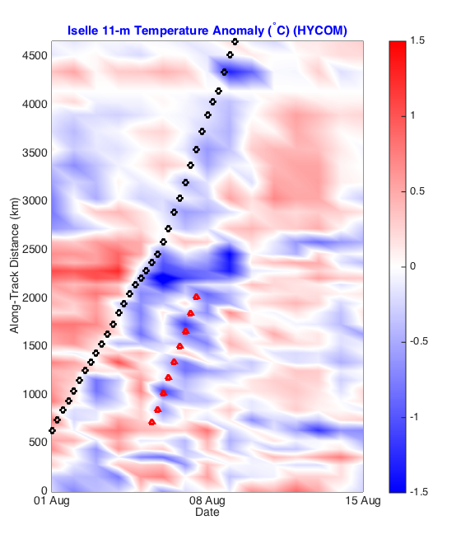
MW SST / HYCOM Iselle Comparison
Surface: comparison to satellite data
  general agreement in the pattern in the first 2000m
  differences in location of maximum cooling, the duration and degree of cooling
11m: within the mixed layer (MLD between 50-100m in AXBT data)
  similar to the surface pattern
  weaker in magnitude
9
03 Mar 15 2015 Interdepartmental Hurricane Conference Jacksonville, FL

Slide 10
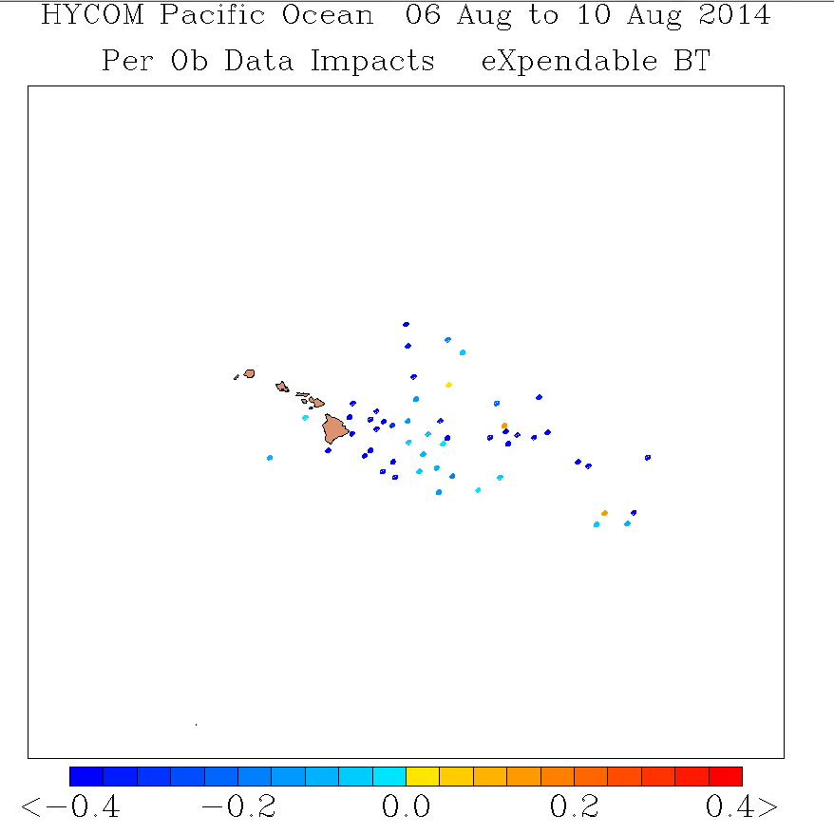
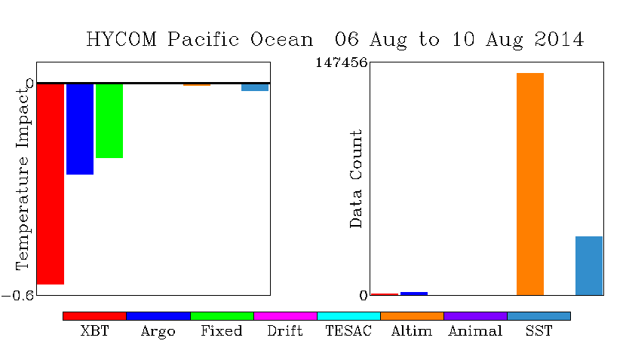
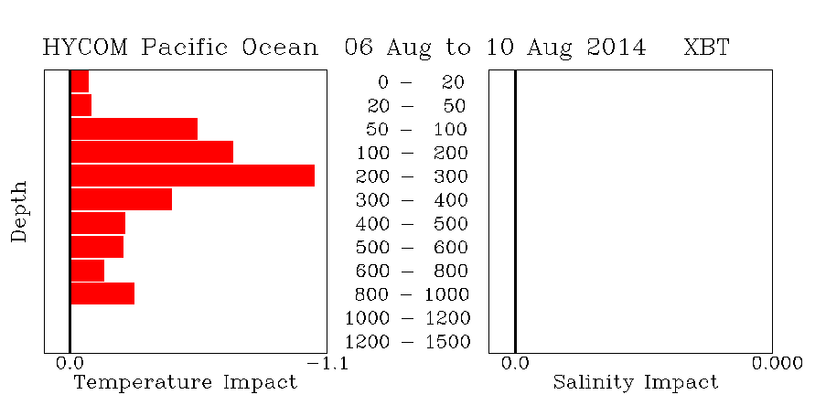
2014: HYCOM AXBT Data Impacts
Success: AXBTs had the greatest total impact on reducing HYCOM model error during Hurricane Iselle and Julio.
The AXBT impact to HYCOM 48-h sea temperature forecast between 06-10 August 2014. A negative value (cool color) is a beneficial impact (reduced the 48 hr forecast error in deg C according to the color). A positive value (warm color) means assimilation of the AXBT increased forecast error.
10
03 Mar 15 2015 Interdepartmental Hurricane Conference Jacksonville, FL

Slide 11
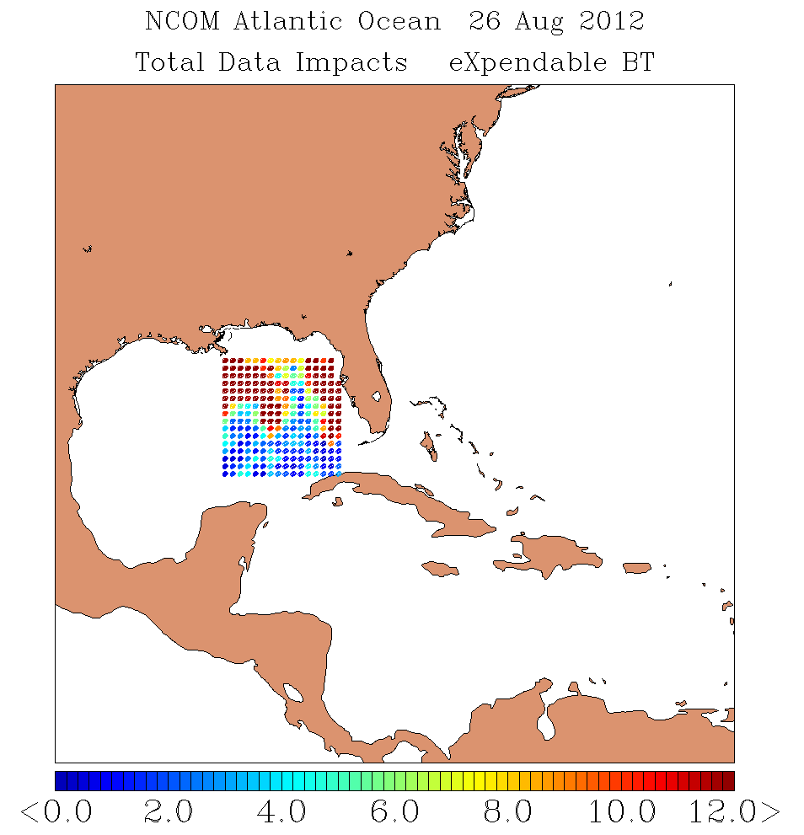
Idealized Optimal Ocean Observation Sampling Study
A newly developed NRL optimal ocean observation sampling tool for TCs, based on the Navy Coupled Ocean Data Assimilation System (NCODA) adjoint method.
Idealized ocean observations with a 20-km horizontal resolution come from the coupled COAMPS-TC Isaac (2012) analysis and 36 – 72 h forecasts
The data impact is a combination of the model forecast error and area of model sensitivity for large error growth.
Warm color observations represent reduced forecast ocean temperature error.
Results indicate two areas of large observation impact on the forward quadrants of TC for this case along the TC track and near the Florida shelf water.
11
03 Mar 15 2015 Interdepartmental Hurricane Conference Jacksonville, FL

Slide 12
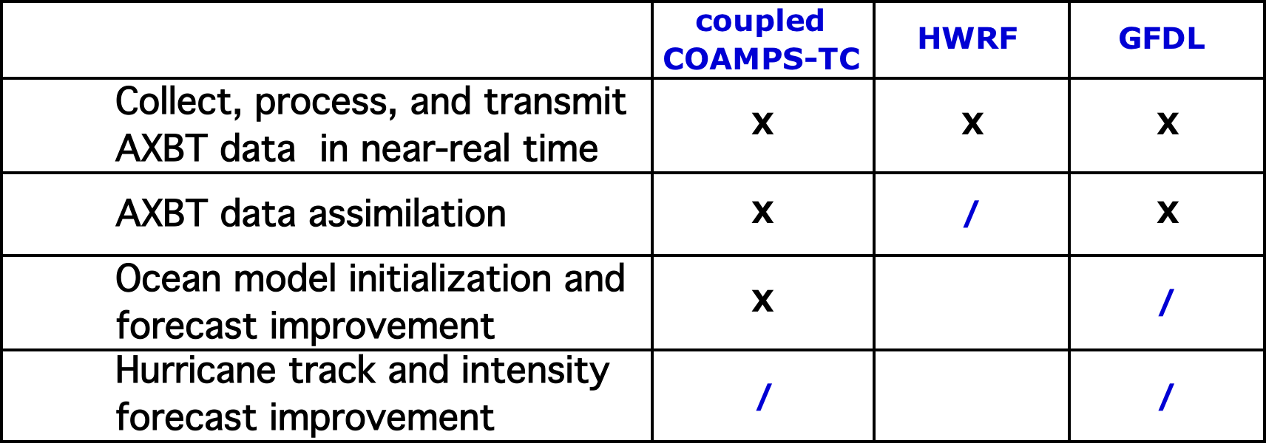
Research Progress
The AXBT Demonstration Project
  Incremental Objectives:
Iselle and Julio (2014)
  Ocean analysis and impact studies
    Observation analyses
    AXBT data impact on HYCOM
    Data denial study
  Outflow analysis
    Connection to ONR DRI
    Midshipmen projects
HFIP Ocean Modeling Impacts Tiger Team (OMITT)
Ocean-TC presentations this week:
  10 presentations and posters, including 3 by coupled modelers:
1
2
3
4
Tues 4:00pm (S3b-02) | Isaac Ginis (URI) | Improving the Ocean Component of the Operational HWRF and GFDN/GFDN Hurricane Models
Wed 2:15pm (S5a-04) | Hyun-Sook Kim (NOAA/NCEP/EMC) | Identifying and Understanding Ocean Model Impacts on Coupled HWRF Forecasts
Wed 4:00pm (S5b-03) | Sue Chen (NRL Monterey) | Sensitivity of Ocean Sampling for Coupled COAMPS-TC Prediction
12
03 Mar 15 2015 Interdepartmental Hurricane Conference Jacksonville, FL

Slide 13
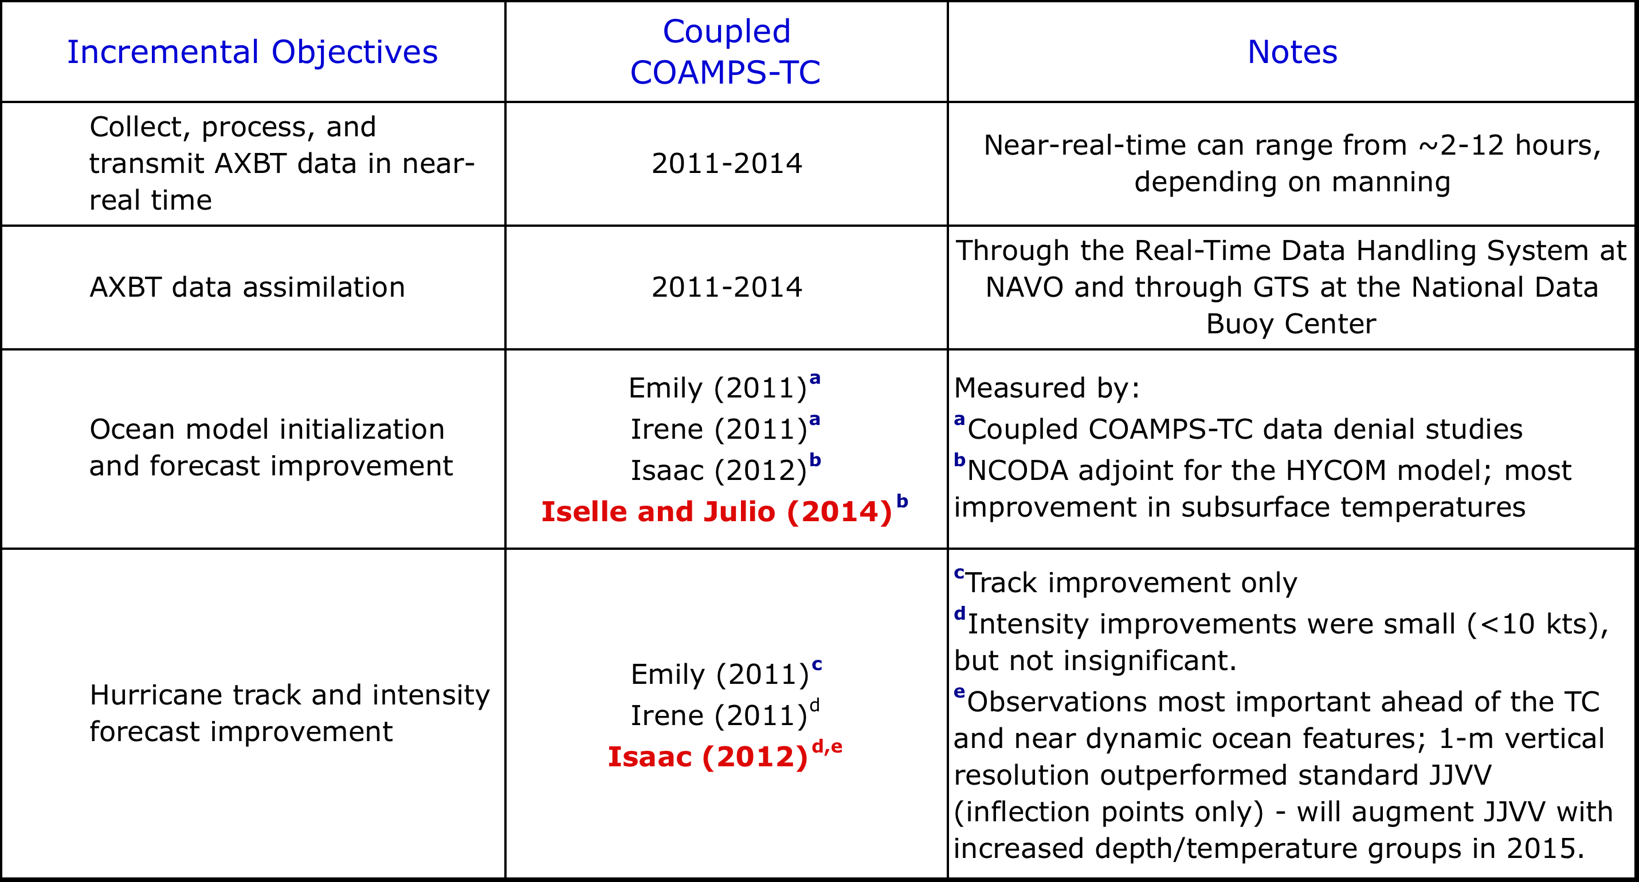
Coupled COAMPS-TC Research Summary
1
2
3
4
13
03 Mar 15 2015 Interdepartmental Hurricane Conference Jacksonville, FL

Slide 14

Questions?
STY Jangmi, 26Sep08
14
03 Mar 15 2015 Interdepartmental Hurricane Conference Jacksonville, FL

