Slide 1


53rd Weather Reconnaissance Squadron
2014 Hurricane Season – Ops Review
I n t e g r i t y - S e r v i c e - E x c e l l e n c e
Notes:
1
1
1
1
1
1
1
1
1
1
1
1
1
1
1
1

Slide 2
Season Comparison
For Tasking
’ 10 ’11 ’12 ’13 ‘14
TASKED 232 191 162 103 141
CANCELLED 85 59 36 61 28
REQUIRED 147 132 126 42 113
ACCOMP 142 130 125 42 111
RELIABILITY 97% 99% 99% 100% 98%
I n t e g r i t y - S e r v i c e - E x c e l l e n c e
Notes:
1
1
1
1
1
1
1
1
1
1
1
1
1
1
1
1
The 2014 Season was more active than the 2013 season mainly due to the ramp up in the Pacific

Slide 3
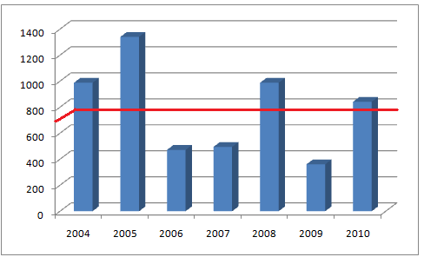
NHOP Flight Hours
H
O
U
R
S
Notes:
6
Our average flying hours (including deploy and redeploy, Atlantic and Pacific) over the last 9years is 773hours and is —indicated by the red line.
In 2014 our total hours flown in support of the National Hurricane Operations Plan was 915.7hrs
PLEASE SEE DUTTON FOR DATA ERRORS AND EXTRA INFO.

Slide 4
53rd Flying Hrs by Month
Notes:
4
4
4
4
4
4
4
4
4
4
4
4
4
4
4
4
45 percent of your flying done in August! Oct comes in second with 31%.

Slide 5
Flying Hours by Storm
I n t e g r i t y - S e r v i c e - E x c e l l e n c e
Notes:
Arthur, Cristobal, and Gonzalo took 46% of the flying hours
33% of hours this year spent in the Pacific.

Slide 6
CHAT and the HAT
Caribbean Hurricane Awareness Tour
  The 2014 CHAT was successful and visited Manzanillo, Ixtap Zihuatenejo, and Huatulco Mexico, St Vincent, and San Juan Puerto Rico. Severe Weather cancelled the event in San Juan
  The 2015 CHAT will visit Merida, and Cozumel Mexico, Bonaire, Santo Domingo, St Kitts, St Eustatius, and San Juan PR.
  This May, the 53WRS along with NOAA AOC will visit Halifax, Nova Scotia; Atlantic City, NJ; Norfolk, VA; Myrtle Beach, SC; St Augustine and Marathon, FL as part of the East Coast Hurricane Awareness Tour
I n t e g r i t y - S e r v i c e - E x c e l l e n c e
Notes:
After sequestion cancelled the CHAT in 2013, the CHAT resumed in 2014. The 2015 CHAT is planned to fly as scheduled.
This year, the 53d is partnering with NOAA/AOC in providing an aircraft to participate in the East Coast hurricane awareness tour.

Slide 7
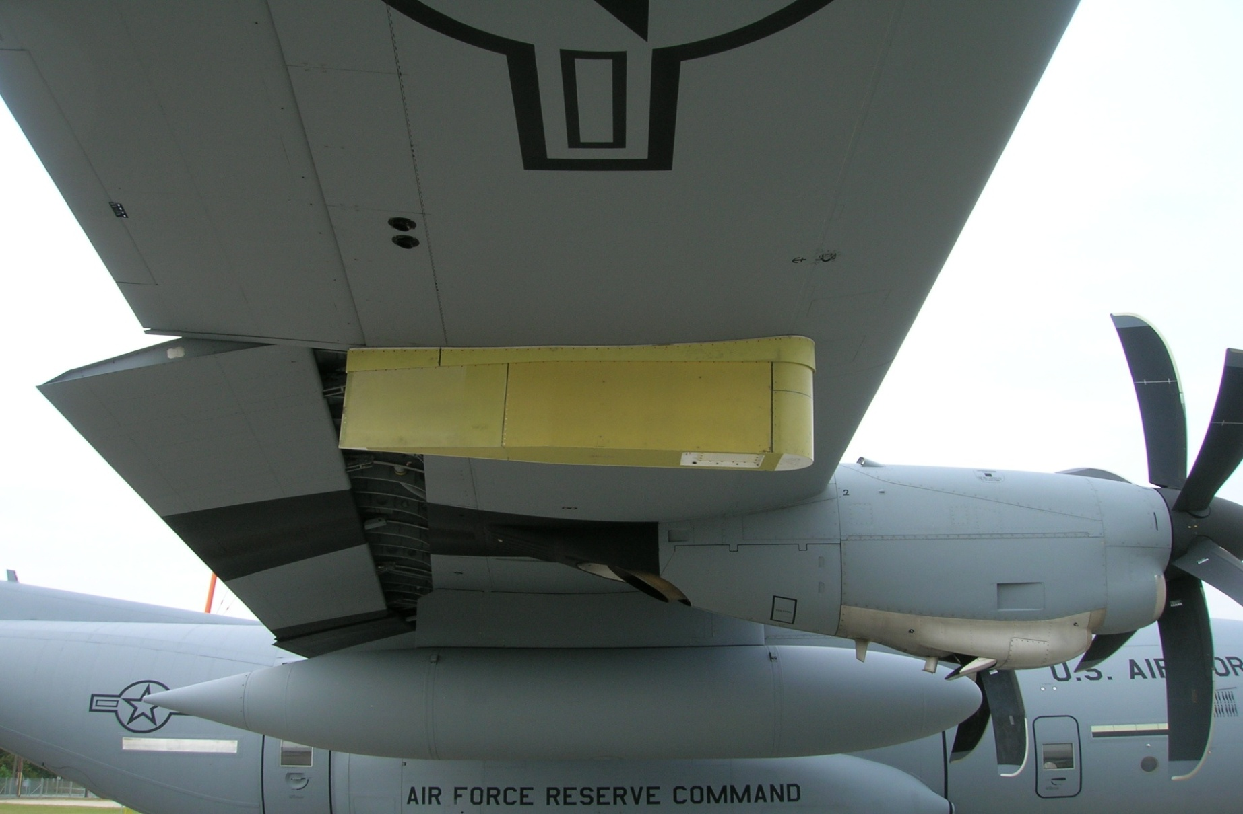
Technological Improvements
Aug 24 Aspen V 3.1.775 installed
Software Upgrade—Spring 2015
-SFMR and mission software
ARWO computer system hardware refresh in the works
  1st step needed to allow radar imagery transmission
Sat-phone Upgrade
-All aircraft modified summer 2014
I n t e g r i t y - S e r v i c e - E x c e l l e n c e
Notes:
The 53d is expecting a spring 15 update to the aircraft data collection software and also new SFMR software to enhance the wind/rain algorithm.
We also submitted a proposal to refresh the aircraft data collection hardware which is the first step in being able to transmit radar imagery.
This hardware refresh is currently going through engineering and will contain many of the same components as the AVAPs system refresh done two years ago.
We should get an ARWO MM upgrade in the spring.
We should get an SFMR algorithm update.
Lastly an upgrade to the data collection system and ground station operating systems from Windows XP to Windows 7 is currently being worked by the AF SPO. It is currently going through engineering and at a minimum, the plan is to upgrade the ground station to Windows 7 prior to hurricane season.

Slide 8
AXBT’s
Started 3yr test program 2011 Season
Current launch system marginal but usable at 10Kft or below
Navy provided data operators and portable receivers
Expect operations to continue 2015
Utility for hurricane operational models will be determined after 2014 season(Delayed)
Extension request submitted 2014-2016
I n t e g r i t y - S e r v i c e - E x c e l l e n c e
Notes:
2014 was the 4th season that Naval Academy personnel provided AXBT data in and around hurricanes in an effort to better quantify ocean heat content. We expect this to continue for several more seasons.

Slide 9
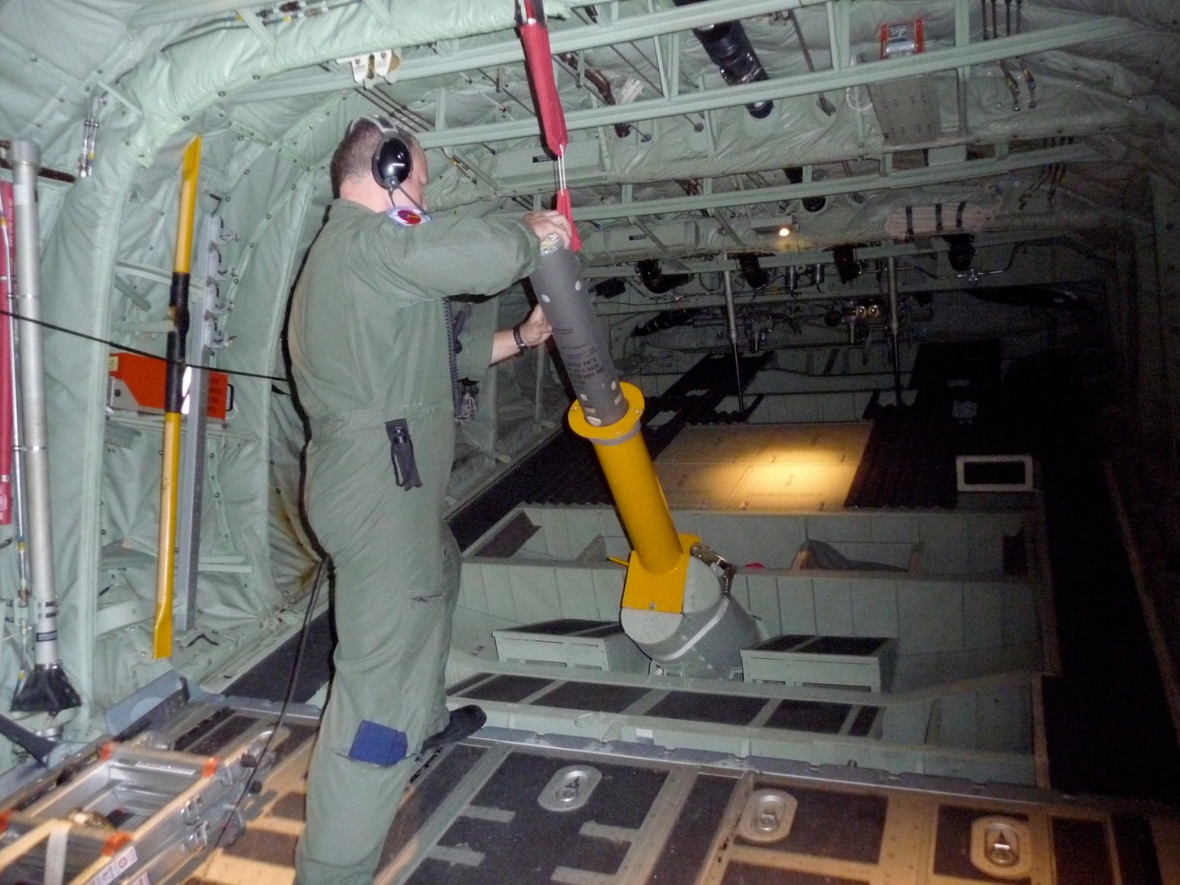
AXBT Launcher
I n t e g r i t y - S e r v i c e - E x c e l l e n c e

Slide 10
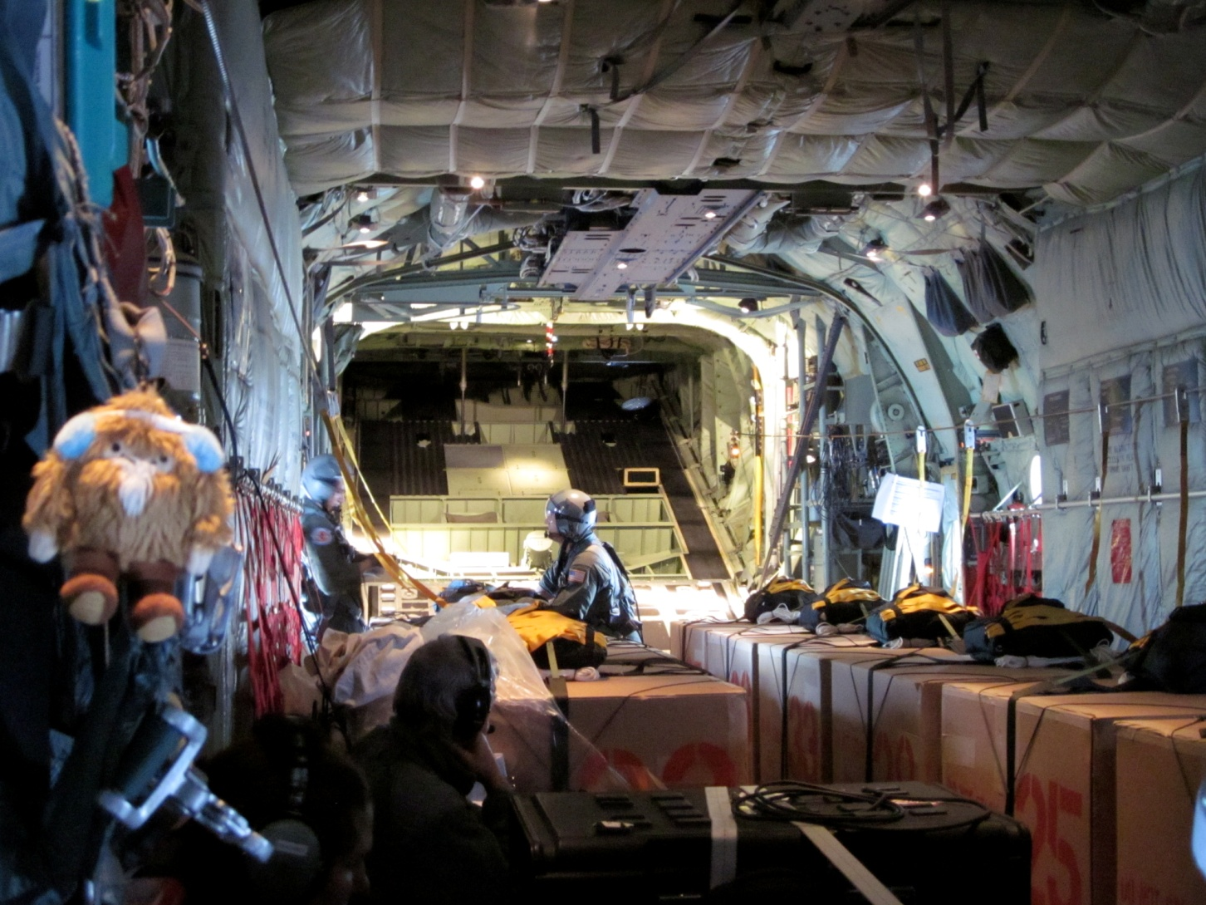
Buoys Deployed for Ana
I n t e g r i t y - S e r v i c e - E x c e l l e n c e
Notes:
This season one buoy mission was flown in conjunction with a fix mission into Hurricane Ana. This was the first time a combined operational NHOP mission was flown where storm fixes were provided along with a buoy deployment. 10 buoy’s were deployed in an array southeast of the big island of Hawaii.

Slide 11

U.S. AIR FORCE RESERVE
Notes:
Update question comment slide!!

