Slide 1
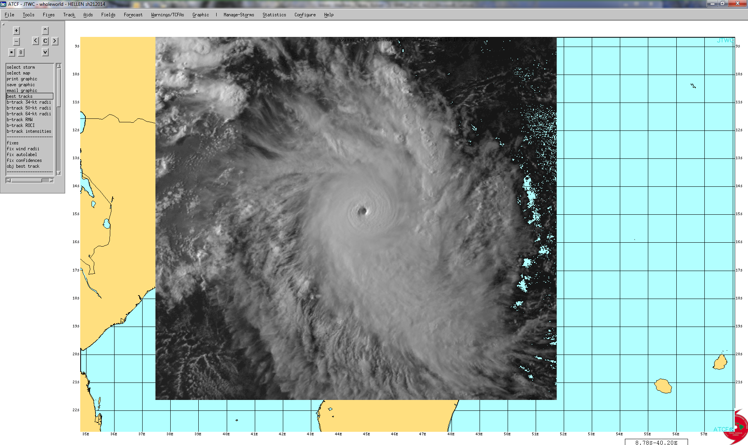
JOINT TYPHOON WARNING CENTER
2014 YEAR IN REVIEW
2015 Tropical Cyclone Research Forum (69th IHC)
3-5 MAR 2015
Mr. Robert (Bob) Falvey
Director, Joint Typhoon Warning Center

Slide 2
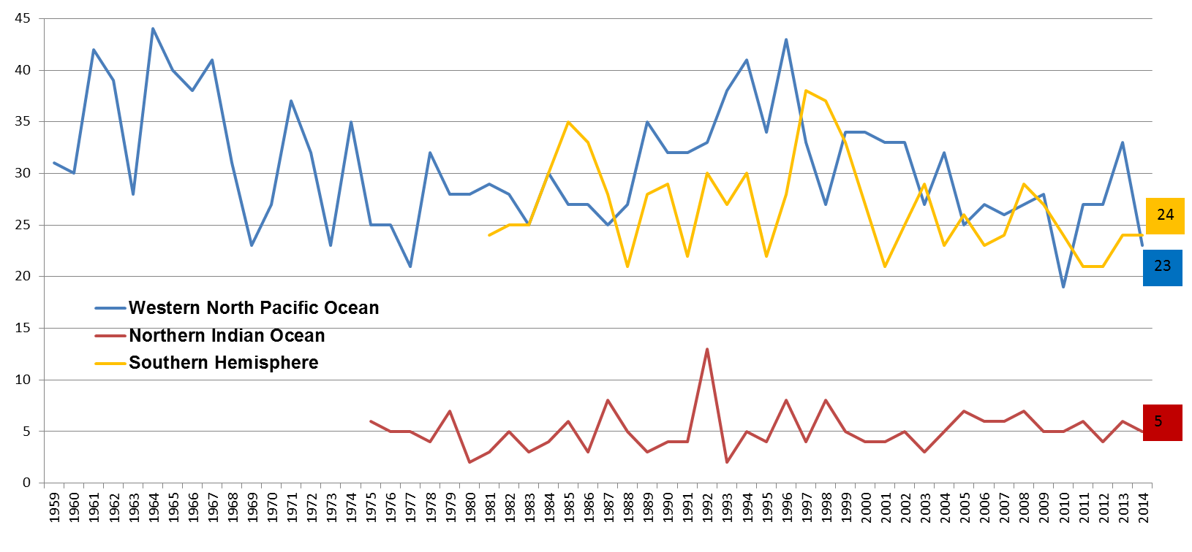
ANNUAL TC ACTIVITY
(All Intensities All Basins)
Below Average Year : 52 Cyclones
Number of Cyclones
Includes 7 Super Typhoons
Year
2

Slide 3
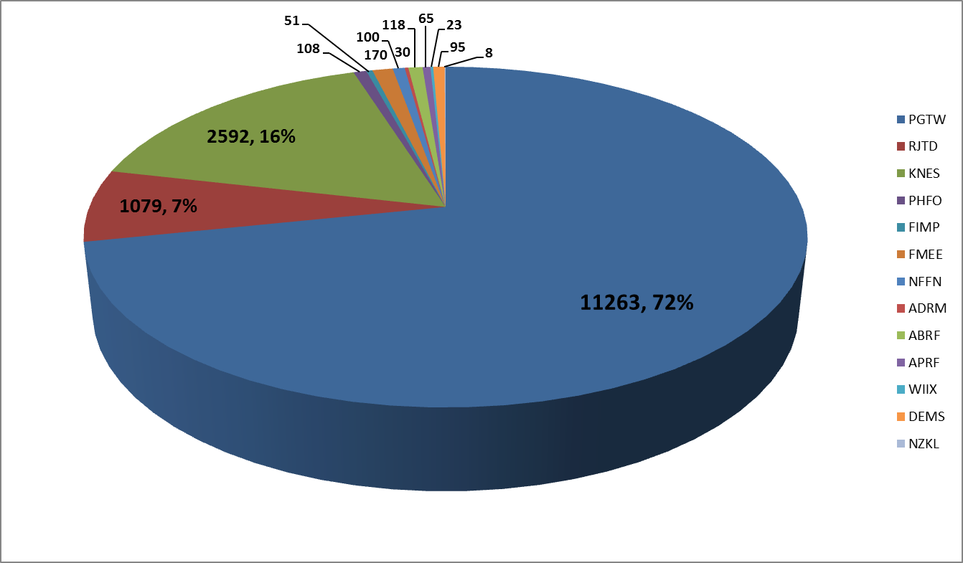
2014 SATELLITE RECON
Fixes by Agency – 15,702
- Nearly 16K satellite fixes in the JTWC AOR
- Over 11K (72%) completed by JTWC Satellite Analysts
- Over 2.5K completed by our partners at NESIS SAB
DMSP F-15 25 May 11 0812Z

Slide 4
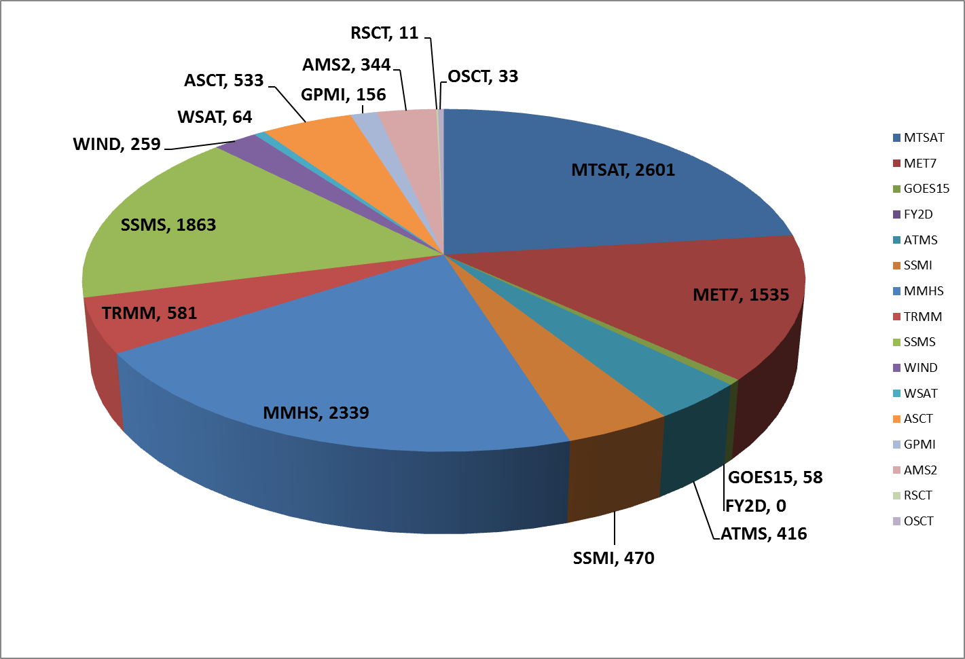
2014 SATELLITE RECON
JTWC Fixes by Sensor
- Over 4K fixes using geostationary imagery
- Over 6K fixes using microwave imagery from polar orbit
- Over 600 scatterometry fixes
DMSP F-15 25 May 11 0812Z

Slide 5
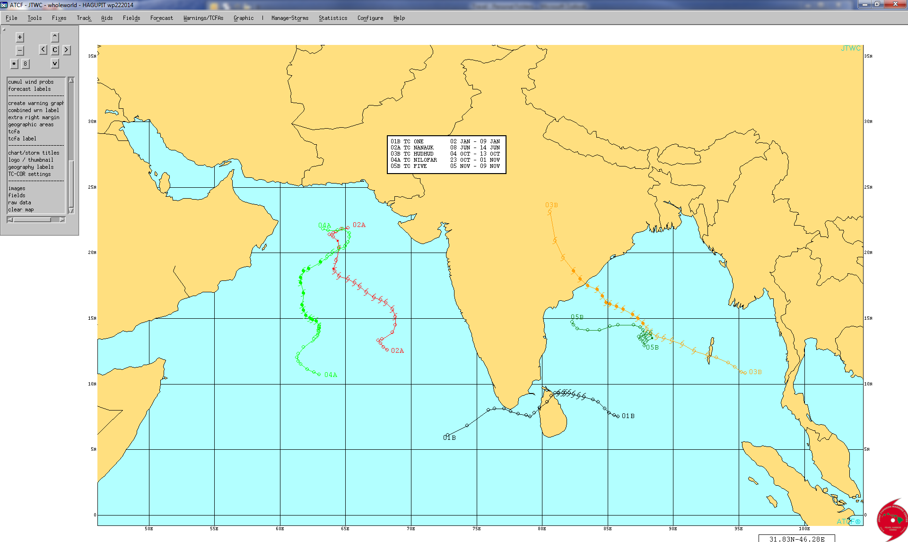
2014 NORTH INDIAN OCEAN
- 5 Cyclones in the north Indian Ocean
- Most significant cyclone was TC 03B (Hudhud) with a peak intensity of 115 kts at landfall in India

Slide 6
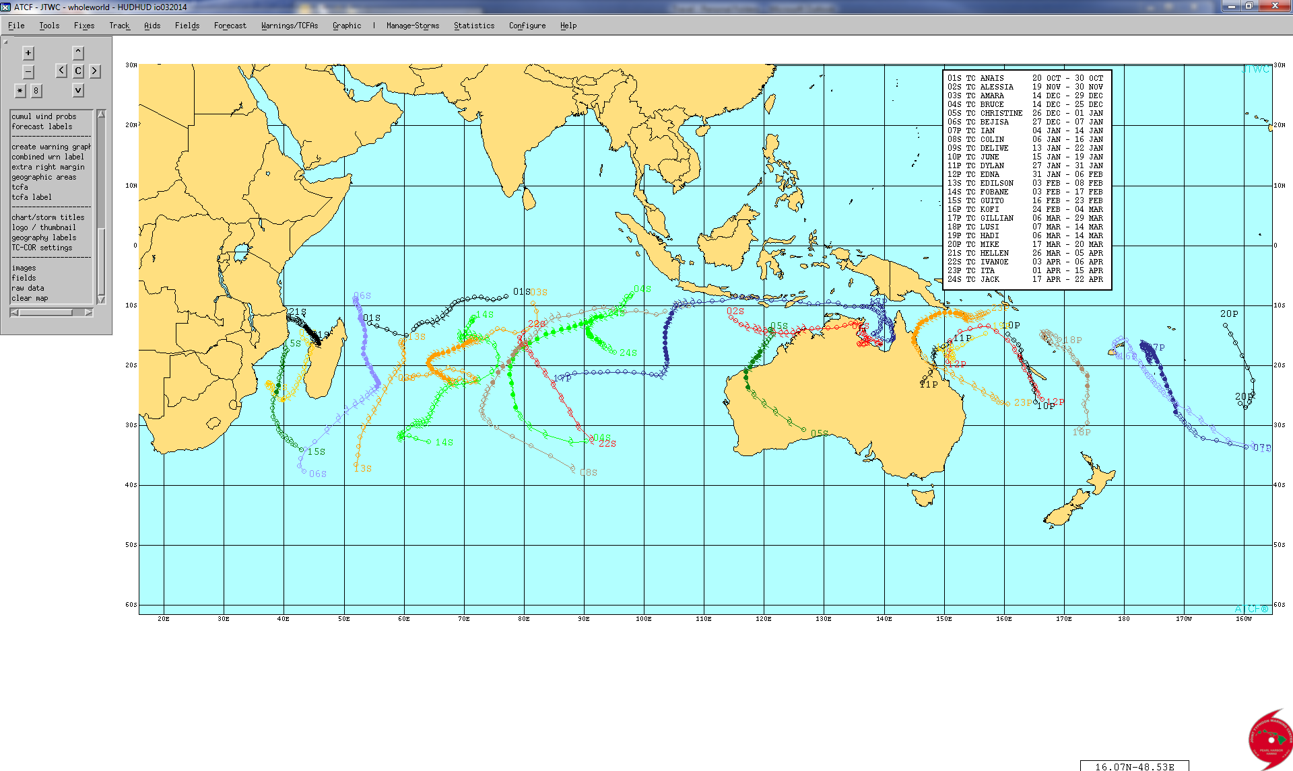
2014 SOUTHERN HEMISPHERE
- Fairly typical SHEM season with 24 cyclones – 4 below the long term average
- Most significant cyclones:
-- TC 23P (Ita) – 140 kt peak intensity impacted the Queensland Australia area
-- TC 21S (Hellen) – 135 kt peak intensity impacted the NW coast of Madagascar

Slide 7
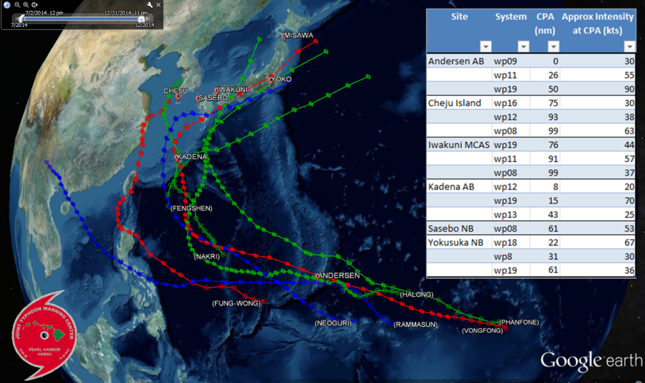
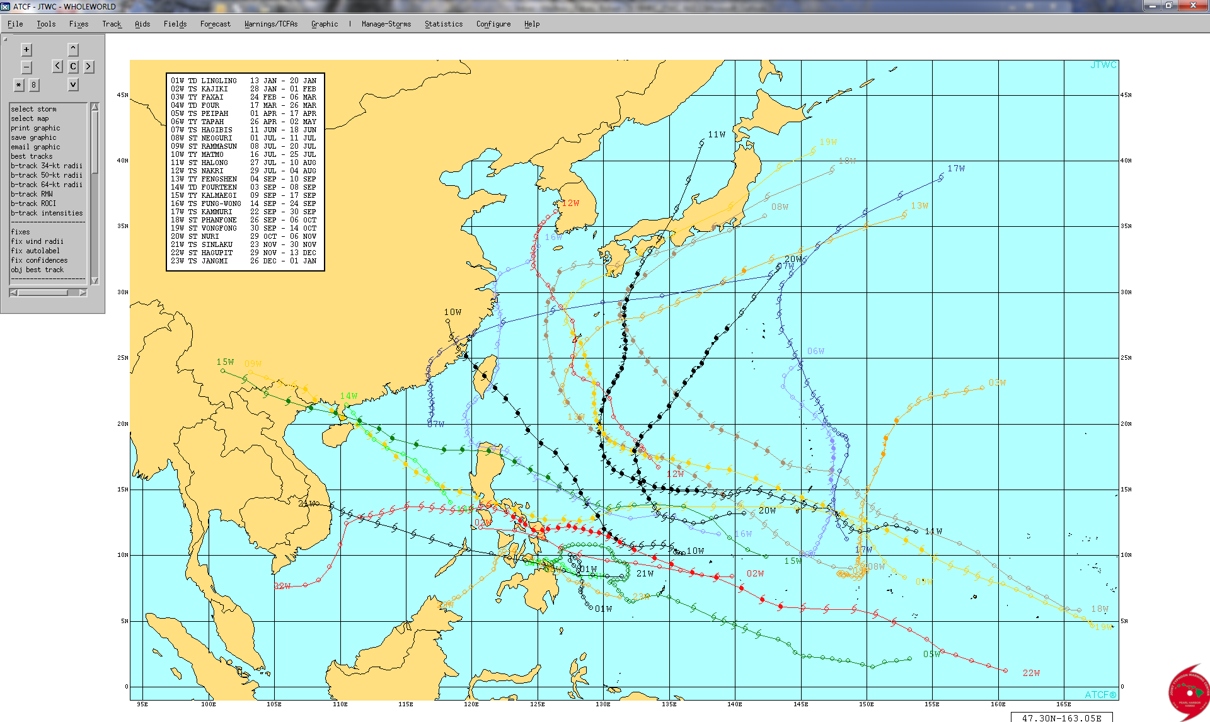
2014 WESTERN NORTH PACIFIC
Tropical Depressions: 3
Tropical Storms: 8
Typhoons: 5
Super Typhoons: 7
- Weak warm event shifted genesis eastward
- More typical tracks, only a few north movers

Slide 8
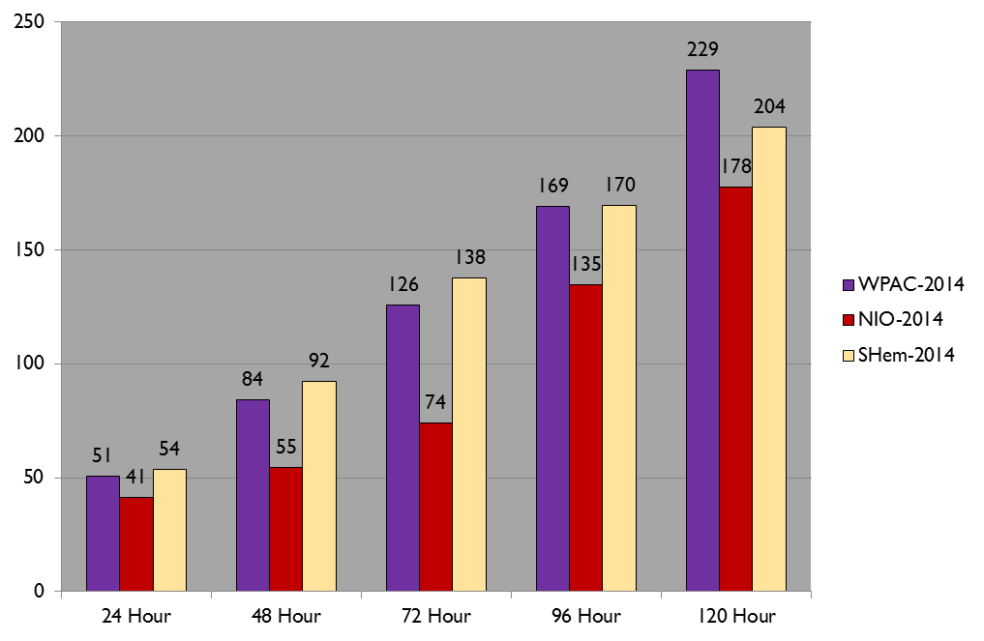
2014 JTWC TRACK ERRORS
All Basins
U.S. Pacific Command Goal

Slide 9
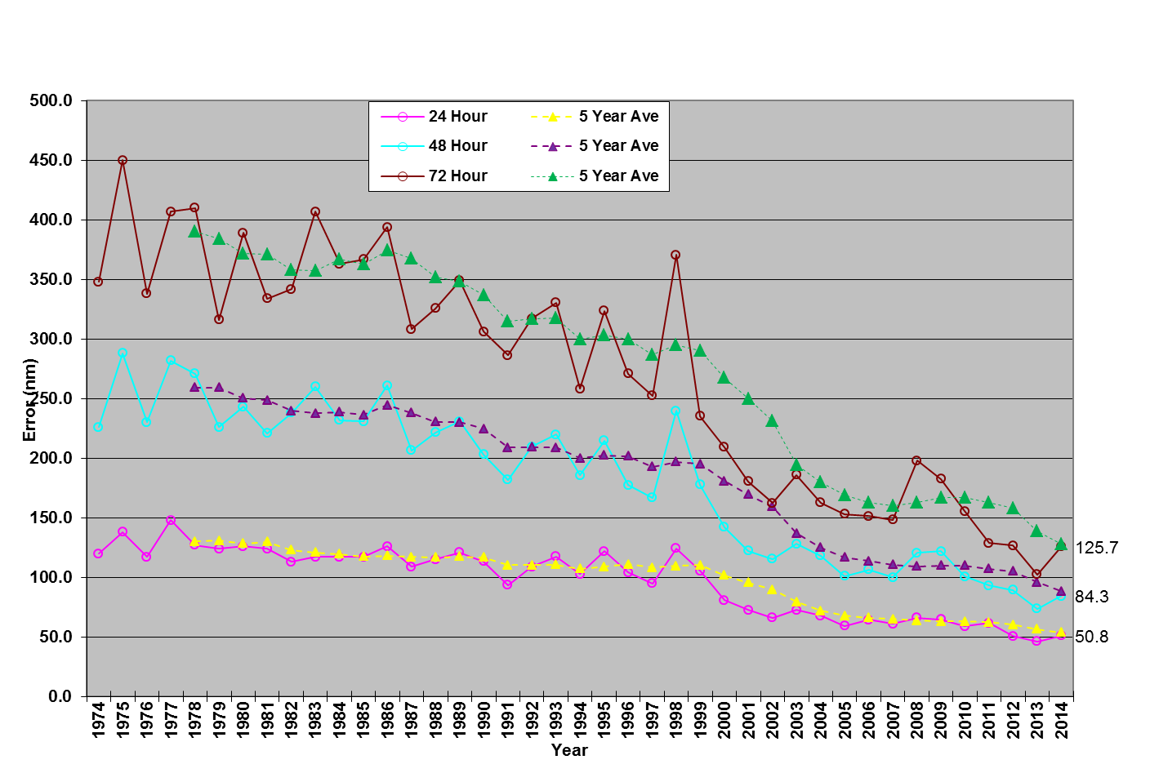
JTWC TRACK ERRORS
(Western North Pacific - 24-72 Hours)
24 Hr 48 Hr 72 Hr
2010 60 99 152
2011 62 93 129
2012 51 90 128
2013 46 77 106
2014 51 84 126
Goal: 25 50 75

Slide 10
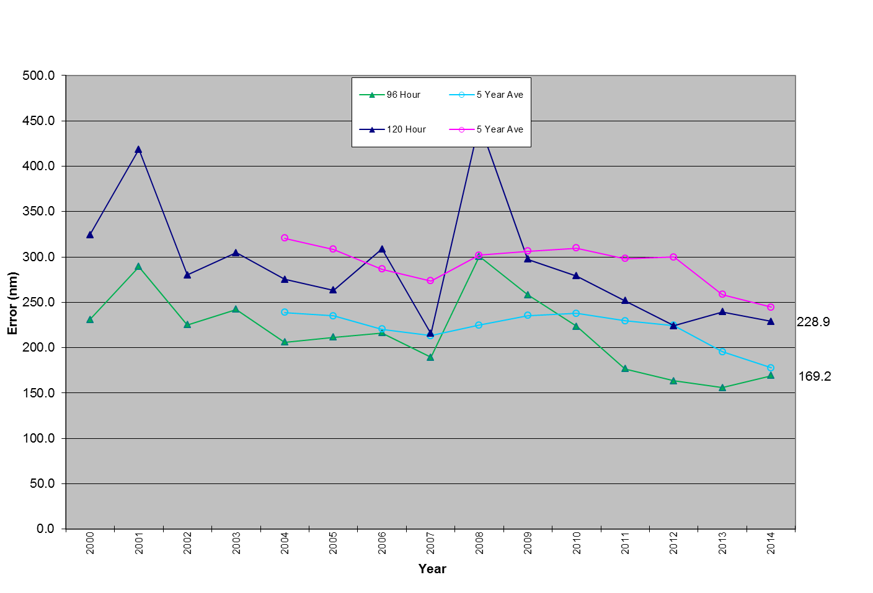
JTWC TRACK ERRORS
(Western North Pacific – 96-120 Hours)
96 Hr 120 Hr
2010 216 261
2011 177 252
2012 166 226
2013 152 241
2014 169 229
Goal: 100 150

Slide 11
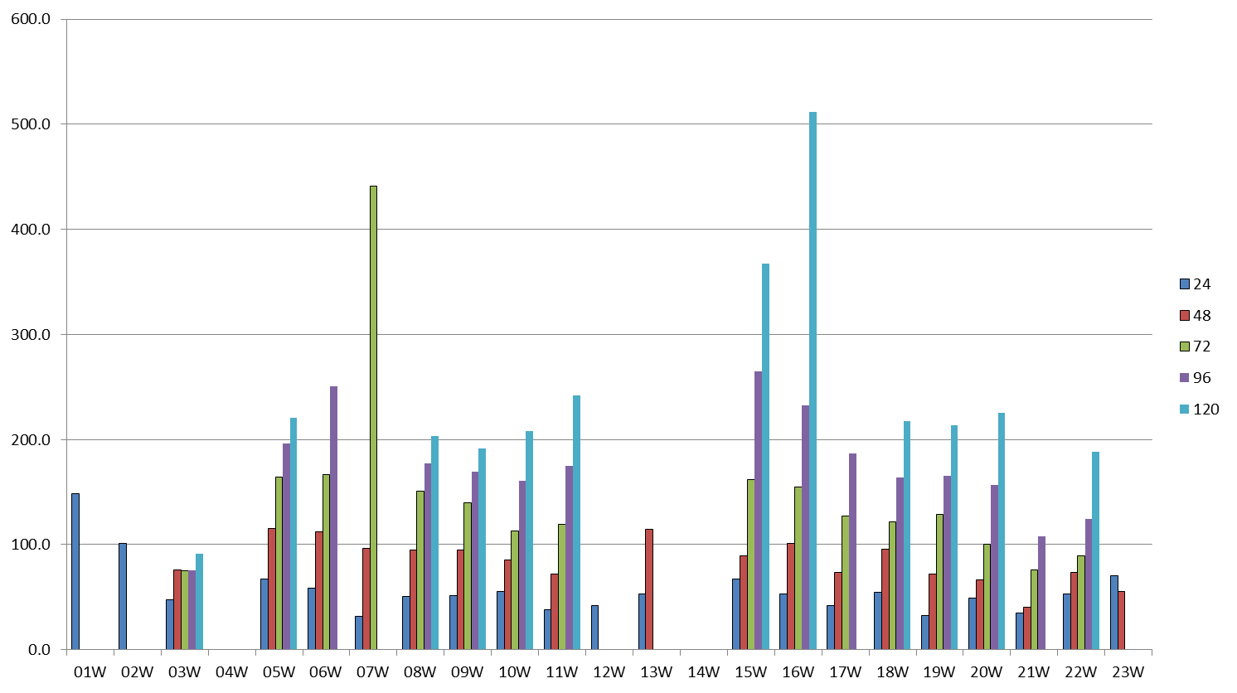
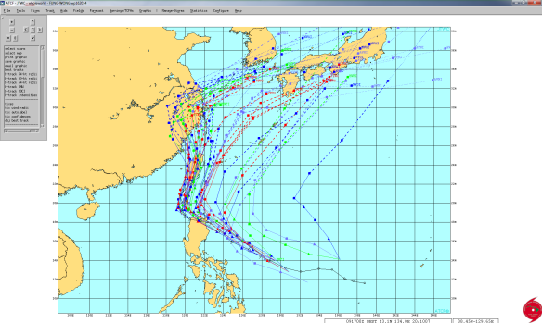
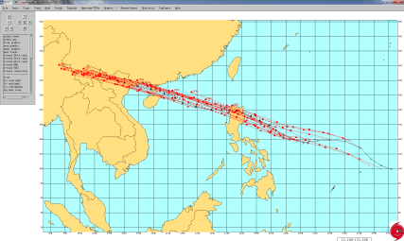
2014 TRACK ERRORS BY STORM
(Western North Pacific)
- 3 storms with “excessive” errors (07W, 15W, 16W)
Initial JTWC & model forecasts
predict recurvature too early
1 verifying position
Large along track errors

Slide 12
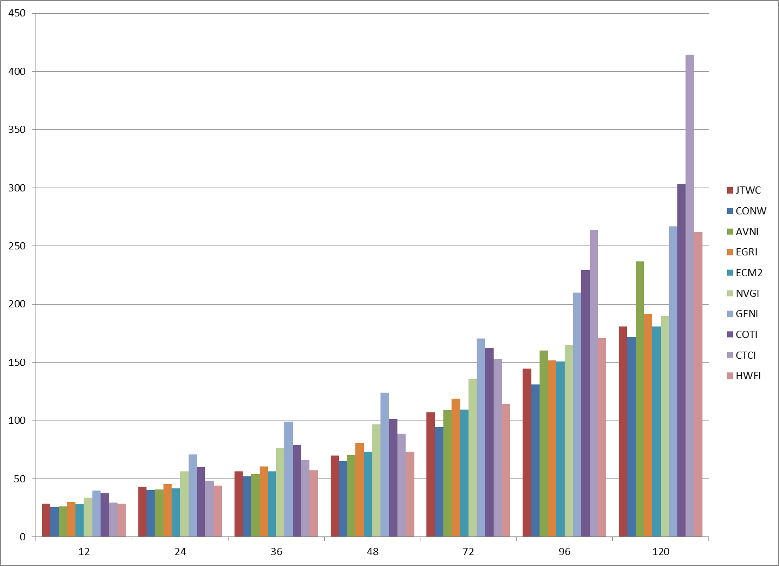
2014 MODEL TRACK ERRORS
(Western North Pacific – Homogeneous)
- Consensus beat JTWC at all forecast times
- Meso models, except H-WRF, continue to lag global models
- All global models performed similarly, except at Day 5 where GFS had ~50nm larger average errors

Slide 13
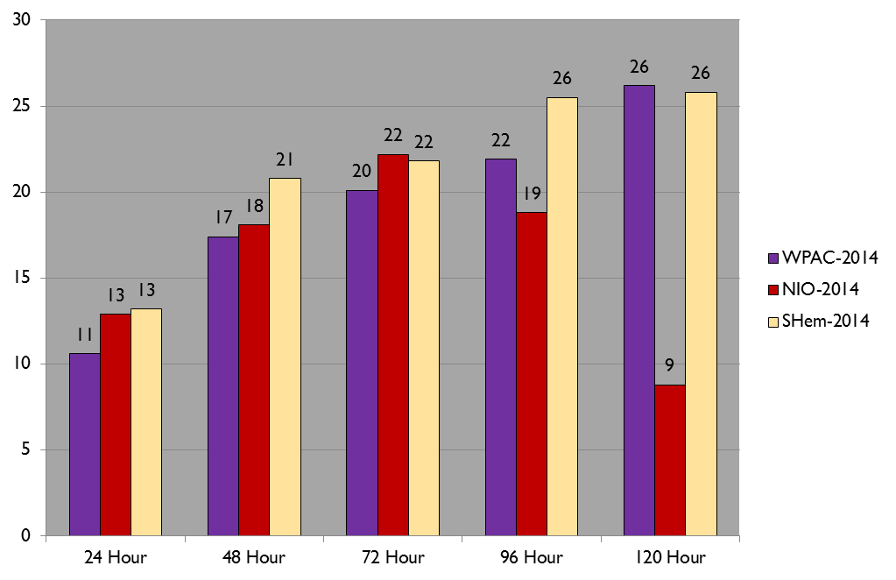
2014 JTWC INTENSITY ERRORS
All Basins
Knots

Slide 14
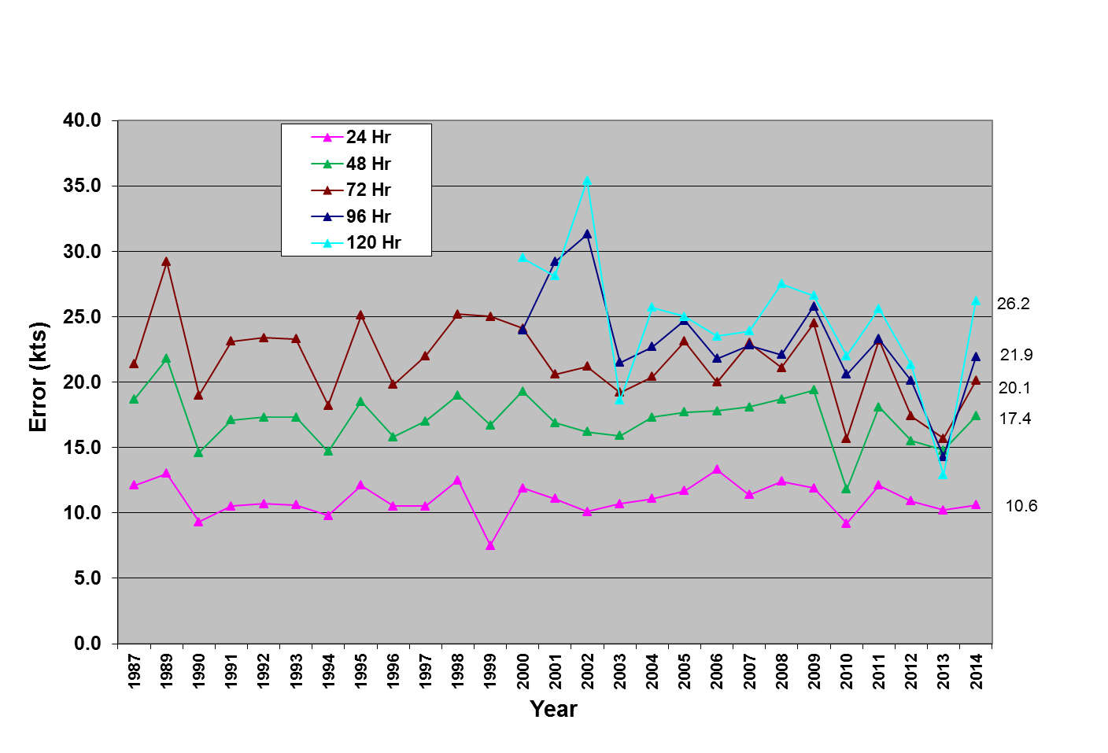
JTWC INTENSITY ERRORS
(Western North Pacific 24 - 120 Hours)
24 Hr 48 Hr 72 Hr 96Hr 120Hr
2010 9 12 15 21 24
2011 12 18 23 23 26
2012 11 15 17 20 21
2013 10 15 16 16 14
2014 11 17 20 22 26

Slide 15
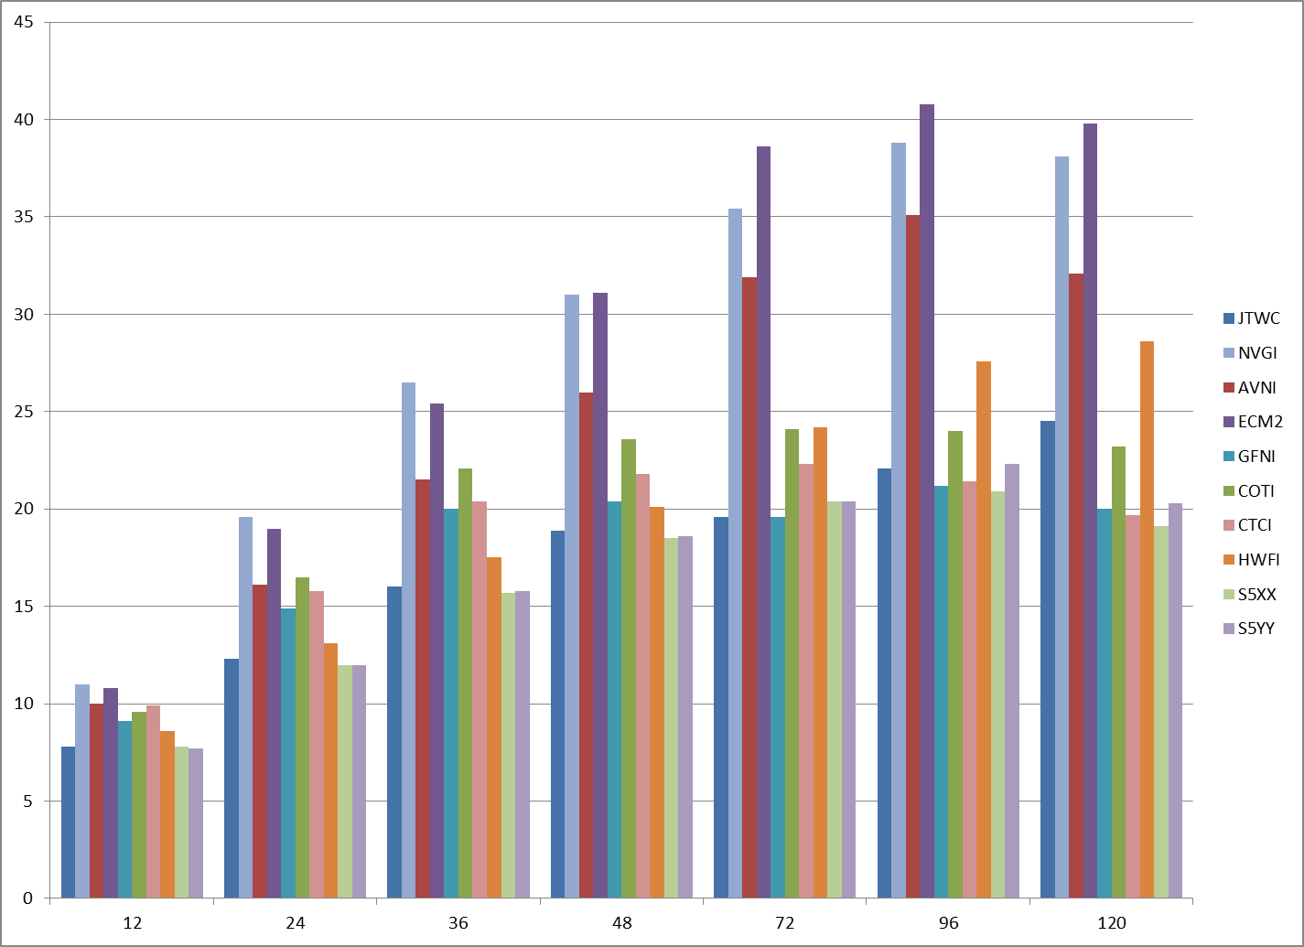
2014 MODEL INTENSITY ERRORS
(Western North Pacific – Homogeneous)
- Statistical-Dynamical models (S5XX/YY) perform best
- GFDN & COAMPS-TC slightly better then H-WRF at Day 4 & 5
- Also received GFDL deterministic and ensemble – performed similarly to other meso models (not shown)

Slide 16
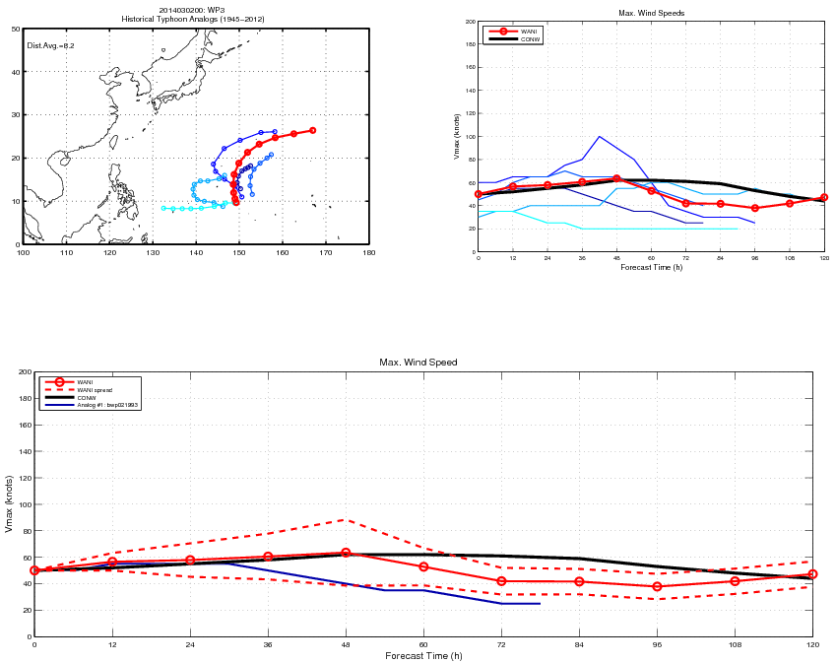
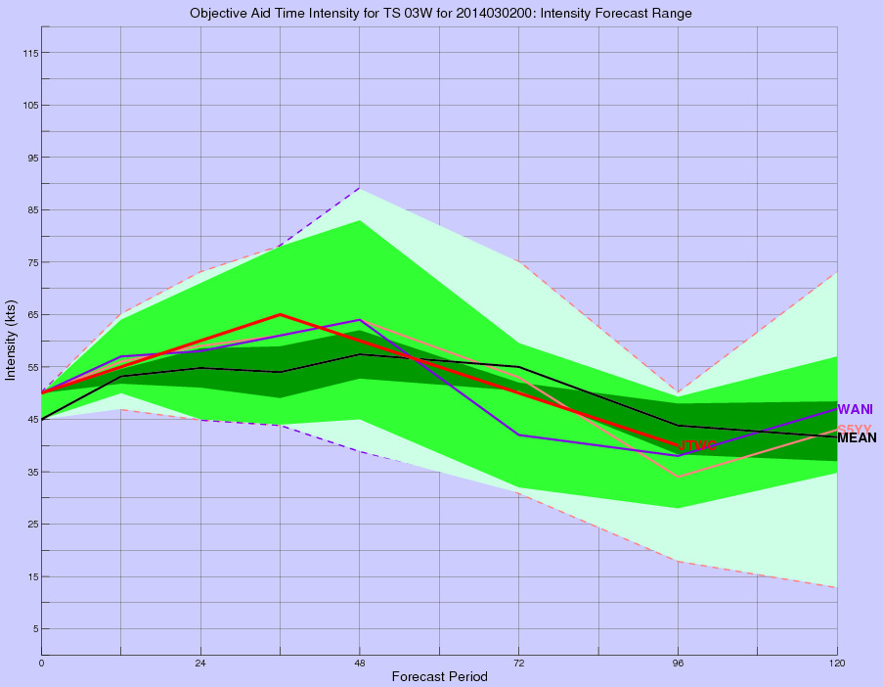
Intensity Prediction: WANI and GPCE
  Weighted Analog Intensity (WANI) technique:
    Intensity prediction (mean/range) based on analogs from best track record (Tsai and Elsberry, 2014)
    Implemented for operational evaluation - western North Pacific and Southern Hemisphere only
    Forecasters view data through automated graphics and within ATCF
    2014 WPAC basin performance slightly worse than existing intensity prediction methods – positive bias
  Consensus intensity forecast error technique:
    Statistical measure of consensus forecast confidence (Goerss and Sampson, 2014)
    Available in ATCF; supplemental graphic displays overlap with WANI range, model standard deviation

Slide 17
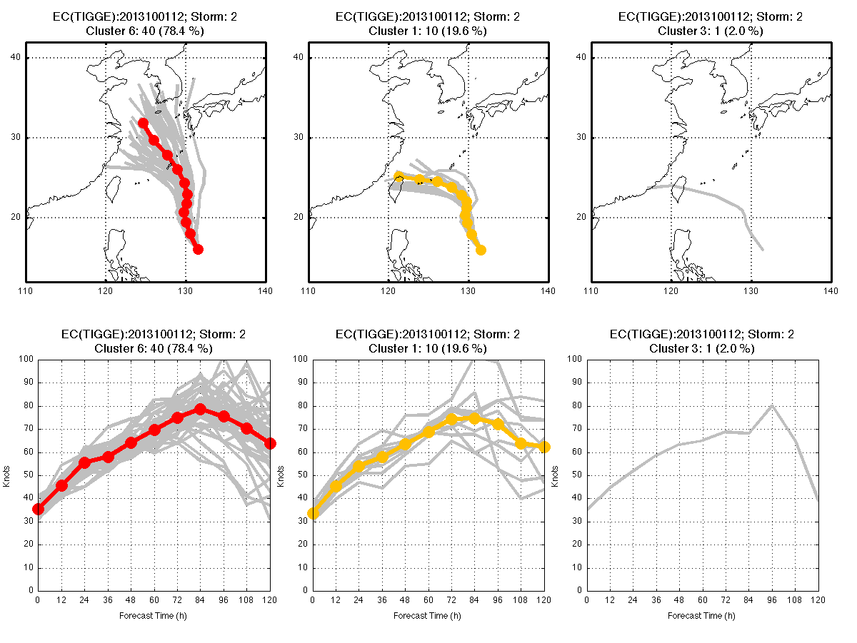
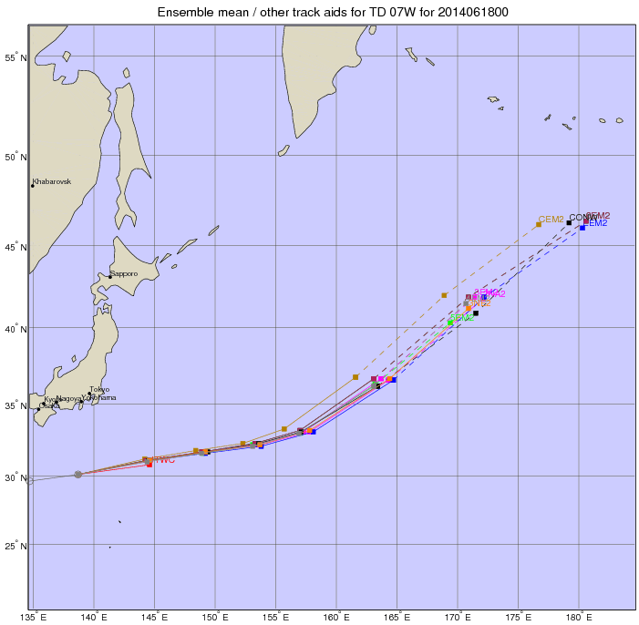
Track Prediction: Ensemble Data
  ECMWF ensemble track clusters (Tsai and Elsberry, 2013)
    NPS plots WPAC TC data for forecaster evaluation
    ATCF data ingest pending
  Single and multi-model ensemble track forecasts from EMC (J. Peng)
    WPAC/IO/SHEM TC data graphics available to forecasters
113
343
86
94
41
93
42

Slide 18
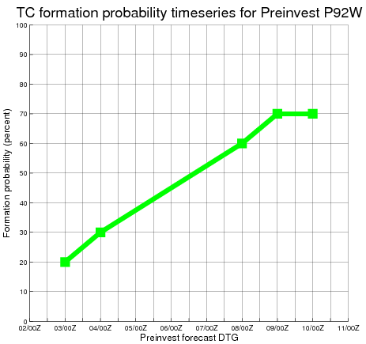
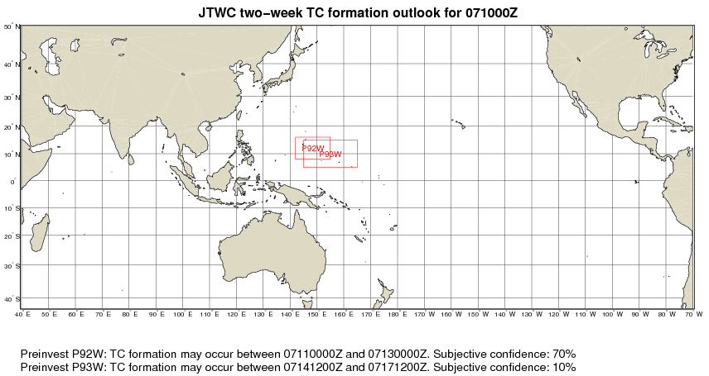
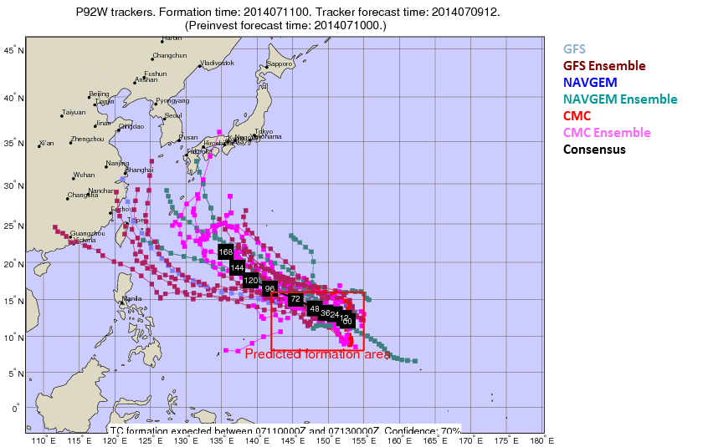
Genesis Prediction: Two-Week Outlook
  Experimental “Preinvest” procedure
    Forecasts based on dynamic model guidance, ENSO status, MJO analyses/forecasts, climatology
    Provides forecasters subjective formation probabilities and track/intensity forecast data
    Improves input for CPC Global Tropics Hazards outlook
  Model track / intensity forecast data for preinvests are downloaded from NCEP cyclogenesis page and plotted (western North Pacific)

Slide 19
OTHER PROJECTS/EVENTS
AWIPS-2
GFDN upgrade
COAMPS-TC upgrade
H-WRF runs to move to NCEP production
JTWC Public website move to NDBC – available soon
  https://metoc.ndbc.noaa.gov/JTWC

Slide 20
Contact Info
Commanding Officer
CAPT Steven Sopko
steven.sopko@navy.mil
(808) 471-0363
Director
Mr. Robert Falvey
robert.falvey@navy.mil
(808) 474-5301
Operations Officer (JTOPS)
LT Thomas Mills
  thomas.j.mills@navy.mil
(808) 471-4597
Technical Services
Mr. Matt Kucas
matthew.kucas@navy.mil
(808) 471-4597
Satellite Operations Flight
Capt Brian DeCicco
  brian.decicco@navy.mil
(808) 474-3946

Slide 21
??QUESTIONS??
JOINT TYPHOON WARNING CENTER
2014 YEAR IN REVIEW

Slide 22
BACKUP SLIDES

Slide 23
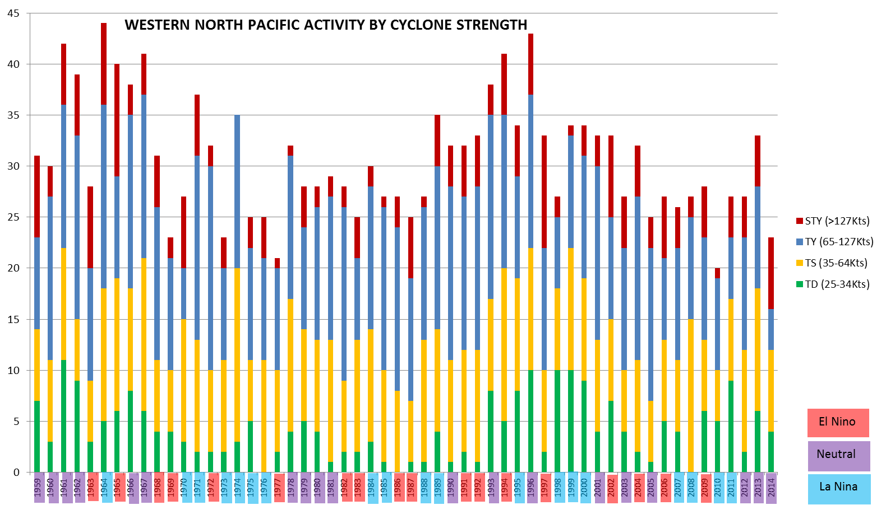
WPAC ENSO CLIMO

Slide 24
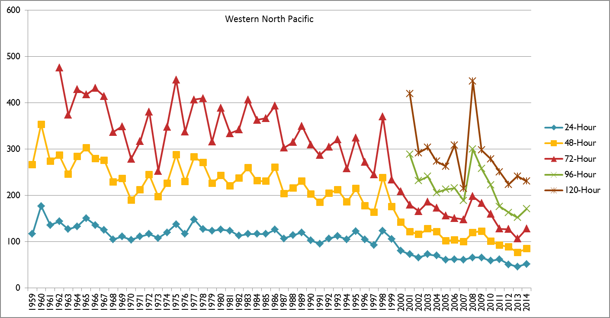
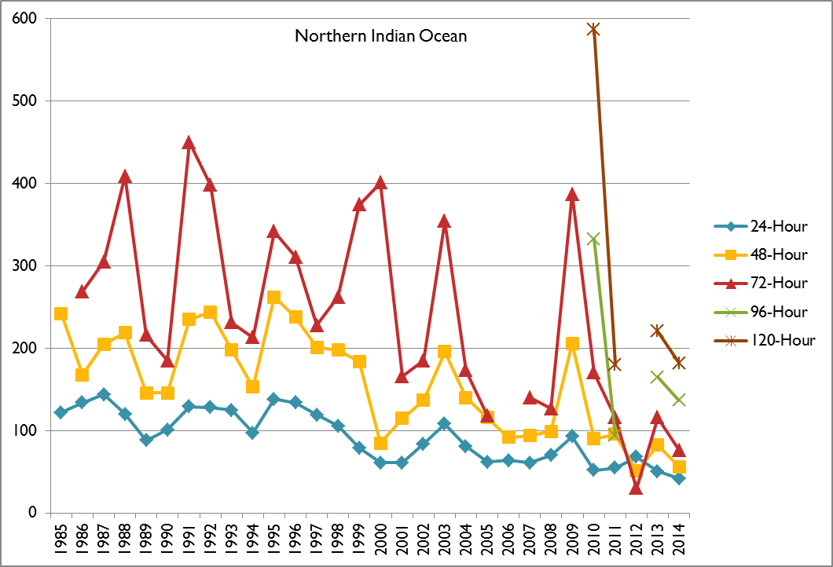
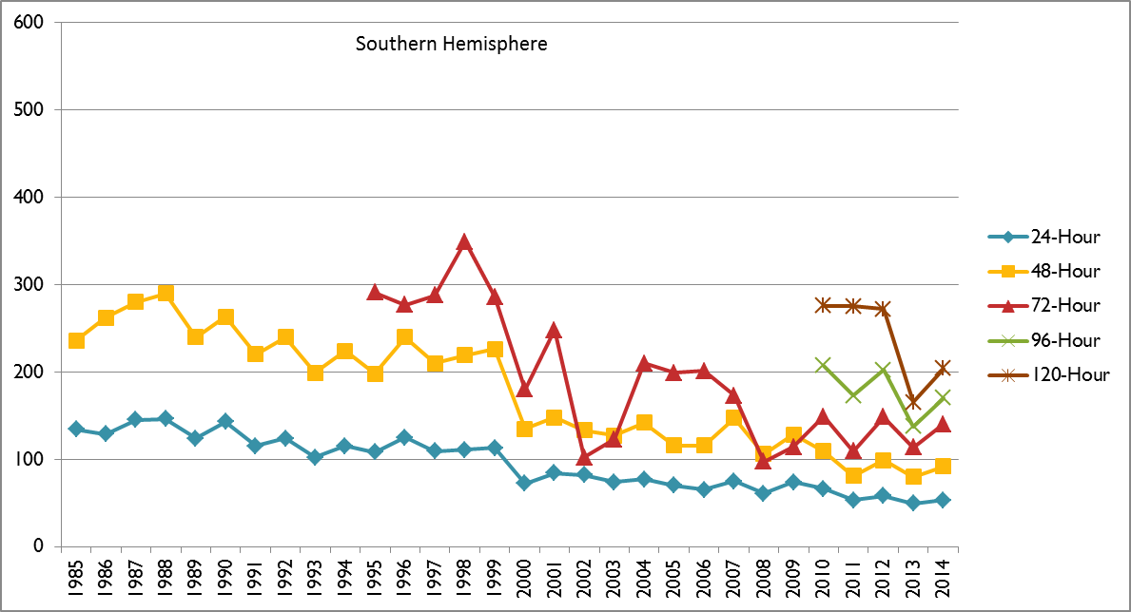
JTWC TRACK ERRORS
All Basins
- Continued improvement in track forecasts
- WPAC errors lowest ever at 24-96 hours
- SHEM errors lowest ever at 24,48,72 and 120 hours
- NIO errors remain low and show high yearly variability – low sample size

Slide 25
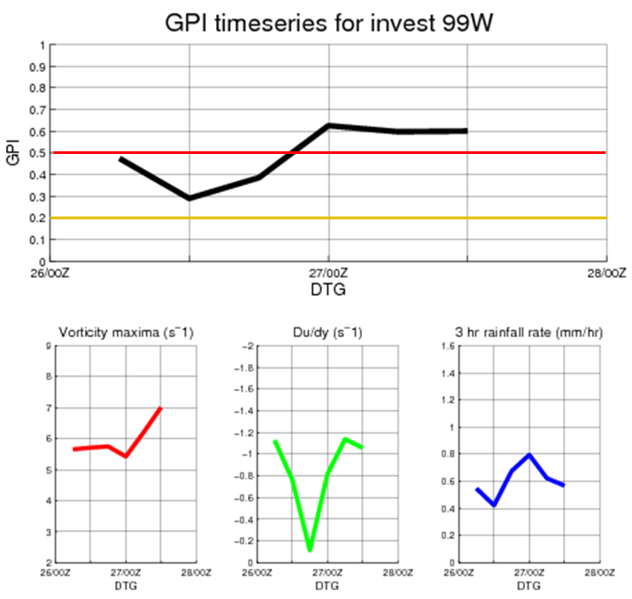
Additional Ongoing Collaboration
  UH / NRL Genesis Potential Index (Peng et al., 2011; Fu et al., 2011)
    Model run in-house for operational testing -> 48-hour formation potential based on:
      NAVGEM 850 mb vorticity analysis
      NAVGEM 750 mb du/dy analysis
      Satellite-derived rainfall rates
    UH runs experimental versions for comparison
    Operational evaluation indicates GPI useful for short-range prediction
  Model forecast evaluations:
    AFWA MEPS ensemble
    ESRL FIM9 model
    Meteo France Arpege model (La Reunion AOR)

Slide 26
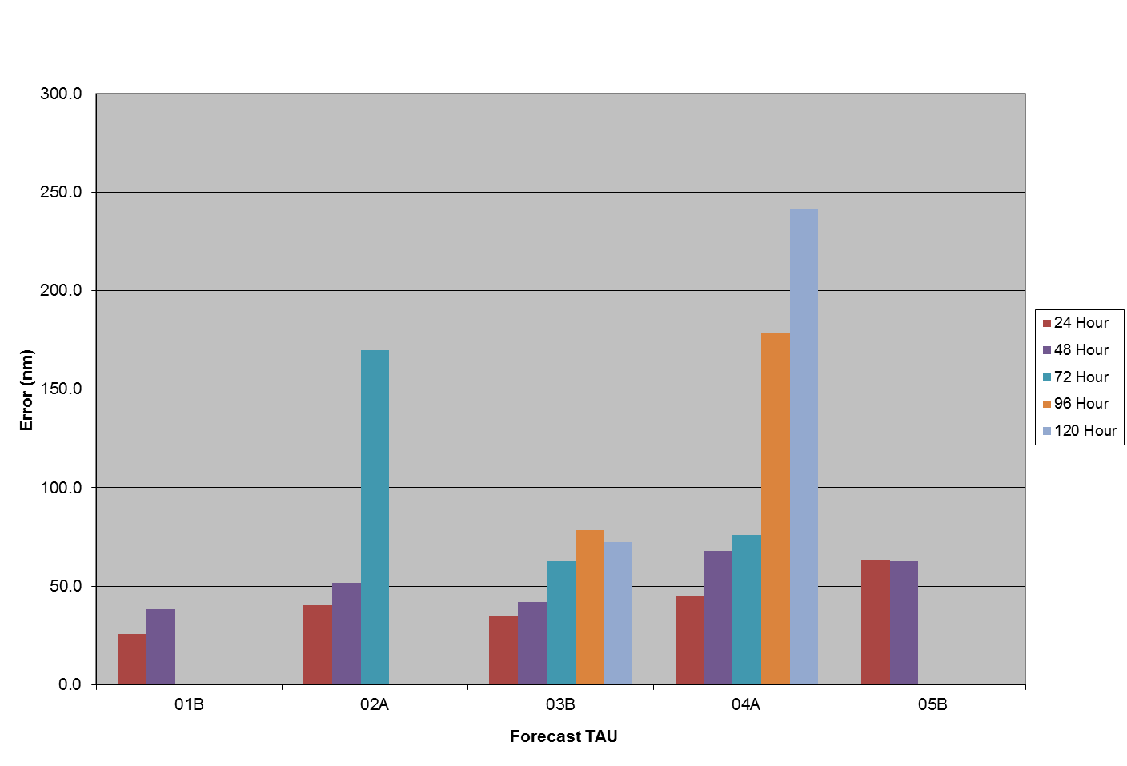
2014 TRACK ERRORS BY STORM
(Northern Indian Ocean)
- Limited verification opportunities

Slide 27
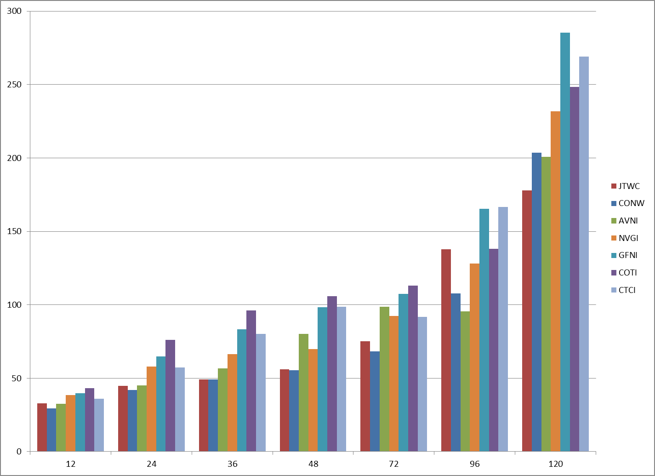
2014 MODEL TRACK ERRORS
(Northern Indian Ocean – Homogeneous)
- Low verification opportunities
- NAVGEM and GFS performed best
- ECMWF & UK omitted to maximize verification counts

Slide 28
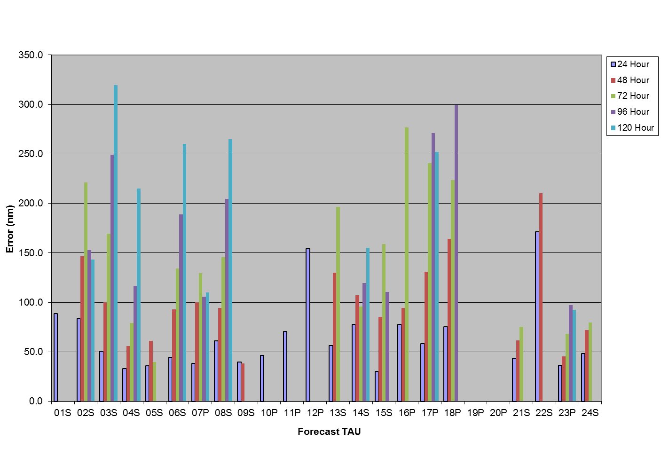
2014 TRACK ERRORS BY STORM
(Southern Hemisphere)

Slide 29
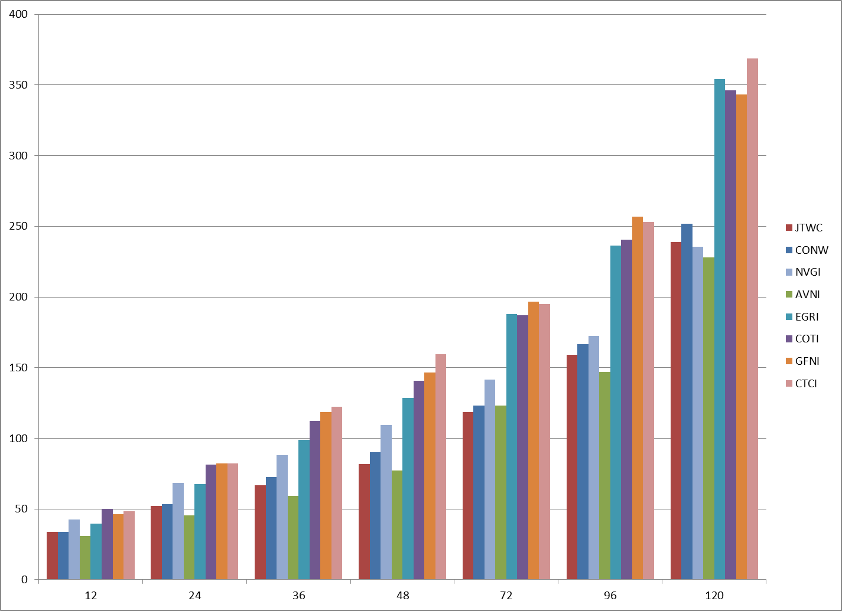
2014 MODEL TRACK ERRORS
(Southern Hemisphere – Homogeneous)
- Consensus better than JTWC at all forecast times
- Meso-models struggled at the extended forecasts
- NAVGEM and GFS performed best

