Slide 1
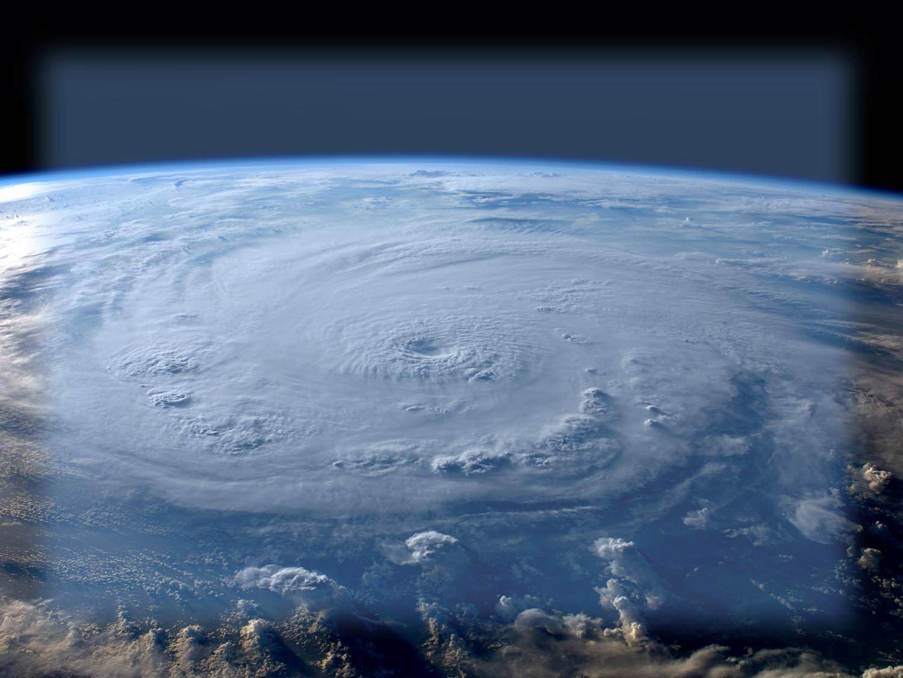
2014 Central Pacific T.C. Season
Tom Birchard
Senior Forecaster/Hurricane Specialist
Honolulu Forecast Office/Central Pacific Hurricane Center

Slide 2
2014 CPHC season in review
T.S. WALI 7/17-7/19*
HURRICANE GENEVIEVE 7/27-8/7
HURRICANE ISELLE 8/5-8/9
HURRICANE JULIO 8/8-8/15
HURRICANE ANA 10/13-10/26*
* Formed in central Pacific

Slide 3
Central Pacific T.C. Names
List 1
Akoni (ah - KOH - nee)
Ema (EH - mah)
Hone (HOH-neh)
Iona (ee-OH-nah)
Keli (KEH-lee)
Lala (LAH-lah)
Moke (MOH-keh)
Nolo (NOH-loh)
Olana (oh-LAH-nah)
Pena (PEH-nah)
Ulana (oo-LAH-nah)
Wale (WAH-leh)
List 2
Aka (AH - kah)
Ekeka (eh - KEH - kak)
Hene (HEH-neh)
Iolana (ee-OH-lah-nah)
Keoni (keh-ON-nee)
Lino (LEE-noh)
Mele (MEH-leh)
Nona (NOH-nah)
Oliwa (oh-LEE-vah)
Pama (PAH-mah)
Upana (oo-PAH-nah)
Wene (WEH-neh)
List 3
Alika (ah - LEE - kah)
Ele (EH-leh)
Huko (HOO-koh)
Iopa (ee-OH-pah)
Kika (KEE-kah)
Lana (LAH-nah)
Maka (MAH-kah)
Neki (NEH-kee)
Omeka(oh-MEH-ka)
Pewa (PEH-vah)
Unala (oo-NAH-lah)
Wali (WAH-lee)
List 4
Ana (AH - nah)
Ela (EH-lah)
Halola (hah-LOH-lah)
Iune (ee-OO-neh)
Kilo (KEE-lo)
Loke (LOH-keh)
Malia (mah-LEE-ah)
Niala (nee-AH-la)
Oho (OH-hoh)
Pali (PAH-lee)
Ulika (oo-LEE-kah)
Walaka(wah-LAH-kah)

Slide 4
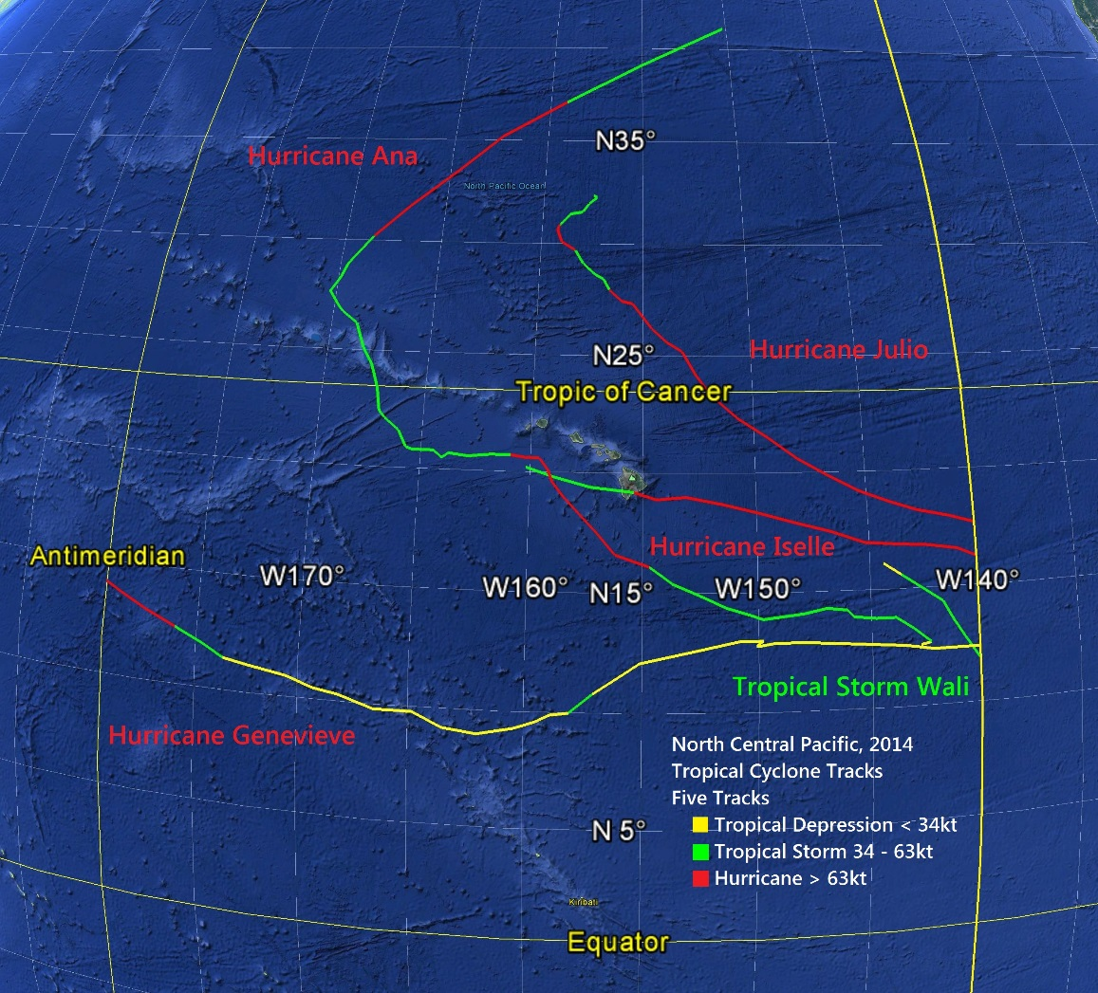
Image: Tom Evans

Slide 5
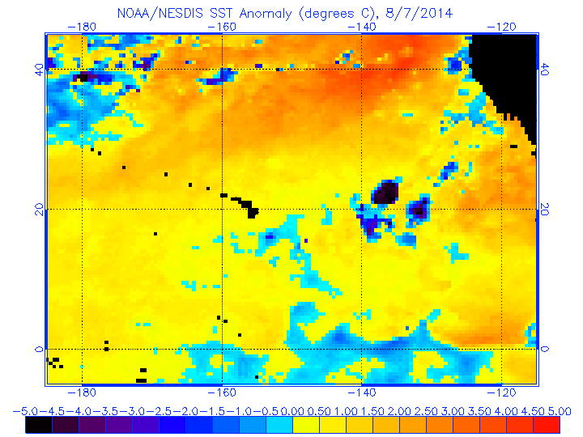
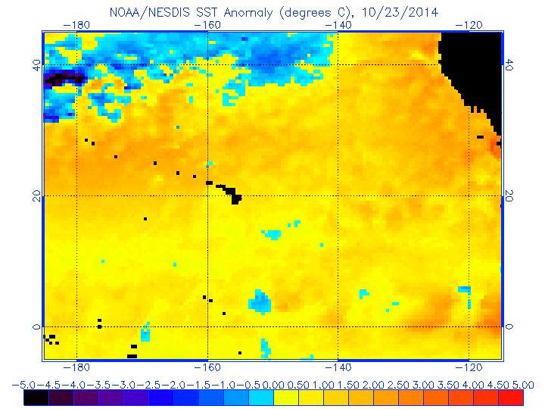
Synoptic factors

Slide 6
2014 CPHC season in review
T.S. WALI 7/17-7/19
HURRICANE GENEVIEVE 7/27-8/7
HURRICANE ISELLE 8/5-8/9
HURRICANE JULIO 8/8-8/15
HURRICANE ANA 10/13-10/26

Slide 7
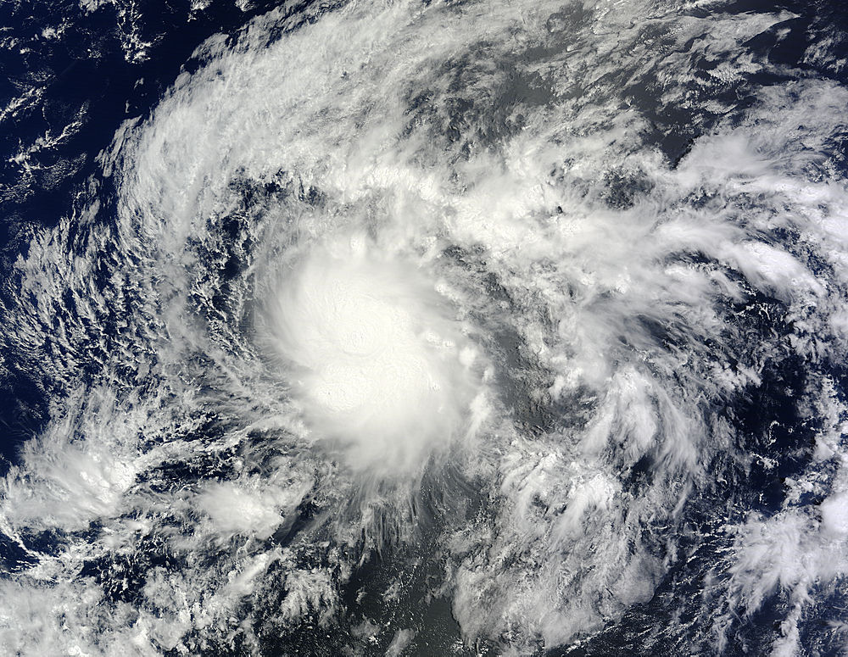
Tropical Storm Wali
Formed/Dissipated well SE of Hawaii
Associated moisture pool led to localized flooding in Hawaii
“Event totals at several sites were in the range of 5 to 10
inches, with peak amounts near 14 inches. Rain rates of
4 inches/hour observed in many areas on Oahu, with
a peak rate of 5.48 inches/hour. Flash flooding forced the
closure of Kamehameha Highway for several hours.
Property damage from the flooding occurred, with several
homes inundated by over a foot of water in Hauula.
Heavy rainfall also affected east Molokai and portions of
Maui. Flash flooding in Kahakuloa Stream overtopped the
bridge in Kahakuloa town and briefly closed Kahekili
Highway. ”
-Kevin Kodama, HFO Senior Service Hydrologist
Image Credit: NASA/NOAA GOES Project

Slide 8
2014 CPHC season in review
T.S. WALI 7/17-7/19
HURRICANE GENEVIEVE 7/27-8/7
HURRICANE ISELLE 8/5-8/9
HURRICANE JULIO 8/8-8/15
HURRICANE ANA 10/13-10/26

Slide 9
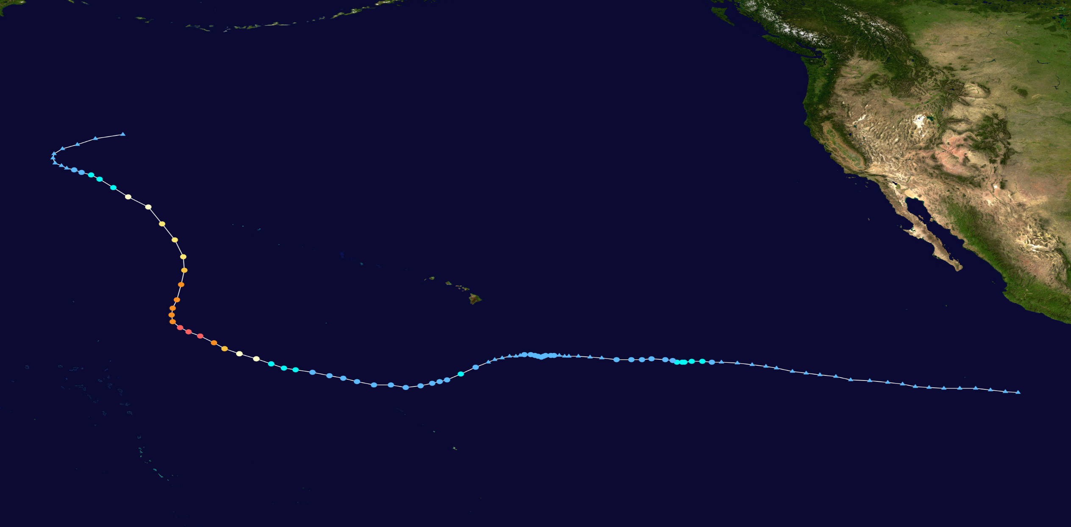
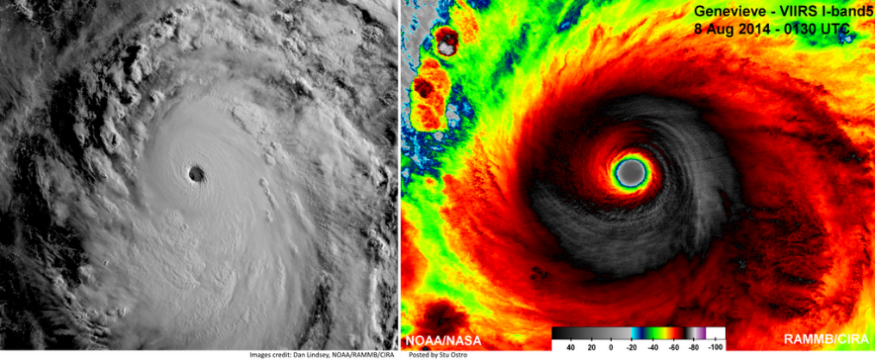
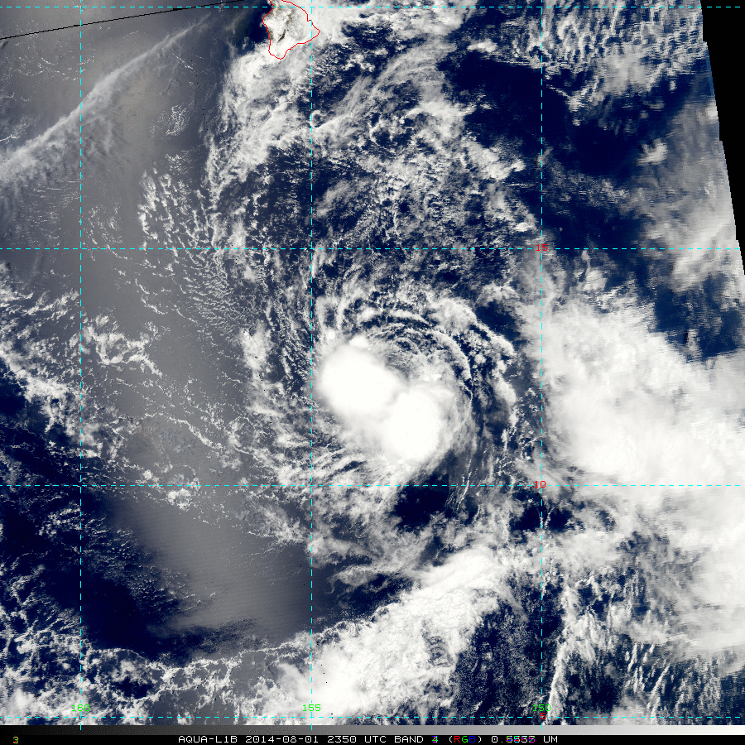
Hurricane Genevieve
Genevieve 2014 track by Cyclonebiskit

Slide 10
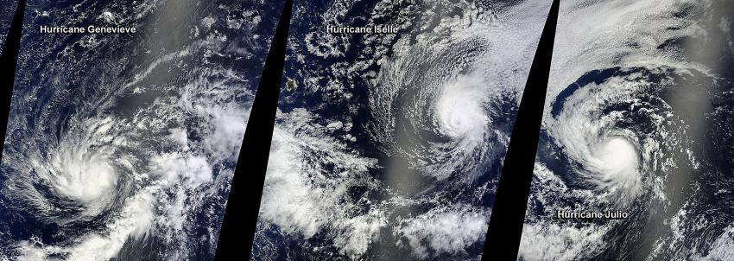
Hurricane Genevieve
Hawaiian Islands
On Aug. 5, at 22:05 UTC NASA's Terra satellite passed over Hurricane Genevieve (left), Hurricane Iselle (center), and Hurricane Julio (right) in the Central and Eastern Pacific Oceans. Credit: NASA Goddard MODIS Rapid Response Team

Slide 11
2014 CPHC season in review
T.S. WALI 7/17-7/19
HURRICANE GENEVIEVE 7/27-8/7
HURRICANE ISELLE 8/5-8/9
HURRICANE JULIO 8/8-8/15
HURRICANE ANA 10/13-10/26

Slide 12
Hurricane Iselle
First Tropical Cyclone to make landfall in Hawaiian Islands since Iniki 1992

Slide 13

Hurricane Iselle
First Tropical Cyclone to make landfall in Hawaiian Islands since Iniki 1992
Y

Slide 14
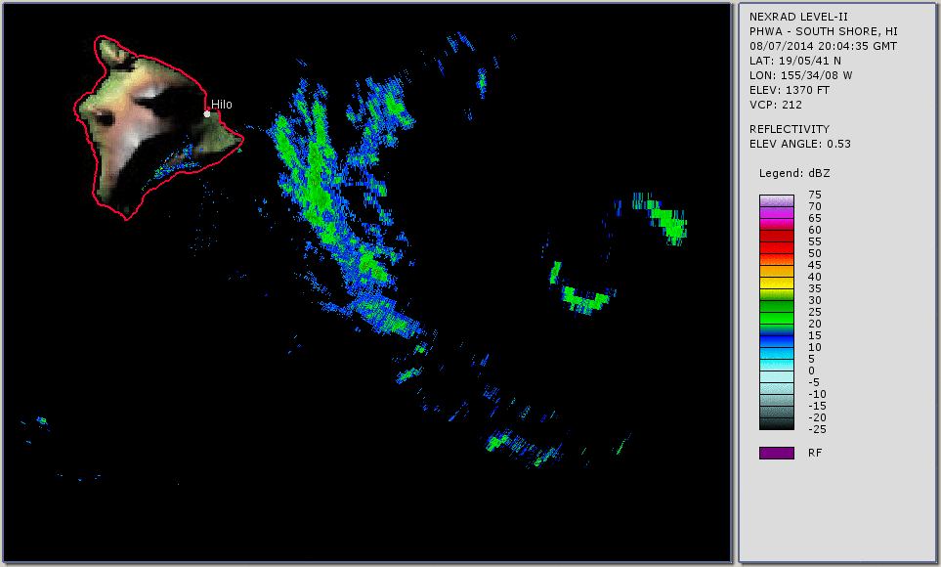
Hurricane Iselle
Loop courtesy The Weather Channel

Slide 15
Hurricane Iselle
Affected primarily rural areas of E/SE Big Island – best possible area for a TC to make landfall due to low population density.
Significant wind impacts reported in SW Maui.
Damage to homes in Kapoho Vacationland subdivision and Pohoiki were mostly due to ocean storm surge/wave runup, while most of the structural damage reported elsewhere in lower Puna was caused by trees toppling onto buildings.
$53 million loss to papaya industry SE Big Island
Significant impacts to macadamia nut, coffee and ornamental flower farmers

Slide 16
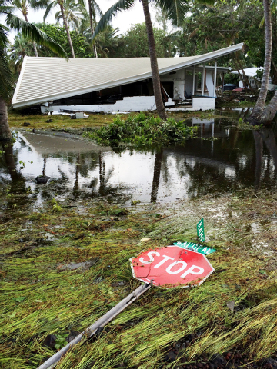
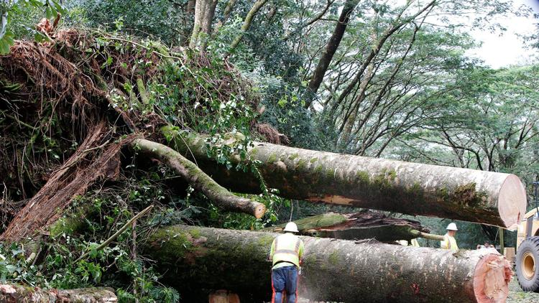
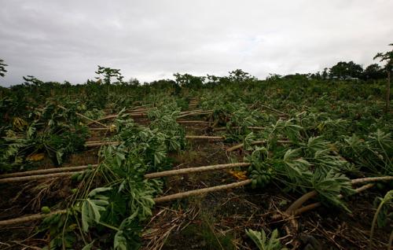
Hurricane Iselle
First Tropical Cyclone to make landfall in Hawaiian Islands since Iniki 1992

Slide 17
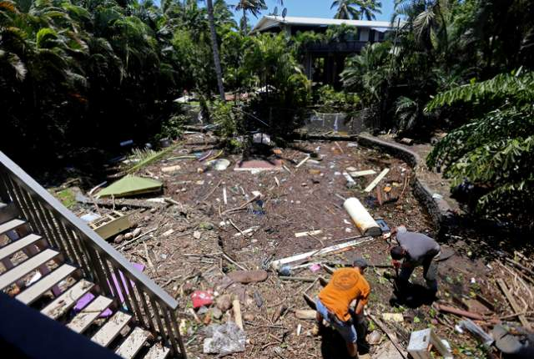
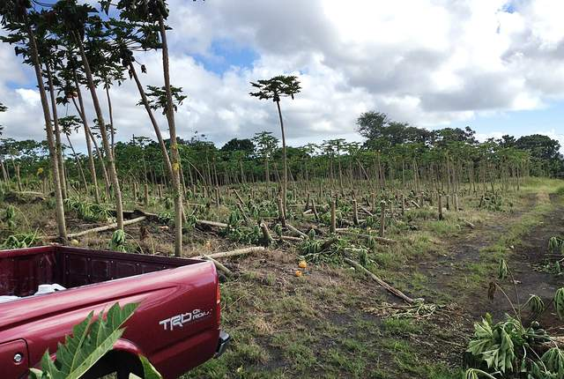
Hurricane Iselle
First Tropical Cyclone to make landfall in Hawaiian Islands since Iniki 1992

Slide 18
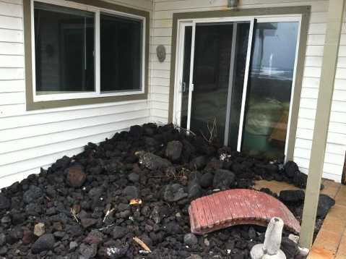
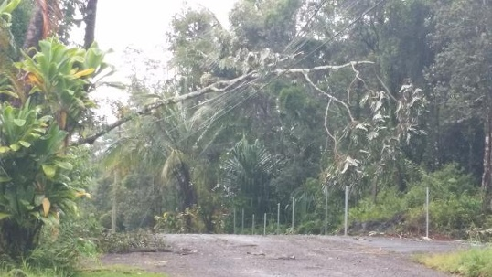
Hurricane Iselle
First Tropical Cyclone to make landfall in Hawaiian Islands since Iniki 1992

Slide 19
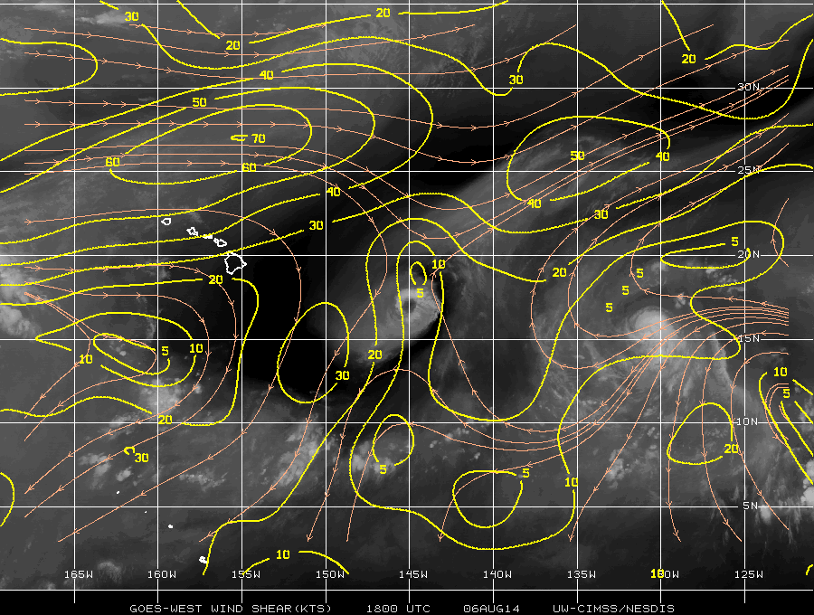
Synoptic factors

Slide 20
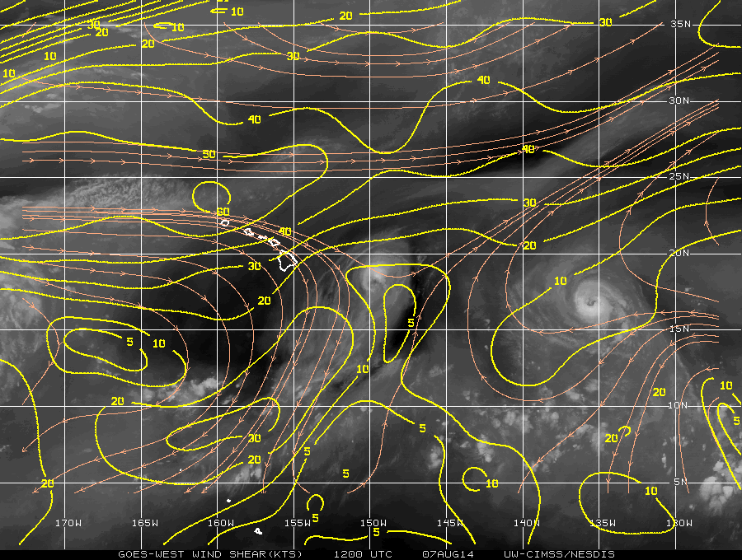
Synoptic factors

Slide 21
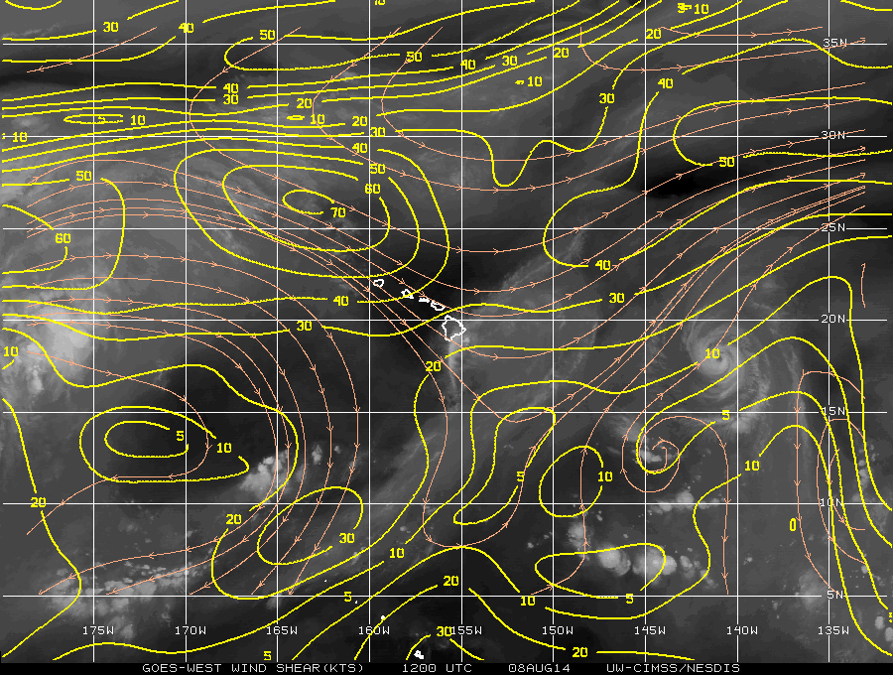
Synoptic factors

Slide 22
2014 CPHC season in review
T.S. WALI 7/17-7/19
HURRICANE GENEVIEVE 7/27-8/7
HURRICANE ISELLE 8/5-8/9
HURRICANE JULIO 8/8-8/15
HURRICANE ANA 10/13-10/26

Slide 23
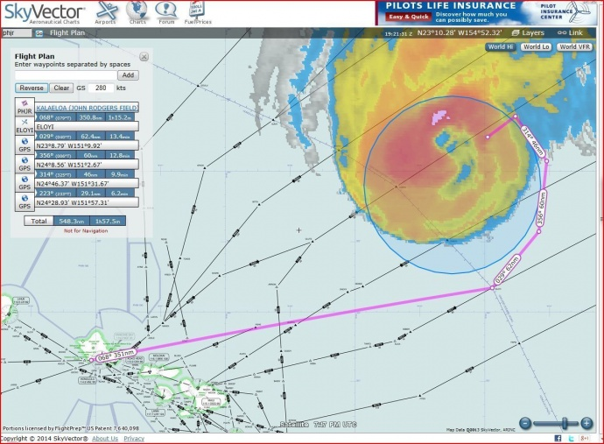
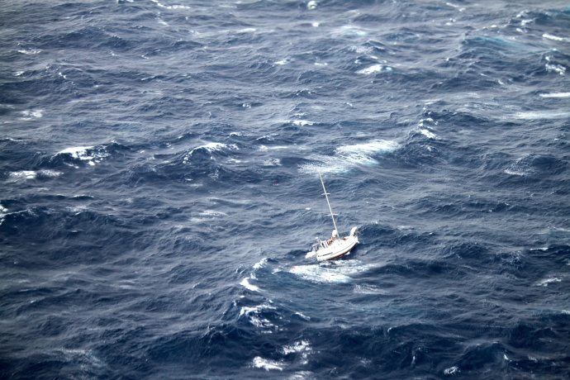
Hurricane Julio
Tracked well NE of Hawaiian Islands – produced high surf in Hawaii
USAF/CARCAH/USCG/Matson collaboration on rescue of boaters caught in Julio’s circulation

Slide 24
2014 CPHC season in review
T.S. WALI 7/17-7/19
HURRICANE GENEVIEVE 7/27-8/7
HURRICANE ISELLE 8/5-8/9
HURRICANE JULIO 8/8-8/15
HURRICANE ANA 10/13-10/26

Slide 25
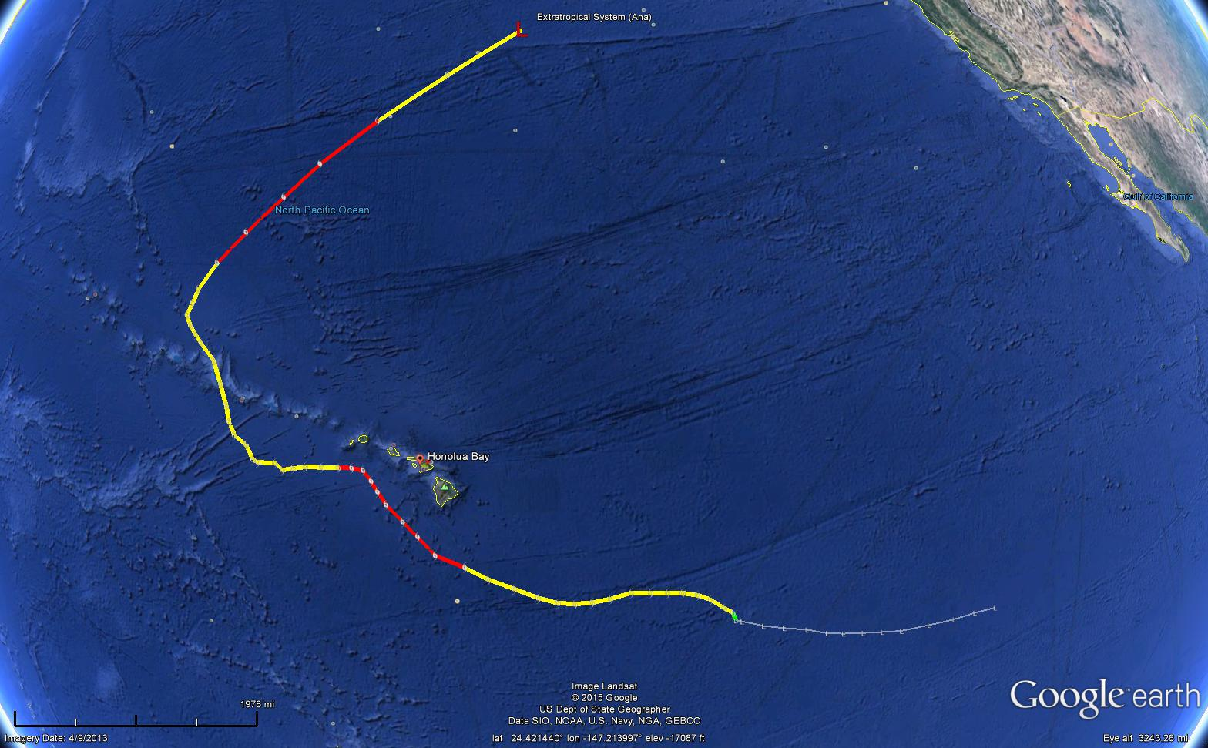
Hurricane Ana
Image based on output from tropicalcentralpacific.com

Slide 26
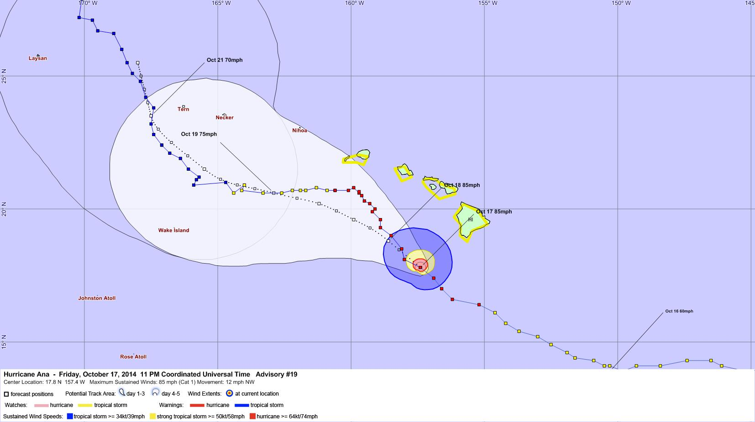
Hurricane Ana

Slide 27
Hurricane Ana
1) Record-setting CPAC system: length of time in basin
2) Prompted watches and warnings in the main and NW Hawaiian islands – no significant impacts.
3) Keith Robinson (half-owner of Niihau) reported that the most southern portion/exposed area of the island experienced extensive vegetation damage / tree tops leveled with an estimated Beaufort wind scale range of 40-50mph.

Slide 28
Preliminary CPHC average track error: Iselle
Model (# of forecasts) | 12 (10) | 24 (9) | 36 (7) | 48 (5) | 72 (1)
OFCL | 20.6 | 28.3 | 35.1 | 36.8 | 55.2
OCD5 | 36.1 | 60.0 | 102.1 | 153.1 | 362.9
AVNI | 26.4 | 43.5 | 57.1 | 54.5 | 53.4
GHMI | 17.8 | 21.4 | 44.7 | 60.1 | 123.1
HWFI | 24.1 | 35.4 | 46.9 | 61.6 | 124.7
TVCN | 17.8 | 26.8 | 35.8 | 40.9 | 62.3
AEMI | 29.8 | 52.3 | 69.1 | 78.2 | 70.3

Slide 29
Preliminary CPHC average track error: Ana
Model (# of forecasts) | 12 (48) | 24 (46) | 36 (44) | 48 (42) | 72 (28) | 96 (20) | 120 (20)
OFCL | 28.2 | 49.5 | 62.9 | 74.4 | 104.5 | 159.4 | 178.9
OCD5 | 46.8 | 101.1 | 154.9 | 188.5 | 203.3 | 202 | 171.3
AVNI | 27.7 | 39.5 | 48.8 | 60.9 | 82.8 | 119.3 | 197.2
GHMI | 29.1 | 51 | 69.8 | 90.1 | 153.7 | 274 | 391.4
HWFI | 28.9 | 47.7 | 59.2 | 73.3 | 107.8 | 161.8 | 197.8
TVCN | 25.4 | 40.8 | 52.9 | 65.4 | 84.9 | 131.8 | 175.1
AEMI | 28.4 | 46.9 | 61.6 | 72.1 | 90.6 | 137.1 | 192.7

Slide 30
Hawaiian Islands & motion
Iselle and Ana highlighted that interaction with the topography of the Hawaiian Islands remains an area ripe for further research (with mesoscale models & ensembles expected to increase understanding)
The effects of land and topography on TC tracks have been studied in many contexts, but only Chambers and Li (2011) focused on Hawaiian Islands
Horizontal SST gradients and effects on track?
Plethora of aircraft data with which to work

Slide 31
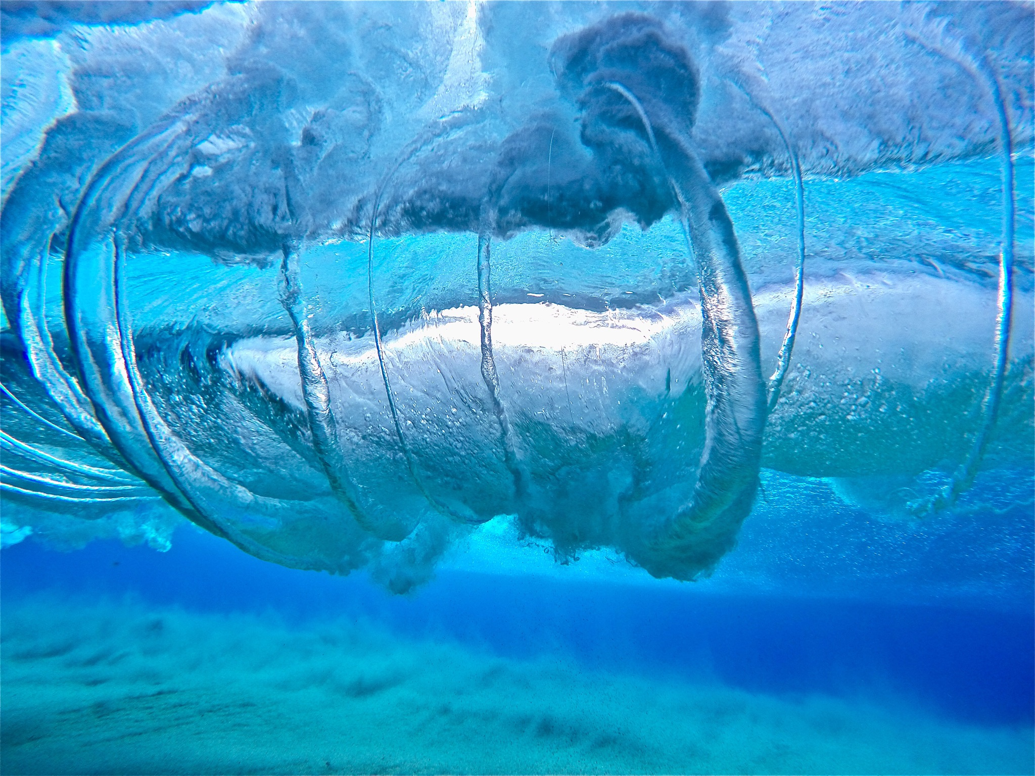
MAHALO!
Tom Birchard
Central Pacific Hurricane Center/Honolulu Forecast Office
Thomas.Birchard@noaa.gov
808-973-5280

