Slide 1
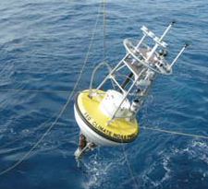
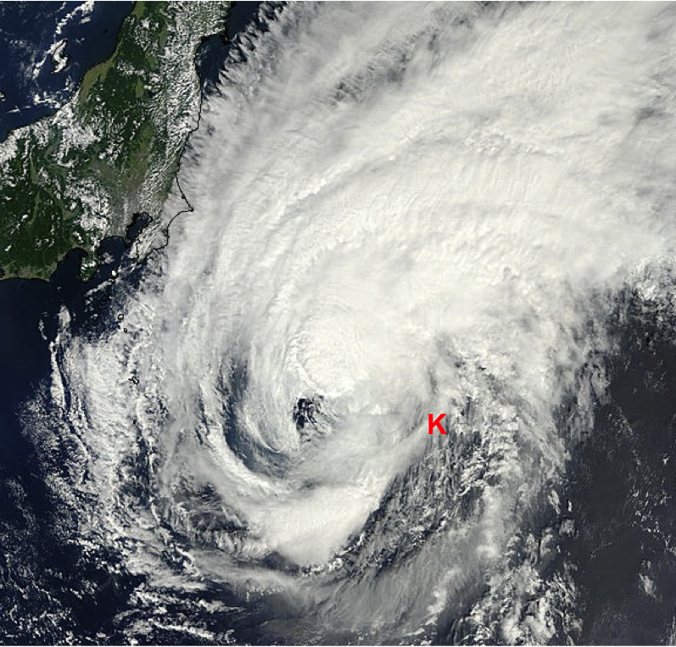
Kuroshio Extension Observatory (KEO) MEASUREMENTS of the
Upper-Ocean Response to TROPICAL CYCLONES in the Western North Pacific
Nick Bond (UW/JISAO), Meghan Cronin (NOAA/PMEL), Hyun-Sook Kim (NOAA/EMC)
and Jennifer Keene (UW/JISAO)
BACKGROUND:
PMEL Kuroshio Extension Observatory (KEO) moored buoy deployed off the coast of Japan since 2004.
Routinely in the path of mature tropical cyclones.
SANDY SUPPLEMENTAL SUPPORT:
Systems modernized and made more robust for 2014.
Data transmissions to shore increased to once per hour, allowing researchers to monitor in near real-time.
IMPACTS:
KEO struck by TC Fengshen on 9 Sep 2014 & by TC Kammuri on 28 Sep 2014; complete hourly data set returned to shore for both storms.
  PMEL & UW/JISAO in collaboration with NCEP/EMC will investigate value of high resolution time series for improved forecasts.
  Since KEO is in western Pacific, real-time forecasting exercises are not liable to interfere with operations during hurricanes in the Atlantic. Lessons learned will be able to be applied to hurricane forecasts impacting east coast of U.S.

