Slide 1

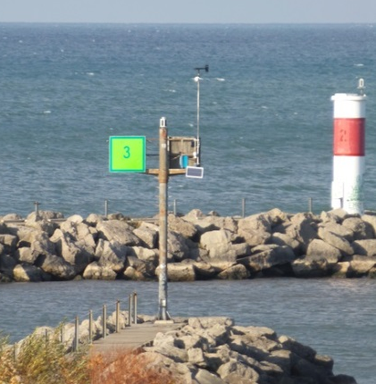
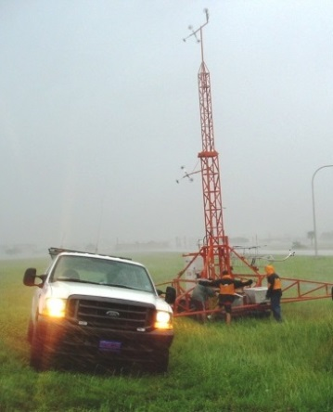
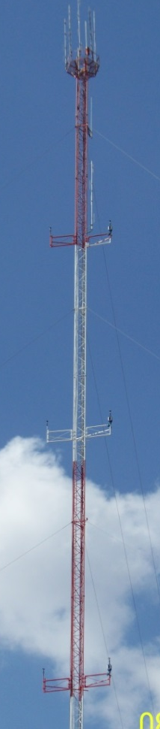
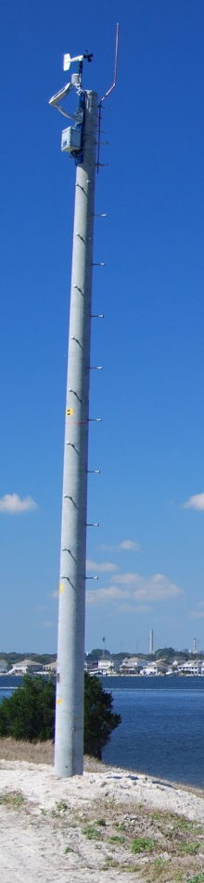
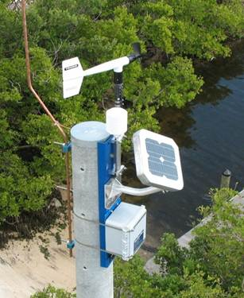
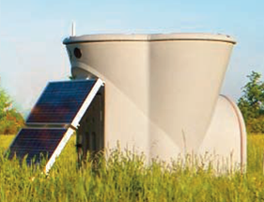
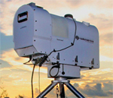
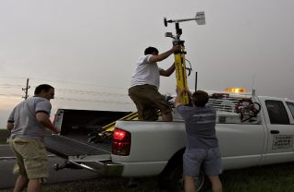
National Mesonet Program
On the Continued Need for Public-Private Partnerships in the Observation of Land-Falling Tropical Cyclones
Poster Session – P10
Presented by Marty Bell
WeatherFlow
StormPrint

Slide 2
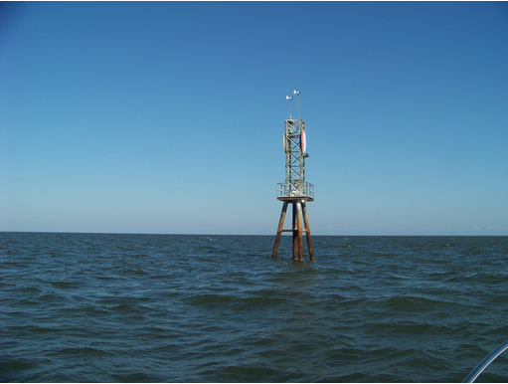
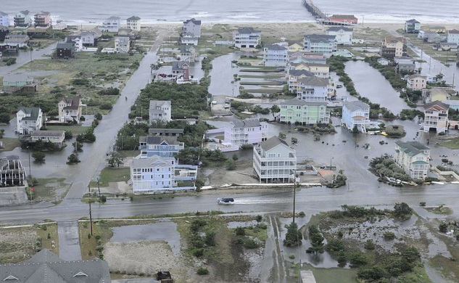
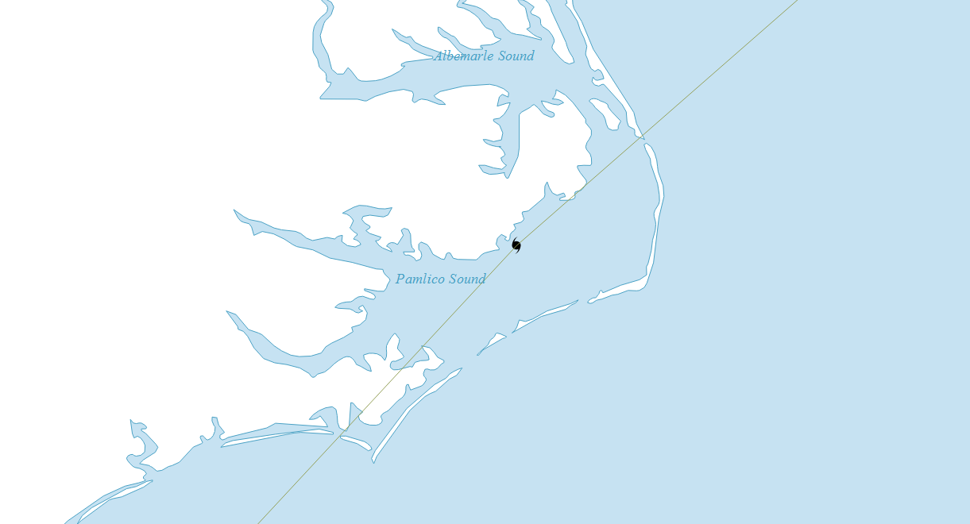
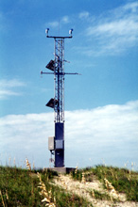
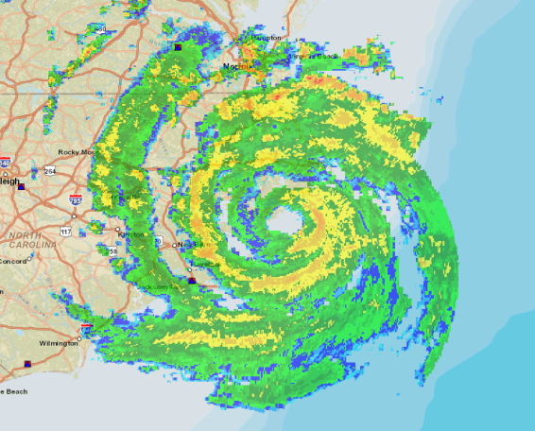
Hurricane Arthur
Pamlico Sound (WeatherFlow)
85 mph max sustained
99 mph max gust
55
58
63
76
66
66
73
83
Top 25 Max Sustained Winds
85
74
64
73
Federal Stations
71
71
NMPA Stations
73
79
56
62
64
55
71
77
Cape Lookout (CMAN)
77 mph max sustained
101 mph max gust

