Slide 1


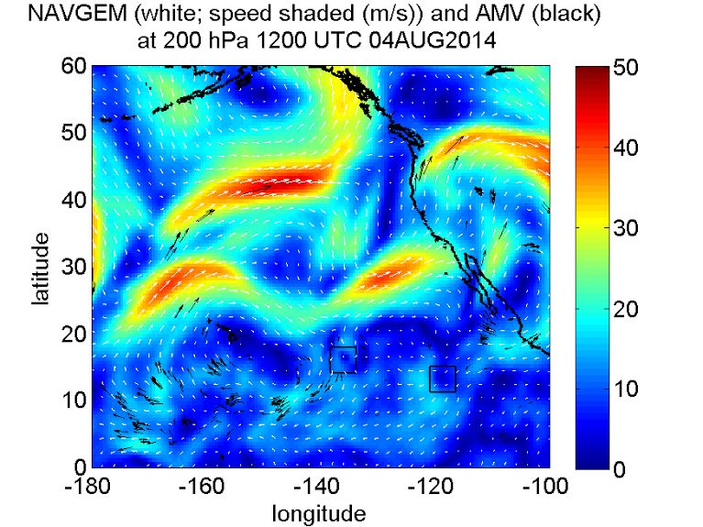
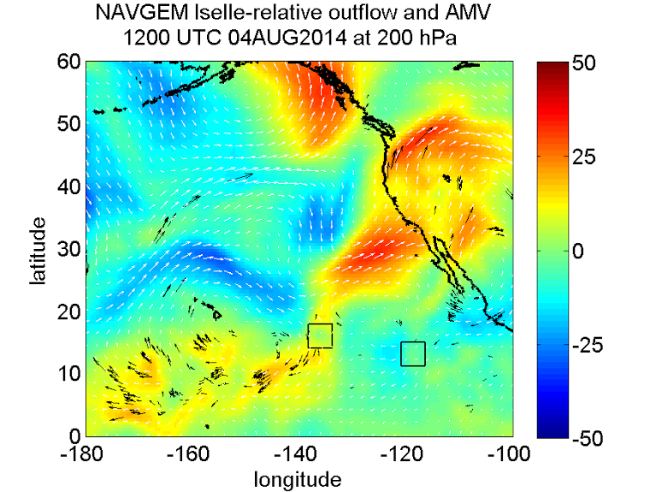
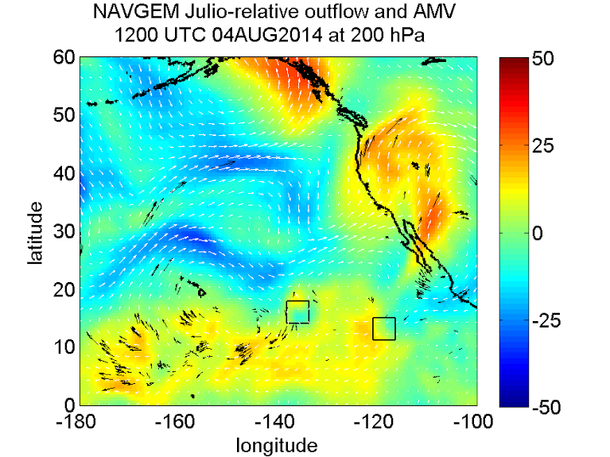

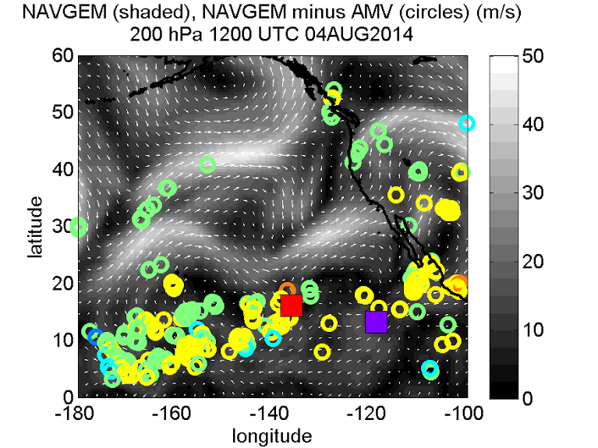
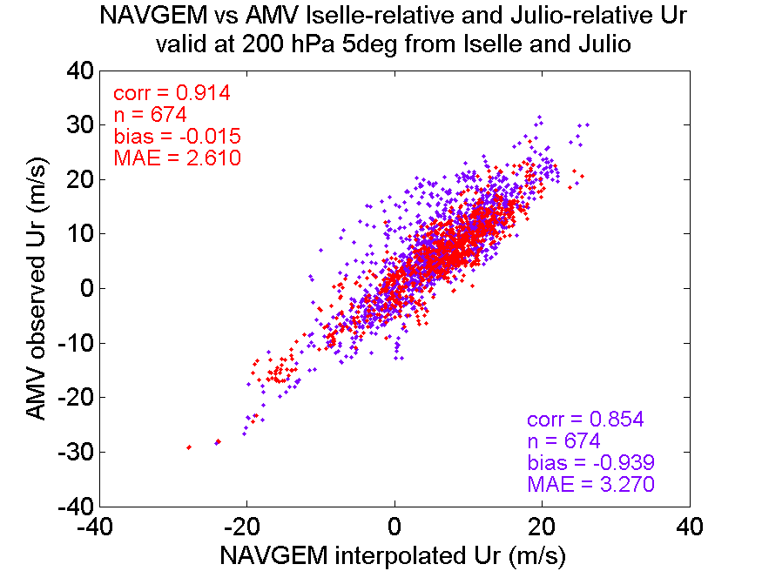
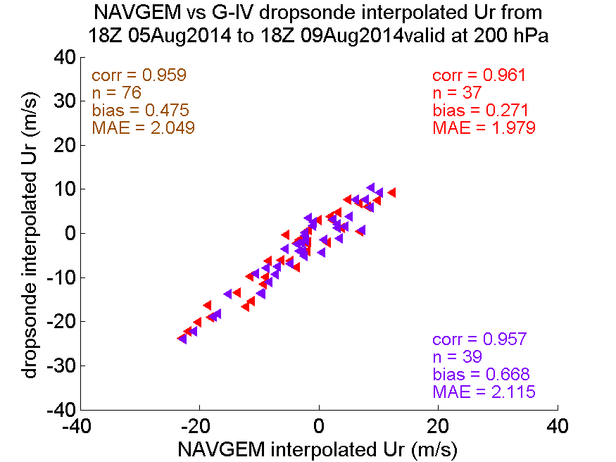

Satellite and Aircraft Observations of Upper-Level Outflow in
Hurricanes Iselle and Julio (2014)
Julie K. Stapleton, Anthony L. Borrego, Sara C. Reynolds, Elizabeth R. Sanabia, and Bradford S.Barrett
Oceanography Department, U.S. Naval Academy, Annapolis, MD
Abstract
a
b
c
Results from an analysis of the relationship between upper-level outflow and tropical cyclone (TC) intensity in Hurricanes Iselle and Julio revealed that in the Navy Global Environmental Model (NAVGEM) outflow was concentrated at the 200-hPa level and was influenced by large scale synoptic features surrounding the storms. Several relationships between outflow and intensity were also noted. Here, the NAVGEM model analyses are compared to observational data to develop confidence in the accuracy of the NAVGEM 200-hPa winds, and thereby also the results of the outflow study. Both satellite and aircraft observational data were evaluated in the large-scale environment of the eastern North Pacific as well as in a smaller region surrounding each TC.
d
e
f
Fig. 1. The 200-hPa NAVGEM (a) wind speed (shaded) and (b) Iselle- and (c) Julio-relative outflow (shaded) with AMV (black) and dropsonde (brown) wind vectors and TC centers (Iselle in red, Julio in purple) at 1200 UTC 04 August 2014. (d) The NAVGEM (shaded) and NAVGEM-minus-AMV (circles) wind speeds (m s⁻¹) also at 1200 UTC 04 August 2014 with Iselle (red) and Julio (purple) storm centers. (e) The NAVGEM (model) vs. AMV (observed) 200-hPa TC-relative outflow for locations within 5º latitude and longitude of Iselle (red) and Julio (purple) throughout each TC life cycle. (f) The NAVGEM (model) vs. dropsonde (observed) 200-hPa TC-relative outflow for all NOAA G-IV dropsonde locations.
Results
Strong correlations between the NAVGEM and AMV 200-hPa outflow were evident in both the large-scale environment of the eastern North Pacific and the small-scale regions near the Iselle and Julio storm centers. Similar results were found for the NAVGEM and dropsonde outflow observations. It is reasonable to assume that the very high correlations were due at least in part to the assimilation of the AMV and dropsonde data into the NAVGEM, yet the results increased confidence in the accuracy of the NAVGEM 200-hPa winds and thereby also in the results of the outflow study.

