Slide 1


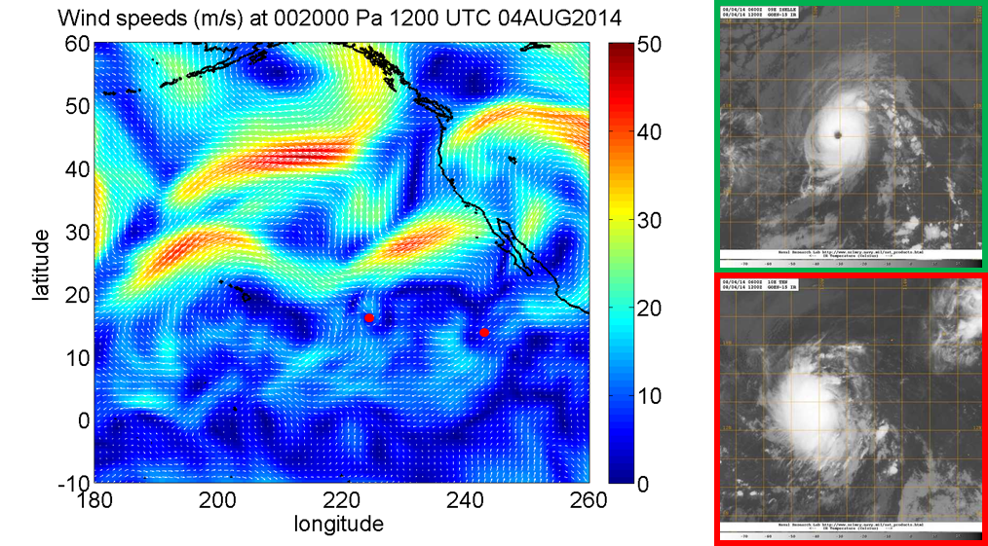
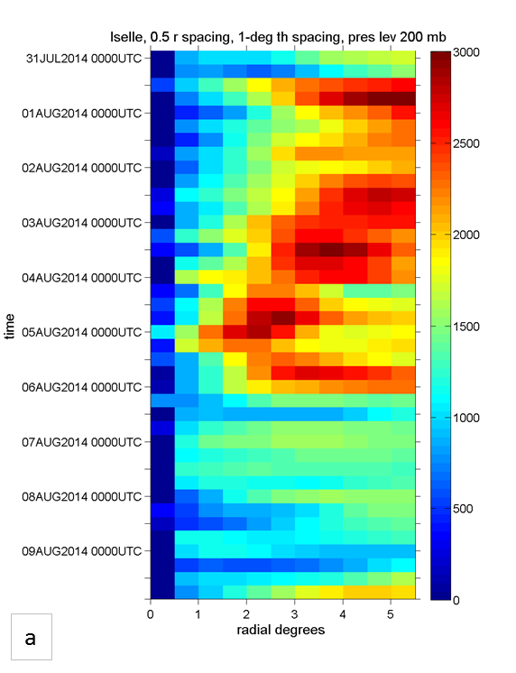
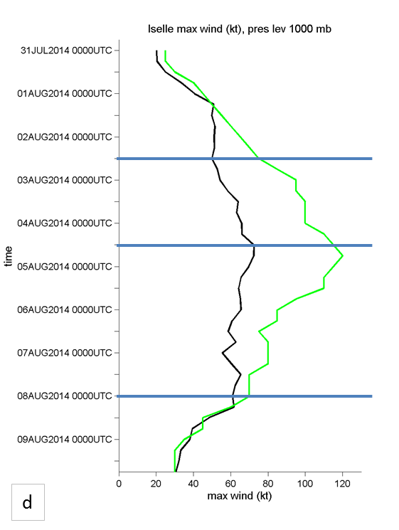
Evolution of the Upper-Level Outflow During Hurricanes Iselle and Julio (2014) in the Navy Global Environmental Model (NAVGEM) Analyses
Sara C. Reynolds, Anthony L. Borrego, Julie K. Stapleton, Elizabeth R. Sanabia, and Bradford S.Barrett
Oceanography Department, U.S. Naval Academy, Annapolis, MD
Abstract
During the summer of 2014, a group of midshipmen flew through Hurricanes Iselle and Julio with the TROPIC internship. Stemming from this experience, interest grew regarding the outflow mechanisms of a tropical cyclone (TC). Not much is known about the relationship between TC outflow, structure, and intensity. Outflow is defined as the outward branch of the TC’s secondary circulation. Model output can be used to analyze outflow, and here the Navy Global Environmental Model (NAVGEM) is used to understand the evolution of the outflow in Hurricanes Iselle and Julio (2014).
b
a
c
Results/Conclusions
For both Hurricanes Iselle and Julio, the TC intensity increased during periods of increased outflow and when the maximum outflow was located close to the storm center
  The TC intensity was greatest when dual outflow channels were present
    Outflow channels were greatly impacted by adjacent large-scale environmental features.
•Iselle and Julio transited nearly identical tracks early in their respective lifecycles and were affected by many of the same environmental features.
d
e
Fig. 1. (a) The 200-hPa wind speed (shaded) and direction (white arrows) from the NAVGEM operational analysis. Geostationary infrared imagery of Hurricanes (b) Iselle (outlined in green) and (c) Julio (outlined in red) from 1200 UTC 04 August 2014. (d) Radial variation in total outflow from the NAVGEM data for Hurricane Iselle (shaded, scale at right). (e) The 850-hPa model (black) and best track (green) intensities (kts) for Hurricane Iselle. Plots (d) and (e) extend from 0000 UTC 04-14 August 2014.

