Slide 1




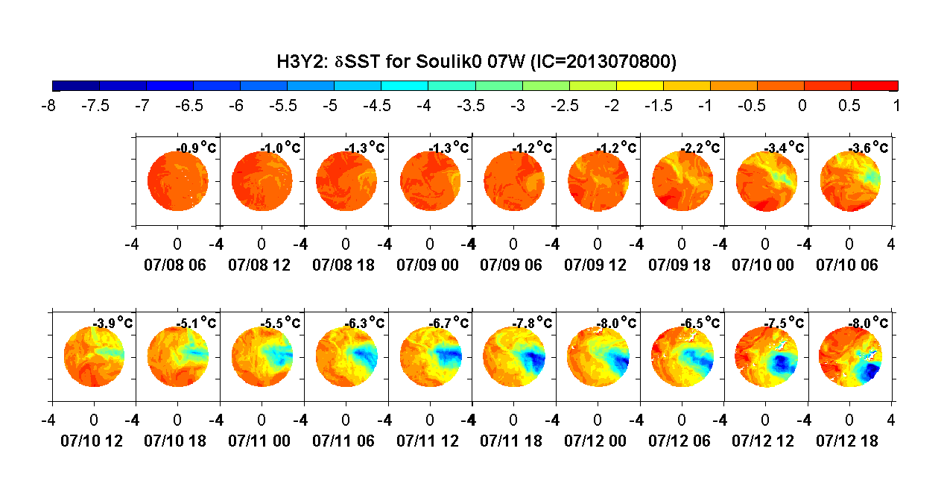
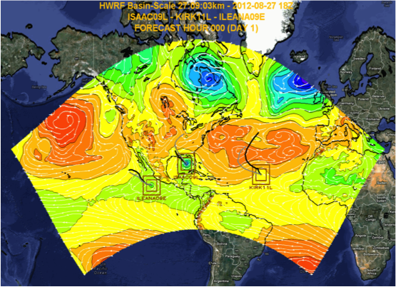
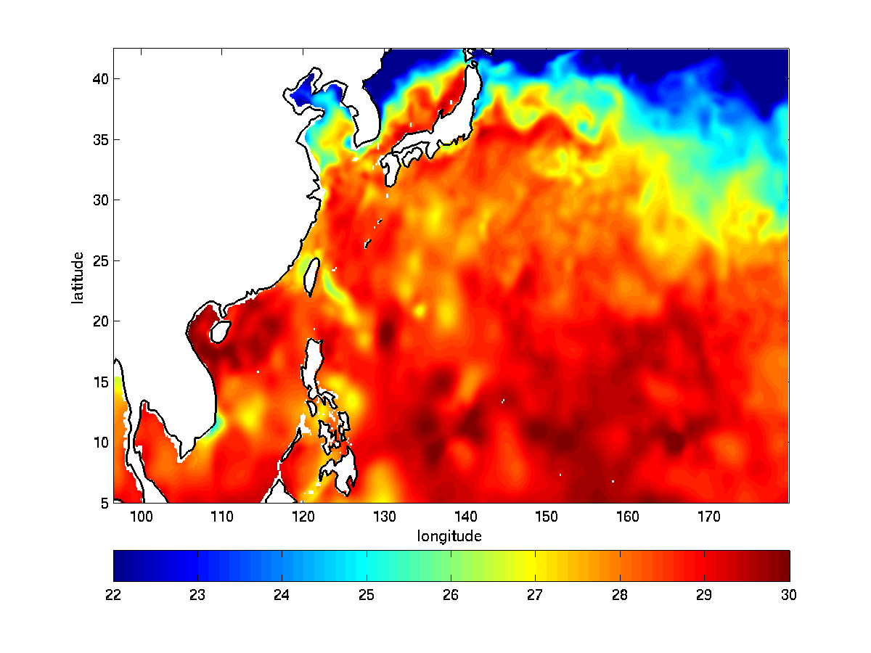
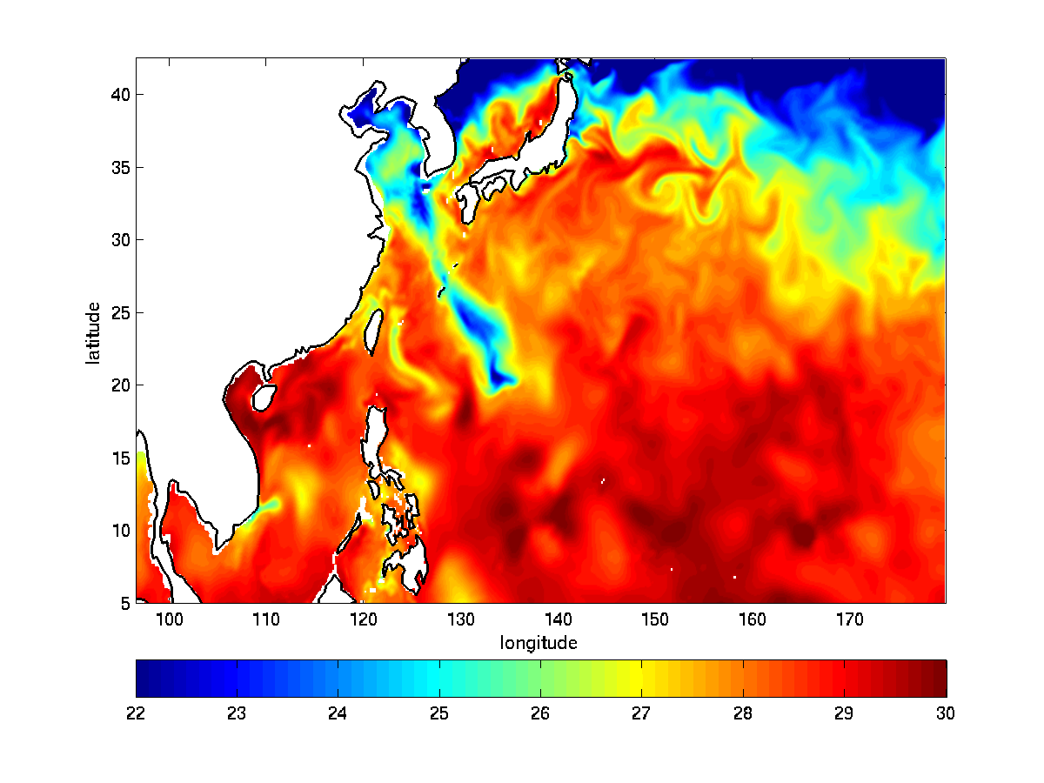
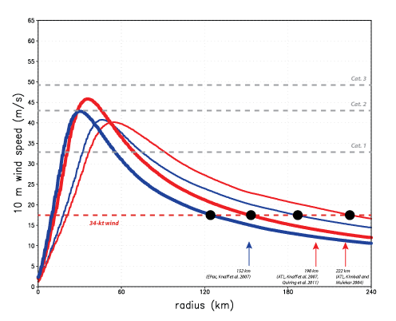
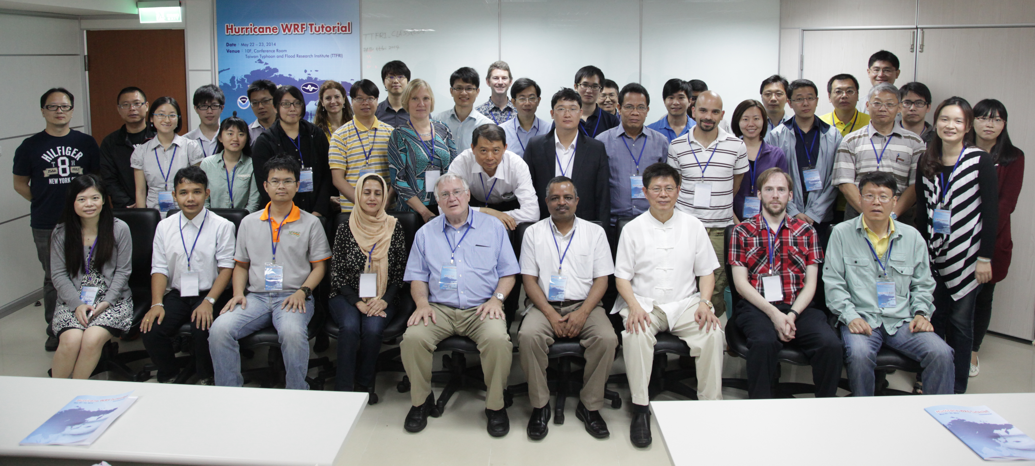
Support for Users and Developers of the Hurricane WRF Model
L. Bernardet^{1,2,3}, V. Tallapragada⁴, M. Biswas^{1,5}, C. R. Holt^{1,2,3}, S. Trahan^{4,6}, L. Carson^{1,5}
¹Developmental Testbed Center
²CIRES/University of Colorado
³NOAA ESRL/GSD
⁴NOAA EMC
⁵NCAR
⁶I.M. Systems Group
Community Support
Developer Support
Code Management Practices
DTC Visitor Program
Community Resources
Multi-Storm capability (Gopal et al. HRD/AOML)
POM Advancements
(R. Yablonsky, URI)
HYCOM Plots (H.-S. Kim, EMC)
Atmospheric Physics Innovation
(R. Fovell, UCLA)
P04
Follow-up work in DTC led to implementation/testing of partial cloudiness
Share Related Code Among Developers
DTC incorporating mulitstorm capability into HWRF Python Scripts
DTC Visitor Program
DTC Visitor Program

