Slide 1
Coupled Air-Sea Observations in
Hurricane Edouard
Eric W. Uhlhorn NOAA/AOML/HRD | Joseph J. Cione NOAA/AOML/HRD and NOAA/ESRL/PSD
Benjamin Jaimes University of Miami/RSMAS | Lynn K. (Nick) Shay University of Miami/RSMAS
2015 Tropical Cyclone Research Forum
3 March 2015

Slide 2
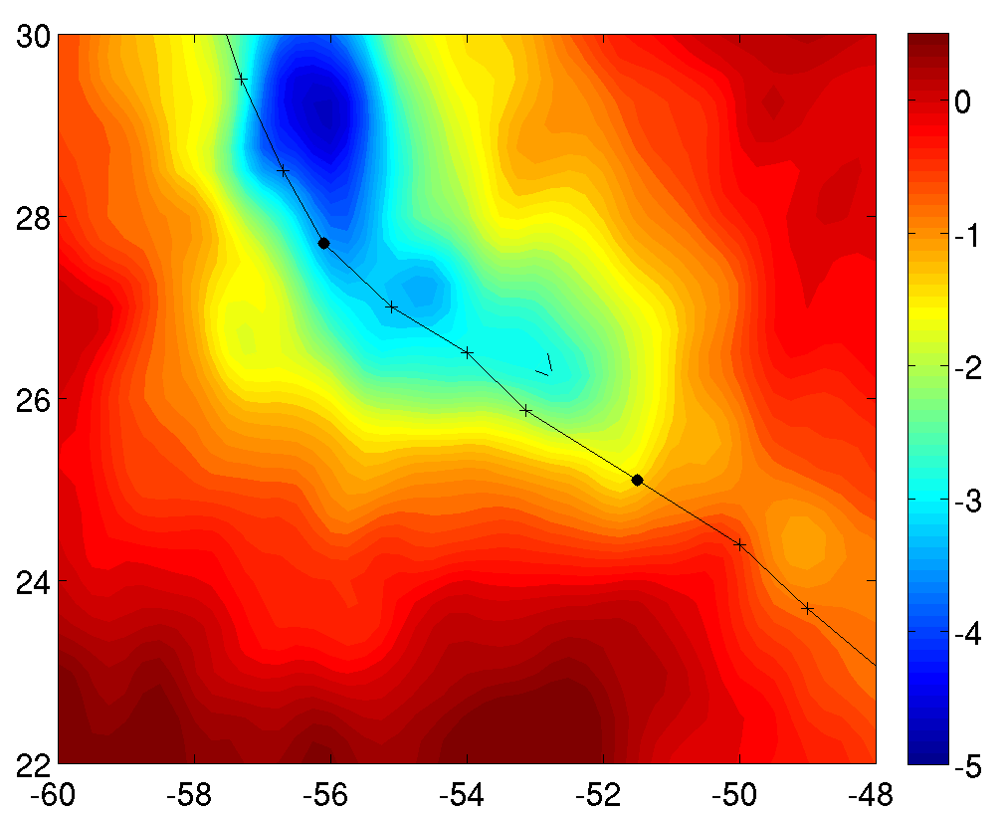
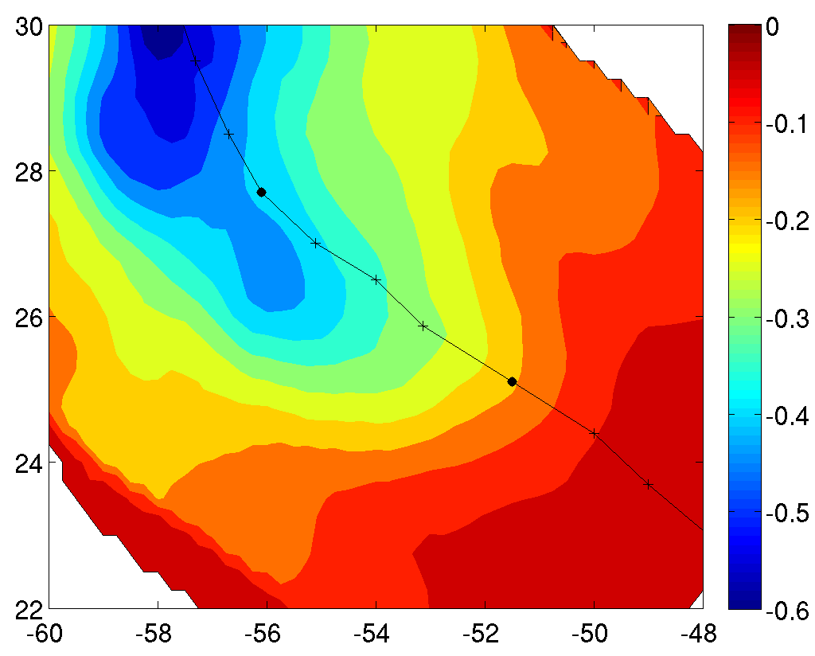
Coupled Air-Sea Observations in
Hurricane Edouard
Developing a mixed-layer temperature budget for coupled TC/ocean model evaluation
?
0915/18Z
0914/18Z
ML Cooling ΔT
Sfc Flux

