Slide 1
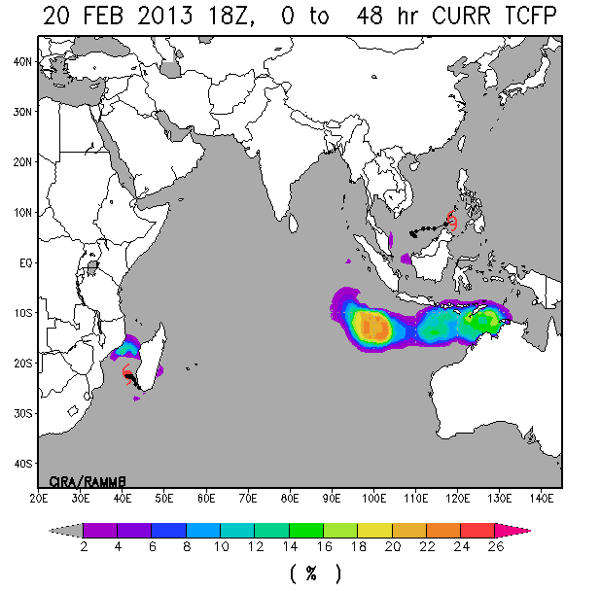
The 48-hour NESDIS Tropical Cyclone Formation Probability Product Andrea Schumacher (CIRA/CSU), Mark DeMaria (NOAA/NESDIS/StAR), and Kate Musgrave (CIRA/CSU)
Current TCFP product provides 24 hr probabilities of TC formation
Operational need for 48 hr probabilities (NHC Tropical Weather Outlook, JTWC TC Formation Alerts)
In response to user request, TCFP product has been updated to provide 0-24 hr, 24-48 hr, and 0-48 hr TC formation probabilities
Uses GFS forecast fields
Same methodology as 24 hr product
Statistical algorithm based on environmental, climatological, and convective input parameters.
Other product enhancements
Increased resolution (from 5 degree to 1 degree)
Better continuity (replaced discrete grid box methodology)
Larger statistical sample (added 2010 to developmental dataset, particularly important for S. Hemisphere where water vapor data only available back to 2005)
Product verification will be presented
Brier scores -> skillful with respect to reference forecast of climatology
More skillful than 24 hr probabilities
48-hr TC formation probability (left) 48 hours prior to formation of TC Rusty to the NW of Australia on 22 Feb 2013.
http://rammb.cira.colostate.edu/projects/gparm/gparm_glob_test/
Poster Preview - 67th Interdepartmental Hurricane Conference, Tropical Cyclone Research Forum, 5-7 March 2013, College Park, MD

