Slide 1
Aerosols-Cloud-Microphysics Interactions in Tropical Cyclones
using Aircraft Observations and the WRF model
Yaítza Luna-Cruz^{1,2}, Andrew J. Heymsfield³, Gregory Thompson³, Gregory Jenkins¹,
Trude Eidhammer³ and Aaron Bansemer³
¹Howard University Program in Atmospheric Sciences (HUPAS), Washington DC
²NOAA Center for Atmospheric Sciences (NCAS), Washington DC
³National Center for Atmospheric Sciences, Boulder, Colorado
Lv = l_{v0} + (c_{pv} - c_{l})(T – T₀)
N_{i} = 10⁻⁵ exp[0.6(T₀ - T)]
V [m s⁻¹] = q_{s}V_{s} + q_{g}V_{g}/ q_{s} + q_{g}
Questions remains unanswered about the role of aerosols (e.g. dust, sulfates and sea salt) in hurricane cloud-microphysics processes and its effects in genesis and intensification.
To address some of the questions in-situ microphysics measurements from the NASA DC-8 aircraft were obtained during the GRIP 2010 field campaign.
Earl presented the excellent opportunity to study aerosols-cloud-microphysics interactions with a total of 4 days sampling the storm.
To assist in the interpretation of the microphysics observations, high resolution numerical simulations of hurricane Earl were performed using the Weather Research and Forecasting (WRF-ARW) model.
NCAS
NOAA Center for Atmospheric Sciences

Slide 2
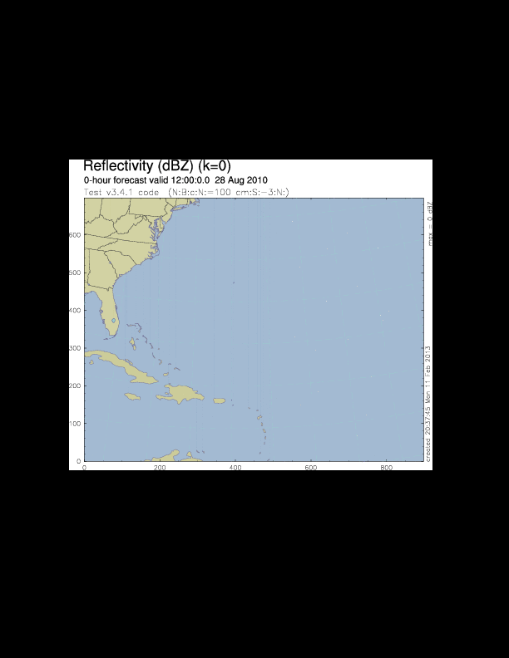
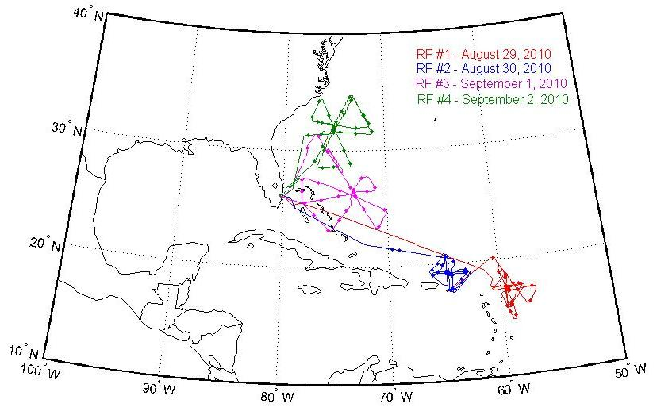
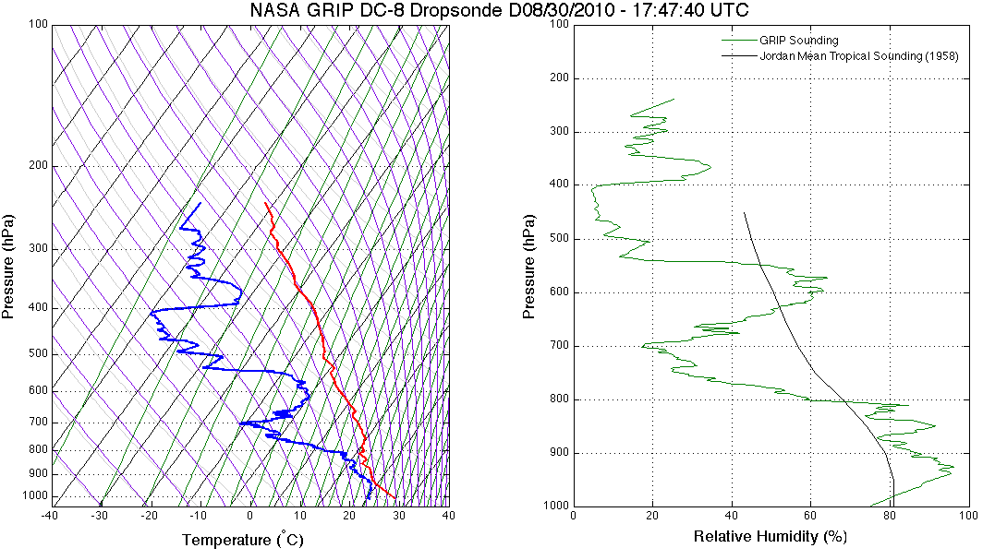
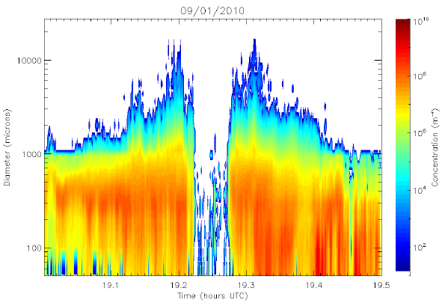
Preliminary Results
N_{i} = 10⁻⁵ exp[0.6(T₀ - T)]
Lv = l_{v0} + (c_{pv} - c_{l})(T – T₀)
Observations
V [m s⁻¹] = q_{s}V_{s} + q_{g}V_{g}/ q_{s} + q_{g}
Modeling
During the evolution of Earl:
A dust layer (SAL) was detected
High concentration of super cooled droplets were observed
High concentration of small cloud droplets/ice crystals
Droplets likely activated aloft rather than near cloud base
WRF-ARW 3.4.1 vortex following
132 hrs of simulation
Control Case: Thompson Microphysics, 2008
Intensity difference w.r.t. obs ~12mb
Simulation track off to the north w.r.t. obs

