Slide 1
Ensemble Kalman Assimilation of Global-Hawk-based Data
from Tropical Cyclones – Jason Sippel
Ensemble Kalman filter used to assimilate HIWRAP radial velocity data from Hurricane Karl
Similar scheme as Zhang et al. 2009 used to produce superobs from raw data
Initial tests with 1000 superobs produce vortex in wrong location then fail
Subsampling superobs to the strongest 100 every hour outside R=30 km considerably improves results
Results improve more when position and intensity are also assimilated
(a) 1000 Vr superobs/hr
(b) Supsampled 100 superobs/hr

Slide 2
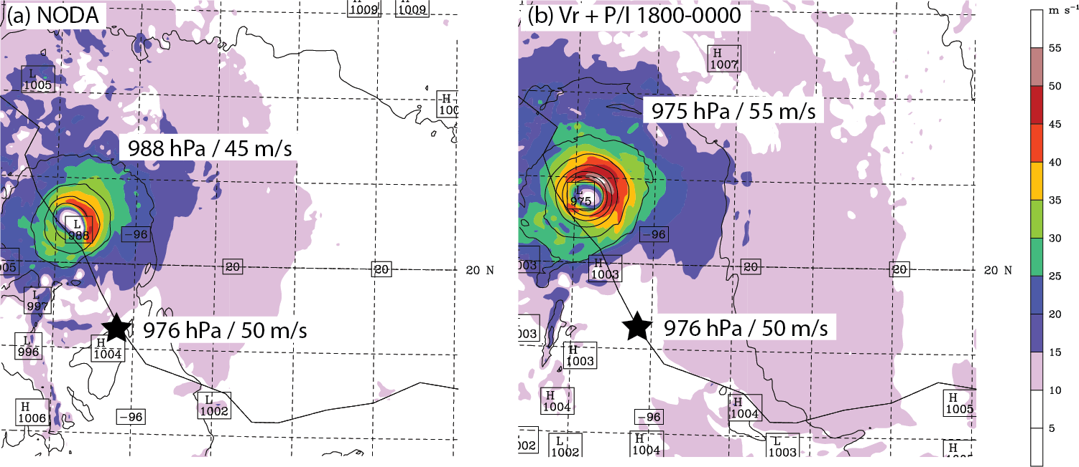
Ensemble Kalman Assimilation of Global-Hawk-based Data
from Tropical Cyclones – Jason Sippel
Assimilation does improve forecast maximum intensity of Karl
No improvement in the track due to persistent problems with multiple vorticity maxima in analyses
Forecasts of Karl’s landfall with and without assimilation

