Slide 1
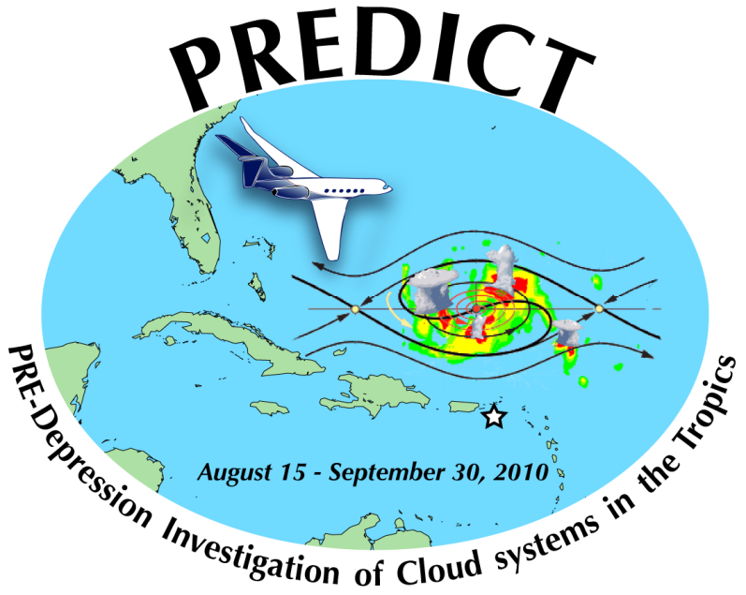
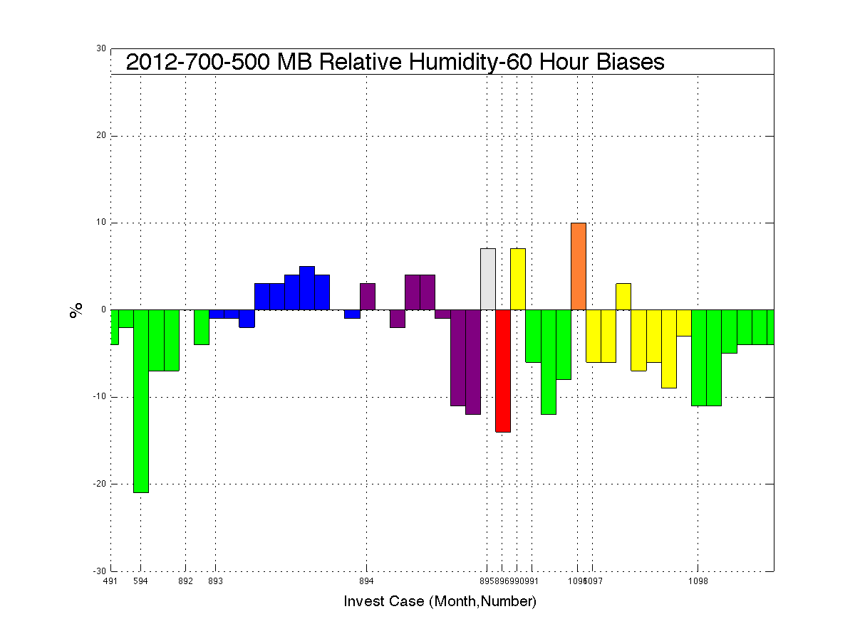
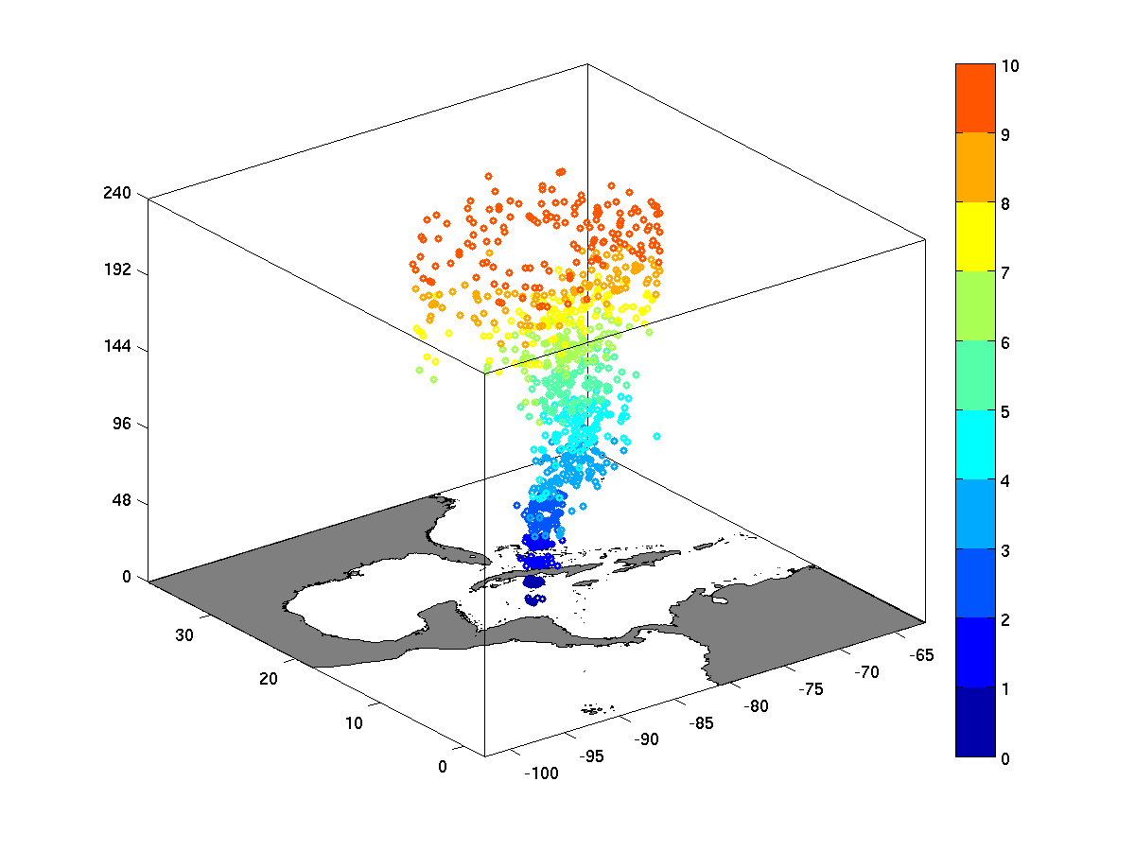
Quantifying Predictability of Environmental Parameters associated with Tropical Cyclogenesis
William Komaromi, Jonathan Labriola, Sharan Majumdar
RSMAS / University of Miami
A. ENSEMBLE-BASED METRICS
B. BIASES IN SHIPS PARAMETERS
PRE-GORDON
PRE-PATTY
PRE-ISAAC
PRE-RAFAEL

