Slide 1
Communication of Hurricane Storm Surge Threat: A Mixed-Method Analysis
Kathleen Sherman-Morris,
Karla B. Antonelli,
Carrick C. Williams,
Amanda Lea

Slide 2
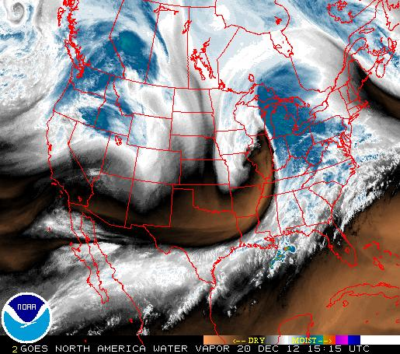
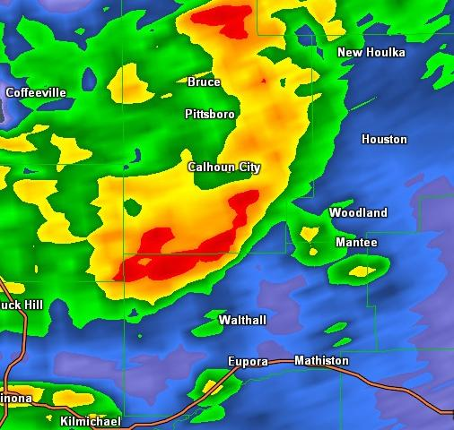
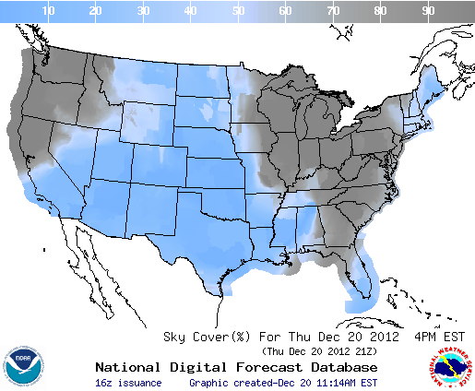
Purpose
Many graphic styles used to communicate weather information.
Little research has been done on understanding
Test effectiveness of storm surge graphics as a function of color palette and legend type.

Slide 3
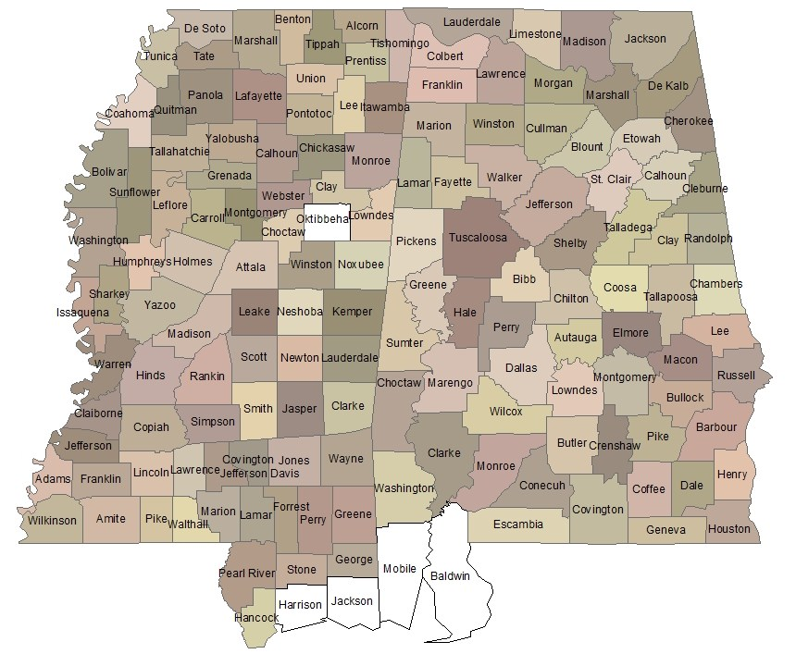
Two Methods
Eye tracking experiment
MSU Eye tracking lab
Participants included Student and General Public
Online survey of Mississippi and Alabama Gulf Coast residents
SurveyMonkey
Email-mailout from InfoUSA, supplemented by publicity from local TV meteorologist
Targeted Harrison and Jackson Counties in MS, Mobile and Baldwin Counties in Alabama.

Slide 4
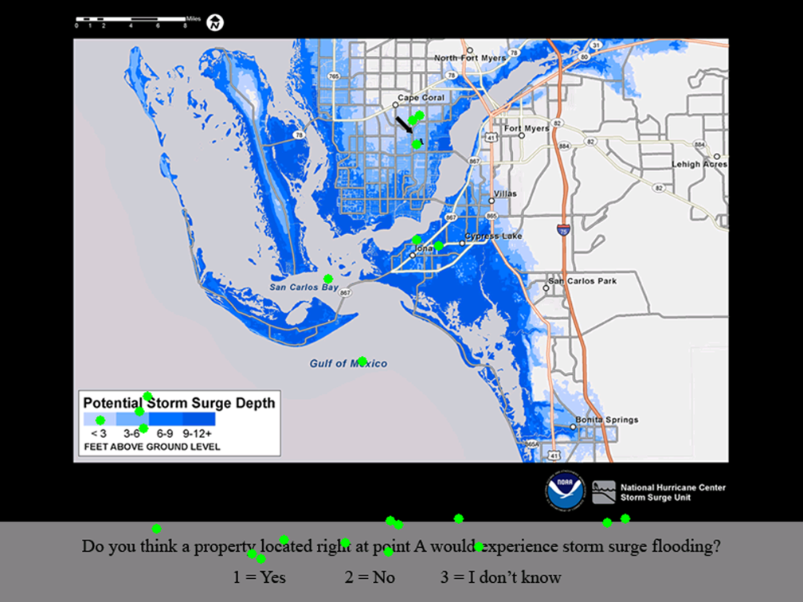
What does eye-tracking add?
A real-time, online measure of behavior
Eye movements can be seen as a stand-in for attention
Measures of where and how long looking at stimuli can measure interest, effort to process

Slide 5
Apparatus
ISCAN ETL-400
Uses a camera, infrared light shone into subject’s right eye
Camera records reflection from cornea (CR) and the lack of reflection from pupil
Calibrates these angles with computer display to determine where subject is looking
Chin rest used for head stabilization

Slide 6
Participants
40 participants
Recruited from MSU meteorology program, MSU general student body, and Starkville community
21 male, 19 female
Aged 19 to 55 years

Slide 7
Eye Tracking Procedure
Within subjects design with 5 levels
3 color palettes
2 legends (feet and text)
Order and location were varied for familiarity effects
8 questions for each image (4 accuracy, 2 behavioral, 1 risk perception rating and 1 helpfulness rating)

Slide 8
Questions
Question 1 | Which color do you believe is associated with the highest and worst storm surge?
Question 2 | In which location is the storm surge forecast to be higher?
Question 3 | What is the storm surge at point A forecast to be?
Question 4 | Do you think a property located right at point A would experience storm surge flooding?
Question 5 | If you lived in a single level house or on the ground level of an apartment building at point A, would you take any precautions to prevent damage to your home or belongings?
Question 6 | If you lived in a single level house or on the ground level of an apartment building at point B, would you take any precautions to prevent damage to your home or belongings?
Question 7 | On a scale from 1 to 8, where 1 is not bad at all and 8 is very bad, how would you rate this hurricane based on its storm surge potential?
Question 8 | On a scale from 1 to 8, where 1 is not helpful at all and 8 is very helpful, how helpful do you think this image is in your ability to judge the storm surge risk associated with this hurricane?

Slide 9
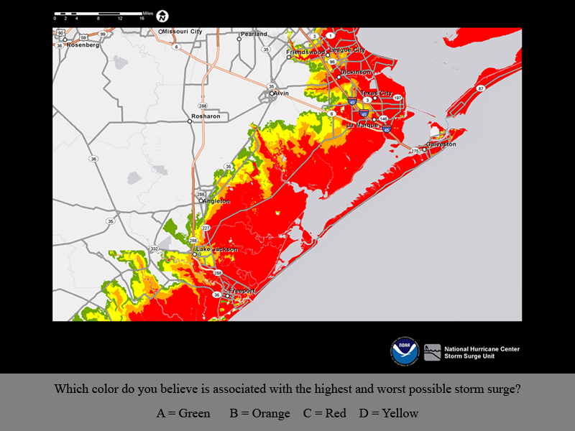
Image Conditions--Green/Red
** No legend on 1st image

Slide 10
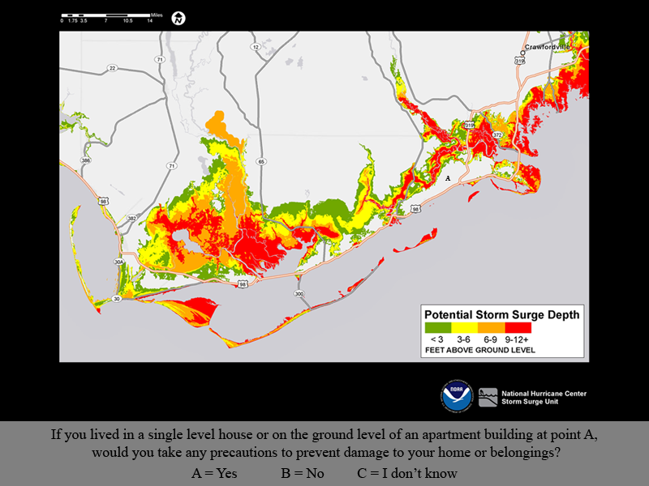
Green/Red Values (Feet)

Slide 11
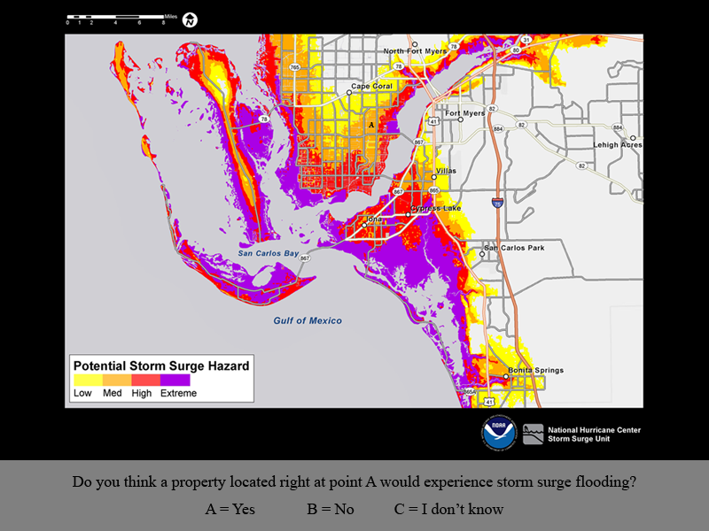
Yellow/Purple Text

Slide 12
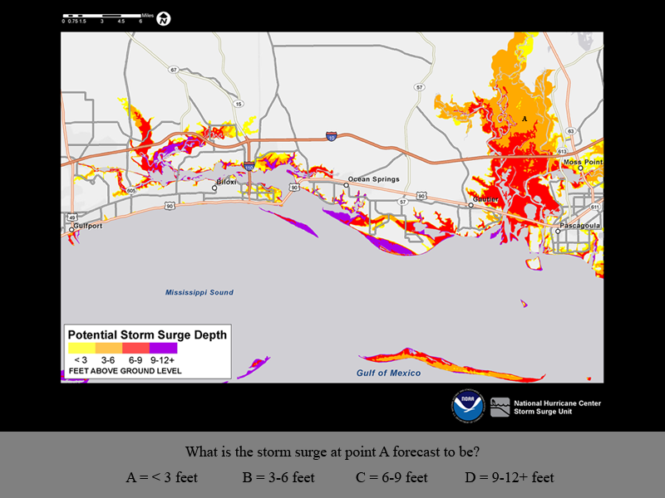
Yellow/Purple Values (Feet)

Slide 13
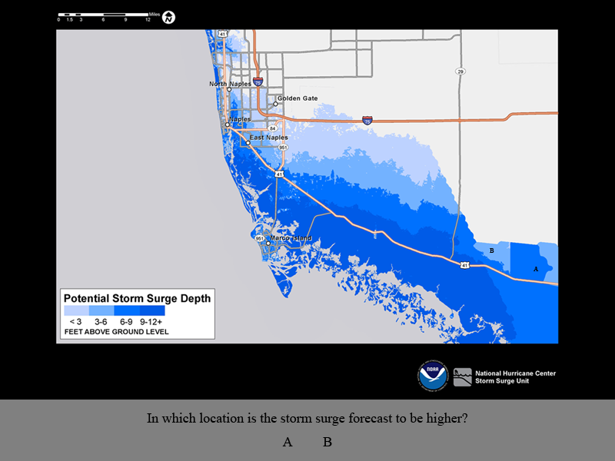
Blue Values (Feet)

Slide 14
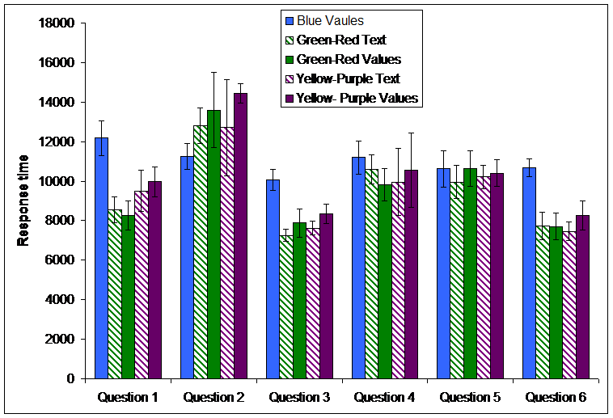
Notes:
Q2 compared two points directly.

Slide 15
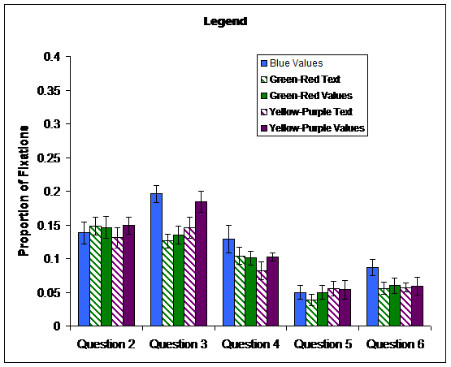

Slide 18
Which does the BEST job of informing the public about their storm surge risk?
 | Legend Type |  |  | Color Palette
 | Values | Text | Blue | G/R | Y/P
Experts | 7 | 2 | 2 | 5 | 2
Community | 9 | 11 | 2 | 14 | 3
Undergraduates | 5 | 6 | 1 | 7 | 3
Total | 21 | 19 | 5 | 26 | 8

Slide 19
Eye Tracking Results
Blue had longest response time
Text references had somewhat shorter response times than feet
Green/red produced most accurate* results, but accuracy was high for all palettes
People thought the green/red palette was the best, but did not prefer one legend type over the other
* Not significant in most cases

Slide 20
Online Survey, briefly
129 responses from Alabama counties
Average age 55 (range 19-84)
40% women, 43% men, 7% no response
76% White
78% homeowners

Slide 21
Scenarios
Same color palettes/legends
One stronger storm, one weaker storm
8 risk perception questions, 1 accuracy question, 1 intended behavior, 1 perceived helpfulness

Slide 22
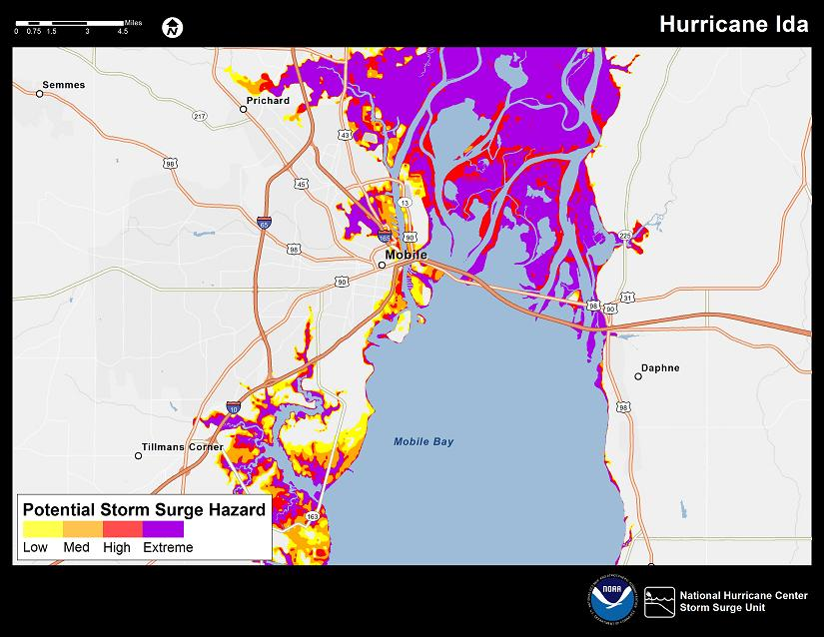
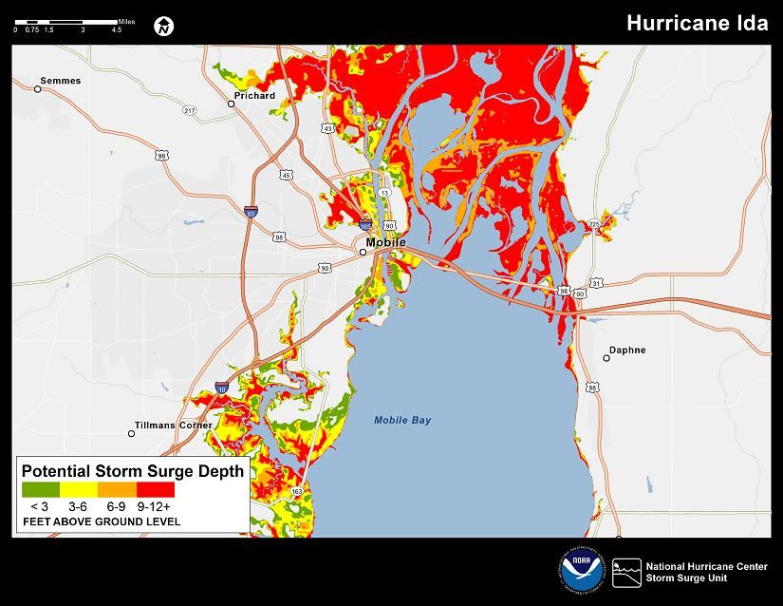
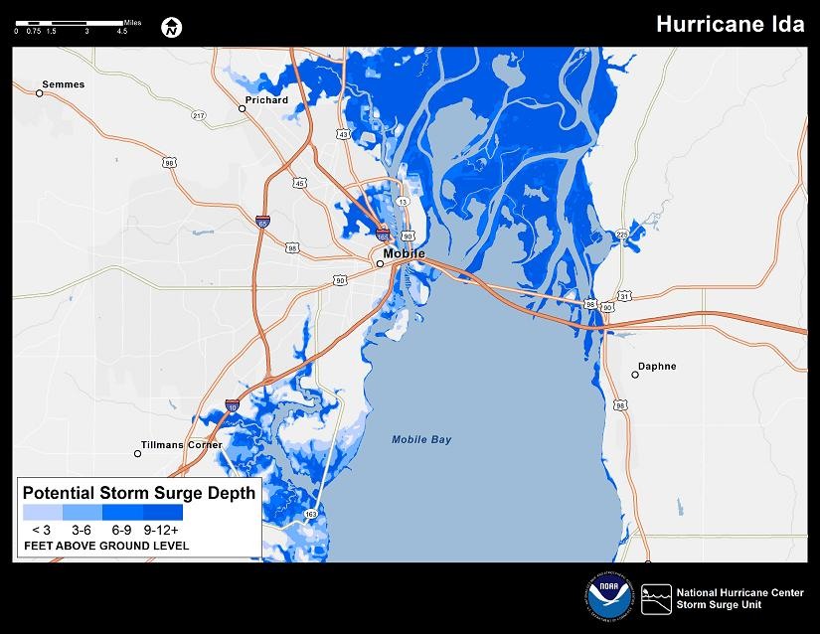
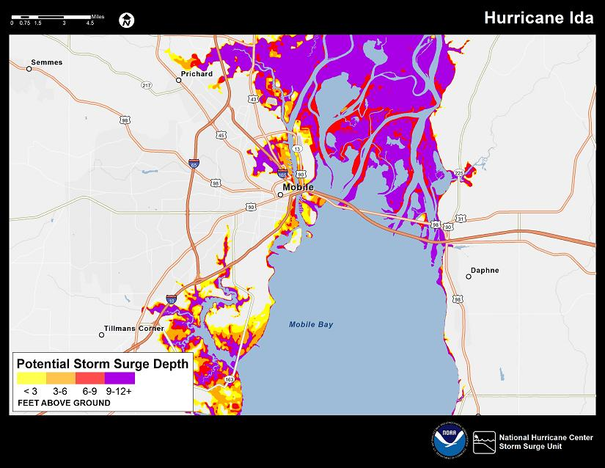
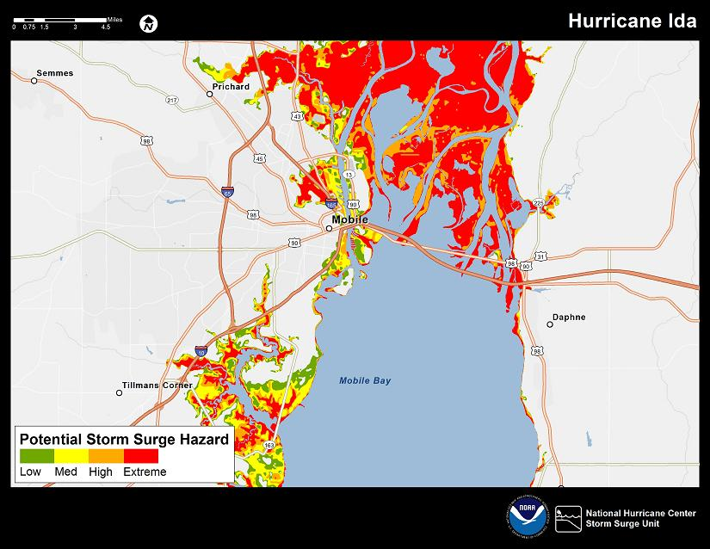

Slide 23
Weaker storm results
Notes:
Can’t combine all risk perception questions because some of them were purposefully switched (e.g. point A on Irma is less than Ida)

Slide 24
Accuracy by palette and legend
 | Text | Values (Feet)
Green/Red | 88.4% | 85.0%
Yellow/Purple | 83.6% | 66.7%
Blue |  | 73.5%

Slide 25
Online Survey Results
No significant differences in risk perception among palettes and legends
Legend values in feet led to marginally less accuracy than text
Green/Red more accurate than Blue combined with Yellow/Purple
Could this be a legend effect?
More responses are necessary for further evaluation

Slide 26
Acknowledgements
This project was funded by NOAA, through the Northern Gulf Institute. The authors also thank Ethan Gibney, for creating the storm surge images.

