Slide 1
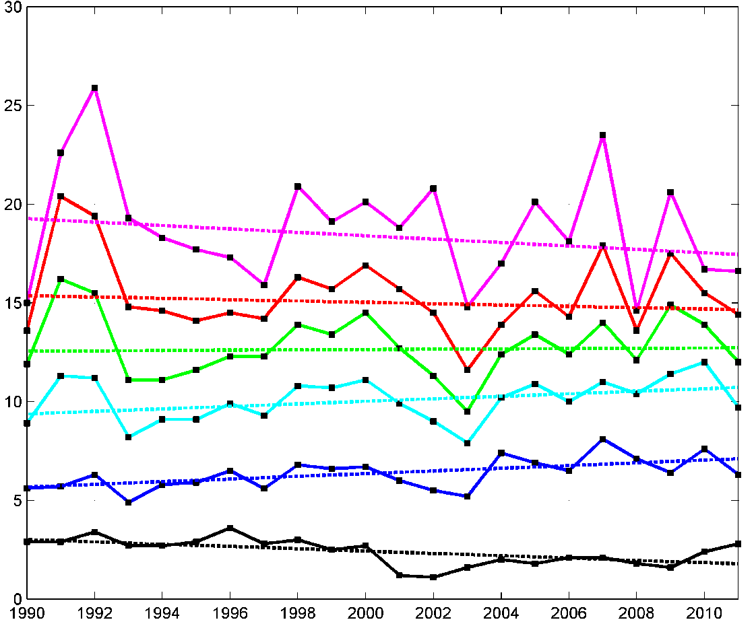
Are Atlantic basin tropical cyclone
intensity forecasts improving?
Jonathan R. Moskaitis
67th IHC / 2013 Tropical Cyclone
Research Forum
Naval Research Laboratory
Monterey, CA
7 March 2013
OFCL yearly Atlantic intensity MAE, with weighted trends
0 h 12 h 24 h 36 h 48 h 72 h
% change
(1990-2011)
Statistically
Significant?
-9%
Mean absolute error (kt)
-4%
+1%
+14%
*
+25%
**
-41%
**
Year

Slide 2
Introduction
In order to understand the OFCL intensity MAE trends, it is necessary
to consider how both the statistics of the forecasts and the statistics
of the best track analyses have changed over the years.
OFCL yearly Atlantic intensity MAE, with weighted trends
0 h 12 h 24 h 36 h 48 h 72 h
% change
(1990-2011)
Statistically
Significant?
-9%
Mean absolute error (kt)
-4%
+1%
+14%
*
+25%
**
-41%
**
Year

Slide 3
Objective
Investigate best track intensities over the 1990-2011 period in order to discern if
significant changes to the statistics of the verifying analyses have taken place
(2) Evaluate the implications of the evolution of the best track intensity statistics
over the years for the interpretation of the OFCL intensity MAE trends
Data: ATCF a-decks and b-decks
Intensity change:
Irene (2011) best track intensity
Best track
intensity
change
ΔI = 30 kt
Δt = 96 h
Best track intensity
change time interval

Slide 4
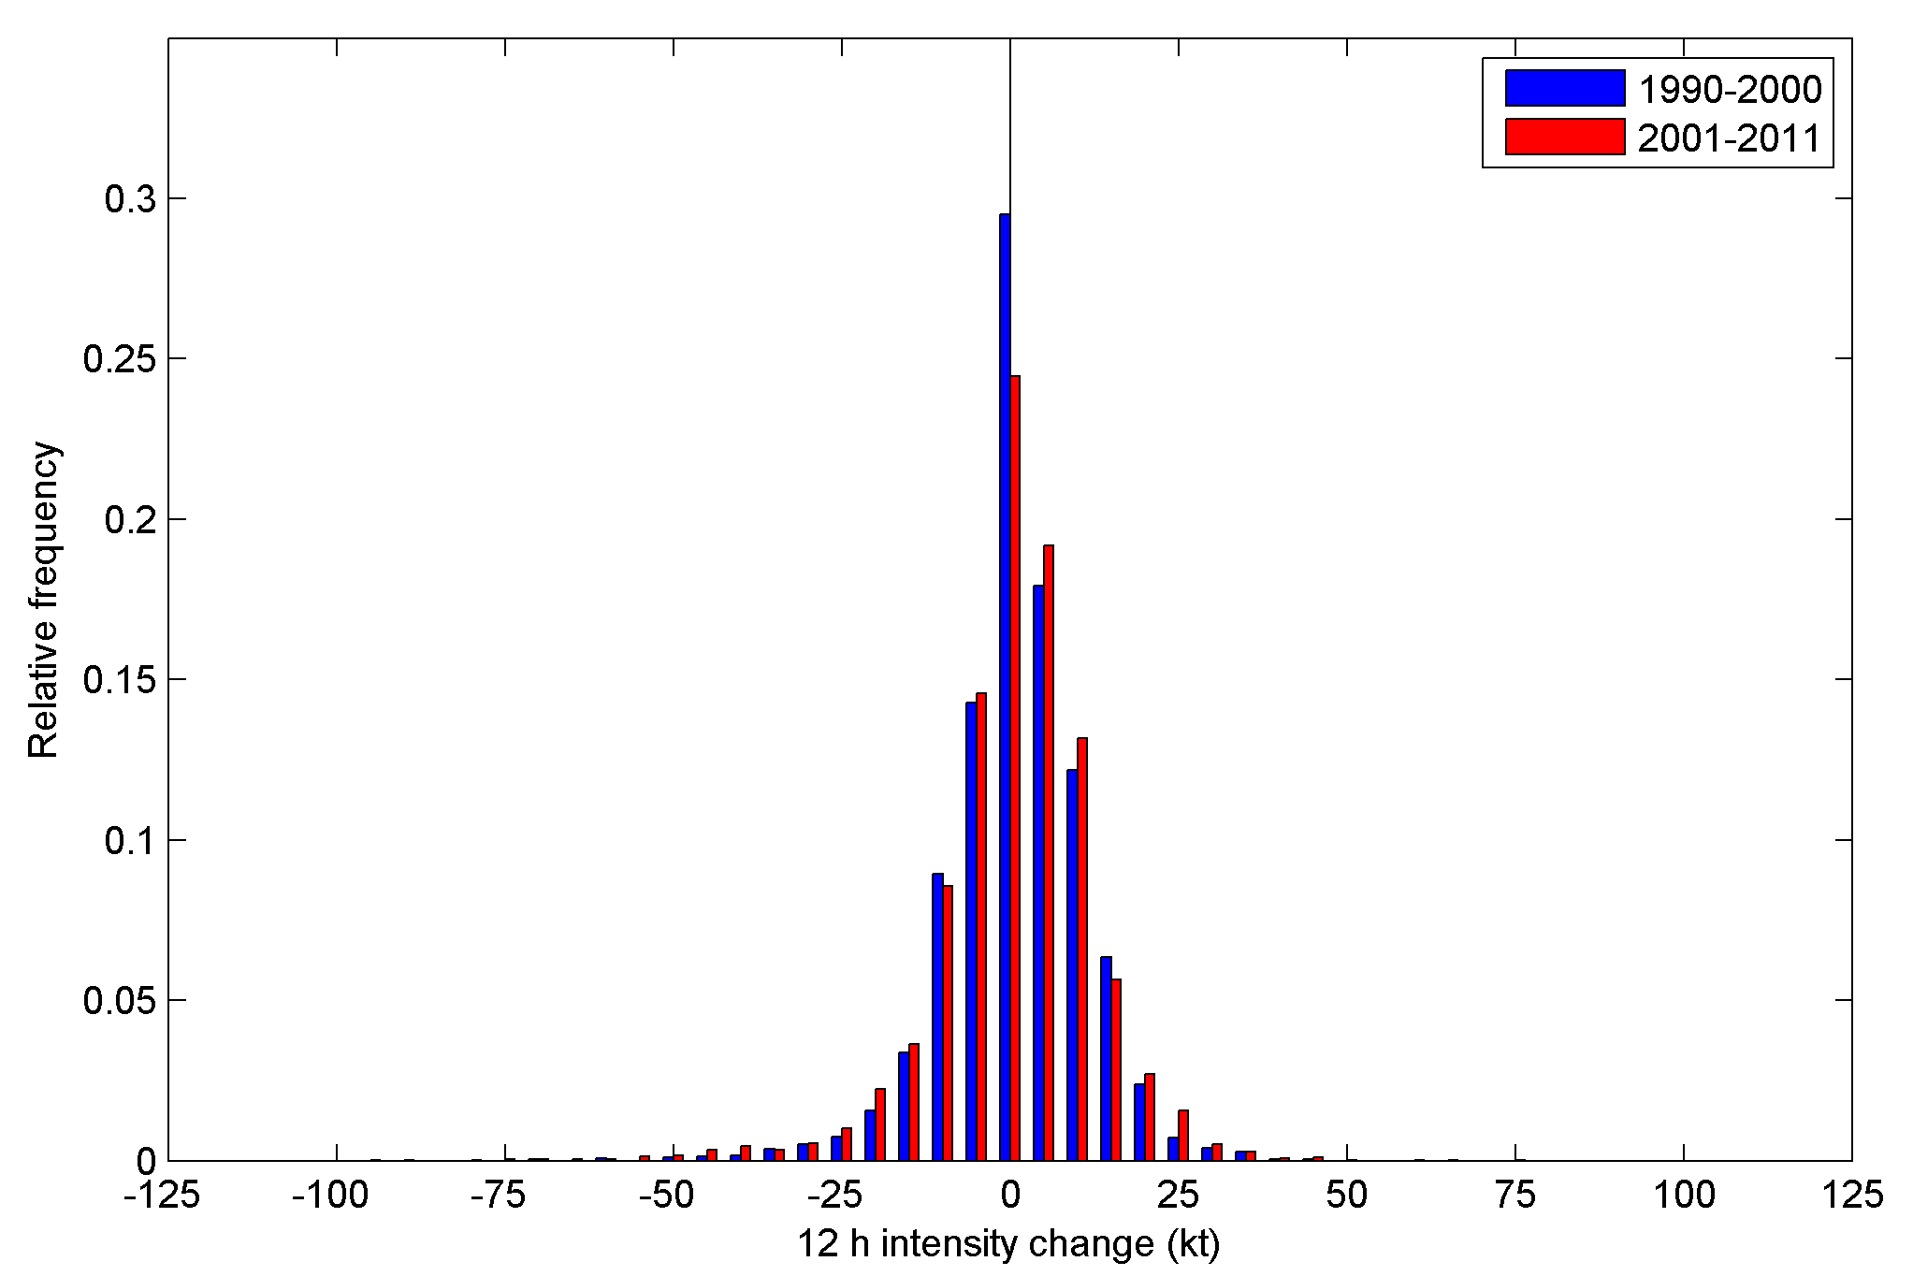
Best track intensity change:
1990-2000 vs. 2001-2011
ΔI relative frequency distribution, Δt = 12 h
Lower relative frequency of small-magnitude intensity changes for 2001-2011 than for 1990-2000
Higher relative frequency of large-magnitude intensity changes for 2001-2011 than for 1990-2000

Slide 5
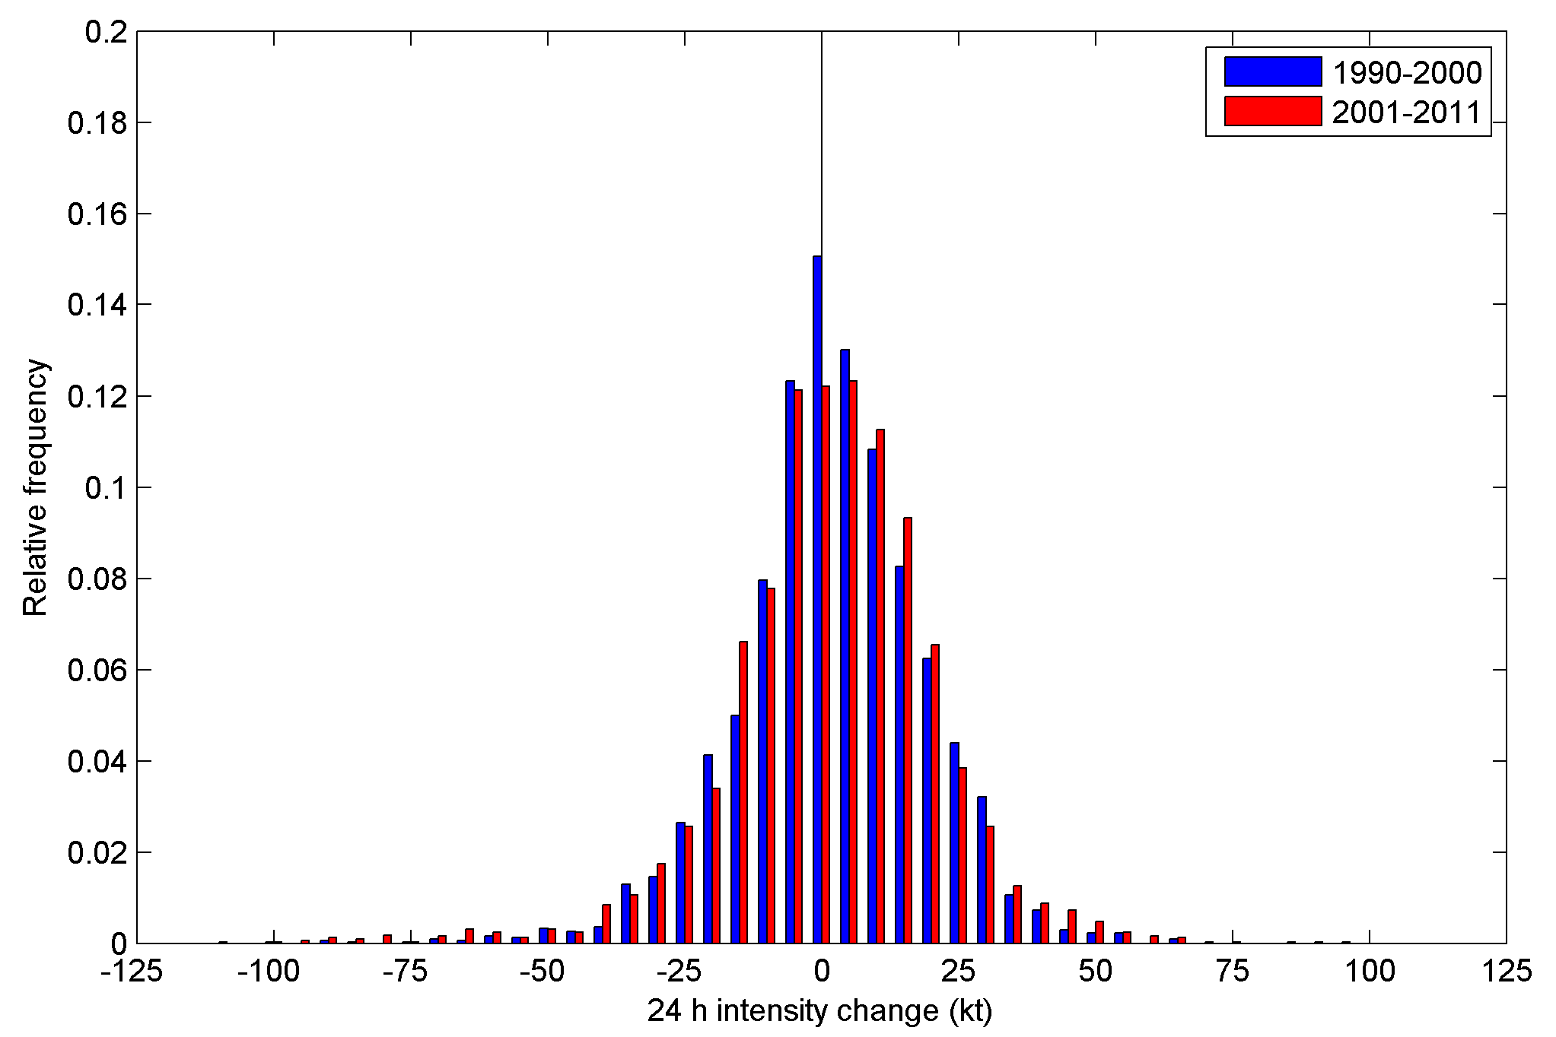
Best track intensity change:
1990-2000 vs. 2001-2011
ΔI relative frequency distribution, Δt = 24 h
Lower relative frequency of small-magnitude intensity changes for 2001-2011 than for 1990-2000
Higher relative frequency of large-magnitude intensity changes for 2001-2011 than for 1990-2000

Slide 6
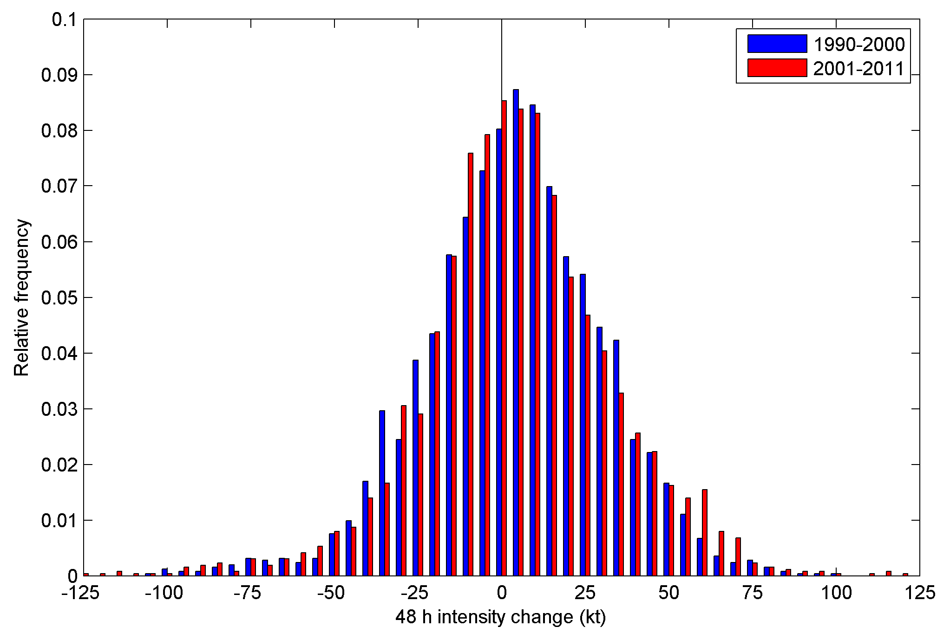
Best track intensity change:
1990-2000 vs. 2001-2011
ΔI relative frequency distribution, Δt = 48 h
Lower relative frequency of small-magnitude intensity changes for 2001-2011 than for 1990-2000
Higher relative frequency of large-magnitude intensity changes for 2001-2011 than for 1990-2000

Slide 7
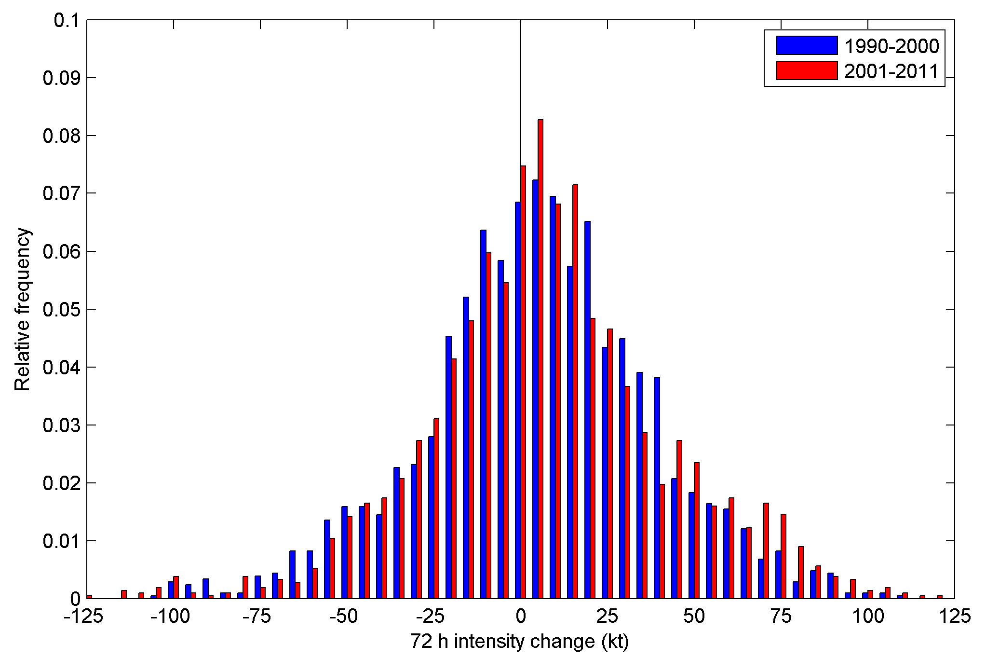
Best track intensity change:
1990-2000 vs. 2001-2011
ΔI relative frequency distribution, Δt = 72 h
Lower relative frequency of small-magnitude intensity changes for 2001-2011 than for 1990-2000
Higher relative frequency of large-magnitude intensity changes for 2001-2011 than for 1990-2000

Slide 8
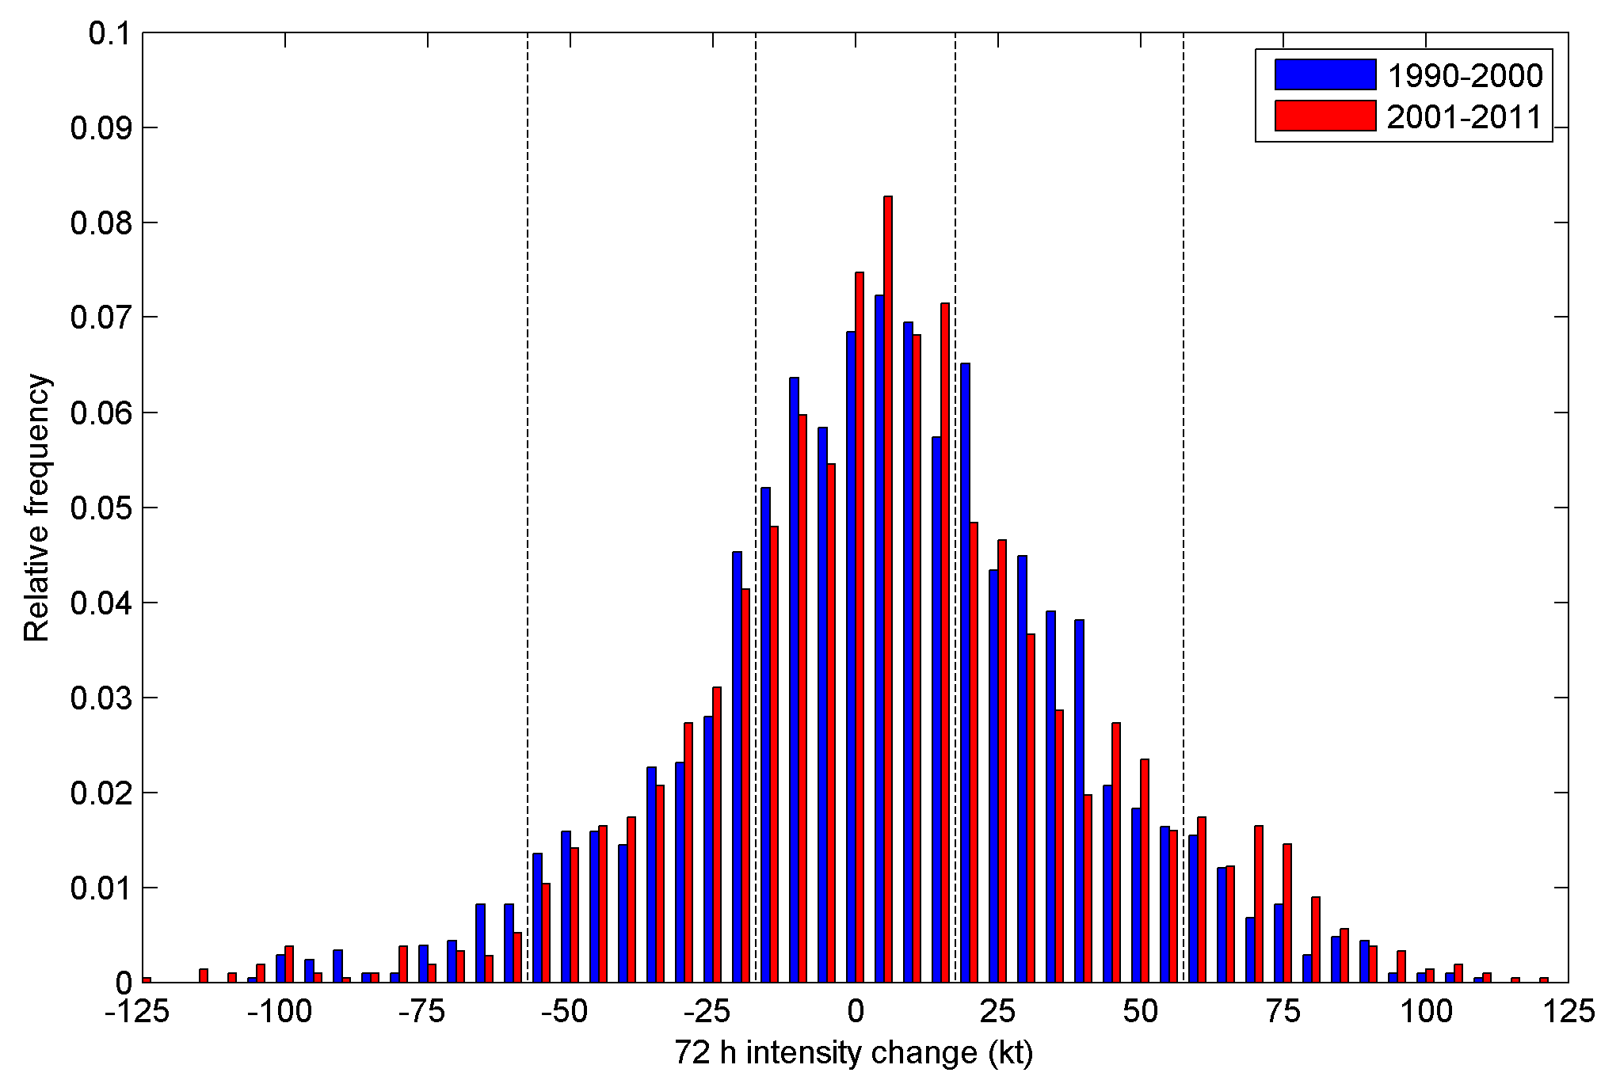
Best track intensity change:
1990-2000 vs. 2001-2011
ΔI relative frequency distribution, Δt = 72 h
-h₂
-h₁
h₁
h₂
RF_{S} = Relative frequency of small-magnitude intensity change, | ΔI | ≤ h₁
RF_{L} = Relative frequency of large-magnitude intensity change, | ΔI | ≥ h₂

Slide 9
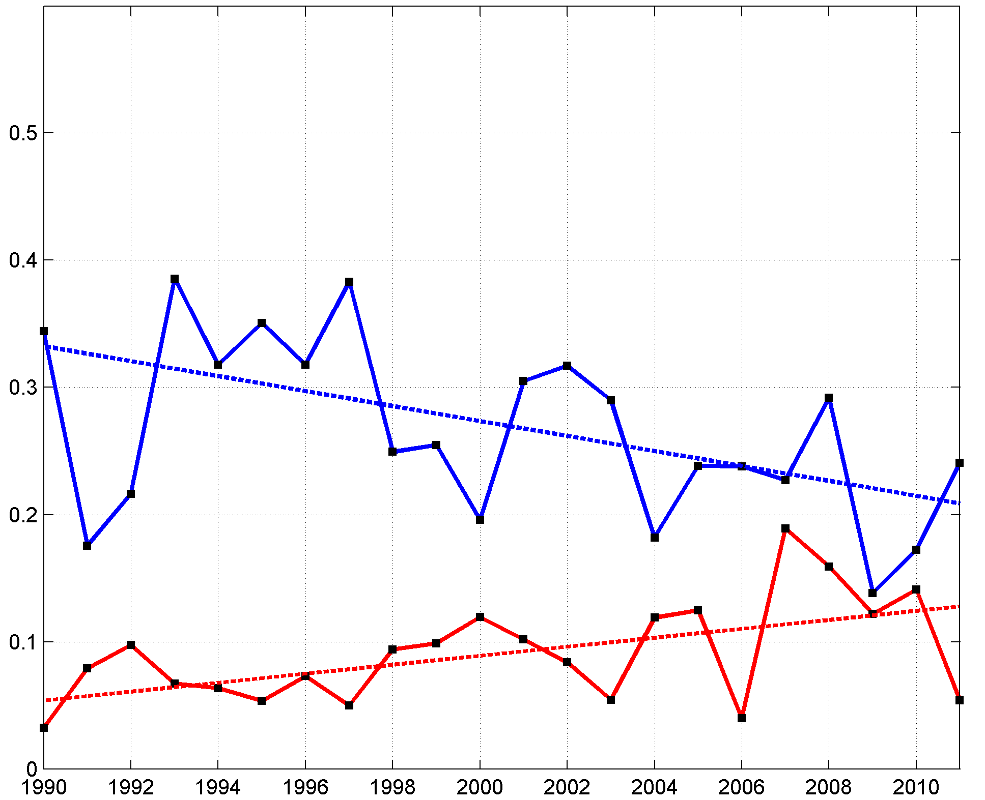
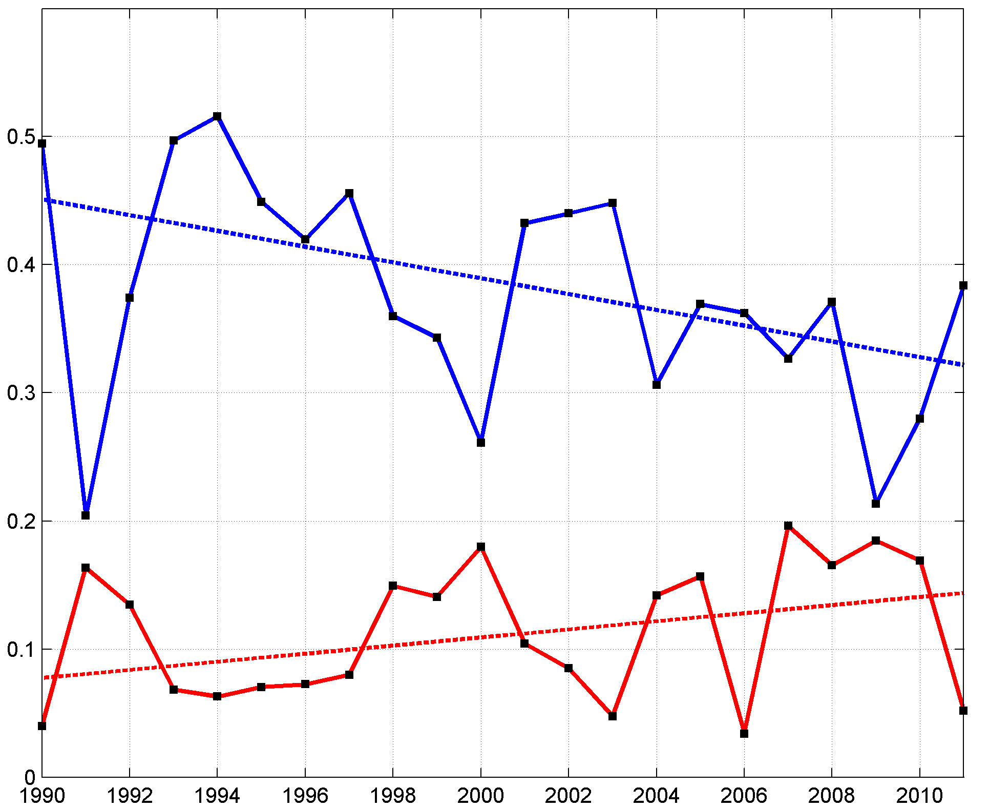
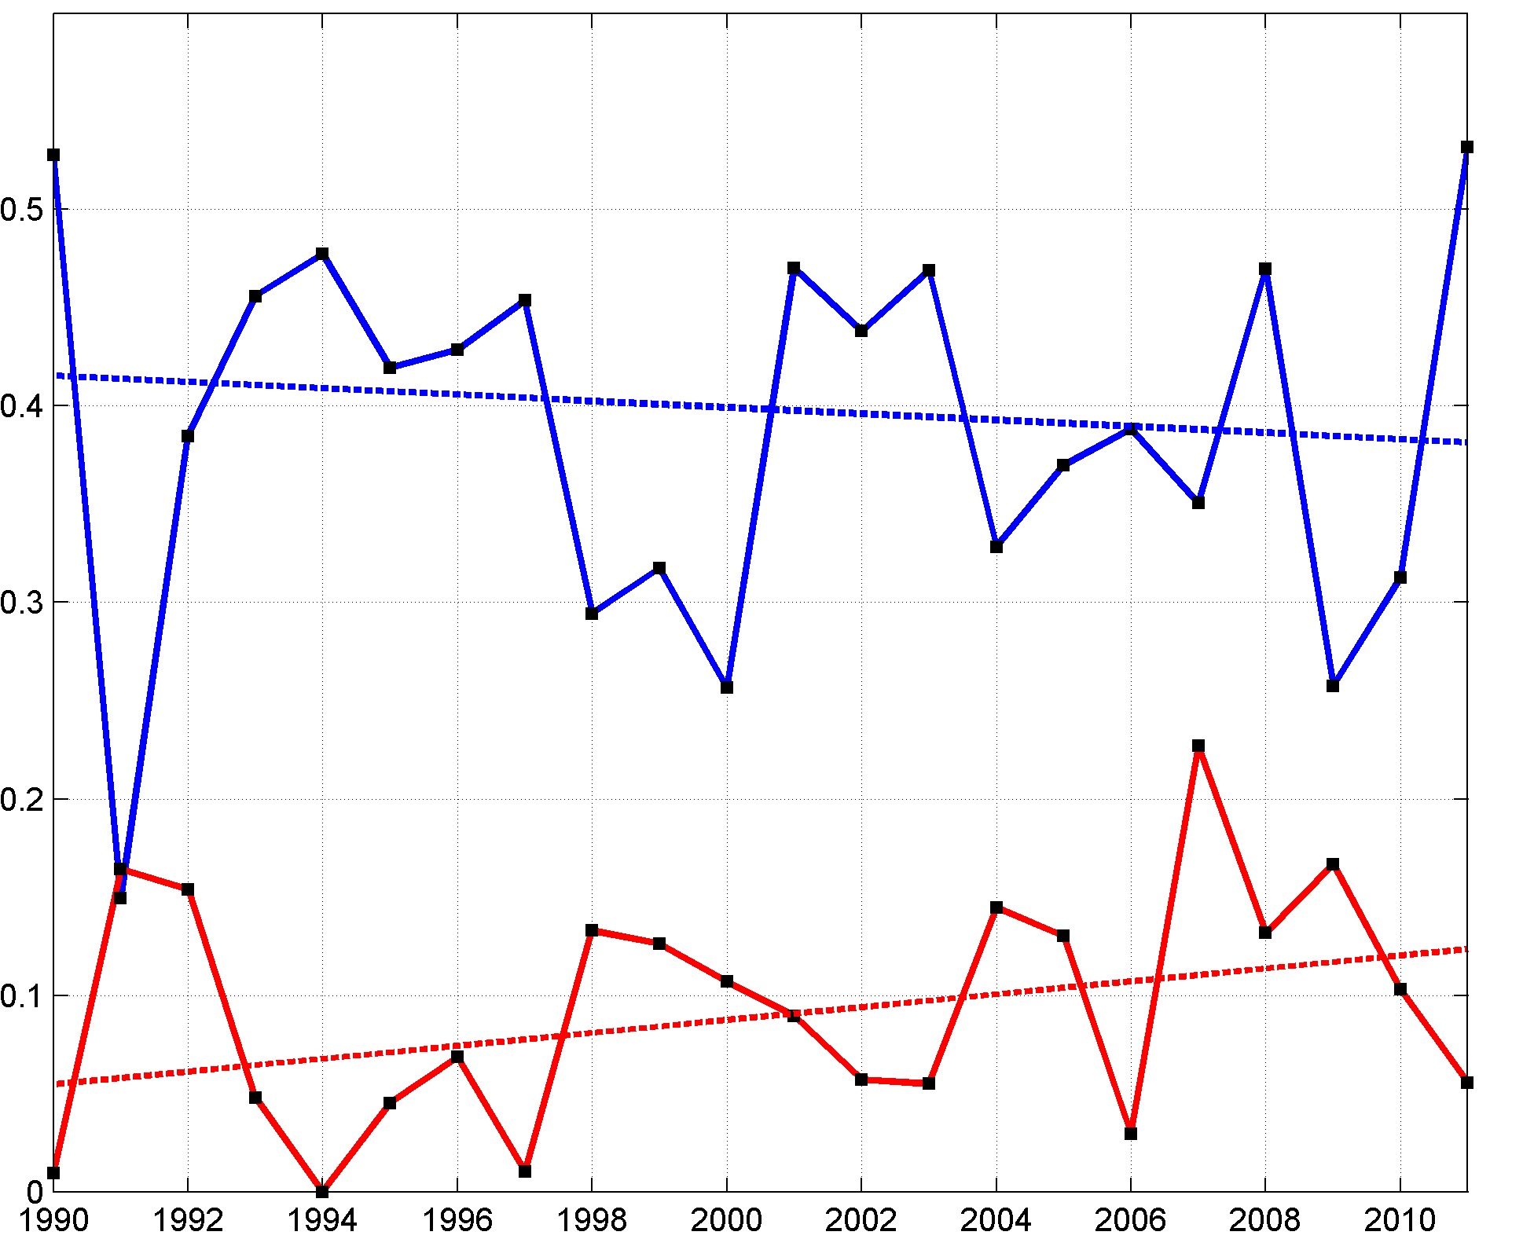
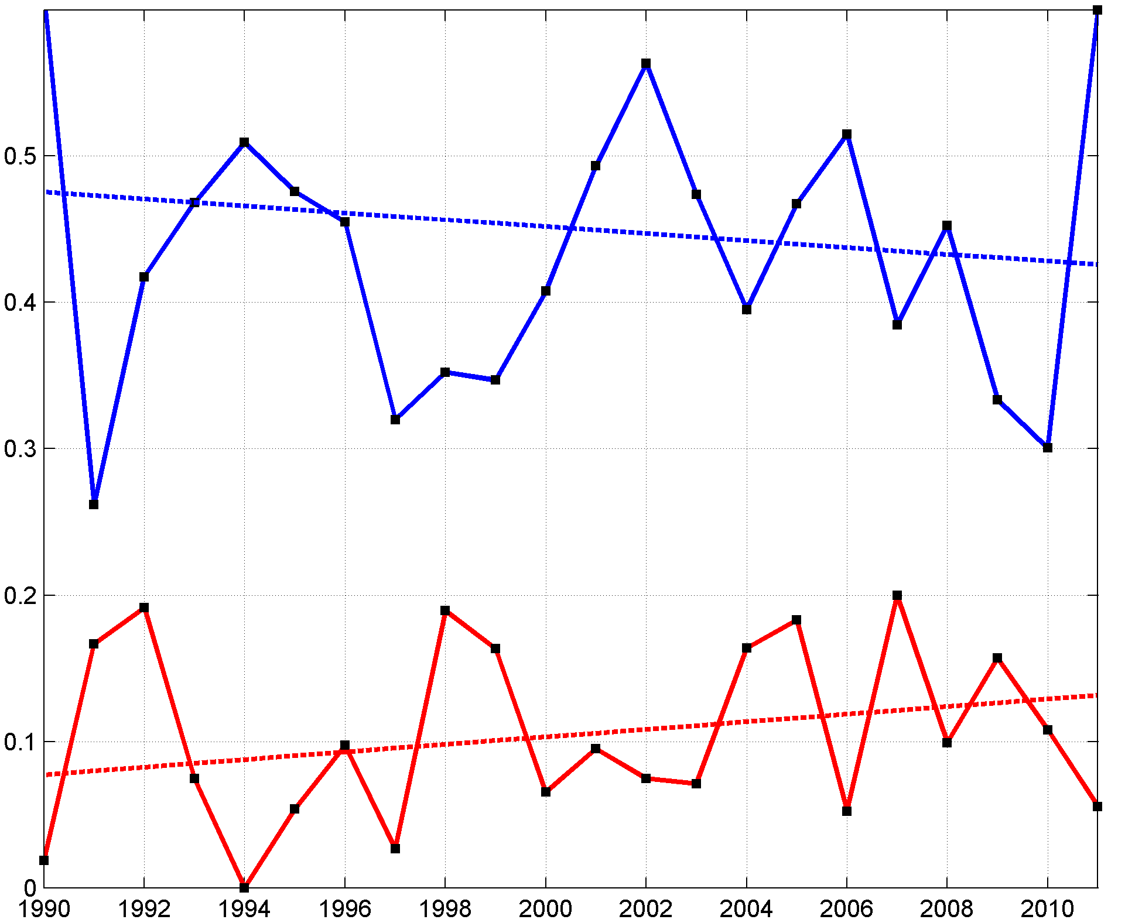
Best track intensity change:
Trends in yearly samples
Relative frequency of small-magnitude
intensity change (RF_{S})
Relative frequency of large-magnitude
intensity change (RF_{L})
Δt = 12 h
Δt = 24 h
Relative frequency
% change
(1990-2011)
Δt | RF_{S} | RF_{L}
6 h | -23** | 90*
12 h | -37** | 138*
24 h | -29** | 86*
36 h | -17 | 117*
48 h | -8 | 126*
72 h | -10 | 70
96 h | -18 | 78
120 h | -10 | 93
Δt = 48 h
Δt = 72 h
Relative frequency
Year
Year
For all Δt, the trend indicates decreasing relative frequency of small-magnitude intensity changes and increasing relative frequency of large-magnitude intensity changes

Slide 10
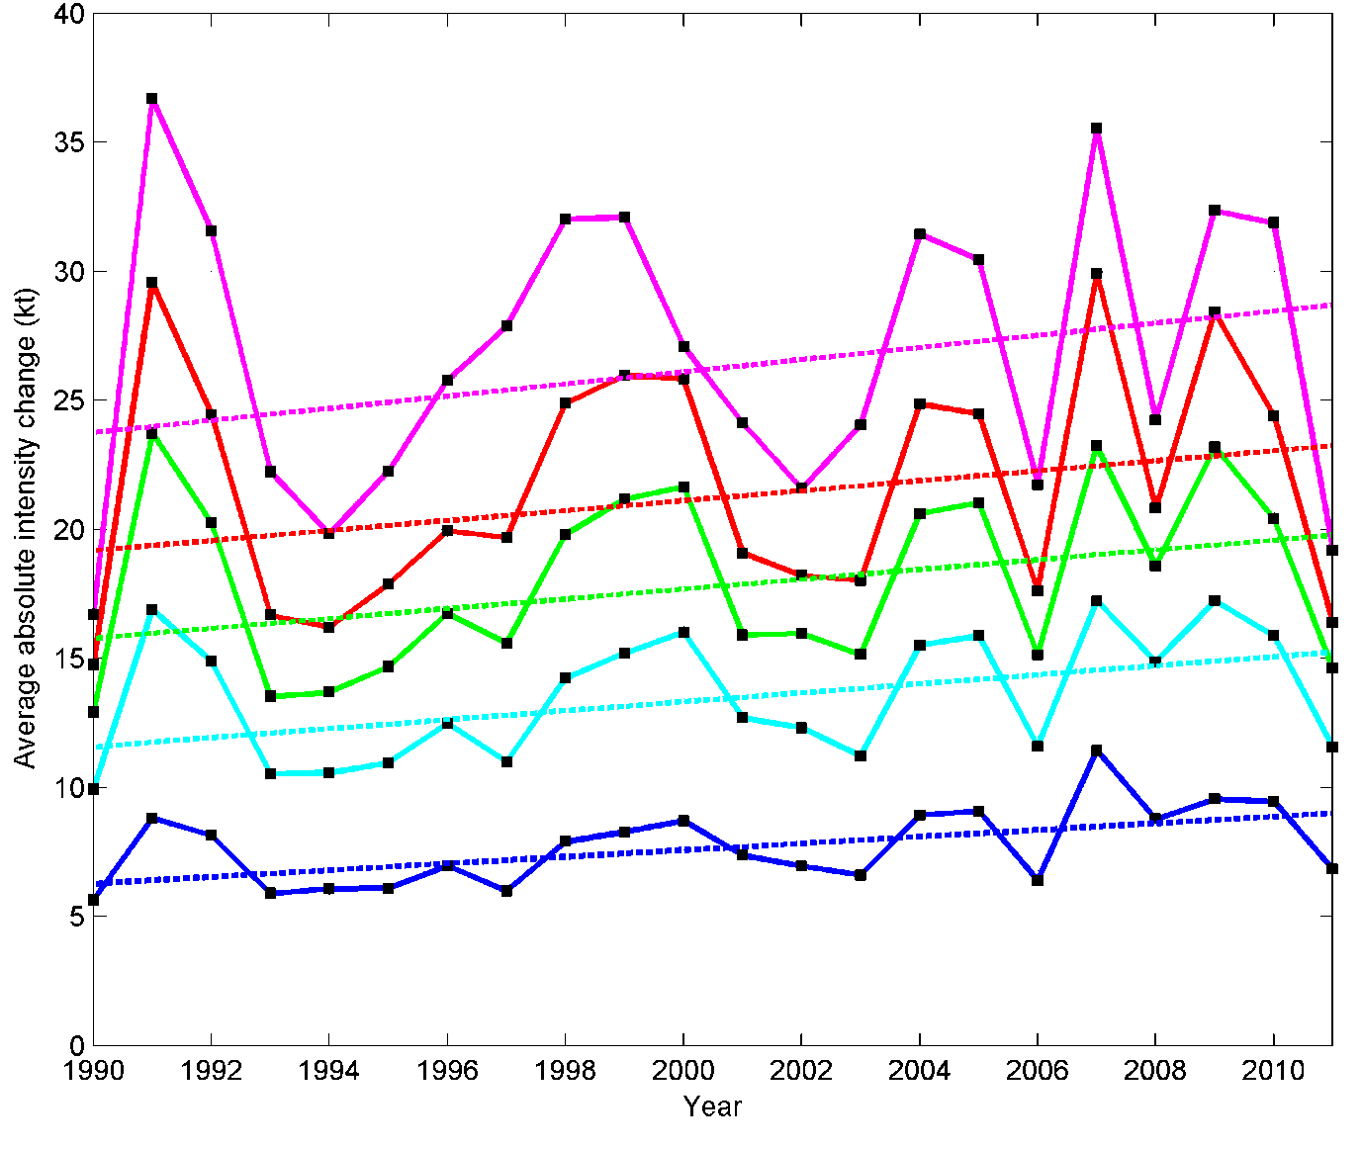
Best track intensity change:
Trends in yearly samples
Yearly AAIC with weighted trend, Δt = 12, 24, 36, 48, 72 h
AAIC = Average absolute intensity change
12 h 24 h 36 h 48 h 72 h
% change
(1990-2011)
Δt | AAIC
6 h | 46**
12 h | 44**
24 h | 32*
36 h | 25*
48 h | 21
72 h | 21
96 h | 23
120 h | 19
+21%
+21%
+25%
*
+32%
*
+44%
**
% change
(1990-2011)
Statistically
Significant?
For all Δt, there is an increasing trend in AAIC

Slide 11
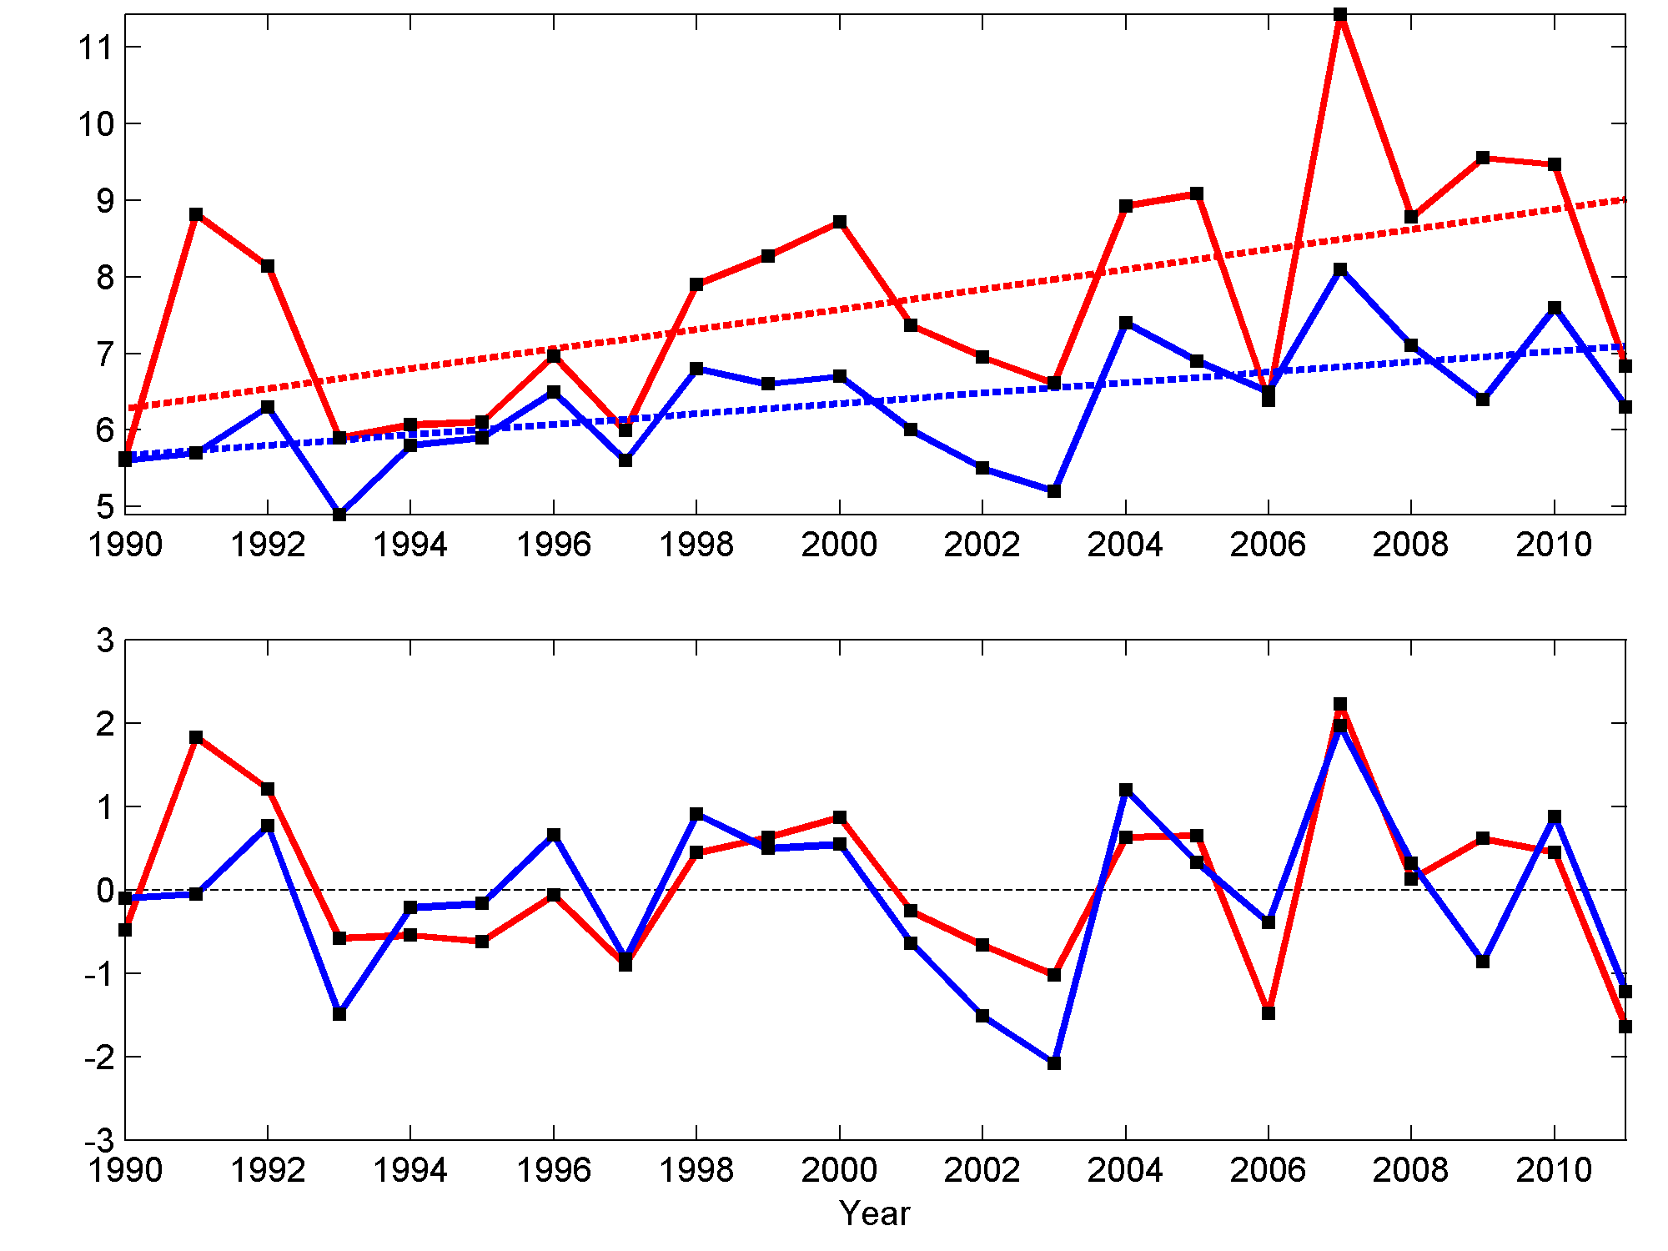
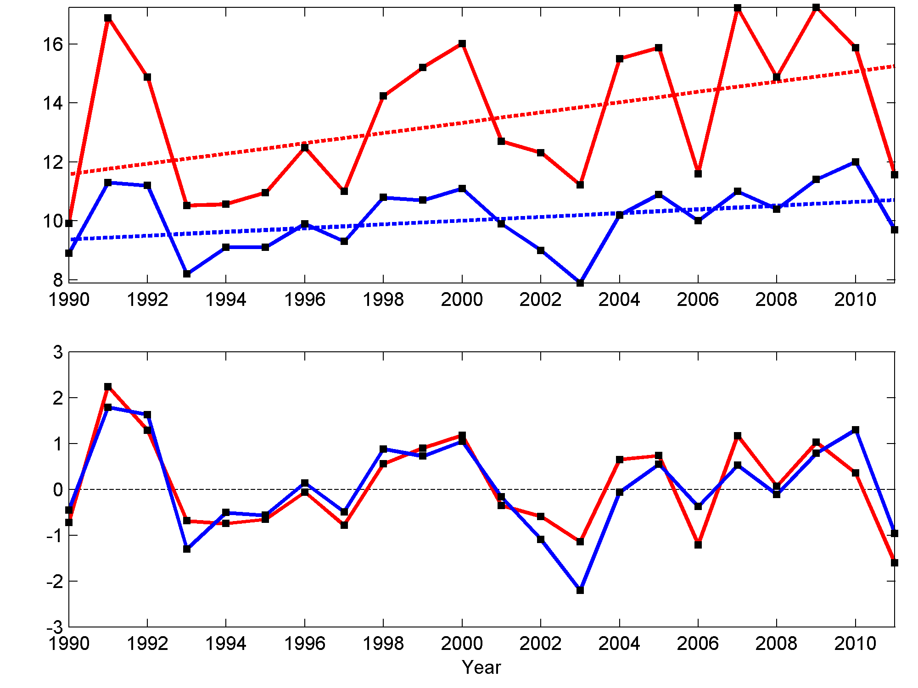
Best track intensity change:
Relationship with OFCL intensity MAE
AAIC can be interpreted as a measure of forecast difficulty
AAIC = MAE of persistence intensity forecasts
How does AAIC compare to OFCL intensity MAE?
AAIC for Δt = 12 h and OFCL MAE for lead time = 12 h
AAIC for Δt = 24 h and OFCL MAE for lead time = 24 h
+44%
+32%
Yearly value and
weighted trend (kt)
+25%
+14%
Standardized
residuals
ρ = 0.72
ρ = 0.87

Slide 12
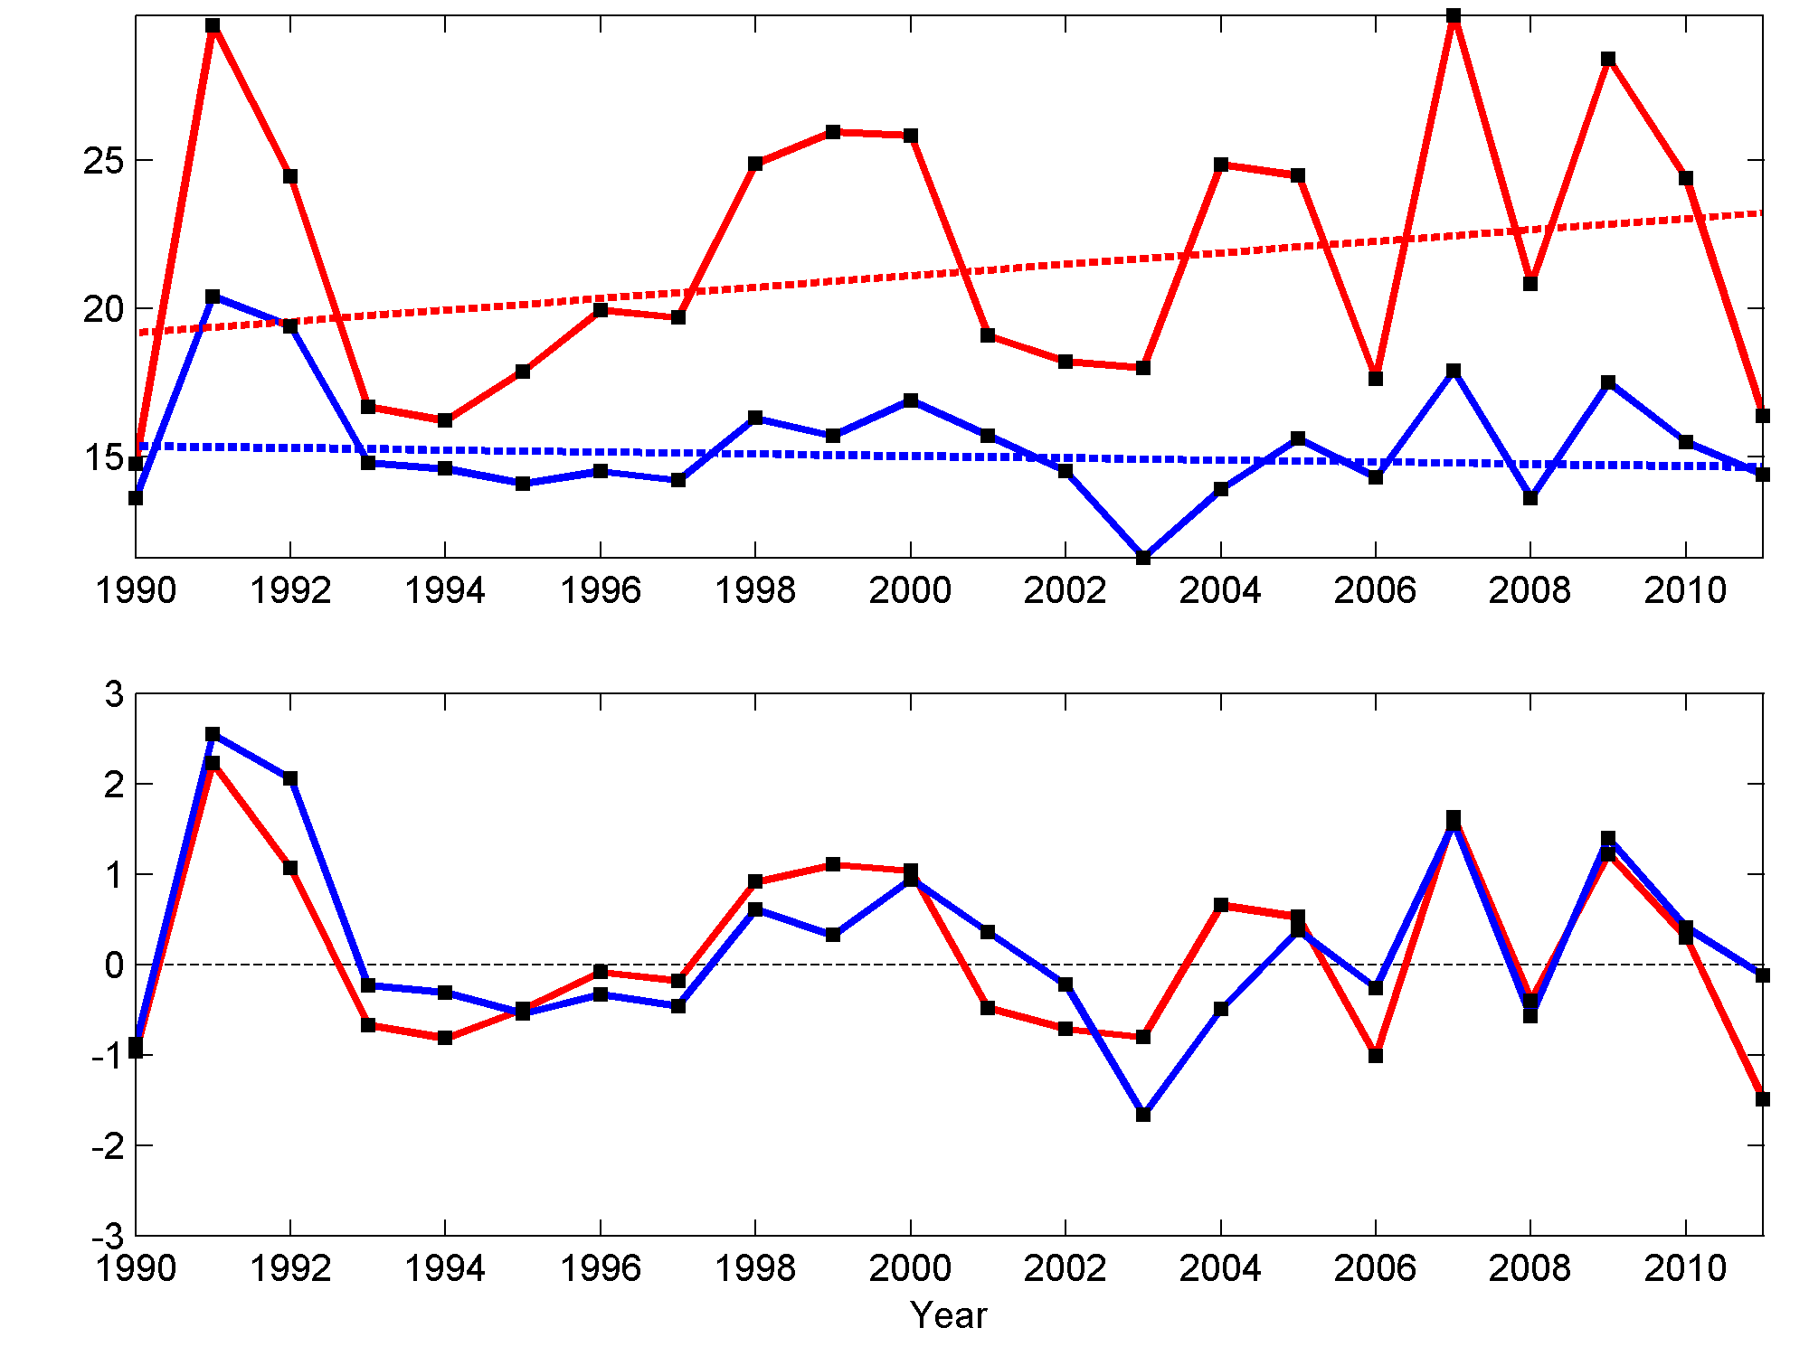
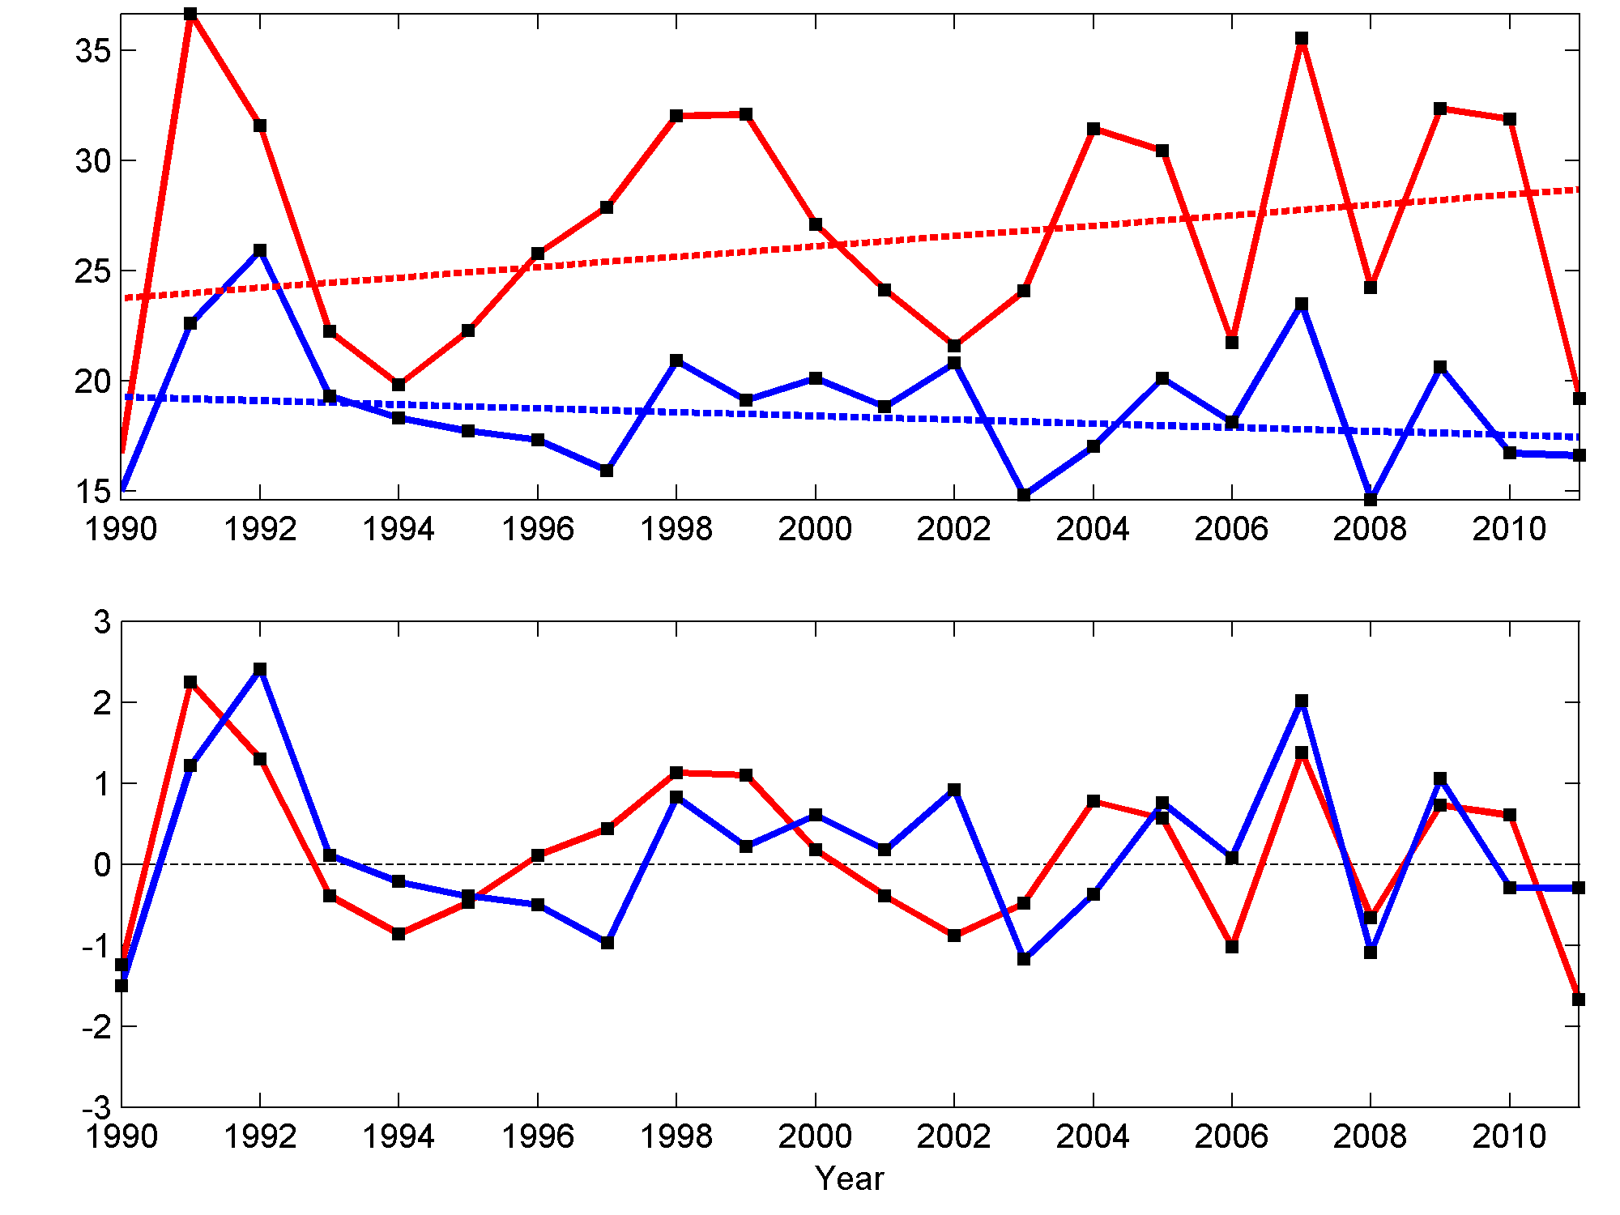
Best track intensity change:
Relationship with OFCL intensity MAE
AAIC can be interpreted as a measure of forecast difficulty
AAIC = MAE of persistence intensity forecasts
How does AAIC compare to OFCL intensity MAE?
AAIC for Δt = 12 h and OFCL MAE for lead time = 48 h
AAIC for Δt = 24 h and OFCL MAE for lead time = 72 h
+21%
+21%
Yearly value and
weighted trend (kt)
-9%
-4%
Standardized
residuals
ρ = 0.81
ρ = 0.61
On the decadal time scale, AAIC (forecast difficulty) and OFCL MAE have
different trends. The slope of AAIC trend > slope of OFCL MAE trend.
Year-to-year departures from the trend lines are highly correlated,
suggesting the AAIC departure controls the OFCL MAE departure.

Slide 13
Best track intensity change:
Relationship with OFCL intensity MAE
Normalized MAE = OFCL MAE / AAIC
Accounts for forecast difficulty, as measured by AAIC
48 h
-13%
*
-21%
*
12 h
72 h
-14%
*
-23%
*
24 h
For all lead times, there is a statistically significant decreasing trend in normalized MAE
-20%
*
36 h

Slide 14
Summary and conclusions
Analysis of Atlantic best track intensities during the 1990-2011 period shows:
Decreasing trend in relative frequency of small-magnitude intensity changes (RF_{S})
Increasing trend in relative frequency of large-magnitude intensity changes (RF_{L})
Increasing trend in average absolute intensity change (AAIC)
Trends in OFCL intensity MAE should be interpreted in context of the AAIC, to account for evolution in the statistics of the best track intensities on the decadal time scale
AAIC can be interpreted as a measure of forecast difficulty
After normalizing by AAIC, OFCL intensity MAE shows statistically significant
decreasing trends at 12, 24, 36, 48, and 72 h
Question for future research: Why are there trends in AAIC, RF_{S}, and RF_{L}?

