Slide 1
Impact of New Predictors on
Corrected Consensus TC Track Forecast Error
James S. Goerss
Innovative Employee Solutions / NRL Monterey
March 7, 2013

Slide 2
Review of the current
Corrected Consensus (TVCC)
Just as for GPCE, predictors of east-west and north- south forecast error of the consensus models must be quantities that are available prior to the time when official forecasts must be issued.
Consensus model spread is defined to be the average distance of the member forecasts from the consensus forecast.
The GPCE predictors are used and are consensus model spread; initial and forecast TC intensity; initial TC location and forecast displacement of TC location (latitude and longitude); TC speed of motion; and number of members available (for TVCN).

Slide 3
Review of the current
Corrected Consensus (TVCC)
Using stepwise linear regression and the aforementioned pool of predictors for previous seasons, regression models are found to predict east-west and north-south TC track forecast error for each combination of forecast length, consensus model, and basin.
The means of the consensus east-west and north-south forecast errors for all forecast lengths for previous seasons are found for all to be used as possible bias correctors.
For the Atlantic and eastern North Pacific basins, combinations of the statistical and bias correctors, depending on forecast length, are used to create the corrected consensus (TVCC) forecasts.

Slide 4
2011 TC Track Forecast Errors (nm)
Atlantic
Eastern North Pacific
284
213
168
137
114
197
153
114
81
51
Number of Forecasts

Slide 5
New Predictors for
Corrected Consensus
Using the GPCE predictors, we have found that the corrected consensus (TVCC) forecast performance is at best about the same as the consensus (TVCN) forecast performance and is often worse.
The proposed new predictors are the differences in latitude and longitude between the TVCN member forecasts and the TVCN forecast.
Using the new predictors, the same techniques were applied to estimate east-west and north-south correctors to be applied to the TVCN forecasts and create a new corrected consensus (CCON).

Slide 6
2008-2011 Atlantic
120-h TVCN Latitude Error
R = .498

Slide 7
2008-2011 Atlantic
120-h TVCN Latitude Error
R = .469

Slide 8
2008-2011 Atlantic
120-h TVCN Latitude Error
PE = 0.515 * ECLAT + 0.457 * AVLAT + 0.16 (R = .603)

Slide 9
2008-2011 Atlantic (Dependent Data)
TC Forecast Error (nm)
14%
9%
6%
9%
4%
1029
802
637
497
398
Number of Forecasts

Slide 10
Corrected Consensus vs.
Weighted Consensus
Because the new predictors are linear combinations of the TVCN member forecasts, the corrected consensus forecasts can be shown to be equivalent to weighted consensus forecasts.
Using the equations used to produce the east-west and north-south correctors, we can derive weights to be applied to the TVCN member forecasts of latitude and longitude and use them to created a weighted consensus.
Thus, using the new correctors, we have an objective way to determine appropriate weights, based on past performance, to apply to each TVCN member forecast to produce a weighted consensus forecast (CNWT) that is equivalent to the corrected consensus forecast (CCON).

Slide 11
2008-2011 Atlantic Weighted Consensus
Latitude Weights

Slide 12
2008-2011 Atlantic Weighted Consensus
Longitude Weights

Slide 13
2012 Atlantic (Independent Data)
TC Forecast Error (nm)
10%
6%
10%
11%
7%
367
287
229
187
149
Number of Forecasts

Slide 14
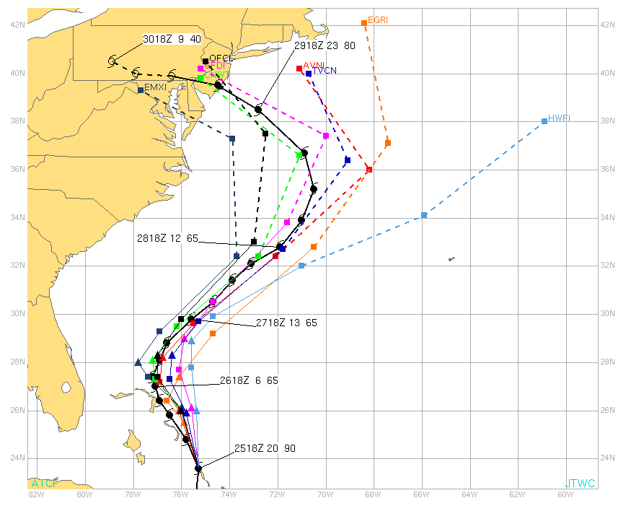
Hurricane Sandy Forecasts
18Z October 25, 2012

Slide 15
Summary
The TC track forecast performance of the corrected consensus (TVCC) derived using the GPCE predictors has been at best about the same and often worse than the forecast performance of the consensus (TVCN).
A new corrected consensus (CCON) has been derived applying the GPCE methodology to new predictors, the differences between the TVCN member latitude and longitude forecasts and the TVCN latitude and longitude forecasts. Using the 2008-2011 Atlantic seasons, the leading predictors for CCON were found to be the EMXI and AVNI latitude and longitude differences for all forecast lengths.
Because the new predictors are linear combinations of the TVCN member forecasts, the corrected consensus forecasts can be shown to be equivalent to weighted consensus forecasts (CNWT). The weights to be applied to the EMXI and AVNI forecasts were found to be considerably greater than those to be applied to the other TVCN members. The EMXI and AVNI weights were found to vary with forecast length as well as with latitude and longitude.
For the 2012 Atlantic season, the CCON (or CNWT) forecast improvements over TVCN were 7, 11, 10, 6, and 10 percent for the 24-h, 48-h, 72-h, 96-h, and 120-h forecasts, respectively.

Slide 16
Questions?

