Slide 1
Implementation of upper-ocean temperature measurements in operational hurricane reconnaissance: an update on the AXBT Demonstration Project
Elizabeth R. Sanabia¹, Bradford S. Barrett¹, Peter G. Black²,
Sue Chen³, and James Cummings³
¹Oceanography Department, United States Naval Academy; ²Naval Research Laboratory and SAIC, Inc.;
³Naval Research Laboratory, Monterey, CA
Sponsor: Office of Naval Research, Marine Meteorology Division
1
07 Mar 13 67th Interdepartmental Hurricane Conference / Tropical Cyclone Research Forum College Park, MD

Slide 2
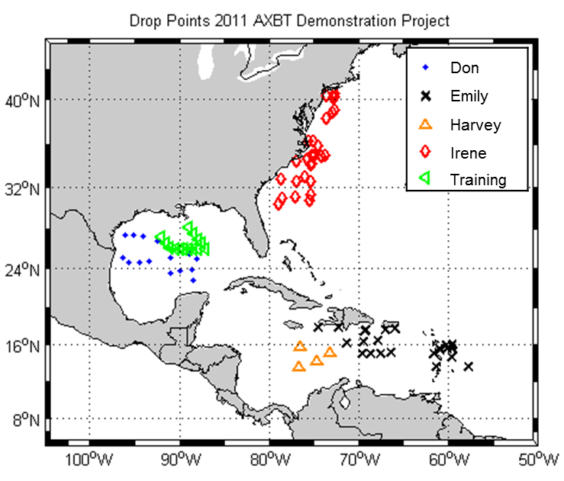
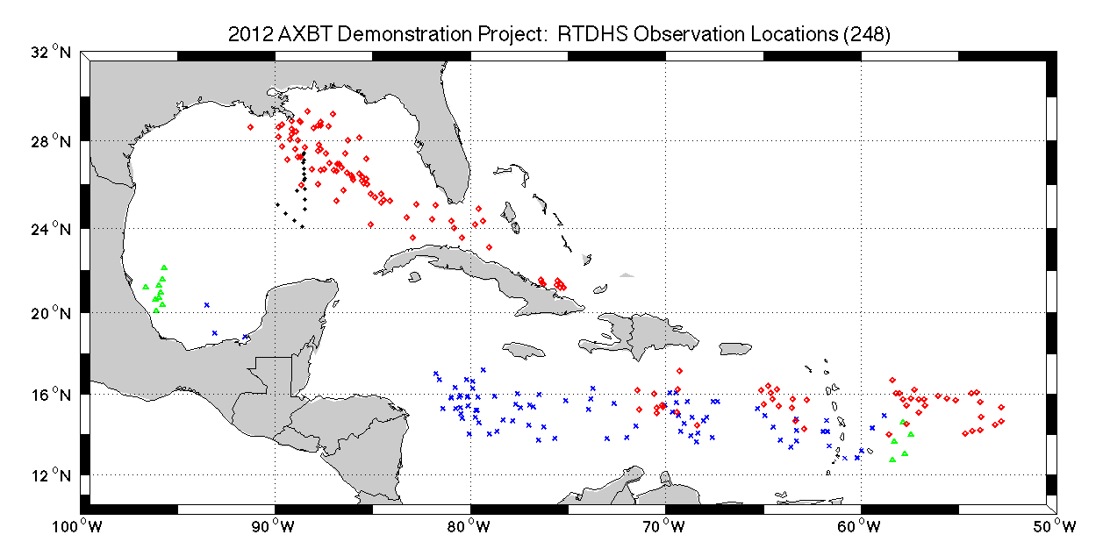
Quick Look & Outline
2011
28 July – 28 August
109 AXBTs deployed
12 flights
TS Don (2)
TS Emily (3)
Training /transit (2/1)
TS Harvey (1)
Hurricane Irene (3)
2012
31 July – 29 August
294 AXBTs deployed
23 flights
Training (1)
Hurricane Ernesto (8)
TS Helene (2)
Hurricane Isaac (12)
Today
Data Collection
Model Impacts
Ocean
Coupled
Statistical
Future Work
Training 31 July 2012
Ernesto 3-9 August 2012
Helene 11,17 August 2012
Isaac 21-29 August 2012
2
07 Mar 13 67th Interdepartmental Hurricane Conference / Tropical Cyclone Research Forum College Park, MD

Slide 3
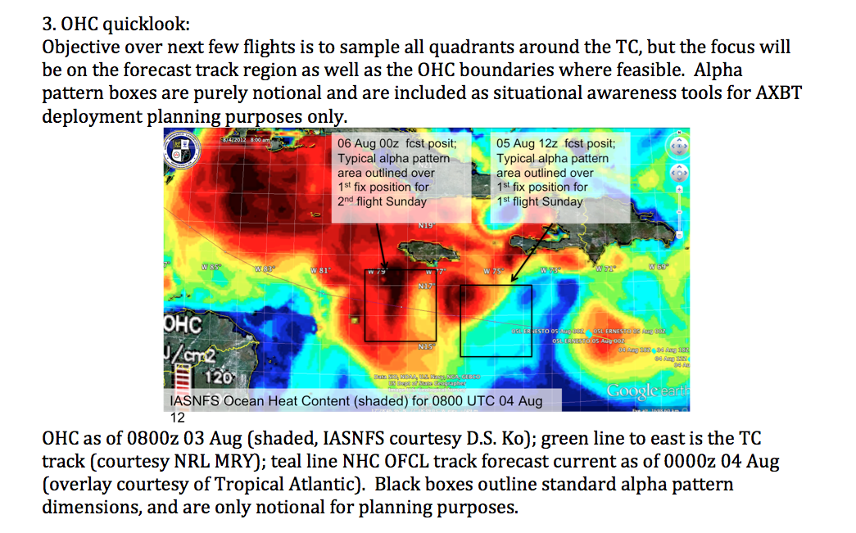
Data Collection
Successes
AXBT deployment from WC-130J aircraft during operational reconnaissance missions tasked by the National Hurricane Center (NHC)
Real-time processing and data transmission to Navy and NOAA hurricane numerical forecast centers
Near-real-time assimilation of upper-ocean temperature observations into the COAMPS-TC model.
Challenges
Operational flight patterns
Data format
Position errors
Mission Planning
source: 2012_axbt_demo_proj_update_04aug12.docx
3
07 Mar 13 67th Interdepartmental Hurricane Conference / Tropical Cyclone Research Forum College Park, MD

Slide 4
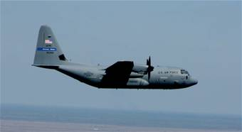
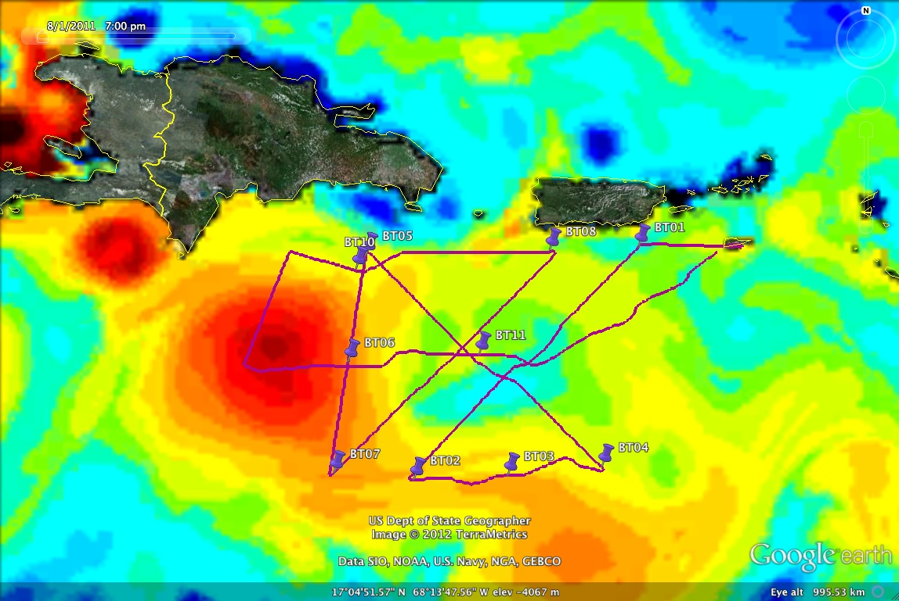
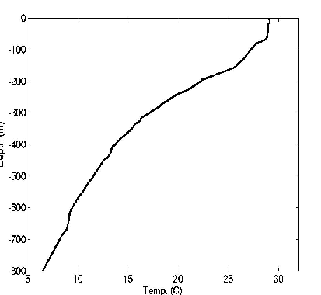
WC-130J in flight
2011 AXBT Data Path
AXBT Demonstration Project
Deploy → Collect → Process → Transmit
53rd SATCOM
Ground Station
NAVO
NRL MRY
REAL TIME
Disseminate
JJVV
RTDHS → NCODA → NCOM
COAMPS-TC
National Hurricane Center
NDBC
NCEP/EMC
Upload
GTS
HWRF
AXBT 06
JJVV Message
AXBT 06
Profile
JJVV 03081 0741/ 716360 069460 88888
51099 00291 00291 00291 14291 19289
57289 66287 72284 80278 99901
08270 30265 39261 56256 73242
83234 90228 93224 99902 00222
14216 33206 36202 51194 59190
69185 73183 80181 99903 15163
26162 36157 48154 56152 88140
99904 00138 06134 26133 42129
48126 65123 99905 04115 31108
48105 74099 99906 11092 65089
87084 99907 11080 97066 99908
48065 AF306
4
07 Mar 13 67th Interdepartmental Hurricane Conference / Tropical Cyclone Research Forum College Park, MD

Slide 5
WC-130J in flight
2012 AXBT Data Path
AXBT Demonstration Project
Deploy → Collect → Process → Transmit
53rd SATCOM
Ground Station
NAVO
NRL MRY
REAL TIME
Disseminate
JJVV
RTDHS → NCODA → NCOM
COAMPS-TC
National Hurricane Center
NDBC
NCEP/EMC
Upload
GTS
HWRF
Coupled Models (Research)
Other Research & Analysis
REAL TIME
Disseminate
1-m files
NRL MRY: COAMPS-TC
NAVO
NCEP EMC: HWRF
RSMAS
URI: GFDL
NOAA HRD / AOC
POST-QC (Dec 2012)
http://www.usna.edu/Oceanography/sanabia/tropic.htm
5
07 Mar 13 67th Interdepartmental Hurricane Conference / Tropical Cyclone Research Forum College Park, MD

Slide 6
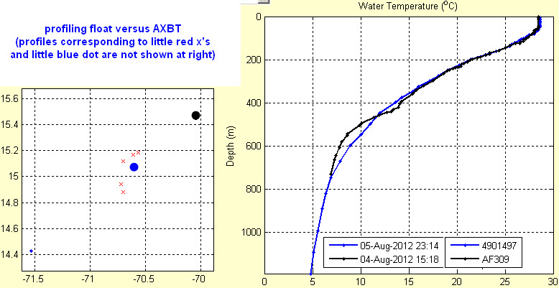
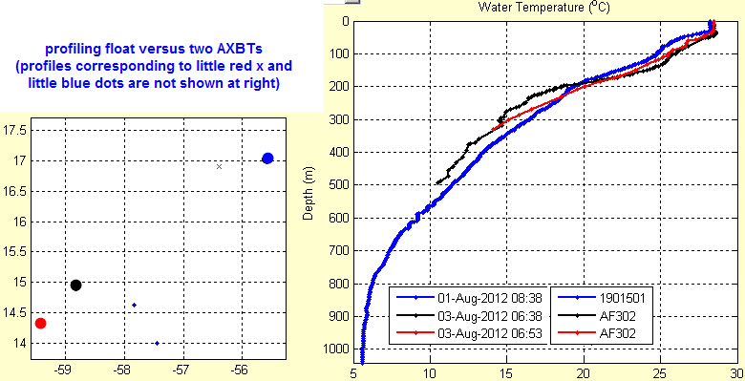
2012 Field Phase Focal Points
Improve Data Quality
Spatial (and temporal) distribution
Minimize delays in transmission
Improve QC
Revised SOPs
Training by NAVO personnel
Portable bathy database
onboard the aircraft
Ob Inter-comparison
CTD casts: UM R/V Walton Smith
Multiple sensors: NAVO
Increase Data Availability
URI
TROPIC web page
Tropical Atlantic
Courtesy: Carl Szczechowski, NAVO
6
07 Mar 13 67th Interdepartmental Hurricane Conference / Tropical Cyclone Research Forum College Park, MD

Slide 7
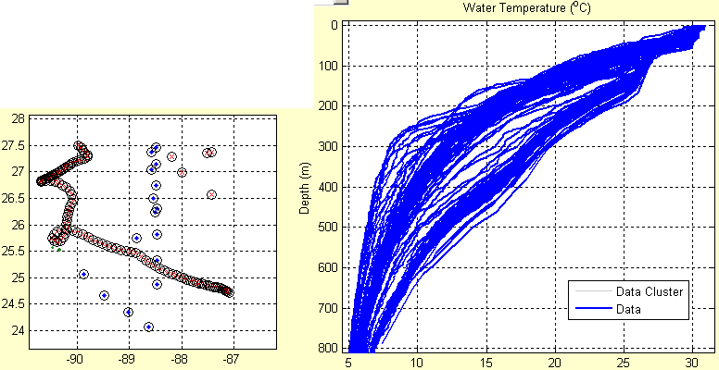
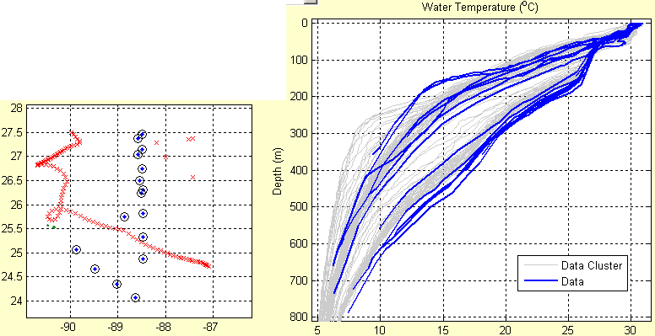
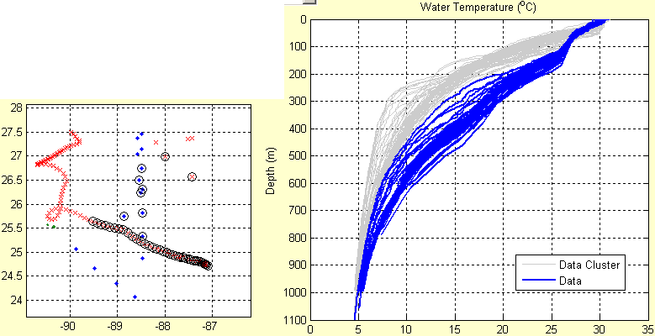
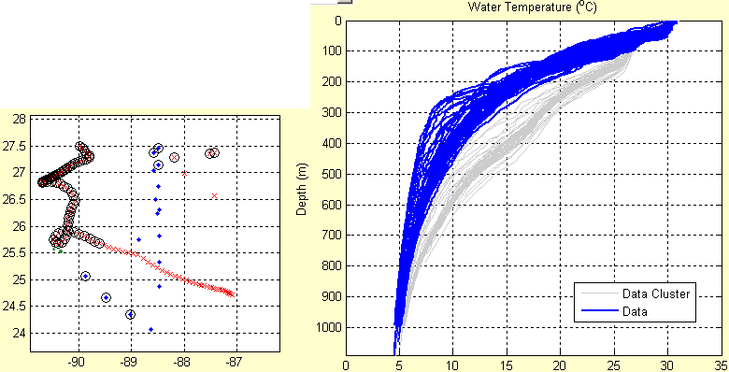
Observation Inter-comparison
All Profiles (glider,
profiling floats, AXBTs)
AXBT Profiles
Map graphics: red x’s correspond to temperature-salinity profiles
blue dots correspond to temperature-only profiles.
Temperature profile graphics: gray profiles (background) correspond to all of the data in the area,
blue profiles (foreground) correspond to the circled positions on the map graphics.
Quality of AXBT profiles appears good; the AXBT profiles are consistent with the other profiles within the Gulf of Mexico.
Courtesy: Carl Szczechowski, NAVO
Cold Mode
Profiles (all sources)
Warm Mode
Profiles (all sources)
7
07 Mar 13 67th Interdepartmental Hurricane Conference / Tropical Cyclone Research Forum College Park, MD

Slide 8
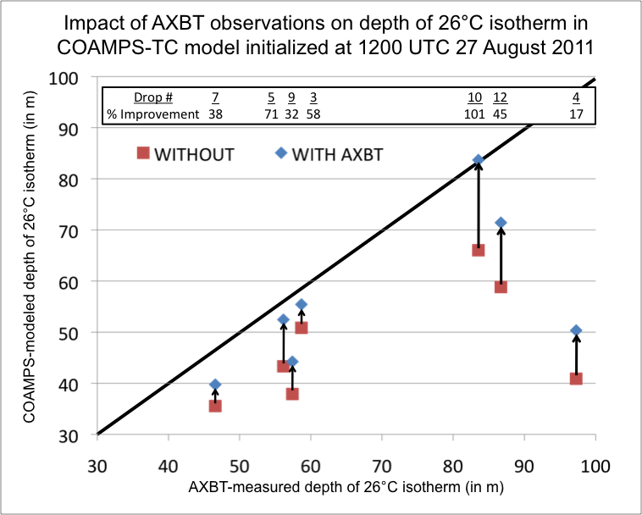
Impacts: Ocean Models
Successes:
Data denial studies revealed AXBT data increased model accuracy in upper-ocean temperatures at the AXBT drop locations in both NCOM and HYCOM (2011)
Adjoint analysis quantified significant value added by AXBT observations to HYCOM (2012)
Challenges:
Weighting the observation in the ocean models
Translating improvement in ocean initial conditions to coupled model TC forecasts
EMILY
IRENE
8
07 Mar 13 67th Interdepartmental Hurricane Conference / Tropical Cyclone Research Forum College Park, MD

Slide 9
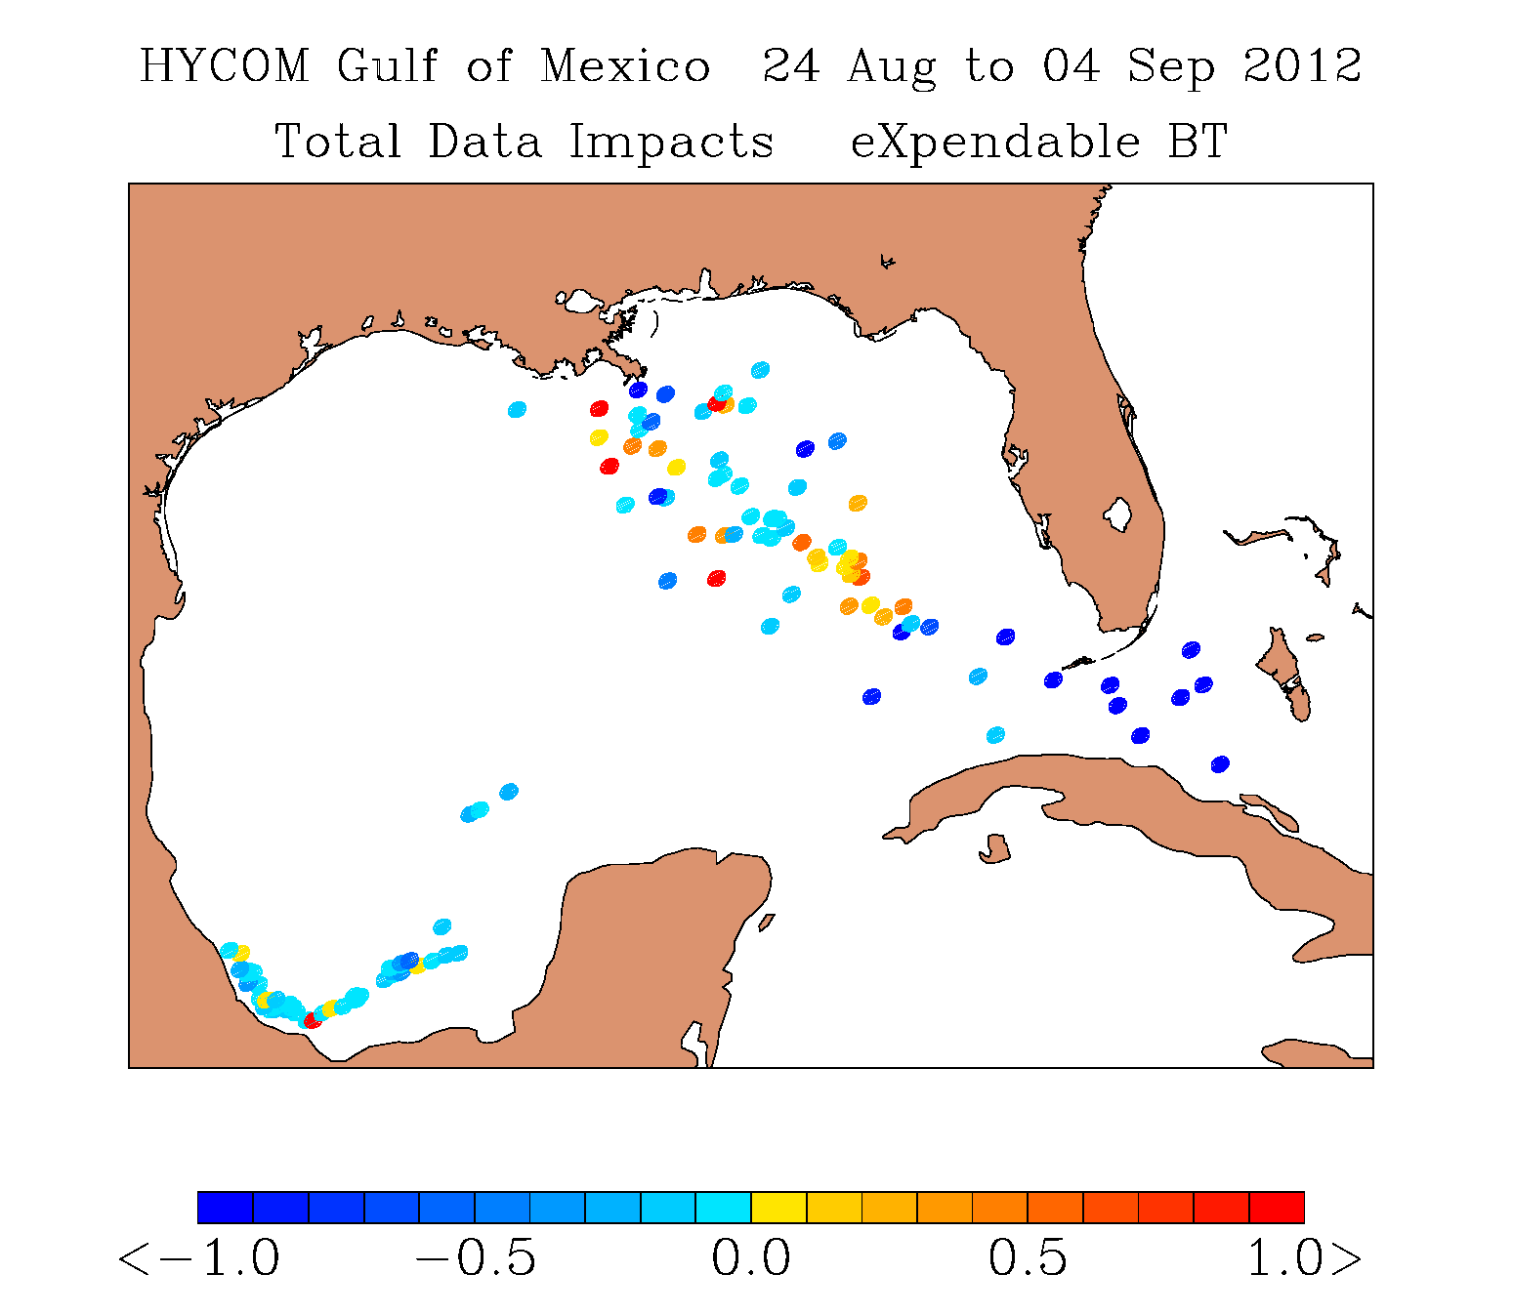
2012: HYCOM AXBT Data Impacts
Data map of AXBT impact to HYCOM 48-h sea temperature forecast between 24 August and 04 September 2012. A negative value (cool color) is a beneficial impact (reduced the 48 hr forecast error in deg C according to the color). A positive value (warm color) means assimilation of the AXBT increased forecast error. The region affected by position reporting errors is outlined in blue.
9
07 Mar 13 67th Interdepartmental Hurricane Conference / Tropical Cyclone Research Forum College Park, MD

Slide 10
AXBTs: High-Impact Observations
Success: AXBTs were the most important data in reducing HYCOM model error during this time period.
10
07 Mar 13 67th Interdepartmental Hurricane Conference / Tropical Cyclone Research Forum College Park, MD

Slide 11
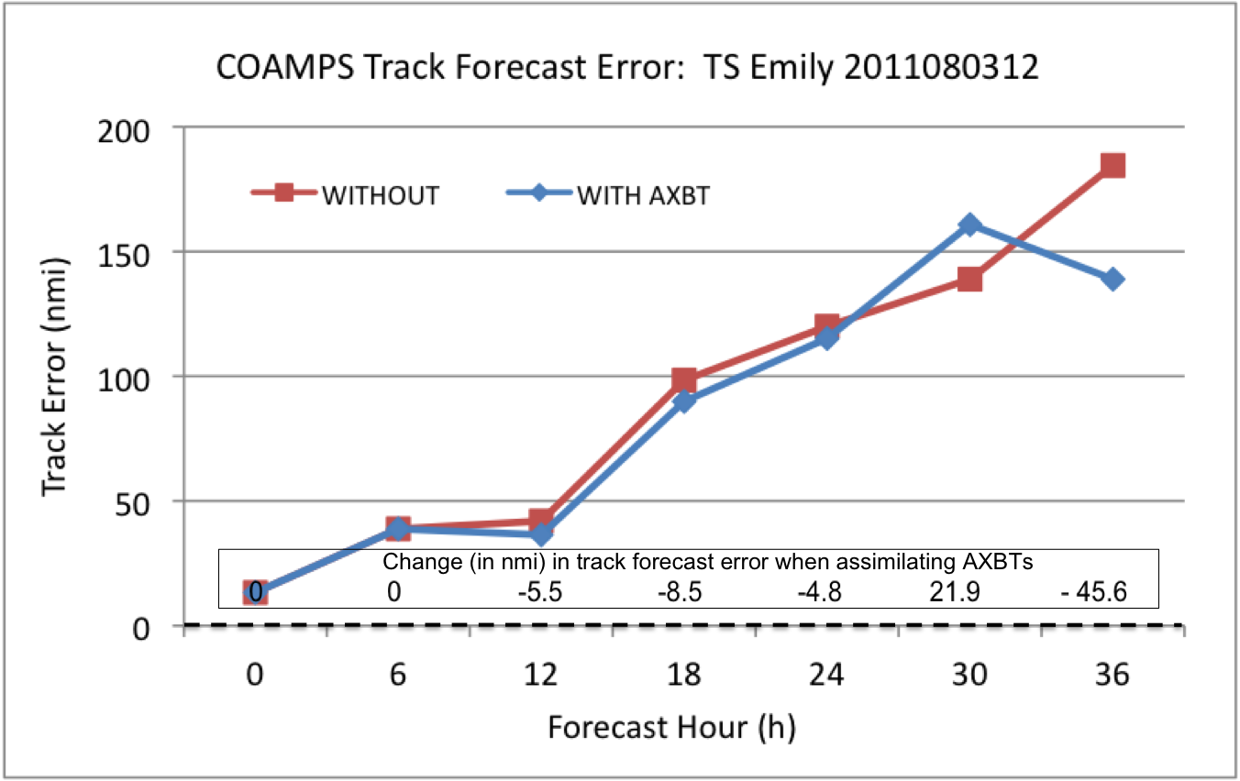
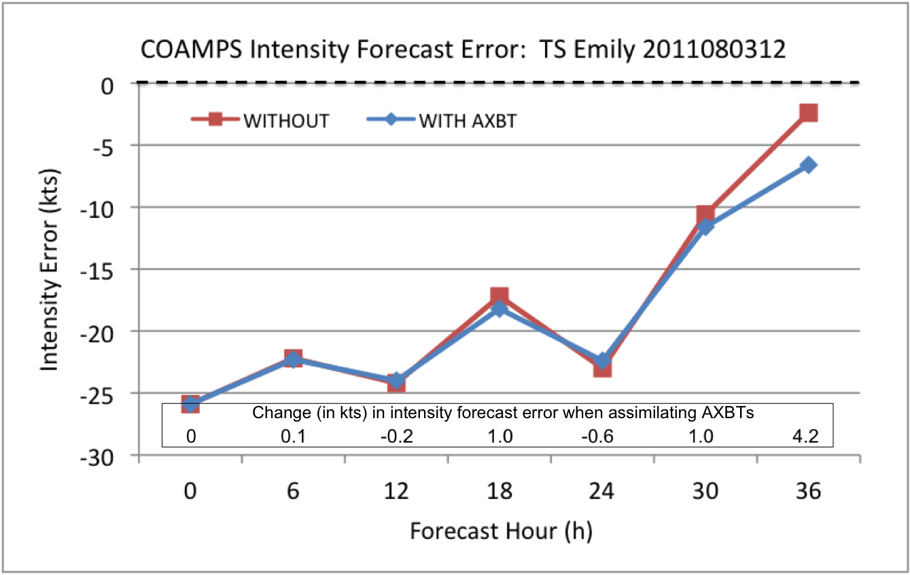
2011 COAMPS-TC AXBT Data Denial: Emily
EMILY
1200 UTC 03 August 2011
TC Forecast Track: some improvement
Track errors at 12, 18, 24, and 36 h were 10, 16, 9, and 84 km lower (relative improvement averaged 12.5%)
The track error at 6 h was unchanged, and the track error at 30 h was degraded by 40 km.
TC Forecast Intensity: little change
Little impact
May have shown little sensitivity to the inclusion of AXBT data because of the weak initial intensity of Emily (45 kt), compounded by an even weaker initialization in the model (only 25 kt the in COAMPS-TC initialization).
a
b
(a) Track and (b) intensity forecast errors for the COAMPS model run initialized at 1200 UTC 03 August 2011 with (blue diamonds) and without (red squares) AXBT data. The improvement (reduced error) or degradation (increased error) at each time step is noted above the x-axis in each plot.
11
07 Mar 13 67th Interdepartmental Hurricane Conference / Tropical Cyclone Research Forum College Park, MD

Slide 12
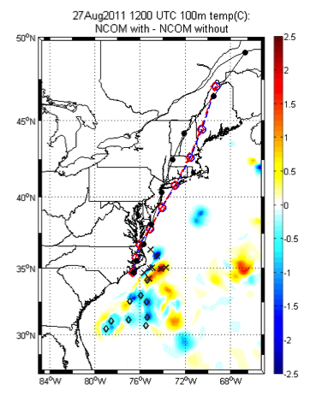
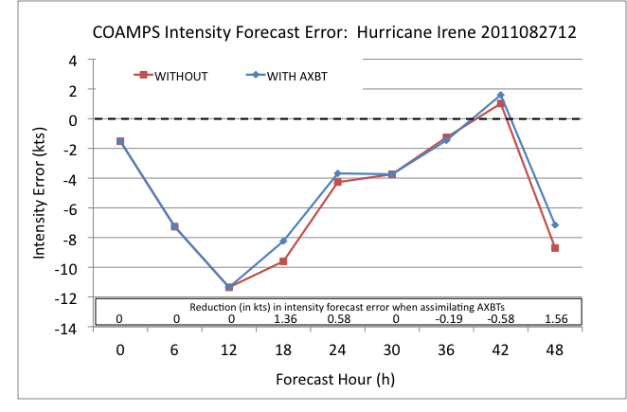
2011 COAMPS-TC AXBT Data Denial: Irene
IRENE
0000 UTC 27 August 2011
Little change in track and intensity errors
Possibly due to model initial TC position was located within the area with little SST/OHC difference
1200 UTC 27 August 2011
Some improvement to intensity at multiple time steps (<5 kts) when assimilating AXBTs
Little change in track errors
12
07 Mar 13 67th Interdepartmental Hurricane Conference / Tropical Cyclone Research Forum College Park, MD

Slide 13
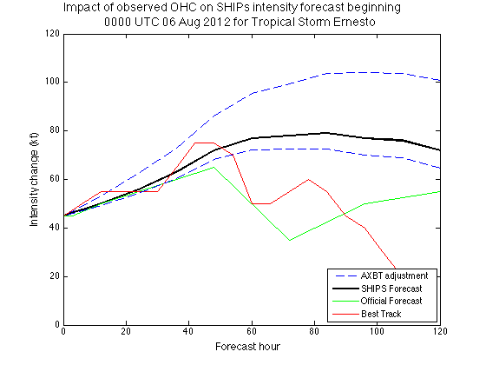
AXBT Impact on TC Intensity in SHIPS
ERNESTO
landfall
06 AUG 12
Differences in model and observed OHC impact SHIPS intensity forecasts
Intensity increments are calculated at each forecast time step applying SHIPS coefficients (courtesy M. DeMaria) to NCODA (model) and AXBT (observed) OHC values .
Range of model and observed OHC differences each day corresponds to range of model and observed intensity differences in the SHIPS forecast.
Provides a threshold of intensity variability at each time step (good agreement with the improvement in COAMPS-TC data denial studies).
Comparison to official forecast and best track intensities reveal some positive impact.
In 2013
Incorporate Decay SHIPS
Investigate possible cooling in the model ahead of the TC center
TOP: Hurricane Ernesto best track (purple line) and AXBT drop locations (shapes by flight) over NCODA OHC values (shaded) for 05 August 2012.
BOTTOM: From right to left: Intensity (blue line) and OHC (red line) beneath the center of Hurricane Ernesto as the TC moved westward (positions based on NHC TC Report). Error bars indicate the range of differences between observed and model OHC values by flight.
13
07 Mar 13 67th Interdepartmental Hurricane Conference / Tropical Cyclone Research Forum College Park, MD

Slide 14
Summary
Successes
Demonstrated the capability
Deployed AXBTs from USAF WC-130J aircraft during operational missions
Received, processed, and QCd the data onboard the aircraft and transmitted to modeling centers
Data assimilated in two ocean models (NCOM and HYCOM) and one coupled model (COAMPS-TC) in real time
Improved model initializations and TC forecasts
Ocean: clear, quantifiable
Coupled: small improvements at later forecast hours
Statistical: impact evident; evaluation in progress
Joint, interagency collaboration
Remaining tasks
Demonstrate the need
Clear demonstration of forecast impacts
Coupled and statistical models
Optimize field phase operations
Sampling strategy (horizontal and vertical)
Improve timeliness and quality
Continue collaboration
Field phase – USAF, NAVO, NDBC, HRD/AOC
Research phase – NRL, EMC, URI
2012 TROPIC crew: Mary Cox, Ian Park, Ellen Deckinga, Kyle Coffey, Lauren McCann, Topher Leiby
14
07 Mar 13 67th Interdepartmental Hurricane Conference / Tropical Cyclone Research Forum College Park, MD

Slide 15
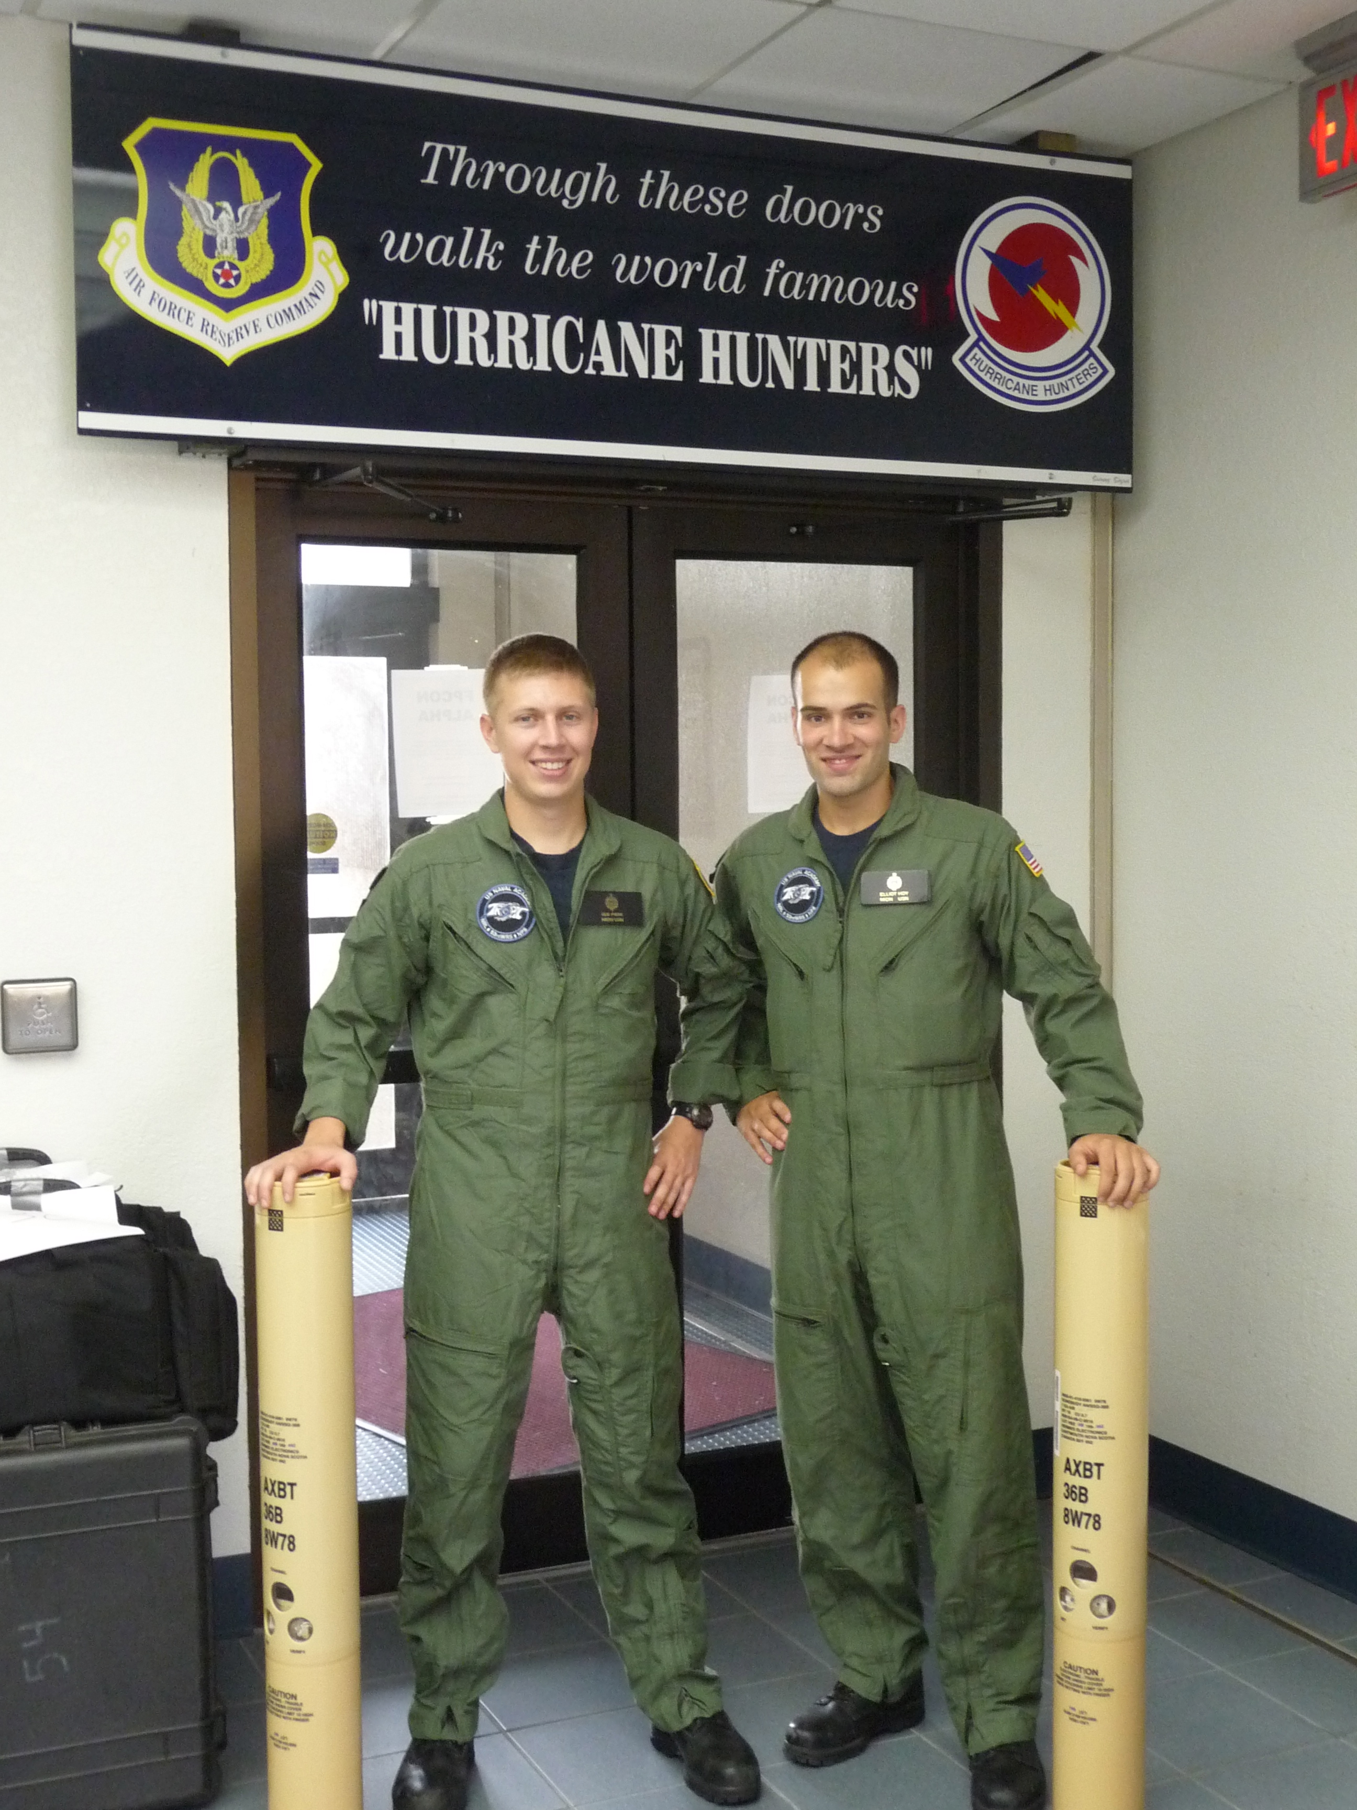
Future Work
2013 Field Phase
3rd year field phase: ~20 July – 20 September 2013
Funded by ONR
Data Collection / Quality
Identify the optimal AXBT sampling strategy
resolution (horizontal & vertical),
location (relative to TC center), and
frequency for modeling initialization
Continue collaboration with NOAA HRD
Coordinate deployment planning (when feasible)
Increase observation accuracy and availability
Standardize data format
Investigate instrument error / biases
Variations due to fall rate
Temperature to frequency conversions
Horizontal displacement (atm / ocn)
Model Impacts
Run Coupled COAMPS-TC data denial studies
Continue NCODA/SHIPS OHC analysis
Continue collaboration with EMC/HWRF and URI/GFDL
2011 TROPIC crew: Ian Park & Elliot Hoy
15
07 Mar 13 67th Interdepartmental Hurricane Conference / Tropical Cyclone Research Forum College Park, MD

